Slide 1
Discussion: Collecting Spending Data during a Pandemic
Stephanie Eckman
Fellow, Survey Research Division

Slide 2
Tracking Trends
Average Z
Notes:
Rather steady, slow trend upward over time
But estimates are different due to CHANGE IN TRUE VALUE as well as CHANGE IN ERROR

Slide 3
Change in Trends due to Pandemic
Important questions:
Are households eating out less?
Which households increased spending on home improvement during pandemic?
How much did spending on home office equipment increase?
Trends by income groups, age, race/ethnicity, gender, region, etc.
Notes:
Applies to other questions as well

Slide 4

Measuring Change
Change in Z from time 1 to time 2
$$change=Z_{t2}−Z_{t1}$$
$Z_{t1}=$ $Z_{t1}^{∗}+ε_{t1}$ $Z_{t2}=$ $Z_{t2}^{∗}+ε_{t2}$
$$change=Z_{t2}^{∗}−Z_{t1}^{∗}+ε_{t2}−ε_{t1}$$
true value
error
true value
error
change in true value
change in error

Slide 5

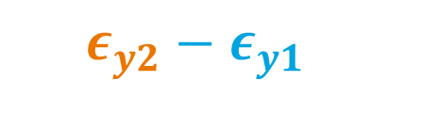
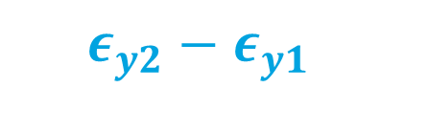
Factors Affecting Measures of Change
$$change=Z_{t2}^{∗}−Z_{t1}^{∗}+ε_{t2}−ε_{t1}$$
$$ε_{y2}−ε_{y1}$$
Focus before pandemic was on stable $ε$
ME, NR somewhat understood
Pandemic changed $ε$drastically
ME, NR changed
$$ε_{y2}−ε_{y1}$$
Notes:
1 -- Few changes in data collection protocol over years
Little understanding of how changes WOULD affect data
2 – when pandemic hit and DC methods changed, little
Due to COVID-19 we cannot separate true changes from changes in errors
Errors before pandemic (e1) somewhat understood
But e2 is not – we struggled simply to collect the data
Irony is that …

Slide 6
Factors Affecting Measures of Change
Changes in true value of Z
Reduced income
Stockpiling
Delivery
Changes in error term
Nonresponse
Mode effects
Nonresponse
Measurement error
How to distinguish?
External source
Testing before pandemic
Notes:
NONRESPONSE
At home patterns
Ash paper explores this
MODE
Affects who responds
Spam calls
Internet access, ability
Literacy
Interviewers encourage response
Affects responses
Aural vs visual
Self-administered vs interviewer
EXTERNAL – Rigg & Creech

Slide 7

Thought Experiment
What would we have done, if we’d had time to prepare?
What experiments could have helped us understand $ε$?
Notes:
1 -- Few changes in data collection protocol over years
Little understanding of how changes WOULD affect data
2 – when pandemic hit and DC methods changed, little
Due to COVID-19 we cannot separate true changes from changes in errors
Errors before pandemic (e1) somewhat understood
But e2 is not – we struggled simply to collect the data
Irony is that …

Slide 8
Prepare for Next Disruption
Run parallel web survey
Impute face-to-face estimates from web survey data
When jump to web data collection necessary, we have adjustments ready
Source | Background Vars | Z F-to-F | Z Web
Face-to-Face Survey | X | X
Web Survey | X |  | X
֍
Similar to design used in: Eckman (2021) 10.1093/jssam/smab024
Notes:
Relies on assumptions -- but so does doing nothing
MI not embraced within some agencies

Slide 9
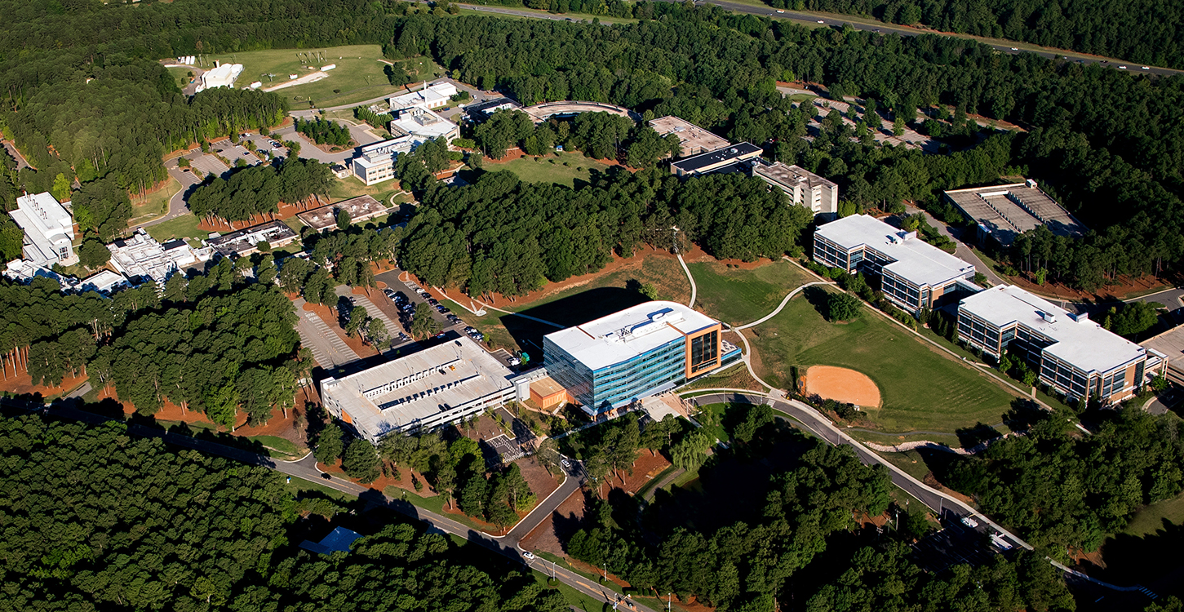
Thank You
seckman@rti.org
http://stepheckman.com
@stephnie

