Slide 1
Communicating Complex Data Simply at the U.S. Bureau of Labor Statistics
Jay Meisenheimer
Chief, Division of New Media

Slide 2
AORTA — An acronym that reflects BLS values
Accurate
Objective
Relevant
Timely
Accessible

Slide 3
My focus today is on the last three
Relevant
Timely
Accessible

Slide 4
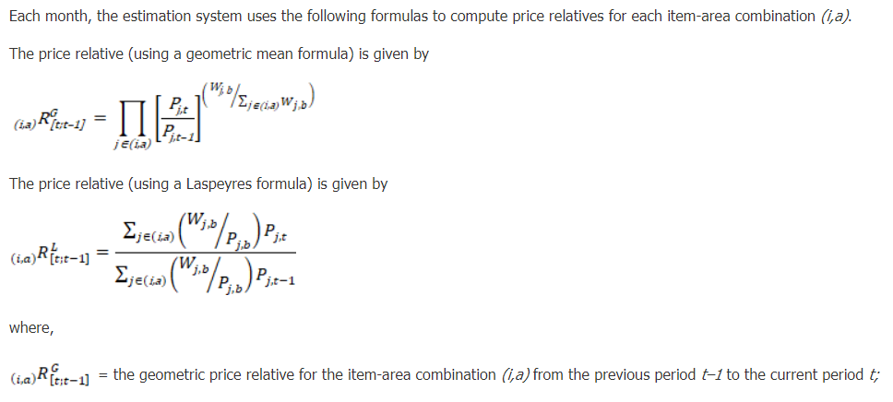
From Handbook of Methods chapter on Consumer Price Index

Slide 5
Is that excerpt relevant and accessible?
Maybe for experts.
We strive to reach the full range of potential data users, from novice (including K–12 students and their teachers) to experts.

Slide 6
Products and tools to reach more people
Publications for a range of audiences
Chart packages
Fact sheets and similar web content
Blog
Videos
Podcasts (coming soon!)

Slide 7
BLS news releases
Still with an old-school look, but modern version coming soon!
Current design created long before the internet.
Redesigned news releases will have interactive data visualizations and analysis with quick facts and less dense text.
Learn more at our beta page.

Slide 8
Interactive Chart Packages
Complement our current news releases, but we still plan to keep these packages even after redesigned news releases are available.
Charts help people see historical trends or compare groups more easily.
Available at www.bls.gov/charts/

Slide 9
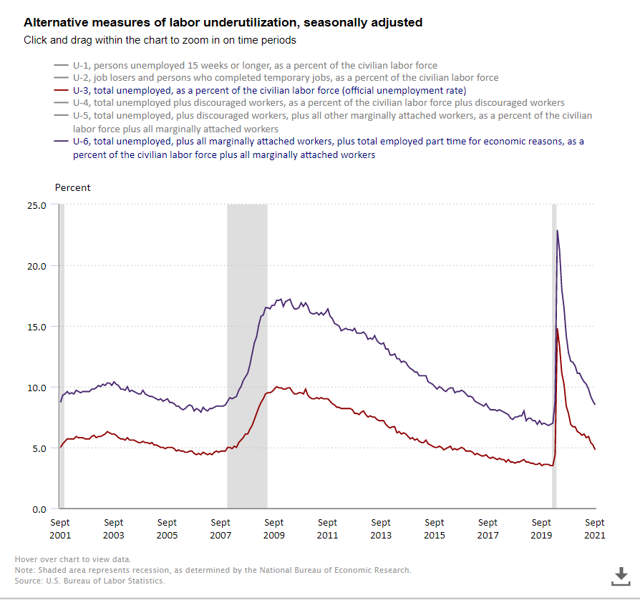
Showing trends

Slide 10
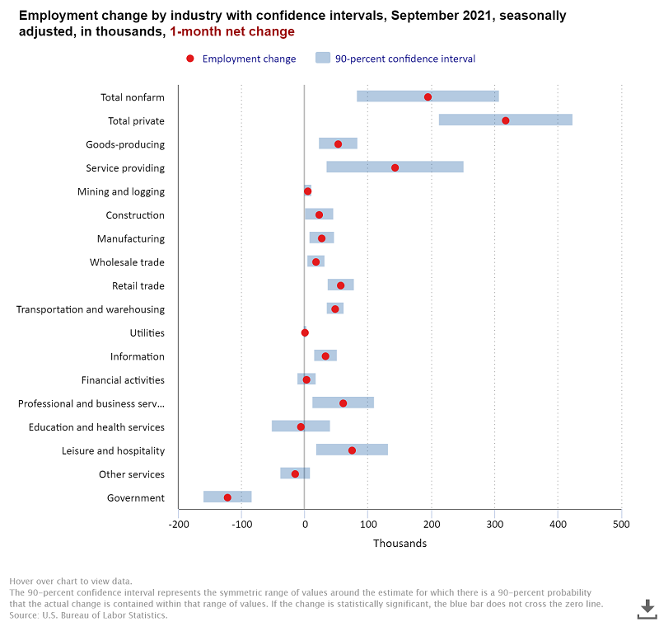
Teaching confidence intervals

Slide 11
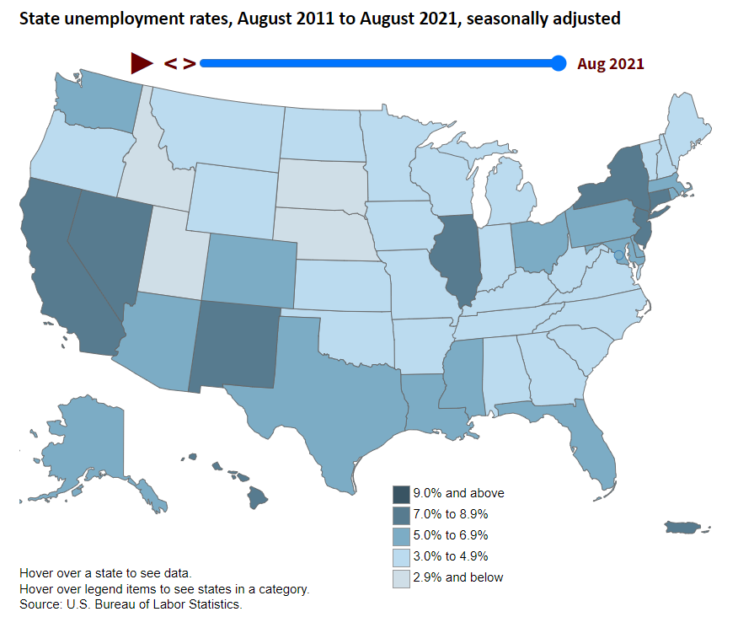
Animated unemployment map

Slide 12
The Economics Daily
The gateway to BLS data.
Published every business day since 1998.
The heart of every TED is a chart or map (sometimes two).
Brief nontechnical text, typically around 200 words, to tell an interesting data story.
At the end we provide links so interested readers can dig deeper.

Slide 13
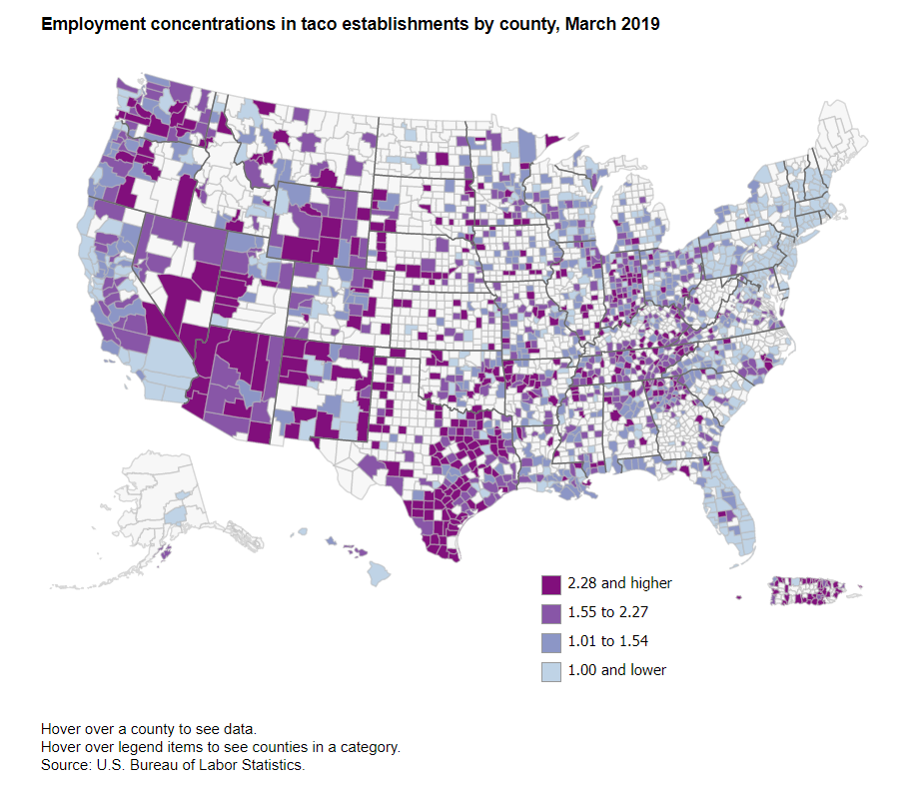
National Taco Day!

Slide 14
Spotlight on Statistics
The Style section of BLS.
Slideshow layout with a series of charts and brief supporting text telling a data story.

Slide 15
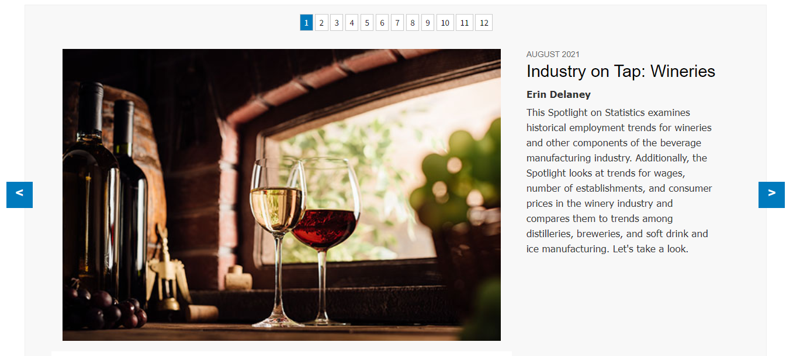
One of my recent favorites

Slide 16
Beyond the Numbers
More focused on written analysis than The Economics Daily or Spotlight on Statistics.
May also include charts and maps to help tell an interesting story.
Target audience is entry-level data users and journalists, not necessarily with economic or statistical background.

Slide 17
Monthly Labor Review
The BLS research journal.
Began publishing in 1915.
Target audience includes people in academia, researchers, and sophisticated data user.
We still strive to make articles clear, readable, and interesting to a broader audience.

Slide 18
Commissioner’s Corner Blog
Less formal, chattier than some of our other publications
May dig into the weeds on issues that can be pretty technical, but in a nontechnical way.

Slide 19
Some recent blog favorites
BLS Data in More Than a Century of Pictures
A Look at the Price of Construction
BLS at the Olympics
Brood X Cicadas over the History of BLS Data
How Much Does a Cup of Coffee Cost?
Update on the Misclassification that Affected the Unemployment Rate

Slide 20
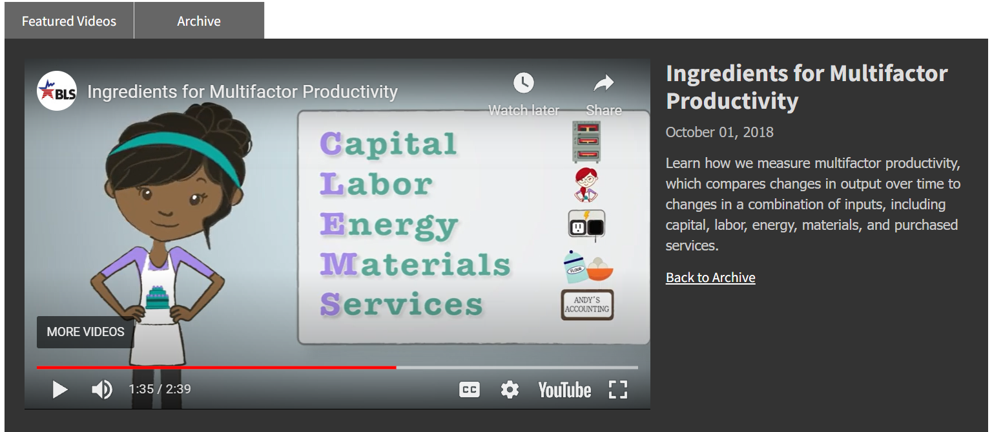
Videos

Slide 21
@BLS_gov
Meet data users where they are; it’s not enough to post things on our website and hope people find them.
Promote BLS publications, new products, our data user conferences, and commemorative events.
Engage users and answer questions (without feeding the trolls).

Slide 22
Jay Meisenheimer
Chief, Division of New Media
www.bls.gov
twitter.com/BLS_gov
703-409-0845
meisenheimer.joseph@bls.gov

