Slide 1




Using Web Scraping and Network Analysis to Study International Collaboration in Open Source Software
Brandon L. Kramer¹ Gizem Korkmaz¹
J. Bayoán Santiago Calderón² Carol A. Robbins³
1
2
3
Federal Committee on Statistical Methodology
2021 Research and Policy Conference
This work is supported by the National Center for Science and Engineering Statistics (49100420C0015).
The views expressed in this work are those of the authors and not necessarily those of their respective institutions.
1 / 23

Slide 2
Presentation Overview
Project Background
Project Background
Open Source Software International Collaboration
Data & Methods
Data Collection & Classification Networks Construction
OSS International Collaboration
Contributor networks
Country-to-country networks
2 / 23

Slide 3



What is Open Source Software?
Project Background
Software that is published under an Open Source Initiative (OSI) approved license
OSI-approved licenses establish permissions (e.g., use, inspect, modify, distribute, attribution) and limitations (e.g., liability, warranty) Most common licenses are: MIT, Apache, GPL, BSD, etc.
Prominent OSS examples include: Apache, Linux, Mozilla, R, etc. Past work has conducted network analysis of either single projects and/or smaller-scale networks of code hosting platforms like GitHub
3 / 23

Slide 4
The Scope and Impact of OSS
Project Background
Current NCSES and other economic indicators do not measure the scope and impact of open source software developed outside the business sector.¹
Scope and Value: How much open source software is in use? Who creates these products? How can we measure the value of open source software?
Collaboration Networks: What is the structure of OSS collaboration networks? How do collaborations span across geographic boundaries?
¹S. Keller, G. Korkmaz, et al. “Opportunities to observe and measure intangible inputs to innovation: Definitions, operationalization, and examples”. In: Proceedings of the National Academy of Sciences 115.50 (2018), pp. 12638–12645.
4 / 23

Slide 5
International Collaboration
Project Background
International collaboration doubled in academic papers since 1990
More governmental funding for projects that developed through international collaboration tend to lead to higher impact publications
Understanding international contributions in the context of OSS will help explain:
Which countries are most likely to contribute to OSS? Which countries are most likely to collaborate internationally?
What is the structure of international collaboration and how does it change over time?
Which are the most influential countries in the OSS ecosystem?
Using network analysis to study:
Individual and country-to-country collaborations

Slide 6
Data Collection
Data & Methods
Developed GHOST.jl to scrape commit data
Package developed for targeted scraping of GitHub user and activity data using the GitHub v4 GraphQL API
Find public repositories with an OSI-approved license
Collect development activity information (e.g., commits, additions)
Used GHTorrent to classify contributors
Commit data supplemented with user data from GHTorrent² User data includes login, email, location and company information Developed algorithm to convert location data to country codes
²Georgios Gousios. “The GHTorrent dataset and tool suite”. In: Proceedings of the 10th Working Conference on Mining Software Repositories. MSR ’13. San Francisco, CA, USA: IEEE Press, 2013, pp. 233–236.

Slide 7
Tools for Scraping OSS Data
Data & Methods
GHOST.jl*
Julia package used for targeted scraping of commit activity data
tidyorgs*
R package used for organizational and sectoring classification
diverstidy*
R package used for geographic and population classification
PyGithub
Python package used for scraping user and repository attributes
* Developed at UVA SDAD

Slide 8
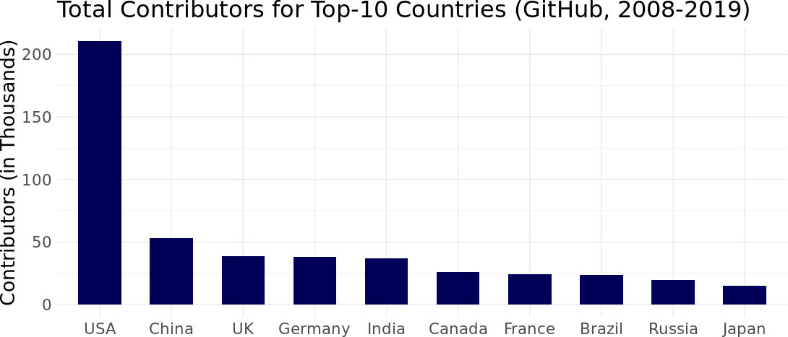
Data Summary: Contributors
Data & Methods
Our original dataset is comprised of 3.3M distinct contributors and
7.8M distinct repositories
To examine international collaborations, we reduced the dataset to only include logins with valid country codes, which included 733K contributors and 3.5M repositories dating from 2008 to 2019

Slide 9
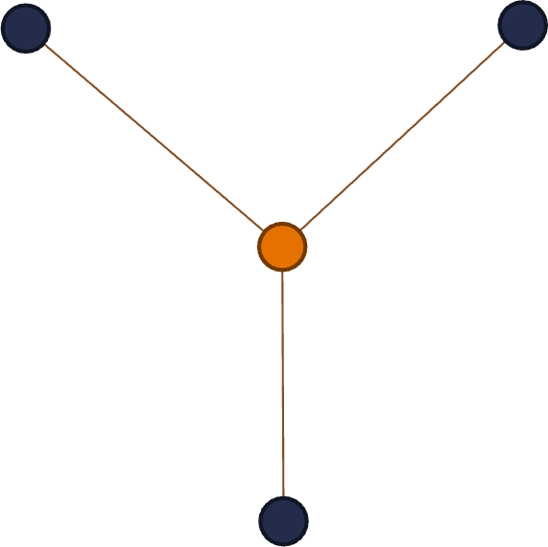
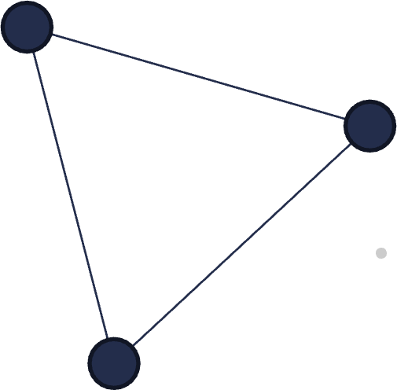
Network Data
Data & Methods
To convert these data into network format, we “projected” a bipartite login-repository network into single-mode contributor networks
The contributor network is comprised of
Nodes represent contributors
Edges correspond common repositories that users contribute
The country-country network is comprised of
Nodes represent countries
Edges correspond to international collaborations
Analyzed networks using R’s igraph and ggraph as well as Gephi

Slide 10
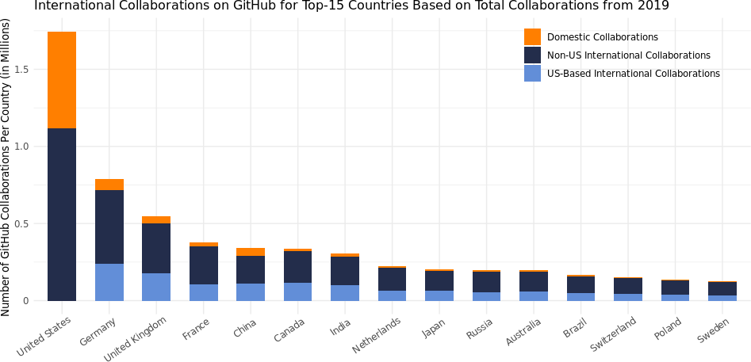
International Collaboration Tendencies
Results
US engages in domestic collaboration more than other top countries Top countries collaborate with US developers more than domestic colleagues

Slide 11
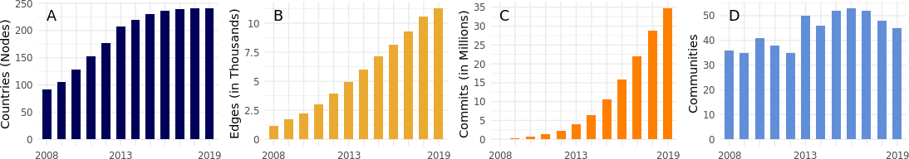
Longitudinal Trends
Results
Marked contrast with exponential growth of contributor networks Countries join the network until around 2013
Collaborations steadily rise while commits increase exponentially
The number of communities fluctuate in a way that clearly depends on the upper threshold of countries

Slide 12
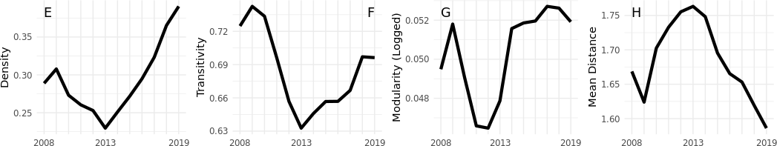
Longitudinal Trends
Results
The density, transitivity, modularity, and mean distance all reflect a similar shift around 2013

Slide 13
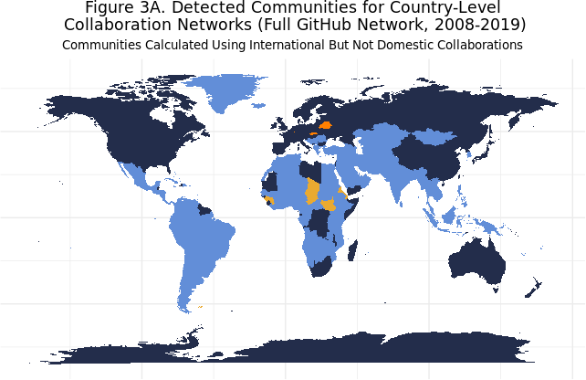
Results
Community Detection Analyses

Slide 14
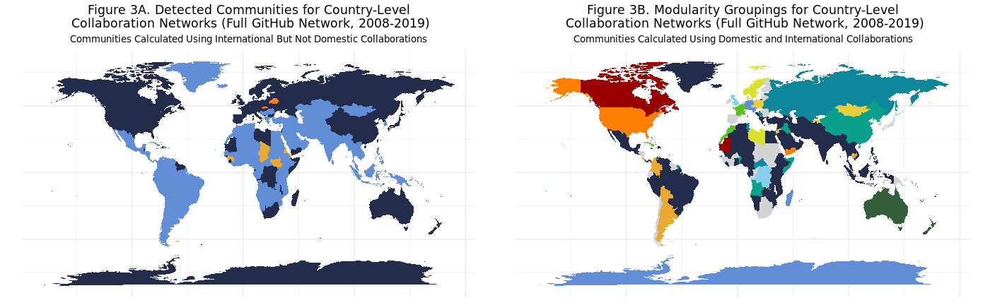
Community Detection Analyses
Results
The inclusion of domestic collaborations (loops) in our community detection analyses revealed regional collaboration tendencies

Slide 15
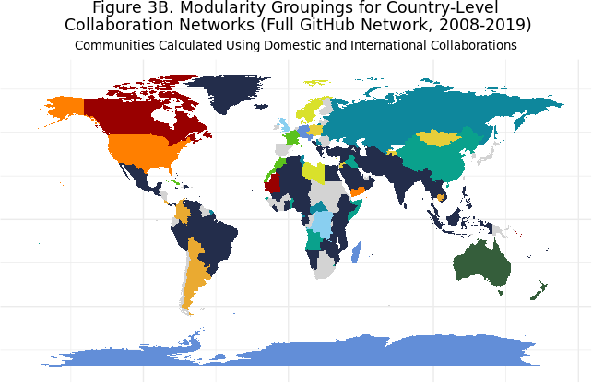
Community Detection Analyses
Results
Regional communities formed between Nordic, African, South American, and former-Soviet countries

Slide 16
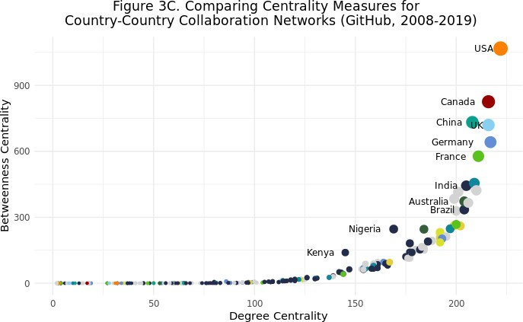
Comparing Centrality Measures
Results
Comparing betweenness centrality vs. degree centrality shows more relative brokering capacity for the US, Canada, China, Nigeria and Kenya

Slide 17
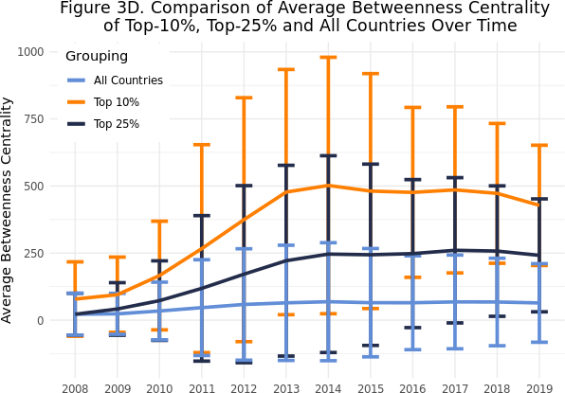
Comparing Centrality Measures
Results
Examining average betweenness centrality over time reveals that top countries have started yielding influence

Slide 18
Main Takeaways
Main Takeaways
GitHub Contributor Networks
US-based users are most likely to contribute to GitHub
Country-to-Country Networks
Network growth affected by upperbound of countries in the world
Centrality measures reveal that some countries (like the USA) have more influence in the OSS ecosystem
The country-country network clusters into regional communities, reflecting a likely combination of socio-political and economic factors that shape OSS development
Policy Implications
Use of SNA can help the federal government monitor the level of incoming and outgoing OSS projects as well as their economic value by capturing international collaboration dynamics over time.

Slide 19
Questions?
Main Takeaways
Q&A

Slide 20
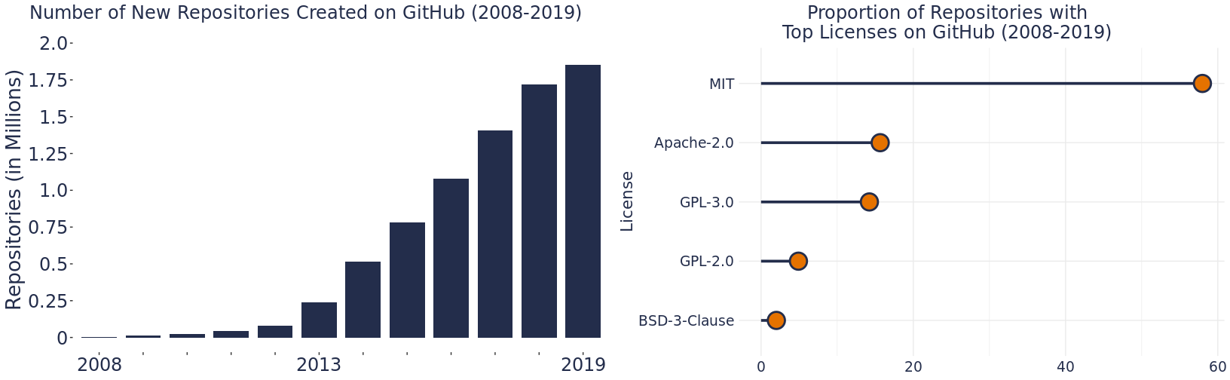
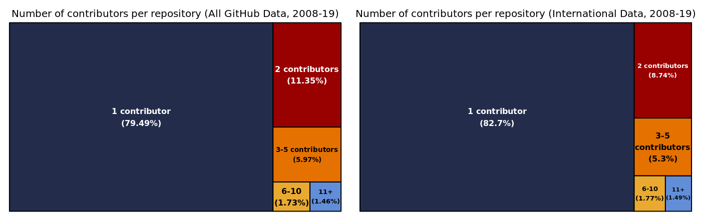
Main Takeaways
Summary of Scraped GitHub Data

Slide 21
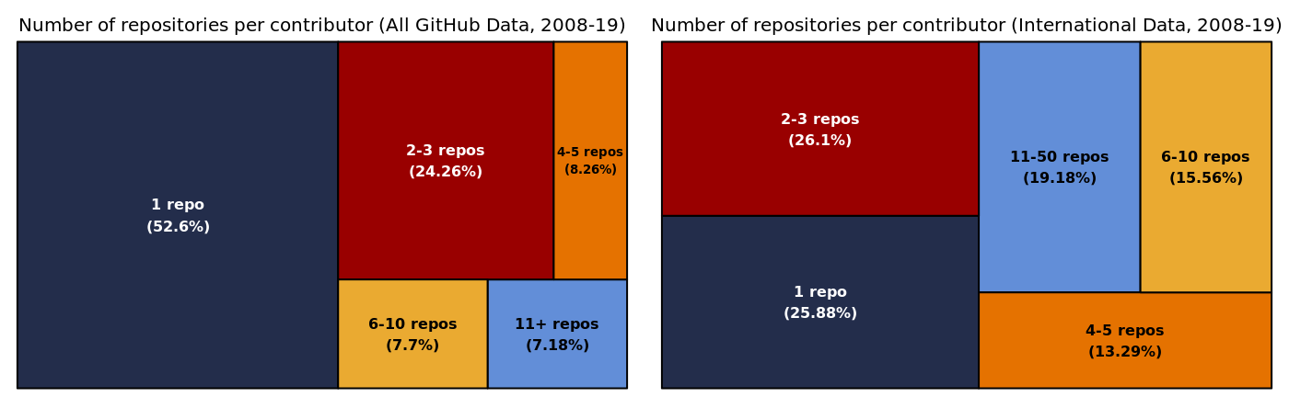
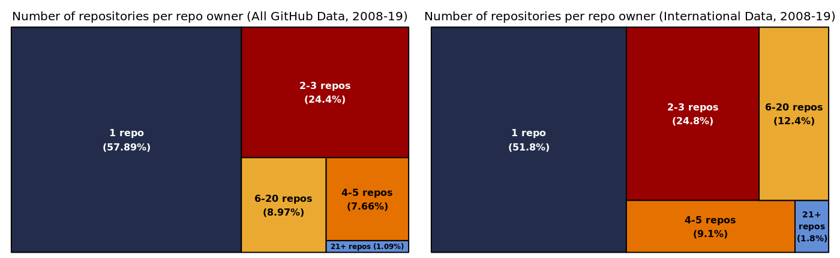
Main Takeaways
Summary of Scraped GitHub Data

Slide 22
Summary of Results
Main Takeaways
Country Users Repos R/U Commits C/R Adds A/C Dels D/C TotColabs DomColabs USColabs
USA | 216K | 1.2M | 5.3 | 43.0M | 37.5 | 65.9B | 1531.6 | 26.7B | 621.5 | 2.4M | 26.4% | 26.4%
China | 54K | 289K | 5.3 | 6.6M | 22.9 | 13.7B | 2080.1 | 4.9B | 633.5 | 339K | 14.9% | 33.2%
Germany | 40K | 298K | 7.4 | 11.4M | 38.2 | 11.2B | 986.8 | 5.2B | 452.8 | 790K | 9.0% | 30.1%
UK | 40K | 271K | 6.8 | 9.4M | 34.8 | 11.2B | 1191.6 | 5.2B | 550.0 | 548K | 8.2% | 32.6%
India | 37K | 160K | 4.3 | 2.7M | 16.9 | 7.1B | 2615.7 | 1.9B | 684.5 | 306K | 6.9% | 33.2%
Canada | 27K | 174K | 6.4 | 5.1M | 29.4 | 7.4B | 1449.9 | 3.0B | 585.9 | 335K | 4.5% | 33.9%
Brazil | 25K | 142K | 5.7 | 2.8M | 20.0 | 6.0B | 2115.4 | 2.1B | 749.5 | 165K | 6.2% | 29.0%
France | 25K | 173K | 7.0 | 6.0M | 34.7 | 7.8B | 1287.2 | 3.0B | 499.2 | 375K | 6.4% | 28.0%
Russia | 22K | 120K | 5.5 | 3.4M | 28.5 | 3.6B | 1063.5 | 1.5B | 435.6 | 197K | 5.9% | 27.6%
Japan | 16K | 130K | 8.2 | 3.9M | 29.9 | 3.7B | 955.9 | 1.5B | 390.4 | 205K | 6.7% | 32.6%
Descriptive Statistics for Top-10 Countries Based on Users, GitHub 2008-19
The table shows US-based contributors higher number of users, repos, commits, and overall collaborations relative to other countries in the network. We also observed substantial country-level variability in the number of repos per user (R/U), the commits per repo (C/R),
as well as the additions (A/C) and deletions per commit (D/C).

Slide 23
Summary of Results
Main Takeaways
Year Nodes Edges Commits Triads Cmtys Comps K -Core Dens Trans Mod µDist µDeg µBtw GCent GBtw
2008 | 91 | 1183 | 123K | 11K | 36 | 15 | 33 | 0.289 | 0.725 | 0.001 | 1.669 | 24.0 | 22.1 | 0.533 | 0.170
2008-09 | 106 | 1713 | 320K | 20K | 35 | 18 | 38 | 0.308 | 0.742 | 0.003 | 1.624 | 30.3 | 23.6 | 0.511 | 0.125
2008-10 | 128 | 2220 | 688K | 30K | 41 | 18 | 45 | 0.273 | 0.734 | 0.003 | 1.703 | 32.7 | 34.1 | 0.546 | 0.117
2008-11 | 153 | 3028 | 1.3M | 45K | 38 | 15 | 51 | 0.260 | 0.696 | 0.002 | 1.733 | 37.6 | 46.6 | 0.601 | 0.159
2008-12 | 177 | 3939 | 2.3M | 64K | 35 | 13 | 55 | 0.253 | 0.657 | 0.002 | 1.755 | 42.5 | 58.4 | 0.633 | 0.142
2008-13 | 208 | 4944 | 4.0M | 87K | 50 | 22 | 59 | 0.230 | 0.633 | 0.002 | 1.763 | 45.5 | 64.5 | 0.611 | 0.101
2008-14 | 219 | 5992 | 6.5M | 120K | 46 | 20 | 63 | 0.251 | 0.646 | 0.001 | 1.748 | 52.7 | 68.7 | 0.616 | 0.107
2008-15 | 230 | 7160 | 10.5M | 161K | 52 | 24 | 70 | 0.272 | 0.657 | 0.001 | 1.695 | 60.3 | 65.1 | 0.601 | 0.087
2008-16 | 236 | 8177 | 15.8M | 199K | 53 | 22 | 74 | 0.295 | 0.657 | 0.000 | 1.665 | 67.3 | 64.9 | 0.594 | 0.060
2008-17 | 240 | 9270 | 22.0M | 245K | 52 | 18 | 81 | 0.323 | 0.667 | 0.001 | 1.653 | 75.2 | 68.0 | 0.572 | 0.052
2008-18 | 241 | 10565 | 28.9M | 314K | 48 | 12 | 90 | 0.365 | 0.697 | 0.003 | 1.619 | 85.7 | 67.7 | 0.539 | 0.042
2008-19 | 241 | 11294 | 34.7M | 348K | 45 | 18 | 93 | 0.391 | 0.696 | 0.002 | 1.586 | 91.7 | 64.0 | 0.534 | 0.035
Longitudinal Descriptive Analysis of Country Networks, GitHub 2008-19 (Cmtys=Communities, Comps=Components, Btw=Betweenness)
At the country-level, the network moves through two growth periods marked first by rapid growth before all countries join the network. After 2013, the network becomes more dense and more transitive as the number of distinct communities drops and communities of OSS collaboration form around specific geographical regions.

