Slide 1
Utilizing Occupational Employment and Wage Statistics (OEWS) to Improve Occupational Requirements Survey (ORS) Small Domain Estimation (SDE)
Xingyou Zhang
2021 FCSM Research & Policy Conference
Washington, DC (Virtual Conference)
November 3, 2021

Slide 2
Co-authors
Statistical Methods Group (SMG)
Office of Compensation and Working Conditions (OCWC)
Bureau of Labor Statistics (BLS)
Erin McNulty
Ellen Galantucci
Patrick Kim
Joan Coleman
Tom Kelly
Notes:
Here is an overview of what we will be covering in today’s presentation.
First, we will talk a little bit about the changes in the ORS sample design for the second wave and what is driving the need for new weighting methodology.
Then we will cover a little bit on all of the different weighting components including:
Final Establishment Weights
Final Occupational Weights and some of the weights and factors that are new.
Sample Group Factor
Benchmark Final Weights
And last we will provide some future research and recommendations for ORS Weighting.

Slide 3
Overview
Background (ORS and OEWS)
ORS small domain estimation objective
Small Domain Estimation with ORS
Modeling Framework
Basic steps
Preliminary Results
What is next?
Notes:
Here is an overview of what we will be covering in today’s presentation.
First, we will talk a little bit about the changes in the ORS sample design for the second wave and what is driving the need for new weighting methodology.
Then we will cover a little bit on all of the different weighting components including:
Final Establishment Weights
Final Occupational Weights and some of the weights and factors that are new.
Sample Group Factor
Benchmark Final Weights
And last we will provide some future research and recommendations for ORS Weighting.

Slide 4
Occupational Requirements Survey (ORS)
A survey conducted by BLS on behalf of the Social Security Administration (SSA) and collects data to measure the requirements of work in the national economy in four areas:
1) Physical demands; 2) Environmental conditions; 3) Education, training, and experience; 4)Mental and cognitive demands
Sample design
A two-stage stratified sample of establishments and occupations within selected establishments
Annual sample size of 10,000
8,500 (85%) private industry establishments
1,500 (15%) State and Local Government establishments
ORS721&722 data collected from 2018-2020

Slide 5
ORS Small Domain Estimation Objective
Objective: producing reliable estimates at 6-digit 2018 Standard Occupational Classification (SOC) level for 844 target occupations
Only 310 out of 844 SOCs met minimum ORS estimation criteria
Model-based Small Domain(Area) Estimation
A small domain (area) is defined as any domain if the domain-specific sample is not large enough to support direct survey estimates of adequate precision
Small domain estimation is to making estimates for small domains with adequate precision via borrowing information statistically from the survey and other relevant data sources
Borrow information from OEWS

Slide 6
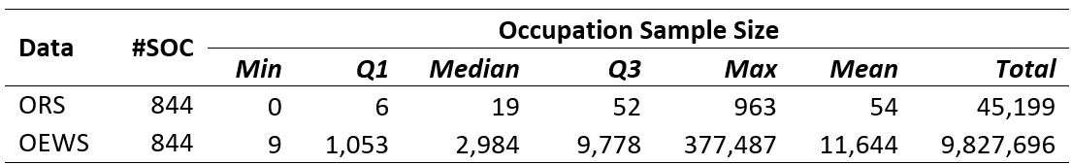
Occupational Employment and Wage Statistics (OEWS)
A semiannual survey designed to produce estimates of employment and wages for specific occupations, with an annual sample size of nearly 400,000.
OEWS Nov 2017-May 2020 had sampled about 1 million establishments
OEWS and ORS occupation sample size distribution

Slide 7
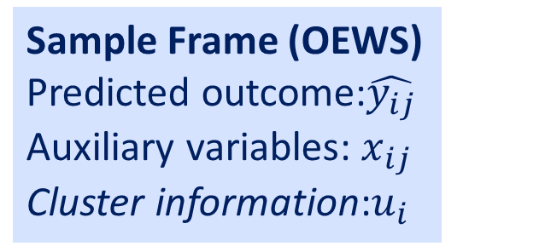
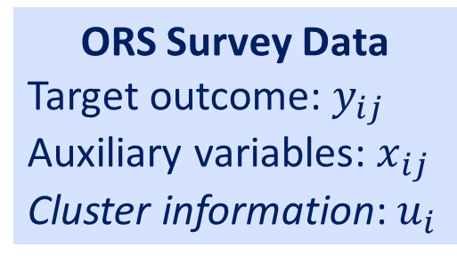
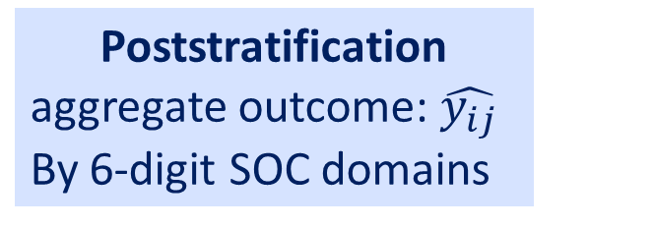
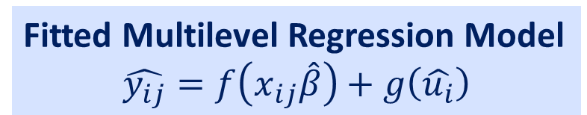
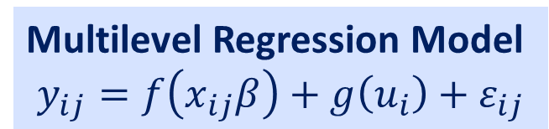
Multilevel Regression and Poststratification for Small Domain Estimation
ORS Survey Data
Target outcome: $y_{ij}$
Auxiliary variables: $x_{ij}$
Cluster information: $u_{i}$
Multilevel Regression Model
$$y_{ij}=f\left(x_{ij}β\right)+g\left(u_{i}\right)+ε_{ij}$$
Model Specification
Model Fitting
Sample Frame (OEWS)
Predicted outcome:$\hat{y_{ij}}$
Auxiliary variables: $x_{ij}$
Cluster information:$u_{i}$
Model Prediction with OEWS
Fitted Multilevel Regression Model
$$\hat{y_{ij}}=f\left(x_{ij}\hat{β}\right)+g\left(\hat{u_{i}}\right)$$
Poststratification
aggregate outcome: $\hat{y_{ij}}$
By 6-digit SOC domains
Estimate SEs via Bootstrapping
Small domain estimates
at levels of 6-digit SOC
Validation by reliable direct survey estimates

Slide 8
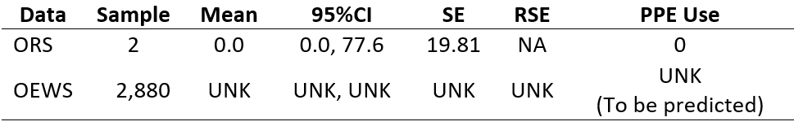
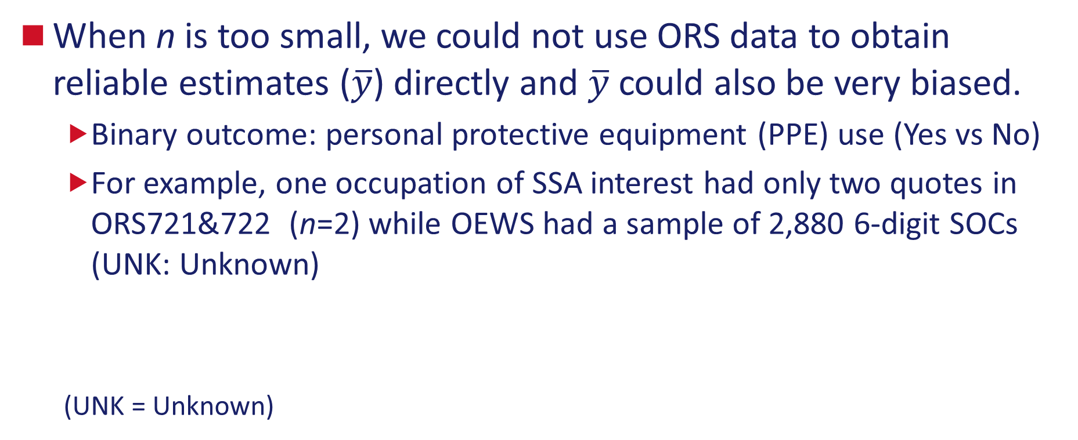
Step 1: Obtain the ORS direct survey estimates by SOC $\overline{y}=\frac{\sum_{i=1}^{n}{w_{i}y_{i}}}{\sum_{i=1}^{2}{w_{i}}}$
When n is too small, we could not use ORS data to obtain reliable estimates ($\overline{y}$) directly and $\overline{y}$ could also be very biased.
Binary outcome: personal protective equipment (PPE) use (Yes vs No)
For example, one occupation of SSA interest had only two quotes in ORS721&722 (n=2) while OEWS had a sample of 2,880 6-digit SOCs (UNK: Unknown)
(UNK = Unknown)

Slide 9
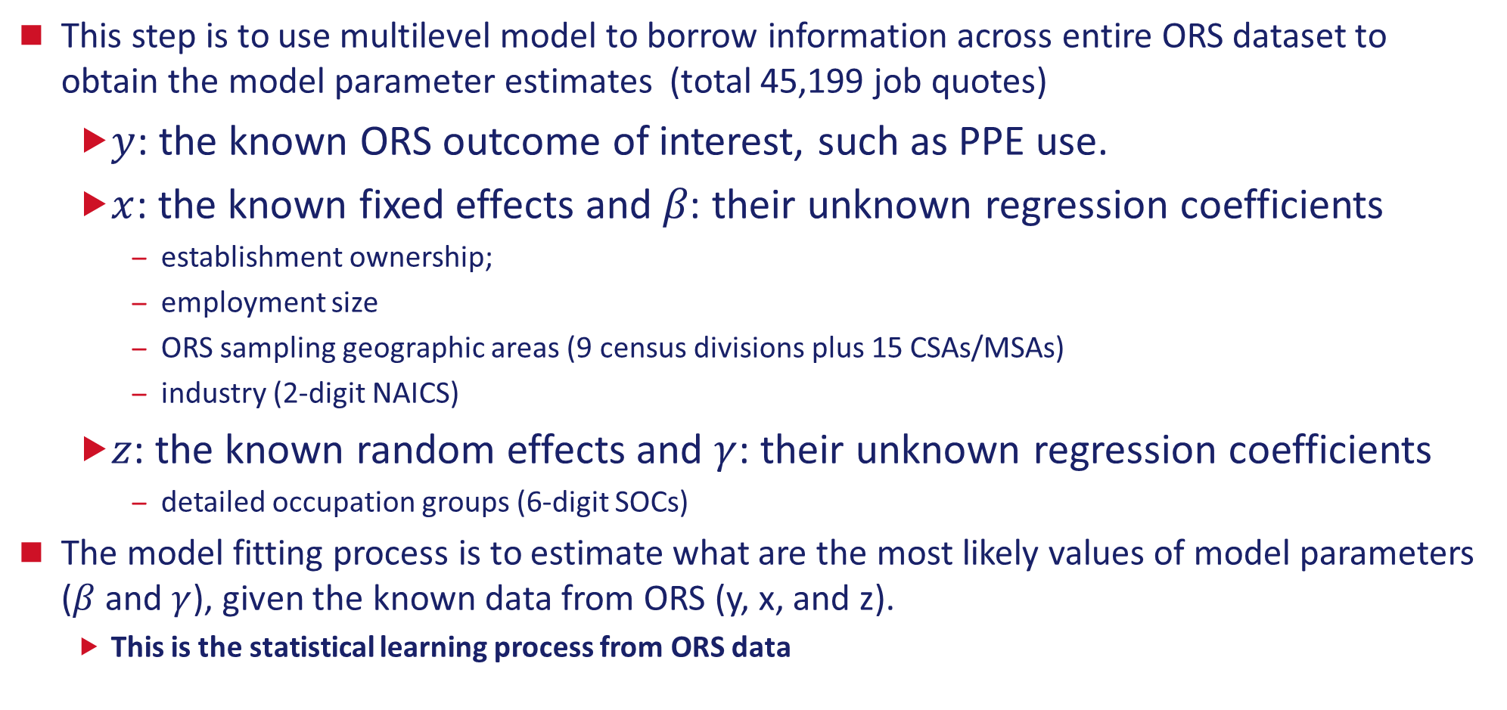
Step 2a: Use ORS data to construct and fit a multilevel model $y_{i}=x_{i}β+z_{i}γ$
This step is to use multilevel model to borrow information across entire ORS dataset to obtain the model parameter estimates (total 45,199 job quotes)
$y$: the known ORS outcome of interest, such as PPE use.
$x$: the known fixed effects and 𝛽: their unknown regression coefficients
establishment ownership;
employment size
ORS sampling geographic areas (9 census divisions plus 15 CSAs/MSAs)
industry (2-digit NAICS)
$z$: the known random effects and $γ$: their unknown regression coefficients
detailed occupation groups (6-digit SOCs)
The model fitting process is to estimate what are the most likely values of model parameters ($β$ and $γ$), given the known data from ORS (y, x, and z).
This is the statistical learning process from ORS data

Slide 10
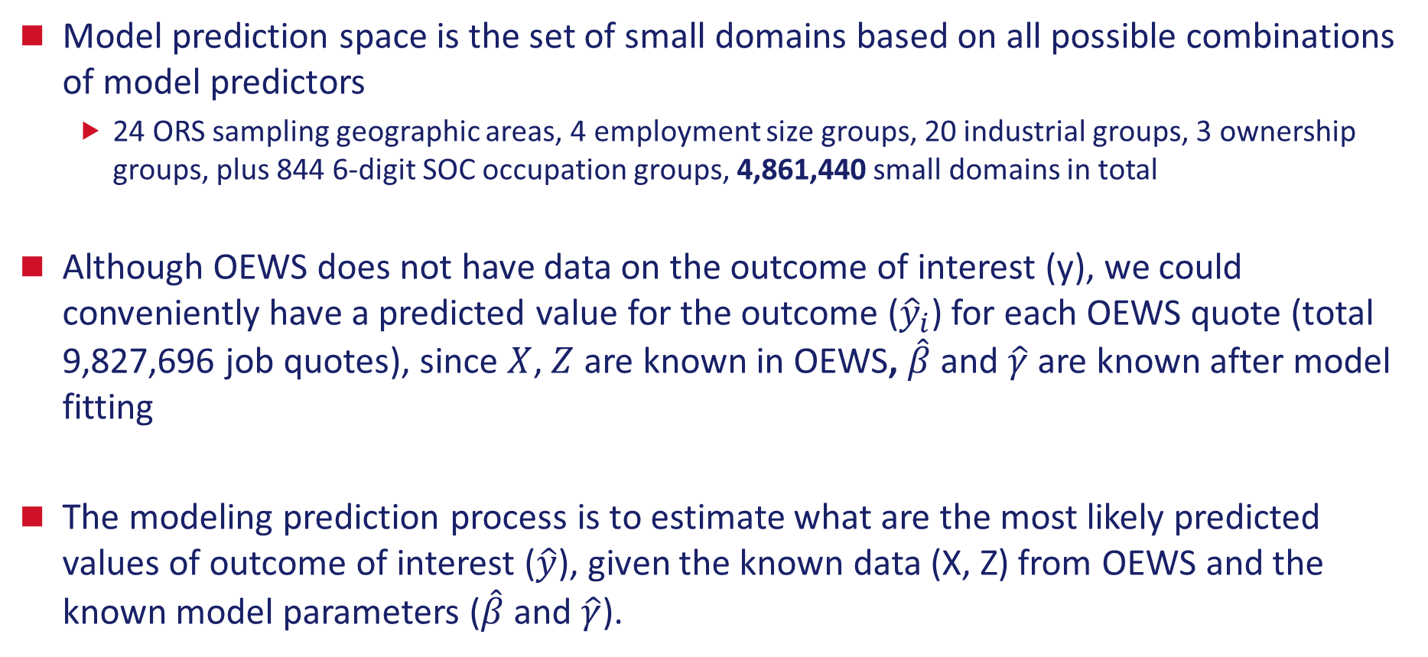
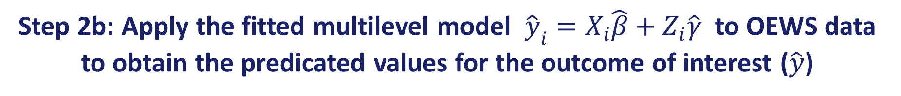
Step 2b: Apply the fitted multilevel model ${\hat{y}}_{i}=X_{i}\hat{β}+Z_{i}\hat{γ}$ to OEWS data to obtain the predicated values for the outcome of interest ($\hat{y}$)
Model prediction space is the set of small domains based on all possible combinations of model predictors
24 ORS sampling geographic areas, 4 employment size groups, 20 industrial groups, 3 ownership groups, plus 844 6-digit SOC occupation groups, 4,861,440 small domains in total
Although OEWS does not have data on the outcome of interest (y), we could conveniently have a predicted value for the outcome (${\hat{y}}_{i}$) for each OEWS quote (total 9,827,696 job quotes), since $X$, $Z$ are known in OEWS, $\hat{β}$ and $\hat{γ}$ are known after model fitting
The modeling prediction process is to estimate what are the most likely predicted values of outcome of interest ($\hat{y}$), given the known data (X, Z) from OEWS and the known model parameters ($\hat{β}$ and $\hat{γ}$).

Slide 11
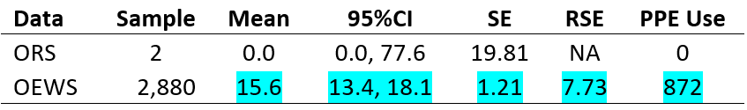
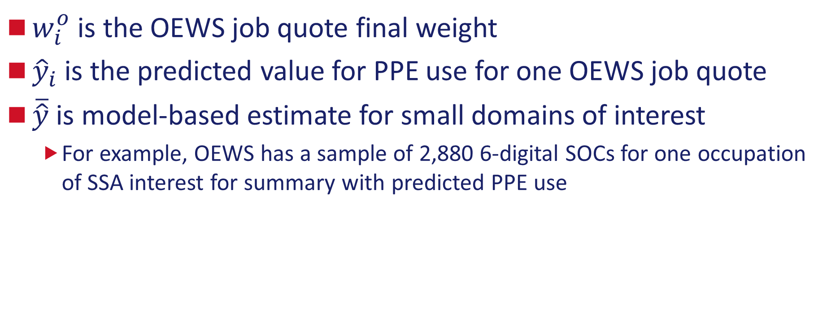
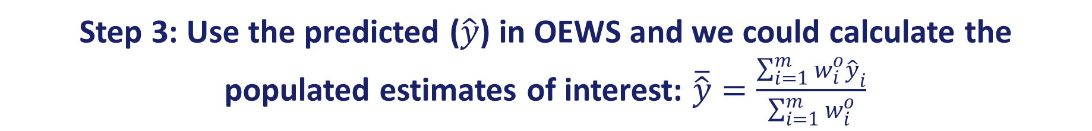
Step 3: Use the predicted ($\hat{y}$) in OEWS and we could calculate the populated estimates of interest: $\overline{\hat{y}}=\frac{\sum_{i=1}^{m}{w_{i}^{o}{\hat{y}}_{i}}}{\sum_{i=1}^{m}{w_{i}^{o}}}$
$w_{i}^{o}$ is the OEWS job quote final weight
${\hat{y}}_{i}$ is the predicted value for PPE use for one OEWS job quote
$\overline{\hat{y}}$ is model-based estimate for small domains of interest
For example, OEWS has a sample of 2,880 6-digital SOCs for one occupation of SSA interest for summary with predicted PPE use

Slide 12
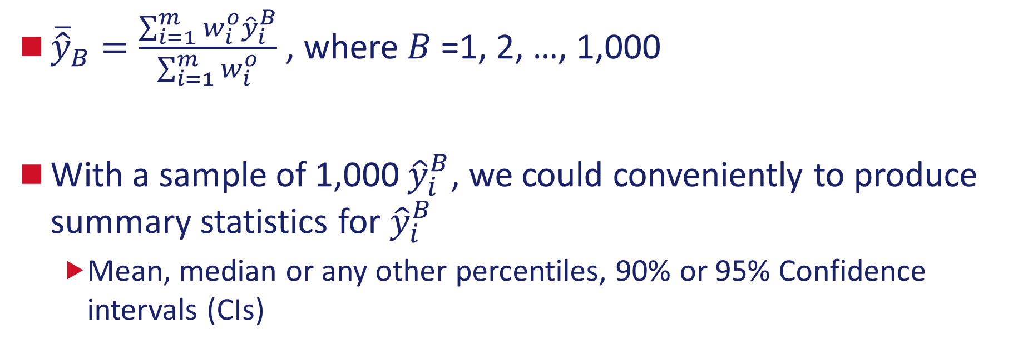
Step 4: obtain the variance estimates associated with small domain estimates that account for both model-based uncertainties and OEWS sampling uncertainties via bootstrapping
${\overline{\hat{y}}}_{B}=\frac{\sum_{i=1}^{m}{w_{i}^{o}{\hat{y}}_{i}^{B}}}{\sum_{i=1}^{m}{w_{i}^{o}}}$ , where $B$ =1, 2, …, 1,000
With a sample of 1,000 ${\hat{y}}_{i}^{B}$, we could conveniently to produce summary statistics for ${\hat{y}}_{i}^{B}$
Mean, median or any other percentiles, 90% or 95% Confidence intervals (CIs)

Slide 13
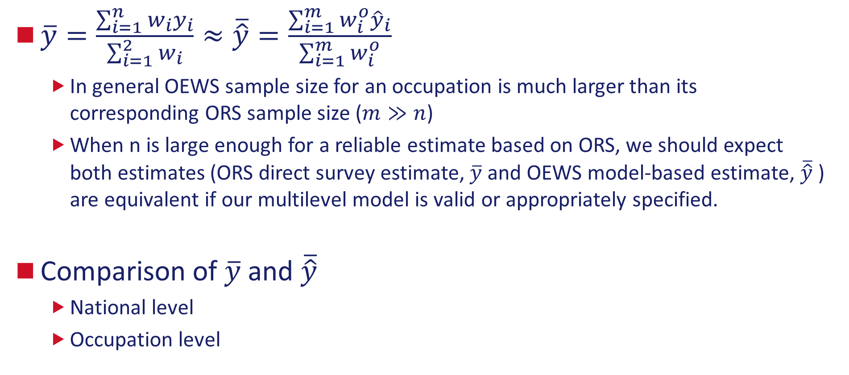
Step 5: Compare reliable estimates from both ORS and OEWS to check our model validity
$\overline{y}=\frac{\sum_{i=1}^{n}{w_{i}y_{i}}}{\sum_{i=1}^{2}{w_{i}}}≈\overline{\hat{y}}=\frac{\sum_{i=1}^{m}{w_{i}^{o}{\hat{y}}_{i}}}{\sum_{i=1}^{m}{w_{i}^{o}}}$
In general OEWS sample size for an occupation is much larger than its corresponding ORS sample size ($m≫n$)
When n is large enough for a reliable estimate based on ORS, we should expect both estimates (ORS direct survey estimate, $\overline{y}$ and OEWS model-based estimate, $\overline{\hat{y}}$ ) are equivalent if our multilevel model is valid or appropriately specified.
Comparison of $\overline{y}$ and $\overline{\hat{y}}$
National level
Occupation level

Slide 14
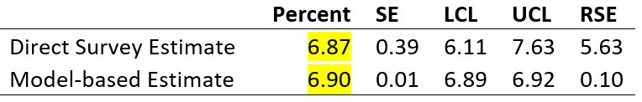
Preliminary Results
Outcome: Personal protective equipment use (Yes vs No)
National Level Comparison ORS direct survey estimate and model-based estimate of PPE use

Slide 15
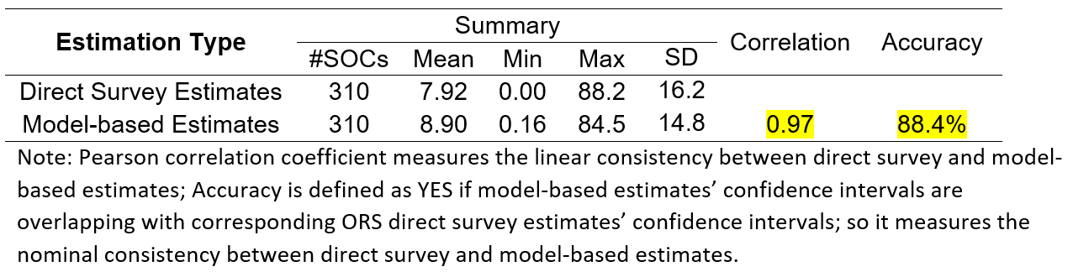
Comparison ORS direct survey estimate and model-based estimate of PPE use
6-digit SOC Occupation Level
Occupations that passed minimum number of observations based on ORS publication criteria

Slide 16
What is next?
Cross-validation
Drop all quotes for one occupation with a large sample size from model fitting process, then compare its model-based estimate with its direct survey estimate
116 SOCs with at least 100 quotes from ORS
Test model predictive power for those occupations without ORS samples at all
Reduce sample sizes for one occupation with a large sample size for model fitting, then compare its model-based estimate with its direct survey estimate
116 SOCs with at least 100 quotes from ORS
Test model predictive power for those occupations with small ORS sample sizes

Slide 17
Acknowledgement
Office of Employment and Unemployment Statistics (OEUS)
Julie Hatch
Laurie Salmon, David Byun and Andrea Wagoner.
Occupational Employment and Wage Statistics (OEWS) program team
Office of Compensation and Working Conditions (OCWC)
OCLT: DCDAP&DCDE
SMG ORS Team
Notes:
Here is an overview of what we will be covering in today’s presentation.
First, we will talk a little bit about the changes in the ORS sample design for the second wave and what is driving the need for new weighting methodology.
Then we will cover a little bit on all of the different weighting components including:
Final Establishment Weights
Final Occupational Weights and some of the weights and factors that are new.
Sample Group Factor
Benchmark Final Weights
And last we will provide some future research and recommendations for ORS Weighting.

Slide 18
Xingyou Zhang
Division Chief, Statistical Methods Group
Office of Compensation and Working Conditions (OCWC)
www.bls.gov/ors
202-691-6082
Zhang.Xingyou@bls.gov

