Slide 1
Estimating SNAP Eligibility and Access Using Linked Survey and Administrative Records
Renuka Bhaskar, Michaela Dillon, Brad Foster, Brian Knop,
Linden McBride, Maria Perez-Patron, and Erik Vickstrom
Center for Economic Studies
U.S. Census Bureau
November 4, 2021
Disclaimer: This research is released to inform interested parties and to encourage discussion.
The views expressed are those of the authors and not necessarily those of the U.S. Census Bureau.

Slide 2
Supplemental Nutrition Assistance Program (SNAP)
Largest nutrition assistance program aimed at reducing domestic hunger by providing low-income households benefits that can be used to purchase food at authorized retailers
SNAP has been shown to reduce food insecurity, improve health outcomes and has provided essential assistance in economic downturns and disaster situations

Slide 3
Monthly SNAP Participation, 2000-2021
Great Recession
COVID-19
Source: SNAP National Data Bank estimates available from USDA

Slide 4
SNAP Eligibility
Standard eligibility based primarily on income being below thresholds tied to federal poverty guidelines with assets below specified limits
Many states have adopted broad-based categorical eligibility in which households may be eligible for SNAP because they qualify for other benefit programs

Slide 5
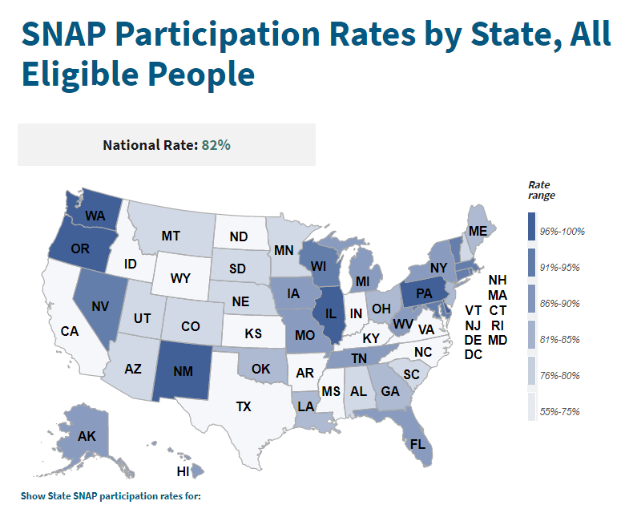
Measuring SNAP’s reach
Estimation of eligibility and participation among eligible populations is difficult
Using survey data and administrative records, USDA’s Food and Nutrition Service and Mathematica estimate that 82 percent of those eligible for SNAP nationwide received SNAP benefits in 2018
Source: SNAP Participation Rates by State, All Eligible People | USDA-FNS

Slide 6
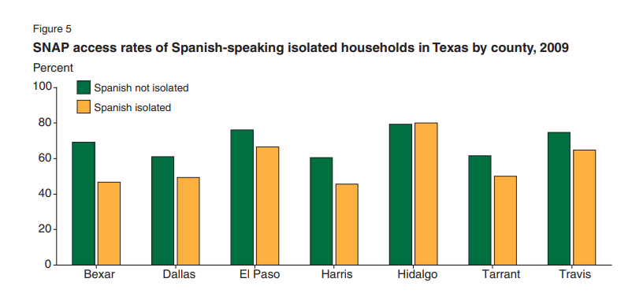
Using linked data to estimate SNAP eligibility and access
Newman and Scherpf (2013) linked administrative records on Texas SNAP participants to American Community Survey (ACS) to estimate eligibility and access to SNAP benefits
Measurement of access is different from standard estimates of participation but allows for sub-state estimates for a range of characteristics
Source: Newman and Scherpf (2013)

Slide 7
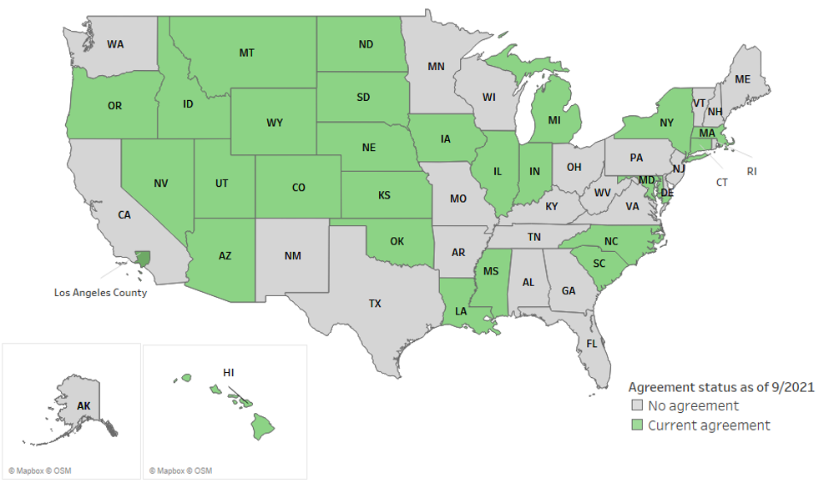
State SNAP data sharing
As part of a joint project with USDA Economic Research Service and Food and Nutrition Service, U.S. Census Bureau has acquired SNAP data from states and applied this approach to estimate eligibility and access
Data acquisition and estimation for Special Supplemental Nutrition Programs for Women, Infants, and Children (WIC) and Temporary Assistance for Needy Families (TANF)
States with current SNAP data sharing agreements as of 9/2021

Slide 8
Data sources
American Community Survey (ACS)
Approximately 3.5 million households sampled each year
Representative and timely information on the population
State SNAP data from participating states
Monthly records on participating clients and cases
Link ACS and state SNAP data at the individual level
State-level estimates: one year of ACS linked with two years of SNAP data
County-level estimates: three years of ACS linked with four years of SNAP data

Slide 9
Data linkage
U.S. Census Bureau’s Person Validation System (PVS) (Wagner and Layne 2014)
Uses Personally Identifiable Information (PII) and probabilistic matching techniques to assign individuals an anonymous Protected Identification Key (PIK)
PII is stripped from records after PIK assignment and before researchers are granted access
PIKs are used to link individuals in state SNAP data to their ACS responses
Adjustments to ACS person weights to account for the likelihood of PIK assignment
Notes:
.

Slide 10
Eligibility estimation using methodology from Newman and Scherpf (2013)
Define SNAP Units using age and relationship status within households
Eligibility estimation
Estimate income of SNAP unit
Net income and gross income tests applied to others using SNAP unit size responses to income in the last year, considering deductions as possible
Public assistance / SSI receipt
Citizenship and college attendance used to consider other SNAP rules
Use state SNAP administrative records to assign eligibility to those living with SNAP participants

Slide 11
SNAP access among eligible
Among eligible, look for benefit receipt in SNAP administrative records in the twelve months prior to survey date
Month surveyed and determined to be eligible
Sep-18 | Oct-18 | Nov-18 | Dec-18 | Jan-19 | Feb-19 | Mar-19 | Apr-19 | May-19 | Jun-19 | Jul-19 | Aug-19 | Sep-19 | Oct-19
 |  | SNAP | SNAP | SNAP | SNAP | SNAP | SNAP | SNAP | SNAP | SNAP | SNAP | SNAP | SNAP
 |  |  |  |  | SNAP
SNAP
Access?
Yes
Yes
No
Person 1
Person 2
Person 3
12 months we look for SNAP receipt

Slide 12
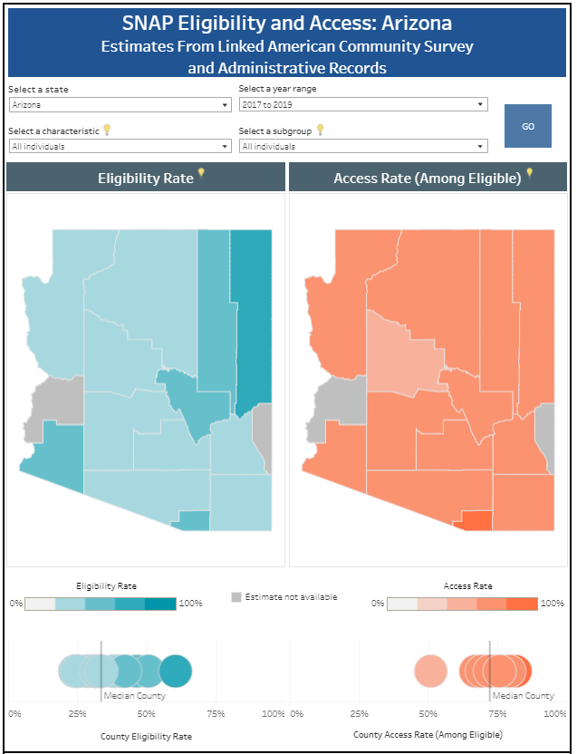
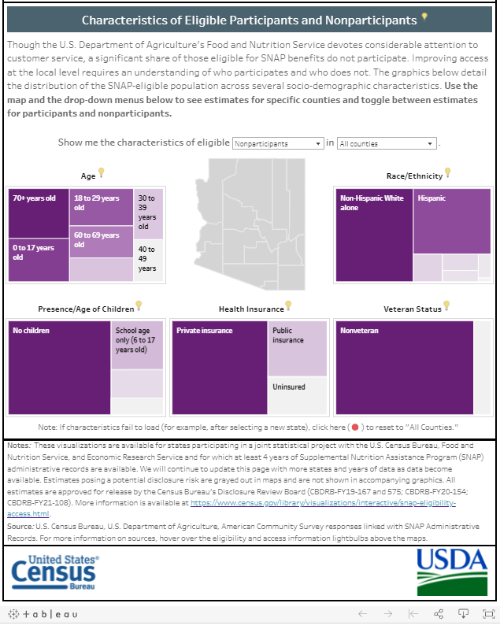
SNAP data visualizations
Estimates for 21 states available on Census website
County-level eligibility and access rates, by characteristics
Characteristics of participants and non-participants
Source: Supplemental Nutrition Assistance Program (SNAP) Eligibility & Access (census.gov)

Slide 13
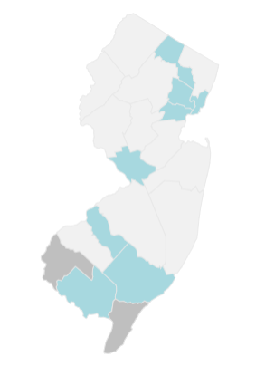
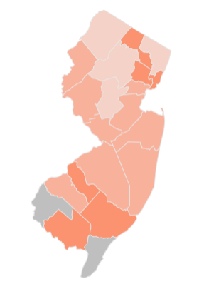


New Jersey
Eligibility Rate
Access Rate
State-level estimates (2019)
Eligibility rate: 19.5% (+/-0.5)
Access rate: 54.4% (+/-1.4)
Source: Supplemental Nutrition Assistance Program (SNAP) Eligibility & Access (census.gov)

Slide 14
New Jersey
Eligibility Rate
Access Rate
State-level estimates (2019)
Eligibility rate: 19.5% (+/-0.5)
Access rate: 54.4% (+/-1.4)
Cumberland County (2017-2019)
Eligibility rate: 36.9% (+/- 2.8)
Access rate: 70.9% (+/- 4.5)
Source: Supplemental Nutrition Assistance Program (SNAP) Eligibility & Access (census.gov)

Slide 15
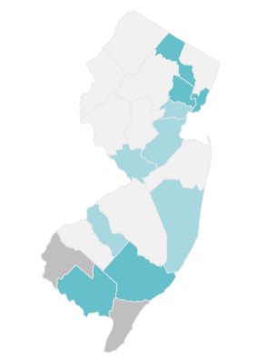
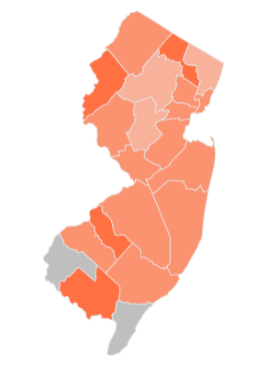
Higher rates of eligibility and access among children
Eligibility Rate
Access Rate
All ages
Ages 0-17
All ages
Ages 0-17
Source: Supplemental Nutrition Assistance Program (SNAP) Eligibility & Access (census.gov)

Slide 16
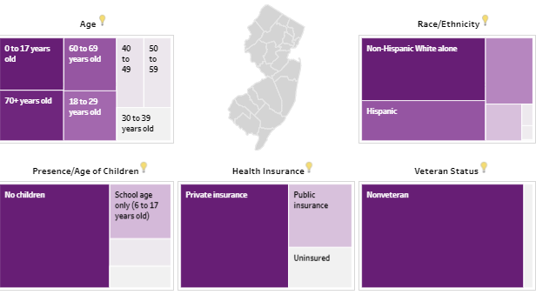
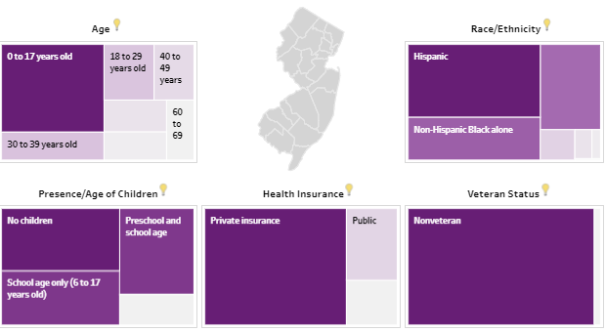
Characteristics of eligible populations
Eligible non-participants
Eligible participants
Source: Supplemental Nutrition Assistance Program (SNAP) Eligibility & Access (census.gov)

Slide 17
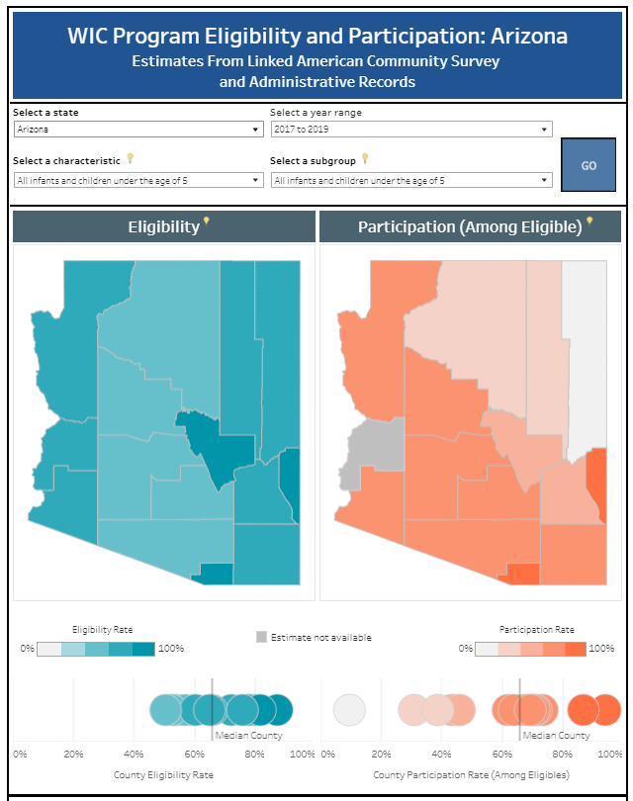
TANF and WIC estimates
State TANF and WIC data also linked to ACS to better understand participation in these programs
TANF participation among population in poverty
WIC eligibility and participation among infants/children
WIC participation among women
WIC data visualization for 8 states
Source: WIC Program Eligibility and Participation (census.gov)

Slide 18
Future work
Continued estimation of SNAP eligibility and access
Further evaluation of SNAP unit simulation
Further evaluation of eligibility assumptions

Slide 19
Thank you!
Renuka Bhaskar
Center for Economic Studies
renuka.bhaskar@census.gov

