Slide 1
Democratic Aggregation: Issues and Implications for Consumer Price Indexes
Robert Martin
Division of Price and Index Number Research
FCSM 2021 Research and Policy Conference
November 4, 2021

Slide 2
Outline
Introduction
Group Price Index Theory
Methods
Results
Discussion and Conclusion

Slide 3
Overview
Current Consumer Price Index (CPI) methodology geared to measure inflation from macroeconomic perspective
Prices and expenditure weights for a “representative consumer”
Budget shares matches the “average dollar” of expenditure
Different from inflation experienced by the average household?
Among other potential differences, like consumption vs. payments
Main finding: Aggregation differences are three times larger when using Tornqvist formula than when using modified Laspeyres (Lowe)

Slide 4
Selected Literature
Price index theory: Prais (1958), Pollak (1989), ILO/IMF/OECD/UNECE/Eurostat/World Bank (2004), Ley (2005)
Individual and subgroup heterogeneity: Garner, et. al. (1996), Cage, Garner, and Ruiz-Castillo (2002), McGranahan and Paulson (2005, Chicago Fed IBEX), Hobijn and Lagakos (2005), Hobijn, et. al. (2009), Jaravel (2018, 2021), Kaplan and Shulhofer-Wohl (2017), Cage, et. al. (2018)
Common finding: Plutocratic-Democratic gap tends to be small when using Lowe (a.k.a. modified Laspeyres) formula

Slide 5
Group Price Indexes
Standard price index formulas use market-level prices and expenditures (i.e., a “representative consumer”)
Formulas used by BLS
Lowe/modified Laspeyres: For CPI-U, fixed biennial weights
Tornqvist: For Chained CPI-U, updating monthly weights
These implicitly give more weight to households with higher expenditure
Democratic price indexes give equal weight to each household
Building blocks are household-specific price indexes

Slide 6
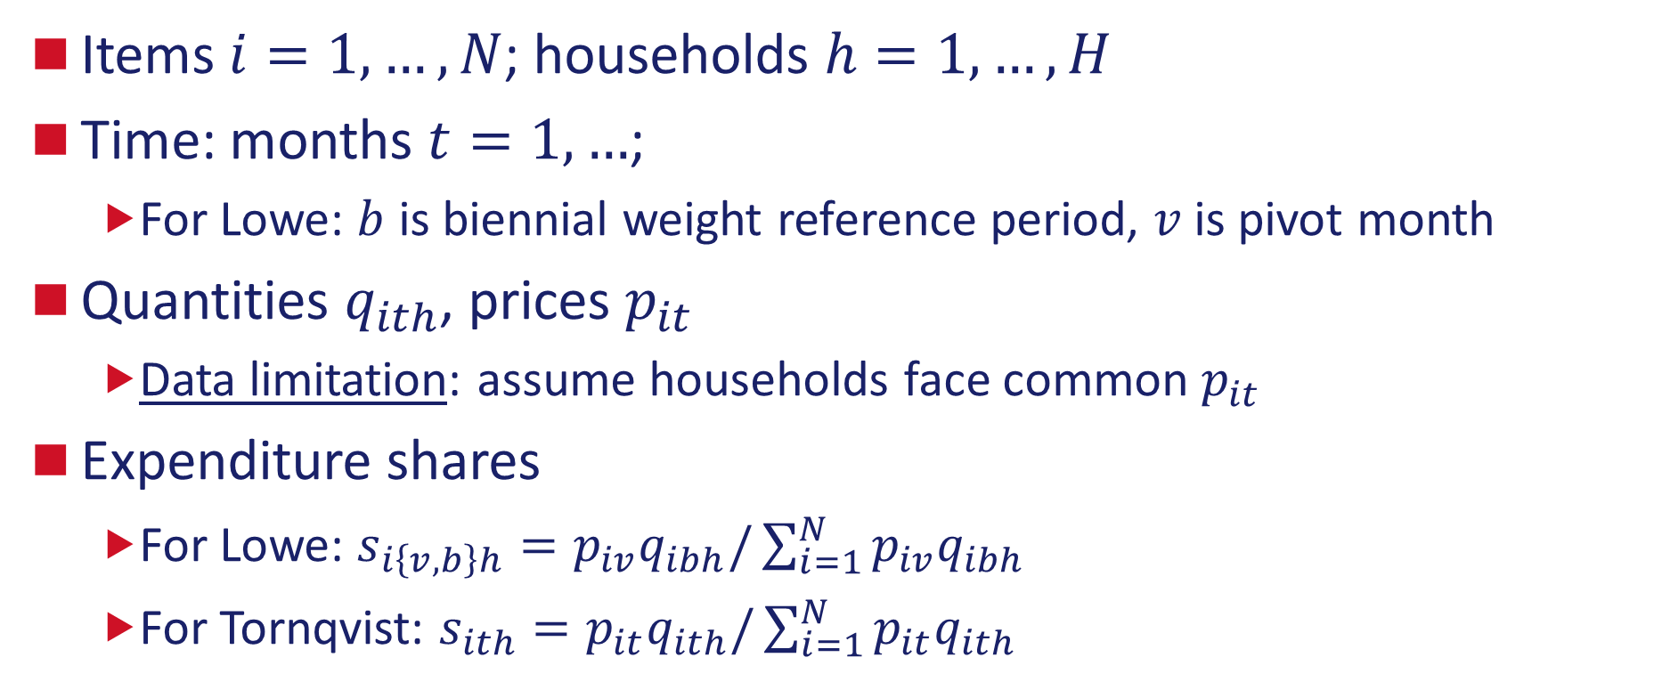
Household Price Indexes
Items $i=1,…, N$; households $h=1,…, H$
Time: months $t=1,…$;
For Lowe: $b$ is biennial weight reference period, $v$ is pivot month
Quantities $q_{ith}$, prices $p_{it}$
Data limitation: assume households face common $p_{it}$
Expenditure shares
For Lowe: $s_{i\left\{v,b\right\}h}=p_{iv}q_{ibh}/\sum_{i=1}^{N}{p_{iv}q_{ibh}}$
For Tornqvist: $s_{ith}=p_{it}q_{ith}/\sum_{i=1}^{N}{p_{it}q_{ith}}$

Slide 7
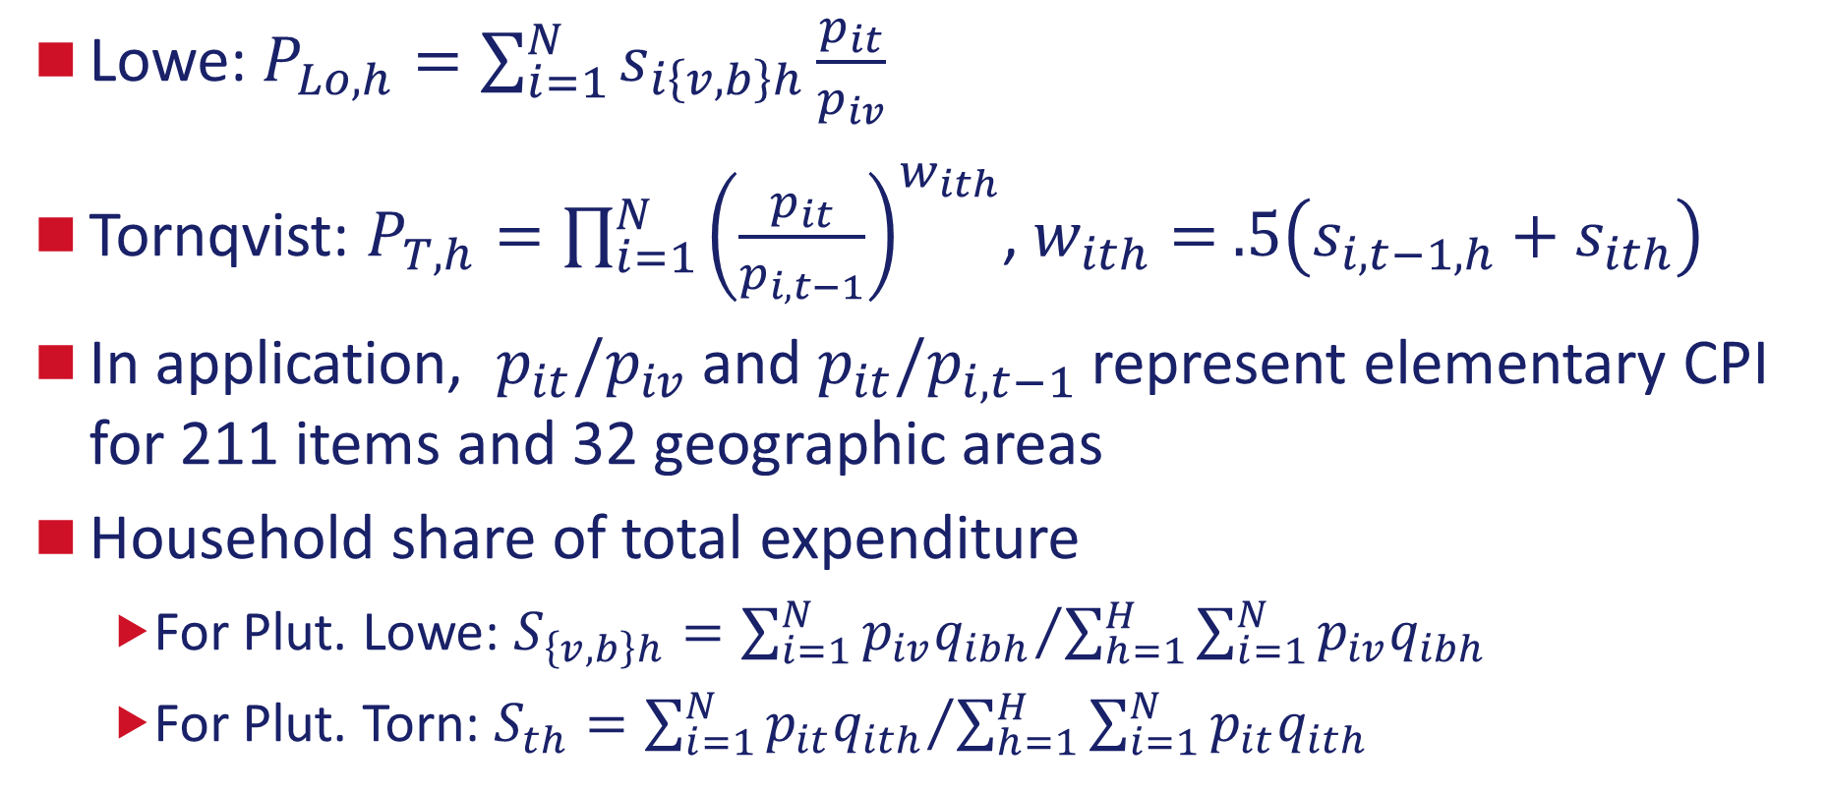
Household Price Indexes (2)
Lowe: $P_{Lo,h}=\sum_{i=1}^{N}{s_{i\left\{v,b\right\}h}\frac{p_{it}}{p_{iv}}}$
Tornqvist: $P_{T,h}=\prod_{i=1}^{N}{{\left(\frac{p_{it}}{p_{i,t−1}}\right)}^{w_{ith}}}$, $w_{ith}=$ $.5\left(s_{i,t−1,h}+s_{ith}\right)$
In application, $p_{it}/p_{iv}$ and $p_{it}/p_{i,t−1}$ represent elementary CPI for 211 items and 32 geographic areas
Household share of total expenditure
For Plut. Lowe: $S_{\left\{v,b\right\}h}={\sum_{i=1}^{N}{p_{iv}q_{ibh}}}/{\sum_{h=1}^{H}{\sum_{i=1}^{N}{{p_{iv}q}_{ibh}} }}$
For Plut. Torn: $S_{th}={\sum_{i=1}^{N}{p_{it}q_{ith}}}/{\sum_{h=1}^{H}{\sum_{i=1}^{N}{{p_{it}q}_{ith}}}}$

Slide 8
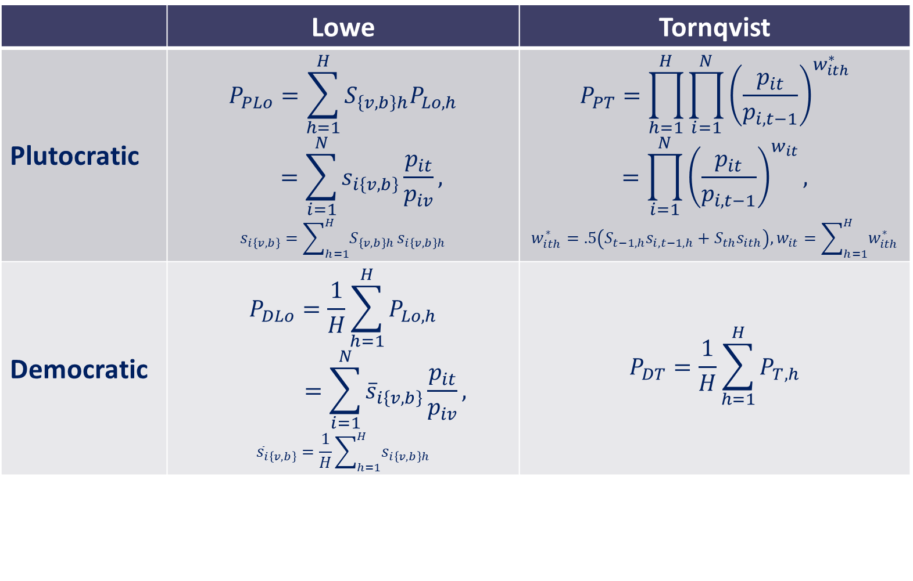
Democratic and Plutocratic Price Indexes
 | Lowe | Tornqvist
Plutocratic | $$P_{PLo}=\sum_{h=1}^{H}{S_{\left\{v,b\right\}h}P_{Lo,h}}$$ $$=\sum_{i=1}^{N}{s_{i\left\{v,b\right\}}\frac{p_{it}}{p_{iv}}},$$ $$s_{i\left\{v,b\right\}}=\sum_{h=1}^{H}{S_{\left\{v,b\right\}h}}s_{i\left\{v,b\right\}h}$$ | $$P_{PT}=\prod_{h=1}^{H}{\prod_{i=1}^{N}{{\left(\frac{p_{it}}{p_{i,t−1}}\right)}^{w_{ith}^{∗}}}}$$ $$=\prod_{i=1}^{N}{{\left(\frac{p_{it}}{p_{i,t−1}}\right)}^{w_{it}}},$$ $$w_{ith}^{∗}=.5\left(S_{t−1,h}s_{i,t−1,h}+S_{th}s_{ith}\right), w_{it}=\sum_{h=1}^{H}{w_{ith}^{∗}}$$
Democratic | $$P_{DLo}=\frac{1}{H}\sum_{h=1}^{H}{P_{Lo,h}}$$ $$=\sum_{i=1}^{N}{{\overline{s}}_{i\left\{v,b\right\}}\frac{p_{it}}{p_{iv}},}$$ $${\overline{s}}_{i\left\{v,b\right\}}=\frac{1}{H}\sum_{h=1}^{H}{s_{i\left\{v,b\right\}h}}$$ | $$P_{DT}=\frac{1}{H}\sum_{h=1}^{H}{P_{T,h}}$$

Slide 9
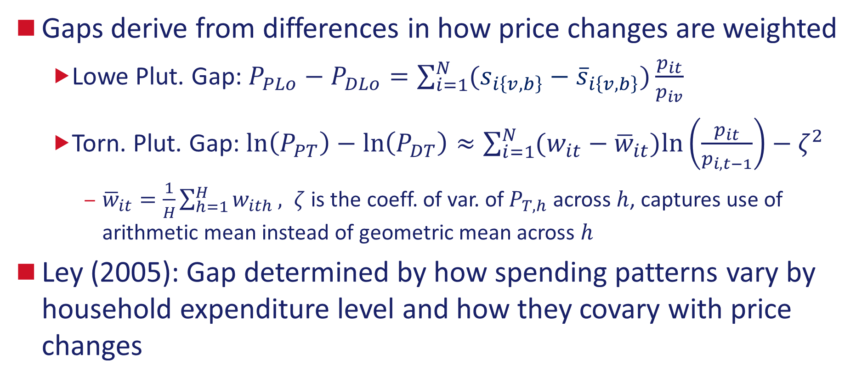
The Plutocratic Gap
Gaps derive from differences in how price changes are weighted
Lowe Plut. Gap: $P_{PLo}−P_{DLo}=\sum_{i=1}^{N}{(s_{i\left\{v,b\right\}}−{\overline{s}}_{i\left\{v,b\right\}}})\frac{p_{it}}{p_{iv}}$
Torn. Plut. Gap: $\ln\left(P_{PT}\right)−\ln\left(P_{DT}\right)≈\sum_{i=1}^{N}{(w_{it}−{\overline{w}}_{it}})ln⁡\left(\frac{p_{it}}{p_{i,t−1}}\right)−ζ^{2}$
${\overline{w}}_{it}=\frac{1}{H}\sum_{h=1}^{H}{w_{ith}}, ζ$ is the coeff. of var. of $P_{T,h}$ across $h$, captures use of arithmetic mean instead of geometric mean across $h$
Ley (2005): Gap determined by how spending patterns vary by household expenditure level and how they covary with price changes

Slide 10
Methods Overview
Using CPI elementary indexes, Consumer Expenditure Survey (CE) for second-stage aggregation weights
Key limitation: same elementary price indexes (211 items) used for each household. Only variation is by 32 geographic areas
CE = two independent surveys: Interview and Diary
For Tornqvist, the democratic average is over the one-month index links, which are then chained together as in C-CPI-U
For Lowe, to better mimic biennial weighting of CPI-U, using only households who completed four interviews

Slide 11
Interview-Diary Matching
Interview households: Records for 3-12 months
Roughly 75% of CPI expenditures: most of Housing, Transportation, Medical Care, Education and Communication
Diary households: Records for 1-2 weeks
Roughly 25% of CPI expenditures: Most of Food and Beverages, Apparel. Significant portion of Recreation and Other Goods
For each Interview-month, select one Diary which has similar demographic characteristics, where similarity is based on predicted expenditures (similar to Hobijn, et. al. 2009)

Slide 12
Results

Slide 13
Indexes for the Urban Population
Avg. 12 mo. Percent Change
(Dec. 2002-Dec. 2019)
Index Levels (Dec. 2001 = 1.0)
Index | Estimate
Plutocratic Lowe | 2.055%
Democratic Lowe | 2.132%
Difference, Lowe | -0.077%
Plutocratic Tornqvist | 1.831%
Democratic Tornqvist | 2.073%
Difference, Tornqvist | -0.242%
Official Indexes
CPI-U (Lowe) | 2.099%
C-CPI-U (Torn.) | 1.845%

Slide 14
Tornqvist Aggregation Differences Over Time
Gap in Tornqvist 12 mo. % ch., Urban
Avg. 12 mo. % ch., Urban
 | P. Torn. | D. Torn | Diff
2001-04 | 1.910% | 2.389% | -0.479%
2005-08 | 3.016% | 3.508% | -0.492%
2009-12 | 1.540% | 1.568% | -0.028%
2013-16 | 0.941% | 0.959% | -0.018%
2017-19 | 1.679% | 1.916% | -0.237%
Note: Margins of error are preliminary and conditional on elementary item-area indexes.

Slide 15
Contributions to Tornqvist Plutocratic Gap
By CPI Major Group (December 12 mo. log-change)
Bars represent $\sum_{t=Jan.}^{Dec.}{\sum_{i∈MG}{\left(w_{it}−{\overline{w}}_{it}\right)\ln\left(\frac{p_{it}}{p_{i},t−1}\right) }}$over items in the major group

Slide 16
Tornqvist Indexes for Subgroups
Average 12-month Percent Change
*Averages cover Dec. 2000 – Dec. 2019. Quintiles based on total CPI-eligible expenditures of CE Interview households in the index month
**Averages cover Jan. 2005 – Dec. 2019. Quintiles based before-tax income of CE Interview households in the prior year. CE started imputing missing income in 2004.

Slide 17
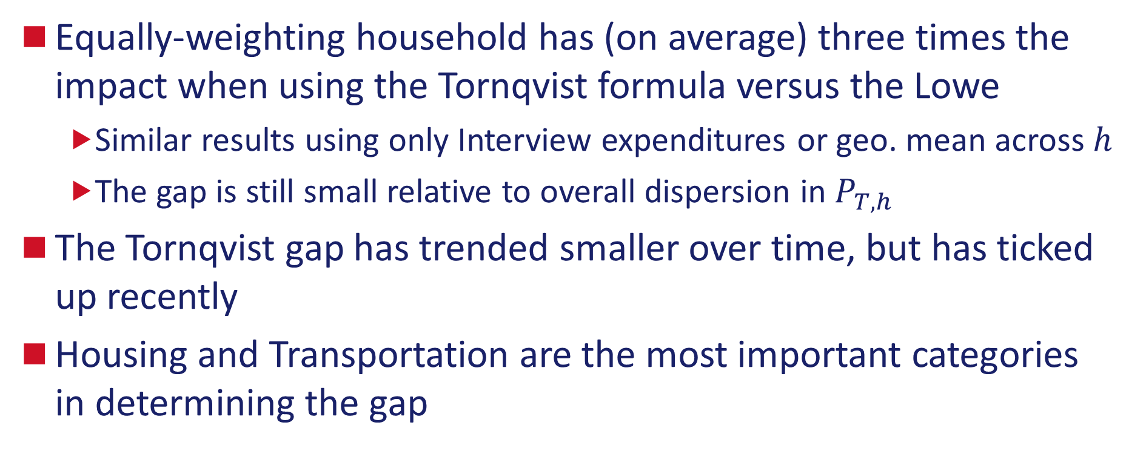
Summary and Conclusions
Equally-weighting household has (on average) three times the impact when using the Tornqvist formula versus the Lowe
Similar results using only Interview expenditures or geo. mean across $h$
The gap is still small relative to overall dispersion in $P_{T,h}$
The Tornqvist gap has trended smaller over time, but has ticked up recently
Housing and Transportation are the most important categories in determining the gap

Slide 18
Future Research
This is work in progress, so comments are welcome
Ongoing: more practical approximations to democratic index (i.e., an average of indexes by expenditure quintile)
Ongoing: impact of democratic aggregation on sampling variation
Long-term: missing “within-stratum” heterogeneity (e.g., in prices paid) is likely very important (Jaravel, 2021)

Slide 19
Thank you! Robert Martin Division of Price and Index Number Research Bureau of Labor Statistics martin.robert@bls.gov

Slide 20
References (1)
Cage, R. A., Garner, T. I., & Ruiz-Castillo, J. (2002). Constructing Household Specific Consumer Price Indexes: An Analysis of Different Techniques and Methods. Washington, DC: Bureau of Labor Statistics. Retrieved from https://www.bls.gov/osmr/research-papers/2002/pdf/ec020030.pdf
Cage, R. A., Klick, J., & Johnson, W. (2018). Population Subgroup Price Indexes: Evidence of Heterogeneity or Measurement Error? Meeting of the Group of Experts on Consumer Price Indexes, United Nations Economic Commission for Europe Geneva, Switzerland, May 7-9, 2018. https://www.unece.org/fileadmin/DAM/stats/documents/ece/ces/ge.22/2018/United_States.pdf.
Garner, T. I., Johnson, D. S., & Kokoski, M. F. (1996). An experimental Consumer Price Index for the poor. Monthly Labor Review, 32-42. Retrieved from https://www.bls.gov/opub/mlr/1996/09/art5full.pdf
Hobijn, B., & Lagakos, D. (2005). Inflation Inequality in the United States. Review of Income and Wealth, 51(4), 581-606.
Hobijn, B., Mayer, K., Stennis, C., & Topa, G. (2009). Household Inflation Experiences in the U.S.: A Comprehensive Approach. Working Paper 2009-19. Federal Reserve Bank of San Francisco.
ILO/IMF/OECD/UNECE/Eurostat/World Bank. (2004). Consumer Price Index Manual: Theory and Practice. (P. Hill, Ed.) Geneva: International Labor Organization.

Slide 21
References (2)
Jaravel, X. (2018). The Unequal Gains from Product Innovations: Evidence from the U.S. Retail Sector. The Quarterly Journal of Economics, 134.2, 715-783. Retrieved from https://doi.org/10.1093/qje/qjy031
Jaravel, X. (2021). Inflation Inequality: Measurement, Causes, and Policy Implications. The Annual Review of Economics 13.
Ley, E. (2005). Whose Inflation? A characterization of the CPI plutocratic gap. Oxford Economic Papers, 634-646.
Kaplan, G., & Schulhofer-Wohl, S. (2017). Inflation at the household level. Journal of Monetary Economics, 91, 19-38.
McGranahan, L., & Paulson, A. L. (2005). Constructing the Chicago Fed Income Based Economic Index-Consumer Price Index: Inflation Experiences by Demographic Group: 1983-2005, Working Paper 2005-20.
Pollak, R. A. (1989). The Theory of the Cost-of-Living Index. New York, NY: Oxford University Press.
Prais, S. J. (1958). Whose Cost of Living? The Review of Economic Studies, 26, 126-34.

