Slide 1
Evaluating Previously Reported Data in the Census of Agriculture: Results from Usability Testing
For
2021 FCSM Research and Policy Conference
November 4, 2021| Washington, DC
By
Heather Ridolfo and Ken Pick

Slide 2
Disclaimer
All research presented today was conducted at the National Agricultural Statistics Service (NASS)
The findings and conclusions in this presentation are those of the authors and should not be construed to represent any official USDA or U.S. Government determination or policy

Slide 3
Background
Establishment respondents are surveyed frequently, sometimes multiple times per year
Responding can feel burdensome and redundant
Use of previously reported data (PRD) may ease that burden
PRD in the 2022 Census of Agriculture Content Test web questionnaire
Experiment
Usability testing

Slide 4
Research Questions
Does displaying PRD assist respondents?
Does displaying PRD impact efficiency?
Does displaying PRD impact measurement error/data quality?

Slide 5
Methodology
Nine usability interviews in April–May 2020
Conducted remotely using WebEx and Zoom
Respondents used their own devices/browsers to view survey
PRD presented as prefilled answers
Usability Testing focused on PRD messaging and PRD use in 5 sections

Slide 6
PRD Messaging

Slide 7
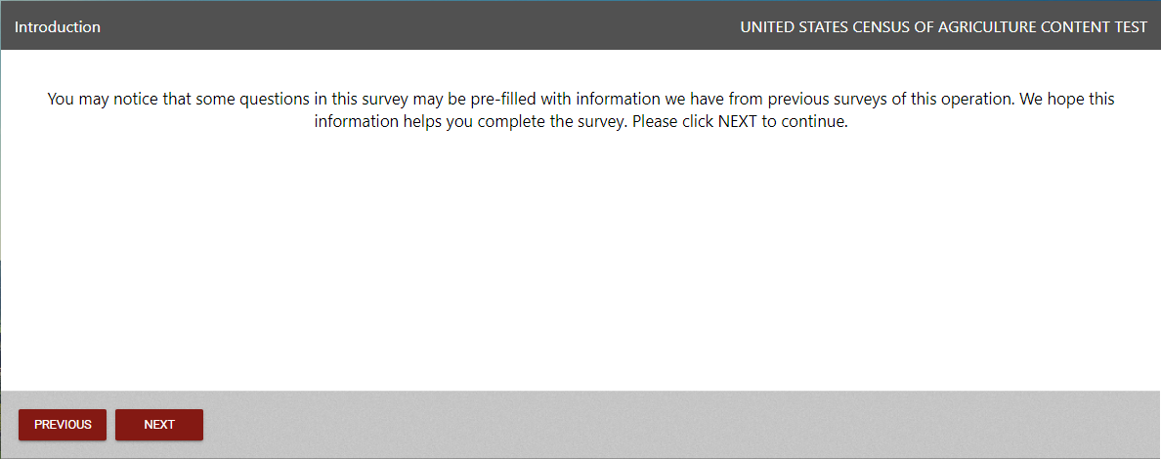
First PRD Statement

Slide 8
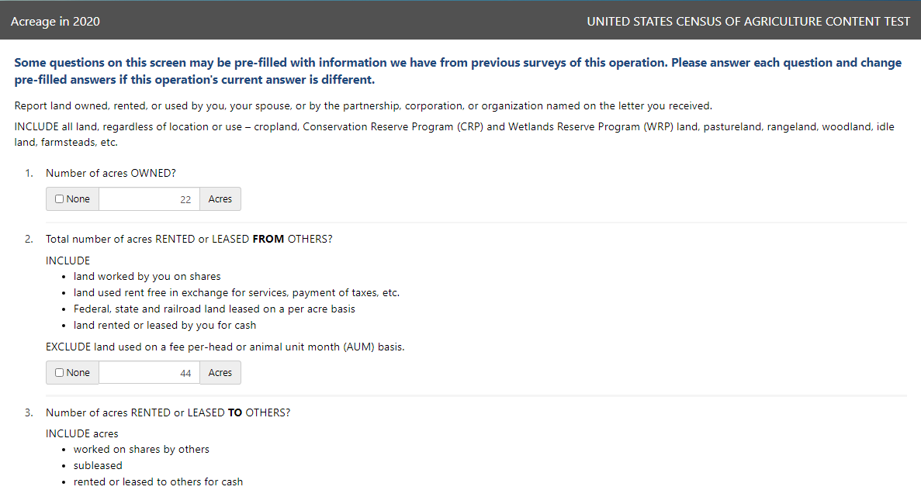
Research Questions

Slide 9
PRD Statements – Recommendation and Outcome
Recommendation:
Keep a statement on a separate screen at the beginning of the survey alerting respondents of the use of PRD and setting respondents’ expectations on how the PRD will be displayed and how they can use it
Outcome:
Revised first PRD statement instructing respondents to correct information that is no longer accurate
Second PRD statement only appears on first screen with PRD

Slide 10
Reactions to and Utility of PRD

Slide 11
Positive Aspects of PRD
Respondents generally like the idea of PRD
When no change, PRD appears to reduce reporting burden
(retrieval and judgement steps in response model)
When no change, PRD appears to improve efficiency
(comprehension and communication steps in response model)
“Anything that saves me time is good.”

Slide 12
Example of Where PRD Worked Well

Slide 13
Negative Aspects of PRD
When change occurred, PRD appeared to increase response burden and respondents questioned its source
Changed occurred for different reasons:
Information has changed
Different respondent reported in the past
Respondent entered information incorrectly in past (comprehension issue, typing issues, etc.)
Errors in reading PRD into web instrument
Use of PRD reduced the reading of questions and instructions (may reduce data quality)
If answered incorrectly in the past, errors will not be corrected
May not capture change
Current presentation of PRD did not align with respondents’ expectations
Web functionality worked against PRD

Slide 14
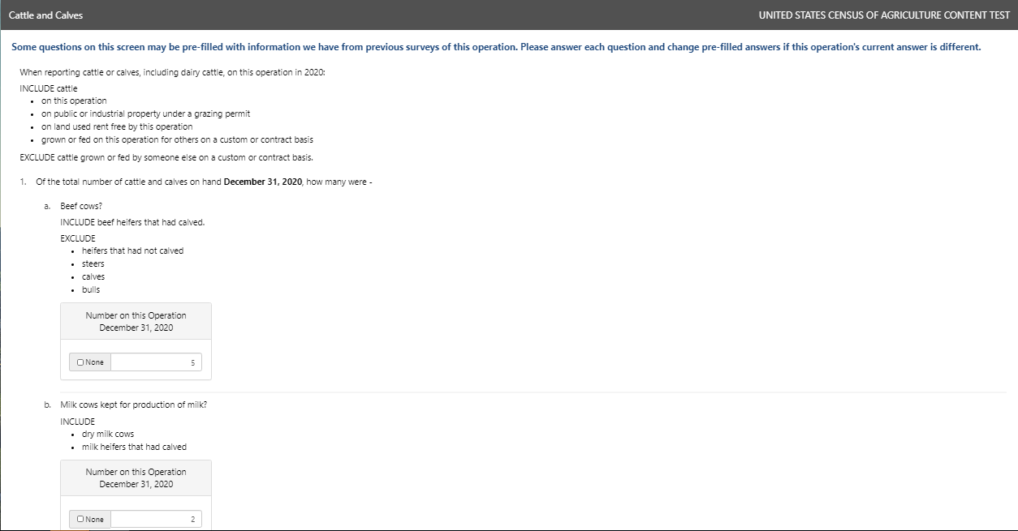
Where PRD Did Not Work Well: Example 1

Slide 15
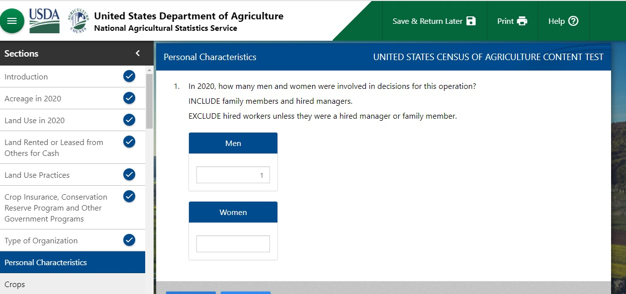
Where PRD Did Not Work Well: Example 2

Slide 16
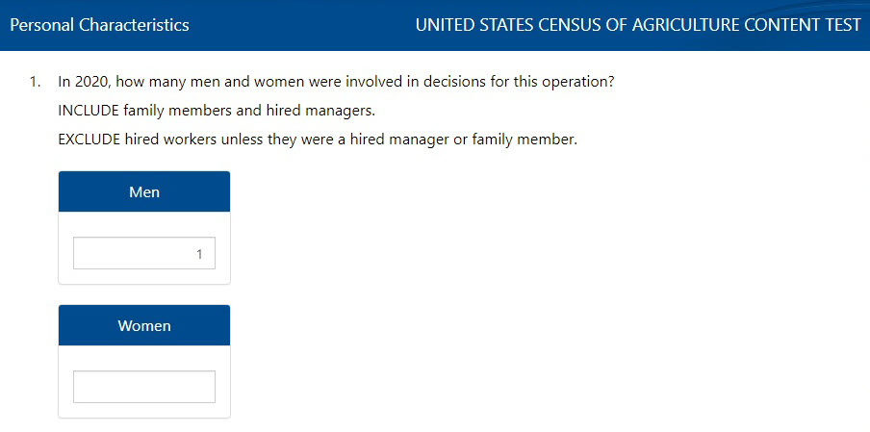
Where PRD Did Not Work Well: Example 2
“I’ve probably answered this with ‘one’ all along… my daughters would be insulted.”

Slide 17

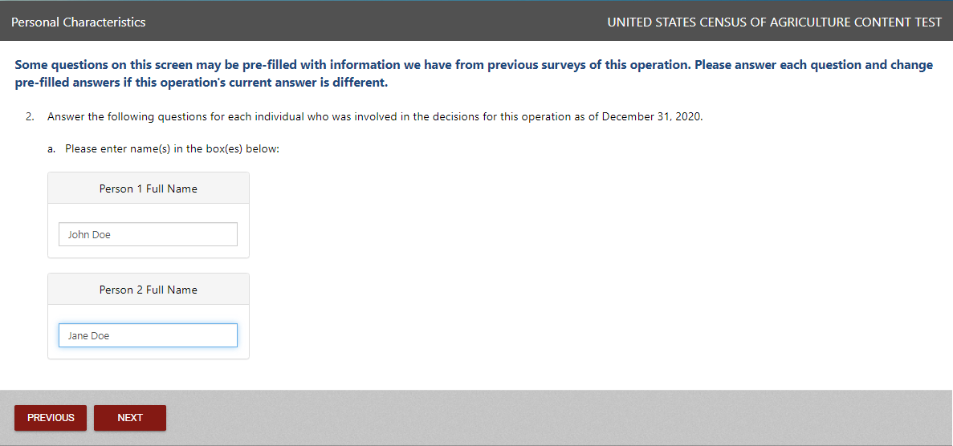
Where PRD Did Not Work Well: Example 2
Screen 1
Screen 2

Slide 18
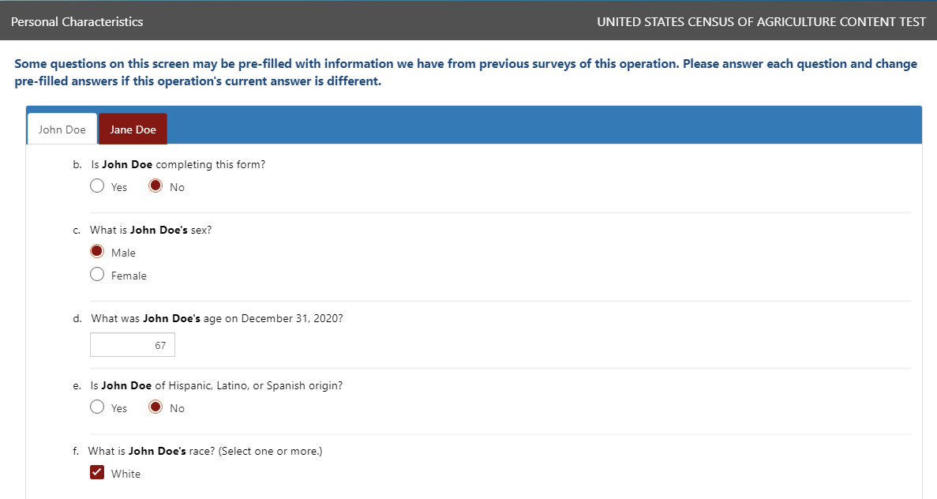
Where PRD Did Not Work Well: Example 2

Slide 19
Summary
Respondents had positive reaction to PRD when there was no change
Some items can be easily answered without PRD
Respondents did not always read full questions and instructions when PRD present
When current answer is different from PRD, burden is increased and data quality may be affected

Slide 20
PRD Recommendations
Recommendations:
Conduct analysis to understand the variability of data from year to year, or census to census, before deciding on where to use PRD
When using PRD, use it for all questions in a section, if appropriate
Conduct additional review of dependent interviewing literature on how to present PRD in web form
Align web functionality with PRD functionality
Outcome:
PRD removed from the personal characteristics section

Slide 21
Thank you!
Heather Ridolfo
Heather.Ridolfo@eia.gov
Ken Pick
Kenneth.Pick@eia.gov

