Slide 1
Displaying Previously Reported Data
to Respondents in the
Quarterly Census of Employment and Wages Program at the
Bureau of Labor Statistics
Emily Thomas
US Bureau of Labor Statistics
2021 FCSM Research and Policy Conference
November 4, 2021

Slide 2
Quarterly Census of Employment and Wages (QCEW)

Slide 3
What is the Quarterly Census of Employment and Wages (QCEW)?
QCEW is a Fed-State program that partners with Unemployment Insurance Tax departments in each state to collect and publish employment and wage information at the local County and MSA levels
Publishes monthly employment and quarterly wages for over 10 million establishments covering 97% of U.S. workers.
Publishes county-level summaries of monthly employment and quarterly wages by industry.
2-, 3-, 4-, 5-, and 6-digit NAICS industry detail
QCEW also serves as the universe sample for BLS sample-based surveys.

Slide 4
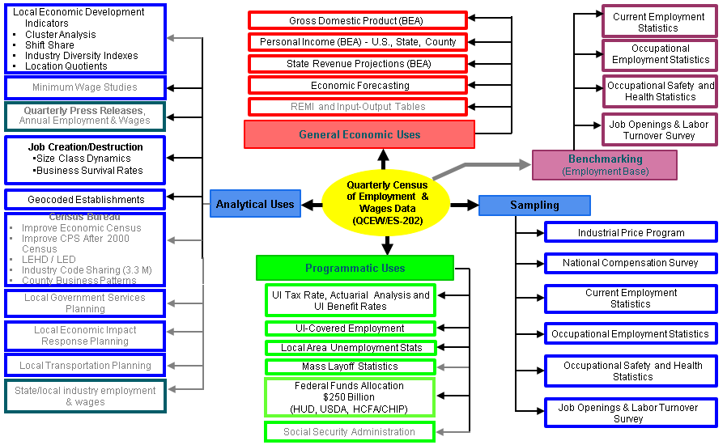
Uses of Quarterly Census of Employment and Wages Data

Slide 5
Data Collection in QCEW
BLS 3020 - Multiple Worksite Report (MWR)
BLS 3023 – Annual Refiling Survey (ARS)

Slide 6
Multiple Worksite Report (MWR)

Slide 7
QCEW - MWR
QCEW states receive the Quarterly Contribution Report (QCR) from UI Tax on a monthly basis. This report contains monthly employment and quarterly wages for each firm operating in the state.
For single-establishment firms, this is sufficient for QCEW.
For multi-establishment firms, QCEW supplements this with the Multiple Worksite Report so that we have detailed NAICS and CTY level employment and wage data.

Slide 8
Who files an MWR?
Most multi-location employers with a total of 10 or more employees combined in their secondary locations are required or requested to complete the MWR.
An employer's primary location is the location with the most employment in a State. All other locations within the State are secondary locations.
The MWR is mandatory in 31 states

Slide 9
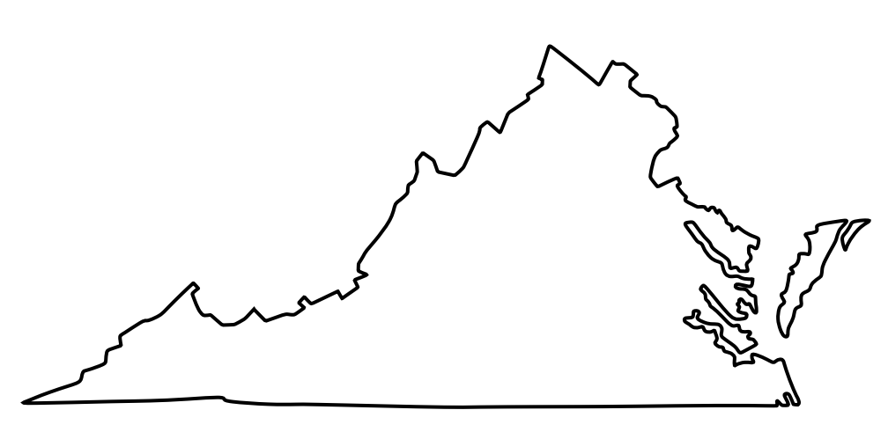
Why do we collect the MWR?
Location 3
-County 333
-Manufacturing
Company ABC’s UI Report
-Reports E&W in CTY 123
-All E&W in retail industry
Location 2
-County 222
-Warehouse
Company XYZ’s UI Report
-Reports E&W in CTY 789
-All E&W in retail industry
Location 1
-County 111
-Manufacturing

Slide 10
Multiple Worksite Report
Collected quarterly and covers:
1.5% of all employers nationwide
17% of all worksites nationwide
41% of all employment and wages nationwide

Slide 11
MWR Web
The MWR Web system is prepopulated each quarter with all eligible multis in QCEW.
Each individual worksite and address
Reported monthly employment and quarterly wages from the prior quarter
Respondents log into the web system and report current quarter employment and wages for their worksite.
For existing MWR Web accounts, there is a >90% response rate each quarter.

Slide 12
MWR Web Edits
Prepopulated data allow more complex, live data editing
Current quarter data are compared with prior quarter for unexpected reporting patterns
(Ex. Higher than expected employment or wage levels)
Respondents are prompted to fix or explain anomalies (Ex. Seasonal hires, etc.)

Slide 13
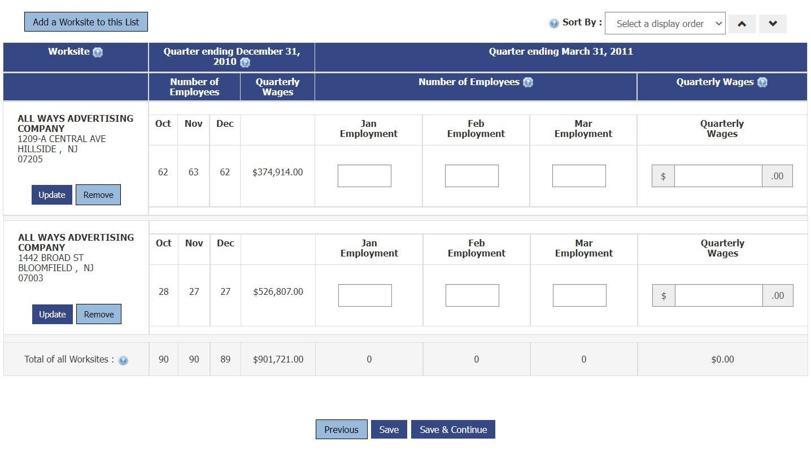
MWR Web Screens

Slide 14
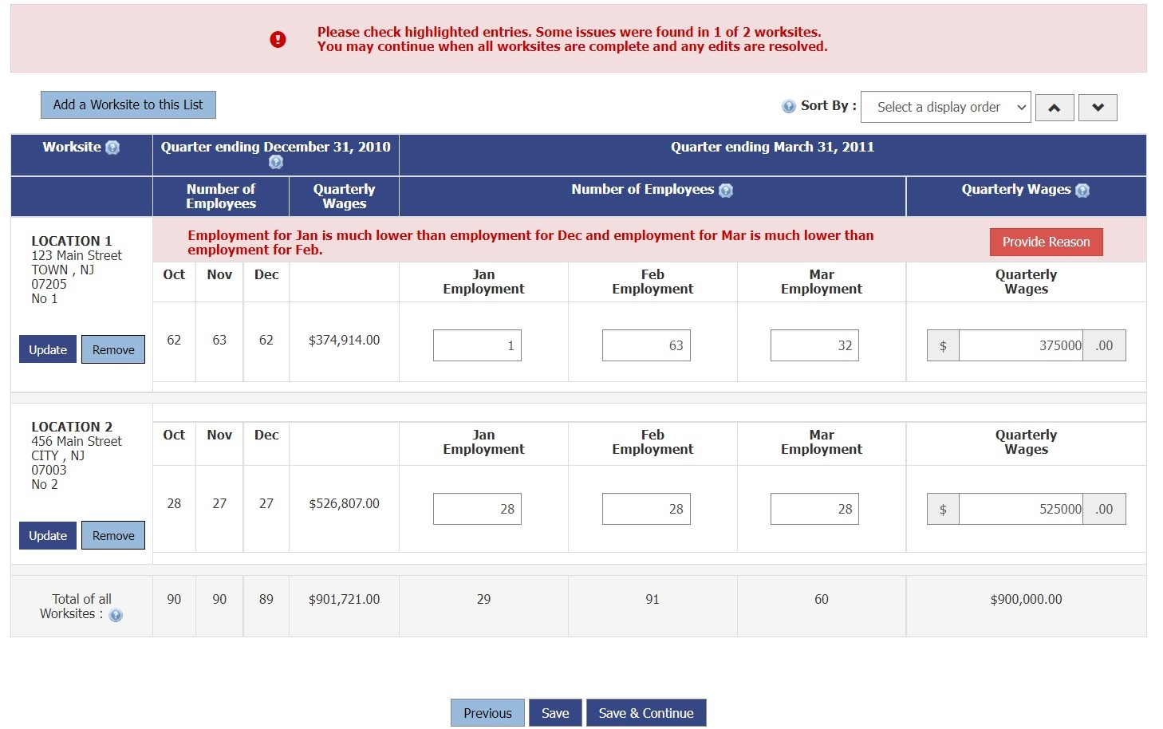
MWR Web Screens

Slide 15
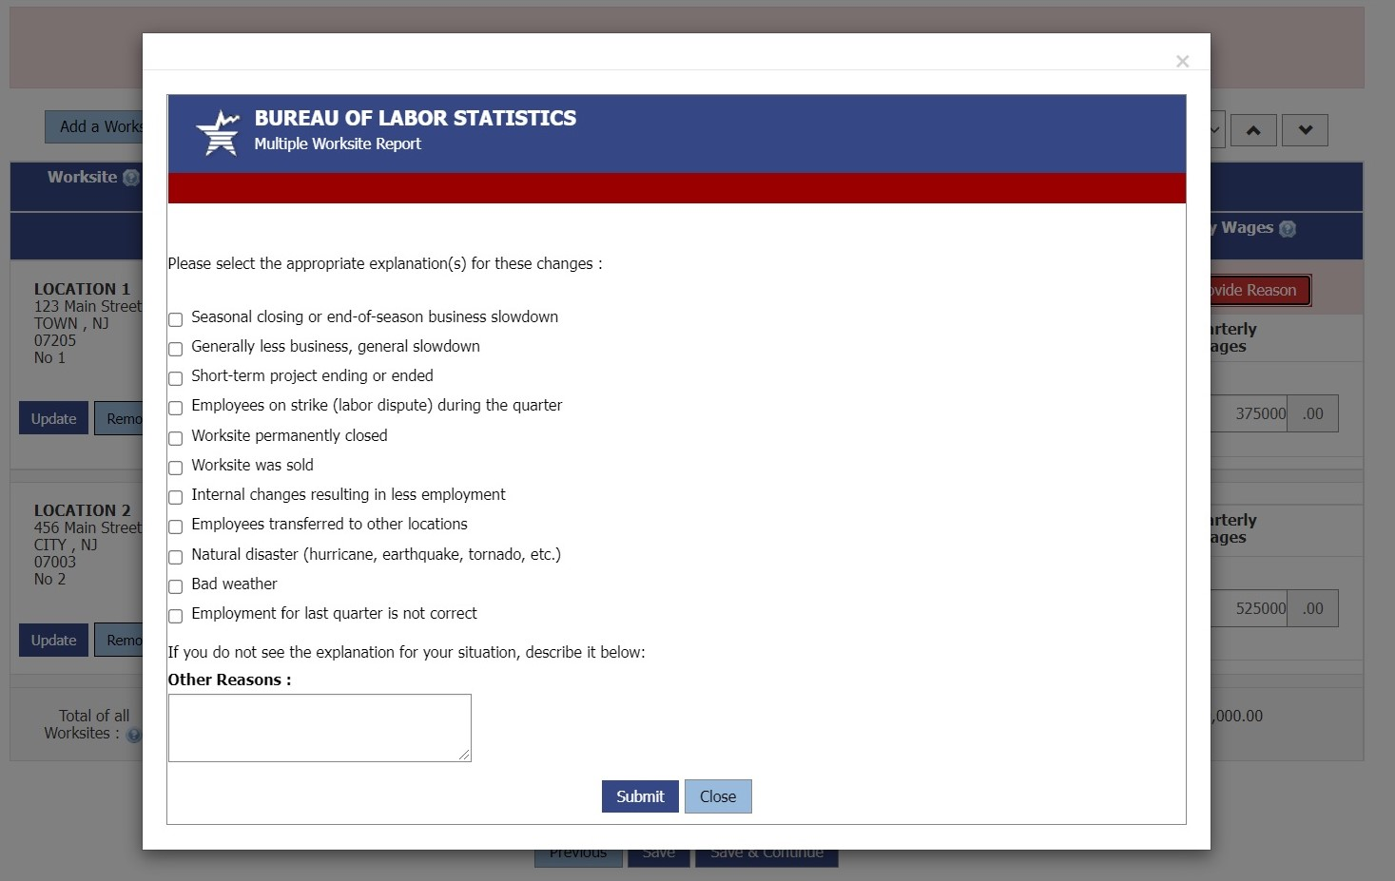
MWR Web Screens

Slide 16
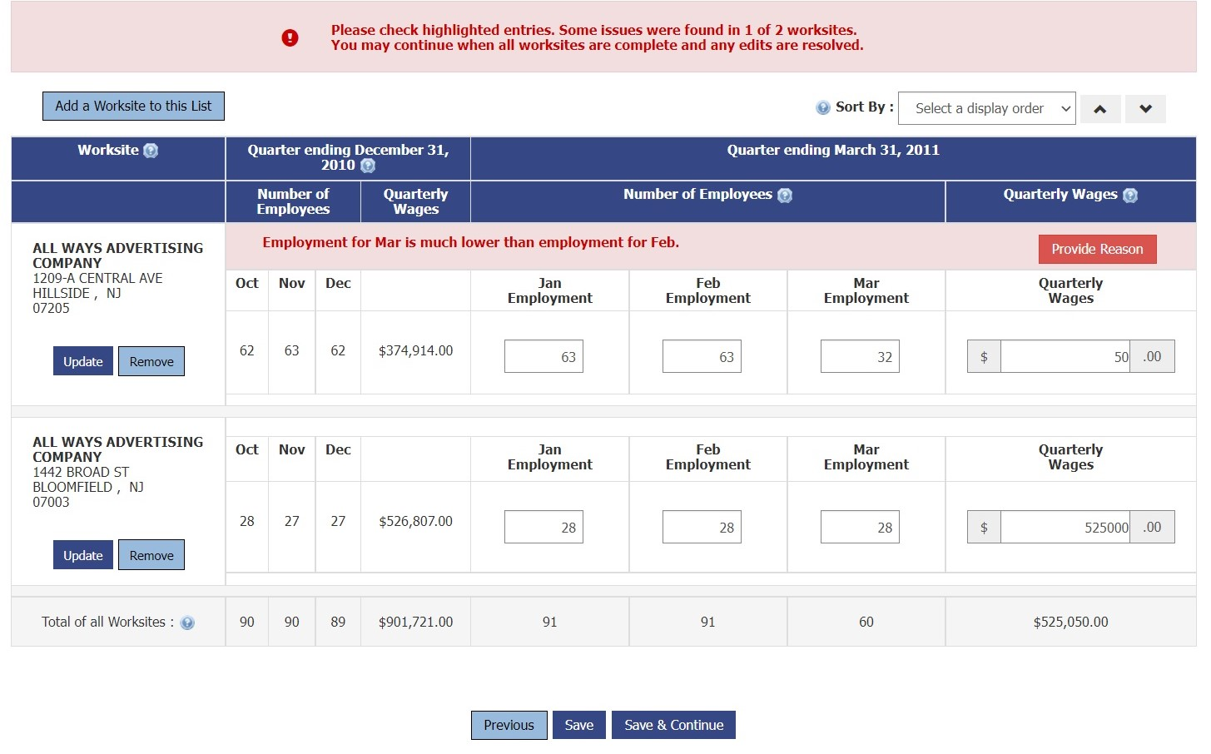
MWR Web Screens

Slide 17
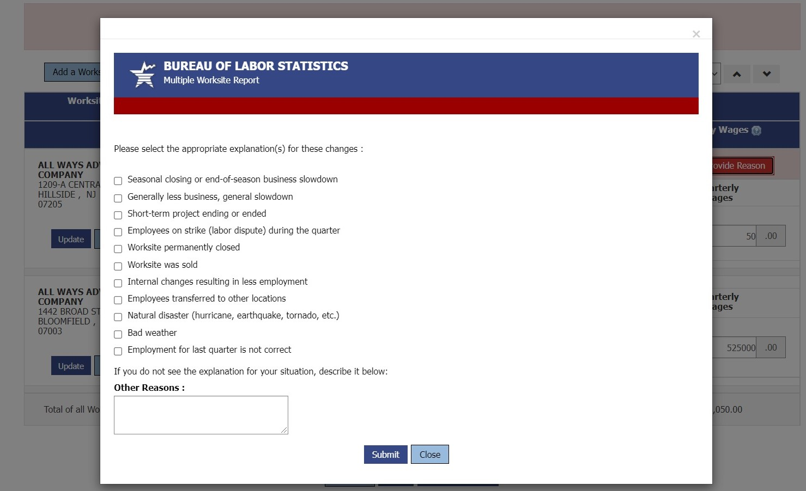
MWR Web Screens

Slide 18
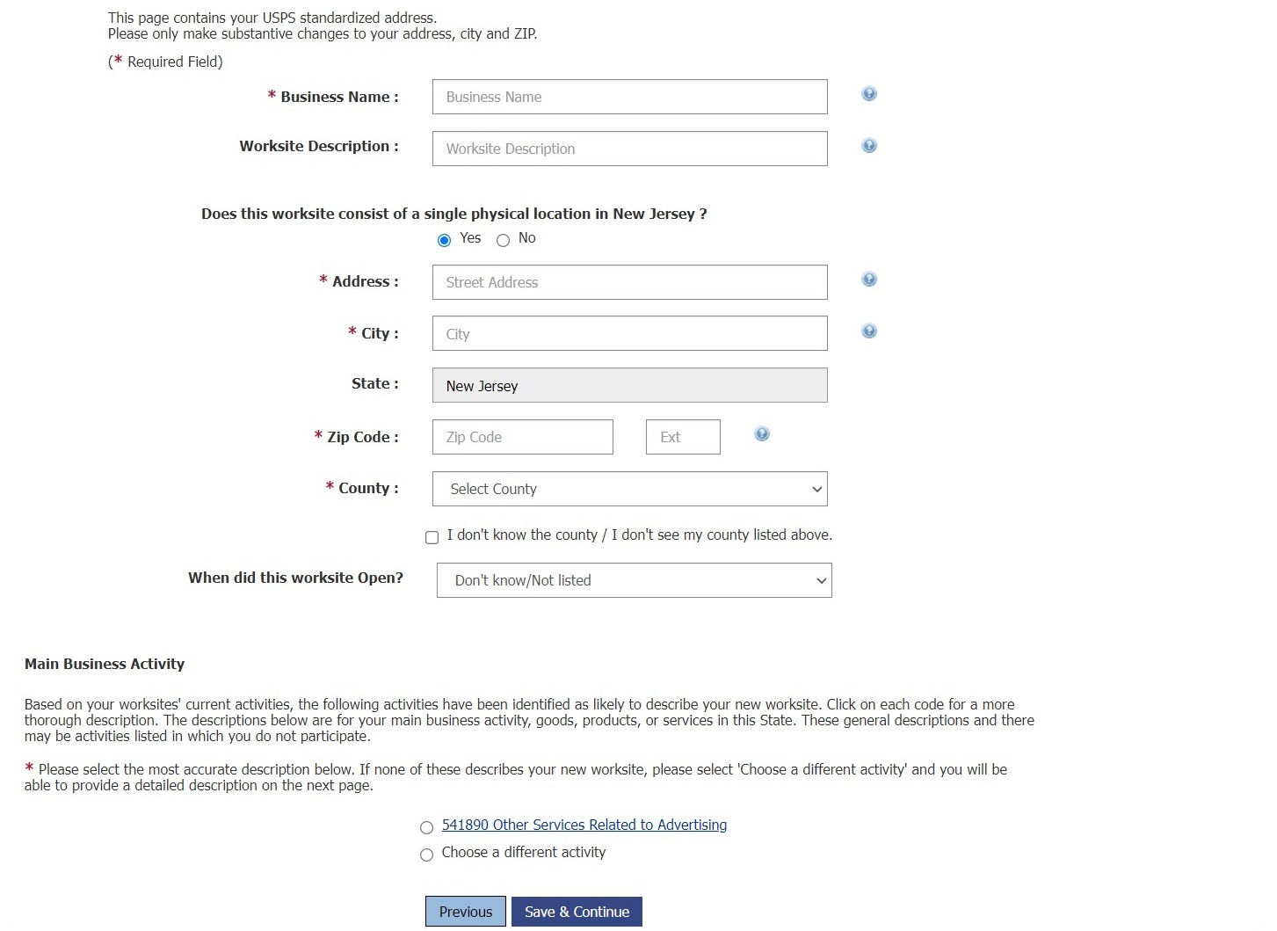
MWR Web Screens

Slide 19
Annual Refiling Survey (ARS)

Slide 20
What is the ARS?
The ARS makes sure the information we have on file for establishments is correct.
This survey presents respondents with their current industry and location
Respondents are asked to either verify that the current information is correct, or provide updated information.
Notes:
Purpose of the Annual Refiling Survey
As discussed earlier, the county, ownership, and NAICS codes are assigned initially to new establishments based on information received on the Status Determination Report.
The Annual Refiling Survey is an employer survey conducted to verify and update the industry and location codes of the reporting units on the QCEW micro file as well as verifying mailing and physical location addresses.
In addition , it can be used to identify potential multi establishment accounts - MWR accounts. These are accounts which report more than one location in a state under one UI account number. These will be covered in more detail in the next section.

Slide 21
Why is the ARS needed?
The basis for sampling by industrial and geographic coding for CES, OES, OSHS, LAUS, MLS and BLS Wage programs is the QCEW file.
INDUSTRY and GEOGRAPHIC codes in QCEW flow to many other sources and it is important that they are accurate.

Slide 22
ARS Identifies Multis
The ARS also asks employers if they have opened up any additional locations
This is a major source that QCEW uses to determine if an employer should be a multiple-establishment employer
Notes:
Purpose of the Annual Refiling Survey
As discussed earlier, the county, ownership, and NAICS codes are assigned initially to new establishments based on information received on the Status Determination Report.
The Annual Refiling Survey is an employer survey conducted to verify and update the industry and location codes of the reporting units on the QCEW micro file as well as verifying mailing and physical location addresses.
In addition, it can be used to identify potential multi establishment accounts - MWR accounts. These are accounts which report more than one location in a state under one UI account number.

Slide 23
ARS Three Year Cycle
Conducted on a 3 year cycle so that 1/3 of eligible employers are selected each year
Employers are selected based on the 7th and 8th digits of their EIN number
Selection pattern allows an even distribution of industries, locations, and size classes each year.
Notes:
The ARS is conducted on a 3 year cycle.
The codes that are verified by Annual Refiling Survey are input to the microfile. Since the BLS Longitudinal Database (LDB) is the sampling source for most BLS establishment surveys, it is pertinent that it contain correct industry, location, and ownership codes.
Correct coding is critical to minimizing sampling and tabulation errors
Especially since the basis for sampling by industrial and geographic coding for CES, OES, OSHS, LAUS, MLS and BLS Wage programs is the QCEW file.
You may ask yourself why does an employer only receive a survey form once every three years?
A 3-year cycle is used because:
1. It's inefficient to contact all employers every year -- only a small percentage change business activity yearly. The 3-year cycle minimizes employer reporting burden.
2. The 3 year cycle spreads out the work load for the state QCEW staff.
Employers are selected based on the 7th and 8th digits of their EIN number.
00-33 the first year,
34-6566-99 the third year
the second year,
Therefore, the sample chosen will represent approximately one-quarter of all units each year.
This sampling pattern was instituted in the QCEW program because a random selection across industries limits artificial industry employment changes that does occur when refiling is concentrated in certain industries.
Units with blank or zero-filled EINs are selected based on 9th and 8th position of the UI Number.

Slide 25
Prepopulated Industry

Slide 27
Why display current information?
25+ years ago, this survey was conducted without presenting the respondent with their current information.
Respondents were only asked to provide their current industry and location.
Using pre-populated data reduces:
Non-economic churn
Respondent burden
Data processing/review cost
Notes:
Purpose of the Annual Refiling Survey
As discussed earlier, the county, ownership, and NAICS codes are assigned initially to new establishments based on information received on the Status Determination Report.
The Annual Refiling Survey is an employer survey conducted to verify and update the industry and location codes of the reporting units on the QCEW micro file as well as verifying mailing and physical location addresses.
In addition , it can be used to identify potential multi establishment accounts - MWR accounts. These are accounts which report more than one location in a state under one UI account number. These will be covered in more detail in the next section.

Slide 28
Emily Thomas
Supervisory Economist
US Bureau of Labor Statistics
Quarterly Census of Employment and Wages
www.bls.gov/cew
Thomas.Emily@bls.gov

