Slide 1
Parsing the Code of Federal Regulations for the Commodity Flow Survey's Expanded Hazardous Materials Supplement
Krista Chan, U.S. Census Bureau
Christian Moscardi, U.S. Census Bureau
FCSM
November 4, 2021
Disclaimer: Any views expressed are those of the author(s) and not necessarily those of the U.S Census Bureau. The Census Bureau has reviewed this data product for unauthorized disclosure of confidential information and has approved the disclosure avoidance applied. (Approval ID: CBDRB-FY22-ERD006-001)

Slide 2
The Commodity Flow Survey and Expanded Hazardous Materials Supplement
Commodity Flow Survey (CFS)
Provides a comprehensive multimodal picture of national freight flows
Sponsored by the Bureau of Transportation Statistics (BTS) and the Census Bureau
Includes hazmat shippers, but not focused on them
Expanded Hazardous Materials (EHM) supplement
Part of CFS, but focused on hazardous materials (hazmat)
Sponsored by Pipeline and Hazardous Materials Safety Administration (PHMSA)

Slide 3
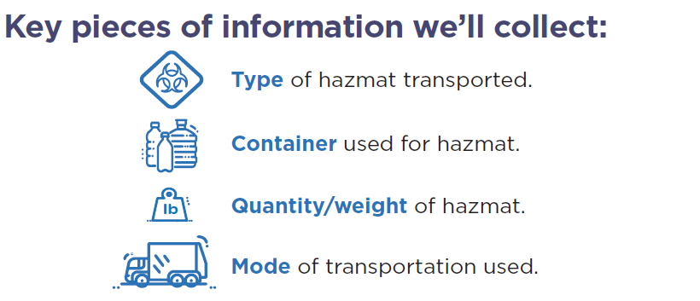
Expanded Hazardous Materials (EHM) Supplement
Estimates by hazmat type and packaging type
National and possibly subnational level
No survey currently collects detailed data on packaging of hazardous materials offered for transportation
For PHMSA: determine the impact of changes to hazmat shipping rules and regulatory requirements, application of the Evidence Act

Slide 4
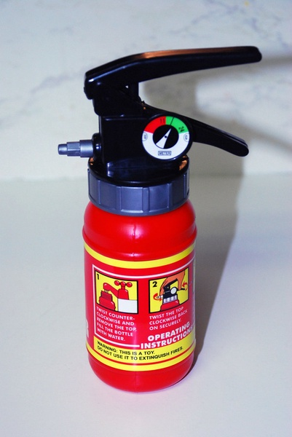



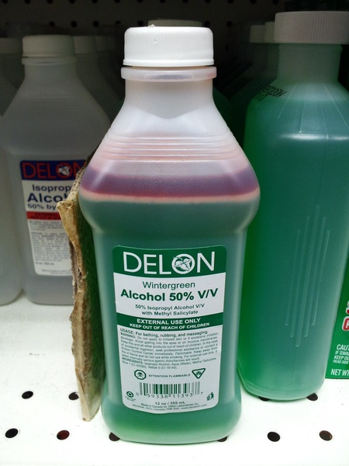
The Code of Federal Regulations (CFR)
Hazardous Materials Regulations (HMR): 49 CFR parts 171-180
Contains all PHMSA's rules and regulations for
Shipment of hazmat
Packaging instructions and standards
Modes of transit
Valuable information to support editing and imputation of survey results
However, there are many barriers to using the CFR in its raw form
Examples of hazmat regulated by the HMR

Slide 5
The CFR's Contributions to EHM's Survey Process
Generate realistic instrument test cases
Verification of respondent entries against regulation during survey editing
Standardizing free-response packaging code text
Imputing based on regulations where respondents do not answer
Reduced analyst burden
Improved data quality

Slide 6
The Problem
CFR text is highly unstructured

Slide 7
Key steps involved in understanding packaging regulations
1. Part 172.101 Hazmat Table
2. Part 173 Packaging Requirements
3. Part 178
Packaging Standards
Look up United Nations/North American (UN/NA) #
Bulk vs nonbulk requirements
Special provisions for types of transit
Find allowable packaging codes
Understand pressure requirements, exceptions, inner vs outer packaging, weight restrictions
Thorough definitions of each packaging code
How packaging need to be tested

Slide 8
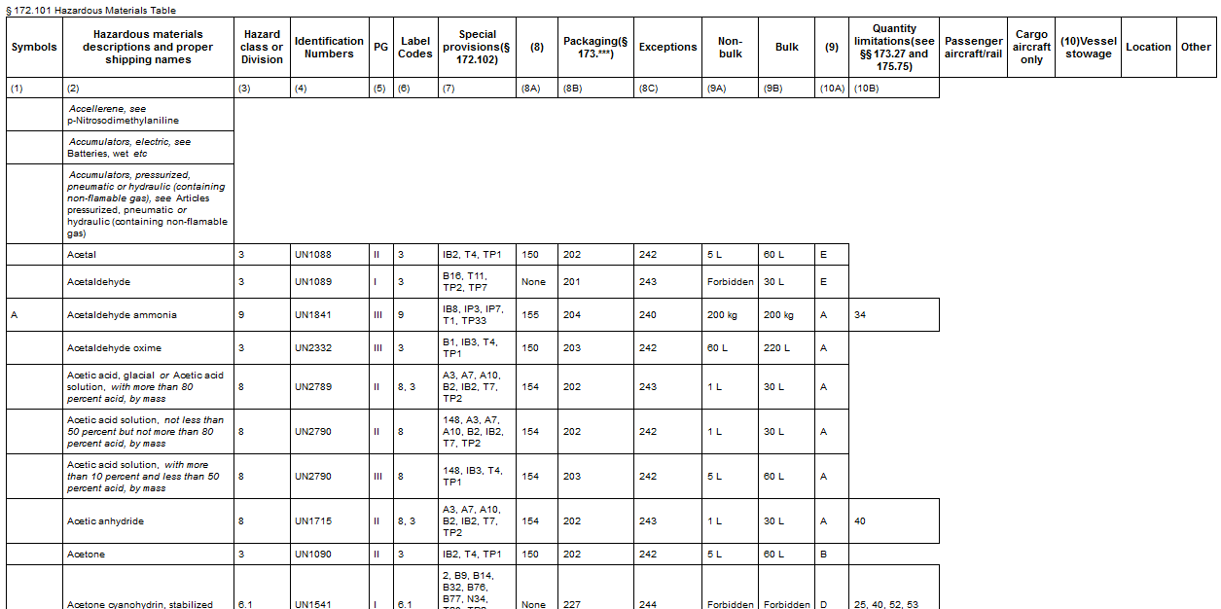
1. Part 172.101 Hazmat Table
UN1993 row of hazmat table
Code of Federal Regulations, Title 49 § 172.101
Hazardous Materials Table
All hazmat have a corresponding United Nations/North American (UN/NA) number
Respondents are asked for UN/NA numbers in the EHM
e.g. Shippers of diesel fuel use UN1993

Slide 9
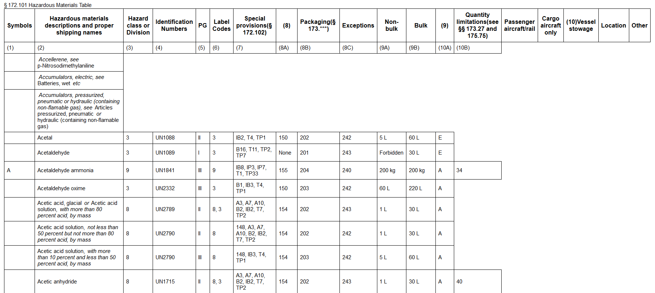
2. Part 173 Packaging Requirements
Code of Federal Regulations, Title 49 § 172.101
Hazardous Materials Table
All hazmat have corresponding packaging instructions
The packaging instructions consist of dense, unstructured text
UN1993 row of hazmat table

Slide 10
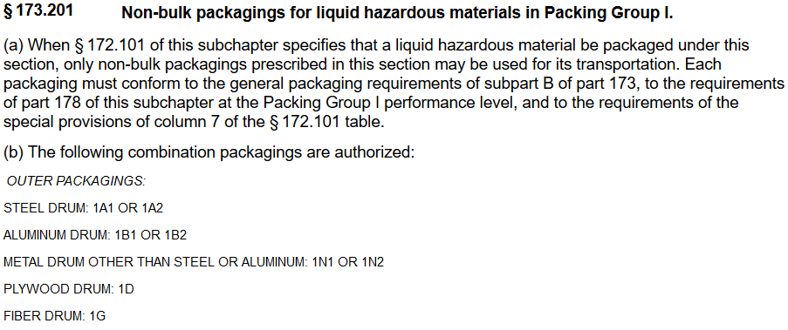
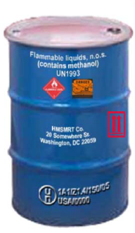
2. Part 173 Packaging Requirements
Example of packaging requirements
Required label for the shipper includes UN/NA packaging code

Slide 11
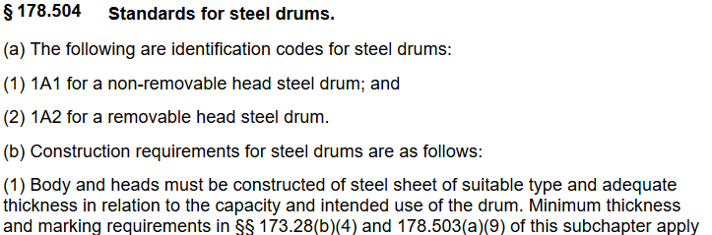
3. Part 178 Packaging Standards
Where packaging codes are defined
Users must read the table of contents to find the corresponding section
Example of packaging standards

Slide 12
The Solution
Scraping the CFR and building a web app

Slide 13
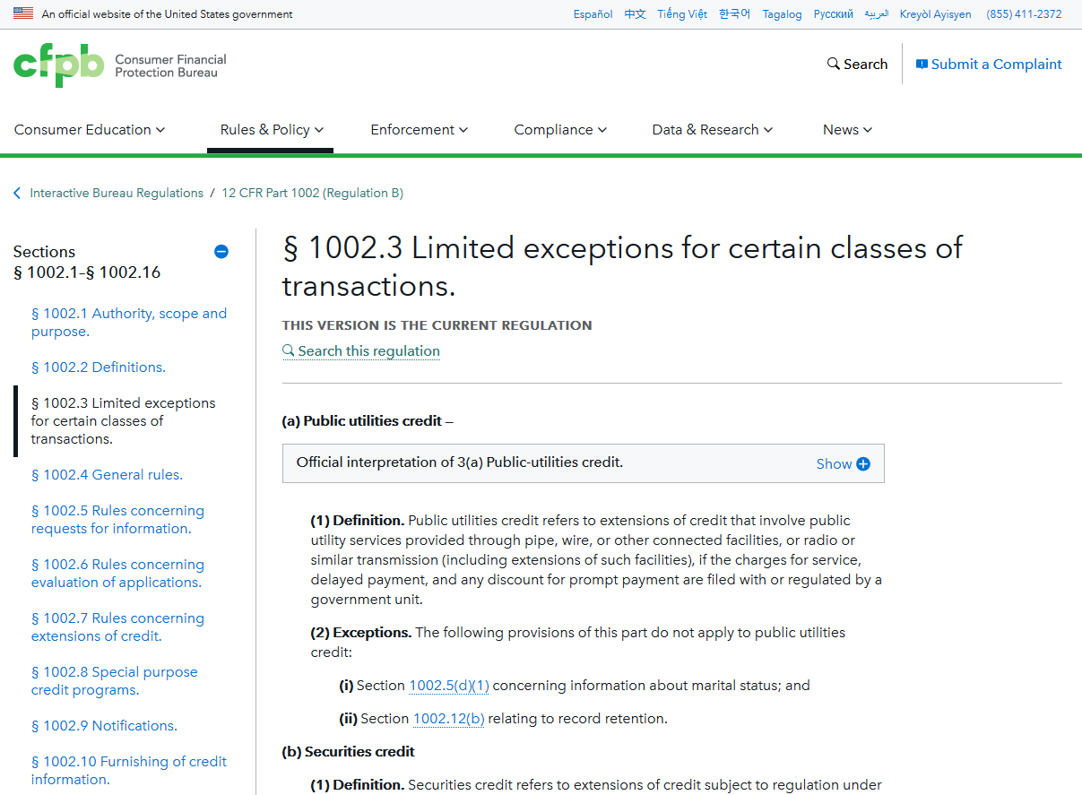
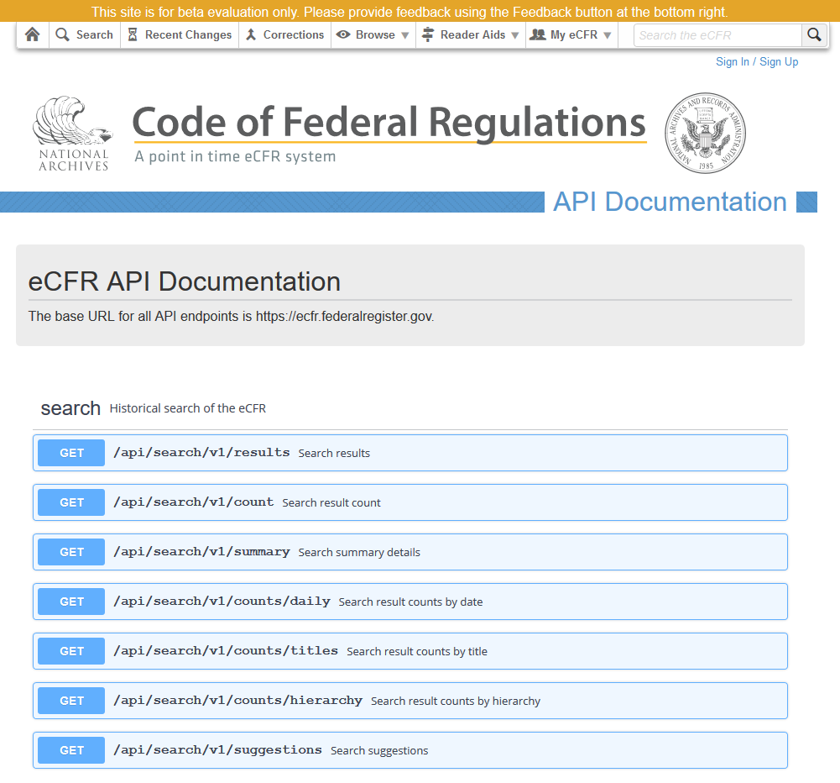
Existing tools for navigating the CFR
eRegs
Built by 18F, part of GSA
Key terms defined
Cross references
Changes over time
New eCFR
Point in time
API to query parts of CFR and hierarchical relationships (chapters, subchapters, paragraphs, etc.)
Remaining gaps:
Relating UN/NA numbers and packaging codes

Slide 14



Our solution: scraping UN/NA and packaging codes
Scraping the CFR
Parsing codes using regular expressions (regex)
Loading into a relational database
Create a web app for UN/NA querying

Slide 15
Tool infrastructure
Scraper
CFR
Database
Web App
1. Part 172.101 Hazmat Table
Hazmat UN/NAs
UN/NA form entry
Packing instructions with codes highlighted
2. Part 173 Packaging Requirements
Scrape, parse
Packaging Codes
Query
Packaging Standards
Immediate lookup of packaging standards
3. Part 178 Packaging Standards

Slide 16
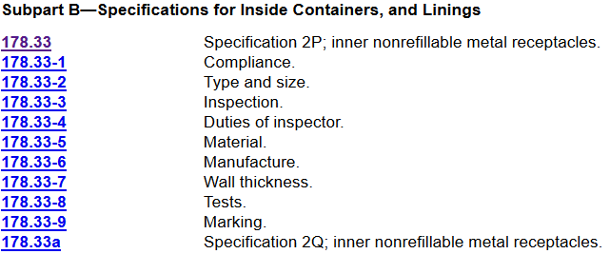
Regular expressions (regex) example
Regex utilizes patterns in text to extract and structure key information
Part | Code | Description
178.33 | 2P | Inner nonrefillable metal receptacles
178.33a | 2Q | Inner nonrefillable metal receptacles

Slide 17
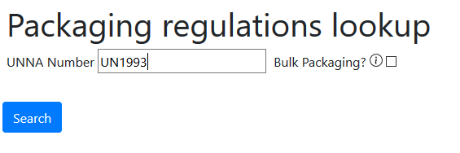
Web App: UN/NA Lookup
UN/NA search
Tooltips to define key terms

Slide 18
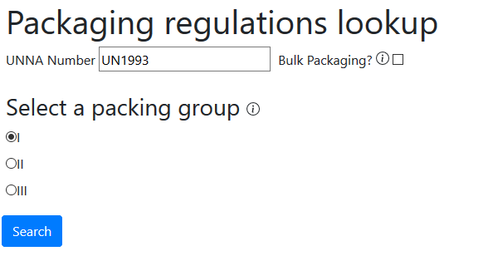
Web App: UN/NA Lookup

Slide 19
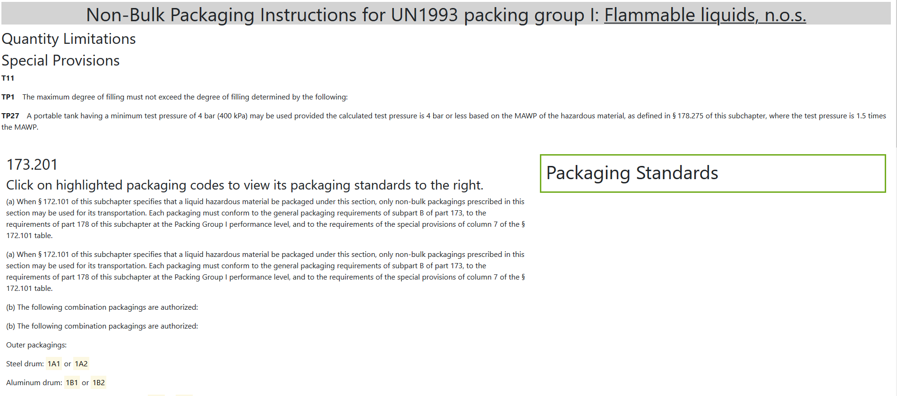

Web App: Highlighted and clickable codes
Pop-up with corresponding packaging standard
Highlighted packaging codes with clickable packaging standards

Slide 20
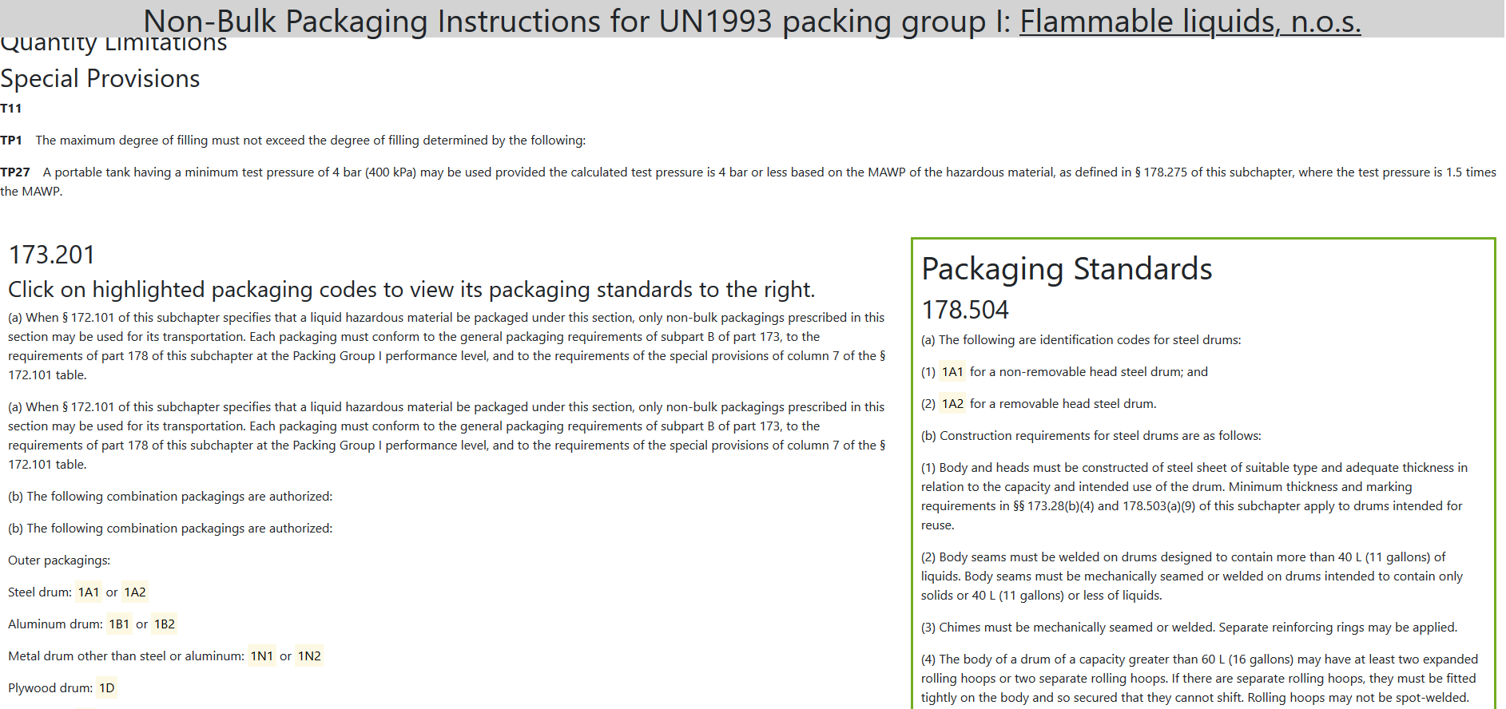

Web App: Highlighted and clickable codes
Pop-up with corresponding packaging standard
Highlighted packaging codes with clickable packaging standards

Slide 21
Potential Applications beyond EHM
Parsing codes within regulations (NAICS, VIN #s, etc.)
Quick querying of the CFR by a certain topic or theme
Quantitative analysis of regulations
Generating a resource for understanding respondents

Slide 22
Questions?
Email: Krista.c.chan@census.gov
Project Github: https://github.com/census-bds/usdot-phmsa-hazmat-parser

