Slide 1
Brief Overview of DICE and the Web Standards Team
Leslie Miller
Product Owner of Electronic Instruments, U.S. Census Bureau
Federal Committee on Statistical Methodology
October 27, 2022
This presentation is released to inform interested parties of research and to encourage discussion. The views expressed are those of the authors and not those of the U.S. Census Bureau.
Notes:
Hi, I’m Leslie Miller. I’m the Product Owner for Electronic Instruments under the DICE Program at the Census Bureau.

Slide 2
What is the DICE Program and what makes it innovative?
Notes:
So what is DICE? The Data Ingest and Collection for the Enterprise (DICE) program is a forward-leaning, bureau-wide effort that will pave the future of data collection at the U.S. Census Bureau. Over the next 8 years, through 2030, the DICE program will integrate and manage the development of an enterprise “system of systems” that provides a shared platform for receiving data collected by external sources and conducting census and survey data collection activities efficiently and cost-effectively. DICE will enable the Census Bureau to fully leverage cutting-edge data collection methods, including adaptive survey design approaches, sampling strategies that integrate administrative data, multi-mode data collection, dynamic case management, and metadata definition on files received from external sources. ​

Slide 3
Mission:
To collect the data necessary to produce U.S. Census Bureau statistics
Vision:
To provide consistent, cost-effective, efficient, standard, and scalable data collection operations and technical solutions that support all directorate needs
Notes:
Key aspects of the overall vision of the DICE Program – particularly to be cost-effective, efficient, and scalable – all serve as targets for innovation in every aspect of our work: in the technology that we use, our project management style, the diverse knowledge base of our staff, and how we integrate with other programs at the Bureau.

Slide 4
DICE provides the processes and solutions for Census Bureau data collection activities, organized into projects. The DICE systems development projects are:
Adaptive Survey Design
Data Ingest
Electronic Correspondence
Electronic Data Collection
Operational Control
Paper Data Collection
Questionnaire Design and Metadata
Notes:
Read the slide

Slide 5
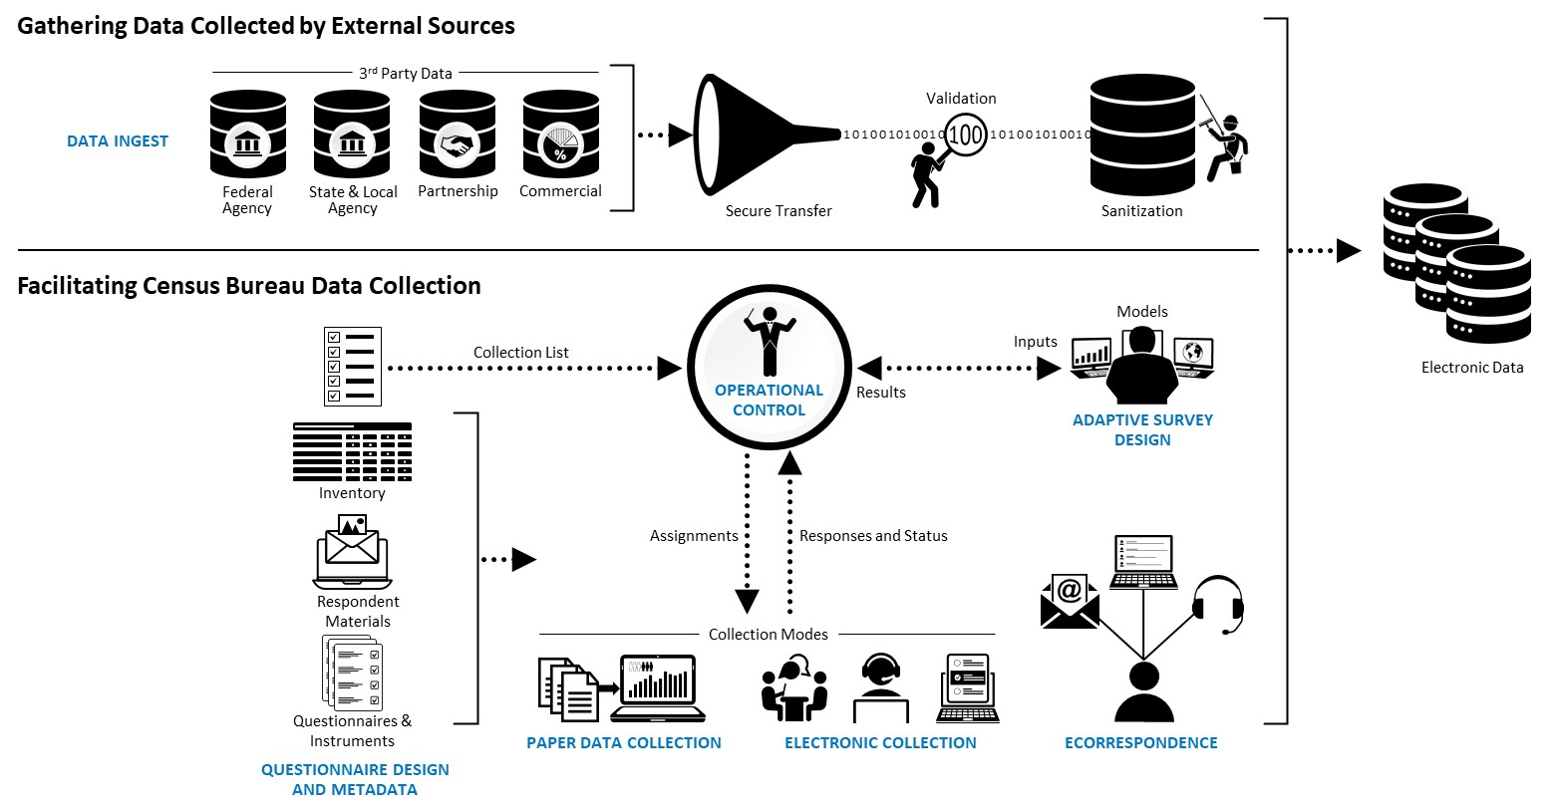
Notes:
This slide is an overview of these different solutions and how they work together. For this presentation, I’d like to focus on two solutions: the Questionnaire Design and Metadata System (or QDM) and Electronic Data Collection
The enterprise questionnaire design solution, QDM, is a central repository for all content and metadata required for the generation of instruments and respondent materials. Survey designers can create new content or reuse existing content from a library of information.
Centurion 2 is the system being developed for Electronic Data Collection that will provide secure data collection for respondents and Census Bureau call agent users via the Internet, as well as provide a disconnected field device application that can be used by Census Bureau field interviewers.
DICE intends to streamline the instrument development process by allowing a survey designer to use the QDM system to design an instrument, including everything from content and skip logic to the look and feel of the survey, and with a click of a button, the instrument will be rendered in Centurion 2 for use in collecting respondent data. This will allow the Census Bureau to minimize developer intervention and greatly reduce the current development time it takes to bring an instrument into production.

Slide 6
DICE Web Standards Team
Mission
Develop empirically-based web survey design standards that maximize data quality and minimize respondent burden
Outcome
Design standards that can be implemented for all Census Bureau web surveys
Create a corporate brand for Census Bureau web surveys that users can expect when asked to respond to our surveys
Deliverable
Web Survey Design Standards document with design templates implemented in the Questionnaire Design and Metadata and Centurion 2 systems for the DICE program
Notes:
Another initiative that is crucial to the success of the DICE program’s vision for consistency and standardization includes the onboarding of the DICE Web Standards Team. This team was originally sponsored under the Census Bureau’s Improving Operational Efficiency (IOE) program. The mission of this IOE team was to develop empirically-based web survey design standards that maximize data quality and minimize respondent burden. The team was absorbed by the DICE program as the need for consistency and direction during initial development became apparent. Modernizing and streamlining the development process for web surveys includes creating a standard set of guidelines for design and functionality of the instruments.
This team has two outcome goals: First to design standards that can be implemented for all of our web surveys, both household and business surveys. And second to create a corporate brand for all Census Bureau web surveys that respondents can recognize when asked to participate in our surveys.
We have been able to produce a Web Survey Design Standards document, including design templates. The QDM and Centurion 2 systems will implement these standards to ensure uniformity across all Census Bureau web-based data collection instruments.

Slide 7
Web Standards Team Process
Brainstorm topics
Conduct Literature Review
Document the Standard if topic is well researched
Conduct experimental studies if there is no literature or gaps in the literature
Analyze data from experiments
Document the Standard
Produced a list of over 50 design components
Notes:
The idea was to create a consistent design that maximizes best practices in design to result in respondent efficiency, accuracy, and satisfaction. So, the Web Standards Team developed a process for documenting these standards. First the team took time to brainstorm and deconstruct a web survey into its design elements, like navigation buttons, question wording, help text, etc. This activity produced over 50 different design elements. We then conducted a literature review to determine if there were already best practices in place. Literature included academic research, traditional usability websites like the Nielsen Norman Group, and the US Web Design System website produced by GSA. We also relied on previous IOE Team research and groups within the Census Bureau for their expertise. Topics that already had empirically based and consistent research findings were documented and cited. If there was no available literature or if there were any gaps in the literature, we designed split panel tests to compare the current Census practice to recommendations the were found during the lit review. We programmed 9 separate experiments using Qualtrics to test 3 to 5 different design issues in each one. The data was analyzed and each standard that was documented provides the supporting research and experimental evidence. The overall design standards document is a working document. And we expect that new research may need to be conducted as technology changes and survey stakeholder needs are assessed.

Slide 8
Engagement for Standards Development
Fostered collaboration and buy-in with survey stakeholders via the DICE Instrument Creation Value Team. This team was made up of representatives from various Divisions around the Bureau to provide insight and feedback for their survey area needs
Engaged internally with our Public Information Office, Policy and Security Offices to ensure that Census Bureau corporate branding and guidelines were implemented
Gathered feedback from the development teams
Allowed for a review period where Census Leadership was able to comment and provide feedback, and obtained their electronic signatures of acceptance
Notes:
Once the team produced an initial draft of the Web Survey Design Guidelines document, we needed to ensure that we could get buy-in from our survey area stakeholders around the Census Bureau. The DICE program utilizes Value Teams, which are representative groups of survey area stakeholders from around the Census Bureau who have the ability and authority to assist our development teams in identifying and prioritizing their needs. The Instrument Creation Value Team was specifically curated as a team of stakeholders who utilize web instruments and will be using the QDM and Centurion 2 systems. We met with this team over the course of 8 weeks to deep dive into every standard documented. We incorporated all feedback and addressed any new design topics that arose. The Web Standards Team also met with our Public Information Office to ensure our recommendations aligned with Census corporate branding already in place, and they were able to assist in creating some design templates and color schemes. We met with Security and Policy to better understand the requirements for certain elements on the screen, like OMB approval numbers and Privacy and Security links. When there were questions that came up throughout all of our discussions, we engaged with the development teams to tap into their expertise of current industry best practices and capabilities. After months and months of work and collaboration, we were finally able to establish a baseline of the Web Survey Design Guidelines. Census Bureau Leadership was given time to review and comment, and eventually signed off on their acceptance of this baseline document.

Slide 9
DICE proposed timeline
DICE will be onboarding more than 80 surveys over the next 8 years
First couple of surveys will be web-based self response in early 2024
Standards Team thus started with Web Survey Design Guidelines
First CAPI survey (using a disconnected field device) will be in early 2025
First CATI survey (web survey used by Census Bureau call agents) will be in early 2025
Standards Team are beginning to develop CAPI/CATI guidelines
Notes:
​DICE functionality will be delivered across a series of transition states (called product releases) between the Current State, Target State 2026, and End State 2030. The DICE "End State" is when data collection and ingest for most (or all) existing surveys and censuses have been migrated to the DICE solution. To get there, DICE will be onboarding more than 80 surveys over the next 8 years. We have developed a schedule of onboarding that aligns with both the planned development work of the program’s individual projects and the planned survey cycles of our survey stakeholders. The first couple of surveys to join the DICE ecosystem will utilize web-based self-response instruments only, with the first planned survey launching in early 2024. Because of this cadence, the Web Standards Team began with development of these web guidelines first. Census also conducts interviewer-administered surveys, which are done either in person using a disconnected field device or over the phone using a similar web instrument. DICE’s first CAPI and CATI surveys will launch in early 2025, so our team is beginning to develop guidelines for these interviewer-administered instruments now.

Slide 10
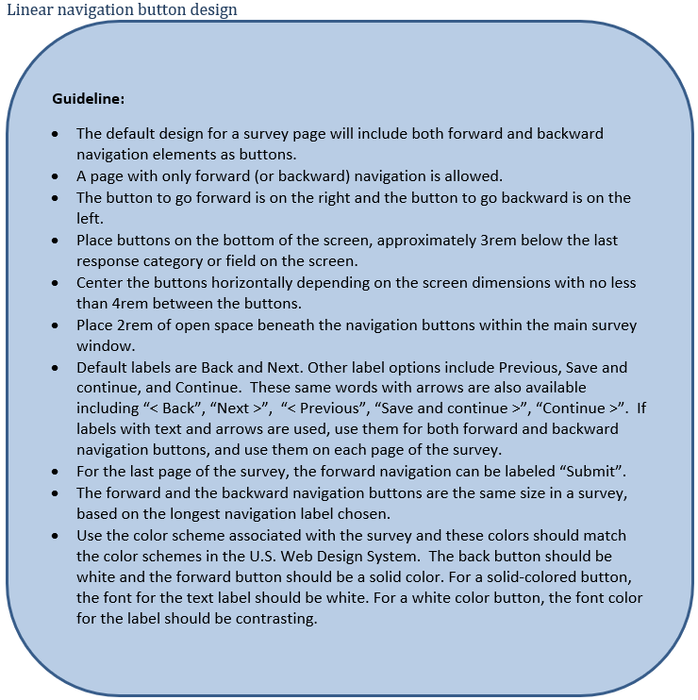
Sample guideline allowing for some flexibility
Notes:
This is an example of one of our guidelines. I don’t want to get too much into the details here, as this is a topic that will be covered later by one of my teammates. But this guideline addresses linear navigation buttons on the screen. I wanted to demonstrate not only the level of detail that our guidelines provide, but also some of the flexibilities. We were able to work with a UX designer within Census Bureau to determine appropriate units of measurement to use for things like font size on the buttons and the spacing between them. And then through working with the Instrument Creation Value Team, we realized that we also needed to allow for some flexibility. While our own experiments had determined a best fit label for these kinds of navigation buttons, we heard from some our of colleagues that the respondents for their surveys actually preferred a different label. So, in order to compromise, in the guideline we make our recommendation for default labels as best practice, but also allow for a little bit of flexibility in choice to satisfy the needs of our survey areas and what works best for their respondents.

Slide 11
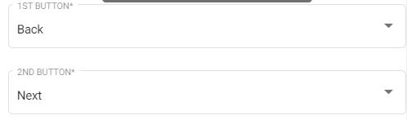
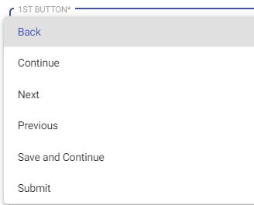

Implementation in QDM and Centurion 2
Default set in QDM based on
Standards Team recommendation
Ability to select additional values to
meet survey needs
How buttons display in Centurion 2
Notes:
Lastly, this slide demonstrates how these flexibilities are built right into the QDM system. As a survey designer is entering their content and designing their screens, they are presented with various dropdown selections. You can see in the first image that the dropdowns are automatically populated with what the Web Standards Teams has recommended as the default. But there is the ability to change this selection in order to meet the needs of the survey area. At the bottom, you can see an example of how these buttons would actually appear in a Centurion 2 web instrument.

Slide 12
Thank you! Leslie Miller Leslie.Ann.Miller@census.gov
Notes:
Now without further ado, my teammates are going to walk you through some actual examples of the different ways that we came up with some of our guidelines.

