Slide 1
Developing an Integrated Annual Survey
FCSM - November 2021
Any views expressed are those of the author and not necessarily those of the Census Bureau. The Census Bureau has reviewed this data product for unauthorized disclosure of confidential information. (Approval ID: CBDRB-FY22-ESMD006-003)

Slide 2

Project Background
The Census Bureau requested the Committee on National Statistics to review our portfolio of annual economic surveys.
Economic Directorate leadership assessed the recommendations and determined the scope.
The end result of this large-scale effort will be a new program called the Annual Integrated Economic Survey (AIES).

Slide 3
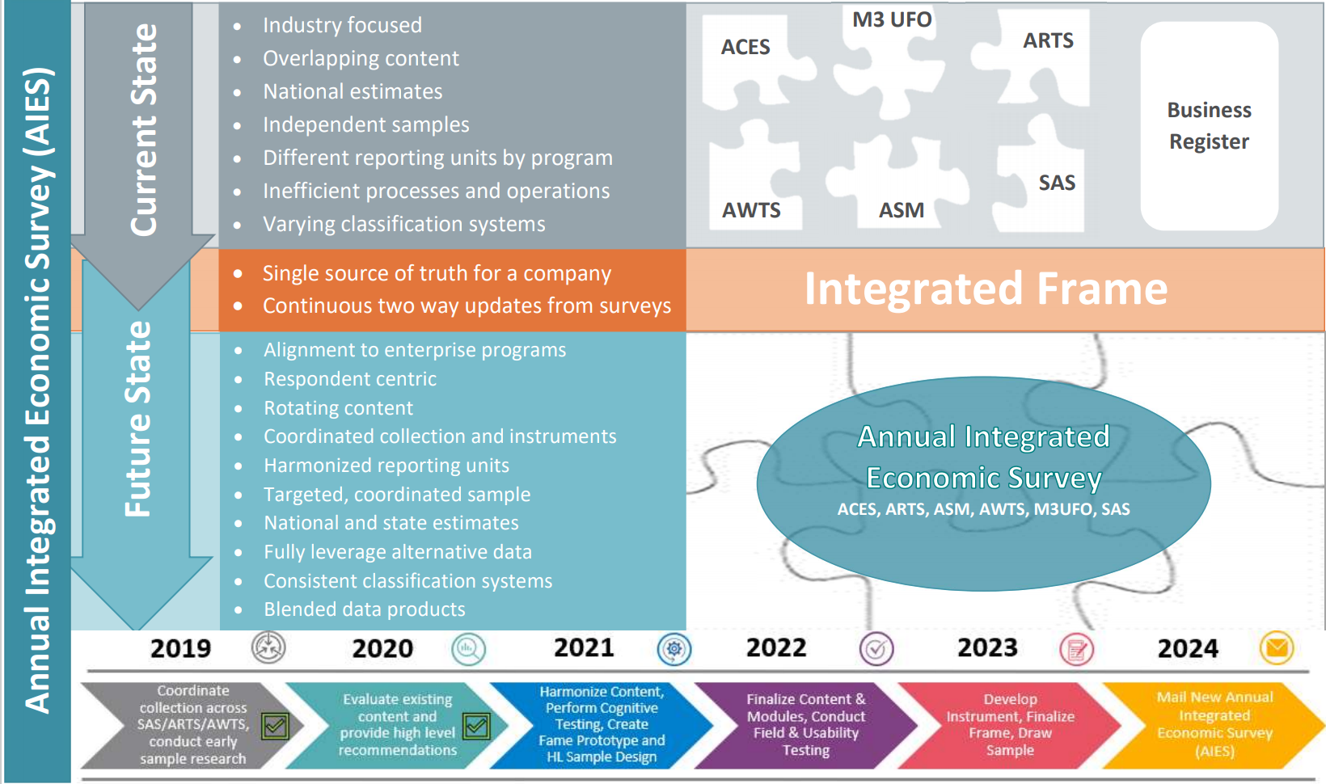

Slide 4
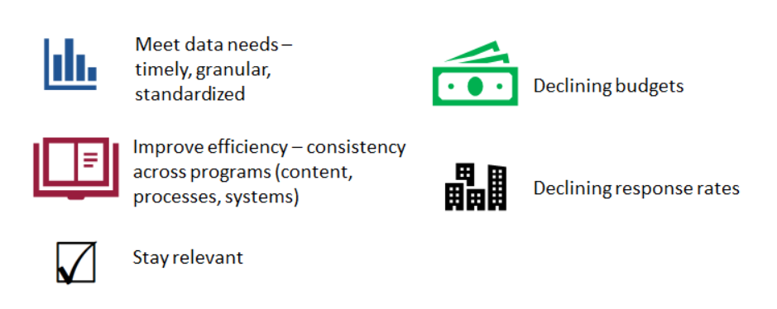
Drivers of this Effort

Slide 5
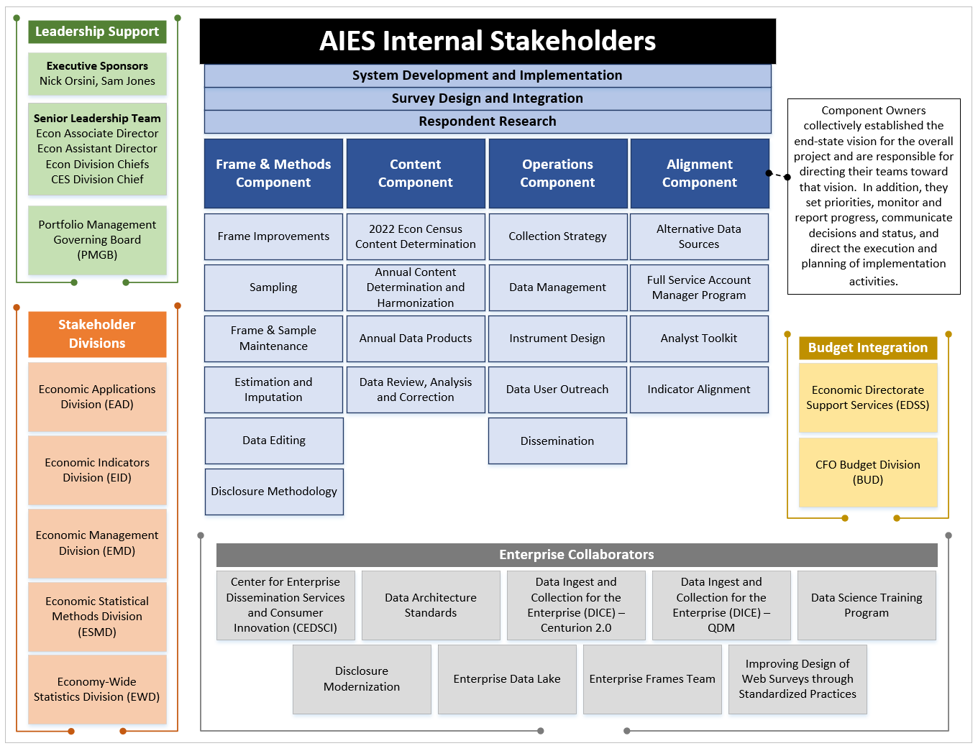
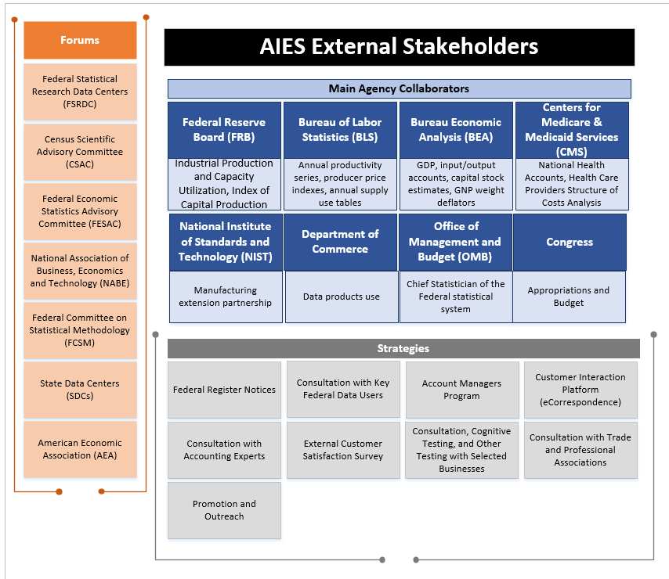
Stakeholders
Communication is key!

Slide 6
Accomplishments
Finalized a Stakeholder Engagement Plan
Completed a draft of the Annual Program Requirements
Built a content repository and identified content for new AIES modules
Conducted a record-keeping study to see how businesses maintain their books and get a better idea of data accessibility

Slide 7
Accomplishments (cont.)
Carried out a coordinated collection pilot, consolidating contacts and communication within companies in multiple in-scope surveys
Completed a prototype list of business units in-scope to AIES
Studied feasibility of coordinated sampling across all in-scope programs
Determined the sampling unit

Slide 8
Current & Upcoming Work
Use sound data management principles to standardize variable names to align across programs, including the Economic Census
Conduct a Pilot Survey in 2022 (for survey year 2021)
Determine program requirements and systematic solutions, leveraging latest technology
Develop the production frame and conduct sample design research
Align edit & imputation methodology and micro/macro review tools
Create table layout plans for publication

Slide 9
Key Tasks/Deliverables
Key Task/Deliverable | Planned Timeframe
Conduct cognitive testing | Oct. 2021 – Mar. 2022
Complete the pilot survey | Jan. – Dec. 2022
Deliver production frame methodology and programs | Sept. 2022
Finalize instrument requirements | Oct. 2022
Obtain the sample | Jul. - Aug. 2023
Perform usability testing | Jul. - Aug. 2023
Receive production-ready instrument | Dec. 2023
Mail the Annual Integrated Economic Survey | Jan.-Mar. 2024
Release new products | 2025

Slide 10
Challenges
Establishing the appropriate collection unit
Determining which processing system to use since current in-scope surveys process data in different systems
Planning for a pilot given tight timeframes and stretched resources
Knowing what to test from a research perspective
Availability of enterprise solutions
Adequate resources and competing priorities

Slide 11
Contacts:
James.N.Burton@census.gov – AIES Program Coordinator
Blynda.K.Metcalf@census.gov – AIES Product Owner
Jenna.Morse@census.gov – AIES Project Manager

