Slide 1
Developing a Unified Sample Design for the Annual Integrated Economic Survey
Katherine Jenny Thompson, Senior Mathematical Statistician
Associate Directorate for Economic Programs
Any views expressed are those of the author and not necessarily those of the Census Bureau. The Census Bureau has reviewed this data product for unauthorized disclosure of confidential information and has approved the disclosure avoidance practices applied. (Approval ID: CBDRB-FY22-ESMD006-001).

Slide 2
Acknowledgements
Sampling Team
Carol Caldwell (ret)
James Burton
James Hunt
Amy Newman-Smith
Laura Bechtel
Nicole Czaplicki
Stephen Kaputa
Adam Smeltz
Justin Z. Smith
Lucas Streng
Michael Christen
Marquita Reynolds
Reviewers
Andreana Able
Lucas Streng

Slide 3
Covering Old Ground…
Annual Survey of Manufactures
Annual Capital Expenditures
Survey
Sampling Unit: Establishment
Sampling Unit: Company
Annual Integrated Economic Survey
M3 Unfilled Orders
Sampling Unit: Company
Services Annual
Survey
Sampling Units:
Company
Employment Identification Number
Annual Retail Trade Survey
Annual Wholesale Trade
Survey

Slide 4

More Old Ground…
Annual Integrated Economic Survey
AWTS
ARTS
SAS
Same Company
ACES
Company as Sampling Unit
Estab. 1
Estab. 2
ASM
Estab. 3

Slide 5
Sampling Unit = Company
Option 1: Sample multi-industry company in one industry
Collect roster data
Company lists all industries
Company reports for all industries
Sampling issues:
Bias in industry-sampling stratum (overrepresentation)
Bias in other industries
(underrepresentation)
Option 2: Create more than one artificial sampling unit for each company, with each sampling unit representing expected proportion of activity in industry
Collect industry-specific data
Sampling issue:
Spurious allocation leads to bias!

Slide 6
Current Decision: Sidestep Both Options
“Complexity” determines initial certainty status
* 4-digit NAICS industry
**Sectors 44, 45, 62
The designated certainty units are excluded from sampling
≈ 50,000 companies included with certainty (probability = 1)
≈ 250,000 companies sampled (probability < 1)
Company operates in | Number of Sectors | Number of Industries* | Number of States | Status | Sampling Weight
 | 2 or more | 2 or more | (Not considered) | Certainty | 1
 | 1 | 3 or more | (Not considered) | Certainty | 1
 | 1 | 2 | 2+ | Certainty | 1
 | 1 | 2 | 1 | Noncertainty** | > 1
 | 1 | 1 | 2+ | Noncertainty | > 1

Slide 7
Sampling Design Requirements (Totals)
National
Subnational (Geographic)
Revenue/receipts, Annual Payroll, Inventories, Capital Expenditures…
Disaggregated industry (NAICS) levels
Differs by sector
4-digit NAICS, 5-digit NAICS, 6-digit NAICS
Revenue/receipts, Annual Payroll, 1st Quarter Employment
Aggregated NAICS levels (3-digit, 4-digit)
“Direct use” states (meet target reliability for Annual Payroll)
26 states
Allocated within region
“Balance” of region category for non-direct use states

Slide 8

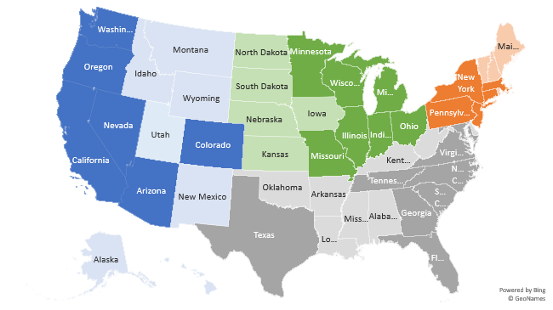
Targeted Direct Use States
 | Region
 | Northeast | Midwest | South | West
State | Connecticut | Illinois | Florida | Arizona
 | Massachusetts | Indiana | Georgia | California
 | New York | Michigan | Maryland | Colorado
 | New Jersey | Minnesota | North Carolina | Nevada
 | Pennsylvania | Missouri | South Carolina | Oregon
 |  | Ohio | Tennessee | Washington
 |  | Wisconsin | Texas
 |  |  | Virginia
Allocated | 5 | 7 | 8 | 6
Total | 9 | 12 | 16 | 13
NE
MW
S
W
Direct Use
Balance of Region

Slide 9
Stratification (Within Sector) Noncertainty Companies
2 Industries
Industry 1
Industry 2
Industry K
> 1 state
AIES strata defined by
Industry
“Complexity” (company)
Geography
Historical strata defined by
Industry
Unit size
Complete set repeated in each industry
Region 1
Direct Use State 1
•••
31 Geographic Strata per Industry
Region 1
Balance of States
•••
Region 4
Direct Use State 1
•••
Region 4
Balance of States

Slide 10
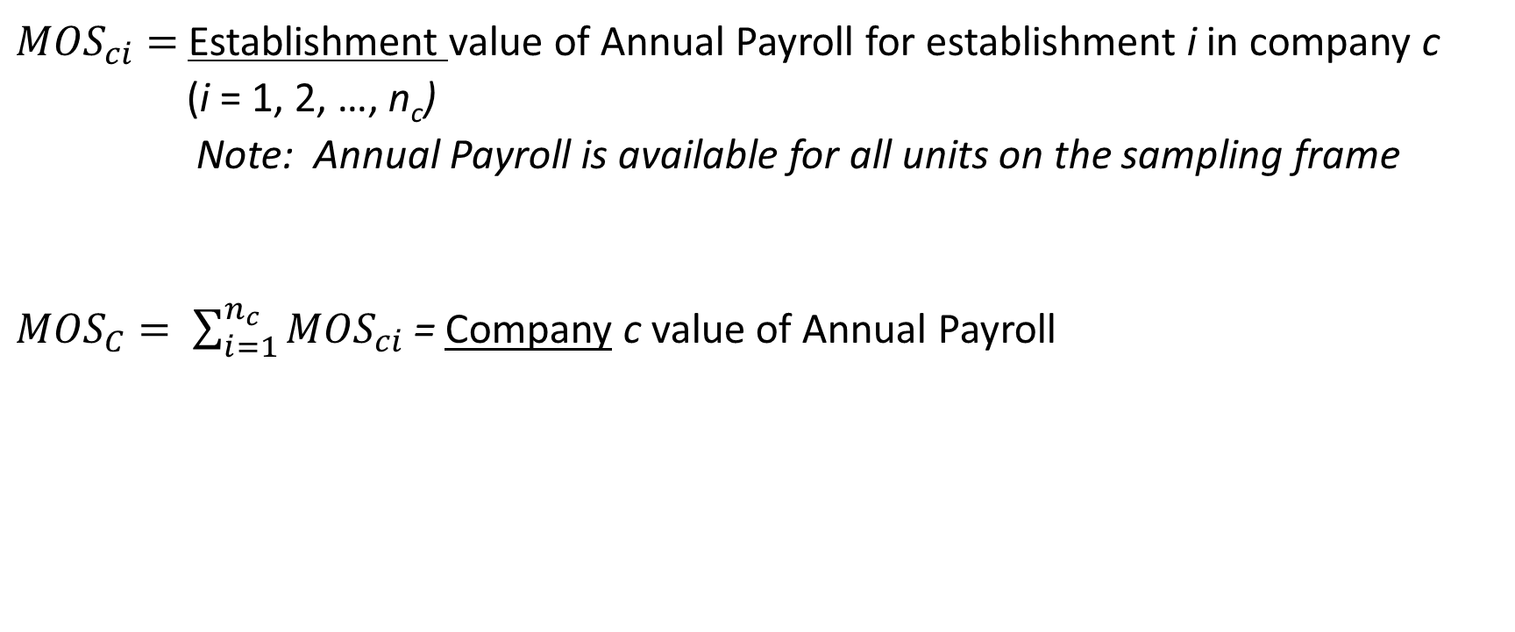
Measure of Size (MOS)
${MOS}_{ci}=$ Establishment value of Annual Payroll for establishment i in company c
(i = 1, 2, …, n_{c})
Note: Annual Payroll is available for all units on the sampling frame
${MOS}_{C}= \sum_{i=1}^{n_{c}}{{MOS}_{ci}}$ = Company c value of Annual Payroll

Slide 11
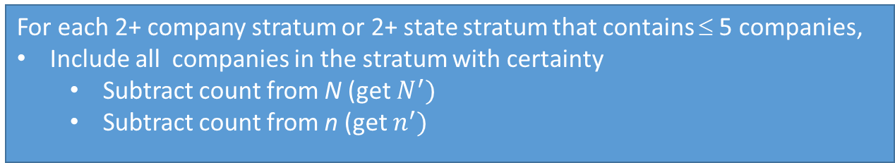

Allocation (Within Sector) Noncertainty Companies
Complete set repeated in each industry
2 Industries
Industry 1
Industry 2
Industry K
> 1 state
Let
$N=$ Number of companies in sector
$N_{h}=$ Number of companies in stratum h
n = Total sample size in sector (predetermined)
Region 1
Direct Use State 1
For each 2+ company stratum or 2+ state stratum that contains ≤ 5 companies,
Include all companies in the stratum with certainty
Subtract count from N (get $N^{′})$
Subtract count from n (get $n^{′})$
•••
Region 1
Balance of States
•••
Region 4
Direct Use State 1
•••
Region 4
Balance of States
31 Geographic Strata per Industry

Slide 12

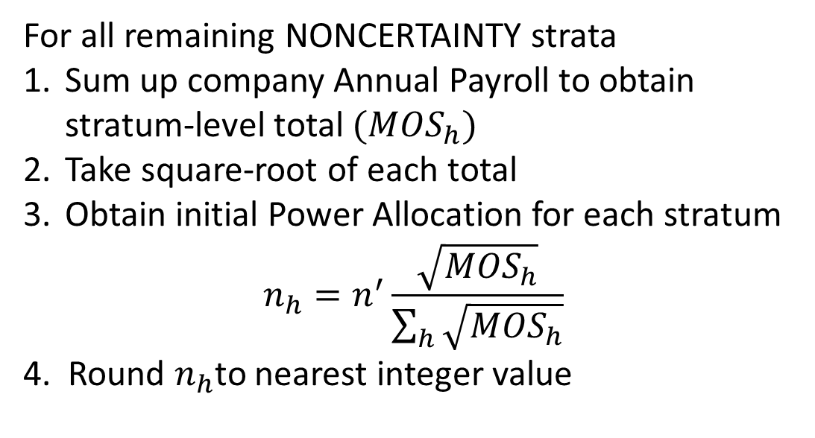
Power Allocation (Within Sector) Noncertainty Companies
Complete set repeated in each industry
2 Industries
Industry 1
Industry 2
Industry K
MOS_{2 industries}
> 1 state
For all remaining NONCERTAINTY strata
Sum up company Annual Payroll to obtain stratum-level total $({MOS}_{h})$
Take square-root of each total
Obtain initial Power Allocation for each stratum
$$n_{h}=n^{′}\frac{\sqrt{{MOS}_{h}}}{\sum_{h}{\sqrt{{MOS}_{h}}}}$$
4. Round $n_{h}$to nearest integer value
MOS_{>1 state}
Region 1
Direct Use State 1
MOS_{Direct Use State 1}
•••
Region 1
Balance of States
MOS _{Region 1 Balance}
•••
Region 4
Direct Use State 1
MOS _{Direct Use State 26}
•••
Region 4
Balance of States
MOS _{Region 4 Balance}
31 Geographic Strata per Industry

Slide 13
Probabilities of Selection (Company)
For each company, need to take into account
Contribution to National estimates
Contribution to Geographic estimates
Not all units are equally important
Small unit at the national level could be “large” at the subnational level
“Medium sized” company could operate in several states
Probability of selection needs to account for contributions to totals at different levels of aggregation

Slide 14

Important Slide
From here on, all examples use completely fictional data generated to prove my points.

Slide 15
Step 1: Create Pseudo Units
Company | Establish-ment | Industry | State | MOS_{ic}
1 | 1 | AAAA | MO | 56
 | 2 | AAAA | MO | 9
 | 3 | AAAA | TN | 39
 | 4 | AAAB | MO | 33
 | 5 | AAAB | MO | 20
 | 6 | AAAB | TN | 24
2 | 1 | AAAA | MO | 37
 | 2 | AAAA | TN | 27
3 | 1 | AAAA | MO | 54
4 | 1 | AAAB | MO | 100
FRAME
Sampling & Allocation Units
Company | Sampling Stratum | MOS_{c}
1 | 2 Industries | 181
2 | > 1 State | 64
3 | AAAA_MO | 54
4 | AAAB_MO | 100

Slide 16
Step 1b: Create National Estimate Pseudo Units
Company | Establish-ment | Industry | State | MOS_{ic}
1 | 1 | AAAA | MO | 56
 | 2 | AAAA | MO | 9
 | 3 | AAAA | TN | 39
 | 4 | AAAB | MO | 33
 | 5 | AAAB | MO | 20
 | 6 | AAAB | TN | 24
2 | 1 | AAAA | MO | 37
 | 2 | AAAA | TN | 27
3 | 1 | AAAA | MO | 54
4 | 1 | AAAB | MO | 100
FRAME
National Industry Units
Unit | Company | “Sampling Stratum” | MOS
1_AAAA | 1 | AAAA | 104
1_AAAB | 1 | AAAB | 77
2_AAAA | 2 | AAAA | 64
3_AAAA | 3 | AAAA | 54
4_AAAB | 4 | AAAB | 100

Slide 17
Step 1c: Create National Estimate Initial Probabilities of Selection
National Industry Units
Company National π
Unit | Company | “Sampling Stratum” | MOS
1_AAAA | 1 | AAAA | 100
1_AAAB | 1 | AAAB | 77
2_AAAA | 2 | AAAA | 64
3_AAAA | 3 | AAAA | 54
4_AAAB | 4 | AAAB | 100
Company | π
1 | 1 – ((1-0.4685)(1-0.4350)) = 0.6997
2 | 0.2936
3 | 0.2477
4 | 0.5650
Unit | Company | “Sampling Stratum” | MOS | π
1_AAAA | 1 | AAAA | 104 | 0.4685
2_AAAA | 2 | AAAA | 64 | 0.2883
3_AAAA | 3 | AAAA | 54 | 0.2432
1_AAAB | 1 | AAAB | 77 | 0.4350
4_AAAB | 4 | AAAB | 100 | 0.5650
Probability that Company 1 is NOT sampled in AAAA
Probability that Company 1 is NOT sampled in AAAB

Slide 18
Steps 2a&B : Repeat for Geographic Strata
Company | Establish-ment | Industry | State | MOS_{ic}
1 | 1 | AAAA | MO | 56
 | 2 | AAAA | MO | 9
 | 3 | AAAA | TN | 39
 | 4 | AAAB | MO | 33
 | 5 | AAAB | MO | 20
 | 6 | AAAB | TN | 24
2 | 1 | AAAA | MO | 37
 | 2 | AAAA | TN | 27
3 | 1 | AAAA | MO | 54
4 | 1 | AAAB | MO | 100
Geographic Industry Units
FRAME
Unit | Company | Ind | State | MOS
1_AAA_MO | 1 | AAA | MO | 118
1_AAA_TN | 1 | AAA | TN | 63
2_AAA_MO | 2 | AAA | MO | 37
2_AAA_TN | 2 | AAA | TN | 27
3_AAA_MO | 3 | AAA | MO | 54
4_AAA_MO | 4 | AAA | MO | 100

Slide 19
Steps 2a&B : Repeat for Geographic Strata
Geographic Industry Units
Unit | Company | Ind | State | MOS | π
1_AAA_MO | 1 | AAA | MO | 118 | 0.3819
2_AAA_MO | 2 | AAA | MO | 37 | 0.1197
3_AAA_MO | 3 | AAA | MO | 54 | 0.1748
4_AAA_MO | 4 | AAA | MO | 100 | 0.3236
1_AAA_TN | 1 | AAA | TN | 63 | 0.7
2_AAA_TN | 2 | AAA | TN | 27 | 0.3
Company Geographic π
Unit | Company | Ind | State | MOS
1_AAA_MO | 1 | AAA | MO | 118
2_AAA_MO | 2 | AAA | MO | 37
3_AAA_MO | 3 | AAA | MO | 54
4_AAA_MO | 4 | AAA | MO | 100
1_AAA_TN | 1 | AAA | TN | 63
2_AAA_TN | 2 | AAA | TN | 27
Company | π
1 | 1 – ((1-0.3819)(1-0.70)) = 0.8146
2 | 1 – ((1-0.1197)(1-0.30)) = 0.3838
3 | 0.1748
4 | 0.3236

Slide 20
Step 3: Sampling Unit Probabilities
Strata | Index | Original Company | National π | Geographic π | Initial Company π | Final Company π
2 Industries | 1 | 1 | 0.6942 | 0.8146 | 0.8146
 | ••• | •••
 | N_{2 industries} | N_{2 industries} | 0.0652 | 0.0322 | 0.0652
Industry AAAA > 1 State | ••• | ••• | ••• | ••• | ••• | •••
Industry AAAA MO | •••
Industry AAAB TN
Industry AAAB > 1 State
Industry AAAB MO
Industry AAAB TN
Strata | Index | Original Company | National π | Geographic π | Initial Company π | Final Company π
2 Industries | 1 | 1 | 0.6942 | 0.8146 | 0.8146
 | ••• | •••
 | N_{2 industries} | N_{2 industries} | 0.0652 | 0.0322 | 0.0652
Industry AAAA > 1 State | ••• | ••• | ••• | ••• | ••• | •••
Industry AAAA MO | •••
Industry AAAB TN
Industry AAAB > 1 State
Industry AAAB MO
Industry AAAB TN
Strata | Index | Original Company | National π | Geographic π | Initial Company π | Final Company π
2 Industries | 1 | 1 | 0.6997 | 0.8146 | 0.8146 | 0.7722
 | ••• | •••
 | N_{2 industries} | N_{2 industries} | 0.0652 | 0.0322 | 0.0652 | 0.0524
Industry AAAA > 1 State | ••• | ••• | ••• | ••• | ••• | •••
Industry AAAA MO | •••
Industry AAAB TN
Industry AAAB > 1 State
Industry AAAB MO
Industry AAAB TN
Select MAX
Sum initial probabilities within company sampling strata
Rake each value so that initial probabilities sum to company sampling strata allocation

Slide 21
Current (Ongoing) Research Topics
Determine PPS-WOR selection method
Requirements
Variance estimation (3+ sampled units per stratum)
Need joint inclusion probabilities within stratum (variances, sampling weights)
Rotation groups and/or permanent random numbers
Determine weights for
Industry pseudo units (goal: national industry estimates)
Industry-geographic pseudo units (goal: geographic industry estimates)

Slide 22
What about Weights?
Initial Certainty Companies
2 Industries
Industry 1
Industry 2
Industry K
> 1 state
Region 1
Direct Use State 1
•••
Region 1
Balance of States
•••
Region 4
Direct Use State 1
•••
Region 4
Balance of States
Direct Use State Estimate

Slide 23
Remaining Decisions
Sampling frequency
Annual, quinquennial, other?
Economic indicator design(s)
Monthly and quarterly estimates
Estimation, imputation, variance estimation…

Slide 24
Questions, suggestions, comments?
katherine.j.thompson@census.gov

