Slide 1
Impact of the COVID-19 Pandemic on the National Health and Nutrition Examination Surveys
Ryne Paulose-Ram, Ph.D.
Acting Director, Division of Health and Nutrition Examination Surveys
FCSM 2021 Research and Policy Conference
November 2, 2021

Slide 2
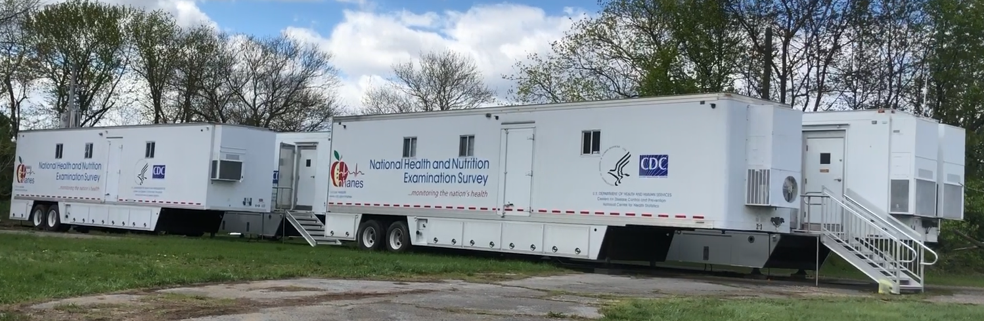
NHANES 2019 – 2020 Data Collection
In March 2020, NHANES was in the second year of its 2019 – 2020 survey cycle.
All 2020 data collection was suspended on March 16, 2020 due to COVID-19.
NHANES mobile exam center (MEC) trailers were parked in Maryland.

Slide 3
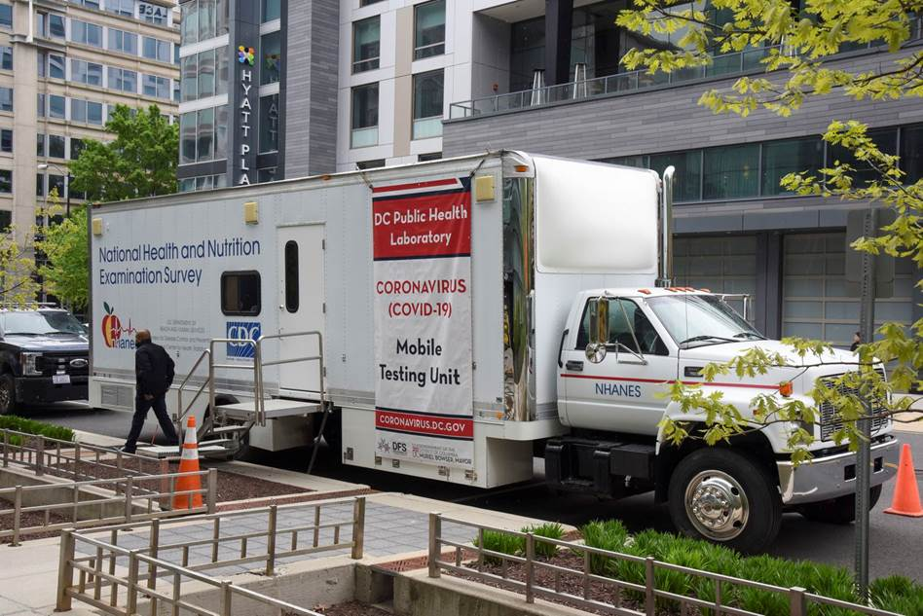
NHANES assistance with COVID-19 Response
Deployment of NHANES staff
Contact tracing, Quarantine station, FEMA National Response Coordination Center (NRCC)
Trailers / trucks for COVID-19 testing
CLIA certified labs
Offered use to DOH in NY, MD, and DC
4/24/2020 we transferred our truck to DC’s Dept of Forensic Sciences, DOH for mobile testing
of DC residents
Explored serology testing for SARS-CoV-2
Burden estimates for severe obesity and other health conditions

Slide 4

Data from an incomplete NHANES 2019-2020 cycle
As of mid-March 2020, 18 of 30 planned locations for the full 2-year cycle were visited
No feasible way to safely resume in-person exams in 2020
2019 – March 2020 sample not nationally representative
No method to create sample weights
Data release could increase disclosure risk

Slide 5

A solution: a 2017-March 2020 pre-pandemic data file
Evaluated incomplete 2019-2020 sample
Examined non-response bias
Discussed with NCHS Board of Scientific Counselors
Decided on a statistical approach to combine…
a probability sample (2017-2018)
with a partial probability sample (2019-March 2020)
Resulting pre-pandemic data file can be used to make national estimates

Slide 6
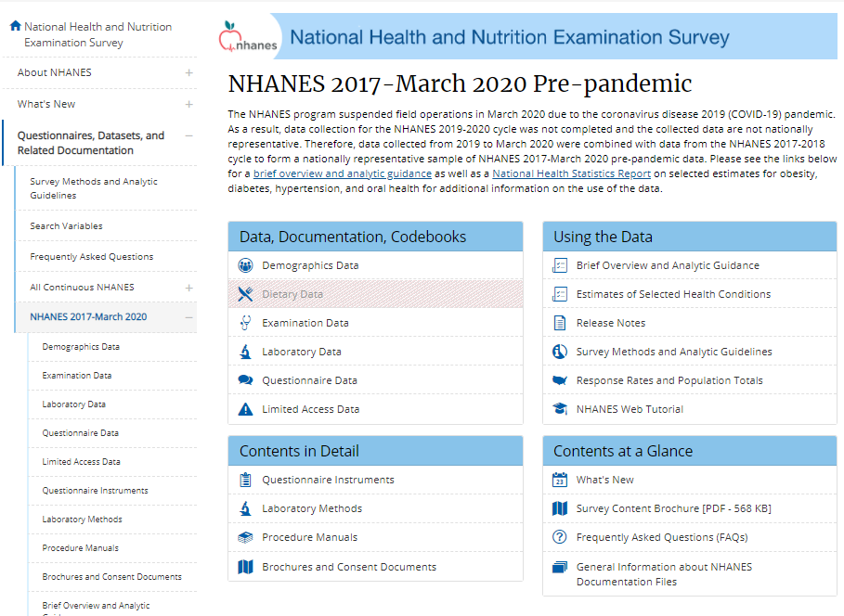
2017-March 2020 Pre-Pandemic Data

Slide 7
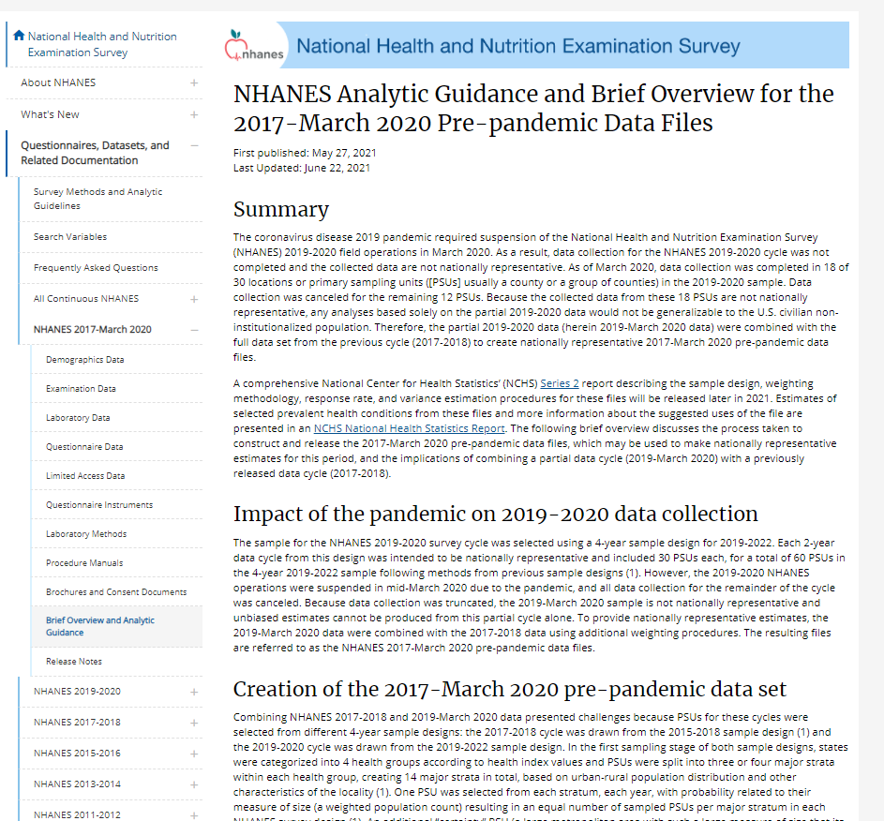

Slide 8
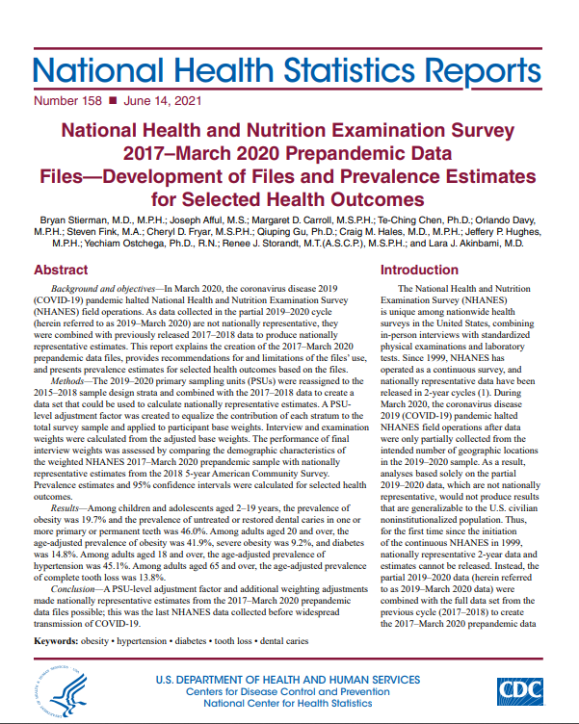

Slide 9
NHANES 2021– 2022

Slide 10
NHANES 2021 – 2022 Data Collection
 | Screening Households | Sample Participant Interviews | Examinations at MEC | MEC Closing Date
Dress Rehearsal | June 14 | July 26 | Aug 15 | Sept 25

Slide 11
NHANES 2021 – 2022 Data Collection
 | Screening Households | Sample Participant Interviews | Examinations at MEC | Closing Date
Dress Rehearsal | June 14 | July 26 | Aug 15 | Sept 25
Stand 428 | July 12 | Aug 23 | Sept12 | Oct 18

Slide 12
NHANES 2021 – 2022 Data Collection
 | Screening Households | Sample Participant Interviews | Examinations at MEC | Closing Date
Dress Rehearsal | June 14 | July 26 | Aug 15 | Sept 25
Stand 428 | July 12 | Aug 23 | Sept12 | Oct 18
Stand 429 | July 29 | Sept 9 | Sept 29 | Nov 6
Stand 430 | Aug 6 | Sept 18 | Oct 23 | Dec 2
Stand 431 | Sept 7 | Oct 18 | Nov 8 | Dec 18
Stand 432 | Oct 4 | Nov 15 | Dec 6 | Jan 23

Slide 13
NHANES 2021 – 2022
When we returned to the field, we did not expect infection rates to be zero
As a result, several changes were made
Guiding principles around these changes were to:
Promote the safety of survey participants and field staff
Shorten the face-to-face contact in the home and the MEC
Preserve the essential data collection needed to monitor the nation’s health
Reduce respondent burden in order to maximize response rates

Slide 14
2021 – 2022 Sample Design
No oversampling by race and ethnic groups
No oversampling low-income white/other group
In every selected dwelling unit…
All persons 0-19 years of age are eligible to participate
All 60+ years are eligible
1-2 persons 20-59 years, depending on number of persons in HH 20-59
About half the number of DUs will need to be screened than in 2019
Target examined sample ~10,000 persons across the 30 PSUs; Each 15 nationally representative

Slide 15
Monitoring COVID-19 in the field
Prior to starting in an NHANES location, COVID risk levels are closely monitored
NHANES uses the 7-day rolling average for new cases per 100K to classify counties into…
green (less than one case),
yellow (between 1 and 9 cases),
orange (between 10 and 24 cases), and
red (more than 24 cases) risk levels.
In-person data collection only occurs after assessing a county’s risk level and vaccination rates, field staff vaccination rates, and the latest CDC guidance.

Slide 16
Monitoring COVID-19 in the field
Prior to starting in an NHANES location, COVID risk levels are closely monitored
NHANES uses the 7-day rolling average for new cases per 100K to classify counties into…
green (less than one case),
yellow (between 1 and 9 cases),
orange (between 10 and 24 cases), and
red (more than 24 cases) risk levels.
In-person data collection only occurs after assessing a county’s risk level and vaccination rates, field staff vaccination rates, and the latest CDC guidance.
Stand | Interview Start
695 | Mon, Jul 26, 2021
428 | Mon, Aug 23, 2021
429 | Thu, Sep 9, 2021
430 | Sat, Sep 18, 2021
431 | Mon, Oct 18, 2021
432 | Mon, Nov 15, 2021

Slide 17
2021 – 2022 Household Screening
A multi-mode approach allows screener responses via web, paper, phone or in-person interview.
Mailings include:
Introductory Letter – push to the web (and phone option)
Reminder Postcard, 7 days later – push to the web (and phone option)
Follow-up Letter via FedEx, 10 days later - push to the web, also includes a paper screener
Final Letter, 10 days later - push to the web, with statement noting an upcoming field interviewer visit

Slide 18
2021 – 2022 Household Screening
A multi-mode approach allows screener responses via web, paper, phone or in-person interview.
Mailings include:
Introductory Letter – push to the web (and phone option)
Reminder Postcard, 7 days later – push to the web (and phone option)
Follow-up Letter via FedEx, 10 days later - push to the web, also includes a paper screener
Final Letter, 10 days later - push to the web, with statement noting an upcoming field interviewer visit
Contact mode among completed Household Screeners
 | Dress Rehearsal Stand | Stand 428 | Stand 429
Web, Paper, or Phone | 20% | 22% | 19%
In-person | 80% | 78% | 81%

Slide 19
2021 – 2022 Home Interview
Sample Participant (SP) and family questionnaire are now administered by telephone, with an option for in-person
SP questionnaire reduced by over 50%; Family questionnaire reduced by about a quarter
In-home collection of infant formula, salt use, and home water were all discontinued
In-home collection of individual prescription medications through medication inventory method was discontinued.
Dietary supplement collection was moved to after the MEC visit with the dietary interview.
Notes:
-

Slide 20
2021 – 2022 Home Interview
Sample Participant (SP) and family questionnaire are now administered by telephone, with an option for in-person
SP questionnaire reduced by over 50%; Family questionnaire reduced by about a quarter
In-home collection of infant formula, salt use, and home water were all discontinued
In-home collection of individual prescription medications through medication inventory method was discontinued.
Dietary supplement collection was moved to after the MEC visit with the dietary interview.
Interview mode among persons interviewed
 | Dress Rehearsal Stand | Stand 428 | Stand 429*
In-person | 64.4% | 62.5% | 10.1%
Phone | 35.6% | 37.5% | 89.9%
* Closes Nov 6

Slide 21
Median time of home interview among interviewed persons
Age Group (years) | Dress Rehearsal Stand (minutes) | Stand 428 (minutes)
SP Questionnaire
0-15 | 9.5 | 9.1
16-19 | 17.2 | 13.5
20-39 | 16.7 | 16.9
40-59 | 18.4 | 18.4
60+ | 19.2 | 20.4
Family Questionnaire
 | 7.6 | 8.4
Notes:
at

Slide 22
Median time of home interview among interviewed persons
Age Group (years) | Dress Rehearsal Stand (minutes) | Stand 428
Age Group (years) | Dress Rehearsal Stand (minutes) | Median (minutes) | 90th Percentile (minutes)
SP Questionnaire
0-15 | 9.5 | 9.1 | 19.6
16-19 | 17.2 | 13.5 | 25.7
20-39 | 16.7 | 16.9 | 34.6
40-59 | 18.4 | 18.4 | 34.6
60+ | 19.2 | 20.4 | 41.6
Family Questionnaire
 | 7.6 | 8.4 | 17.0

Slide 23
2021 – 2022 Incentive Structure
All incentives paid using debit cards
Total incentive stays the same with some modifications
SP interview incentive added - $25
MEC Exam
Age 0-11y - $40, 12-15y - $60, and 16 and older - $85
Transportation and child/adult care unchanged
No fasting incentive
Post-exam interviews
Dietary Day 1 - $25, Dietary Day 2 - $25, and Food Consumer Behavior Survey phone follow-up module - $15

Slide 24
2021 – 2022 Mobile Examination Center (MEC)
Structural Changes to trailers to promote social distancing
Modified MEC flow options to reduce interaction with others
New exam schedule with 4 or 5, 2.5h sessions per day that accommodate about 5 SPs each session.
Extra cleaning between SPs
Staff
Wear PPE (masks, gloves, lab coat)
Be vaccinated
Conduct daily symptom screening
Participants and visitors, prior to MEC entry
CDC COVID-19 screening questions
Temperature checks
Wear face mask

Slide 25
COVID-19 Specific Content: SARS-CoV-2 serology testing
Two antibody tests added:
Spike-based tests will detect antibodies after vaccination and natural infection.
Nucleocapsid-based tests will detect antibodies only after natural infection.
Produce nationally representative prevalence estimates of past infection and/or vaccine-induced immunity among NHANES participants aged 1 year and older using blood-based (serological) antibody testing.

Slide 26
COVID-19 Specific Content: Home Interview Questions
Prior to the health exam and blood draw at the mobile exam center, participants are asked the following COVID-19 questions during their home interview:
Have you ever had COVID-19, or the illness caused by the Coronavirus 2019?
How would you describe your symptoms when they were at their worst? (None, Mild, Moderate, Severe)
Have you ever been tested for coronavirus or COVID-19?
Did the swab or saliva test find that you had coronavirus or COVID-19? What was the date of your positive COVID-19 test. This does not include the blood test.
Have you ever had an antibody blood test to determine if you had coronavirus or COVID-19 in the past? Did the blood test find that you had antibodies for coronavirus or COVID-19? What was the date of this blood test?
Have you ever received a vaccine for COVID-19? Some COVID-19 vaccines are given in 2 separate doses and some are given in one dose. Which kind of COVID-19 vaccine did you receive? The one-dose vaccine or the two-dose vaccine?
How many doses of COVID-19 vaccine have you received? In what month and year did you receive the most recent dose of vaccine for COVID-19?
Have you ever had an overnight stay in a hospital for suspected or confirmed COVID-19?
Has anyone in your household ever tested positive for coronavirus or COVID-19?
Do you currently have a health condition that a doctor or other health professional told you weakens the immune system, making it easier for you to get sick?
In the past 12 months, have you taken prescription medication or had any medical treatments that a doctor or other health professional told you/ would weaken your immune system?
During the past 12 months, have you had a flu vaccination?

Slide 27
Summary of select COVID questions from first few Stands of NHANES 2021 – 2022
Have you ever had COVID-19
Yes | 11.0%
No | 86.6%
Maybe | 1.8%
RF | 0.1%
DK | 0.5%
Ever been tested for COVID-19
Yes | 59.4%
No | 40.3%
DK | 0.3%
Ever received a vaccine for COVID-19
Yes | 61.3%
No | 38.5%
RF | 0.2%
Note: unweighted percentages; includes Dress Rehearsal Stand and first 3 Stands with SP questionnaire data

Slide 28
NHANES 2021 – 2022: Current Learnings
Overall changes to sampling, home interview, and MEC appear successful.
Some modifications were necessary:
Adjusting MEC schedule due to lab constraints
Adjusting protocols based on new or updated policies (e.g., vaccination of federal contractors, updates to CDC COVID screener)
Challenges:
Hiring field positions
Managing when staff become infected
Some scheduling challenges
Regional shortage of dry ice
Needs further assessment:
Value of multimode screening
Reasons for SP refusals at each stage of survey (i.e., screener, interview, and exam)

Slide 29
Thank you For further information please contact: Ryne Paulose RPaulose@cdc.gov

