Slide 1
Survey Isolation during COVID-19: The Effects of Suddenly Relying on Address-Matched Phone Numbers for Interviewing Households Jonathan Eggleston U.S. Census Bureau FCSM 2021
I would like to thank Yarissa Gonzalez, Tim Trudell, John Voorheis, as this presentation is an offshoot of our joint research on weighting with the Current Population Survey. Any opinions and conclusions expressed herein are those of the author and do not necessarily reflect the views of the U.S. Census Bureau. The Census Bureau's Disclosure Review Board and Disclosure Avoidance Officers have reviewed this data product for unauthorized disclosure of confidential information and have approved the disclosure avoidance practices applied to this release. DRB Delegated Authority Number FY2021-CES010-017.

Slide 2
Introduction
U.S. Census Bureau conducts in-person interviews for numerous surveys, including the Current Population Survey (CPS) and American Community Survey (ACS)
March 2020
In-person interviewing suspended
For the multimodal ACS, paper response options suspended. Materials could not be handled because of the closure of the Census Bureau’s National Processing Center

Slide 3
How Were Interviews Conducted After March 2020?
Decentralized phone interviews from an interviewer’s home (i.e. non-CATI phone calls)
Respondents contacted in two ways
Letter mailed with interviewer’s phone number -- some respondents took initiative to call their interviewer
Interviewers used phone numbers from either Census Bureau’s Contact Frame or a commercial lookup service

Slide 4
Census Bureau Contact Frame
Dataset with phone numbers for every household address in the United States (if the address has a phone number).
Phone numbers from a variety of sources
Prior respondents to the American Community Survey
Alaska Permanent Fund Dividend data
SNAP/WIC/TANF administrative data for a handful of states
But for most of the U.S. Population, phone numbers come from commercial providers

Slide 5
Census Bureau Contact Frame
Source of commercial data: Exact details proprietary, but some components include
Magazine/periodical change of address information
Utility records
Concern: Lower income households may be less likely to be in these data
Fewer utilities: No internet at home, utilities part of apartment rent
Less likely to subscribe to magazines
Hypothesis: Low-income households are less likely to be contacted with these commercial phone numbers
Rest of Talk: Provide some evidence in support of this hypothesis

Slide 6
Nonresponse and Income-CPS
Match IRS and other administrative data to CPS sampled addresses, including nonrespondent households
Compare means between respondents and nonrespondents for each CPS month
Adjusted gross income (AGI) from tax returns
Characteristics of address-matched phone numbers: model-based quality score
Higher quality score → More confidence phone number is associated with address in question
Income results similar to Rothbaum and Bee (2020), who look at same measures for the CPS ASEC (“March” CPS)

Slide 7
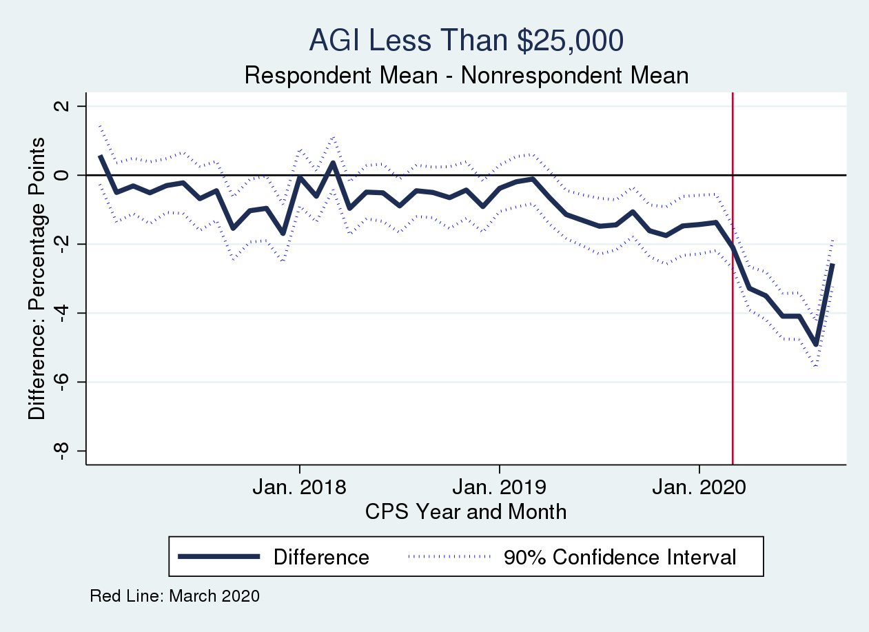
Income of Respondents Higher After March 2020
Last Month: September 2020
Source: 2017-2020 Basic Monthly CPS + Administrative Data

Slide 8
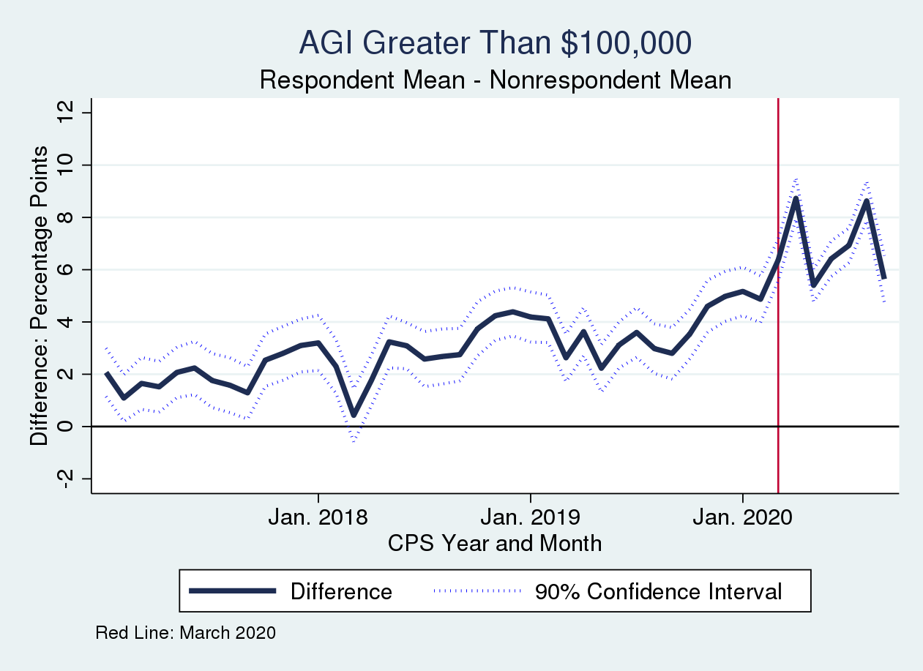
Income of Respondents Higher After March 2020
Source: 2017-2020 Basic Monthly CPS + Administrative Data

Slide 9
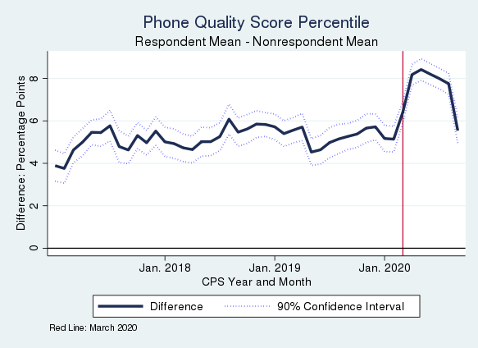
Change in Phone Number Quality Too
Source: 2017-2020 Basic Monthly CPS + Administrative Data

Slide 10
Nonresponse and Income
Change in income of respondents associated with change in phone number quality of respondents
However, unclear if phone number quality is the driving factor or something else
Additional evidence comes from phone numbers reported by respondents to the American Community Survey (ACS)

Slide 11
Regression: ACS Phone Number Matching Other Census Sources
Sample: Respondents sampled in 2018 for the ACS who had a landline phone number linked to their address
Further Restriction: Household matched to at least one IRS or other administrative record
For various technical reasons, only have data for the landline ACS reported number
Dependent variable: Binary variable =1 if the phone number the ACS respondent reported matches any of their landline phone numbers from the contact frame
Linear Probability Model
Explanatory variables: Economic and demographic data from administrative records
Takeaway: Higher income households more likely to have a matched landline number

Slide 12
Demographics (Inferred from IRS data, 2010 Census, and demographic data from the Social Security Administration)
Any Household Member who is… | Coefficient (Percentage Points)
Over 60 | 16.47%***
Under 10 | -8.82%***
Black | 1.58%***
Hispanic | -4.22%***
Foreign Born | -3.35%***
Married | 5.93%***
Households with a member over 60 are 16.47 percentage points more likely to have their ACS reported phone number match one of their landline contact frame phone numbers
***: p<.01
Source: 2018 ACS + Administrative Data

Slide 13
Adjusted Gross Income
AGI Amount | Coefficient (Percentage Points)
Less than $25,000 | (Excluded Outcome)
Between $25,000 and $50,000 | 1.06%***
Between $50,000 and $100,000 | 0.74%***
Over $100,000 | 1.44%***
***: p<.01
Source: 2018 ACS + Administrative Data

Slide 14
Asset Income From IRS Records
Received Any… | Coefficient (Percentage Points)
Interest Income | 6.02%***
Dividend Income | 5.20%***
***: p<.01
Source: 2018 ACS + Administrative Data

Slide 15
Structure Type
Housing Unit Type | Coefficient (Percentage Points)
Trailer/Other/Unknown | (Excluded Outcome)
Single-family | 7.96%***
Multi-Unit | -1.22%***
***: p<.01
Source: 2018 ACS + Administrative Data

Slide 16
Number of Jobs
Most W2s a Household Member Has Is….. | Coefficient (Percentage Points)
1 | (Excluded Outcome)
2 | -2.43%***
3 | -3.42%***
4 or more | -3.59%***
***: p<.01
Source: 2018 ACS + Administrative Data

Slide 17
Conclusion
Takeaway: Lower income households less likely to have a phone number matched to their address
Implications for other surveys: Potential bias from linkage of addresses to phone numbers
Some surveys use addresses linked to phone numbers as alternative to landline RDD (e.g. Link et al. 2009 for Nielsen TV Ratings Diary)
However, nonlinkage bias may exclude the same types of people excluded from landline RDDs
Notes:
Some Sources:
https://www.pewresearch.org/methods/2017/05/15/what-low-response-rates-mean-for-telephone-surveys/
Stephen J. Blumberg, Julian V. Luke, Coverage Bias in Traditional Telephone Surveys of Low-Income and Young Adults, Public Opinion Quarterly, Volume 71, Issue 5, 2007, Pages 734–749, https://doi.org/10.1093/poq/nfm047
Link, M., Gail Daily, C. Shuttles, Tracie L. Yancey, A. T. Burks, and C. Bourquin. "Building a new foundation: Transitioning to address based sampling after nearly 30 years of RDD." In 64th Annual conference of the American Association for Public Opinion Research, Hollywood, FL. 2009.

Slide 18
Contact Information
Jonathan Eggleston
Senior Economist
Survey Improvement Technical Lead
Survey and Economic Research Group
Center for Economic Studies
U.S. Census Bureau
Office: 301.763.2357
jonathan.s.eggleston@census.gov

Slide 19
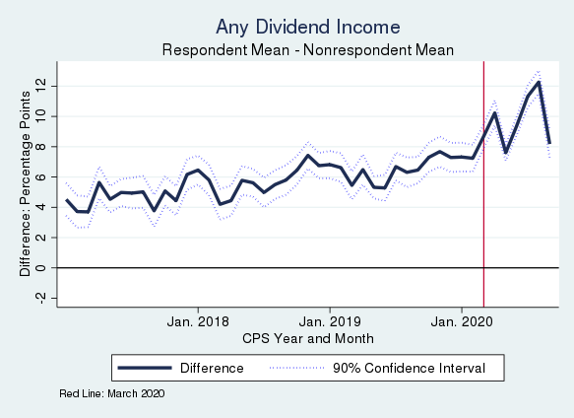
Income of Respondents Higher After March 2020
Source: 2017-2020 Basic Monthly CPS + Administrative Data

