Slide 1
Developing State Personal Income Distribution Statistics
Dirk van Duym
Christian Awuku-Budu
FCSM Conference, November 2

Slide 2
Introduction
Goal: create a distributional account for State Personal Income
Allows for analysis of inequality by state and over time
Benchmarked to BEA SPI aggregates
Contributes to BEA’s Beyond GDP initiative
Builds off BEA work distributing national personal income (Fixler et al, 2020), adapting to state data constraints

Slide 3
Other Estimates of State Inequality
Census provides official state median household money income and Gini coefficients by state
Directly from American Community Survey and/or Current Population Survey
Not benchmarked to NIPA or State Personal Income, or tax data
Economic Policy Institute (think tank) has top 1% state and county estimates up to 2015, based on IRS SOI data and ACS
Forthcoming research from Census using linked survey and tax microdata

Slide 4
Source Data
Base datasets
State Personal Income accounts
CPS Annual Social and Economic Supplement (ASEC) microdata
Other data sources
IRS Statistics of Income
Medical Expenditure Panel Survey
Survey of Consumer Finances
American Community Survey
Center for Medicare and Medicaid Services
Congressional Budget Office

Slide 5
Base Dataset 1: SPI Accounts
We start by selecting 75 detailed annual state personal income components, to be allocated to households
These population aggregates are BEA’s bread & butter: measured using a variety of source data, often in partnerships with IRS, BLS
Components measured on place-of-work basis are transformed to place-of-residence basis, to be consistent with survey data used in next steps

Slide 6
Base Dataset 2: CPS ASEC microdata
Base dataset for allocation to state households is pooled CPS ASEC microdata, from three previous years
CPS is only source that has enough variety of income types
Following Census guidance on using multiple years for state estimates
Similar structure to ACS 3 or 5-year files used for smaller geographies

Slide 7
CPS Adjustments
CPS is adjusted for under/misreporting, to improve estimates of the top of the distribution
Using state IRS Statistics of Income data on wages, interest, dividends, business income (sole proprietor & partnership)
Other data sources used to supplement, or “fill out” CPS
CPS alone is not suitable to distribute some income types to households: medical income components, imputed interest/rent, etc.
Bring in: CMS, MEPS, SCF, BEA’s recent housing work based on ACS, others

Slide 8
Allocating, and Generating Estimates
Each detailed, place-of-residence SPI component is allocated to state households using adjusted CPS
We now have microdata that adds up to State Personal Income
Household size-adjusted income is used to define the ranking of households
Inequality measures can now be produced
Median, Gini, quintile shares of State PI
Quintile shares of sub-aggregates, consistent with existing BEA Regional publication tables

Slide 9
Results
New results for 2009-2018
Many statistics to look at, just a selection today (more in paper)
Focus on Gini, median income, top quintile borders
Quintiles borders are defined at the state level
Comparison to Census state money income estimates

Slide 10
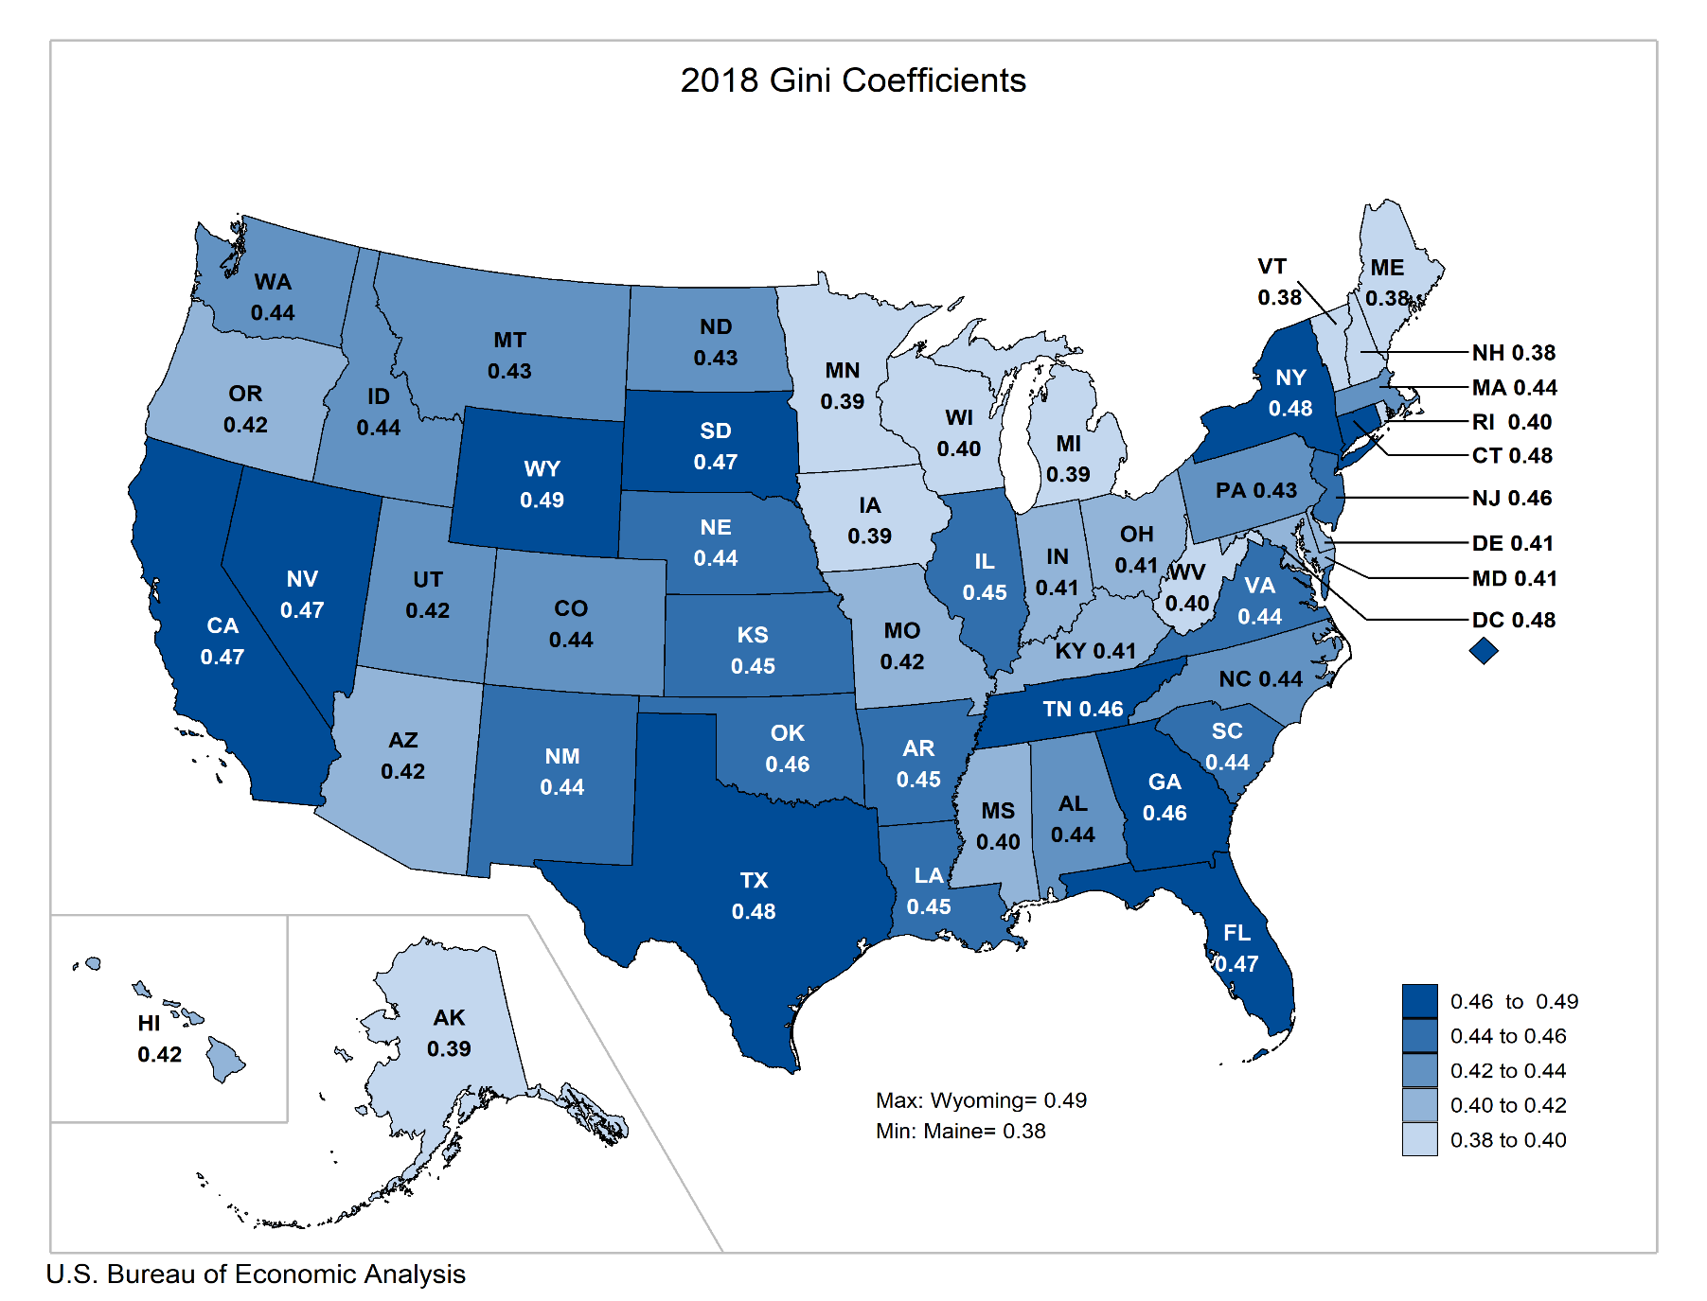
Gini Coefficients, 2018

Slide 11
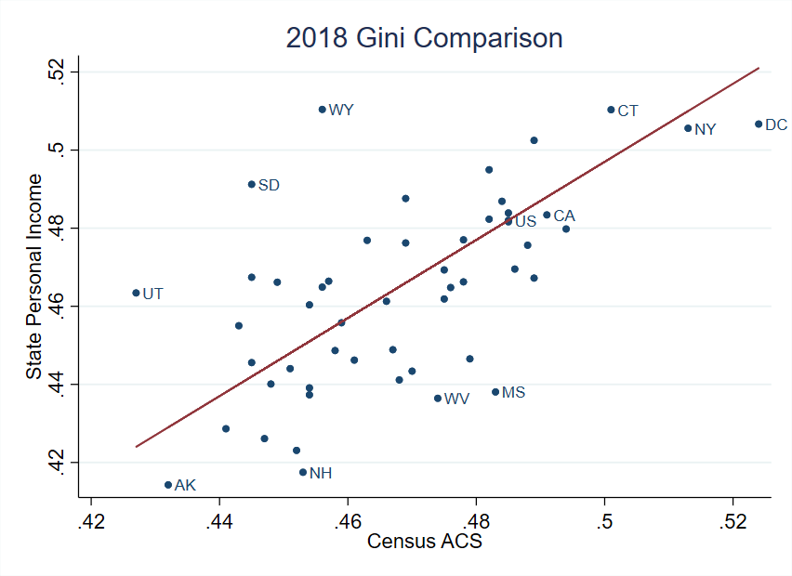
Our estimates vs. Census state estimates from ACS
Note: results not equivalized for household size, for comparability to Census

Slide 12
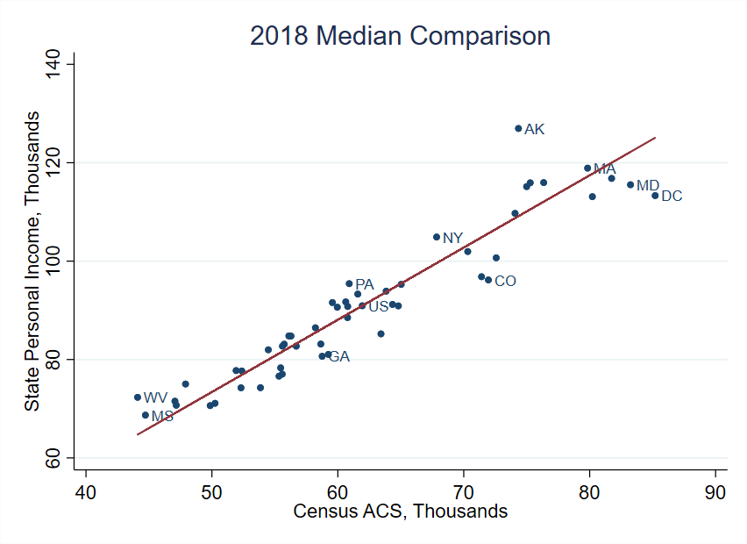
Our estimates vs. Census state estimates from ACS
Note: results not equivalized for household size, for comparability to Census

Slide 13
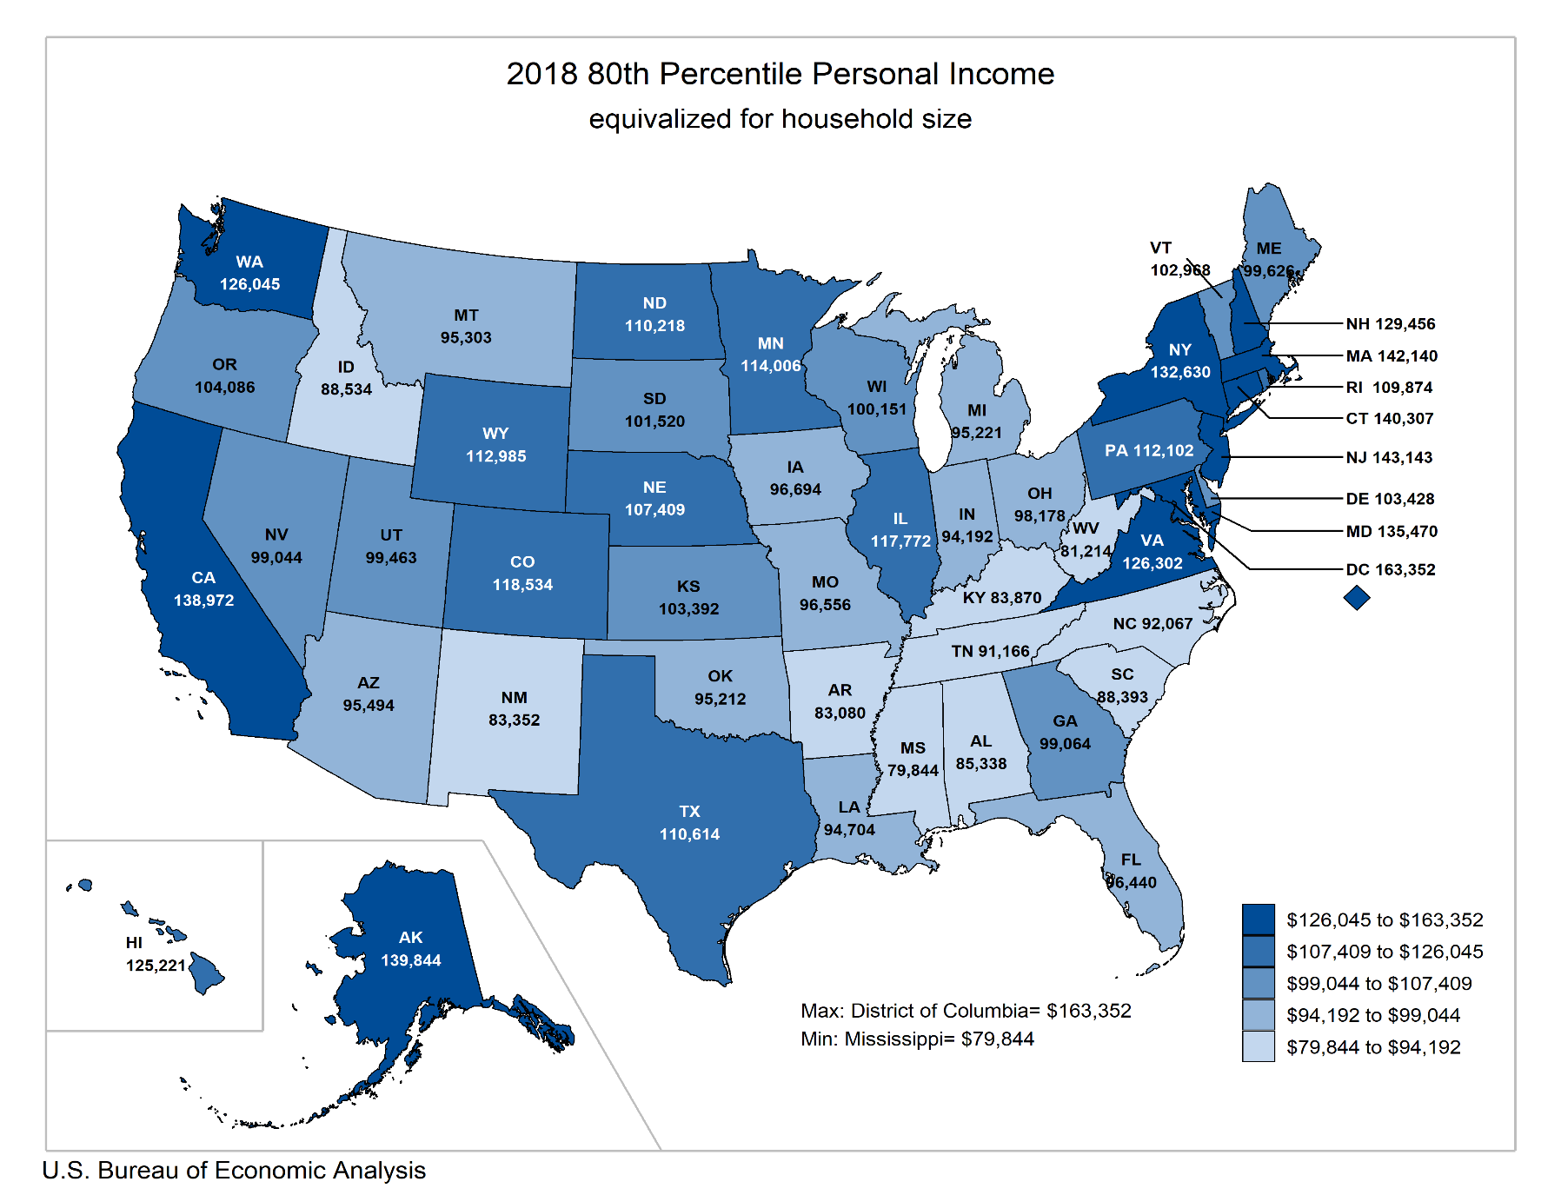
80th Percentile of Equivalized SPI, 2018

Slide 14
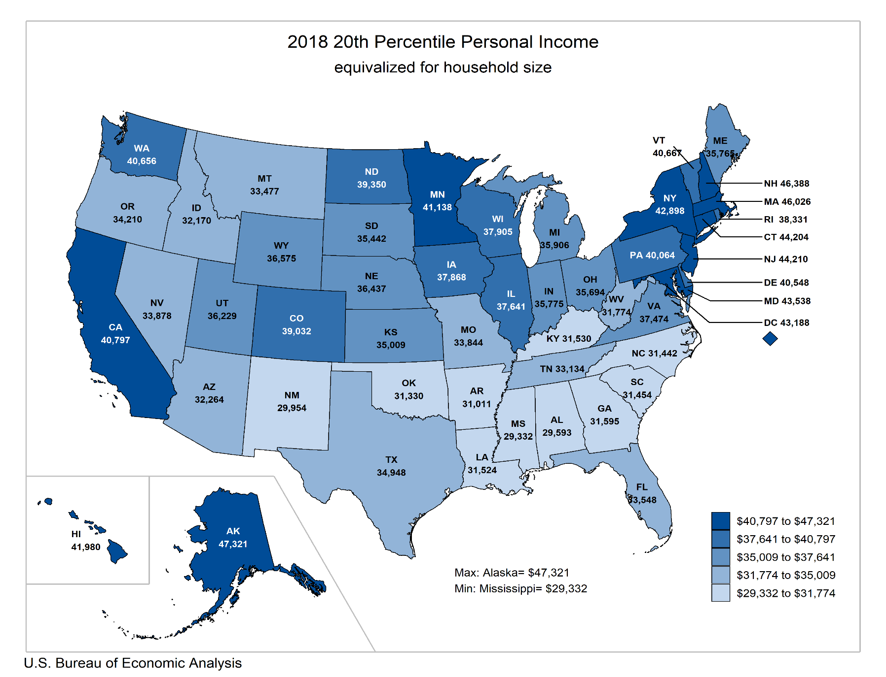
20th Percentile of Equivalized SPI, 2018

Slide 15
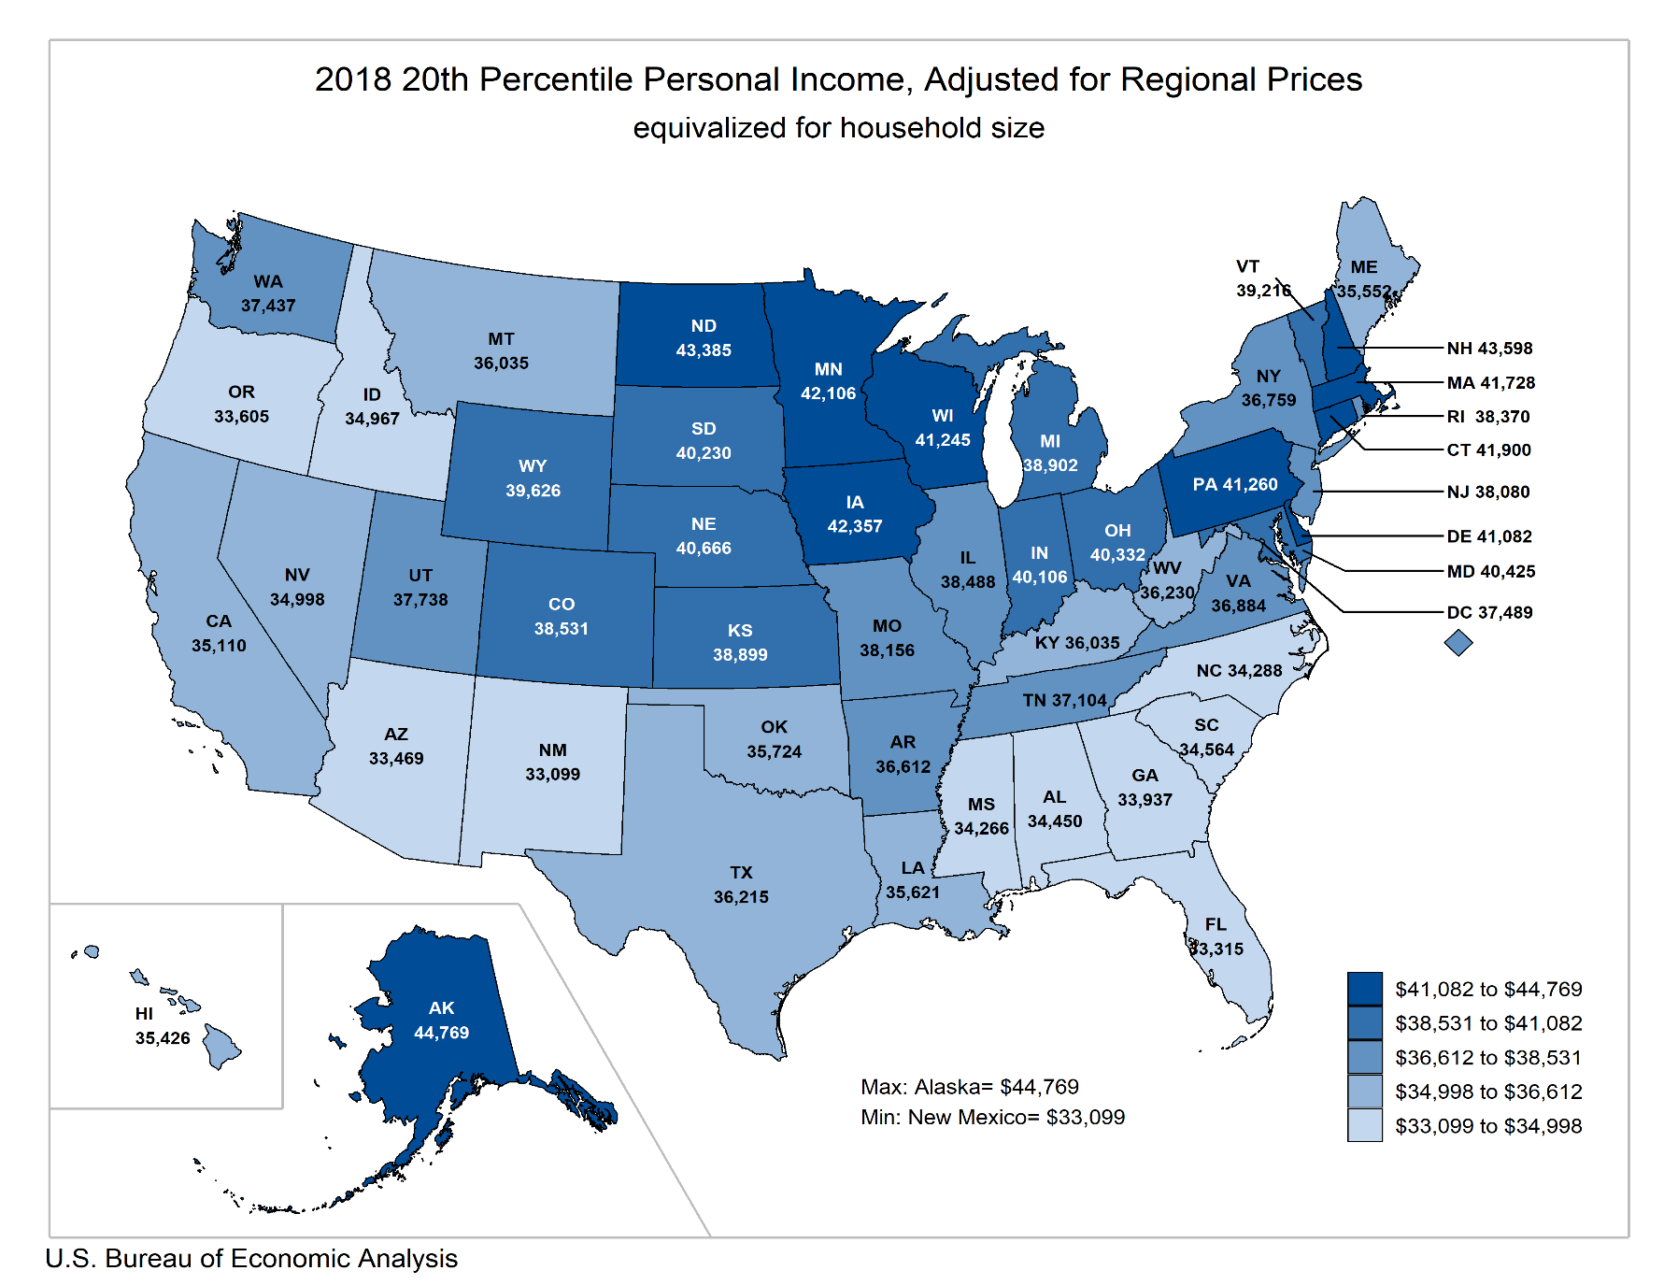
20th Percentile of RPP-Adjusted Equiv. SPI, 2018

Slide 16
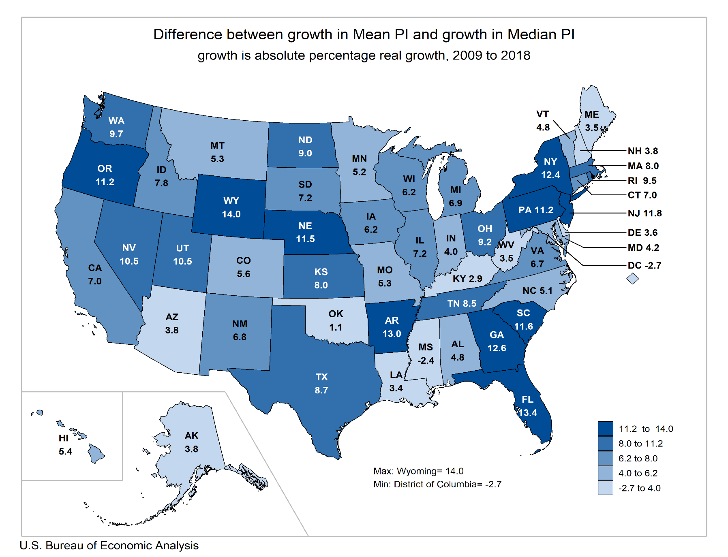
Mean vs. Median Growth

Slide 17
Future Research
State disposable personal income
Involves distributing taxes
Allows for analysis post-tax and post-transfer
Moving towards official BEA statistics
Your feedback needed!

