Slide 1

The Standard Application Process Portal Pilot
Heather Madray, U.S. Census Bureau
Center for Enterprise Dissemination
The views expressed in this presentation represent the author and are not necessarily the views of the Census Bureau.
This presentation represents the views of the presenter and does not represent the views of the U.S. Census Bureau.

Slide 2
The Evidence Act
Congress passed the 2018 Foundations for Evidence-Based Policy-Making Act in late 2018. It was signed into law in January of 2019.
The Evidence Act seeks to provide a framework to support evidence-building activities, including policy and program evaluation.
The Act addresses:
Limitations on data access
Privacy practices
Challenges found by researchers and data users when seeking access to data for evidence-building statistical activities

Slide 3
Why was the Evidence Act Passed?
A bipartisan data-driven approach to public policy is influencing legislators.
With limited resources for funding evaluation inside Federal agencies, outside researchers are seen as being key partners evaluating Federal programs.
To provide easier data access to State and local governments to improve their own local programs and better use Federal grants and other funding.
A long-term effort towards outcome management and budgeting with improved evidence and analytics.

Slide 4
What does the Evidence Act Require?
Agency strategic plans to support evidence-building activities
Establishment of an evaluation officer to lead evidence-building activities
Making data open by default in formats that are readily accessible by the public
When data cannot be made public, streamlining the processes by which the public can request access to restricted use data
The Evidence Act covers all agencies that fall under the Confidential Information Protection and Statistical Efficiency Act of 2002 (CIPSEA)

Slide 5
Section 3583 of the Evidence Act
Section 3583 calls for a Standard Application Process (SAP) that includes:
(1) Sufficient detail to ensure that each statistical agency or unit establishes an identical process.
(2) A common application form.
(3) Criteria for statistical agencies and units to determine whether to grant an applicant access to a data asset.
(4) Timeframes for prompt determinations by each statistical agency or unit.
(5) An appeals process for adverse decisions and noncompliance with the process established under this subsection.
(6) Standards for transparency, including requirements to make application information public

Slide 6
The SAP Pilot
In 2019, OMB charged the Census Bureau with contracting for a service to provide a pilot portal that could serve as a proof of concept for a full application process and portal.
This initial application was not intended as a full implementation of Section 3583 – only a preliminary application with a limited number of agencies.
The Census Bureau awarded the contract to the University of Michigan, ICPSR in September of 2019.
During a ten-week period, requirements were gathered and a pilot portal was developed.
This pilot portal, ResearchDataGov, was implemented in December of 2019.

Slide 7
The Agencies
Participating agencies in this pilot effort included partner agencies in the Federal Statistical Research Data Center (FSRDC) network.
These agencies included:
Bureau of Economic Analysis
Bureau of Justice Statistics
Bureau of Labor Statistics
U.S. Census Bureau
Internal Revenue Service, Statistics of Income Division
National Center for Health Statistics
National Science Foundation, National Center for Science and Engineering Statistics.

Slide 8
Why the FSRDC Agencies?
The Federal Statistical Research Data Center (FSRDC) network provided a unique stage to pilot this effort. The first FSRDC was established in 1994 and has since grown to become a network of physical locations where researchers can access legally restricted data in a secure environment on approved projects.
In early 2018, prior to the passage of the Evidence Act, the FSRDC Technical Working Group identified the need for a single application and review process to streamline the application process and better facilitate projects that used more than one agency’s data.
The team began work on this single application and process for the FSRDC agencies in spring of 2018 under the direction of the FSRDC Executive Committee.
As a result of this preliminary work, the FSRDCs became the logical platform for the development of the pilot portal with the FSRDC Technical Working Group serving as the implementation team.

Slide 9
The Portal
Portal Functionality included:
Dataset metadata inventories for each participating agency
A preliminary application for data users to complete
Routing of the application to the appropriate agency
Ability for each agency to review the application and download
Ability for each agency to record a final disposition for the application in the system
Basic metrics available

Slide 10
The Preliminary Application
The fields for the preliminary application included:
Name of primary researcher with institutional affiliation and contact information
Name of additional researchers with institutional affiliations and contact information
Data requested
Description of the proposed research
Proposed duration of the research
Requested FSRDC location(s) where the data would be accessed.

Slide 11
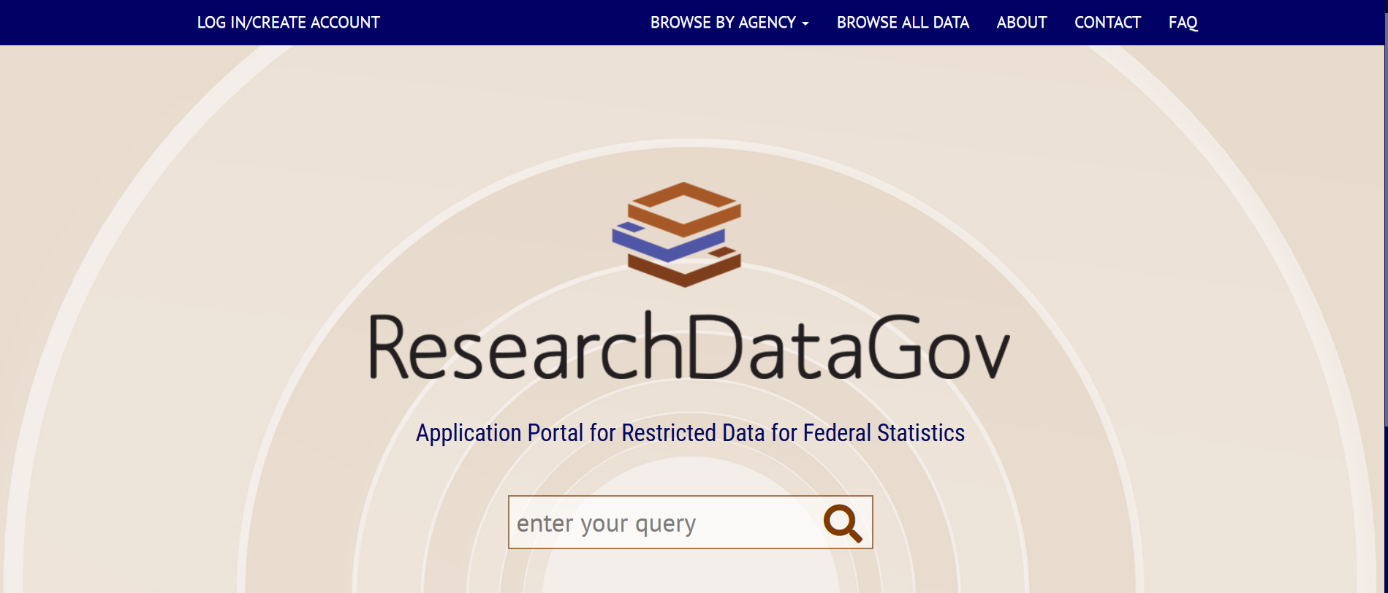

Slide 12
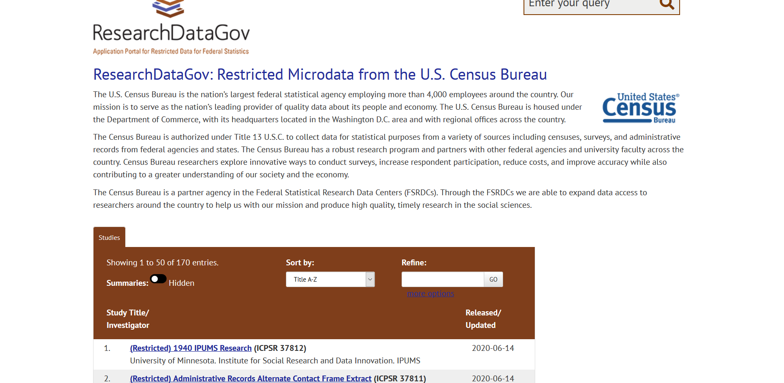

Slide 13
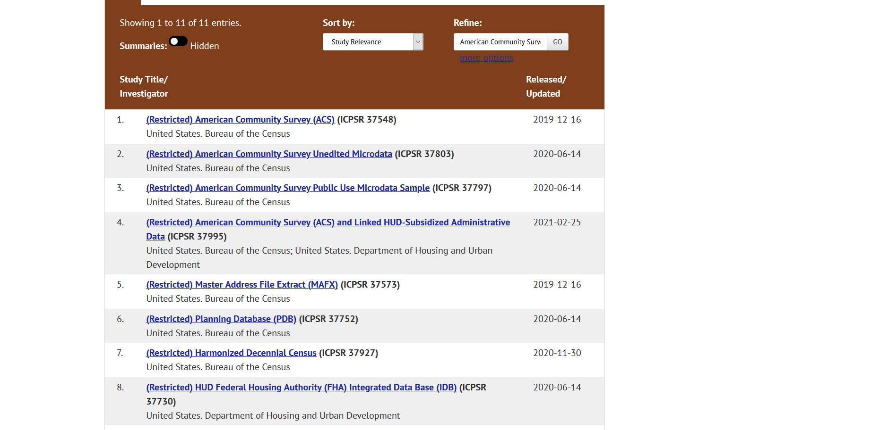

Slide 14
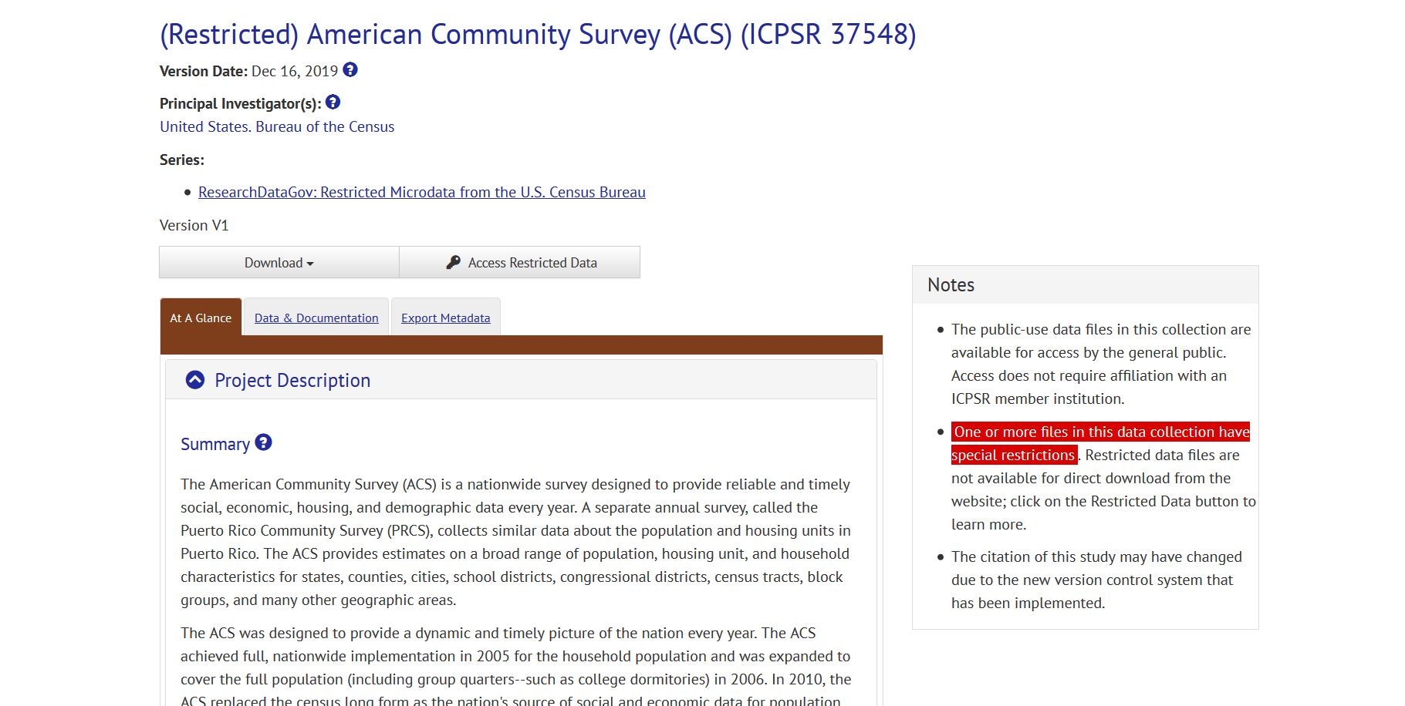

Slide 15
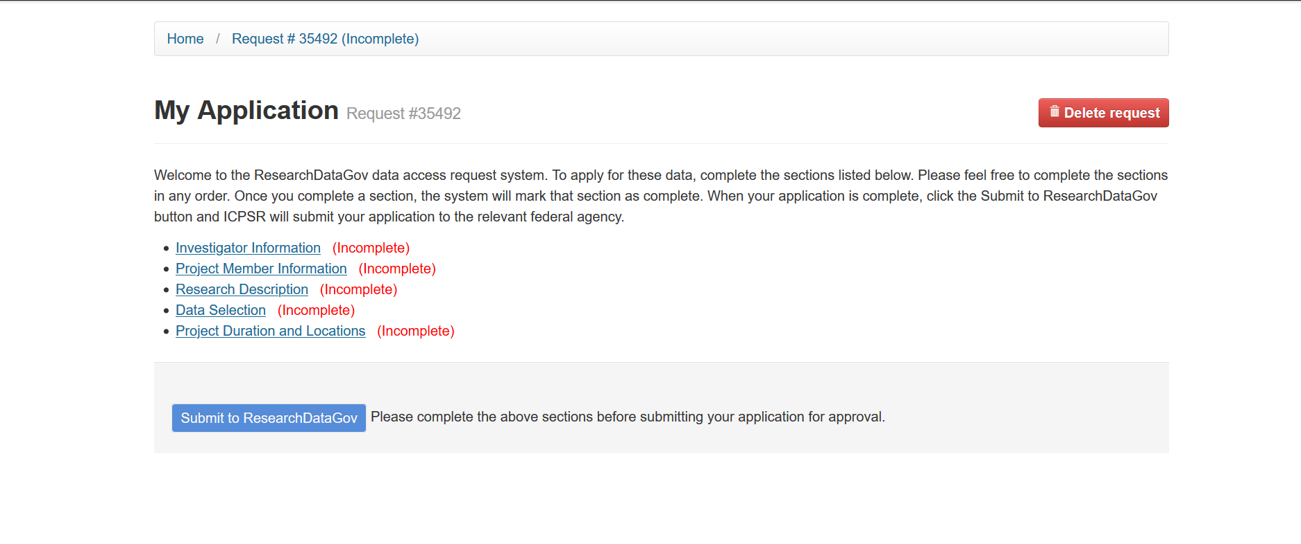

Slide 16
Key Successes of this Pilot
Implementation of a fully functioning pilot portal with limited time and resources.
Successful development of a metadata inventory for multiple CIPSEA agencies.
Consensus among seven CIPSEA statistical agencies on requirements for the portal and the portal functionality.
Successful communication strategies with agency and FSRDC stakeholders as well as the University of Michigan’s ICPSR.
Portal testing and demonstrations to stakeholders were accomplished despite differing technology platforms.
Groundwork was laid with multiple stakeholder groups for the full build-out of the portal.

Slide 17
Recommendations for the Future
A multi-pronged approach to statistical agency communication is needed to ensure agency senior leadership is informed and aligned with the goals of the project.
More status meetings between the Project Management Office and OMB to align vision.
The standard application process requires clear policy guidelines and governance that balance legal requirements, stakeholder needs, and support of existing research programs.
More demonstrations and opportunities for users to test the system are needed to provide opportunities for stakeholder feedback.
Resources should be made available to fund not only the contractor to develop the tool itself but the full-time staff and other supporting contractors to support the entire effort.
Sufficient time should be allotted to ensure all viewpoints are heard and the final product meets the needs of customers.
Future metadata standards need to reflect the needs of users.

Slide 18

Questions?
Heather.Madray@census.gov

