Slide 1
An Evaluation of the Gender Wage Gap using Linked Census and Administrative Records
November 2, 2021
Brad Foster and Marta Murray-Close
U.S. Census Bureau
Christin Landivar and Mark deWolf
U.S. Department of Labor

Slide 2
Disclaimer
Any opinions and conclusions expressed herein are those of the authors and do not necessarily reflect the views of the U.S. Census Bureau or the U.S. Department of Labor.
The underlying data used throughout this presentation are protected by Titles 13 and 26 of the U.S. Code. Several steps have been taken to avoid unwarranted and unauthorized disclosure.
The Census Bureau’s Disclosure Review Board has approved all statistics and estimates presented today for public release under approval numbers CBDRB-FY2019-CES005-002, CBDRB-FY2019-CES010-002, and CBDRB-FY2019-461

Slide 3
Context
Men
Source: Fontenot, Semega, and Kollar. 2018. “Income and Poverty in the United States: 2017.” U.S. Census Bureau. Issued September 2018. Data from the CPS ASEC.

Slide 4
Motivation and Goals
Measurement of gender wage gap (commissioned by Congress)
Employer-reported earnings (SSA-DER and W-2s) and reconstructed work histories
Measurement and decomposition of the wage gap in 316 detailed occupation categories
Census benefits related to survey-based income measurement
Substantive contributions to the wage gap literature
Whether/how length of work history influences decompositions
Account for work history and occupational sorting simultaneously
Relationship between occupational characteristics and occupation-specific residual gaps (Goldin 2014)

Slide 5
Data
CPS – DER
Links CPS-ASEC (2004-2013) to SSA-DER (1978-2012)
25-year work histories
ACS – W-2
Links ACS (2015 and 2016) to W-2s (2005-2016)
10-year work histories
316 Detailed occupation categories
O*NET occupational characteristics (Goldin 2014)
Time Pressure, Competition, Hazards, Autonomy, and Communication/Teamwork
Restrict to full-time, year-round workers ages 25 to 54 in civilian sector occupations
Adjust for non-random variation in PIK assignment

Slide 6
Measuring Wages
We discuss the wage gap in terms of hourly wages, which we construct as follows:
Sum all earnings and deferred compensation reported by employers for a given year (from SSA-DER and IRS W-2s)
Divide by the number of weeks worked in the past year (from CPS and ACS)
Divide by the number of usual hours worked per week (from CPS and ACS)
Adjust to 2017 dollars using Consumer Pricing Index inflation factors and top-code wages at $500/hr

Slide 7
Measuring Work Histories
Rule: An individual worked in a given year if their wages were greater than those that would be earned by someone working 520 hours at the federal minimum wage (Goldin and Mitchell 2017)
Improvement over relatively standard approximation of “potential experience” (Age – Years of Education – 6)
Potential experience overestimates actual experience from work histories by about 3.6 years for women and 2.9 years for men, on average.
In some of the most populous occupations, potential experience can overestimate actual experience by 4 years among men and nearly 7 years among women.

Slide 8
Other Variables
Age, Age²
Race/Ethnicity (5-category)
Marital status, Presence/age of children*
Educational attainment (5-category)
Weeks worked last year, Usual hours worked per week
Industry (13-category)
Region (4-category)
Survey year
*These variables were used for summary statistics, but were left out of final decomposition models due to their multicollinearity with other variables, like work history, weeks worked last year, and usual hours worked per week.

Slide 9
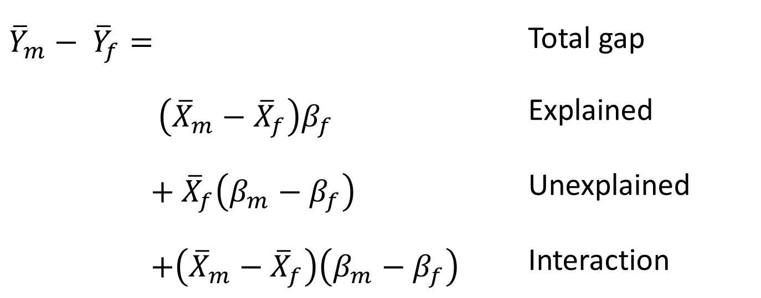
Oaxaca-Blinder Decomposition
${\overline{Y}}_{m}− {\overline{Y}}_{f}=$ | Total gap
$$\left({\overline{X}}_{m}−{\overline{X}}_{f}\right)β_{f}$$ | Explained
$$+ {\overline{X}}_{f}\left(β_{m}−β_{f}\right)$$ | Unexplained
$$+\left({\overline{X}}_{m}−{\overline{X}}_{f}\right)\left(β_{m}−β_{f}\right)$$ | Interaction
Effects of Observed Differences between Men and Women
Residual
Gaps

Slide 10
Raw and Residual Gender Wage Gaps
In ACS-IRS data (2015-2016), the median women-to-men hourly wage ratio is $20.31/$24.82, or 0.82.
Around 30% of this gap is “explained”, leaving a residual gap of about 12.5%.
In CPS-DER data (2004-2013), the median women-to-men hourly wage ratio is $19.75/$24.84, or 0.80.
Using 25 years of work history, around 40% of this gap is “explained”, leaving a residual gap of about 12%.
Source: American Community Survey (2015-2016) linked with IRS W-2s (2005-2016); Current Population Survey (2004-2013) linked with SSA-DER (1978-2012). Median wages calculated using administrative earnings. Sample is limited to full-time, year-round civilian sector workers age 25 to 54. CBDRB-FY2019-CES005-002 and CBDRB-FY2019-461.

Slide 11
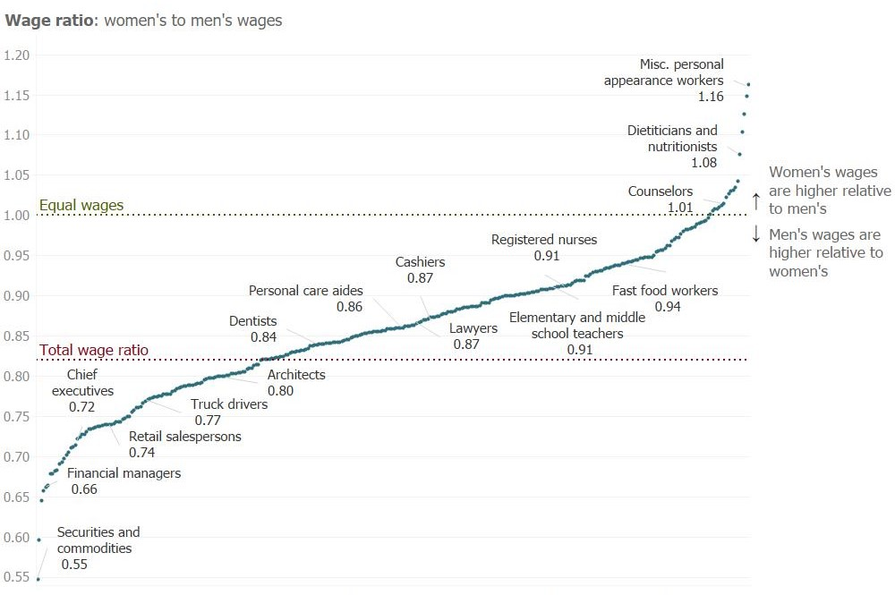
Raw Gender Wage Ratio by Occupation (ACS-IRS)
Source: American Community Survey (2015-2016) linked with IRS W-2s (2005-2016). Sample is limited to full-time, year-round civilian sector workers age 25 to 54. CBDRB-FY2019-CES005-002.

Slide 12
Experience and the Wage Gap (CPS-DER)
Years of Work Experience included in Decomposition
Source: Current Population Survey (2004-2013) linked with SSA-DER (1978-2012). Sample is limited to full-time, year-round civilian sector workers age 25 to 54. CBDRB-FY2019-461. Note: Decomposition also includes education, hours worked, age, metro status, region, race/ethnicity, industry, and occupation.

Slide 13
Experience and the Wage Gap (CPS-DER)
Years of Work Experience included in Decomposition
Source: Current Population Survey (2004-2013) linked with SSA-DER (1978-2012). Sample is limited to full-time, year-round civilian sector workers age 25 to 54. CBDRB-FY2019-461. Note: Decomposition also includes Age, Race/Ethnicity, Region, and Metro Status.

Slide 14
O*NET Characteristics and the Wage Gap (ACS-IRS)
Source: American Community Survey (2015-2016) linked with IRS W-2s (2005-2016). Sample is limited to full-time, year-round civilian sector workers age 25 to 54. CBDRB-FY2019-CES010-002. Note: Decomposition also includes Work History, Age, Race/Ethnicity, Education, Usual Weekly Hours, Industry, Region, and Metro Status.

Slide 15
Residual wage gaps by occupation
To better understand gaps within occupations, we run 316 occupation-specific decompositions and estimate each occupation’s residual gap
We find wide variation in residual wage gaps
In some occupations, all or nearly all of the gap is explained
In others, residual gaps in logged wages as large as 0.63 (or $1.88/hour in favor of men)
To what extent are O*NET characteristics associated with these residual gaps?
Predict residual gaps as a function of occupation characteristics

Slide 16
Occupation Characteristics and Residual Gaps
Source: American Community Survey (2015-2016) linked with IRS W-2s (2005-2016). Sample is limited to full-time, year-round civilian sector workers age 25 to 54. CBDRB-FY2019-CES005-002. Note: Residuals are obtained from 316 occupation-specific decompositions. Occupation characteristics are standardized to Mean = 0 and SD = 1.

Slide 17
Summary & Conclusions
Current wage gap is around 18%-20% at the median of the hourly wage distribution
Survey- and AR-derived hourly wage gaps are not significantly different from one another
Work history results show that we can explain more of the overall gap as we include longer histories, but the effects of other variables are robust
When facing trade-offs in publicly-available data, err on the side of more detailed industry/occupation categories

Slide 18
Summary & Conclusions
Gendered sorting into industries and occupations accounts for approximately one-third of the overall gap – a much larger share than work history
Wage gap varies significantly by occupation
While at parity in some occupations, others see gaps as large as 45%
Gap is larger than average in 19% of occupations, but smaller than average in 51% of occupations
Finance occupations are common among those with the largest wage gaps
Occupation-specific residual gaps vary widely
In some occupations, all or nearly all of the gap is explained
In others, residual gaps as large as 0.63 (or $1.88/hour in favor of men) exist

Slide 19
Summary & Conclusions
To some extent, the occupation effect is attributable to characteristics of occupations and not just sorting/segregation
Competition and hazards increase the gap
Autonomy and communication reduce the gap
“If one can isolate the features of occupations that have high and low residual differences by gender, one can figure out what factors make for more equal pay.” (Goldin 2014: 1102)
Residual gaps tend to be smaller in occupations requiring more communication and teamwork
Residual gaps tend to be larger in more hazardous occupations, and in occupations with disproportionate returns to overtime

Slide 20
Thank you! Questions/Comments? thomas.b.foster@census.gov Working Paper link: https://www2.census.gov/ces/wp/2020/CES-WP-20-34.pdf

