Slide 1
Patterns of Response During Covid-19 in a National Survey of Businesses: A Look at the Medical Expenditure Panel Survey – Insurance Component (MEPS-IC)
David Kashihara
Agency for Healthcare Research and Quality
FCSM Research and Policy Conference – November 2021

Slide 2
Disclaimer
The views expressed in this presentation are those of the author and no official endorsement by the Department of Health and Human Services or the Agency for Healthcare Research and Quality is intended or should be inferred.

Slide 3
Presentation Outline
Introduction to MEPS
Insurance Component (IC)
Background
Changes due to COVID-19
Survey Response
Response by survey characteristics
Summary
Moving Forward & Continuing Research

Slide 4
Medical Expenditure Panel Survey (MEPS)
Household Component (HC)
Annual survey of households
Survey administered by Westat
Medical Provider Component (MPC)
Sample of providers of services to HC respondents
Physicians
Hospitals
Home health agencies
Pharmacies
Administered by RTI International
Insurance Component (IC)
Annual survey of
Business establishments
State & local governments
Survey administered by the U.S. Census Bureau

Slide 5
Medical Expenditure Panel Survey Insurance Component (MEPS-IC)
Annual sample
Over 42,000 business establishments
Over 3,300 State & local governments
This presentation will only cover private sector (businesses) operations
National & State-level estimates
% of employers offering health insurance
# of enrolled employees
Average health insurance premiums, copays & deductibles

Slide 6
COVID and the MEPS-IC
Operations at time of Fed Gov’t Covid shutdown
Census Bureau’s National Processing Center (NPC) shut down on March 18, 2020
Sample being prepared
Research about to begin
Update contact information
Find contact within business to respond to the survey
Conducted by analysts at the NPC
Prescreener data collection operation ready

Slide 7
2020 MEPS-IC Survey Operations Summary of Covid Effects
Sample
Frame set in March
Sample drawn in April
No changes due to Covid
Research
Analysts update contact information for sampled businesses
Find best contact within the business to send the survey
Initially canceled; operation completed
Telephone Pre-screener
Determine if offer insurance. If no - end of survey
Initially delayed; operation completed
Added collection of email address for future web contacts

Slide 8
2020 MEPS-IC Survey Operations Summary of Covid Effects
Mail & Web
Survey forms mailed if offer insurance or nonresponse to pre-screener (primary option)
Web response option given in introductory letter of mailed survey forms packet & on first page of mailed survey form
Mail: canceled
Web: only response option
Survey shifted to web response as primary option
Paper forms mailed to some businesses once NPC re-opened
Mail response: 24.1% in 2019 → 10.5% in 2020
Web response: 37.8% in 2019 → 50.0% in 2020
Personal Visit
Very few – only for the largest-size non-respondents
No personal visits in 2020
Telephone Follow-up
For establishments with no response via mail or web
Extended field period to increase response

Slide 9
Covid and the IC: Issues & Concerns
Survey Operations
NPC shut down → no Research, Prescreener or Mailout operations
No contact information updates & no contact information for some businesses
Major data collection operations halted
Telephone interviewers not telework-ready
Telephone follow-up (TFU) operation may be overwhelmed (volume)
Skeleton staffing → capabilities & pace of operations compromised
Manual operations by Census NPC & HQ staffs
Survey Respondents
Certain industries may be severely affected
Certain regions or areas may be severely affected
Temporary & permanent business closures
Changes in business structure → furloughs, telework, etc.
Survey Challenges
Identifying business closures vs non-response
High unit non-response
May vary by industry, firm size & location
Quality of State-level estimates

Slide 10
MEPS-IC Private Sector Overall Response Rate

Slide 11
Data Collection: Prescreener
Prescreener Operation
Brief telephone interview
Determine offer insurance status
Yes: receive full survey (web & mail response options)
No: ask business characteristics questions & end survey
June 2020 – August 2020
Phone centers closed
Interviewers worked remotely for the first time

Slide 12
IC Prescreener Response Rates
Prescreener Response Rates
Decreasing, but relatively small change from 2018 to 2019
Year | 2018 | 2019 | 2020
Response Rate (%) | 58.6 | 54.8 | 44.9
# of Establishments | 39,487 | 39,315 | 39,426

Slide 13
IC Prescreener Response Rates
Prescreener Response Rates
2020 response rates decline in all NAICS-2 industries
Industries with lowest response rates include [NAICS-2]:
Agriculture, forestry, fishing, hunting [11]
Real estate [53]
Accommodation, food services [72]
Publishing, movies, broadcasting, telecommunications [51]
Year | 2018 | 2019 | 2020
Response Rate (%) | 58.6 | 54.8 | 44.9
# of Establishments | 39,487 | 39,315 | 39,426

Slide 14
2020 MEPS-IC Post-Prescreener Response
MEPS-IC private sector response
Preliminary high-level examinations
By industry
By type of firm (single unit vs multiunit)
By firm size
Overall response rates close to previous years
Response rates fairly consistent across subgroups of respondents
Response bias analyses in progress

Slide 15
MEPS-IC Response Rate By Industry (2-Digit NAICS)

Slide 16
MEPS-IC Response Rate By Type of Firm

Slide 17
MEPS-IC Response Rate By Firm Size

Slide 18
Response by Mode
Initial push during COVID to move the IC from a mail & web survey to a web-only survey
Census Bureau currently moving economic surveys to web-only format
Effects of promoting web response over mail
Data quality?
Bias?
Certain industries prefer mail response
Smaller firms prefer mail response

Slide 19
MEPS-IC Response Percentages by Mode

Slide 20
2019 & 2020 MEPS-IC Response Percentage by Mode & Firm Size

Slide 21
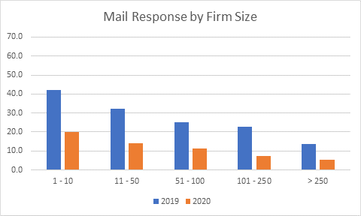
2019 & 2020 MEPS-IC Response Percentages by Mail & Firm Size

Slide 22
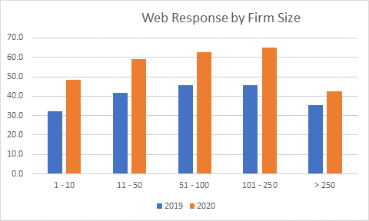
2019 & 2020 MEPS-IC Response Percentages by Web & Firm Size

Slide 23
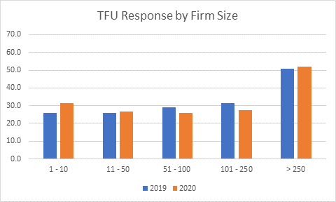
2019 & 2020 MEPS-IC Response Percentages by Phone & Firm Size

Slide 24
2019 & 2020 MEPS-IC Response Percentage by Mode & Firm Size

Slide 25
MEPS-IC Mail vs Web Response
Before 2020
Mail becomes steadily less popular as firm size increases
Mail only more popular than web for the smallest firms (1-10 employees)
Web more popular than mail for all other firm sizes
Data quality (Kashihara, 2019)
Better quality likely due to automated edits in web instrument
Web reporting issues include:
Internet access
Some respondents not computer savvy
Paper surveys preferred by some
During 2020
Web response more prevalent in all firm size categories
Mail becomes steadily less popular as firm size increases

Slide 26
Response Mode by Industry (NAICS-2)
Findings from an analysis of 2017 MEPS-IC data
Web response more popular than mail
Most industries
Mail response more popular than web
Agriculture, Forestry, Fishing & Hunting
Retail Trade
Warehousing & Storage
Other Services
Repair & Maintenance
Personal & Laundry Services
Etc.

Slide 27
Summary
Covid-based MEPS-IC disruptions in 2020
Survey operations
Sampled businesses
Overall private sector response rate
2019: 59.2%
2020: 56.3%
Response rate by industry, type of firm, firm size
Generally followed annual trends
Response by mode noticeably altered
Shift in primary survey mode: mail → web
Overall response rate relatively unchanged from 2019

Slide 28
Moving Forward
2021 Survey Operations
Data collection operations will be similar to 2020
Initial Mail
2019: letter & survey forms (paper response w/ web option)
2020: letter only (web response)
2021: letter only (web response)
Mail Follow-up
2019: follow-up letter & survey forms
2020: follow-up letter & survey forms
2021:
1st mail follow-up: follow-up letter & fact sheet
2nd mail follow-up: follow-up letter & survey forms

Slide 29
Continuing Research
2021 Research Projects
COVID survey questions
2020 MEPS-IC data quality analysis
2020 MEPS-IC bias analysis
Independent pilot study
5,000 establishments
Remove costly & time-consuming operations
No Research, Prescreener or TFU
Examine effects on estimates, response & bias

Slide 30
Contact Information
David Kashihara
Email: David.Kashihara@ahrq.hhs.gov
Thank You!

