Slide 1
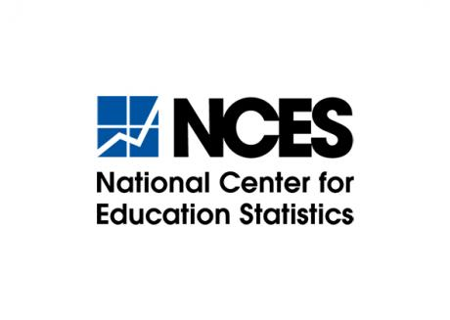



Sharing Sensitive Department of Education Data Across Organizational Boundaries Using Secure Multiparty Computation
NCES Project Report
Stephanie Straus, M.Ed., Georgetown University, Massive Data Institute
David Archer, Ph.D., Galois, Inc.
Amy O’Hara, Ph.D., Georgetown University, Massive Data Institute
Rawane Issa, M.S., Galois, Inc.

Slide 2
Background
Push for inter-agency data sharing
The Federal Data Strategy (FDS)
Foundations for Evidence-Based Policymaking Act of 2018 (H.R.4174)
Hampered by privacy policy, statute, agency practices
Current privacy approaches carry risks
Solution →
Privacy-Preserving Technologies
Secure Multiparty Computation (SMC)

Slide 3

Secure Multiparty Computation (SMC)
Subfield of cryptography
Joint computation of a calculation, among users with sensitive data
Performs computation while data remain encrypted
Only aggregate results are decrypted
Requires little to no hardware

Slide 4
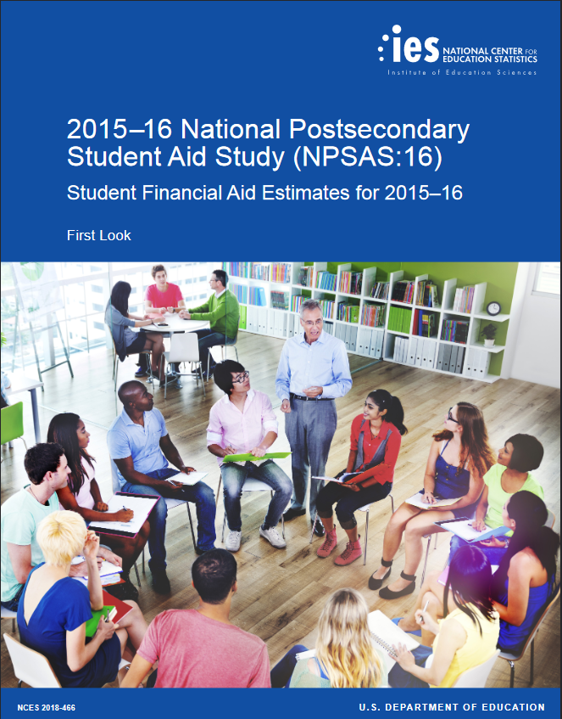

Slide 5
Current NPSAS Structure
National Center for Education Statistics
National Student Loan Data System
Attendance & Sampling weights
Loan balances &
Grant amounts
National
Post-Secondary Student Aid Study

Slide 6
Potential NPSAS Structure with SMC
National Center for Education Statistics
SMC
National Student Loan Data System
Encrypted Attendance & Sampling weights
Encrypted
Loan balances &
Grant amounts
Decrypted Results
National
Post-Secondary Student Aid Study

Slide 7
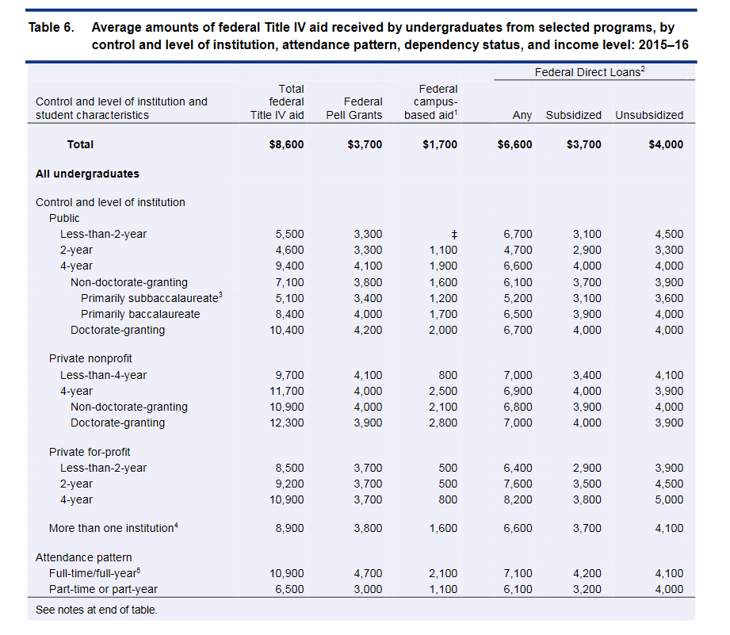
NPSAS:16 Table 6 - Excerpt

Slide 8
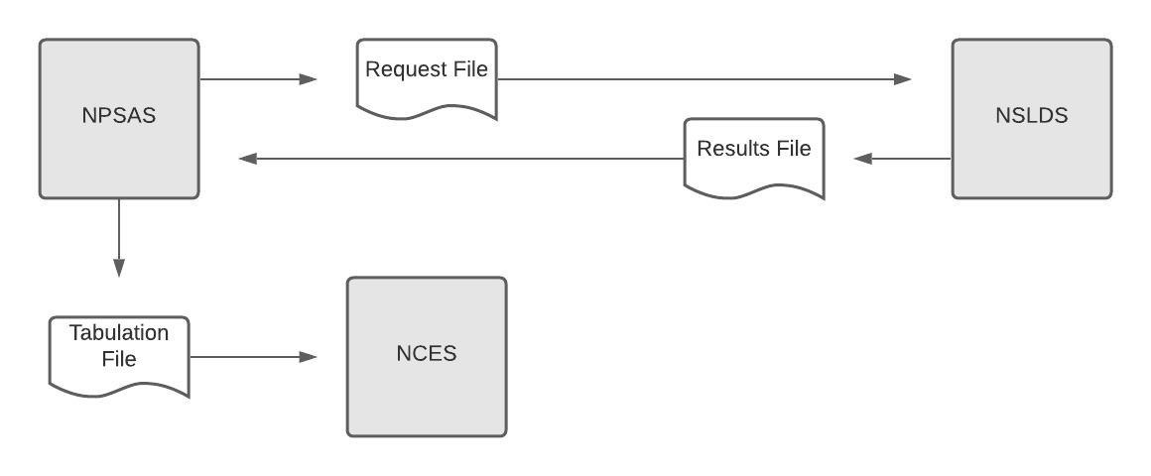
How NPSAS Table 6 is Constructed Today - A Non Privacy Preserving Approach

Slide 9
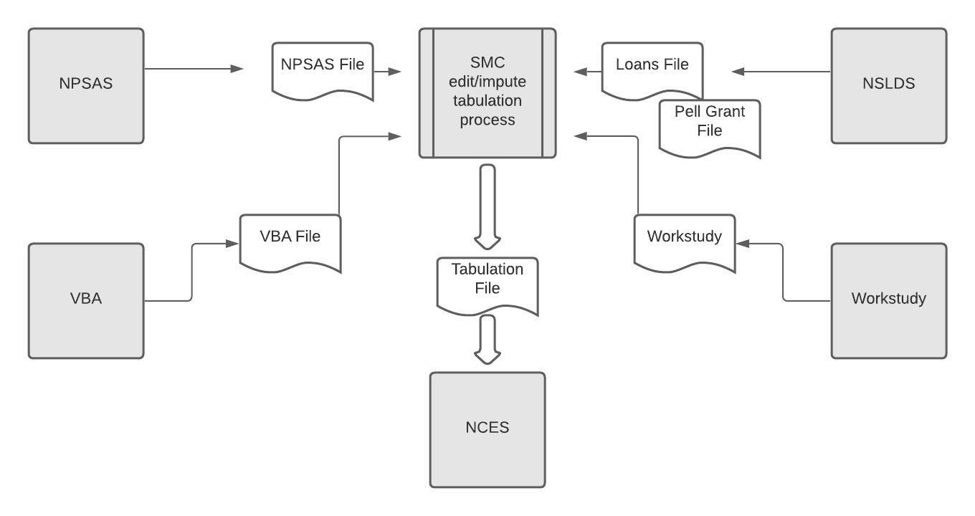
This Project: Privacy Preserving Computation Protocol
NPSAS “Trust” Zone
NSLDS “Trust” Zone

Slide 10
Demonstration Details
NCES Fellow Designation
Access to ED infrastructure
Uploaded 2 separate datasets, one per server
Simple command line interface
No “party” learns the other’s input
Aggregate results only revealed by SMC

Slide 11
NPSAS:16 Table 6 - Excerpt

Slide 12
Sample Results, Showing Output, Runtime, Data Sizes
 | Unsubsidized Federal Direct Loans Awarded
 | Ground Truth | Project Results
 | Avg. Loans ($) | Avg. Loans ($) | Runtime (s) | Records Merged
Total | 4000 | 4100 | 278 | 34040
Public: Less-than-2-year | 4500 | 4600 | 138 | 100
Public: 2-year | 3300 | 3300 | 137 | 1500
Public: 4-year | 4000 | 4000 | 145 | 8070
Non-doctorate-granting | 3900 | 4000 | 145 | 2330
Primarily subbaccalaureate | 3600 | 3700 | 145 | 1050
Primarily baccalaureate | 4000 | 4000 | 139 | 1280
Doctorate-granting | 4000 | 4000 | 138 | 5740
Private nonprofit: Less-than-4-yr | 4100 | 4200 | 139 | 520
Private nonprofit: 4-year | 3900 | 4000 | 137 | 5810
Non-doctorate-granting | 4000 | 4000 | 140 | 3090
Doctorate-granting | 3900 | 4000 | 144 | 2720

Slide 13
Summary
Successful interagency data sharing
Privacy-preserving
Accurate
Efficient computation and network costs
Cost-effective
Easy to use

Slide 14
Where To Go From Here?
First-of-its-kind demonstration
Some challenges remain:
Legal issues
IT/Technical issues
Regulatory issues
Routine use
Future demonstration projects

Slide 15
Thank You
stephanie.straus@georgetown.edu
See conference platform for technical paper.

