Slide 1
Building a Culture of Data Sharing at EPA
2021 FCSM Research and Policy Conference
November 3, 2021

Slide 2

Capture Hearts and Minds
We must capture the imaginations of people who manage and use data, at all levels, if we are going to achieve transformative, meaningful change in our collective use of data to address our biggest challenges.

Slide 3
Main Obstacles are not Technological
Core issues include lack of common agreement around
Statutory/regulatory hurdles (i.e., legal or policy)
Standards and requirements for data-sharing agreements
Transparency and standards for data quality and measurement
Ensuring proper data security and privacy

Slide 4
To Share or Not to Share: Why is the Question
Make our argument – Obvious reasons to share
Benefit for themselves, their group, the public, the environment…
Build better counter arguments – Reasons not to share
Data are classified or otherwise controlled
Data quality are not where we want them to be
Data quality are without reproach for one use, but not for all
Data are complex and would require significant explanation (context)
Politics can make sharing complex

Slide 5
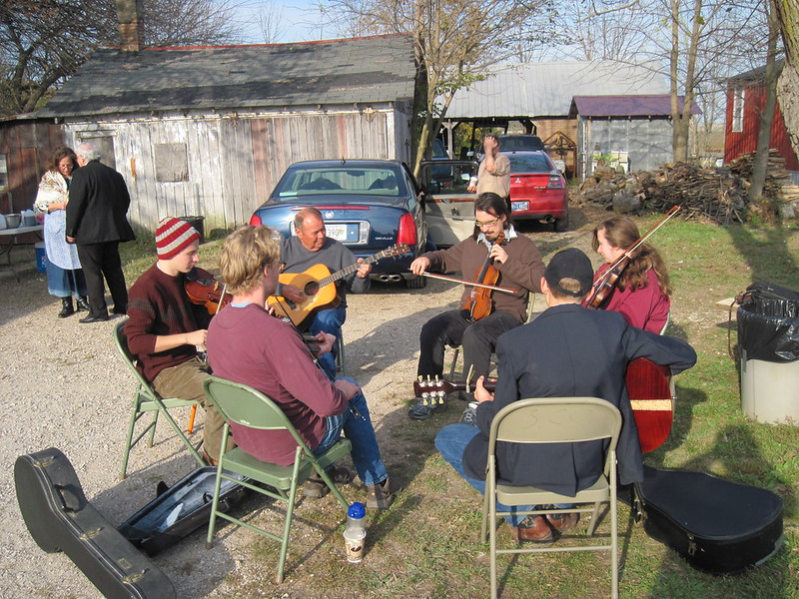
Working Across EPA to Address Data Culture
Talk to Everyone to Build Trust
Hold data focused discussions with every Agency component
Share results
Invite Everyone to Participate
Create broad cross agency communities
Work with peers and senior executive class
Listen to What the People Say
Vet priorities
Bring people on to help
Notes:
Microcosom

Slide 6
Focus on the People Need
Data Standards: Comprehensive approach for data standards
Data Quality: Comprehensive approach for better data quality
Data Governance: Policies, guidance, training
Data Management Resources: People and money
Awareness of Data: Better communication of data resources
Accessing Data: Permissions, technology, formats and standardization​
Integration of Data: Gaps in connecting data (programmatic & technical)
Coordination/Collaboration: Challenges across regions and program offices, with states, municipalities, and academics
Data Stewardship: Improved stewardship community
Data Skills: Training in collection, storage, interpretation, analysis
Data Security: Need for data management guidance on handling, protecting and transporting data

Slide 7
Foster Common Understanding through Standards
Standards – are highly domain and technology specific
Format
Definition
Structure
Metadata
Tagging
Transmission
Use
Management

Slide 8
Respect the Data but Drive at Purpose
Too often we become slaves to the data we manage
Too often we spend our max efforts on controlling the data
Look above the data to the people and their needs
These needs will inform us about data and its fitness for purpose
Quality
Standards
Utility
Other features specific to the intersection

Slide 9
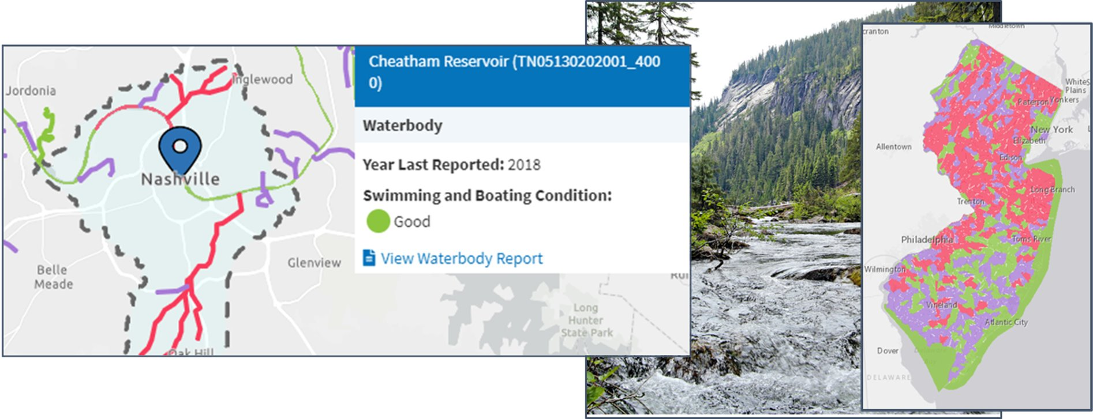
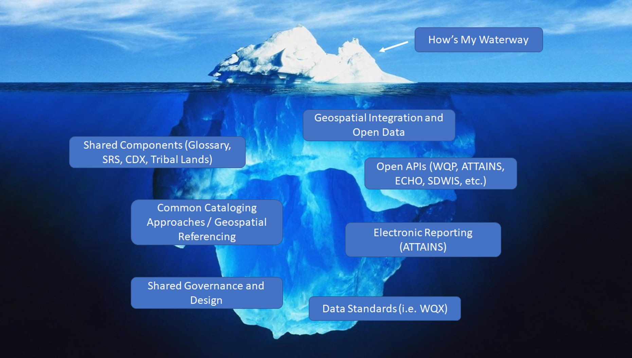
How’s My Waterway: Built on Data Sharing
All information is based on a service (API first)
Data standards matter
Integration of data across multiple systems
Shared ownership between states / tribes / EPA
User centered design
Code is reusable and publically available on GitHub

Slide 10
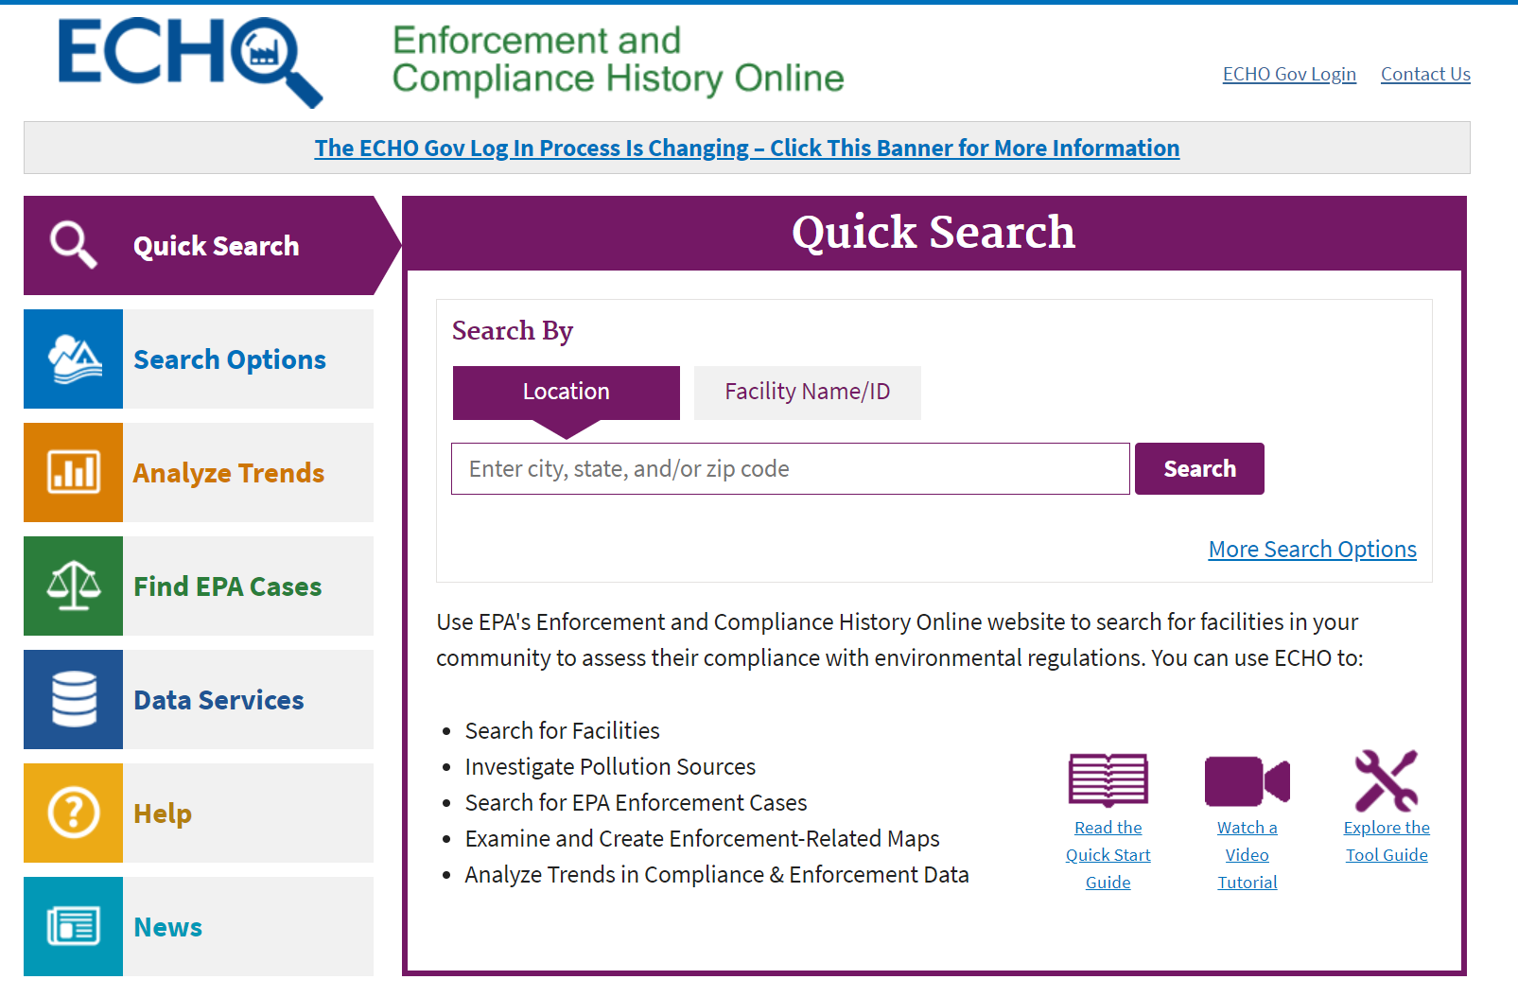
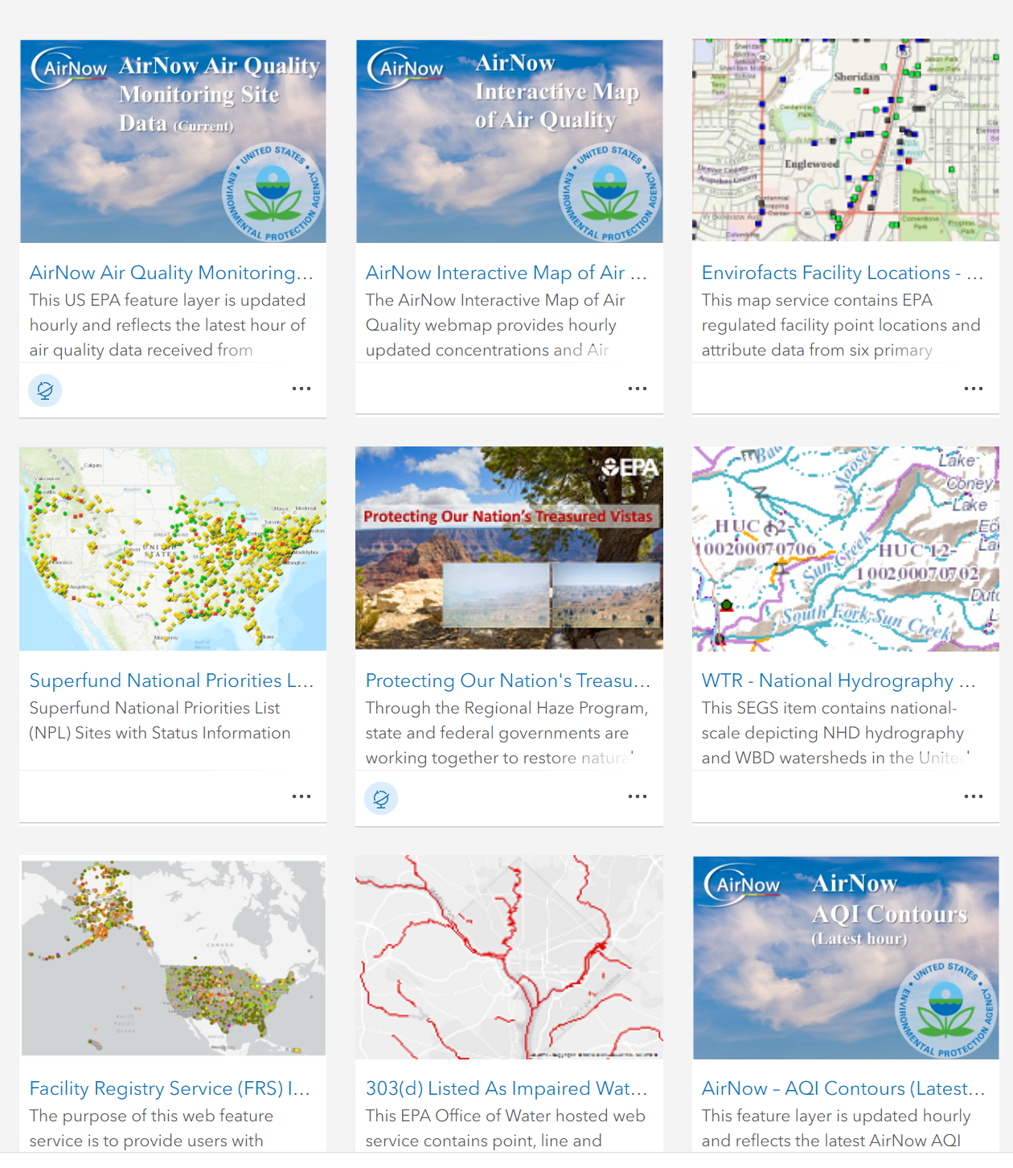
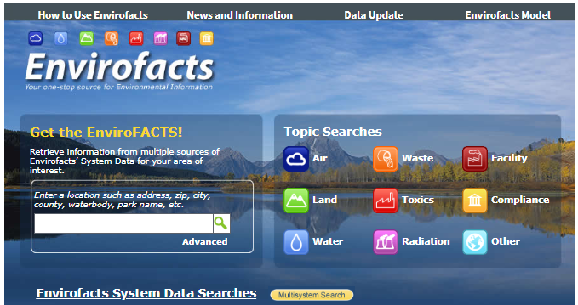
Data Warehouses, Portals and Platforms
ECHO - EPA GeoPlatform - Envirofacts
Provides public w/ points of access to combined information about environmental activities that may affect air, water, and land anywhere in the United States.
Suites of Web Tools
Emphasis on service enabled data flows

Slide 11

Vision of Future of Data Sharing at EPA
Data Management and Analytics Platform
supporting data and scientific projects across the agency
Shared and searchable Data Commons
data storage and discovery; well-governed format that is ready to use
Data hosting via Amazon Web Services
containerization (software/application bundling), serverless compute, and Internet of Things capabilities (sensors, networks)
Multiple analytics offerings
shared analytics notebooks, data visualization software (Qlik), GeoPlatform Online
+ Commercial Cloud Service Hosting
proposed sharing of large model data sets

Slide 12
Points of Focus
Communicate, communicate, communicate
Invite participation
Build a common understanding
Promote data sharing
Focus on larger needs not specifically data needs
Manage for data services and integration
Focus on people and build community

Slide 13
Thank you
Building a Culture of Data Sharing
Richard Allen
Chief Data Officer
US Environmental Protection Agency

