Slide 1
Examining Earnings of U.S. Physicians Using Tax Return Information
Federal Committee on Statistical Methodology: 2021 Research and Policy Conference
November 3, 2021
Presenter: Victoria Udalova, PhD, Senior Economist and Manager of the Enhancing Health Data (EHealth) program at the U.S. Census Bureau
Disclaimer: Any opinions and conclusions expressed herein are those of the presenter and do not necessarily reflect the views of the U.S. Census Bureau. All results were approved for release by the Census Bureau’s Disclosure Review Board, authorization numbers CBDRB-FY19-241, CBDRB-FY19-248, CBDRB-FY19-277, CBDRB-FY19-327, CBDRB-FY19-278, CBDRB-FY20-078, CBDRB-FY2020-CES005-015, CBDRB-FY20-177, CBDRB-FY2020-CES005-019, CBDRB-FY2020-CES005-024, CBDRB-FY2020-CES010-016, CBDRB-FY2020-CES005-035, CBDRB-FY2020-CES005-037, CBDRB-FY2020-CES010-021, CBDRB-FY20-349.

Slide 2
Acknowledgements
Enhancing Health Data (EHealth) team at the U.S. Census Bureau
Results are from my paper titled “Who Values Human Capitalists’ Human Capital? The Earnings and Labor Supply of U.S. Physicians” jointly with Joshua Gottlieb (University of Chicago), Maria Polyakova (Stanford University), Kevin Rinz (U.S. Census Bureau), and Hugh Shiplett (University of British Columbia) (https://www.census.gov/content/census/en/library/working-papers/2020/adrm/CES-WP-20-23.html)

Slide 3
Enhancing Health Data at the Census Bureau
Enhancing Health Data (EHealth) is a research program that identifies opportunities to enhance health records with existing survey and administrative records data available at the Census Bureau
Our team links multiple data sources to create new data products and conduct research aimed at improving measurement of patient and provider characteristics

Slide 4
Developing Provider-Business Linkage Framework
Goal is to develop a new framework for linking multiple existing data sources on healthcare providers and their places of employment
Better understand the structure of the U.S. healthcare system and where healthcare providers are employed and located
Produce new data products on characteristics of healthcare providers and businesses
Create gold-standard survey frame of healthcare providers and businesses
Initial focus is on physicians and their employers
Attach additional physician characteristics from Census and IRS data: race/ethnicity, employment status, earnings
Identify physicians’ employers from the IRS tax filings data
Attach additional employer characteristics from Business Register and Economic Census: industry, employer size/age, payroll, geography, legal form of organization, ownership, revenue/expenses

Slide 5
Developing Provider-Business Linkage Framework
Goal is to develop a new framework for linking multiple existing data sources on healthcare providers and their places of employment
Better understand the structure of the U.S. healthcare system and where healthcare providers are employed and located
Produce new data products on characteristics of healthcare providers and businesses
Create gold-standard survey frame of healthcare providers and businesses
Initial focus is on physicians and their employers
Attach additional physician characteristics from Census and IRS data: race/ethnicity, employment status, earnings
Identify physicians’ employers from the IRS tax filings data
Attach additional employer characteristics from Business Register and Economic Census: industry, employer size/age, payroll, geography, legal form of organization, ownership, revenue/expenses

Slide 6
Restricted NPPES Data at the Census Bureau
National Plan and Provider Enumeration System (NPPES) - registry of all healthcare providers and organizations with a National Provider Identifier (NPI)
Under agreement with the Centers for Medicare & Medicaid Services (CMS) (PI: Udalova)
Personally Identifiable Information (PII) is used to assign internal anonymized Census Bureau linkage keys, Protected Identification Keys (PIKs)
Cumulative list of all providers with an NPI who were active on April 28, 2018 (the date of the current NPPES pull)
Type 1 providers are individuals (physicians, nurse practitioners, etc.)
Type 2 providers are organizations (hospitals, clinics, etc.)
PIKs/NPIs allow for linkages across person-level data sources
EINs allow for linkages across business-level data sources

Slide 7
This Project’s Objectives
Describe physician earnings and compare to survey data
Existing evidence relies on survey data with many measurement challenges
Determine what influences physician earnings
Examine how physician earnings affect labor supply
Observe direct labor supply measures
Why you should care:
Survey measurement of top-earning occupation (issues of top-coding and complicated income structures)
Growing income inequality, physicians common in top 1%
Spending on physician services is 20% of U.S. healthcare spending

Slide 8
This Project’s Objectives
Describe physician earnings and compare to survey data
Existing evidence relies on survey data with many measurement challenges
Determine what influences physician earnings
Examine how physician earnings affect labor supply
Observe direct labor supply measures
Why you should care:
Survey measurement of top-earning occupation (issues of top-coding and complicated income structures)
Growing income inequality, physicians common in top 1%
Spending on physician services is 20% of U.S. healthcare spending

Slide 9
Data
NPPES data to identify physicians
Merge NPPES with universe of individual federal income tax returns (Forms 1040/1099-SSA/W-2)
W-2s from 2005–2017, aggregated across EINs
Location – state and county of residence
Panel income data
Merge with Census Numident data to add date of birth, date of death, and sex
Merge with Census Bureau’s American Community Survey (ACS) responses
Self-reported occupation (physicians) and income

Slide 10
How are Physicians Paid in the U.S.?
Complicated; well studied from the payer perspective (fee for service, capitation, etc.)
Not a lot of work on physicians’ personal earnings sources
Physician incomes come through a diverse and changing mechanisms
best studied using tax data
3 common payment models:
Model 1 – employed physicians with only W-2 income (common in large organizations such as academic medical centers)
Model 2 – only sole proprietorship income on Form 1040’s Schedule C
Model 3 – hybrid, includes pass-through entity, usually S-corporation or partnership (W-2, Form 1040’s Schedules E and K-1)
Important to capture both wages and business income

Slide 11
Income Measures from Tax Data
Wages from IRS Form W-2
Business income = Adjusted Gross Income (AGI) minus W-2 wages, taxable interest, dividends, Social Security
Total professional earnings = wages + business income

Slide 12
Establishing Basic Facts About Physicians’ Earnings
Our baseline sample in 2017 = 863,000 physicians
Mean earnings in 2017 = $344K/year
Median earnings in 2017 = $255K/year
Physicians’ personal incomes account for 8.5% of U.S. total health spending

Slide 13
High Earnings and Steep Life-Cycle Profile
Source: Authors’ calculations based on NPPES (2018), IRS tax returns (2005-2017), and Census Numident (2018).

Slide 14
One Quarter of Physician Households are in Top 1%
Source: Authors’ calculations based on NPPES (2018), IRS tax returns (2005-2017), and Census Numident (2018).

Slide 15
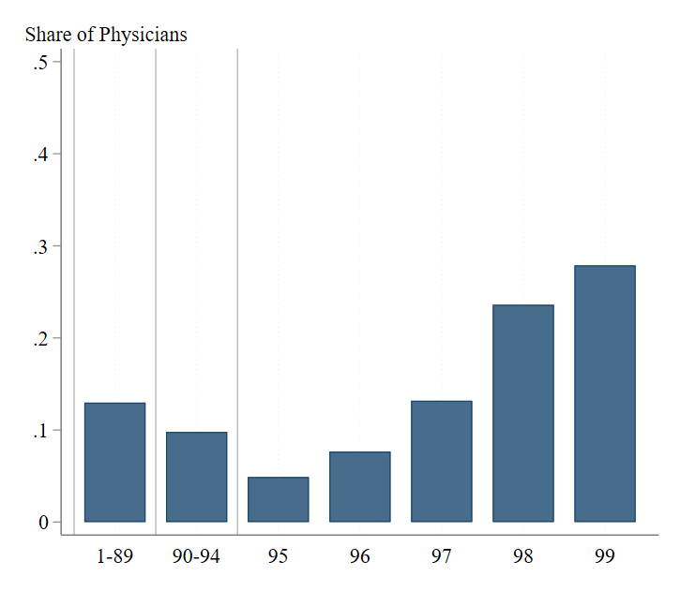
Location of Physician Households in the U.S. Income Distribution
Half of physician households are in the top 2% of the U.S. income distribution
Significant variation by specialty (50% of surgeons vs. 14% of primary care physicians are in the top 1%)
Source: Authors’ calculations based on NPPES (2018), IRS tax returns (2005-2017), and Census Numident (2018).

Slide 16
Top Earners Among Physicians
Average earnings of the top 1% of physicians is $3.9 million annually
12 times the average annual earnings across all physicians
Business income is crucial for the top 1% of earners
91% of these physicians report large business income (compared to 32% among all physicians)
78% of these physicians’ income is business income (compared to 32% among all physicians)
Top earners are more likely to be in high-paying specialties

Slide 17
Importance of Business Income:
Only 68% of Income Reported on W-2
Source: Authors’ calculations based on NPPES (2018), IRS tax returns (2005-2017), and Census Numident (2018).

Slide 18
Substantial Heterogeneity Across Physicians
Source: Authors’ calculations based on NPPES (2018), IRS tax returns (2005-2017), and Census Numident (2018).

Slide 19
Substantial Heterogeneity Across Physicians
Across specialties (primary care physicians $243K, surgeons $500K+)
Time
Space
Source: Authors’ calculations based on NPPES (2018), IRS tax returns (2005-2017), and Census Numident (2018).

Slide 20
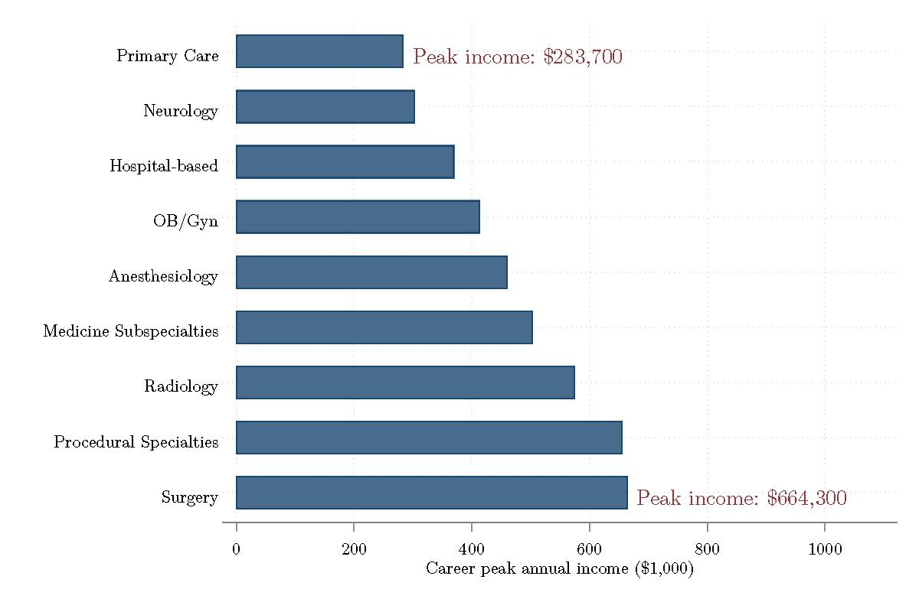
Peak Age (45-50) Annual Earnings by Specialty
Earnings across specialties can be explained by training length and work hours
But there are some exceptions: for example, radiologists earn nearly twice as much as neurologists despite working fewer hours
Source: Authors’ calculations based on NPPES (2018), IRS tax returns (2005-2017), and Census Numident (2018).

Slide 21
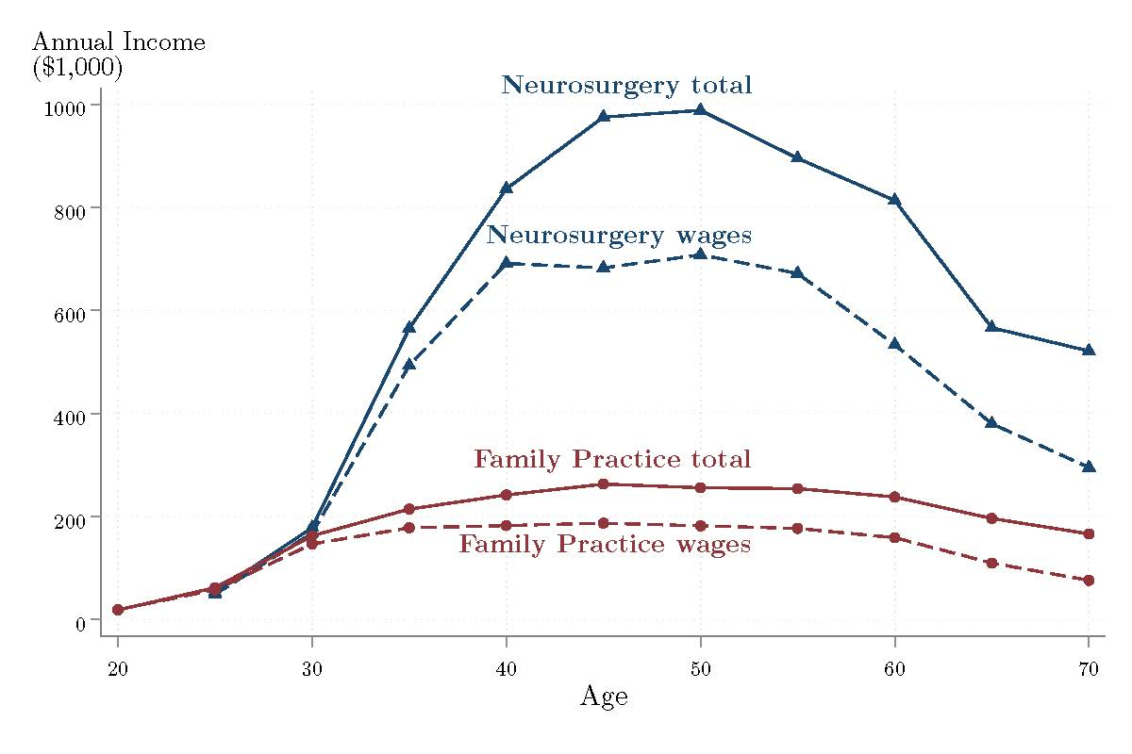
Average Annual Income for Top and Bottom Earning Specialties
Source: Authors’ calculations based on NPPES (2018), IRS tax returns (2005-2017), and Census Numident (2018).

Slide 22
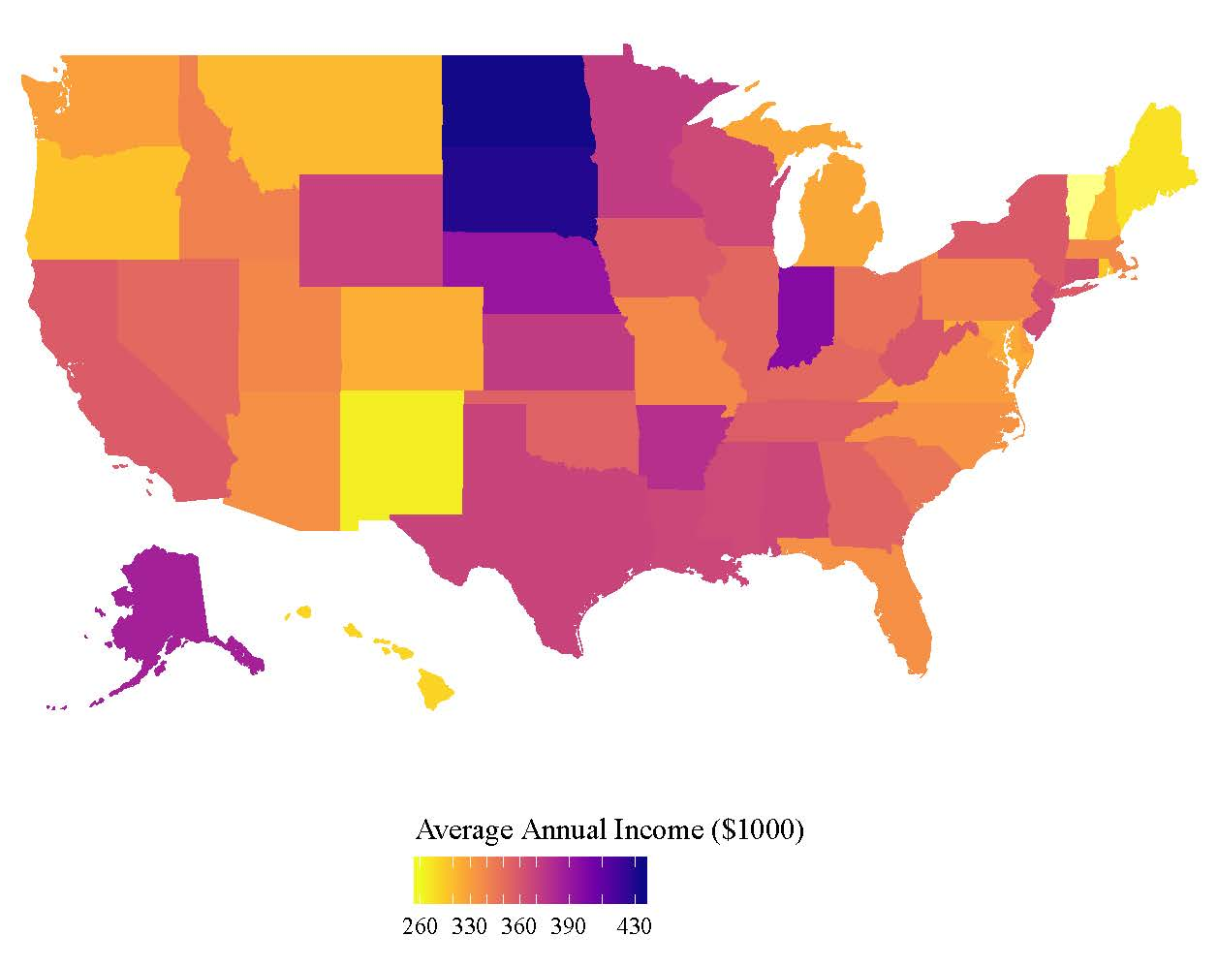
Variation in Mean Earnings Across States
Highest average physician earnings are not in states with the highest incomes for other workers, highest costs of living, or productivity
Source: Authors’ calculations based on NPPES (2018), IRS tax returns (2005-2017), and Census Numident (2018).

Slide 23
Growth in Mean Earnings Over Time
Source: Authors’ calculations based on NPPES (2018), IRS tax returns (2005-2017), and Census Numident (2018).

Slide 24
Administrative vs. Survey data (Same Physicians)
Source: Authors’ calculations based on NPPES (2018), ACS (2001-2017), IRS tax returns (2005-2017), and Census Numident (2018).

Slide 25
Administrative vs. Survey Data (Same Physicians)
Mean earnings for the same physicians: $362K (tax data) vs. $237K (ACS)
During physicians’ most productive years, age 40-55, ACS underestimates annual income by about $130,000-$150,000
Represents about a third of physicians’ average annual earnings
The difference between the two measures is driven by fewer physicians reporting any business income in the survey data
Average wages are similar between tax and survey data
Self-employment income is substantially lower in ACS
Only 20% of physicians report positive self-employment income in ACS, while according to tax data 76% have positive business income

Slide 26
Conclusion
Underreporting of income in survey data, especially business income of top earners
Tax records allow for new, more granular estimates
Tax records along with Census and CMS administrative records can be used to describe the complexities in organizational and employment arrangement of healthcare providers

Slide 27
Thank you!
For more information about this project and to access the research paper:
https://www.census.gov/programs-surveys/ehealth/information/examining-earnings.html
For more information about other EHealth projects: https://www.census.gov/programs-surveys/ehealth.html
Victoria Udalova, PhD
Senior Economist
Manager of the Enhancing Health Data (EHealth) program
U.S. Census Bureau
victoria.m.udalova@census.gov
301-763-7101

