Slide 1
Recruiting a probability sample of 18 year olds for a longitudinal study on interpersonal violence
David Cantor and Reanne Townsend
Westat
November 3, 2021

Slide 2
Background
Young adults are a population of interest for many different topics, including victimization, smoking, drug use and other risky behaviors.
They are also difficult to survey because they are highly mobile, are hard to contact and generally not highly motivated to participate in surveys.
To study many outcomes of interest, a large sample is required.
For this study: Research questions include risk of interpersonal violence for those in post secondary school and those that are not in school.
Start with a cohort of 18 year olds and follow them for 4-6 years.

Slide 3
National Study of Young Adults
Longitudinal pilot study sponsored by the National Institute of Justice
Collaborative effort between Westat, New York University, and Dr. Bonnie Fisher (University of Cincinnati)
Push-to-web design to recruit young adults into the study
Longitudinal studies of young adults on other topics have found promising results with push-to-web designs (e.g. Cantrell et al 2018).
Even with push-to-web design, finding and contacting 18 year olds can be very expensive (2% of population)

Slide 4
Research Questions
Can a general population of 18 year olds be successfully recruited for a panel study using a push to web design?
Overall response and retention rates
What are the social and demographic profiles?
What level of incentives work to maximize response rate?
Does gamefication work to recruit this population?

Slide 5
Sample design
Started with an address based sample (ABS) of all households in the US.
National sample frame was supplemented by a list of high school seniors purchased from ASL marketing
ASL list included date of birth and gender
Excludes non-students (e.g. dropouts)
The ASL list was matched to a general population ABS sample and used to stratify the sample.

Slide 6
Sample design
Heavy oversample of matched group.
Oversample was done as part of Pilot to maximize returns for later analysis
 | General population sample | Percent of general population sample | Final sample of addresses | Percent sampled
Matched to list | 15,510 | 1.5% | 6,549 | 42.2%
Unmatched to list | 1,005,877 | 98.5% | 7,500 | 0.7%
Total sample | 1,021,387 | 100.0% | 14,049 | 1.4%

Slide 7
Recruitment process overview
Invitation mailed to sampled households in the Spring 2019
Sampled person goes to study website and enters access code
Person enters date of birth to confirm age, and completes the recruitment survey
Nonresponders are given option to complete survey by mail on the fourth contact
After submitting the web survey, respondents land on a personalized study homepage, with study info and a dashboard tracking study activities.
Starting in Fall 2019, qualified respondents are invited to subsequent data collections (wave 1, micro-assessments, wave 2)

Slide 8
Experimemts
 | Recruitment Survey |  | Wave 1 | Wave 2 | Micro-Assessments | Gamefication
 | Survey | Early Bird
$20 vs. $30 | x
$0 vs. $10 |  | x
$40 vs. $60 |  |  | x | x
(No Micro) vs. (Biweekly) vs. (Monthly) |  |  |  |  | x
(No Game) vs. (Game) vs (Game with $) |  |  |  |  |  | x

Slide 9
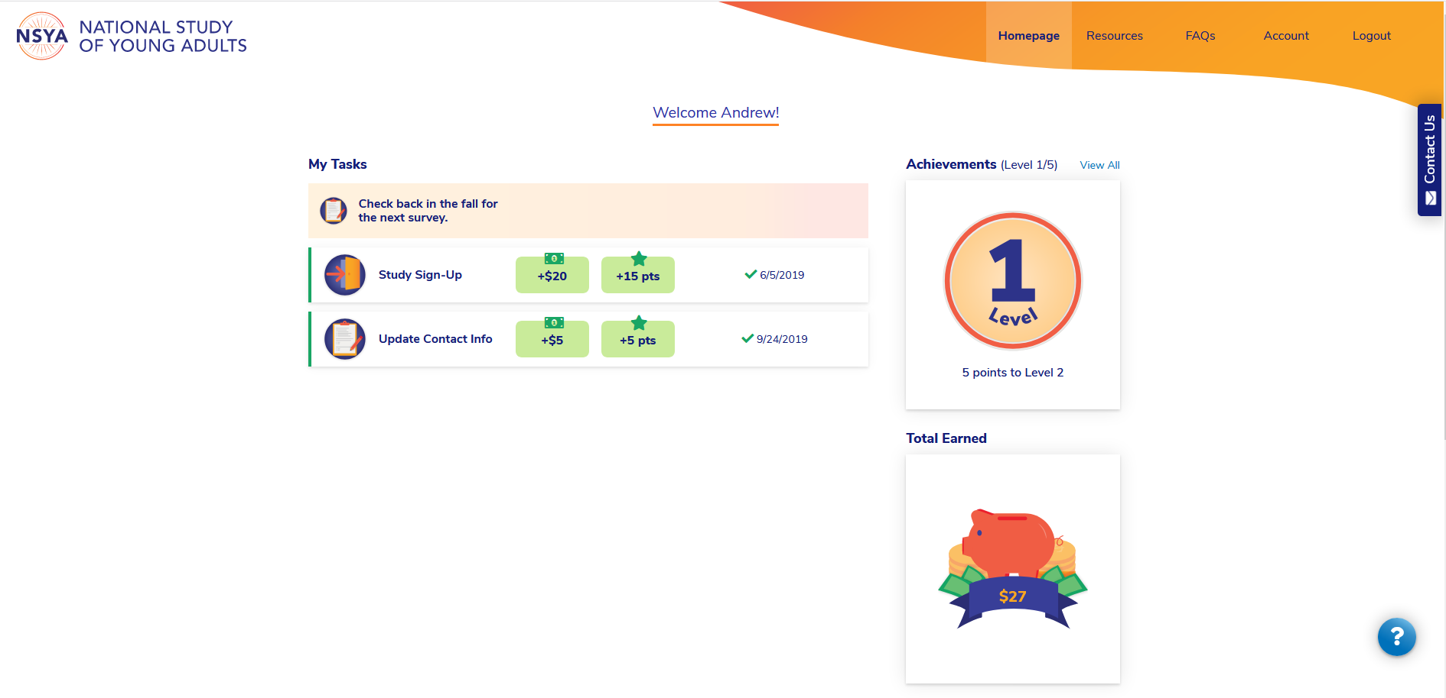
Study website

Slide 10
Recruitment results
Highest yield rate for matched sample
Unmatched rate is close to percentage of 18 year olds in the population
Group | Initial sample | Recruitment responses | Yield rate
Matched | 6,549 | 1,759 | 26.9%
Unmatched | 7,500 | 163 | 2.2%
Total ABS records | 14,049 | 1,922 | 13.7%

Slide 11
Estimated percent of 18 year olds responding to recruitment, wave 1 and wave 2
Approximated a response rate by using the base-weighted totals for 18 year olds and divided it by the number of 18 year olds in the country.
Estimated number of 18 Year represented and response ratio
 | Base Weighted Number of 18 year olds | Response ratio
Recruitment Survey | 2,336,198 | 55%
Wave 1 | 1,667,594 | 39%
Wave 2 | 1,472,485 | 34%
+ Response ratio = Base weighted total divided by total number of 18 year olds in the US.

Slide 12
Socio-Demographic representation of recruitment and Wave 1 respondents (base-weighted)

Slide 13
Retention of respondents by wave by School attendance in last 3 months at time of recruitment (base-weighted)
Percent of Wave 1

Slide 14
Retention of respondents by wave by whether ever been victim of stalking at time of recruitment (base-weighted)

Slide 15
Wave 2 retention rates by micro-assessment experimental condition by whether or not base weights are applied

Slide 16
Results of incentive experiments
 | Yield Rates
Recruitment
$20 | 12.6
$30 | 13.4
Early Bird
$0 | 13.3
$10 | 12.7
Wave 1
$40 | 61.7
$60 | 67.4
Wave 2
$40 | 90.4
$60 | 91.4
None of the incentive experiments found a difference between incentive conditions
Some suggestion that Wave 1 experiment result in higher rate, but not significant.

Slide 17
Results of experiment with gamefication
Percent Responding
Avg # Completed

Slide 18
Summary
Overall recruitment was successful.
Approximation of response rate was respectable (55% and 39%).
There was good representation of key populations, with exceptions
Retention rate between waves was good
Young adults respond well to incentives. Lower amounts work well.
Basic points and badges related to gamefication strategies did not significantly increase participation
Micro-assessments had very high response rate. They did not affect the response rate at wave 2.

