Slide 1

Comparative Analysis of Differential Privacy and Swapping Methods In The Context of The U.S. Census
Miranda Christ* & Sarah Radway^
Steven M. Bellovin*
*Columbia University, ^Tufts University

Slide 2
Roadmap
Background
What are swapping and DP? Why is privacy important?
Theoretical results
In a theoretical model, how do we expect swapping to behave?
Experimental approach
Our method for empirically comparing swapping and DP
Experimental findings
For swapping, good privacy means poor accuracy, especially for diverse counties. DP performs better across varying diversity levels.

Slide 3
Background

Slide 4
Background: Census
U.S. Decennial Census: Demographic info collected every 10 years
Data uses: redistricting, funding decisions (Medicaid, Head Start, SNAP, more…)
Statutory Requirement (13 U.S.C. §9(a)(2)): Census data must not be personally identifiable
Furthermore, lack of privacy may hurt participation and thus accuracy
In 2010, data was de-identified using swapping
In 2020, data was de-identified using differential privacy
How can we balance data utility and privacy?
Notes:
The U.S. Decennial Census occurs every 10 years and involves collecting demographic information pertaining to Americans such as age, sex, and race. This data is used for a variety of important decisions, including redistricting and allocation of funds in programs such as Medicaid. The U.S. Census Bureau is statutorily mandated to ensure that this data is not personally identifiable. This privacy is important for accuracy as well– a lack of privacy may hurt participation and thus accuracy. In 2010, the Census Bureau de-identified its data using swapping. In 2020, it used differential privacy. In both of these methods, higher accuracy comes with lower privacy.
Given the importance of both accuracy and privacy in census data, this begs the question: how can we balance data utility and privacy?

Slide 5
Swapping
Exchange of data about individuals between groups, in order to de-identify
Swap selection can be random or based upon a threshold of similarity
swap rate: proportion of
data to be swapped
Prioritizes unique entries
Notes:
Swapping, the de-identification method used by the Census Bureau in 2010, involves the exchange of data about individuals between groups. In the figure on the right, the green house in the bottom group is being swapped with the yellow house in the top group.
When we swap the green house and the yellow house, we exchange some subset of their data. For example, we may swap their ages and races.

Slide 6
Differential Privacy
Add random noise (parametrized by ε) to make dataset private
Usually mean 0 noise, with variance depending on ε
Privacy guarantee: changing one person’s data only changes the de-identified data by “a little bit”
“A little bit” depends on ε
Lower ε: lower accuracy; higher privacy. Higher ε: higher accuracy; lower privacy
Age range | Sex | Race | Pop. count
15-30 | F | White | 126
30-45 | M | Asian | 89
... | Pop. count
... | 131
... | 83
add noise
Notes:
Differential privacy, the de-identification method used by the Census Bureau in 2020, involves adding random noise parametrized by a variable epsilon to counting queries over a dataset. This random noise usually has mean 0, with variance depending on epsilon. If the noise is structured a certain way, we can achieve a mathematical privacy guarantee known as differential privacy. This means that changing one person’s data only changes the de-identified data by “a little bit,” where “a little bit” depends on epsilon. The figure below shows an example of a DP algorithm operating on demographic data. On the left, we have a table with the population counts of various groups. The first group has age range 15-30, sex F, race White, and population count 126. The de-identified data for this subgroup has count 131. Here, the DP mechanism adds small random noise. These de-identified counts are close to the true counts, but far enough to prevent learning about any individual.
There is a clear tradeoff between accuracy and privacy, parametrized by epsilon. Lower epsilon means lower accuracy and higher privacy, whereas higher epsilon means higher accuracy and lower privacy.

Slide 7
Controversy and Context
Privacy Concerns
Researchers reconstructed 46% of (swapped) 2010 census data
Accuracy Concerns
Effect of DP on minority groups and small towns
National Congress of American Indians
Utility of DP for redistricting (Alabama v. U.S. Dept of Commerce)
Court case brought by Alabama arguing that DP-produced data is too inaccurate
Privacy and Accuracy Concern: How should the epsilon value be chosen for the Census Bureau’s DP implementation (TopDown Algorithm)?
Notes:
Be up to date on alabama (possibly new) case
Report published by NCAI
Just say court case not district court case
We especially focus on minority groups
There is ongoing debate surrounding the Census Bureau’s recent decision to switch from swapping to differential privacy. On one hand, the privacy provided by swapping has been shown to be insufficient. Researchers at the census bureau were able to reconstruct 46% of 2010 census data, which was de-identified using swapping. On the other hand, there are numerous concerns about the accuracy of differential privacy. We were especially interested in addressing a concern raised in a report published by the National Congress of American Indians about the effect of DP on minority groups and small towns. You’ll see later that we designed our experiments with underrepresented minorities in mind. The accuracy of DP has also been questioned in its use for redistricting; this is the focus of a court case brought by Alabama against the U.S. Dept of Commerce.
In addition to these privacy and accuracy issues, there is concern about how the epsilon value of the census bureau’s DP mechanism should be chosen to satisfy both privacy and accuracy needs.
We work towards better understanding these issues by analyzing the privacy and accuracy of DP and swapping.

Slide 8
Our Approach
Two flavors of analysis:
Theory
Analyze how we expect swapping to behave
Not implementation dependent; results generalize beyond the U.S. census
Experiments
Recreate census-like data and simulate their swapping and DP algorithms
Compare the accuracy and privacy of DP and swapping
Notes:
“Filling in a gap of communication”
Mention that CB can’t publish swapping implementation bc of privacy concerns

Slide 9
Theoretical Results

Slide 10
Theoretical Results
For swapping: if a subpopulation differs more from global pop., then there is a higher expected error for counting queries
This expected error increases further as swap rate increases
Generally: smaller, more diverse subpopulations have exponentially more unique entries than larger or more homogeneous subpopulations
higher expected error
lower expected error
Notes:
This means that we expect that:
Under-representation created by swapping should be more extreme in subpopulations with more different race distributions (compared to US distr.)
Swapping methods that prioritize unique entries will result in further accuracy degradation in minority subpopulations
These are theorems! With proofs

Slide 11
Experimental Approach

Slide 12
Synthetic Data
Why do we need synthetic data?
Census data releases de-identified query data, not true data
How did we make our synthetic data?
Used de-identified 2010 US Census block group data
Fit true distribution for sex, age, household size & tenure
Used exact de-identified data for race (to represent minorities effectively)
Age | Sex | Race | Household Size | Household Tenure

Slide 13
Method & Metrics
Method: Replications of Swapping and DP algorithms to the best of our ability
Why? Swapping algorithm can’t be disclosed, DP algorithm is too expensive
Several implementations (swapping similarity thresholds & DP-buckets) of each algorithm for comprehensiveness
Metrics: For minority and overall population representation
Accuracy: two metrics that show minority and overall representation
Privacy: Linkage attack with public dataset
Notes:
Explain threshold and group size

Slide 14
Experimental Findings

Slide 15
DP Privacy
Why is it hard to directly compare privacy of DP and swapping?
DP: Provides privacy guarantee, can only learn about the group
“I know that most people with the zip code 10027 were white. Because your zip code is 10027, you are probably white.”
Swapping: Does not provide privacy guarantee
“I see that there is only one person with a zip code of 10027 in both datasets. Thus, if your zip code is 10027, this must be your data, and you must be white.”
Privacy attacks of this type fundamentally CANNOT WORK against DP

Slide 16
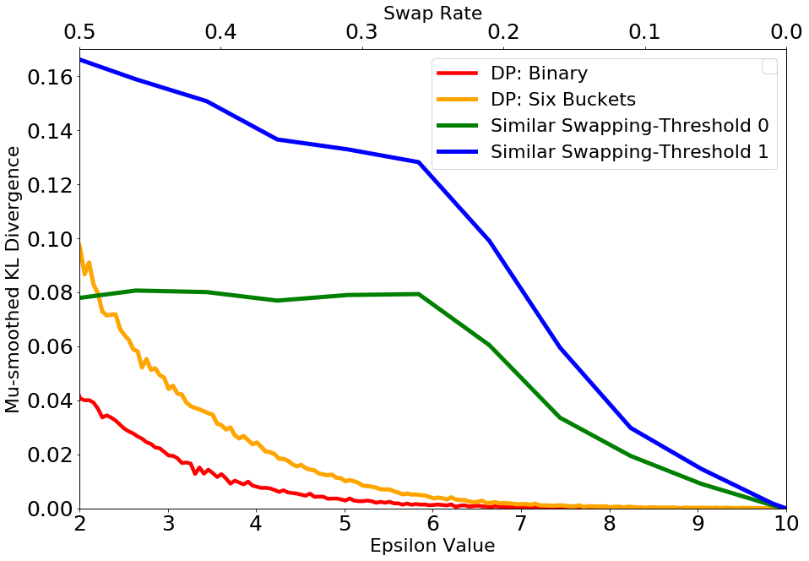
Breaking Down The Figures
X-axes: de-identification mechanism metrics
L → R represents most → least private
Y-axis: represents accuracy (or privacy)
Closer to 0 represents better accuracy (or privacy)

Slide 17
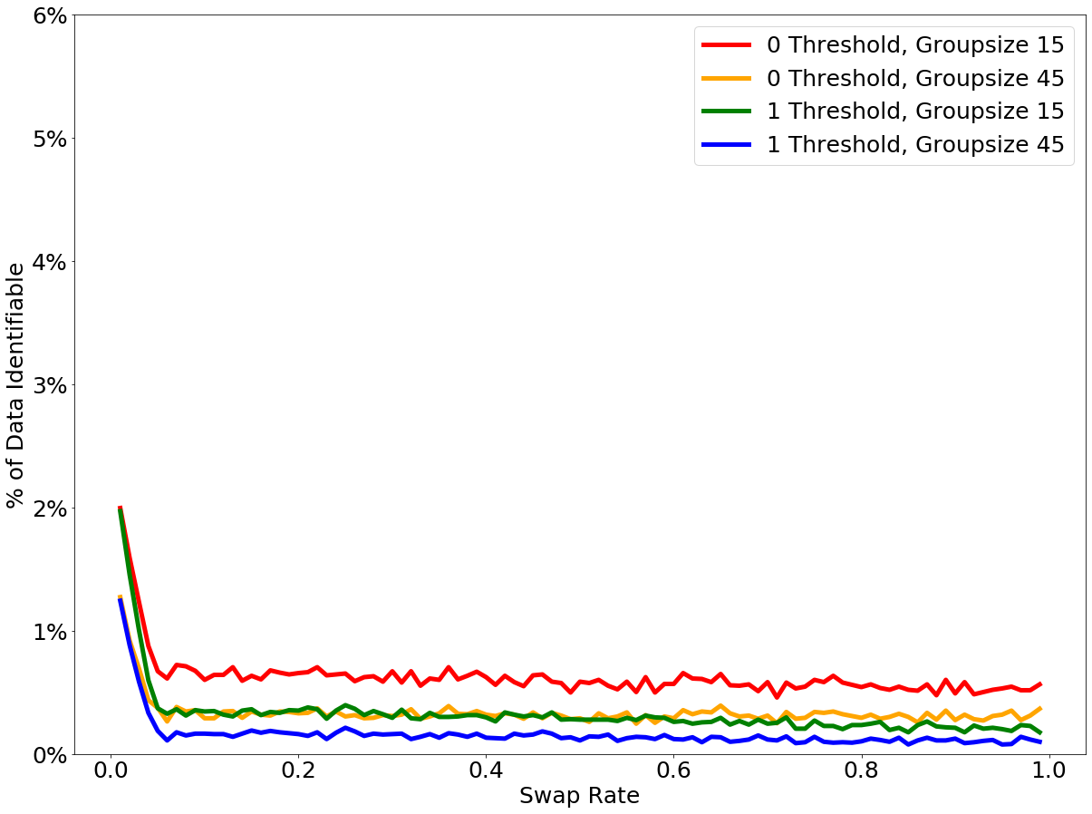
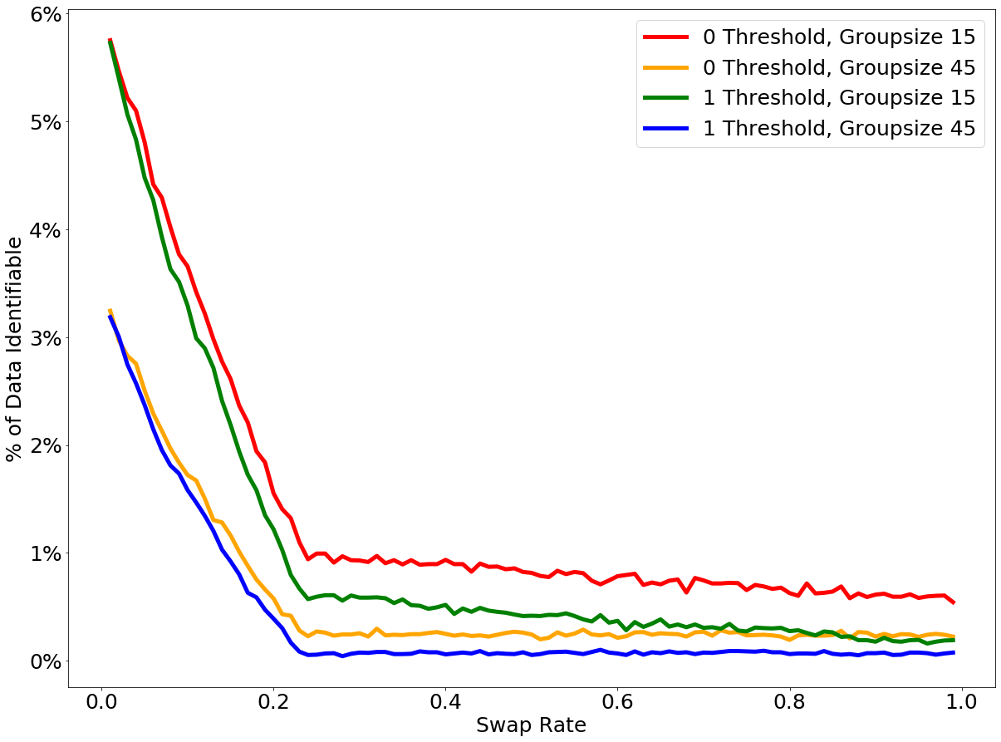
Privacy
We simulate a linkage attack, matching entries from a de-identified database to a public database.
We try to determine whether an individual has some attribute (e.g. is Hispanic)
NOT DIVERSE COUNTY
DIVERSE COUNTY

Slide 18
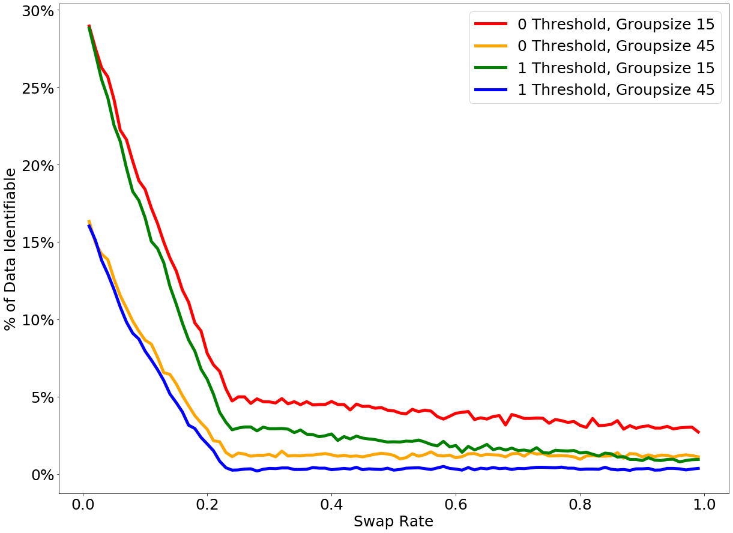
Privacy
MINORITY POPULATION
TOTAL POPULATION

Slide 19
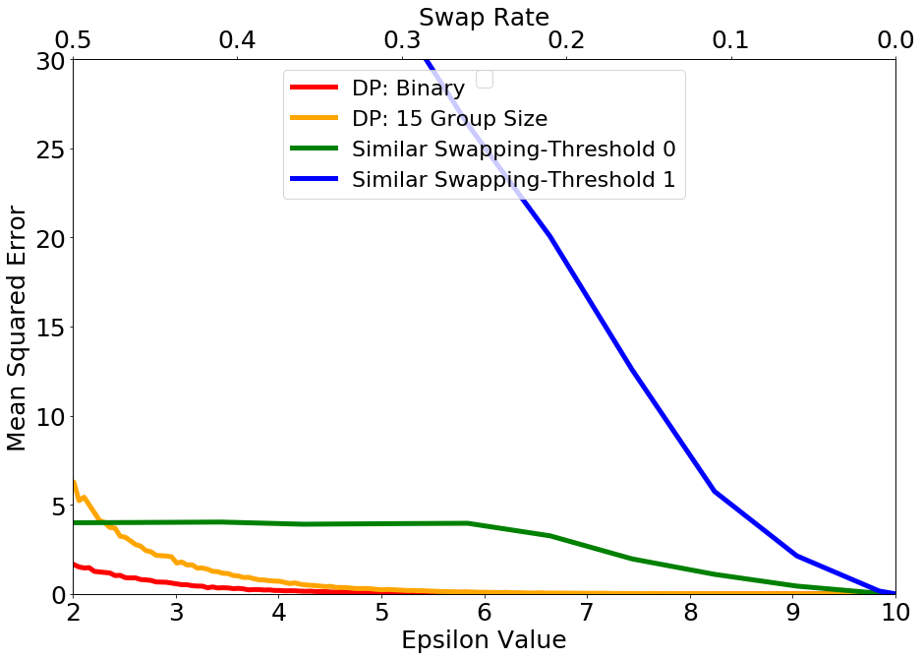
Accuracy
MEAN SQUARED ERROR (MSE)
Considers total population
MU-SMOOTHED KL-DIVERGENCE (μ-KL)
Weighs minority populations; see Cummings et al.

Slide 20
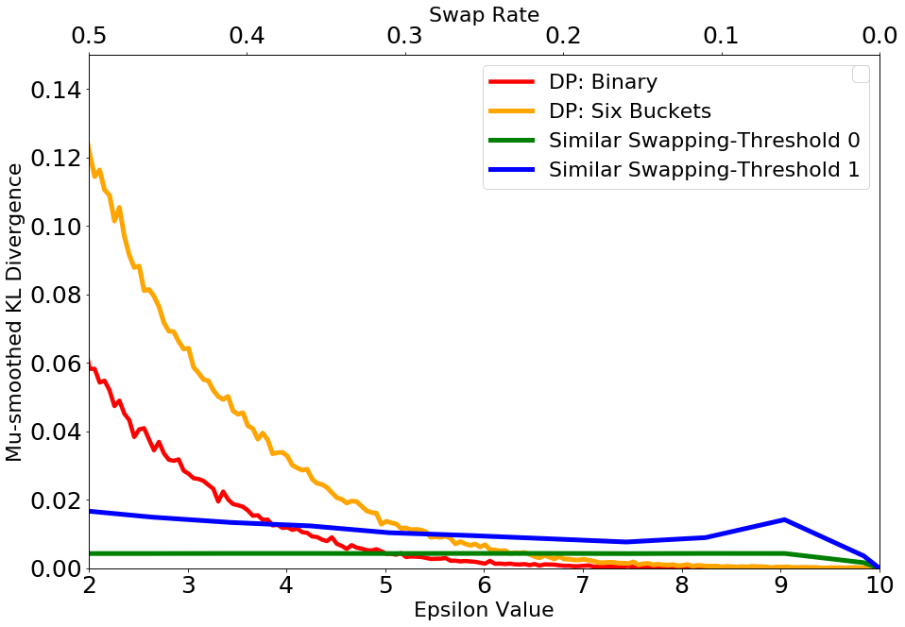
Accuracy
NOT DIVERSE COUNTY (μ-KL)
DIVERSE COUNTY (μ-KL)

Slide 21
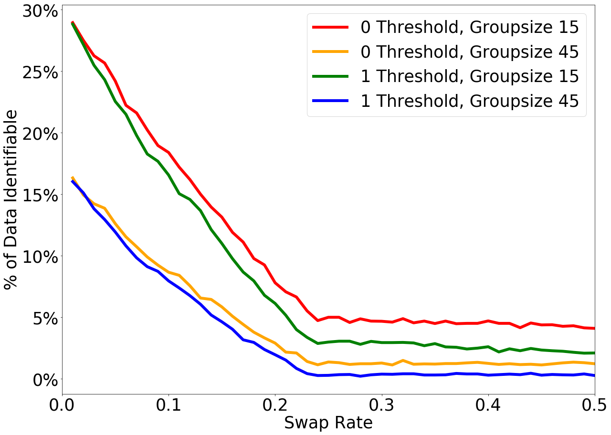
Privacy & Accuracy
For swapping, good privacy means poor accuracy, especially for diverse counties.
DP, however, performs better across varying diversity levels.

Slide 22
Final Remarks
Sarah Radway, sarah.radway@tufts.edu
Miranda Christ, mchrist@cs.columbia.edu
While both swapping & DP mechanisms could produce comparable accuracy:
Swapping mechanisms:
Posed a significant risk of re-identification
No privacy guarantee: bad utility != good privacy, and vice versa
Diverse groups suffered worse accuracy AND privacy, disproportionately impacting minorities
Differentially private mechanisms:
Provide a direct relationship/guarantee between utility and privacy
Performed consistently across groups of varying diversity

Slide 24
Example
3
0
1
3
SWAPPING
2
1
2
2
2
1
2
2
3
0
1
3
DP
TRUE DATA
Notes:
Mention that we look at data in QUERY FORMAT (show that those are kind of queries, but looking at multiple variables)

