Slide 1
Short communication as a medium: Is engagement a substitute for efficacy?
Travis Hoppe, PhD
Chief Data Scientist
National Center for Health Statistics
Federal Committee on Statistical Methodology (FCSM)
Research and Policy conference
November 3rd, 2021
The findings and conclusions in this presentation are those of the authors and do not necessarily represent the official position of the National Center for Health Statistics or the Centers for Disease Control and Prevention.

Slide 2

Outline
Importance of engagement on social media
Measuring impact (by proxy)
Characteristics of an effective communication on Twitter

Slide 3

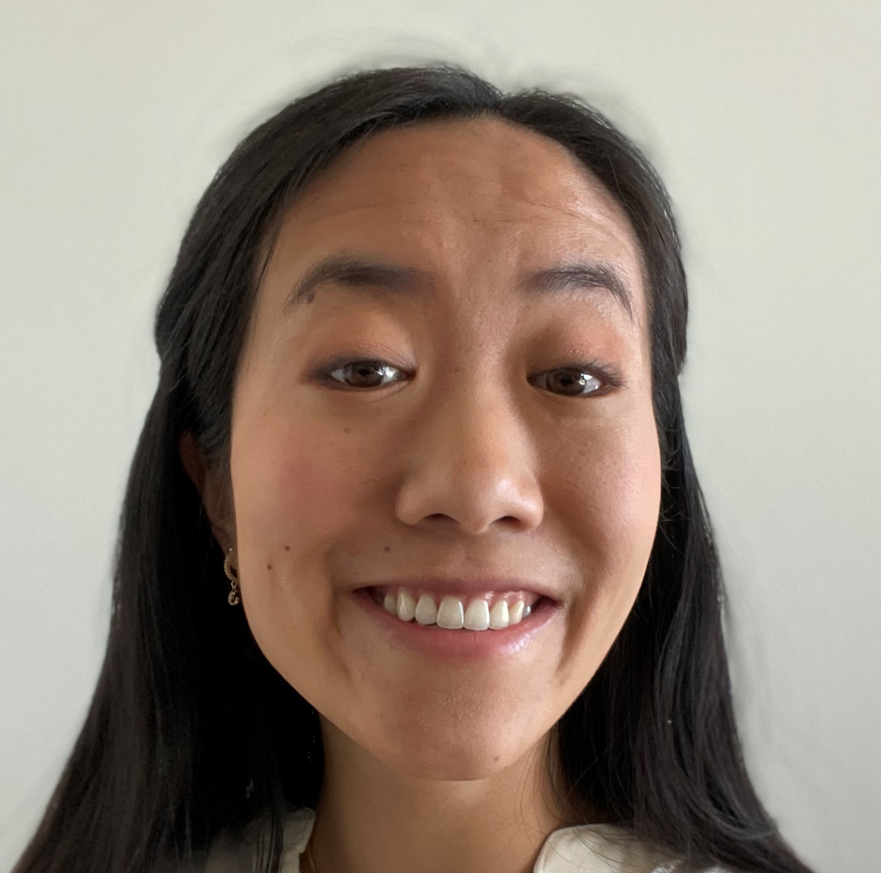
Acknowledgments
Saarika Virkar
ORISE Fellow
NCHS Division of Research Methodology
Florence Lee
Health Statistician
NCHS Division of Analysis and Epidemiology

Slide 4
Why engage on social media?
Federal mandates and recommendations
“… engage the public in using public data assets of the agency and encourage collaboration” ^{[1]}
“Government should be transparent & participatory” ^{[2]}
Social media networks as communication tools
Majority of Americans receive news sometimes or often on social media ^{[3]}
More users seek news on Twitter than other social media networks ^{[3]}
[1] Open, Public, Electronic, and Necessary Government Data Act. 44 USC 101, Section II (Evidence Act)
[2] Memorandum on Transparency and Open Government (Administration of President Obama)
[3] https://www.pewresearch.org/journalism/2021/01/12/news-use-across-social-media-platforms-in-2020/

Slide 5
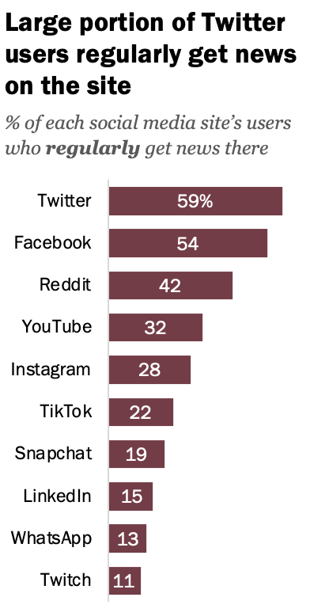
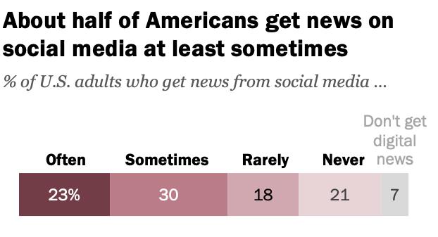
Influence of social media on news consumption
https://www.pewresearch.org/journalism/2021/01/12/news-use-across-social-media-platforms-in-2020/

Slide 6
Amplify authoritative voices to combat misinformation
Nearly 70% of engagement with COVID-19 misinformation came from politicians, celebrities, or other prominent public figures ^{[1]}
Users tend to connect to like-minded users and follow influencers who present as information hubs
Users tend to believe and share (mis)information posted by influencers
(Mis)information is shared in a homophilic social network ^{[2]}
Falsehood diffused farther, faster, deeper, and more broadly
False news was 70% more likely to be retweeted than the truth ^{[3]}
[1] Brennen, J & Simon, Felix & Howard, Philip & Nielsen, Rasmus. (2020). Types, Sources, and Claims of COVID-19 Misinformation.
[2] Xu, W., Sasahara, K. (2021) Characterizing the roles of bots on Twitter during the COVID-19 infodemic. J Comput Soc Sc
[3] Vosoughi, S., Roy, D., & Aral, S. (2018). The spread of true and false news online. Science, 359(6380), 1146-1151.

Slide 7
Federal statistical agencies on Twitter
Agency | Handle | Followers in Thousands
Census Bureau | Uscensusbureau | 118.4
Bureau of Labor Statistics | BLS_gov | 70.6
National Center for Education Statistics | EdNCES | 24.0
National Agricultural Statistics Service | usda_nass | 46.2
National Center for Health Statistics | NCHStats | 6.8
Energy Information Administration | EIAgov | 158.3
Bureau of Economic Analysis | BEA_News | 21.7
Economic Research Service | USDA_ERS | 42.5
Bureau of Justice Statistics | BJSgov | 3.7
Bureau of Transportation Statistics | TransportStats | 15.1
National Center for Science and Engineering Statistics | NCSESgov (unverified) | 0.08
IRS Statistics of Income Division | Not on twitter | -
SSA Office of Research, Evaluation, and Statistics | Not on twitter | -
Follower count data collected 8/12/2021

Slide 8
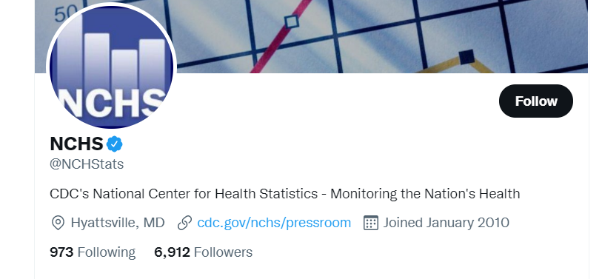
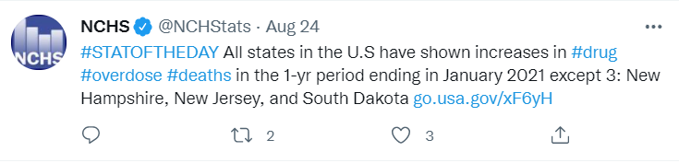
Anatomy of tweets and accounts
Key Ideas
Impressions total views
Engagement interactions
Initial reach followers
Linking URL
# Followers
Verified
@Username
Hashtag
External URL
Comments
Retweets
Likes

Slide 9
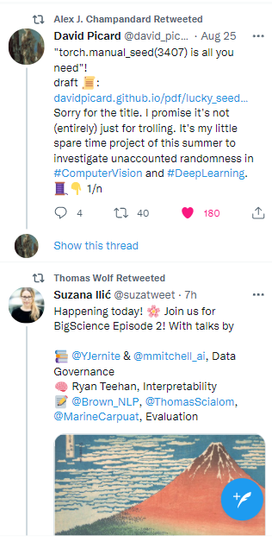
Retweets as a proxy for impact
Impressions are not directly observable
Likes represent emotional engagement by users
Likes don’t increase reach on Twitter
Comments represent emotional and informational engagement
Comments don’t increase reach on Twitter
Retweets spread information and increase reach
Retweets add your content to the timelines of other users

Slide 10
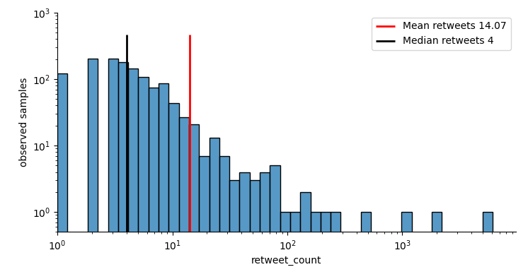
Everyday communication
Only primary tweets are considered for statistics
Retweeted posts, quoted posts, or replies are excluded
Retweets follow power-law distribution (extreme outliers)
Latest 3,000 Tweets from @uscensusbureau
Focus on regular communication vs. virality
Normalize retweet counts to rank value
When comparing accounts
When comparing tweets within accounts
Number of observed samples
Number of retweets

Slide 11
Novel dataset: Government accounts providing topical and continuous information
170M
All Twitter accounts
382K
6K
Government Twitter accounts
1K+2K
Info gov + People gov accounts
Collected metadata for verified accounts and filtered for those with .gov URLs
Removed weather, traffic, law enforcement, parks, space, security accounts
Verified Twitter accounts
People gov accounts acted as control
Collected latest 3,000 Tweets for each account = ~1.3M Tweets

Slide 12
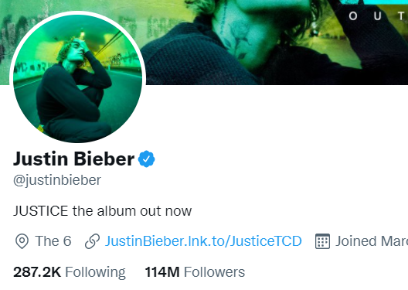
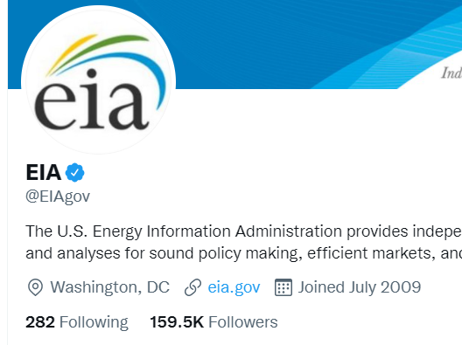

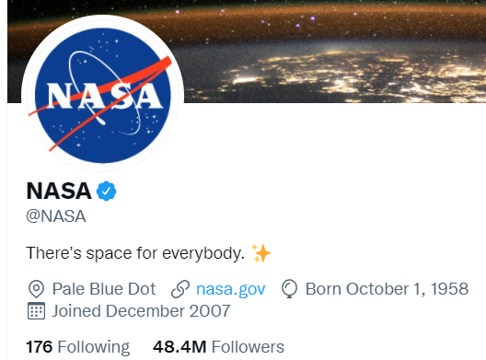
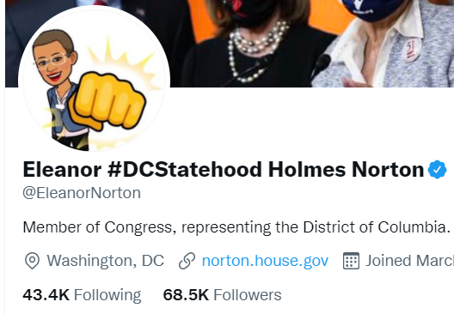
Including and excluding accounts
@justinbieber
Verified, not gov
@EIA
Verified, info gov
@NASA
Verified,
not info gov
nor people gov
@EleanorNorton
Verified, people gov

Slide 13
Correlates of engagement
Top tweets
What characteristics correlate with the top tweets?
Biased towards popular accounts
Top tweets (per account)
Correlations with the top tweets normalized to the baseline of the account
Represents actions account holders can take
Top accounts
Relationship between account actions and follower counts?
Optimal number of actions account holders can take
Change in retweet rank (relative to population) given presence of element
Example Statistic
+7.8
Media
Element

Slide 14
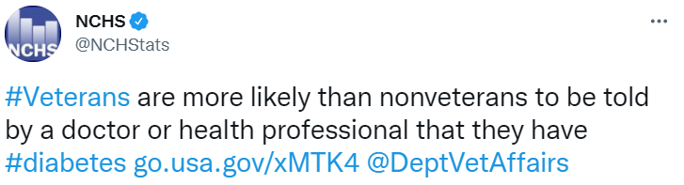
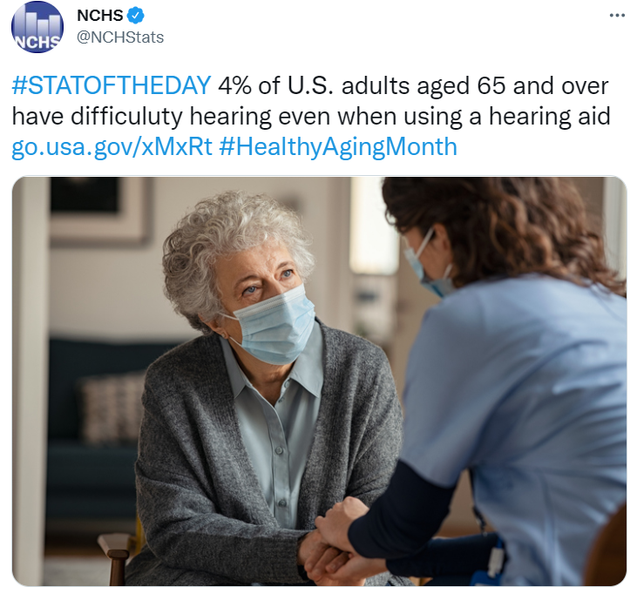
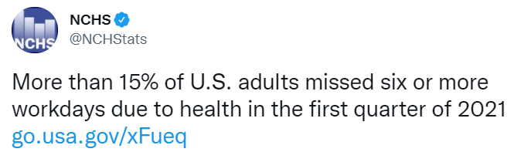
Actionable tweet features
# hashtag
@ mention
external link
media element

Slide 15
Top Tweets Change in percentile rank when including element
info gov
+15.8
+3.9
+8.4
-4.1
Media
@ mentions
#hashtags
External links
people
gov
+4.5
+1.2
-0.9
-7.1
Media
@ mentions
#hashtags
External links

Slide 16
Top Tweets (normalized per account) Change in percentile rank when including element
info gov
+11.4
+2.2
+4.7
-3.6
Media
@ mentions
#hashtags
External links
people
gov
+5.0
+0.2
+1.7
-4.7
Media
@ mentions
#hashtags
External links

Slide 17
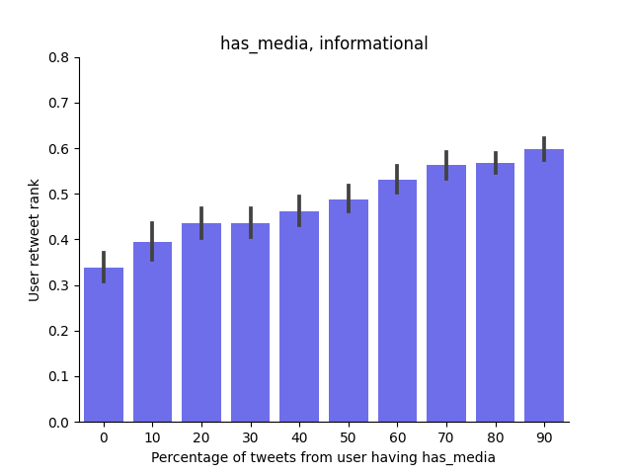
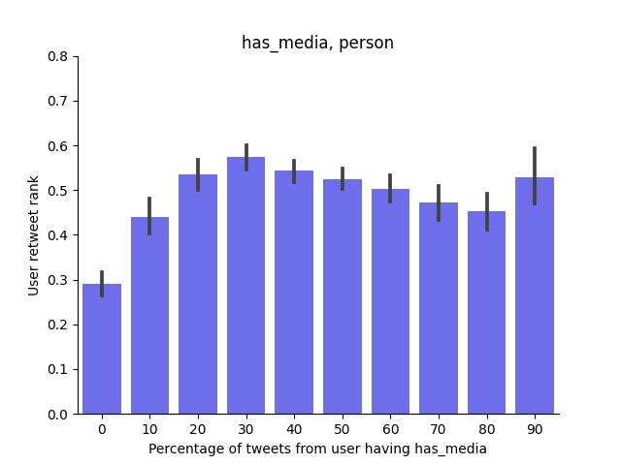
Characteristics of influential accounts: Fraction of media posts vs retweet rank Positive linear relationship with usage of media for info gov; diminishing returns for people gov (30% optimal)
info gov
people gov
Account rank by mean retweets
Account rank by mean retweets
Percentage of tweets from account with media
Percentage of tweets from account with media

Slide 18
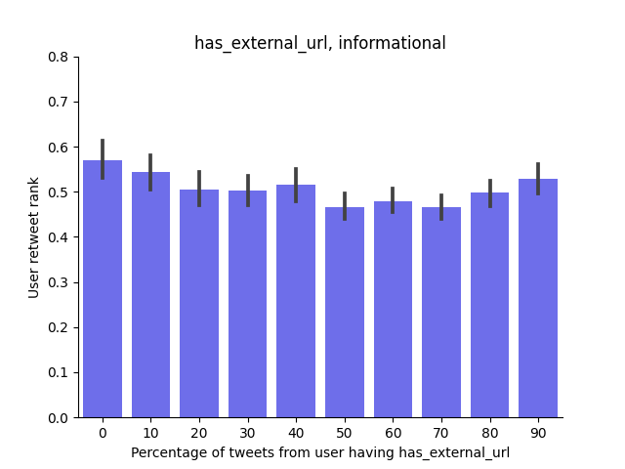
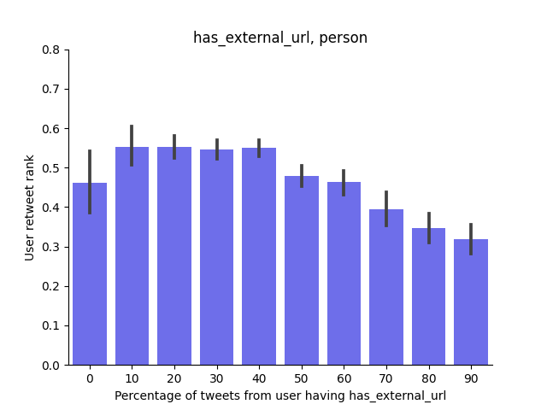
Characteristics of influential accounts: Fraction of external links vs retweet rank Relationship unclear for info gov; strong diminishing returns for people gov starting at 40%
info gov
people gov
Account rank by mean retweets
Account rank by mean retweets
Percentage of tweets from account with external URL
Percentage of tweets from account with external URL

Slide 19
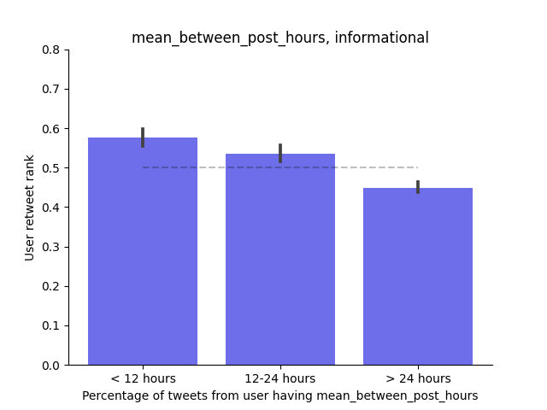
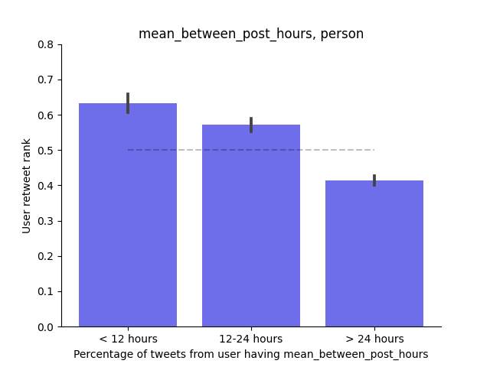
Characteristics of influential accounts: Posting frequency vs retweet rank Posting frequently correlates with higher levels of engagement (stronger effect size for people gov)
info gov
people gov
Account rank by mean retweets
Account rank by mean retweets
Mean time between posts
Mean time between posts

Slide 20
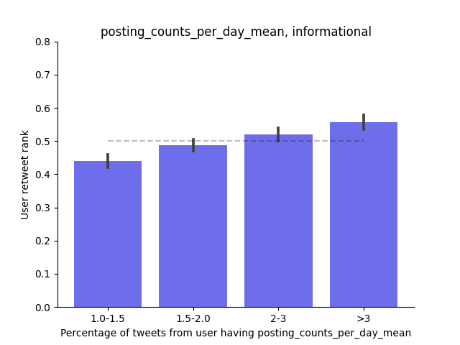
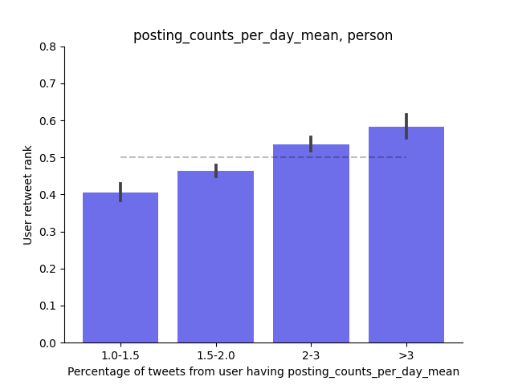
Characteristics of influential accounts: Burst posting vs retweet rank Posting multiple times per day correlates with higher levels of engagement (stronger effect size for people gov)
info gov
people gov
Account rank by mean retweets
Account rank by mean retweets
Mean number of posts/day given one post
Mean number of posts/day given one post

Slide 21
Summary
Twitter works differently for individual accounts and organizational accounts…even within the federal government
When it comes to reach and engagement:
Media matters
Positive correlation for info gov Twitter for all levels of media and reach
People gov has a sweet spot at 30% usage
Frequency counts
Strong correlation to posting frequency, both in aggregate and bursts
#Hashtags help (a little)
Small but positive effect for info gov twitter

Slide 22
Thank you!
Travis Hoppe
Questions or comments?
THoppe@cdc.gov
Federal Committee on Statistical Methodology (FCSM)
Research and Policy conference
November 3rd, 2021

