Slide 1
Controlling Privacy Loss in Survey Sampling
Mark Bun (Boston University), Jörg Drechsler (IAB),
Marco Gaboardi (Boston University), Audra McMillan (Apple),
Jayshree Sarathy (Harvard University)

Slide 2
Outline
Background
Cluster sampling
Stratified sampling
General findings

Slide 3
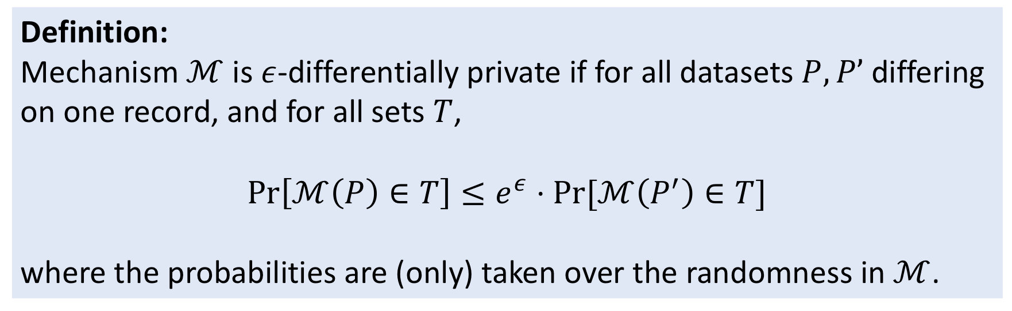
Differential Privacy
Definition:
Mechanism $ℳ$ is $ε$-differentially private if for all datasets $P, P’$differing on one record, and for all sets $T$,
$$\operatorname{Pr}\left[ℳ\left(P\right)∈T\right]≤e^{ε}⋅Pr⁡[ℳ\left(P^{′}\right)∈T]$$
where the probabilities are (only) taken over the randomness in $ℳ$.

Slide 4
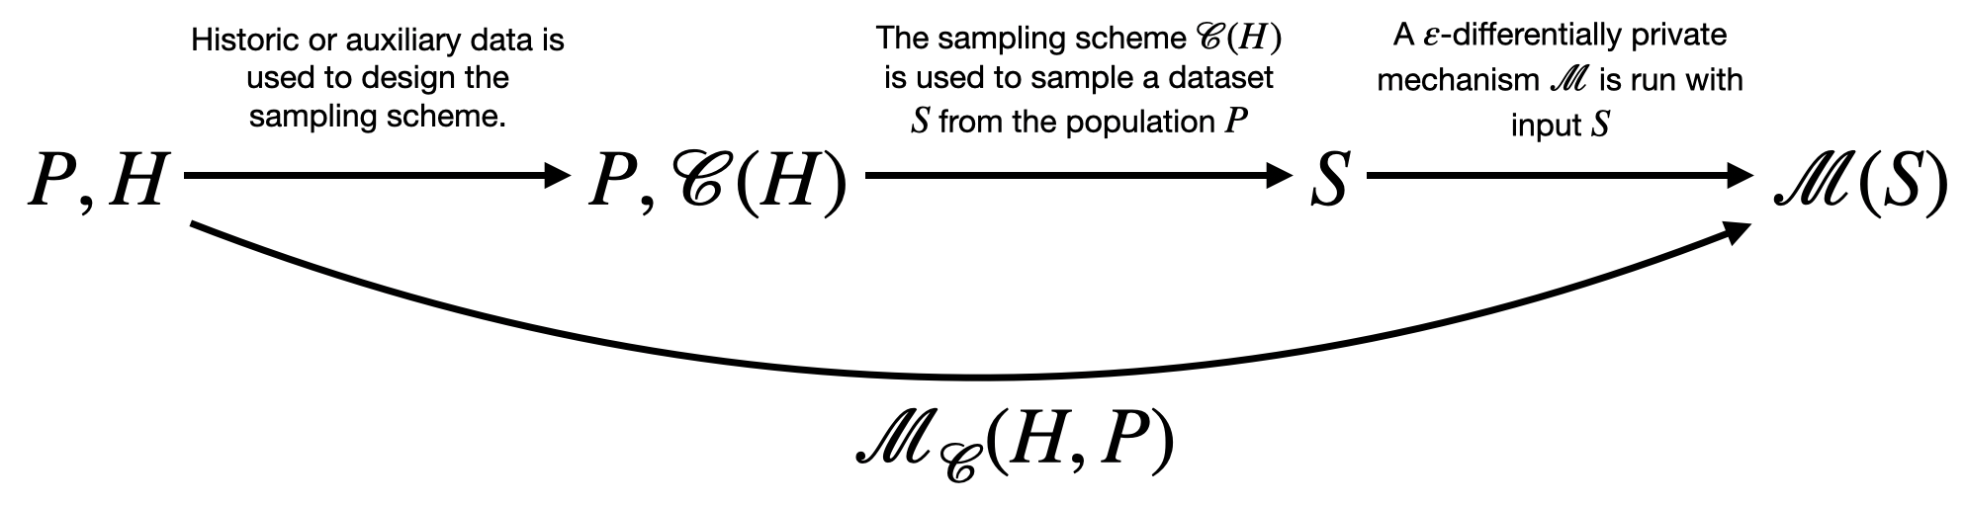
Framework

Slide 5

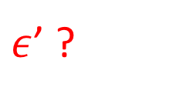
Framework
$$ε$$
$ε$’ ?

Slide 6
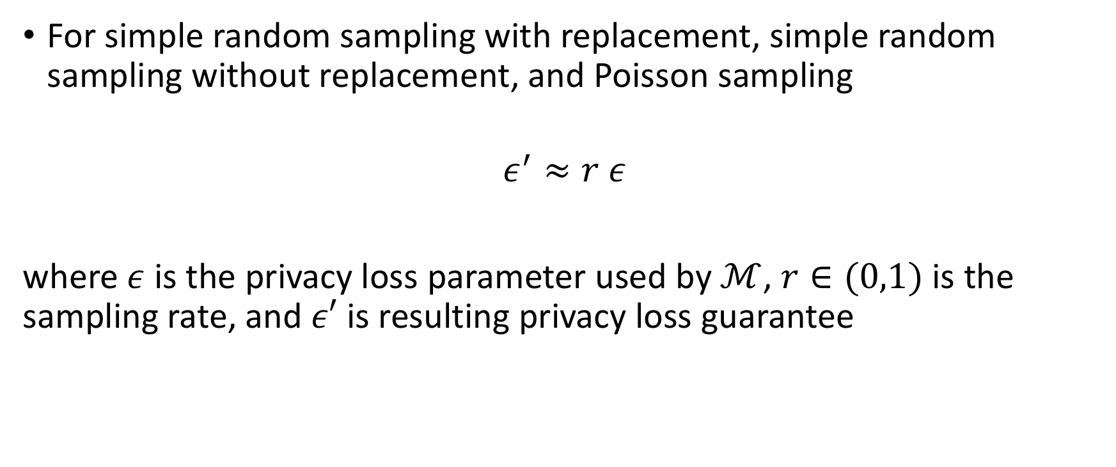
Privacy amplification by subsampling
For simple random sampling with replacement, simple random sampling without replacement, and Poisson sampling
$$ε^{′}≈r ε$$
where $ε$ is the privacy loss parameter used by $ℳ$, $r∈(0,1)$ is the sampling rate, and $ε′$ is resulting privacy loss guarantee
Kasiviswanathan, Lee, Nissim, Raskhodnikova, and Smith (2008)
…
Balle, Barthe, and Gaboardi (2018)

Slide 7
Related Work
Poisson sampling: Kasiviswanathan et al. 2008, Beimel et al. 2010
Simple random sampling with replacement: Bun et al. 2015
Simple random sampling without replacement: Beimel et al. 2010, Bassily et al. 2014, Wang et al. 2016
Unified analysis through probabilistic couplings: Balle et al. 2018

Slide 8
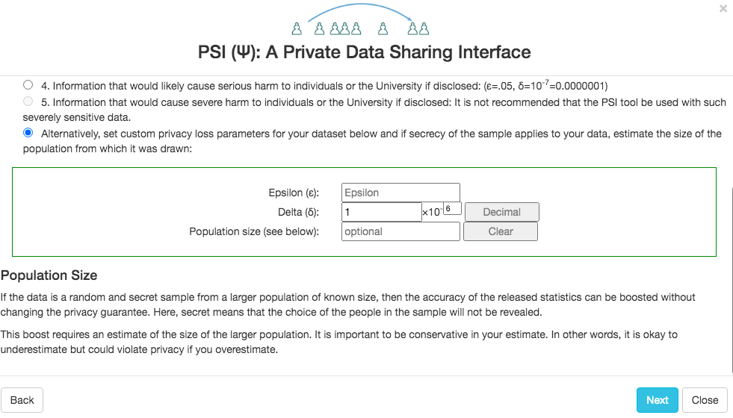
Using amplification results in practice

Slide 9
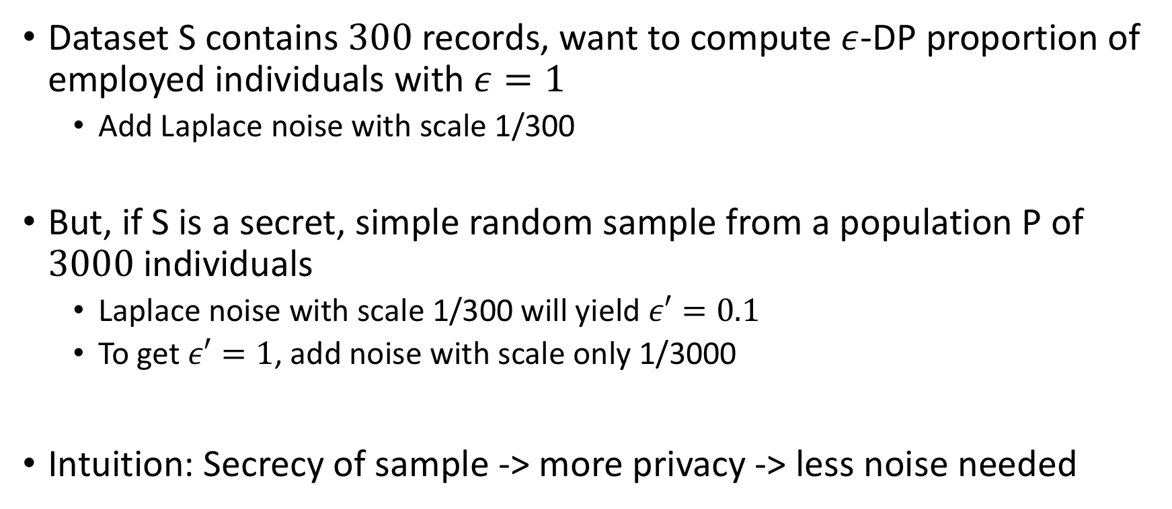
Using amplification in practice
Dataset S contains $300$records, want to compute $ε$-DP proportion of employed individuals with $ε=1$
Add Laplace noise with scale 1/300
But, if S is a secret, simple random sample from a population P of $3000$individuals
Laplace noise with scale 1/300 will yield $ε′=0.1$
To get $ε′=1$, add noise with scale only 1/3000
Intuition: Secrecy of sample -> more privacy -> less noise needed

Slide 10
This work
Q: Can we extend these results to more complex sampling designs?
Privacy amplification not guaranteed for more complex sampling designs
Examples from cluster and stratified sampling
Insight into more general sampling designs

Slide 11
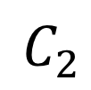
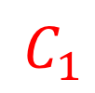
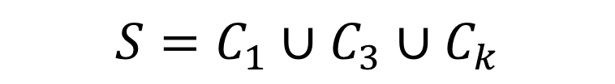
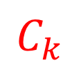
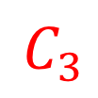
Cluster sampling
P
$$C_{1}$$
$$C_{2}$$
$$C_{3}$$
…
$$C_{k}$$
$${S=C}_{1}∪C_{3}∪C_{k}$$

Slide 12
Cluster sampling
Negligible amplification if size of clusters is large!
Intuition:
Large clusters -> less secrecy of sample
Privacy of records within cluster may not protect privacy of chosen clusters

Slide 13


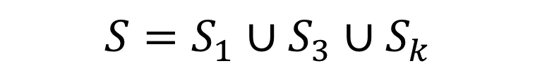
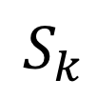
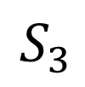
Multi-stage cluster sampling
P
$$C_{1}$$
$$C_{2}$$
$$C_{3}$$
…
$$C_{k}$$
$$S_{1}$$
$$S_{2}$$
$$S_{3}$$
$$S_{k}$$
$${S=S}_{1}∪S_{3}∪S_{k}$$

Slide 14
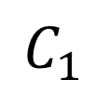
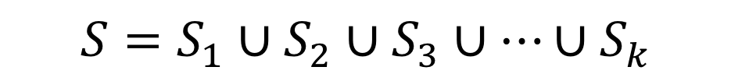
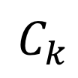
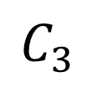
Stratified sampling
P
$$C_{1}$$
$$C_{2}$$
$$C_{3}$$
…
$$C_{k}$$
$$S_{1}$$
$$S_{2}$$
$$S_{3}$$
$$S_{k}$$
$${S=S}_{1}∪S_{2}∪S_{3}∪⋯∪S_{k}$$

Slide 15
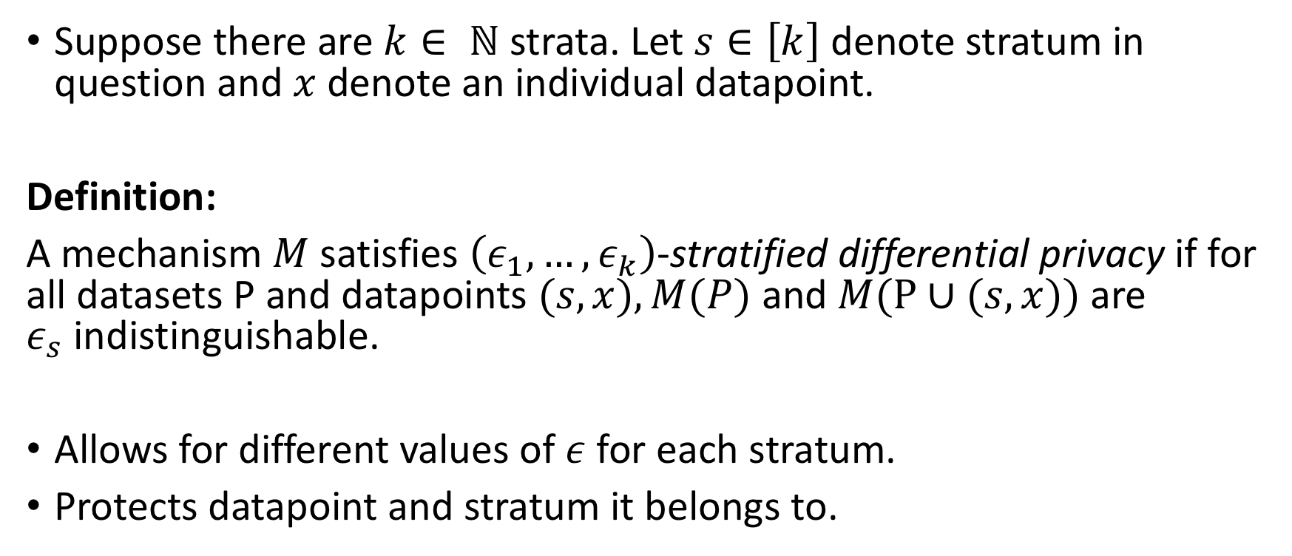
Stratified differential privacy
Suppose there are $k∈ ℕ$ strata. Let $s∈\left[k\right]$ denote stratum in question and $x$ denote an individual datapoint.
Definition:
A mechanism $M$satisfies $\left(ε_{1}, …, ε_{k}\right)$-stratified differential privacy if for all datasets P and datapoints $(s, x), M(P)$ and$M(P∪(s,x))$are $ε_{s}$indistinguishable.
Allows for different values of $ε$ for each stratum.
Protects datapoint and stratum it belongs to.

Slide 16
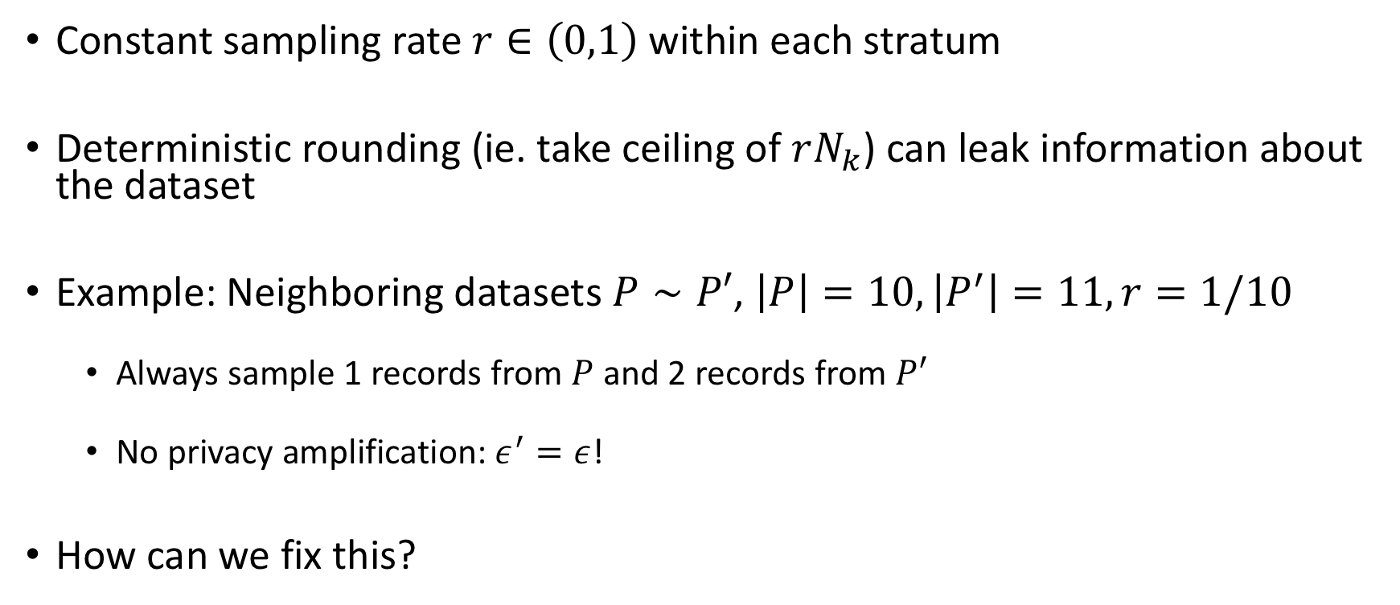
Stratified sampling, proportional allocation
Constant sampling rate $r∈\left(0,1\right)$within each stratum
Deterministic rounding (ie. take ceiling of $rN_{k}$) can leak information about the dataset
Example: Neighboring datasets $P∼P′$, $\left|P\right|=10, \left|P^{′}\right|=11, r=1/10$
Always sample 1 records from $P$ and 2 records from $P′$
No privacy amplification: $ε^{′}=ε$!
How can we fix this?

Slide 17
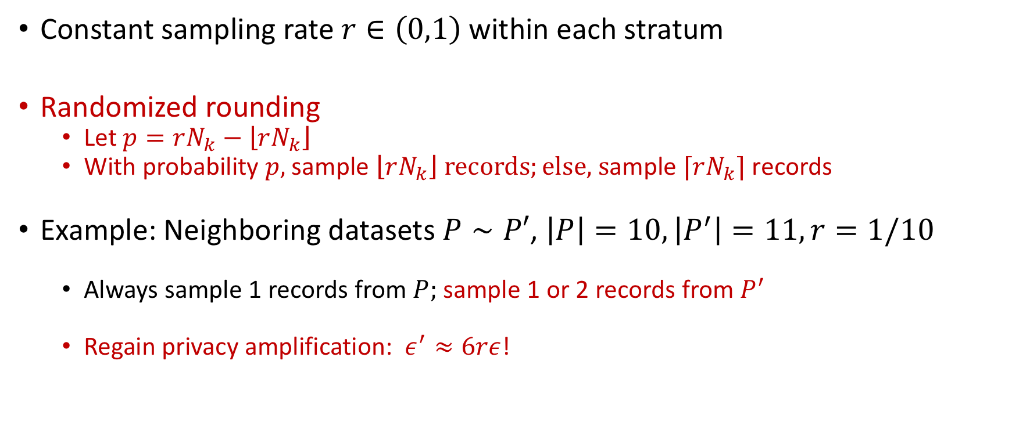
Stratified sampling, proportional allocation
Constant sampling rate $r∈\left(0,1\right)$within each stratum
Randomized rounding
Let $p=rN_{k}−\left\lfloor rN_{k}\right\rfloor$
With probability $p,$sample $\left\lfloor rN_{k}\right\rfloor records;el\text{se}\text{, }\text{s}\text{ample} ⌈rN_{k}⌉ \text{records}$
Example: Neighboring datasets $P∼P′$, $\left|P\right|=10, \left|P^{′}\right|=11, r=1/10$
Always sample 1 records from $P;$sample 1 or 2 records from $P^{′}$
Regain privacy amplification: $ε^{′}≈6rε$!

Slide 18
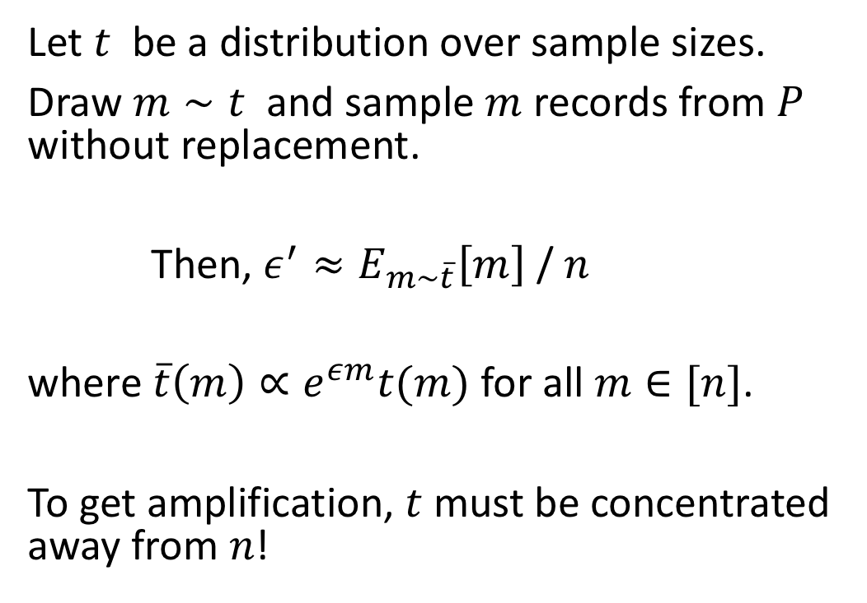
Randomized data-independent sampling rate
Let $t$ be a distribution over sample sizes.
Draw $m∼t$ and sample $m$ records from $P$ without replacement.
Then, $ε^{′}≈E_{m∼\overline{t}}\left[m\right]$ / $n$
where $\overline{t}\left(m\right)∝e^{εm}t(m)$ for all $m∈[n]$.
To get amplification, $t$ must be concentrated away from $n$!

Slide 19
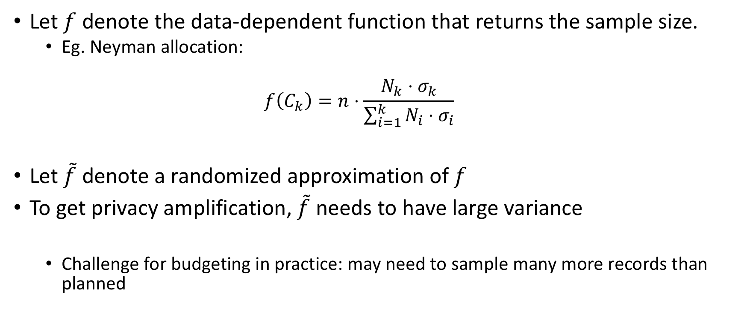
Randomized data-dependent sampling rate
Let $f$ denote the data-dependent function that returns the sample size.
Eg. Neyman allocation:
$$f\left(C_{k}\right)=n⋅\frac{N_{k}⋅σ_{k}}{\sum_{i=1}^{k}{N_{i}⋅σ_{i}}}$$
Let $\tilde{f}$ denote a randomized approximation of $f$
To get privacy amplification, $\tilde{f}$ needs to have large variance
Challenge for budgeting in practice: may need to sample many more records than planned

Slide 20
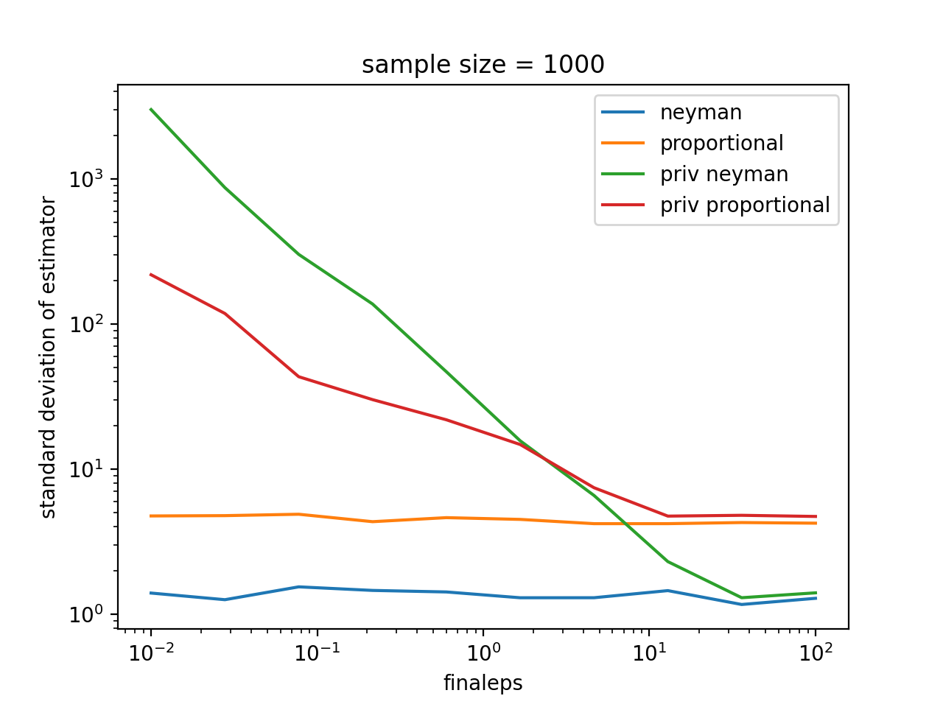
Proportional vs. Neyman allocation
What is optimal in the non-private setting may not be optimal in the private setting
Proportional allocation can perform better than Neyman allocation in high privacy regimes
Discussion question: what practical settings to test this finding?

Slide 21
Conclusion
Intuitively, sampling can increase the privacy amplification
But, privacy amplification not guaranteed for complex sampling designs
Amplification can be negligible even when only a small fraction of the population is included in the final sample
If sampling design is data-dependent, privacy degradation can occur -- the sample design itself can reveal sensitive information

Slide 22
Thank you!

Slide 23
Results
Positive results
Stratified sampling + proportional allocation with randomized rounding
Negative results
Cluster sampling
Stratified sampling + proportional allocation with deterministic rounding
Data-dependent sampling schemes
Neyman allocation

