Slide 1
Using a Web-scraped List-frame for an Agricultural Survey
Habtamu Benecha, Bruce A. Craig, Grace Yoon, Zachary Terner*
Denise A. Abreu, Linda J. Young
National Agricultural Statistics Service (NASS) United States Department of Agriculture
*National Institute of Statistical Sciences (NISS)
FCSM 2021 Research & Policy Conference
November 3, 2021

Slide 2
Disclaimer The findings and conclusions in this presentation are those of the authors and should not be construed to represent any official USDA, or US Government determination or policy.

Slide 3
Background
The June Area Survey (JAS)
Conducted annually
Based on an area-frame that covers all land in the continental U.S.
In-person enumeration
NASS uses the JAS to produce comprehensive estimates of land use and agricultural activities
Number of farms and land in farms
- $1000 in sales or potential sales
Undercoverage adjustment for the Census of Agriculture and several NASS surveys
The JAS is an expensive survey; in-person enumeration, maintenance of the area-frame, rotation of segments

Slide 4
Background
NASS is exploring ways to lower costs and improve data collection by leveraging new statistical methods and technologies
The June Area Research Project (JARP): 2019 Pilot study
- Assess the viability of using a web-scraped list-frame to replace the area-frame
- Evaluate the effectiveness of collecting data by mail, telephone and the web
Parallel study design: the 2018 JAS and the 2017 Census are used to evaluate the estimates and the quality of information from the pilot study
Goals: Discuss the estimation approaches and explore alternatives

Slide 5
2019 JARP: Frames and Surveys
Four states: KS, NE, NY, PA
A web-scraped list-frame developed for each state by scraping for potential farms
State specific and national open-data sources used
- National open-data sources for two of the states
- National and state-specific sources for the other two states
Record linkage to NASS’ main list-frame
Data collection in two phases

Slide 6
2019 JARP: Phase 1 Survey
Sample from records on the web-scraped frame not linked to NASS’ list-frame
Use the data to estimate coverage weights for NASS list frame records
Screening questionnaire
- Determine farm status
- Collect information for farm records: mail, web, and telephone

Slide 7
2019 JARP: Phase 2 Survey
Sample from records on NASS’ list-frame
Some of the Phase 2 sample records linked to both frames
Obtain information consistent with JAS by using mail, web, and telephone
Produce JAS estimates using capture-recapture approach
Farms and non-farms

Slide 8
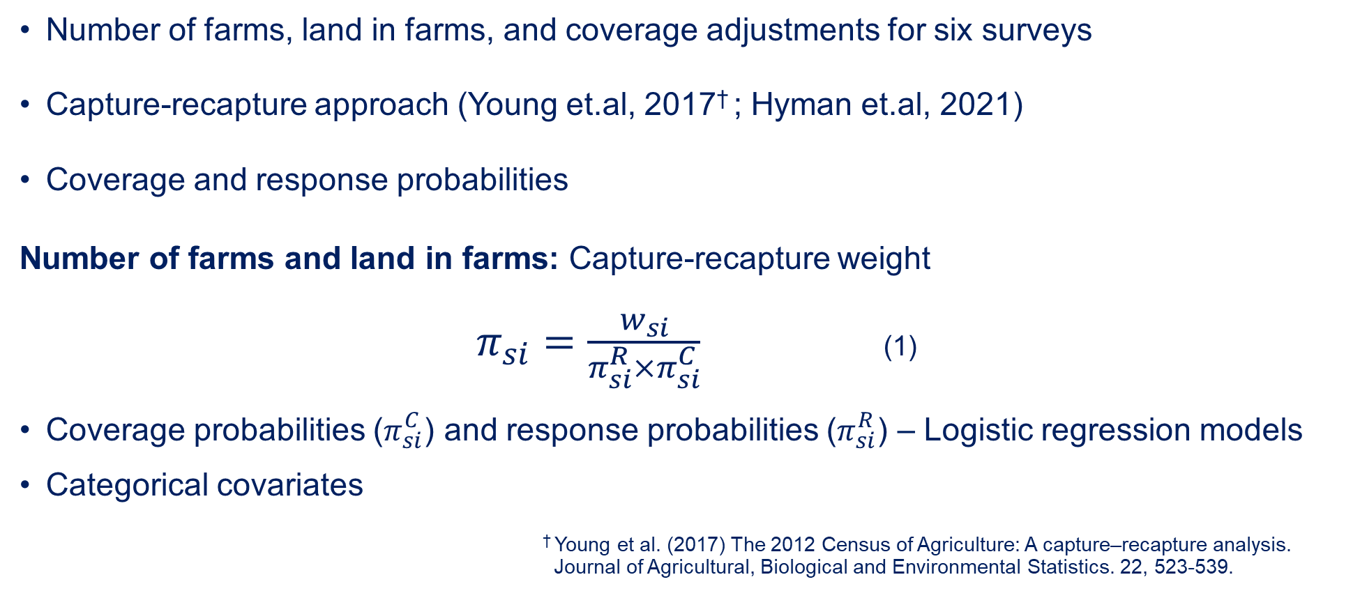
Estimation
Number of farms, land in farms, and coverage adjustments for six surveys
Capture-recapture approach (Young et.al, 2017† ; Hyman et.al, 2021)
Coverage and response probabilities
Number of farms and land in farms: Capture-recapture weight
$π_{si}=\frac{w_{si}}{π_{si}^{R}×π_{si}^{C}}$ (1)
Coverage probabilities ($π_{si}^{C}$) and response probabilities ($π_{si}^{R}$) – Logistic regression models
Categorical covariates
† Young et al. (2017) The 2012 Census of Agriculture: A capture–recapture analysis. Journal of Agricultural, Biological and Environmental Statistics. 22, 523-539.

Slide 9
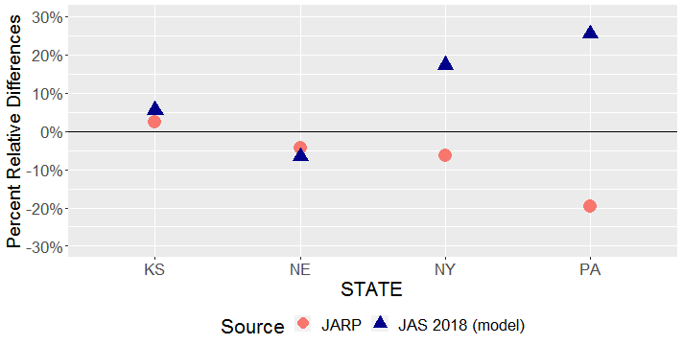
Results
Percent relative differences of the number of farms estimates from 2019 JARP and 2018 JAS compared to the 2017 Census estimates
Reference to 2017 Census

Slide 10
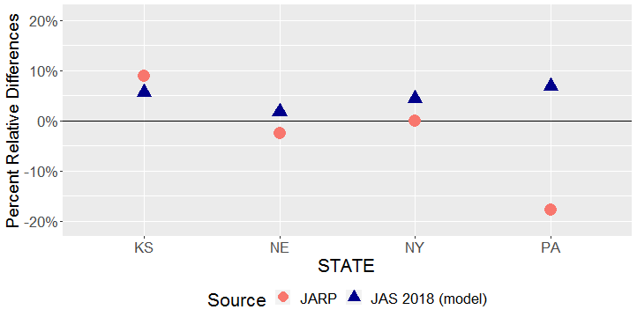
Results
Percent relative differences of the land in farms estimates from JARP and the JAS compared to the 2017 Census estimates
Reference to 2017 Census

Slide 11
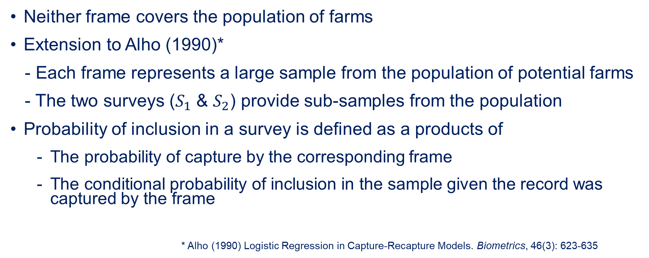
An Alternative Capture-recapture Model: Sampling from the Entire Web-scraped Frame
Neither frame covers the population of farms
Extension to Alho (1990)*
- Each frame represents a large sample from the population of potential farms
- The two surveys ($S_{1}$ & $S_{2}$) provide sub-samples from the population
Probability of inclusion in a survey is defined as a products of
The probability of capture by the corresponding frame
The conditional probability of inclusion in the sample given the record was captured by the frame
* Alho (1990) Logistic Regression in Capture-Recapture Models. Biometrics, 46(3): 623-635

Slide 12
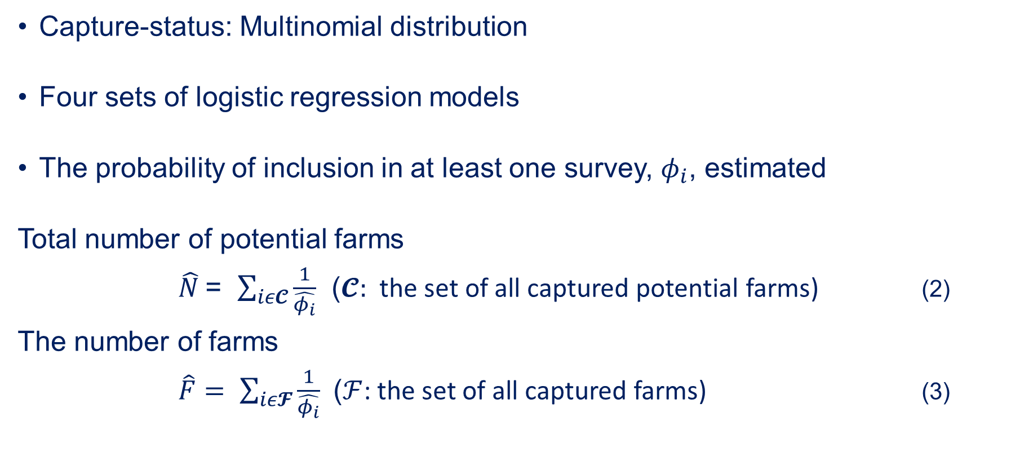
An Alternative Capture-recapture Model
Capture-status: Multinomial distribution
Four sets of logistic regression models
The probability of inclusion in at least one survey, $φ_{i}$, estimated
Total number of potential farms
$\hat{N}$= $\sum_{iε𝓒}{\frac{1}{\hat{φ_{i}}}}$ ($𝓒:$ the set of all captured potential farms) (2)
The number of farms
$\hat{F}= \sum_{iε𝓕}{\frac{1}{\hat{φ_{i}}}}$ ($ℱ$: the set of all captured farms) (3)

Slide 13
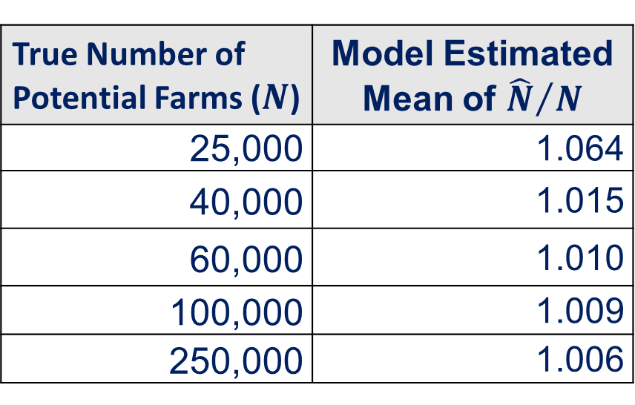
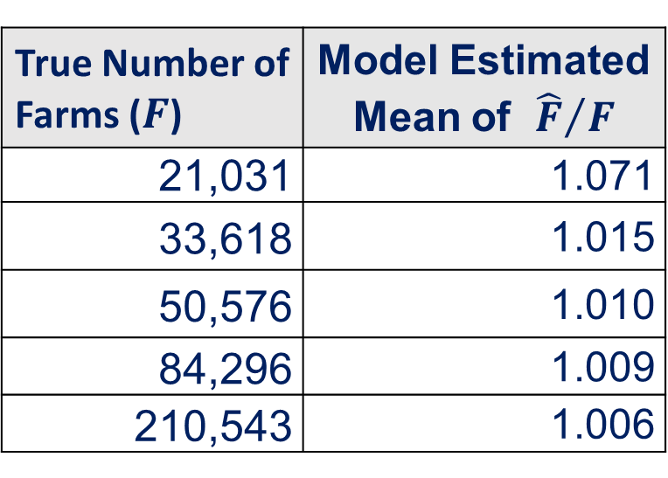
Simulation Study
Two sets of different covariates to generate records for the frames and the surveys; four Bernoulli distributions
Farm status: a function of one variable
500 replicates
True Number of Potential Farms ($N$) | Model Estimated Mean of ${\hat{N}}/N$
25,000 | 1.064
40,000 | 1.015
60,000 | 1.010
100,000 | 1.009
250,000 | 1.006
True Number of Farms ($F$) | Model Estimated Mean of ${\hat{F}}/F$
21,031 | 1.071
33,618 | 1.015
50,576 | 1.010
84,296 | 1.009
210,543 | 1.006

Slide 14
Summary and future work
Promising results
- Many of the estimates are close to results from the JAS,
the Census and multiple-frame analysis
Main challenge: under-estimation of some commodity values
Low response-rate
Quality and quantity of covariates
Scraping at state and national levels may improve estimates
Sampling from the entire web-scraped frame (several options for estimation)

Slide 15
Thank You! Questions? habtamu.benecha@usda.gov

