Slide 1
Innovations in Health Insurance Data Collection and Measurement Across Federal Surveys
Steven B. Cohen, PhD Vice President, Statistical and Data Sciences
Federal Committee on Statistical Methodology Research and Policy Conference
November 2021

Slide 2
The Need for High-Quality Data on Health Insurance Coverage
Health insurance coverage helps facilitate timely access to medical care and protects against the risk of expensive and unanticipated medical events.
Comprehensive data on insurance coverage are essential to the identification of strategies to improve access, foster appropriate use, and reduce unnecessary expenditures.
The Affordable Care Act (ACA) was enacted with major provisions to expand health insurance coverage, control health care costs, and improve the health care delivery system.
The identification of those population subgroups most likely to remain uninsured is essential to the formulation of efficient, effective, and targeted policy interventions.
Notes:
Estimates of the health insurance status of the U.S. civilian noninstitutionalized population are critical to policymakers and others concerned with access to medical care and the cost and quality of that care. Health insurance helps people get timely access to medical care and protects them against the risk of expensive and unanticipated medical events.

Slide 3
Enhancing the Quality of Health Insurance Data and Measurement
Timely, accurate, and relevant data on health insurance coverage are essential inputs to evidence-based decision-making and policy formulation.
Alignment with the Federal Data Strategy to advance the principles and best practices in implementing data innovations that drive more value for the public.
Attention to relevance: Ensuring that data are appropriate, accurate, objective, accessible, useful, understandable, and timely.

Slide 4
Enhancing the Quality of Health Insurance Data and Measurement
Recent DHHS Data Council Focus: Evaluation of Existing Capacity, Content, Comparability, and Alignment of Federal Health Insurance Coverage Estimates.
Presentations in session reflect ongoing efforts to enhance quality of coverage estimates.

Slide 5
Innovations in Health Insurance Data Collection and Measurement
Presentations
Two Times a Charm? Verifying Reports of Uninsurance in a National Survey, AHRQ
Improving Measurement of VA Health Coverage among Military Veterans on the National Health Interview Survey, NCHS
Decomposing Data Processing Improvements on Estimates Health Insurance Coverage in the Current Population Survey Annual Social and Economic Supplement, U.S. Census Bureau
Using Insurance Claims Data in the Medical Price Indexes, BLS

Slide 6
Two Times a Charm? Verifying Reports of Uninsurance in a National Survey—Paul Jacobs and Patricia Keenan, AHRQ
Several household surveys include a health insurance verification question: National Health Interview Survey (NHIS), Current Population Survey (CPS).
DHHS Data Council Health Insurance Workgroup Recommendations:
We recommend that the MEPS add probes to the 2018 MEPS questionnaire for individuals to verify insurance coverage and lack of coverage
AHRQ followed the recommendation: Added in MEPS beginning in 2018 and administered after the initial health insurance questions.
Coverage verification question in general alignment with CPS insurance questions.

Slide 7
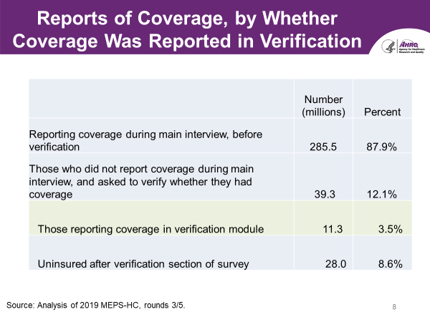
Two Times a Charm? Verifying Reports of Uninsurance in a National Survey—Paul Jacobs and Patricia Keenan, AHRQ

Slide 8
Two Times a Charm? Verifying Reports of Uninsurance in a National Survey—Paul Jacobs and Patricia Keenan, AHRQ
Study also compared additional percentages reporting insurance coverage through inclusion of MEPS verification question by demographics, health spending, and family arrangements; and by sources of coverage.
The most most visible shifts toward insured coverage status occurred for:
those without annual health expenditures
extended family members (e.g., grandchild, sibling)
ESI policyholders living outside household, or ESI not obtained from main job
non-Hispanic individuals, other race
Individuals without post secondary educational degrees

Slide 9
Two Times a Charm? Verifying Reports of Uninsurance in a National Survey—Paul Jacobs and Patricia Keenan, AHRQ
Verification-based coverage status also contributed to a substantial representation of those with Marketplace coverage.
Inclusion of the coverage verification question in MEPS significantly reduced year-end point-in-time national estimates of the uninsured derived from the MEPS.

Slide 10
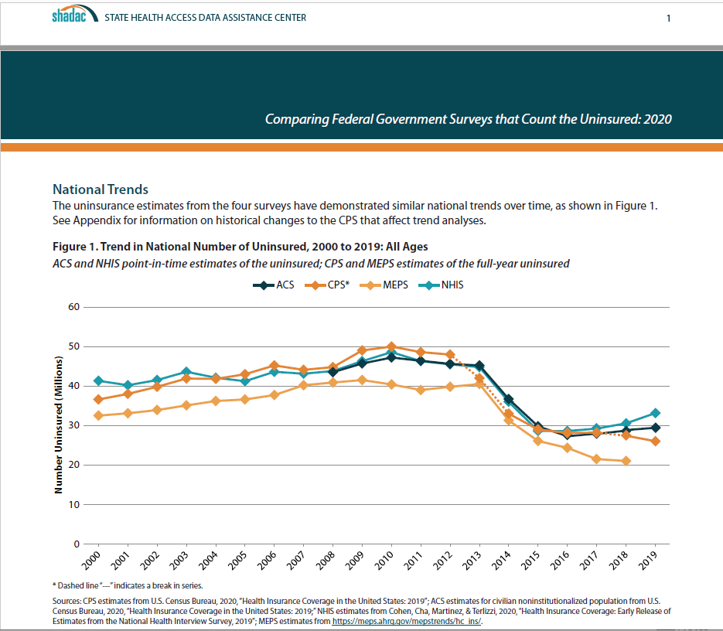
Comparability of Uninsured Estimates from Federal Surveys

Slide 11
Decomposing Data Processing Improvements on Estimates Health Insurance Coverage in the CPS ASEC—Laryssa Mykyta, Amy Steinweg, and Katherine Keisler-Starkey, U.S. Census Bureau
CPS ASEC questionnaire redesigned (2014) to address 1) higher national uninsurance estimates relative to other surveys and 2) to capture ACA and the Marketplace coverage.
Processing system redesigned (2019) to use sub-annual coverage information by type and across people within a unit.
Impact:
reduction in uninsured rate with updated processing system relative to legacy processing system
reduction in multiple coverage
imputed cases more likely to mirror coverage of non-imputed cases

Slide 12
Decomposing Data Processing Improvements on Estimates Health Insurance Coverage in the CPS ASEC—Laryssa Mykyta, Amy Steinweg, and Katherine Keisler-Starkey, U.S. Census Bureau
Ongoing commitment to research initiatives that advance data quality and integrity.
Future efforts focused on determining the relative contribution of specific processing steps on health coverage estimates:
Preprocessing
HIUs
Item and Unit imputations
Income imputations
Further attention to evaluations of Medicaid estimates via benchmarking with Medicaid administrative records

Slide 13
Improving Measurement of VA Health Coverage Among Military Veterans on the National Health Interview Survey—Robin A. Cohen and Carla E. Zelaya, NCHS
Issue: In 2017, the United States Department of Veterans Affairs (VA) estimated that 8.8 million were enrolled in VA Health Care, NHIS estimates (3.5 million) fell short.
Potential Solution: Probe added for Veterans who did not indicate their VA coverage in the NHIS health insurance section.
Have you/has {person} ever used or enrolled in VA Health Care?
Impact Assessment: Evaluation conducted with the inclusion of the VA coverage Probe in the 2018 NHIS.

Slide 14
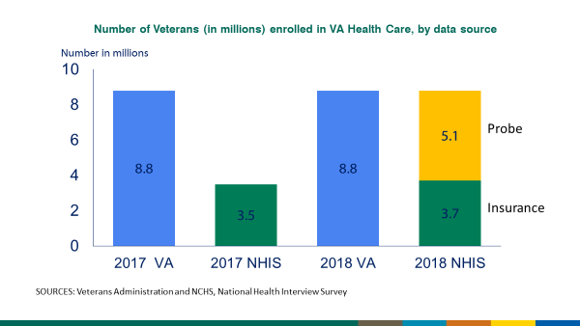
Improving Measurement of VA Health Coverage Among Military Veterans on the National Health Interview Survey—Robin A. Cohen and Carla E. Zelaya, NCHS
Results: The use of the probe question was successful in identifying more VA coverage among Veterans. NHIS associated VA coverage estimates are now in greater alignment with the VA administrative statistics.

Slide 15
Improving Measurement of VA Health Coverage Among Military Veterans on the National Health Interview Survey—Robin A. Cohen and Carla E. Zelaya, NCHS
Analytical results also indicated improved reporting of VA coverage via the probe by those with other public or private coverage; the employed; married participants, those in fair or poor health status, and with proxy respondents.
In addition to the descriptive results, it would be of benefit to see the direct results of the multivariate model.
Further improvements in accuracy likely with the forthcoming planned data linkage between NHIS and VA administrative data.
MEPS will also benefit by these improvements for this measure given its linkage to NHIS.

Slide 16
Advantages of Data Integration Model
Data integration is a process in which related and supplemental data from multiple sources are connected into a unified structure.
The resulting integrated data resource serves as a platform to enhance analytic efforts.
The data integration model facilitates greater analytic utility for each of the component data sets as a consequence of their “connectivity.”
Data integration is often implemented in a data warehouse or data enclave setting to ensure the extraction, linkage, and structure of the combined data resources are presented in a unified manner, while also serving to protect confidentiality.

Slide 17
Using Insurance Claims Data in the Medical Price Indexes—Daniel Wang, John Bieler, Brian Parker, Caleb Cho, and Brett Matsumoto, BLS
Current Medical Pricing methodology is dependent on household survey (CES) and medical provider data.
Quality of the current pricing approach is impacted by declining household survey response rates, declining cooperation by medical providers, rising costs for data retrieval, and representational concerns.
Claims data have been utilized in the past to create price and expenditure indexes using MarketScan data and to construct disease-based expenditure indexes in the BEA Healthcare Satellite Account in concert with MEPS data.

Slide 18
Using Insurance Claims Data in the Medical Price Indexes—Daniel Wang, John Bieler, Brian Parker, Caleb Cho, and Brett Matsumoto, BLS
BLS conducted a Two-Phased Evaluation of the viability and utility of the use of medical claims data in the quantification of medical price indexes.
The evaluation compared the revised estimates with CPI based results and a benchmark for the same time period: based on the Phase II data from a medical claims data aggregator for all CPI areas.
The all-payer index was developed by combining insurance data with CPI cash and Medicare prices.
Study findings appear to support the use of claims data in quantification of the medical price indexes.
Future efforts include full scale implementation with continued attention to ongoing evaluations of accuracy.

Slide 19
Related Initiatives
National Academies of Sciences, Engineering, and Medicine. 2017. Federal Statistics, Multiple Data Sources, and Privacy Protection: Next Steps. Washington, DC: The National Academies Press. https://doi.org/10.17226/24893
New data sources provide opportunities to develop a new paradigm that can improve timeliness, geographic or subpopulation detail, and statistical efficiency.
Potential to reduce the costs of producing federal statistics.

Slide 20
Ongoing Challenges
Maintaining Data Quality and Integrity: Declining levels of participation and trust, addressing conflicting estimates, greater demands for timeliness and efficiencies.
Combining Data Sources While Protecting Privacy: Balancing risks and benefits, identification of models to optimize enhancements and insure adherence to confidentiality provisions.
Budget Constraints: Leveraging available funding to best to preserve the availability of relevant, accurate, and objective data to inform crucial decisions that impact on our well-being.
.

Slide 21
Ongoing Challenges
Provision of support for research initiatives that advance data quality, integrity and innovations.
All the presentations in this session are illustrative of ongoing efforts to help address these ongoing challenges confronting the federal statistical system to improve the quality and utility national health insurance coverage estimates.

Slide 22
Innovations in Health Insurance Data Collection and Measurement Across Federal Surveys
Thank you!
Steven B. Cohen, PhD
scohen@rti.org

