Slide 1
Subsampling to Reduce Nonresponse Bias in the National Food Acquisition and Purchase Survey (FoodAPS) Jeffrey M. Gonzalez Economic Research Service Darcy Miller and Joseph Rodhouse National Agricultural Statistics Service 2021 Federal Committee on Statistical Methodology Research and Policy Conference Session G-4. Data Quality-Nonresponse Bias Wednesday, November 3, 2021
Disclaimer: The findings and conclusions in this presentation are those of the authors and should not be construed to represent any official USDA or U.S. Government determination or policy.

Slide 2
Necessary steps in the development of responsive designs
From Groves and Heeringa (2006):
“…the field needs to study how the survey statistician should best model paradata from early phases. In a real sense, responsive designs are model-assisted designs, not just on sample design issues, but on all the aspects of the data collection. These models, as all models, are imperfect characterizations of the world. They need
development,
sensitivity analyses for alternative specifications,
diagnostic scrutiny,
studies of the meaning of outliers, etc.”

Slide 3
National Household Food Acquisition and Purchase Survey
Relevance: First nationally representative survey to collect unique and comprehensive data on household food purchases and acquisitions
FoodAPS-1: April 2012-January 2013
All acquisitions over a 7-day period, including FAH, FAFH, and free foods
Details on food items and acquisition events
Factors that affect food purchase decisions
Focus on SNAP and low-income households
Supports research and informs policy-making on topics related to food demand, diet quality, obesity, food security, food assistance, food access, food waste, and climate change.

Slide 4
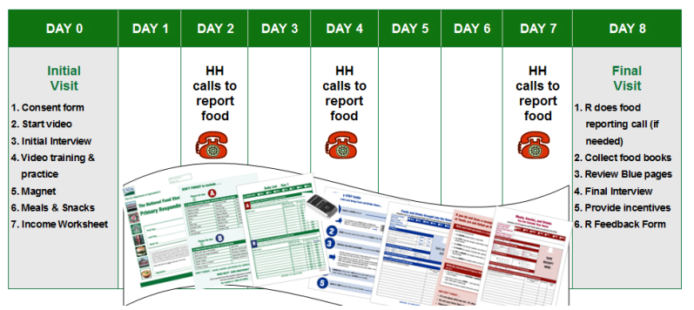
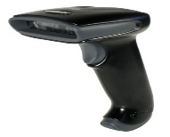
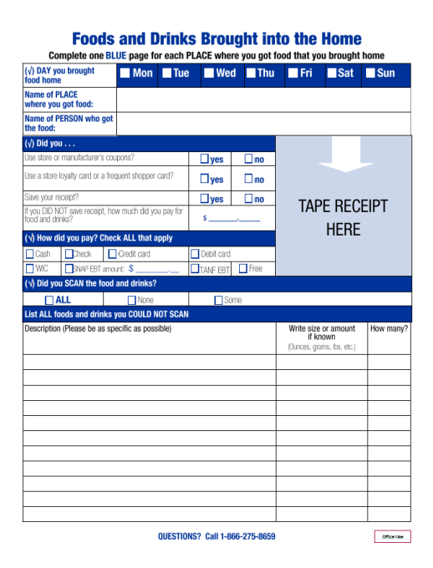

FoodAPS-1 constructs, measurement, and collection protocols
Households
Income
Food assistance program participation
Individuals
Demographics
Events
Place
Payment type
Items
Food security
Diet and nutrition knowledge
Total paid
Descriptions
Quantities
Expenditures
Eating occasions
School attendance
Dietary restrictions
Prices

Slide 5
Data quality, nonresponse, and burden in FoodAPS-1
Major findings:
Nonresponse and underreporting of food acquisition events tended to increase across the survey week (Hu et al 2017; Maitland and Li 2016)
Large households had significantly lower response rates to in-person interviews and telephone calls (Yan and Maitland 2016)
Large households reported significantly fewer per-person food events and food items than smaller households (Yan and Maitland 2016) but characteristics like income and SNAP-status were significantly associated with higher expenditure reporting (Hu et al 2017)
Several socio-demographic factors, including race, ethnicity, and education, are related to the likelihood of refusing to report or failing to confirm no acquisitions (Maitland and Li 2016)
Key challenge for FoodAPS-2 is to find ways to minimize burden and increase reporting over the survey period.

Slide 6
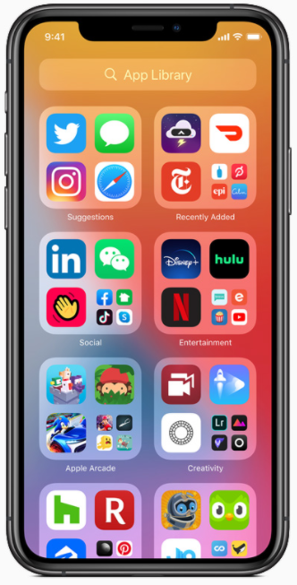
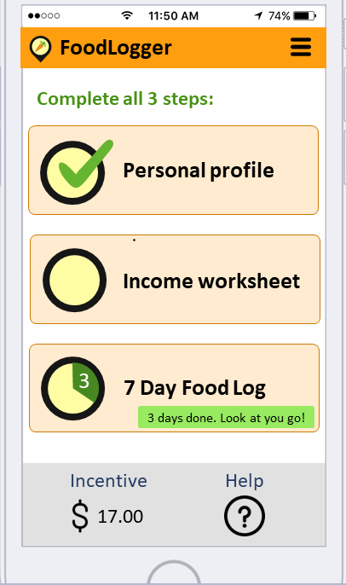
Goals for FoodAPS-2
Capture higher quality data and reduce backend processing time:
Leverage smartphone technologies (e.g., built-in camera and GPS location services)
Implement survey methodological enhancements (e.g., tailored communications and collection strategies, incentives)
Same survey concepts as FoodAPS-1 plus new for FoodAPS-2:
12-month data collection period
Expanded target population to cover Alaska and Hawaii
WIC as a sampling domain leading to larger WIC sample
Better identification of SNAP, WIC, and school meal program participants
Addition of new survey concepts – Feeding America, food pantry usage, veterans’ status, online ordering, etc.
Native smartphone application, FoodLogger

Slide 7
Primary research question
Are responsive design or subsampling strategies feasible in FoodAPS-2 to achieve further reductions in response burden and improve data quality?
Strategies conditional on participating in the seven-day food log and:
Sample characteristics and linked administrative data
Household- and individual- level characteristics
Respondent behaviors and tasks (e.g., save receipt, barcode scanning)
Survey items (e.g., report status, total amount paid)
Motivation: Certain response behaviors are less burdensome but may still yield complete and accurate data

Slide 8
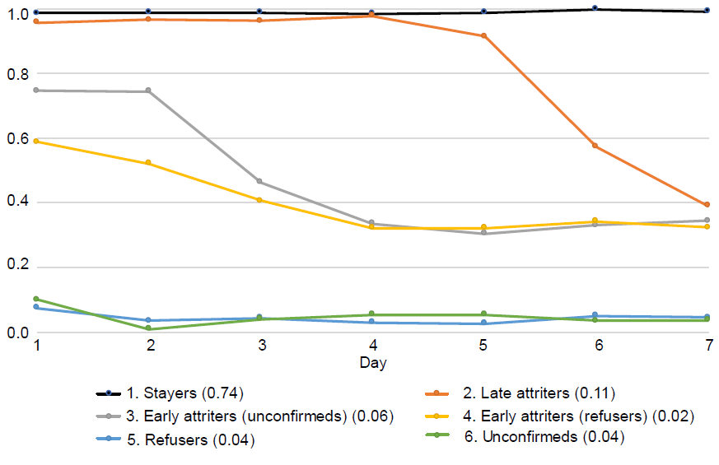
FoodAPS-1 data description and other sample characteristics
14,317 individuals living in 4,826 households with an overall response rate of 41.5%
Paradata includes contact and call history and acquisition report status
Distribution of the number of days on which individuals are …
 | Confirmed |  | Unconfirmed
Day | Percentage (%) | Count (n) | Percentage (%) | Count (n)
0 | 5.9 | 683 | 76.0 | 8,781
1 | 2.4 | 279 | 9.4 | 1,089
2 | 2.3 | 267 | 5.0 | 573
3 | 2.0 | 227 | 2.0 | 225
4 | 2.1 | 245 | 1.5 | 177
5 | 4.9 | 566 | 1.7 | 198
6 | 9.0 | 1,040 | 1.4 | 156
7 | 71.4 | 8,245 | 3.1 | 352
Estimated posterior probabilities of being confirmed
Confirmed acquisition indicates individuals who indicated that they did or did not acquire any food on that day.
Adapted from: Hu et al 2020

Slide 9
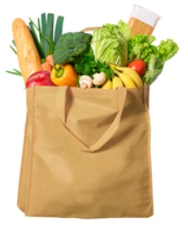

FAH and FAFH event- and item-level information
Method in which item was reported (FAH events)
 | Count | Percent
Scanned UPC code on package | 88,084 | 61.58
Scanned food book barcode | 9,386 | 6.56
Survey book | 11,070 | 7.74
Receipt | 34,510 | 24.12
Saved receipt (FAFH events)
 | Count | Percent
No receipt was provided | 25,290 | 66.24
Indicated saved | 10,574 | 27.70
Itemized provided | 96 | 0.25
Provided, condition unknown | 2,218 | 5.81
Total number of FAH events: 15,998
Total number of FAH items: 143,050
Total number of FAFH events: 39,120
Total number of FAFH items: 116,074

Slide 10
Next steps and simulation setup
Three simulation conditions
Completely random
Conditional on respondent characteristics
Conditional on observed response behaviors
Layers of evaluation
Potential for burden reduction
Traditional survey sampling features, e.g, design effects and CVs on average aggregate weekly expenditures, number of events, items per event

Slide 11
Foundation for FoodAPS-2
Field Test to be conducted in 2022:
Serve as a dress rehearsal for the full collection
Incentives experiment to evaluate the effect of doubling the daily incentive for Food Log reporting at Day 4
Obtain data survey costs
Analyze and model paradata to propose interventions for the full collection
Examples of planned paradata for collection:
Is GPS enabled?
Taps at the “Help Button”
Receipt upload
Food item picture upload

