Slide 1
Theoretical Inflation During Stay-in-Place Behavior by Rachel Soloveichik
Virtual FCSM Conference, November 2021
Disclaimer: The views in this presentation reflect those of the author and not necessarily those of the Department of Commerce or the Bureau of Economic Analysis.

Slide 2
Outline of Talk
Preview of empirical results
Discussion of price measurement literature
Imputing prices for unavailable products:
Official price index method
Theoretical method for products which are only available remotely
Theoretical method for products which are completely unavailable
Measuring theoretical inflation by state:
Hypothetical impact of a full stay-in-place policy
Observed impact of actual stay-in-place policies

Slide 3
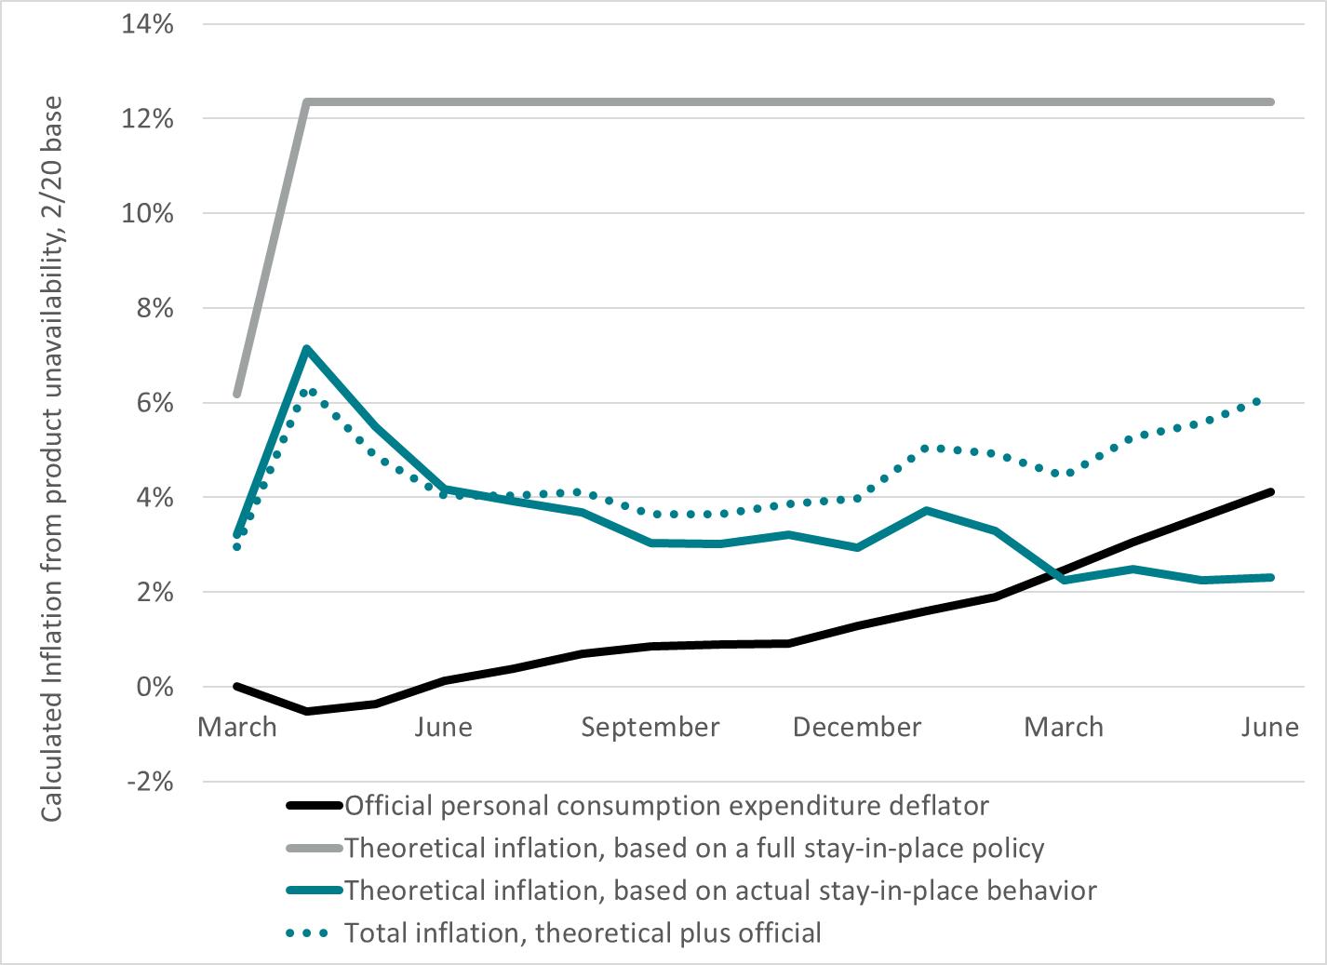
Preview of Results: Cumulative Inflation in U.S.
Notes:
This paper doesn’t study any health effect, so it doesn’t address the benefits from stay-in-place policies. Instead, it focuses on quantifying one cost using price measurement theory.

Slide 4
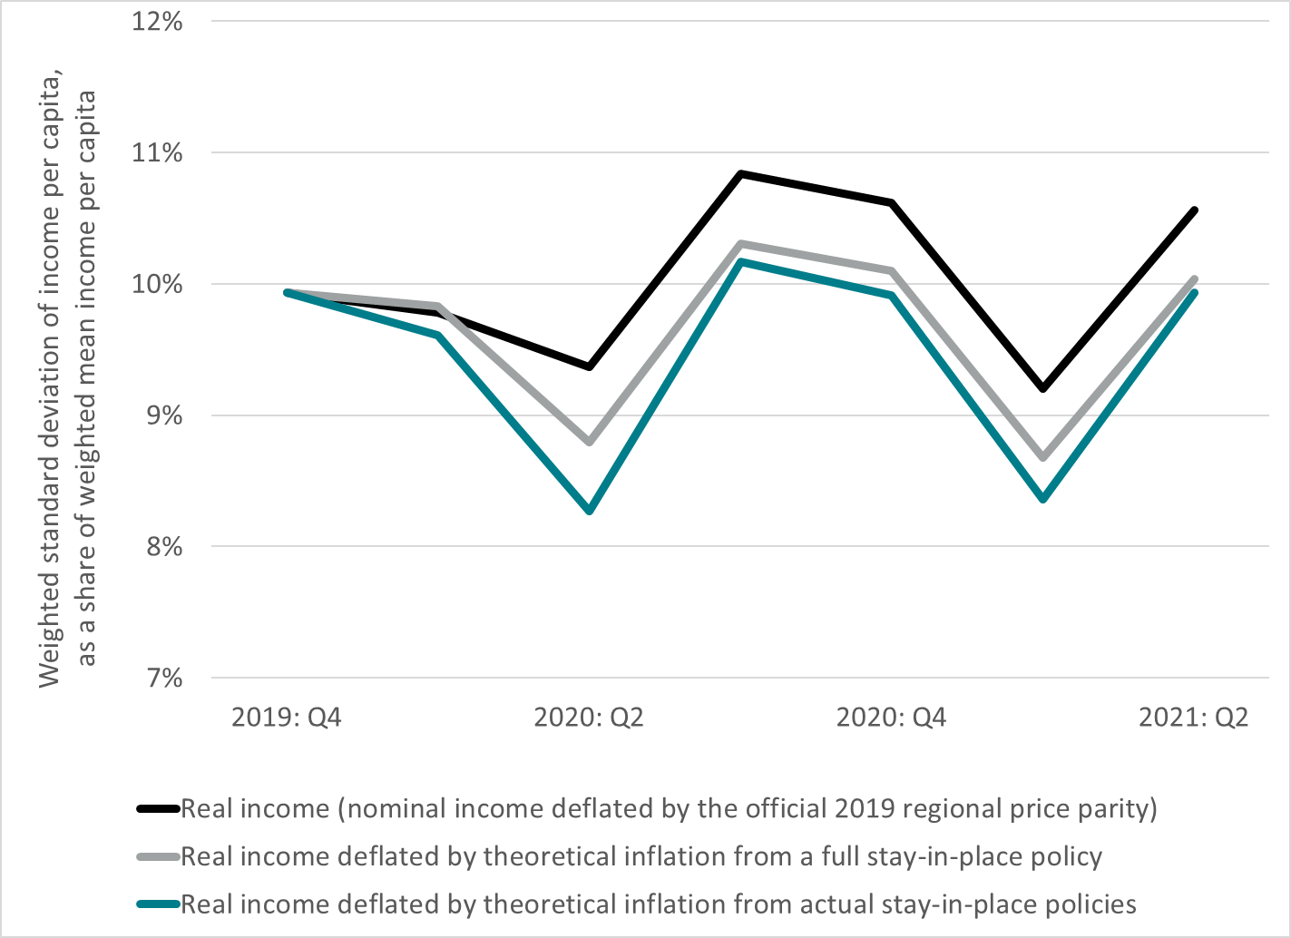
Preview of Results: Inequality Across States

Slide 5
Previous Price Index Research
Theoretical papers studying imputed prices:
“New Goods”: (Hausman 1999), (Hausman 1997), (Petrin 2002), (Goolsbee and Petrin 2004), (Berndt et al. 1996), (Nordhaus 1996), (Diewert and Feenstra 2019), and (Diewert et al. 2019)
“Outlet Substitution Bias”: (Reinsdorf 1993), (Hausman and Liebtag 2009), and (Greenlees and Mclelland 2008)
“Variety Bias”: (Feenstra 1994), (Broda and Weinstein 2010), (Handbury and Weinstein 2014), and (Dolfen et al. 2021)
Measurement papers studying practical issues:
Price aggregation formulas: (Diewert 2003), (Diewert 2001), (Passero, Garner, and McCully 2015), and (Barret, Levell, and Milligan 2015)
Price weights in pandemics: (Cavallo 2020) and (Diewert and Fox 2020)

Slide 6
Theoretical Price Measurement Problem
Standard price indexes summarize prices for products 1 to n into a single value
Laspeyres Price Index_{t} = w₁₀(p_{1t}/p₁₀)+ w₂₀(p_{2t}/p₂₀)+…+ w_{n0}(p_{nt}/p_{n0})
Standard price index formulas require prices for every product in the market basket
Economists generally can’t observe unavailable product prices
Some businesses might list a price for unavailable products – but that list price isn’t economically meaningful
Notes:
Some businesses might list a price on their website – but that listed price is not economically meaningful

Slide 7
Official Price Index Imputation Method
Bureau of Labor Statistics (BLS) assumption:
Imputed prices for unavailable products track observed prices for similar available products
This assumption works well in normal economic times (Bradley 2003)
BEA’s price indexes are based on BLS price indexes
Products which are only available remotely:
Assumption: BLS links remote prices at a retail outlet to the previous in-person prices at that retail outlet without adjustment
Products which are completely unavailable:
Assumption: BLS links each unavailable product with a similar available product and uses that product’s observed prices as an extrapolator
Notes:
I’m fairly sure that’s how BLS handled products which are only available remotely. In fact, BLS did the same for essential products early in the pandemic because they didn’t want to send surveyers to stores unnecessarily.
I’m less sure that’s how BLS handled completely unavailable products. It’s also possible that they just took reported list prices for those products from store websites and other sources. The two different methods might matter during an era of very rapid inflation – but that wasn’t the case early in the coronavirus pandemic.
In practice, this paper isn’t really concerned with measuring official inflation precisely. So, it’s not going to analyze BLS’s method in much detail.

Slide 8

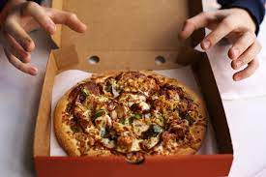
Products Only Available Remotely
Assumption: remote shopping is only a partial substitute for in-person shopping
All nonessential goods and some nonessential services are unavailable in-person but available remotely during a full stay-in-place policy.
The welfare loss from unavailable in-person shopping tracks the welfare gain from the introduction of remote shopping
Restaurant Meal: In-Person vs. Remote
Notes:
In theory, one could have a bad equilibrium where everybody prefers remote but they’re stuck in-person because of coordination issues, government rules, etc. That story might make sense for something like office work or medical care. But it clearly doesn’t apply to products like electronics, books, restaurant meals where there was a larger and easy to use remote market in 2019.

Slide 9


Completely Unavailable Products
Assumption: remote services aren’t even partial substitutes for some in-person services
Most nonessential in-person services are completely unavailable during a full stay-in-place policy
Assumption: the welfare loss from completely unavailable products tracks the welfare gain for tourists from specialized leisure amenities
Gambling: In-person vs. Remote
Notes:
In general, services that can be delivered remotely remained available throughout the coronavirus pandemic. But sports cable was canceled because live events were considered too dangerous.
It may be true that the remote service is produced by the same industry as the in-person service and has the same product code. But that doesn’t mean that they’re even partial substitutes.
Appendix A has much more details on the model set-up and the data used to solve it.
If anything, the price premium that tourists pay for leisure amenities is probably a lower bound. After all, most people think that Broadway plays, skiing, and other tourist amenities are less important than non-emergency medical care, childcare, etc.

Slide 10
Calculating Theoretical Inflation
Products which are only available remotely:
Elasticity of online shopping is estimated at 4.3 (Dolfen et al. 2021)
Theoretical price for product = (official price for product)*(1+1/4.3)
Products which are completely unavailable:
Elasticity for unavailable products is estimated at 1.7 based on a model of tourist behavior and BEA’s regional price parities
Theoretical price for product = (official price for product)*(1+1/1.7)
Aggregate inflation formula:
Theoretical inflation = Official inflation +
(normal budget share for products that are only available remotely)*0.23+
(normal budget share for completely unavailable products)*0.59
Notes:
The 4.3 number is based on pre-pandemic data. So, it measures elasticity relative to offline shopping rather than elasticity when non-essential stores are closed.
Given those two parameters, one can easily calculate aggregate inflation by simply multiplying the budget share for products which are only available remotely by 0.23 and the budget share for products that are completely unavailable by 0.59

Slide 11
Measuring Theoretical Inflation By State: Hypothetical Impact of a Full Stay-in-Place Policy
Assumptions:
Goods and services purchased remotely in 2019 are available
Essential in-person services are available, but non-essential in-person services are either only available remotely or completely unavailable
Goods purchased in-person at essential retailers are available, but other goods are only available remotely
Datasets used:
Product detail by state and industry from the 2017 Economic Census
BEA’s statistics report 15 categories of consumer spending by state
Earnest Research reports remote shopping by purchaser residence
Section 2 of the paper estimates spending and availability for 52 subcategories of consumer spending by state
Notes:
In theory, the line between remote services and essential services is a little fuzzy. For example, which category does housing fall into? In practice, this distinction doesn’t really matter for product unavailability – so I won’t discuss it further.

Slide 12
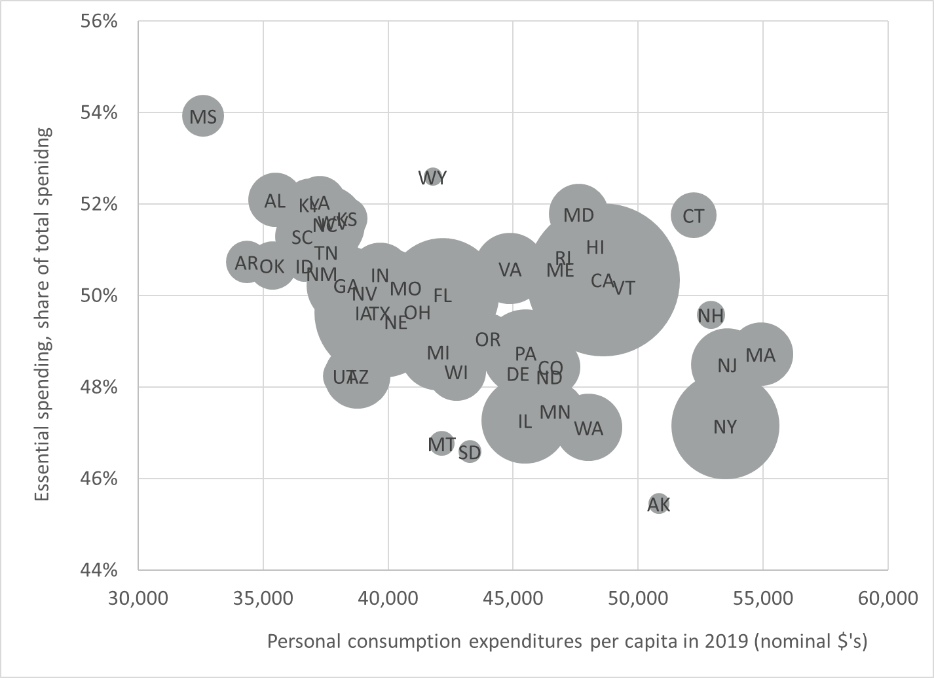
Essential Products in 2019

Slide 13
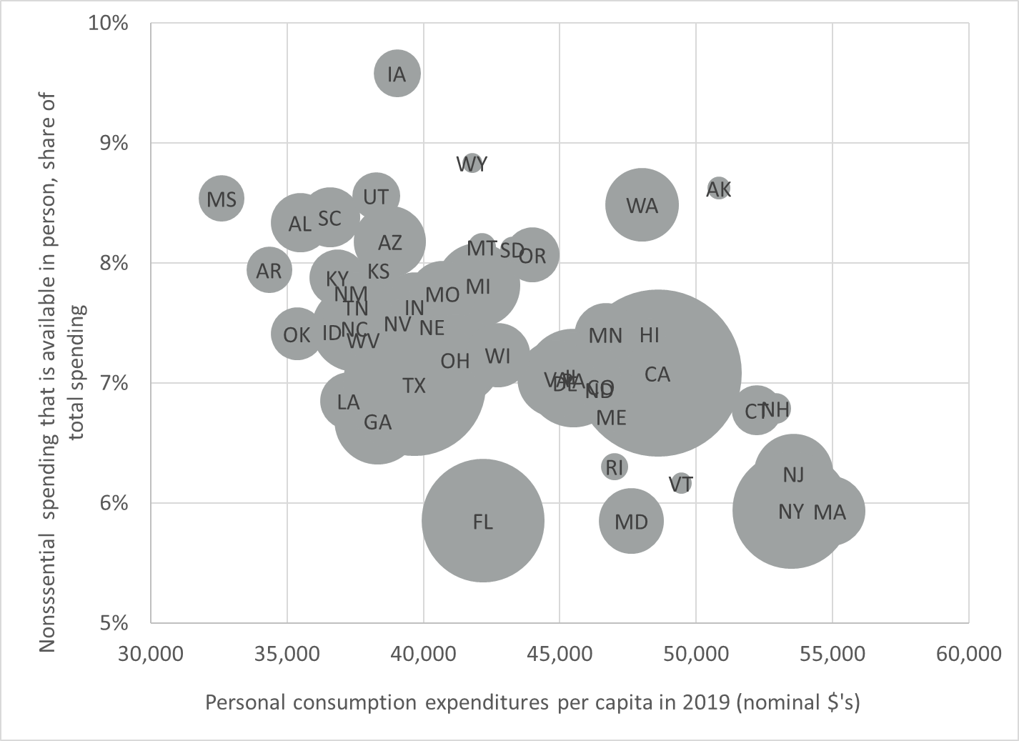
Nonessential Goods Sold in Essential Stores

Slide 14
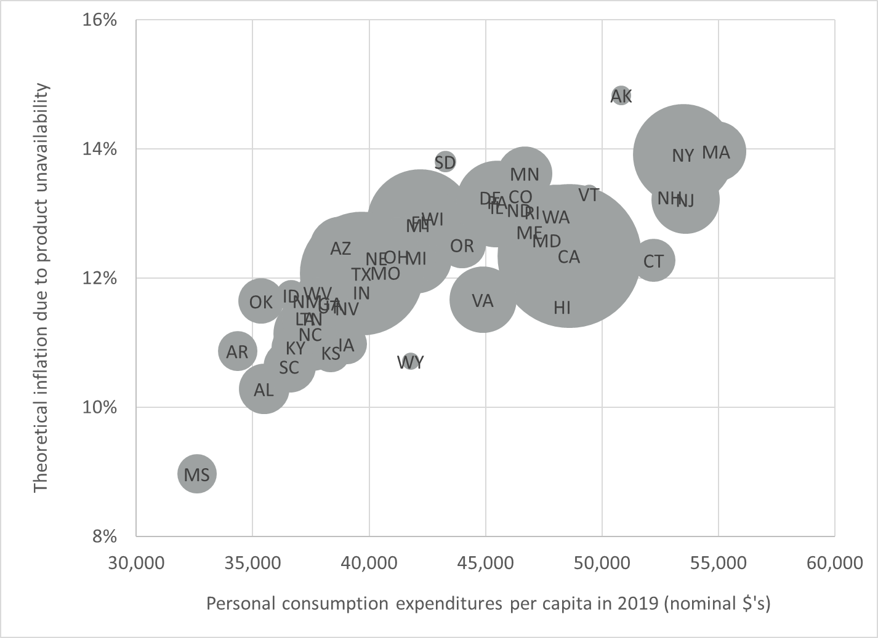
Theoretical Inflation in a Full Stay-In-Place Policy

Slide 15
Measuring Theoretical Inflation By State: Observed Impact of Actual Stay-in-Place Behavior
Data tracking actual stay-in-place behavior by state and month was not located
Some sources track official government rules – but the actual stay-in-place behavior depend on voluntary choices as well as laws
Google’s COVID-19 community mobility reports are used to proxy for theoretical inflation:
Assumption: time spent at retail and recreational locations proxies for availability of nonessential products sold both there and elsewhere
Assumption: Google’s sample of smartphones is representative of overall consumer spending
Assumption: theoretical inflation is linearly with product unavailability
Notes:
The paper does not distinguish between consumers who could not purchase a product because it was banned by the government, and businesses which stopped producing a product to avoid coronavirus transmission, consumers who stopped buying a product because of coronavirus transmission, or other complex reasons for product unavailability.
Google tracks time spent at grocery stores and pharmacies in a separate category – so those essential retailers don’t really influence this paper’s analysis. Similarly, health care facilities aren’t included in the retail and recreation category. The essential businesses studied here include general merchandise stores, auto supply stores, laundromats, etc. stayed open.

Slide 16
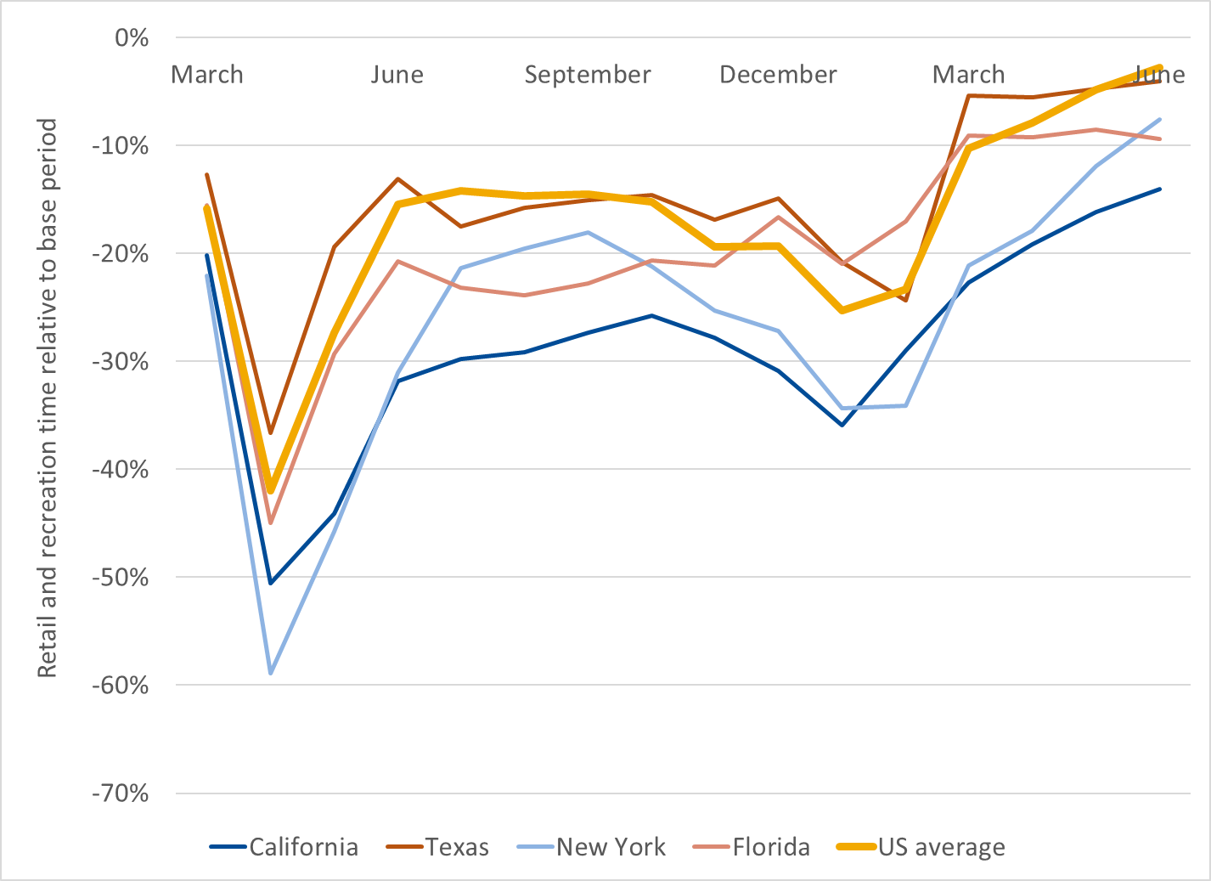
Raw Monthly Retail Time, Selected States
Notes:
The ATUS regional data doesn’t match BEA’s geofips data precisely. The paper uses its best judgment to match the regions which are close, and then drops regions which can’t be matched.

Slide 17
Adjustments to Google’s Raw Retail Time
Daily retail time is higher during moderate weather, so the paper controls for daily weather
Weather matters more when sunset is later because people have more time to enjoy the pleasant weather after work
The impact of weather is similar before and during coronavirus
Daily retail time is adjusted for holidays using data from the American Time Use Survey (ATUS)
Google’s category ‘retail and recreation’ includes essential stores – so retail time can’t fall to zero
Adjusted mobility formula: (observed mobility)/(potential mobility)

Slide 18
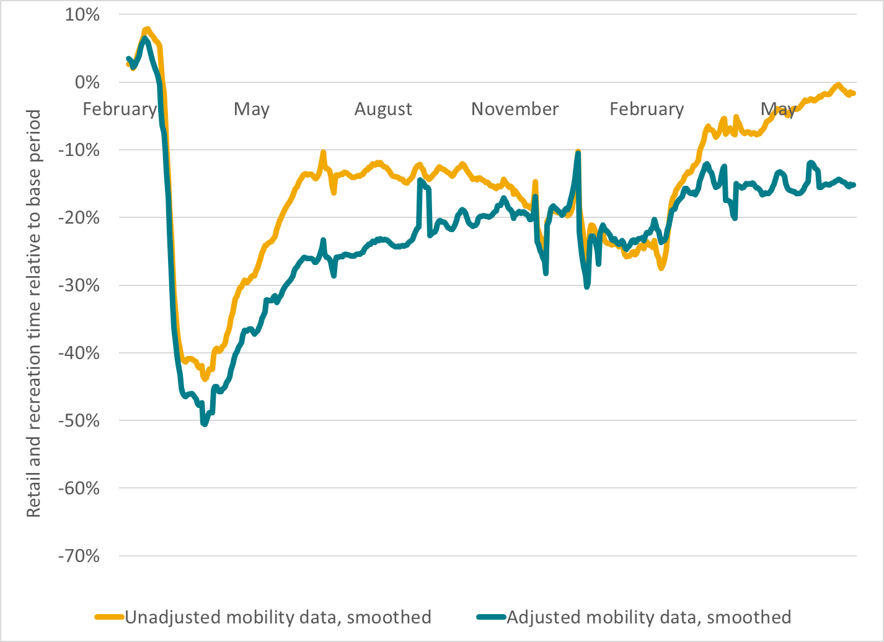
Adjusted vs. Unadjusted Mobility, Smoothed
Notes:
The unadjusted mobility data show much more recovery than the adjusted data. This is due to the fact that mobility is seasonal and normally increases when weather gets good.

Slide 19
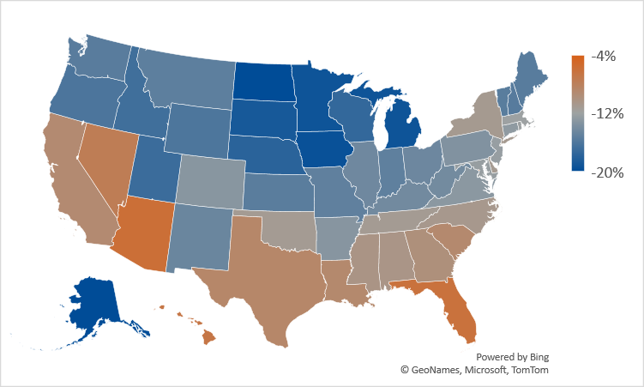
Unadjusted Minus Adjusted Mobility, Average 3/20-6/21

Slide 20
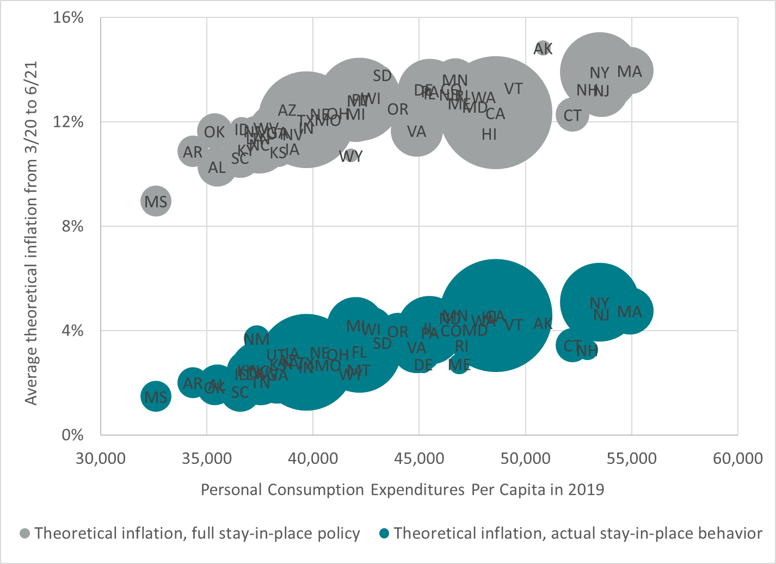
Average Theoretical Inflation by State
Notes:
This graph shows that high income states have both higher theoretical inflation in a full stay-in-place policy, and also higher theoretical inflation in actual stay-in-place behavior. The two lines have the same slope because high income states typically imposed much stricter stay-in-place policies than poorer states. In other words, all state exempted the same absolute spending share.

Slide 21
Cumulative Inflation, U.S. Average

Slide 22

Inequality Across States by Quarter
Notes:
20 percent for available housing; 27 percent for available goods; 5 percent for unavailable goods; 31 percent for available services; 17 percent for unavailable services; and 2 percent for unavailable amenities

Slide 23
Conclusion
This paper developed a simple formula to calculate theoretical inflation during stay-in-place behavior
The theoretical model in this paper does not imply any data problems or computational mistakes with published government price indexes
Revisions to monthly inflation:
0.11 (official) vs. 0.47 (theoretical) percentage point for 2020
0.22 (official) vs. -0.11 (theoretical) for first half 2021
Higher income states have higher theoretical inflation
Based on official statistics, the paper calculates that real regional inequality in 2020 grew 3 percent
This reverses to a 4 percent decline in theoretical regional inequality
Notes:
Partial reopenings are generally much more complicated than full stay-in-place orders. In addition, compliance with official government orders has fallen dramatically. As a result, it may be much harder to analyze prices in the Q2 than Q1.

