Slide 1
Discussion of Final Report of the Interagency Technical Working Group (ITWG) on Evaluating Alternative Measures of Poverty: Consumption as a Resource Measure
Thesia I. Garner
Bureau of Labor Statistics (BLS)
Division of Price and Index Number Research (DPINR)
FCSM 2021 Research and Policy Conference
November 4, 2021
(revised October 30, 2021)

Slide 2
Outline
Why a consumption-based measure of resources?
What to include? How to define?
Recommendations and comments
Select challenging components (i.e., education, health, non-financial assets)
Data quality including administrative data
Data source
Funding
Implementation and future direction
Notes:
Only comments regarding recommendations as only one response based on Report, but another based on ITWG discussions before report completed.
Comments regarding CE regular work on data quality, research within DPINR, and BLS initiative to produce a consumption measure of economic well-being However ongoing BLS research/change in data collection regarding data quality, and BLS initiative to produce a consumption measure of economic well-being .

Slide 3
Why a Consumption-Based Measure of Resources?
Focus on not how we could live, but how we do live…
Consumption-based measure may more directly capture the resources available to a family if it records the consumption that was actually achieved
Conceptually, such a measure reflects long-run “resources” and one’s ability to smooth consumption over life cycle
Depends on
Current income; public and private transfers/in-kind benefits; assets (financial and non-financial); access to credit
Stage in one’s life-cycle, changes in family composition
Expectations/uncertainty about future income, employment, inflation, bequest motives, preferences
Time
Examples of pros and cons
Good measure to identify who is poor based on material deprivation
Empirical studies suggest that people may report more accurately expenditures (a component of consumption) than income
May not be a good if interested in short-term impacts of temporary fluctuations income
Notes:
A family could achieve this consumption through using income, savings, accruing debt, or other means. (UNECE 2017)
Consumption reflects use of resources
Income
Access to debt
Financial assets
Non-financial assets
Time
Families may more accurately report expenditures than income, and conceptually consumption may better reflect their material circumstances because it could reflect the actual consumption a family achieved, rather than what income is available to them to purchase those goods and services.
For research using expenditures and or/or consumption to measure material well-being, e.g.,
Earlier: Cutler and Katz (1991), Garner (1993), Poterba (1991), Slesnick (1993, 2001). More recent: Johnson et al. (2005), Meyer and Sullivan (2012), Fisher et al. (2015), and Meyer and Sullivan (2018)

Slide 4
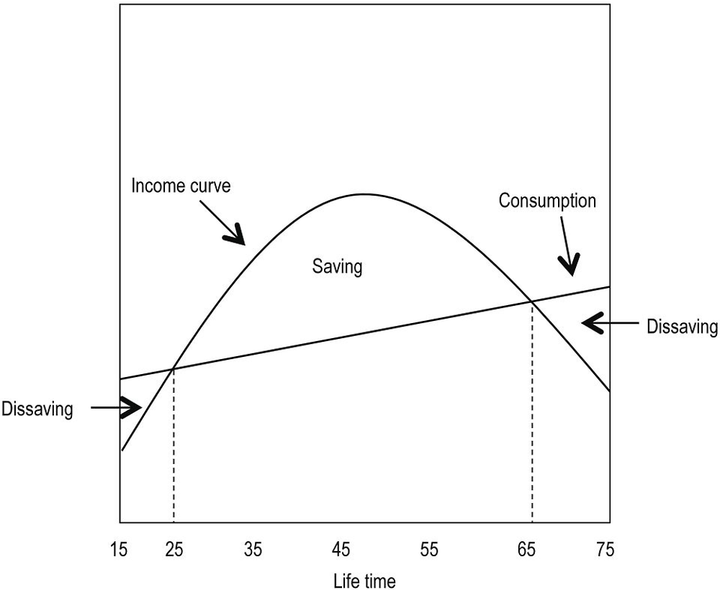
Life Cycle Theory of Consumption suggests that individuals plan their consumption and savings behavior over the course of their lives
from assets
including pensions
Loans
Transfers from family
Working years
Retirement
years
Youth
years
Image address: https://www.oecd-ilibrary.org/sites/9789264281288-12-en/images/images/graphics/g9-1.png
Notes:
Youth years: the individual’s level of income is lower than consumption needs, which are financed through loans or transfers from family, generating a phase of dis-saving.
In the second stage, that of working life, the individual’s income allows them not only to meet their consumption needs, but also to generate a surplus in the form of savings.
Finally, in the third stage, the retirement stage, there is again a process of dis-saving, in which the individual uses the savings that were generated throughout their working life (once the compensation for the initial stage of dis-saving has been discounted) to meet their consumption needs.
Challenge to the life-cycle model has been directed at its basic underlying assumption, that people make rational, consistent, intertemporal plans, that they act as if they are maximizing a utility function defined over the periods of life, according to “the received theory of consumer choice over time à la Fisher” (Modigliani 1975, p. 5). .. Economists behavioral assumptions about consumer choice have long been challenged by psychologists and others but, until recently, these critiques have not had much effect on mainstream economic analysis.
Deaton, Angus, “Franco Modigliani and the life-cycle theory of consumption *“, BNL Quarterly Review, vol. LVIII, nos 233-234, June-September 2005, pp. 91-107. ‘
BNL =Banca Nazionale del Lavoro
1. Franco Modigliani, an Italian-American economist, received the Nobel Prize in Economics for his studies on microeconomics, especially for his life-cycle hypothesis—which originated in Keynes’s work—and for his analysis of how financial markets operate. More specifically, the life-cycle hypothesis suggests that individuals plan their consumption and savings behavior over the course of their lives.
2. Modigliani’s study concludes that, during their economically active period, individuals save and accumulate capital that they use during their retirement. The first stage is the pre-work life stage; the second is the working life stage itself; and the third is the retirement stage once the cycle of productive activity has come to an end.

Slide 5
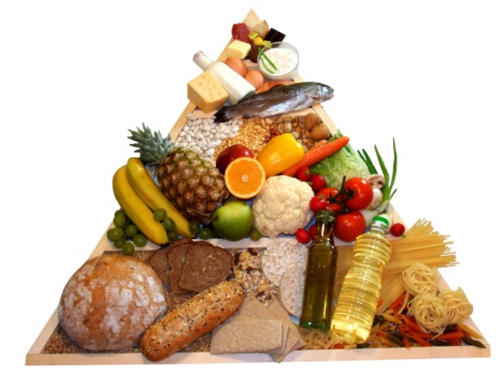
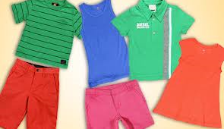


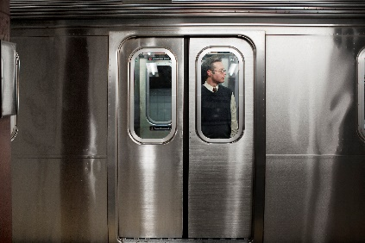





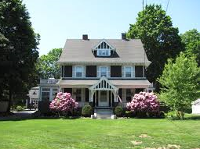
Consumption—What to Include? How to Define?
Expenditures
In-kind benefits
Flow of services
Exclude expenditures
Allocations to pensions and life insurance are assumed to enhance future consumption
Owned shelter and vehicle purchases
To include or exclude?
Health expenses
Education expenditures
Notes:
Researchers begin by summing most categories of expenditures, such as food eaten at home, food eaten away from home, rent, utilities, transportation, clothing and other goods and services. Expenditures that are made through SNAP food assistance program would also be included. Some other social transfers inkind such as WIC would also be included in consumption measures as they would be in comprehensive income measures.
Certain categories of expenditures have been thought of as enhancing future consumption and thus, have been typically excluded, such as pension contributions and education expenses. (See, for example, Cutler and Katz 1991; Slesnick 1993; Meyer and Sullivan 2012b; Fisher et al. 2015.) Health expenditures are less uniformly excluded, since they have both substantial investment and immediate consumption features.
The Working Group proposes a variant on this approach where a value of any public or private health insurance coverage that an individual has is included. Current expenditures on owned vehicles and homes are also typically excluded. Instead, the value of service flows is calculated for these, using methods like those previously described in an earlier section, and included as part of consumption. (p.49)
The main source of consumption data in the U.S. is the CE Interview Survey.

Slide 6
Consumption: Service Flows from Non-financial Assets
Why account for service flows?
Because we do not “consume” the house or car, instead we “consume” the flows of services (market or consumption value) from these
Primarily two main valuation approaches used internationally
User costs
Rental equivalence
Both to measure change over time in the value for the flow of services consumed by owner-occupants or vehicle owners
In theory, both approaches should produce equivalent values, but rarely do empirically
Literature
Focuses on owner-occupied housing
Implication that the same or similar methods can be used for durables or non-financial assets like vehicles (see ILO 2003, paragraph 292)
Notes:
As noted by Garner and Verbrugge (2009), “In standard frictionless Jorgesonian capital theory with competitive markets, a durable good’s rental costs will equal its ex ant user cost, suggesting that these alternative measurements of the value of the flow services should be roughly equivalent.” However, empirically, values based on the two approaches diverge.

Slide 7
Consumption: Service Flows Defined in Terms of User Costs
Costs of producing (using) the service: “…user cost approach attempts to measure the changes in the cost to owner-occupiers of using the dwelling; user costs account for both recurring costs and the opportunity cost of having money tied up in the dwelling rather than being used for some other purpose” (ILO 2004, p. 179).
Components of user costs
Recurring costs like mortgage interest payments, property taxes, property insurance, and routine maintenance and repairs (including those for major appliances included in the shelter unit when covered by the rental contract)
Opportunity costs of investing in this shelter property as opposed to another asset or for another purpose
Depreciation rate
Expected appreciation rate
Income tax rate (advantages of owning: lowers user costs)
Notes:
As noted by Garner and Verbrugge (2009), “In standard frictionless Jorgesonian capital theory with competitive markets, a durable good’s rental costs will equal its ex ant user cost, suggesting that these alternative measurements of the value of the flow services should be roughly equivalent.” However, empirically, values based on the two approaches diverge.
User costs of capital
Market value of home
Nominal mortgage rate
Depreciation, maintenance and repairs, insurance
Property tax rate
Income tax rate (will lower user costs)
Expected appreciation rate (will lower user costs)
Return to investment
Gross implicit rent =capitalization rate*market value of home

Slide 8
Consumption: Service Flows Defined in Terms of Rental Equivalence
Selling price of the service: “…rental equivalence approach attempts to measure the change in the price of the housing service consumed by owner-occupants by estimating the market value of those services” (ILO 2004, p. 180)
Market rent that landlord would charge for a unit (selling price of the service provided by the housing structure)
The rent an owner occupant would pay to rent her own home
In the U.S., service flows from major appliances (e.g., refrigerators, stoves) are included in comparable rental units, unlike in many European countries, and thus are implicitly included in rental equivalence
Most often used valuation approaches
Imputed rents (e.g., from regression models) + “premium”
Reported rental equivalence (asked in CE Interview)
Notes:
As noted by Garner and Verbrugge (2009), “In standard frictionless Jorgesonian capital theory with competitive markets, a durable good’s rental costs will equal its ex ant user cost, suggesting that these alternative measurements of the value of the flow services should be roughly equivalent.” However, empirically, values based on the two approaches diverge.

Slide 9
Rental Equivalence and Adjustments for Renter-like Expenditures
Rental equivalence question in CE Interview If someone were to rent this “dwelling” how much do you think it would rent for monthly, unfurnished and without utilities?
Optional treatments for owner shelter-related expenses (those not implicitly included in rental equivalence)
Exclude all
Ratio adjust as is done for Consumer Price Index to make them “renter-like”, for example
Adjust expenditure for homeowners’ insurance premium by a factor is 0.41 to reflect the share that only covers “contents and personal items” (tenants’ insurance)
Adjust expenditures for homeowners’ landscape maintenance by a factor of 0.061 to reflect share not covered by rental equivalence (rental contracts that require renter to maintains the yard at their own expense)
Notes:
“(including part of the property currently being used for business, farming, or rented/home today) “
What are the following variables used for? Other properties?
03I RNTEQV2X RNTEQV2X If someone were to rent this home today, how much do you think it would rent for? IF (RNTEQV2X lt 200 or gt 800) AND (ne DK and ne RF) then goto ERR1_RNTEQV2X ELSE goto RENTPERD 03I RENTPERD RENTPERD Ask if not already stated.
What period of time does this rental amount cover? 1. Week 2. Month 3. Quarter 4. Other specify 1-3,DK,RF: Goto RENTUTIL 4: Goto RNPEROTH 03I RNPEROTH RNPEROTH Specify: Goto RENTUTIL 03I RENTUTIL RENTUTIL
Does this amount include utilities? 1. Yes 2. No

Slide 10
Recommendations

Slide 11
Accounting for Health in Consumption
Recommendations #5, 13, 14, 15, 16
Recommendation 5. The Working Group recommends that the Bureau of Labor Statistics develop and publish two new sets of research measures of consumption-based resources
Includes a value of health insurance (e.g., market value, willingness to pay, fungible value)
Does not include a value of health insurance
Treatment of non-premium medical out-of- pocket expenditures not covered by insurance, e.g., co-pays, deductibles, prescription drugs, and over the counter items requires further research
Current status
No plans in response to ITWG Report
Related: BLS research initiative to develop a consumption measure of economic well-being, and measure of consumption expenditures for distributional accounts (CE-PCE project)

Slide 12
Recommendations #17, 19: Education
17. The Working Group recommends that expenditures on education be excluded from the recommended extended income-based and consumption-based resource measures because education is generally considered an investment in human capital.
19. The Working Group recommends continued research and additional stakeholder and expert engagement on whether and how to treat education within resource measures.
Current status
No plans in response to ITWG Report

Slide 13
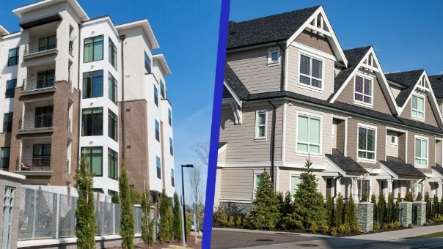


Recommendation # 27: Service Flows from Non-financial Assets
27. The Working Group recommends that the value of service flows from owner-occupied shelter and the value of the service flows from owned vehicles be included in the consumption resource measures.
Current status
CE Interview already includes rental equivalence for owner-occupied housing
Related: BLS research to produce flow of services cars and trucks
Notes:
Income Recommendations # 20: Service Flows and Other Asset Flows 20. The Working Group recommends that further research be undertaken to evaluate alternative methods to estimate the net value of service flows from owner-occupied shelter and the net value of the service flows from owned vehicles to be included in the income resource measures, including the possibility of imputing such values using statistical methods and data from the CE Survey. Such research should consider the availability of data from the CPS ASEC and ACS.
The conceptual framework, underlying the idea that the income or service flows from owner-occupied housing (including second homes) and vehicles be included, is that if two households have identical incomes but one owns a home or vehicle and the other does not, the household with the home or vehicle is often better off than the household without.
From owner-occupied housing and vehicles. PLUS value for the net service flows from household durables and including the value of unpaid domestic services (i.e. home production for the consumption of one’s sharing unit) are included in the conceptual definition of income.

Slide 14
Recommendations #6, 23: Administrative Data
6. The Working Group recommends that the Census Bureau and the Bureau of Labor Statistics use, where available and when appropriate, administrative data to supplement or replace the use of survey data for developing the recommended measures.
23. The Working Group recommends that the advisory structure recommended previously should vet decisions about data sources, adjustment strategies, and other assumptions. This advisory structure should consider and discuss continued research into availability and applicability of administrative data sources.
Current status
No plans in response to ITWG Report
Related: regular CE work to improve data quality
Proof of concept project: match of CE Interview and HUD administrative data for 2013 to 2017 for voucher recipients and consumer units living in public housing (under revision)

Slide 15
Recommendation #22 (in part): Model-Based Approaches
… Regression-based modeling (with or without individual-level or aggregate administrative data) can also improve the quality of estimates of income, expenditures, and program participation…
Current status
No plans in response to ITWG Report
Related: research for Supplemental Poverty Measure (SPM) thresholds could be adapted for production of consumption-based resource
Imputation of non-collected in-kind benefits in the CE for NSLP, WIC, home energy assistance using CPS ASEC in combination with CE, and NSLP and WIC benefits data from USDA
Imputation of “market” rents, using CE Interview data for renters paying “market” rents and renters living in public housing, rent-controlled units, receiving financial assistance with rent (e.g., voucher), rent as pay

Slide 16
Recommendation #24: Data Quality
24. The Working Group recommends that the Census Bureau and the Bureau of Labor Statistics continue to research, and possibly implement, ways to reduce survey burden and improve the quality of resulting data through increased access and use of administrative data in surveys, including the … CE. Current status
No plans in response to ITWG Report
Related: regular CE work to improve data quality
Developing streamlined Interview questionnaire (some on progress, others first phase April 2023)
Reduce the level of detail started April 2021 (e.g., for apparel, can no longer distinguish between men and women, or boys and girls, or infants; only by age group: 18 years and older; 0-17 years of age)
Facilitate the use of records
Some changes to the order and section organization
Developing Consumer Assisted Recorded Interview (CARI) for Interview to be implement in July 2022; goal to improve data collection and question wording
Notes:
Prior to questions below, there are targeted questions asking about men’s suits/uniforms and clothing services. Hence “all other”.
Now I am going to ask about clothing, footwear, and accessory expenses for your household.
Since the first of (reference month), how much (have/has) (you/your household) spent on ALL OTHER clothing, footwear, and accessories for (yourself/the following people in your household)? (Names of person 18
Since the first of (reference month), how much (have/has) (you/your household) spent on ALL OTHER clothing, footwear, and accessories for (Childs name/the following people in your household)? (Names of person 0-17)
Since the first of (reference month), how much (have/has) (you/your household) spent on ALL OTHER clothing, footwear, and accessories for those outside of your household

Slide 17
Recommendation # 26: Data Source
26. The Working Group recommends that the Bureau of Labor Statistics use the CE Interview Survey data to research and develop a consumption-based resource measure.
Current status
Response to ITWG Recommendation #26: planned presentation on consumption resource poverty during ASSA/AEA Annual Meetings 2022
Related: BLS research initiative to develop a consumption measure of economic well-being

Slide 18
Recommendations # 28, 29: Geographic Area for Estimates
28. The Working Group recommends that the CE Interview serve as the primary data source for the production of the consumption resource measures, with estimates produced at the state level.
29. The Working Group recommends that the current CE Interview Survey serve as the interim data source for the production of the consumption resource measures, with estimates produced at the Census Division level.
Current status
No plans in response to ITWG Recommendations

Slide 19
Recommendation # 25: Funding
25. The Working Group recommends funding support of the work to develop the new recommended measures, including funding to support BLS to research the nature and construction of a potential consumption-based poverty measure and improve the CE program in support of improved poverty measurement. A proposal requesting $7.1 million was included in the fiscal year 2021 President’s Budget.
$7.1 million included in President’s FY2021 Budget request to Congress for BLS
Conduct research on potential consumption-based poverty measure
Improvement in CE program in support of production-quality SPM thresholds
Funds not included in the final FY2021 appropriation from Congress
Current status
No additional plans in response to ITWG Report (request made in 2020 during ITWG meetings)
Continues to be much interest within BLS supporting this work
Related: BLS research initiative to develop a consumption measure of economic well-being

Slide 20
Recommendation #1: Engage with Stakeholders
The Working Group recommends that the Census Bureau and the Bureau of Labor Statistics engage with stakeholders and other experts throughout the development of the recommended measures…
Current status
No plans in response to ITWG Report
Related BLS research initiative to develop a consumption measure of economic well-being
Consumption Symposium, virtual in September 22-23, 2021 (see https://stats.bls.gov/cex/consump_symposium.htm )
Federal Statistics Advisory Committee (FESAC) meeting, December 10, 2021
Research presentation during ASSA/AEA 2022

Slide 21
Challenges for a Consumption Resource Measure: Implementation Issues and Future Direction
Implementation
Consumer Expenditure Survey
Interview, Diary, both
Sample size, geography
No to little data collected on in-kind transfers (public, private)
Misreporting and under-estimates
Redesign efforts could complicate production of a consistent measure of consumption over time
Administrative data (e.g., public in-kind benefits)
Availability, coverage, quality, timeliness
Permission to use
Alignment with survey concepts
Disagreement between administrative and survey sources
Imputation methods
Future Direction: integrate ITWG Recommendations with BLS initiative to produce a consumption measure of economic well-being

Slide 22
Contact
Thesia I. Garner, Ph.D.
Chief, Division of Price and Index Number Research
Office of Prices and Living Condition
Bureau of Labor Statistics
Washington, DC 20212
Garner.Thesia@BLS.gov
Office telephone: (202) 691 6576

Slide 23

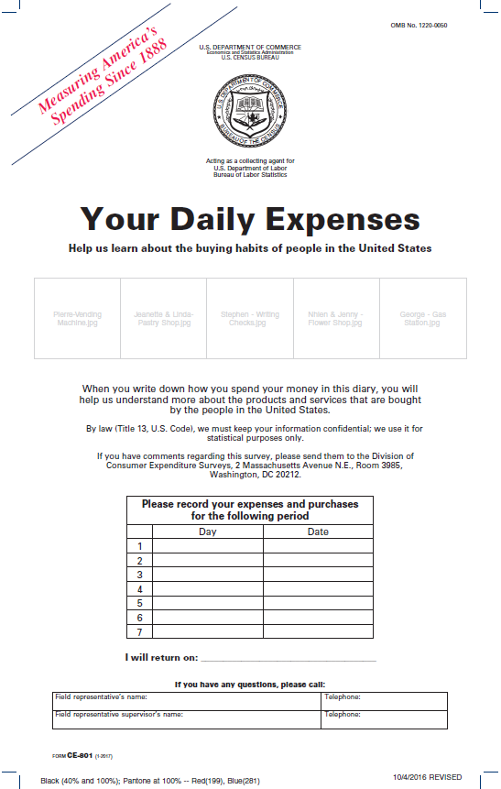
Current CE Design
4 waves of personal interviews
3-month recall
Large or recurring expenditures
2 one-week household paper* diaries
Contemporaneous recall
Small, frequently purchased items
Consumer Expenditure Survey Estimates
Slide from presentation by Laura Erhard, CE Division, Survey Methods Symposium, July 20, 2021
Notes:
Here is the design that we currently use for the CE surveys to create our annual expenditure estimates. Like I said - those of you that are new and are planning to stick around for the microdata user’s workshop, there will be a lot more detail on the CE surveys and design over the next 3 days.
The current survey consists of 2 separate surveys with independent samples: the interview survey and the diary survey. The Interview survey is collected over 4 waves via a personal visit from a Census interviewer and covers a 3 month recall. It’s designed to capture large or recurring expenses that a respondent can reasonably remember over a 3 month period.
The diary survey, in contrast, is designed to capture smaller, more frequently purchased items. The current design is to collect this with two one-week paper diaries. Although, you’ll note the asterix…we are currently using online diaries that were developed for our most recent field test as a contingency due to the pandemic, though the online diary has not been officially implemented. But I’ll discuss that a little later.
Data from the two surveys are combined to produce CE estimates.

Slide 24
CE Design
CE Diary and Interview
CE Interview
Current design: 4 interviews, 3- month reference period
No requirement that consumer units remain in 4 quarters (quarterly data assumed independent; no longitudinal weights)
Consumer units (CUs) enter the sample on a rolling, not calendar-year, basis (data collection period, for example, first interview in June 2020 reference period of March, April, and May 2020; and last interview in February 2021 with reference period of December 2020 through February 2021)
Relevant data for consumption measure: expenditures, rental equivalence of owned home, stock of owned vehicles, presence of health insurance (private-self, employer-provided, Medicaid, Medicare, other government), CU demographic variables

Slide 25
Gemini Redesign Plan
2013: Redesign Plan approved
2015: Proof of Concept Test complete
2016: Incentives Test complete
2020: Large Scale Feasibility Online Diary Test (LSF) complete
2022:
Online Diary Implementation
You are here!
2023 onwards:
Phased Implementation of Streamlined Questionnaire
Slide from presentation by Laura Erhard, CE Division, Survey Methods Symposium, July 20, 2021
Notes:
The CE launched the Gemini redesign project several years ago with an aim to improve data quality in the Consumer Expenditure Surveys…. particularly by reducing measurement error.
Since the redesign plan was approved in 2013, we’ve been working towards testing different elements of the design to assess what works and what hasn’t worked.
This is the timeline of where we’ve been and where we are.
As I mentioned our redesign plan was approved in 2013, which we went on to test in 2015. Following that we conducted an incentives test, which was one of the components of the redesign.
You’ll notice a small break in the timeline…I didn’t know how best to portray that back in early 2018, we slightly shifted from the original redesign plan due to cost constraints and moved into a phased implementation of several of the redesign plans main elements, which I’ll discuss in the next slides
But – continuing on with the timeline
We just finished up a large scale feasibility test of the online diary
We are starting the implementation phase of our redesign.

Slide 26
BLS Production of a Consumption Measure
Who?
Researchers and staff in Divisions of Price and Index Number Research (DPINR) and Consumer Expenditure Surveys (DCES) with assistance from OEUS and outside research community
Support from Commissioner Beach (April 2021)
What?
OECD 2013 Framework definition
Consumption expenditure - value of consumption goods and services used or paid for by a household to directly meet its needs
purchase of goods and services in the market
consumption flows from owner-occupied housing, vehicles, and durables
in-kind transfers from employers
barter of goods and services
household’s own production of goods and services consumed
transfers in-kind from other households (e.g., gifts) and from businesses
GOAL: Actual final consumption - sum of
consumption expenditure
value of social transfers in kind provided by government and non-profit institutions
Source: OECD (2013), OECD Framework for Statistics on the Distribution of Household Income, Consumption and Wealth, OECD Publishing, Paris, Chapter 5. Household Consumption, p.104.

Slide 27
Activities at BLS: Consumption Symposium and Beyond
Consumption Symposium
Topics
Theory, concepts
Non-traditional views/measures of consumption (e.g., time in consumption, within household sharing/allocation, as part of multidimensional measures)
In-kind benefits and use of administrative data
Durables
Health insurance
Home production
Next steps
Internal/external document (past, present, future)
Building on earlier CE framework (2000)
Follow international standards/guidelines
Moving from CE publication definition of expenditures to consumption measure of economic well-being
Developing measures for uses (e.g., CE to PCE distributional accounts, poverty measurement)

