Slide 1
Using machine-learning algorithms to improve imputation in the Medical Expenditure Panel Survey
Chandler McClellan, Emily M. Mitchell, Jerrod Anderson, and Samuel H. Zuvekas
Federal Committee on Statistical Methodology Annual Meeting
2021

Slide 2
Disclaimer
The views expressed in this presentation are those of the author and no official endorsement by the Department of Health and Human Services or the Agency for Healthcare Research and Quality is intended or should be inferred.

Slide 3

Medical Expenditure Panel Survey (MEPS)
Data on frequency and cost of health services
Nationally-representative
Civilian, non-institutionalized U.S. population
Annually, since 1996
Public-use files
“MEPS data are the number one single source of data for papers published in Health Affairs.”
Notes:
Civilian (e.g. not military), non-institutionalized (e.g. no nursing homes, no jails) population.

Slide 4


Medical Expenditure Panel Survey (MEPS)
Utilization
Expenditures
Household Component (HC)
Medical Provider Component (MPC)
Expenditures
Event Types: ER, Inpatient, Outpatient, Medical Visits
Sources of Payments: Total Expenditure, Out-of-pocket, Medicare, Medicaid, Private Insurance, VA, TriCare/CHAMPUS, State and Local, Worker’s Comp., Other
Notes:
We start by interviewing each household, to ask about recent medical events (utilization). Then, with their permission, we go to their providers to get detailed information about the event, particularly expenditure data, (e.g. total charge, how much was paid by the patient, how much was paid by insurance.)
MPC is considered the gold standard, but we also collect similar expenditure data from HC.
Which providers we contact (All ER/HS, etc.)

Slide 5
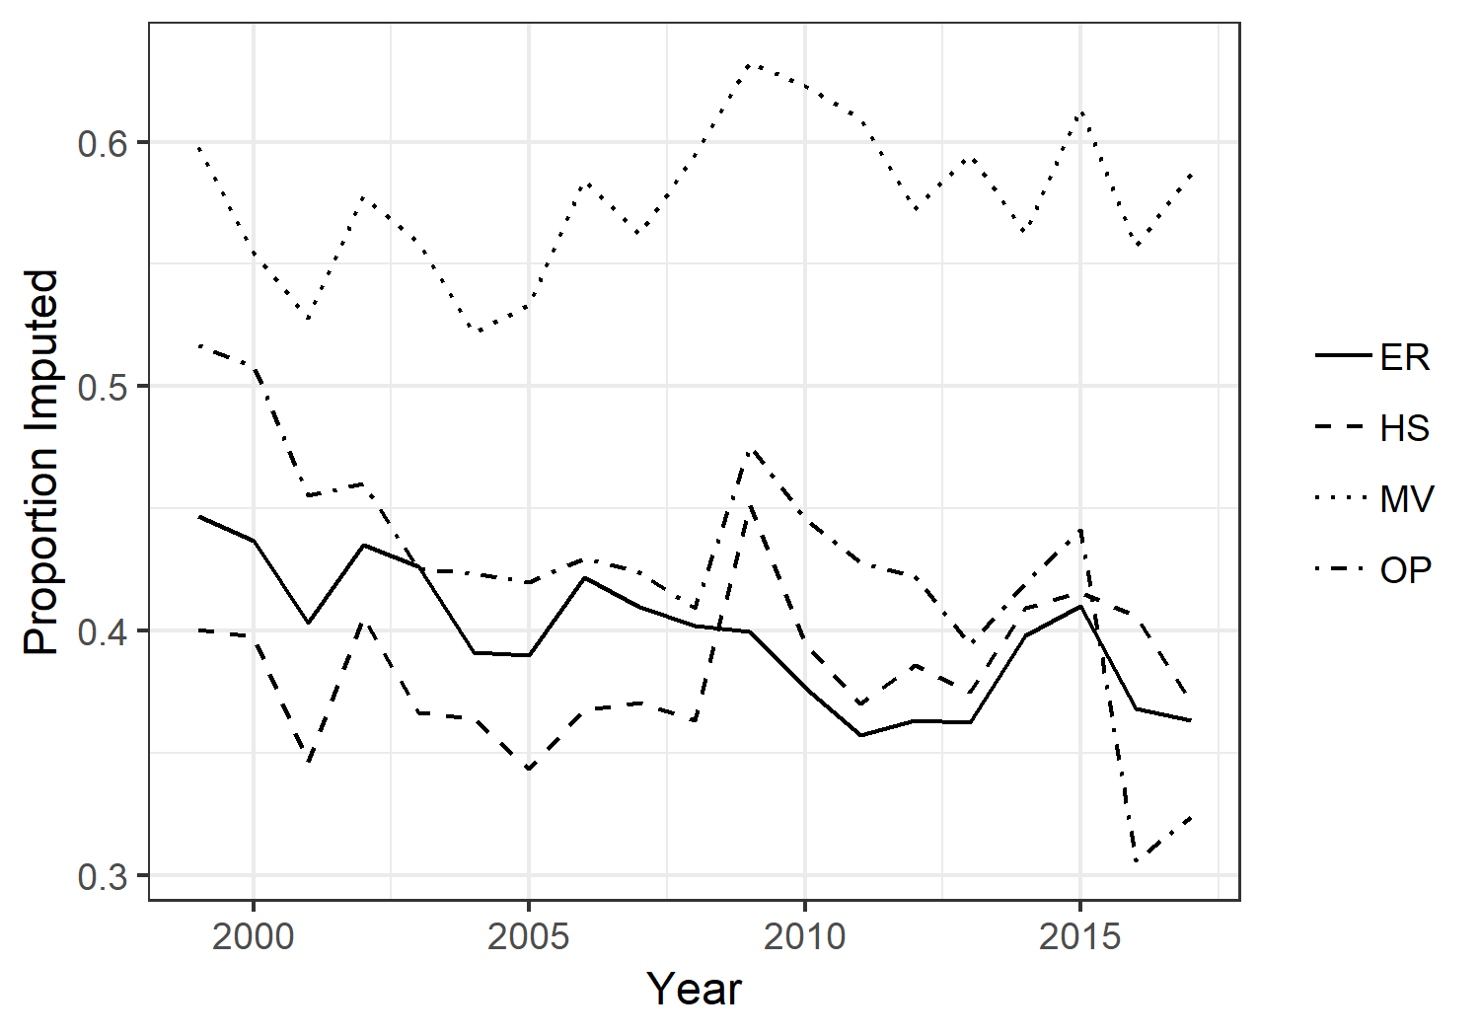
Dealing with Missing Data
Households don’t remember
Trends in the Proportion of Medical Events with Imputed Total Expenditure Values in the MEPS
Emergency Room
Hospitalization
Medical Visit
Outpatient

Slide 6

Medical Expenditure Panel Survey (MEPS)
Household Component (HC)
2
Medical Provider Component (MPC)
1
3
Imputation (predictive mean matching)
Notes:
MPC is considered the gold standard, so we use that data whenever possible.
If MPC is not available, then we use the data that the HC provided.
If neither are available, then we impute (using predictive mean matching)

Slide 7

Predictive Mean Matching
Predictive Mean Matching
Out-of-pocket payments | Third-party payments
X
X | X
X
X | X
Complete MPC data
X
X
X
Donors
Recipients
(not included in imputation)
Notes:
All events with complete MPC data get assigned MPC data
Otherwise, events with complete HC data get assigned HC data, and don’t enter into the imputation
Otherwise, the event is imputed, and is a recipient

Slide 8






Predictive Mean Matching
1. | Model
2. | Fit
3. | Match*
4. | Impute
$$y=\sqrt{Total expenditures }$$
$$y_{d}=X_{d}β+ ϵ$$
$${\hat{y}}_{d}=X_{d}\hat{β}$$
$${\hat{y}}_{r}=X_{r}\hat{β}$$
(donors)
(recipients)
$$δ=min|{\hat{y}}_{d}−{\hat{y}}_{r}|$$
*Within groups with similar sources
of payment available (XGROUPS)
$$y_{d}^{∗} { y}_{r}$$

Slide 9
Predictive Mean Matching - Current
Imputation
 | HC data | MPC data
IMPFLAG = 1 | X
IMPFLAG = 2 | X | X
IMPFLAG = 5 (capitated) | X | X
IMPFLAG = 3/4
3. Match within XGROUP
Not included in imputation
recipients
donors
X | X
X | X
donors
1. Fit MLR model
4. Impute
recipients
2. Predict
recipients
donors
SUMPAYX | TLCHRG
SUMPAYX | TLCHRG
Notes:
For each event type.
Different predictors for each MLR

Slide 10
Can we do better?
Modeling algorithm/fit
Currently OLS
Machine learning offers alternatives for prediction
Neural Networks
Random Forests
Gradient Boosting
Stacked Ensemble
Training completed with H2O.ai
Matching
Currently match on single target – Total Expenditure
Alternatively predict and match on Total Expenditure and Payment Sources
Better alignment on payment sources and eliminate need for XGROUPS

Slide 11


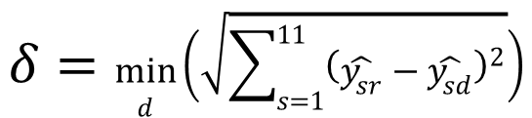


Predictive Mean Matching
1. | Model
2. | Fit
3. | Match
4. | Impute
$$y_{s}=\sqrt{EXP_{s}}$$
$$y_{sd}={f(X}_{d}β)+ ϵ$$
$${\hat{y}}_{sd}=f(X_{d}\hat{β})$$
$${\hat{y}}_{sr}={f(X}_{r}\hat{β})$$
(donors)
(recipients)
$$δ=\min_{d}\left(\sqrt{\sum_{s=1}^{11}{{\left(\hat{y_{sr}}−\hat{y_{sd}}\right)}^{2}}}\right)$$
$$y_{d}^{∗} { y}_{r}$$

Slide 12
PMM – testing alternatives
 | HC data | MPC data
IMPFLAG = 1 | X
IMPFLAG = 2 | X | X
IMPFLAG = 5 (capitated) | X | X
IMPFLAG = 3/4
3. Match Vector
Train
‘new donors’
New recipients
New donors
X | X
X | X
1. Fit ML algorithm
Test
‘new recipients’
2. Predict
EVALUATE R^2
Compare Ypred to Ytrue
4. Impute
New recipients
New donors
SUMPAYX | TLCHRG
SUMPAYX | TLCHRG
EVALUATE R^2
Compare Yimp to Ytrue
Notes:
“Kaggle” competition – give all algorithms same data set, same covariates (a.k.a. features), same outcome (a.k.a. label, target), same matching process.
Using data only from previously identified donors
Split data into training data (‘donors’) and test data (‘recipients’)
Produce imputations for all event types
Estimate process on single years of data and pooled years of data
Compare fit
RMSE, MAE, R², etc.
Compare matches
Compare expenditure estimates

Slide 13
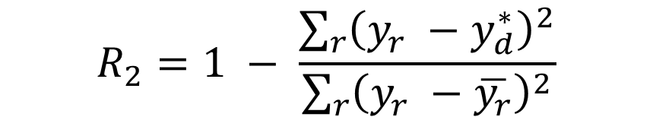
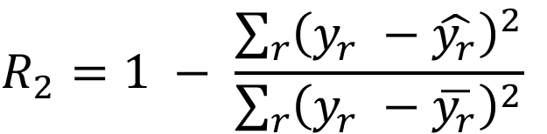
Accuracy Evaluation
Prediction R^2
Imputation R^2
$$R_{2}=1 − \frac{\sum_{r}{{\left(y_{r} −\hat{y_{r}}\right)}^{2}}}{\sum_{r}{{\left(y_{r} −\overline{y_{r}}\right)}^{2}}}$$
$$R_{2}=1 − \frac{\sum_{r}{{\left(y_{r} −y_{d}^{∗}\right)}^{2}}}{\sum_{r}{{\left(y_{r} −\overline{y_{r}}\right)}^{2}}}$$

Slide 14
Prediction Accuracy – Single Target
 | Event Type
Algorithm | Emergency Room | Hospitalization | Outpatient | Medical Visit
Ordinary Least Squares | 0.27 | 0.365 | 0.264 | 0.086
Stacked Ensemble | 0.358 | 0.46 | 0.44 | 0.352
Gradient Boosting | 0.318 | 0.413 | 0.428 | 0.333
Random Forest | 0.318 | 0.411 | 0.396 | 0.341
Extreme Random Forest | 0.32 | 0.415 | 0.408 | 0.333
Deep Neural Net | 0.283 | 0.424 | 0.375 | 0.219

Slide 15
Imputation Accuracy – Single Target
 | Event Type
Algorithm | Emergency Room | Hospitalization | Outpatient | Medical Visit
Ordinary Least Squares | -0.438 | 0.071 | -0.127 | -0.298
Stacked Ensemble | 0.25 | 0.408 | 0.069 | 0.069
Gradient Boosting | 0.06 | 0.345 | 0.038 | 0.019
Random Forest | 0.263 | 0.396 | 0.014 | 0.052
Extreme Random Forest | 0.172 | 0.393 | 0.015 | 0.047
Deep Neural Net | -0.062 | 0.37 | -0.173 | -0.195

Slide 16
Stacked Ensemble Prediction Accuracy – Payment Source
 | Event Type
Expenditure Type | Emergency Room | Hospitalization | Outpatient | Medical Visit
Out of Pocket | 0.714 | 0.503 | 0.643 | 0.717
Medicare | 0.754 | 0.758 | 0.597 | 0.64
Medicaid | 0.658 | 0.711 | 0.659 | 0.716
Private | 0.649 | 0.698 | 0.656 | 0.63
VA | 0.991 | 0.634 | 0.915 | 0.802
Tricare/CHAMPUS | 0.675 | 0.739 | 0.486 | 0.848
Other State and Local | -0.616 | 0.997 | 0.484 | 0.813
Worker's Comp | 0.709 | - | 0.528 | 0.716
Other | 0.63 | -0.044 | 0.655 | 0.739
Total Expenditure | 0.254 | 0.452 | 0.41 | 0.332

Slide 17
Average Imputation Accuracy across Payment Sources of Vector Matching
 | Emergency Room | Hospitalization | Outpatient | Medical Visit
OLS- Single | -3.771 | -1.995 | -0.233 | -0.220
SE - Single | -2.110 | -2.029 | -0.208 | -0.064
SE - Vector | 0.613 | 0.427 | 0.386 | 0.615

Slide 18
Imputation Accuracy – Vector Matching
 | Event Type
Source of Payment | Emergency Room |  |  | Hospitalization |  |  | Outpatient |  |  | Medical Visit
 | OLS- Single | SE - Single | SE - Vector | OLS- Single | SE - Single | SE - Vector | OLS- Single | SE - Single | SE - Vector | OLS- Single | SE - Single | SE - Vector
Out of Pocket | -0.913 | -1.39 | 0.554 | -17.9 | -17.8 | 0.224 | -0.427 | -0.312 | 0.522 | -0.149 | 0.014 | 0.66
Medicare | -1.36 | -0.001 | 0.665 | 0.103 | 0.283 | 0.759 | -1.16 | -1.61 | 0.31 | -0.699 | -0.2 | 0.505
Medicaid | -0.129 | -0.076 | 0.594 | -0.151 | -0.251 | 0.708 | -0.086 | -0.357 | 0.483 | -0.233 | -0.12 | 0.615
Private | -1.71 | 0.151 | 0.556 | -0.134 | -0.14 | 0.655 | -0.568 | 0.07 | 0.49 | -0.615 | -0.322 | 0.437
Veteran’s Admin. | -0.082 | 0.325 | 0.81 | -0.006 | -0.006 | 0.145 | 0.114 | 0.127 | 0.166 | 0.316 | 0.74 | 0.792
Tricare/CHAMPUS | -4.38 | -10.6 | 0.716 | 0.084 | -0.03 | 0.727 | 0.02 | 0.016 | 0.446 | -0.672 | -1.43 | 0.734
Other State and Local | -28.6 | -9.46 | 0.432 | -0.014 | -0.003 | -0.003 | 0.019 | 0.019 | 0.133 | 0.771 | 0.515 | 0.931
Worker's Comp | -0.066 | -0.007 | 0.881 | - | - | - | -0.021 | -0.001 | 0.523 | 0.18 | 0.186 | 0.684
Other | -0.04 | -0.293 | 0.71 | -0.01 | -0.723 | 0.205 | -0.096 | -0.105 | 0.626 | -0.797 | -0.088 | 0.723
Total Expenditure | -0.438 | 0.25 | 0.208 | 0.071 | 0.408 | 0.438 | -0.127 | 0.069 | 0.162 | -0.298 | 0.069 | 0.072

Slide 19
Matching – Proportion of Imputed with exact Sources of Payment Pattern as True
 | XGROUP | Vector
ER | 60.81 | 98.27
HS | 59.47 | 95.00
ME | 64.72 | 97.08
OP | 71.90 | 99.00

Slide 20
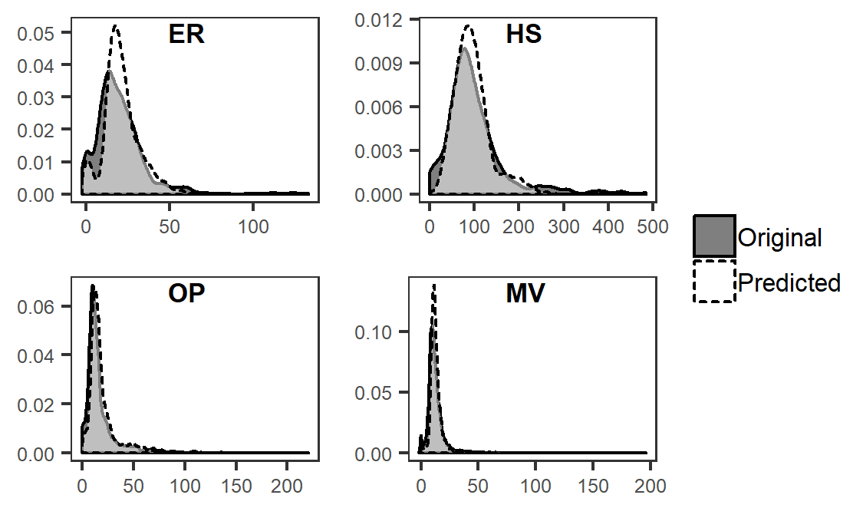
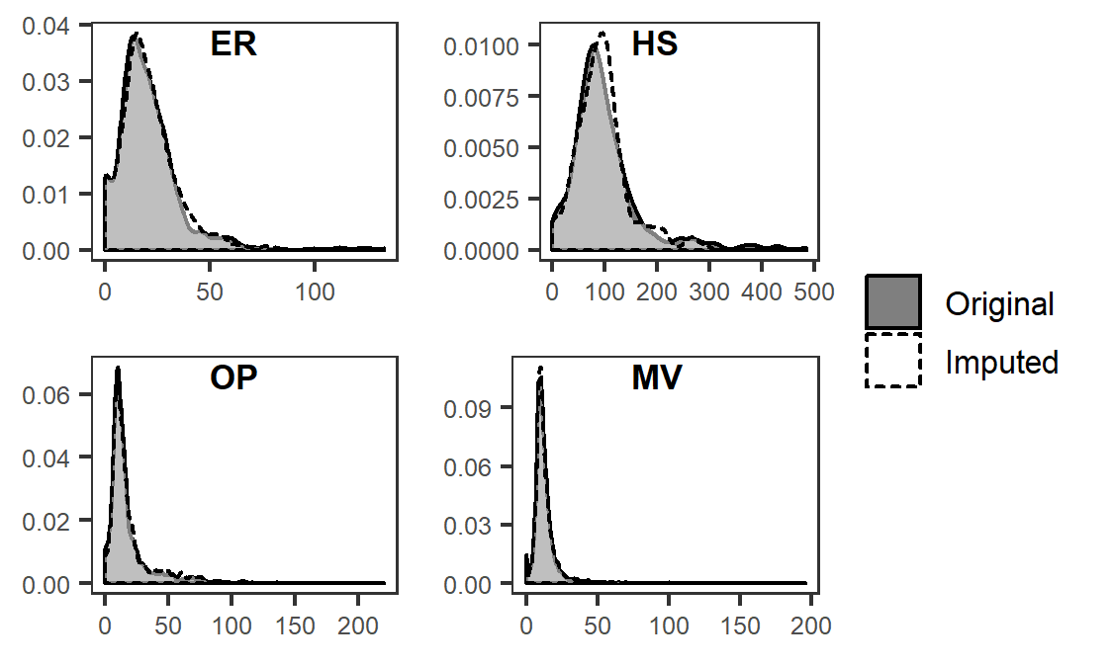
Direct Prediction Vs. Imputation
Predicted
Imputed

Slide 21
Conclusions
ML algorithms produce better predictions than OLS
Predictions tend to compress distributions.
Overestimate at low end, Underestimate at high end
Matching addresses this
Better matching with ML as well.
Even better matching by expanding number of targets

