Slide 1
An Overview of Business Establishment Automated Classification of NAICS (BEACON) for the Economic Census
Federal Committee on Statistics Methodology
Machine Learning Applications
November 4, 2021
Daniel Whitehead
Brian Dumbacher
Economic Statistical Methods Division
U.S. Census Bureau

Slide 2
Disclaimer
Any views expressed are those of the author(s) and not those of the U.S. Census Bureau. The Census Bureau has reviewed this data product for unauthorized disclosure of confidential information and has approved the disclosure avoidance applied. (Approval ID: CBDRB-FY22-ESMD001-001)

Slide 3
Outline
Background: Slides 4-12
Methodology: Slides 13-19
Example: Slides 20-25
Summary: Slides 26-28
Wrap-up: Slides 29-30

Slide 4
Background: North American Industry Classification System (NAICS)
U.S. Census Bureau classifies business establishments by NAICS code based on primary business activity
NAICS is utilized throughout the survey life cycle
Sample selection
Data collection
Analytical review
Publication
Hierarchical 6-digit coding structure
First two digits of NAICS code represent economic sector (22 – Utilities)
Additional non-zero digits add industry detail (221210 – Natural Gas Distribution)

Slide 5
Background: Economic Census
Conducted every five years for years ending in “2” or “7”
Represents approximately eight million establishments, covering most industries and all geographic areas of the U.S.
Key statistics include
Total number of establishments
Total number of employees
Value of sales, shipments, receipts, and revenue
Total annual payroll
Data products are presented by NAICS and geography

Slide 6
Background: What is BEACON?
Business Establishment Automated Classification of NAICS
A machine learning tool developed by the Economic Statistical Methods Division (U.S. Census Bureau) to classify NAICS for establishments based on a write-in business description
After the respondent provides the write-in, the text is outputted to the BEACON Application Programming Interface (API), which then applies the machine learning model
The BEACON API returns the most relevant NAICS codes for the respondent to choose from based on the provided write-in

Slide 7
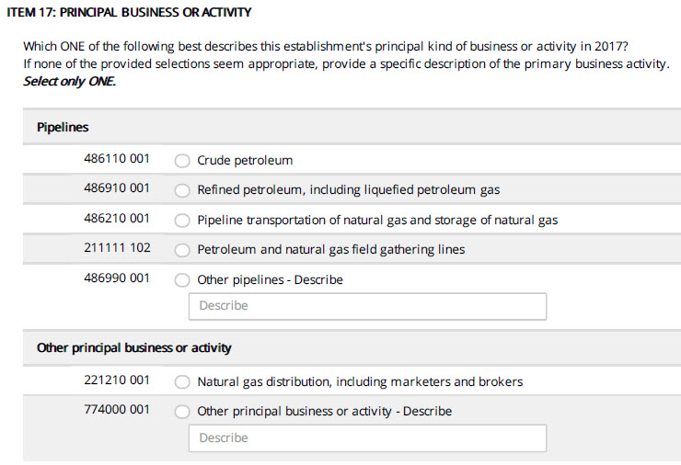
Background: Principal Business or Activity Question from the 2017 Economic Census
Question asks respondents to describe their business
There are prelisted descriptions, but the respondent also has the option of writing in a business description
Manual coding of write-in text is resource-intensive
Source: 2017 Economic Census

Slide 8
Background: BEACON Overview
Goals
Assist respondents in self-designating their NAICS codes
Improve accuracy of self-designated NAICS codes
Reduce manual coding of write-ins
General idea
The respondent inputs a business description
BEACON returns a ranked list of NAICS codes at the 6-digit level
Methodology is based on machine learning, text analysis, and information retrieval (e.g., internet search)

Slide 9
Background: Current Status of BEACON
Plan is to use BEACON in the 2022 Economic Census (EC)
Three rounds of instrument usability testing conducted
Economic Census 2021 Industry Classification Report (currently in the field) will allow further testing with respondents
We continually refine methodology and incorporate new data
Refinement of methodology is ongoing, both now and after 2022 EC

Slide 10
Background: Training Data
Historic write-in responses to the Economic Census (EC)
Frequent write-in text that was autocoded during 2017 EC
Business descriptions from IRS SS-4 forms
Classification Analytical Processing System (CAPS) items
Harmonized System commodity descriptions
Variables
Business description text
Corresponding NAICS code
Business Description Text | NAICS
This is a car dealership. | 441110
R&D lab – medical/health | 541715
we mainly repair furniture, some sales | 811420

Slide 11
Background: Training Data
Data Source | Number of Observations | Advantages | Disadvantages
EC | ~ 1,200,000 (single-unit) | Represents target population Reflects natural language | Descriptions not perfectly classified Descriptions contain misspellings
EC Autocoded | ~ 98,000 * | Improves consistency with autocoding during 2017 EC | Relatively small data source
IRS SS-4 | ~ 860,000 (single-unit) | Provides timely data Reflects natural language | Descriptions not perfectly classified Descriptions contain misspellings
CAPS | ~ 1,490,000 * | Provides a rich vocabulary Descriptions are classified correctly | Does not always reflect natural language
Harmonized System | ~21,000 | Provides examples of industry-specific abbreviations/terminology | Relatively small data source Does not always reflect natural language
* Includes duplicates and variations of original observations

Slide 12
Sources: Economic Census (2002-2017), 2017 Economic Census Autocoder, IRS SS-4, Harmonized System, Classification Analytical Processing System

Slide 13
Methodology: Overview
Text cleaning
Remove common words and phrases (e.g., “the”, “has”, “for instance”)
Correct common misspellings
Dictionary
Words and word combinations that BEACON recognizes
Words are cleaned, stemmed, and meet minimum frequency requirements
Associations between words and NAICS codes in the training data
“tobacconist” is highly associated with NAICS 453991 – Tobacco Stores
“retail” occurs in many NAICS codes and is therefore less predictive

Slide 14
Methodology: Overview
Model ensemble
Information retrieval models look at how words, combinations, and entire descriptions are distributed across NAICS codes
NAICS distributions are averaged, yielding relevance scores
Relevance scores
Range in value between 0 and 100
Reflect how confident BEACON is that the NAICS code is correct

Slide 15
Methodology: Text Cleaning
Convert to lowercase
Account for numbers and punctuation
Remove extra white space and common “stop” words (“the”, “and”, “or”, etc.)
Stem
Apply prefix/suffix stripping rules to reduce number of word variations
For example, “manufacturing” → “manufactur”, “cars” → “car”
Correct common misspellings
Map stems of misspelled words to stems of correctly spelled words
For example, “manifactur” → “manufactur”
Lemmatize
Map synonyms and abbreviations to a common concept
For example, “mfg” → “manufactur”, “auto” → “car”

Slide 16
Methodology: Text Cleaning
Fictional examples
Input Text | Clean Text
This is a convenence store. | conveni store
automobile mfg | car manufactur
We repiar watches & jewelry. | repair watch jewelri

Slide 17
Methodology: Dictionary
Underlying BEACON is a dictionary of words/combinations that occur frequently in the cleaned training data
Current dictionary size: 399,590 words/combinations
All words/combinations in dictionary must occur at least 10 times in training data
All model features are based on this dictionary

Slide 18
Methodology: Model Ensemble
Three information retrieval models
“All”
Consider all words/combinations (combs)
For each word/comb, look at how observations are distributed across NAICS
“Umbrella”
Exclude words/combs that are subsets of other combinations
For each remaining word/comb, look at how observations are distributed across NAICS
“Exact”
Consider observations that use the exact same words/combs
Look at how these observations are distributed across NAICS

Slide 19
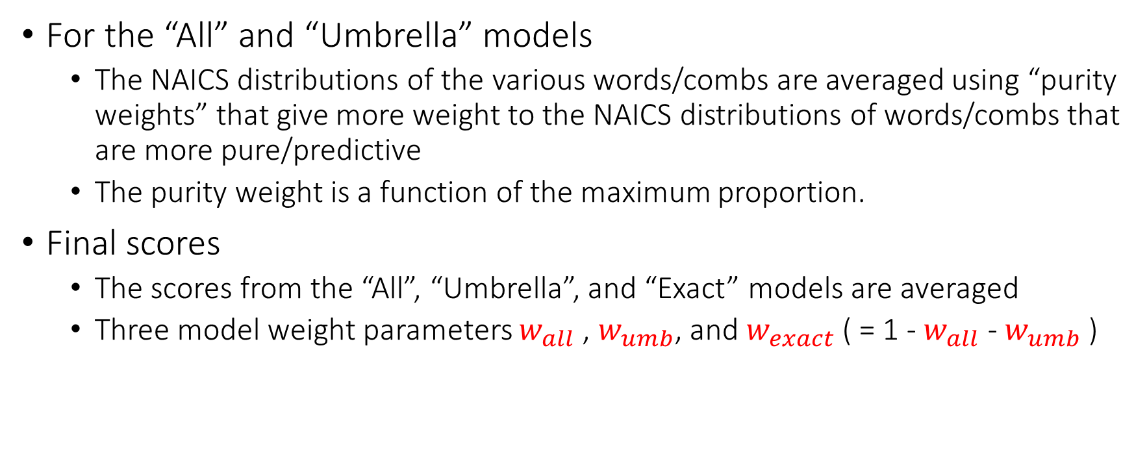
Methodology: Model Ensemble
For the “All” and “Umbrella” models
The NAICS distributions of the various words/combs are averaged using “purity weights” that give more weight to the NAICS distributions of words/combs that are more pure/predictive
The purity weight is a function of the maximum proportion.
Final scores
The scores from the “All”, “Umbrella”, and “Exact” models are averaged
Three model weight parameters $w_{all}$ , $w_{umb}$, and $w_{exact}$ ( = 1 - $w_{all}$ - $w_{umb}$ )

Slide 20
Example: Model Ensemble
Input text: “This is a retail bakery.” → Clean text: “retail bakeri”
The words {retail}, {bakeri}, and the two-word combination {retail, bakeri} are in BEACON’s dictionary
All | Umbrella | Exact
Look at how {retail} is distributed Look at how {bakeri} is distributed Look at how {retail, bakeri} is distributed Average NAICS distributions using purity weights | The words {retail} and {bakeri} are subsets of {retail, bakeri}, so they are excluded from this model Look at how {retail, bakeri} is distributed | Focus attention on observations in the training data that consist entirely of the words {retail} and {bakeri} Look at how these observations are distributed

Slide 21
Example: Sector Distribution of “retail”

Slide 22
Example: Sector Distribution of “bakeri”

Slide 23
Example: Sector Distribution of [“retail”,“bakeri”]

Slide 24
Example: Sector Dist. of exact[“retail”,“bakeri”]

Slide 25
Example: Abbreviated Final Results
Rank | NAICS | Score | Sector Description | NAICS Description
1 | 311811 | 52.24 | Manufacturing | Retail bakeries, baking bread, cakes, and other bakery products…
2 | 722515 | 16.29 | Accommodation and Food Services | Snack and nonalcoholic beverage bars,…
3 | 445291 | 12.91 | Retail Trade | Baked goods stores
4 | 445110 | 3.14 | Retail Trade | Supermarkets and other grocery stores (except convenience stores)
5 | 454390 | 2.44 | Retail Trade | Other direct selling establishments,…

Slide 26
Summary: Performance
Under the latest testing, BEACON’s average response time was less than .2 seconds for up to 10 concurrent requests and less than 2 seconds for up to 250 concurrent requests.
BEACON achieved 87% accuracy on the most recent training/test split performed.

Slide 27
Summary: Facts About BEACON
There are currently 10,642 words, 141,515 two-word combinations and 247,433 three-word combinations in the BEACON data dictionary
BEACON has been tested on independent test data from the 2017 EC
BEACON returns 3-10 possible NAICS codes
Over 15 analysts have reviewed the BEACON output
Notes:
I don't know if you want to specify how sub-second BEACON is (e.g., 0.2 seconds).

Slide 28
Summary: What can BEACON do for other Surveys?
Team continually refines methodology and incorporates new data
BEACON is currently being used in the Economic Census 2021 Industry Classification Report
BEACON can assist respondents in self-classifying their business activities for other programs
Economic Census will use respondent’s selection to direct respondent to appropriate questions
BEACON can reduce manual work required by analysts

Slide 29
Wrap-up: Special Thanks
Kyle Jeong
Justin Nguyen
Justin Z. Smith
Thagendra Timsina

Slide 30

Wrap-up: Questions? Email: Daniel.Whitehead@Census.gov

