Slide 1

FCSM Best Practices for Nonresponse Bias Reporting
Morgan Earp (US National Center for Health Statistics)
Jennifer Madans (US National Center for Health Statistics)
Stephen Blumberg (US National Center for Health Statistics)
Elise Christopher (US National Center for Education Statistics)
Tala Fakhouri (US Food and Drug Administration)
Kathryn Downey Piscopo (US Substance Abuse and Mental Health Services Administration)
Joseph Schafer (US Census Bureau)
Robert Sivinski (US Office of Management and Budget)
Jenny Thompson (US Census Bureau)

Slide 2
Official Disclaimers
The best practices and guidelines presented in this session are an interim product.
Target final version: March 2022
The FCSM welcomes comments
Any views expressed on statistical issues or operational procedures are those of the authors and not necessarily those of the U.S. Census Bureau. The Census Bureau has reviewed this data product for unauthorized disclosure of confidential information and has approved the disclosure avoidance practices applied. (Approval ID:CBDRB-FY22-ESMD001-002)

Slide 3
The Best Practices and Guidelines
Provide a common framework for reporting and disseminating nonresponse bias analysis research conducted by federal agencies
General language designed to cater to the variety of surveys administered by federal agencies
Discuss what should be included in a nonresponse bias analysis report
Provides basic information on nonresponse bias analysis methods
Provides references where additional information can be found
Not a primer on methods of nonresponse bias analysis

Slide 4
Purpose of presentation
Introduce (proposed) best practices and guidelines
Illustrate selected guidelines using fictional examples
Conceptual/clarifying
Not intended as prototypes
Not intended to serve as examples for style, formatting, etc.
Obtain informed feedback on (proposed) best practices and guidelines

Slide 5
FCSM Best Practices for Nonresponse Bias Reporting
Best Practice 1: Describe the survey that is the subject of the nonresponse bias analysis
Best Practice 2: Provide unit response rates for the survey and discuss potential for nonresponse bias
Best Practice 3: Describe the plan for evaluating and quantifying nonresponse bias and for any mitigation strategies to be employed
Best Practice 4: Describe and justify all available sources of auxiliary data used in the nonresponse bias analysis
Best Practice 5: Describe results of nonresponse bias analysis for all key survey items
Best Practice 6: Summarize the major conclusions of the analyses
Best Practice 7: Discuss recommendations for data collection methods and adjustment strategies to mitigate nonresponse bias in future waves of data collection

Slide 6
Best Practice 1: Describe the survey Best Practice 1: Describe the Survey the survey
Guidelines
1.1. Describe the survey target population
1.2. Describe the survey sample frame
1.3. Discuss the potential for coverage error of the frame
1.4. Describe the survey sample design
1.5. Describe the sample unit
1.6. Describe the survey data collection modes
1.7. Describe the survey’s key survey items, and identify those that will be used in the nonresponse bias analysis
1.8. Describe any nonresponse mitigation strategies employed during data collection
Provide detailed information on the target population, survey unit, sample design, and data collection modes, as well as the sponsoring agency, the year the study was conducted, and the years of survey data used for the analyses.
Checklist for NRB Analysis Report
Survey description included
Sponsoring agency acknowledged
Year of study provided
Years of survey data used provided

Slide 7
Best Practice 1: Fictional Example 1 Time Use Survey (Students) – 2019
Target Population | High school students (grades 9-12)
Sampling frame | Listings of public and private high schools from state governments Registries within sampled schools
Frame coverage issues | Home schooled students Transfer students/dropouts
Sample design | Two stage cluster sample: PPS selection of schools within state, stratified by public versus private status Systematic sample of students within grade in sample schools
Sample unit | PSU: High schools USU: Student
Data collection modes | Personal interview, Telephone follow-up, Web collection
Key items | Time usage: classroom, homework, sports & leisure activities (group), social media, other
Nonresponse mitigation strategies employed during data collection | Field Experiment: Incentive offered ($10 VISA card) for students in historically low-responding schools
Only report mitigation activities that include an evaluation of bias reduction.

Slide 8
Best Practice 1: Fictional Example 2 Athletic Shoe Sales (Stores) - 2019
Target Population | Stores that sell athletic shoes
Sampling frame | Business register
Frame coverage issues | Misclassification on frame New stores (births)
Sample design | One-stage stratified simple-random sample
Sample unit | (Business) establishments (Stores)
Data collection modes | Web collection (primary); telephone follow-up
Key items | Total revenue, total revenue from athletic shoe sales
Nonresponse mitigation strategies employed during data collection | Not reported (no special evaluations or experiments)
Target Population | Stores that sell athletic shoes
Sampling frame | Business register
Frame coverage issues | Misclassification on frame New stores (births)
Sample design | One-stage stratified simple-random sample
Sample unit | (Business) establishments (Stores)
Data collection modes | Web collection (primary); telephone follow-up
Key items | Total revenue, total revenue from athletic shoe sales
Nonresponse mitigation strategies employed during data collection | Not reported (no special evaluations or experiments)

Slide 9
Best Practice 2: Provide unit response rates for the survey and discuss potential for nonresponse bias
Guidelines
Guideline 2.1. Identify and report unit response rates based on weights that adjust for selection probabilities
Guideline 2.2. Report response rates for regions or key subgroups for which national estimates are published
Guideline 2.3. Report response rates for all key survey items described in Guideline 1.7
Guideline 2.4. Report response rates for each sampling stage that provides actionable information on survey participation and/or coverage
Guideline 2.5. Report response rates for each wave of data collection in longitudinal surveys
Response rates are unit-level performance metrics that measure the proportion of the eligible sample units that responded to survey or census.
Checklist for NRB Report
Method of calculating response rates provided.
Response rates are reported for the survey (total) and by subdomains of interest for all study years
Guideline 2.6. For cases where responsive design or treatment groups for other experiments designed to reduce bias were used during data collection, report response rates for each of the treatment groups used
Guideline 2.7. Discuss the potential for nonresponse bias given unweighted and weighted response rates, response rates by sampling stage, waves of data collection, and key subgroups

Slide 10
Best Practice 2: Fictional Example 1 (Part 1) Time Use Survey
Guideline 2.2
 | Unit Response Rate | Unit Response Rate | Weighted Item Response Rates
 | Unweighted | Weighted | Classroom | Homework | Sports & Leisure | Social Media
Total | 64 | 70 | 70 | 75 | 30 | 15
Region
NE | 82 | 85 | 85 | 83 | 25 | 12
MW | 66 | 68 | 66 | 68 | 20 | 14
S | 29 | 45 | 43 | 45 | 27 | 9
W | 60 | 71 | 70 | 71 | 35 | 7
Grade
9 | 73 | 87 | 87 | 80 | 80 | 76
10 | 71 | 79 | 78 | 74 | 68 | 73
11 | 70 | 72 | 72 | 74 | 60 | 58
12 | 22 | 35 | 34 | 35 | 30 | 15
 | Unit Response Rate | Unit Response Rate | Weighted Item Response Rates
 | Unweighted | Weighted | Classroom | Homework | Sports & Leisure | Social Media
Total | 64 | 70 | 70 | 75 | 30 | 15
Region
NE | 82 | 85 | 85 | 83 | 25 | 12
MW | 66 | 68 | 66 | 68 | 20 | 14
S | 29 | 45 | 43 | 45 | 27 | 9
W | 60 | 71 | 70 | 71 | 35 | 7
Grade
9 | 73 | 87 | 87 | 80 | 80 | 76
10 | 71 | 79 | 78 | 74 | 68 | 73
11 | 70 | 72 | 72 | 74 | 60 | 58
12 | 22 | 35 | 34 | 35 | 30 | 15
 | Unit Response Rate | Unit Response Rate | Weighted Item Response Rates
 | Unweighted | Weighted | Classroom | Homework | Sports & Leisure | Social Media
Total | 64 | 70 | 70 | 75 | 30 | 15
Region
NE | 82 | 85 | 85 | 83 | 25 | 12
MW | 66 | 68 | 66 | 68 | 20 | 14
S | 29 | 45 | 43 | 45 | 27 | 9
W | 60 | 71 | 70 | 71 | 35 | 7
Grade
9 | 73 | 87 | 87 | 80 | 80 | 76
10 | 71 | 79 | 78 | 74 | 68 | 73
11 | 70 | 72 | 72 | 74 | 60 | 58
12 | 22 | 35 | 34 | 35 | 30 | 15
Key Items:
Time spent in classroom (classes)
Time spent on homework
Time spent on sports & leisure activities
Time spent on social media
Key subdomains
Region (NE, MW, S, W)
Grade (9, 10, 11, 12)
Guideline 2.7
Guideline 2.3

Slide 11
Best Practice 2: Fictional Example 1 (Part 2) Time Use Survey
 | Stage 1: Schools | Stage 2: Students|School
Total | 86 | 70
NE | 90 | 85
Public | 95 | 71
Private | 93 | 80
MW | 75 | 68
Public | 79 | 75
Private | 63 | 62
S | 60 | 45
Public | 61 | 35
Private | 23 | 50
W | 80 | 71
Public | 79 | 70
Private | 81 | 72
 | Stage 1: Schools | Stage 2: Students|School
Total | 86 | 70
NE | 90 | 85
Public | 95 | 71
Private | 93 | 80
MW | 75 | 68
Public | 79 | 75
Private | 63 | 62
S | 60 | 45
Public | 61 | 35
Private | 23 | 50
W | 80 | 71
Public | 79 | 70
Private | 81 | 72
 | Stage 1: Schools | Stage 2: Students|School
Total | 86 | 70
NE | 90 | 85
Public | 95 | 71
Private | 93 | 80
MW | 75 | 68
Public | 79 | 75
Private | 63 | 62
S | 60 | 45
Public | 61 | 35
Private | 23 | 50
W | 80 | 71
Public | 79 | 70
Private | 81 | 72
Two-stage sample
Schools within region
Public and Private
NE, MW, S, W
Students within school
Guideline 2.4
High nonresponse! Targeted nonresponse follow-up? Experiment?

Slide 12
Best Practice 2: Fictional Example 2 Athletic Shoe Sales Survey
Include a Measure-of-Size variable to account for skewed populations
 | Unit Response Rate |  | Weighted Item Response Rates
 | Unweighted | Weighted | Total Sales | Shoe Sales
All Stores | 60 | 81 | 85 | 82
Sporting Goods Stores (45111) | 55 | 70 | 81 | 80
Department Stores (45221) | 65 | 86 | 92 | 75
Low response from smaller units
High response from largest units

Slide 13
Best Practice 3: Describe the plan for evaluating and quantifying nonresponse bias and for any mitigation strategies to be employed
Guidelines
Guideline 3.1. Describe and justify all nonresponse bias evaluation methods used
Guideline 3.2. Describe the analysis plan for comparing and assessing nonresponse bias levels across key stages and subgroups as described by Guidelines 2.2 to 2.6.
Guideline 3.3. Describe post data collection nonresponse bias mitigation strategies that were employed and how they might reduce nonresponse bias
The report should include a complete discussion of all evaluation methods used, including the rationale for the selection of each method along with an explanation of why some standard methods are not used. The discussion should address the aspect of nonresponse that the method will address.
Checklist for NRB Report
Description of activities used to reduce nonresponse bias during data collection included
The analytic plan for evaluating nonresponse bias in the final data file provided
The post-data collection mitigation strategies (if applicable) described

Slide 14
Guideline 3.1 Direct Versus Indirect Analysis
Direct Assessment Methods
Indirect Assessment Methods
Use (micro)data from the data collection
sampling frame
matched auxiliary data
“Sophisticated” analyses at survey level and by subdomains
Alternative weighting methods
Regression trees
R-indicators
Balance and distance indicators
Proxy-pattern mixture models
Compare estimates from the studied program to similar estimates from other sources
Assume the “similar” other source estimates have high accuracy and precision
May be confounded by differences in definition and timing (among others)
Analyses limited to same level of aggregation

Slide 15
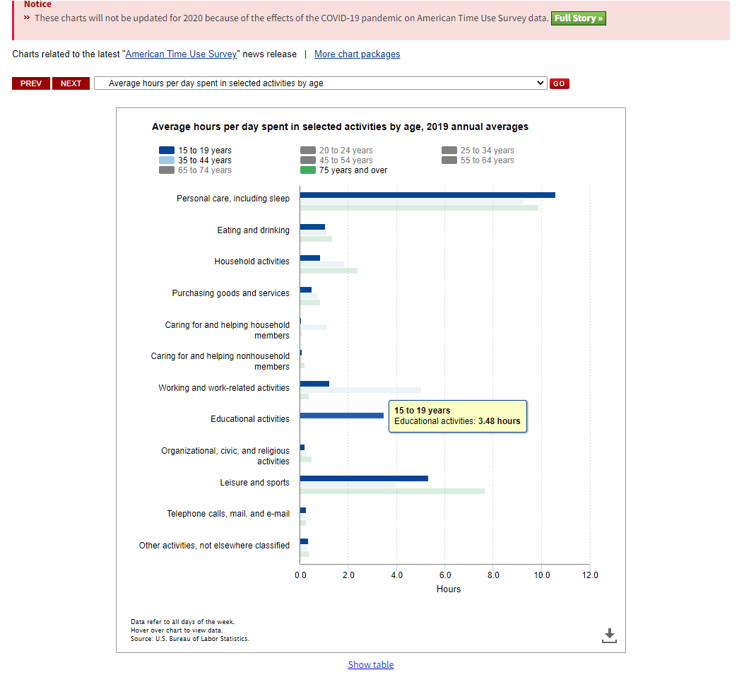
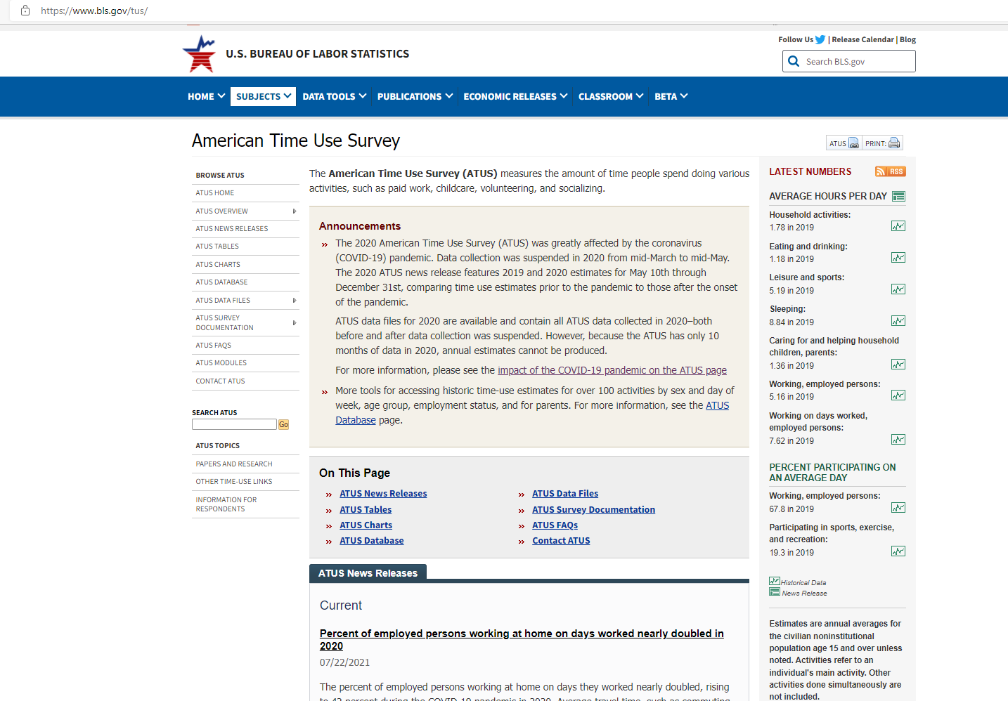
Best Practice 3: Fictional Example 1 Time Use Survey (Indirect Analysis)
Our (fictional) survey
Limited to grades 9-12 (approximate ages 14-18)
Limited available estimates from American Time Use Survey
Civilian noninstitutional population 15+
Different subdomains

Slide 16
Best Practice 3: Fictional Example 2 Athletic Shoe Sales Survey Analysis Plan
Evaluation method | Data | Objective/Interpretation
Compare estimates of total sales in Sporting Goods Stores (NAICS 45111) and Department Stores (NAICS 45221) | Athletic Shoe Sales Survey (2021) (Subject) Annual Retail Trade Survey (Benchmark) | Comparable levels may indicate low impact of nonresponse bias
Balance and Distance Indicators using linked survey response data and frame measure-of-size | Athletic Shoe Sales Survey (2021) Business Register (sampling frame) | Assess existence and extent of systematic differences in composition of full sample and respondent sample (balance) between respondents and nonrespondents in full sample using proxy (measure-of-size) variable
Evaluation method | Data | Objective/Interpretation
Compare estimates of total sales in Sporting Goods Stores (NAICS 45111) and Department Stores (NAICS 45221) | Athletic Shoe Sales Survey (2021) (Subject) Annual Retail Trade Survey (Benchmark) | Comparable levels may indicate low impact of nonresponse bias
Balance and Distance Indicators using linked survey response data and frame measure-of-size | Athletic Shoe Sales Survey (2021) Business Register (sampling frame) | Assess existence and extent of systematic differences in composition of full sample and respondent sample (balance) between respondents and nonrespondents in full sample using proxy (measure-of-size) variable (distance)
Fraction of Missing Information (FMI) from Proxy Pattern-Mixture Model Analysis for Athletic Shoe Sales | Athletic Shoe Sales Survey (2021 and 2022) Business Register (sampling frame) | Assess effects of nonresponse on nonresponse adjusted estimates of athletic shoe sales under alternative response mechanisms
Evaluation method | Data | Objective/Interpretation
Compare estimates of total sales in Sporting Goods Stores (NAICS 45111) and Department Stores (NAICS 45221) | Athletic Shoe Sales Survey (Subject) Annual Retail Trade Survey (Benchmark) | Comparable levels may indicate low impact of nonresponse bias
Indirect analysis – potential evidence of credibility
Sampling/nonsampling errors in both sources
Does not assess NR bias effect on key item
Direct analysis with linked data – potential evidence of missing-at-random response mechanism
Does not assess NR bias effect on key item
Measure-of-size variable may be out of date
Direct analysis with linked data – potential justification of imputation method for key item (and assesses robustness)
Relies on potentially weak imputation model

Slide 17
Best Practice 4: Describe and justify all available sources of auxiliary data used in the nonresponse bias analysis
The type of nonresponse bias analysis as well as the type of inferences that can be drawn depend on what auxiliary sources are available at the time of analysis. The availability of auxiliary data will impact the methods selected, how the analysis is done, and the interpretation of the results.
Guidelines
Guideline 4.1. Describe all sources of auxiliary data used for the nonresponse bias analysis
Guideline 4.2. Discuss the characteristics, quality, and completeness of auxiliary data in terms of coverage, item missingness, and measurement error, and timeliness
Guideline 4.3. Discuss the relationship between auxiliary data being used to evaluate nonresponse bias and the key survey items
Checklist for NRB Report
All key data items should be associated with one or more sources of auxiliary data
List key data items for which auxiliary data are not available (limitation in study)
Descriptions for each source of auxiliary data include
Overlap with study program e.g., timing, coverage
Quality assessments e.g., measurement error, sampling error, nonresponse error

Slide 18
A Few Things to Look For in Auxiliary Data
Missingness
Extent of missing data by data item
Assess whether auxiliary data are missing at random
Extent of imputation
Coverage
Overlap of auxiliary data population and survey target population
Linkage rates for microdata
Definitional differences survey and auxiliary data
Timeliness
Time difference (survey and auxiliary data)
Determine when auxiliary data were last updated
Accuracy
Comparisons of matched survey and auxiliary data on same variables
Sampling error measurements (or coefficients of variation) of auxiliary data
Association with survey data
Correlation or regression analysis

Slide 19
Best Practice 5: Describe results of nonresponse bias analysis for all key survey items
Guidelines
Guideline 5.1. Provide and discuss the results of the nonresponse bias analyses specified in the methods section, including all identified key items and evaluation methods (see Guideline 1.7 and 3.1) across all key stages and subgroups (see Guideline 3.2)
Guideline 5.2. Describe the impact of post data collection mitigation strategies on reducing nonresponse bias
Guideline 5.3. Describe nonresponse bias before and after adjustment across key stages and subgroups as described by Guideline 2.2 to 2.6.
The results of the nonresponse bias analysis should be reported for each method used in terms of the extent of bias identified, even if the results were inconclusive. If mitigation strategies are implemented or adjustment methods were applied, the results of those strategies on bias indicators and key survey items should also be reported.
Checklist for NRB Report
Reporting of the results of the analysis refers to the analytic plan and addresses the key items for the survey by stage and subgroup and identified indicators of bias.
All analyses reported (even if inconclusive)
Assessment of mitigation strategies included, overall and by applicable sampling stage or wave.

Slide 20
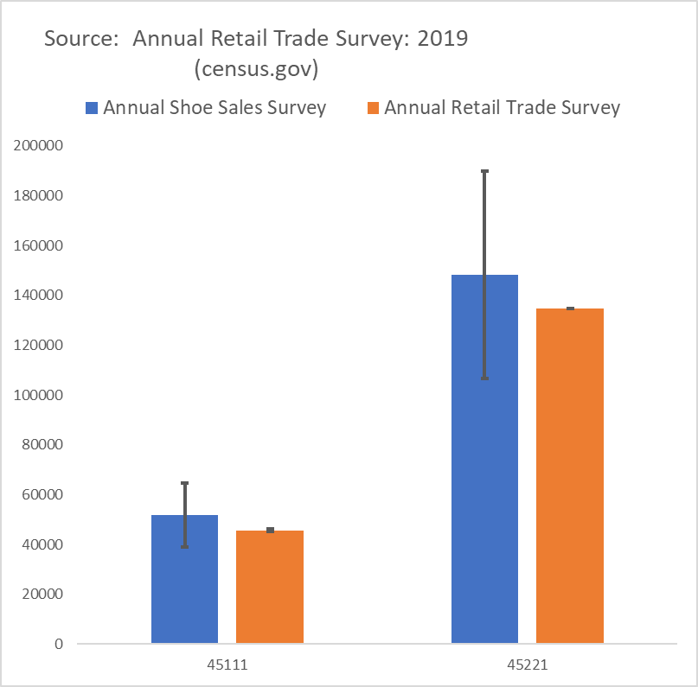
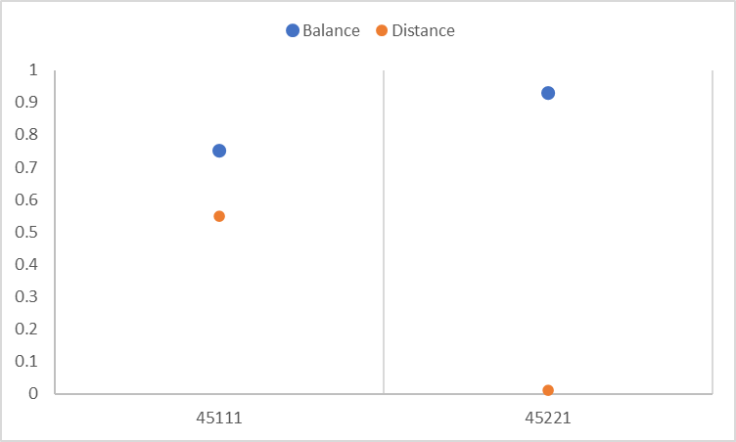


Best Practice 5: Fictional Example 1 Annual Shoe Sales Survey
Comparison to benchmark estimate (Total Sales)
Balance and distance measures
(Measure-of-size = 2017 Sales)
Ideal values: Balance = 1 and Distance = 0
45111 – Indications of potential NR bias
45221 – No indications of NR bias with these indicators
Point estimates from Annual Shoe Sales Survey not statistically different from ARTS estimates

Slide 21
Best Practice 5: Fictional Example 1 (Cont’d) Annual Shoe Sales Survey
Measure: Fraction of Missing Information (FMI)
Proxy Pattern-Mixture Model Analysis
Assessed nonresponse bias in variable after adjustment (imputation)
FMI → 0 indicative of low nonresponse bias
FMI → 1 indicative of high nonresponse bias
Variable of Interest: Total shoe sales
Proxy: Predicted value (all units) from imputation model
Industry | FMI (MAR) | FMI (NMAR) | Nonresponse Rate
45111 (R² = 0.90) | 0.70 | 0.75 | 45%
45221 (R² = 0.95) | 0.13 | 0.18 | 39%
Evidence of NR Bias
EVEN AFTER IMPUTATION
FMI near 1 (both response mechanisms)
FMI > Nonresponse rate
Industry | FMI (MAR) | FMI (NMAR) | Nonresponse Rate
45111 (R² = 0.90) | 0.70 | 0.75 | 45%
45221 (R² = 0.95) | 0.13 | 0.18 | 39%

Slide 22
Best Practice 6: Summarize the major conclusions of the analyses
Guidelines
Guideline 3.1. Summarize the results of the nonresponse bias analysis, any post-data collection mitigation strategies, and the final assessment of potential nonresponse bias for the full data collection and for key indicators
Guideline 6.2. Discuss the implications and potential causes of contradictory results
Guideline 6.3. Discuss potential implications as they relate to fitness of purpose
Provide an executive summary that provides high level findings for the full program and for the key survey items, overall and by studied subgroup. If possible, highlight post-data collection mitigation strategies that appear to be effective, as well as those that are less effective.
Checklist for NRB Report
Executive summary provided
Assessment of post data collection migration strategies highlighted
Implications of assessments provided

Slide 23
Best Practice 6: Fictional Example 1 Time Use Survey
Key Findings
Low response from sampled schools in the South
Levels of estimated totals vary greatly depending on alternative weighting adjustments, providing indications of nonresponse bias
Low response across-the-board for 12th grade students
Evidence that 12th grade respondents are not a random sample
Higher than (national) average time reported spent on homework by 12th grade students
Less than (national) average time reported spent on sports and leisure activities
Low response across-the-board for reporting time on social media
No benchmarks or auxiliary data available for comparison

Slide 24
Best Practice 6: Fictional example 2 Athletic Shoe Sales Survey
Key Findings
Larger businesses more likely to report than smaller businesses
Imputation models may not be adequately correcting for nonresponse bias, as response mechanism is not missing-at-random
Nonresponse bias impacts estimates in from sporting goods stores (NAICS 45111)
Respondents primarily large businesses
FMI near 1
Caution advised with estimates from this industry, as the analysis indicates that shoe sales may be overestimated (fitness for use)

Slide 25
Best Practice 7: Discuss recommendations for data collection methods and adjustment strategies to mitigate nonresponse bias in future waves of data collection
Guidelines
Guideline 7.1. Discuss recommendations for modifications to sample design, questionnaires, or data collection strategies that may reduce the bias in collected data.
Guideline 7.2. Discuss recommendations that may improve post-data collection adjustment strategies.
A thorough nonresponse bias analysis that follows the previous guidelines should provide useful insight into the likely sources of nonresponse bias. In recurring surveys, this information can be used to improve future data collection.
Checklist for NRB Report
Recommendations are justified by results provided
Recommendations can include future research or embedded experiments

Slide 26
Best Practice 7: Fictional Example 1 Time Use Survey
Finding: Low response from sampled schools in the South
Finding: Low response across-the-board for 12th grade students
Finding: Low response across-the-board for reporting time on social media
Recommendations:
Review the sampling design, focusing on first stage allocations in South
If funds permit, consider nonresponse follow-up study
Recommendation:
Consider offering incentives if funding permits provided that ongoing pilot test shows positive incentive effects in low-responding schools
Recommendation:
Do not publish these measures from current collection; fitness for use compromised
High nonresponse indicative of potential issue with question (questionnaire). Conduct focus groups or other cognitive testing, if funding permits

Slide 27
Final Remarks
Reminder that presentation discusses interim report
Comments welcome
In that vein, looking forward to comments from discussant
Presentation today given by a messenger
However, feel free to follow-up
katherine.j.thompson@census.gov

