Slide 1
Using PDF Extraction and Web Scraping Tools to Collect Government Health Insurance Plan Information
Virginia Gwengi, U.S. Census Bureau
FCSM
November 4, 2021
Disclaimer: Any views expressed are those of the author(s) and not necessarily those of the U.S Census Bureau. All results have been reviewed and no confidential information has been disclosed.

Slide 2
Overview
Medical Expenditure Panel Survey-Insurance Component (MEPS-IC)
Motivation
Summary of Benefits and Coverage Form (SBC)
Methods
Web scraping
PDF extraction
Challenges
Next steps

Slide 3
Medical Expenditure Panel Survey-Insurance Component (MEPS-IC)
Voluntary survey that collects information on employer-provided health insurance, which is different from MEPS-Household Component
Reimbursable survey funded by Agency for Healthcare Research and Quality (AHRQ) with data collection conducted by Census
Conducted every year
Universe: private companies and government entities
Two-part survey
Establishment level questions: number of hours worked to be eligible for health insurance
Plan level questions: premiums, copays, deductibles

Slide 4
Motivation
We aim to reduce respondent burden, improve data quality, increase timely responses and reduce survey production costs by applying data science methods on existing administrative records (SBC forms)

Slide 5
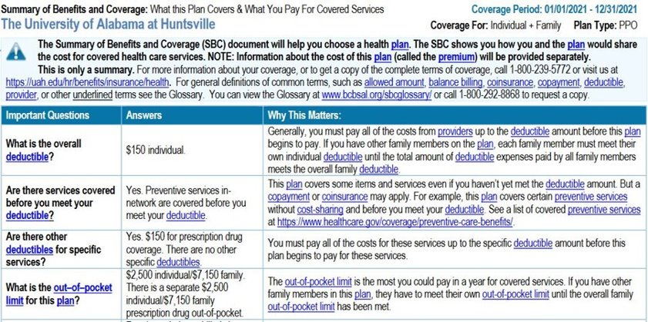
Summary of Benefits and Coverage Form
Mandated as part of Affordable Care Act, the SBC form is the "nutrition facts" of health insurance coverage
Employers with 50+ employees that offer health insurance must provide SBC forms to employees
Many SBC forms can also be found online
Contains information collected in the Medical Expenditure Panel Survey-Insurance Component (MEPS-IC)

Slide 6
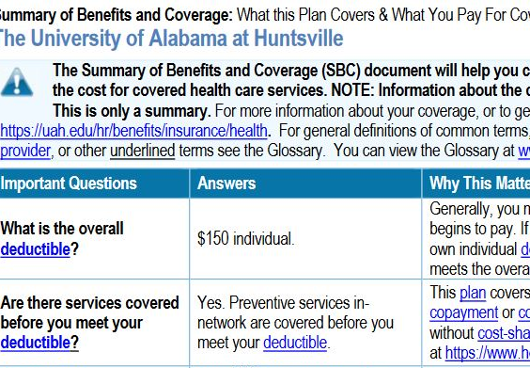
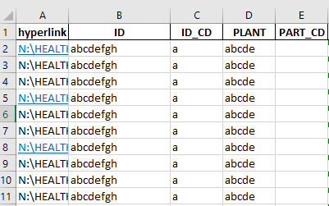
Methods
Government Master Address File (GMAF)
Use search API to get URL to start crawling from
OR
To get PDF
Get unit name from
GMAF
Web
Crawling
Tool
PDF Extraction Tool
Retrieve sample from the frame
Google search API
Scrapy: Python web crawling framework
Camelot: Python library to extract tables from text-based PDFs

Slide 7
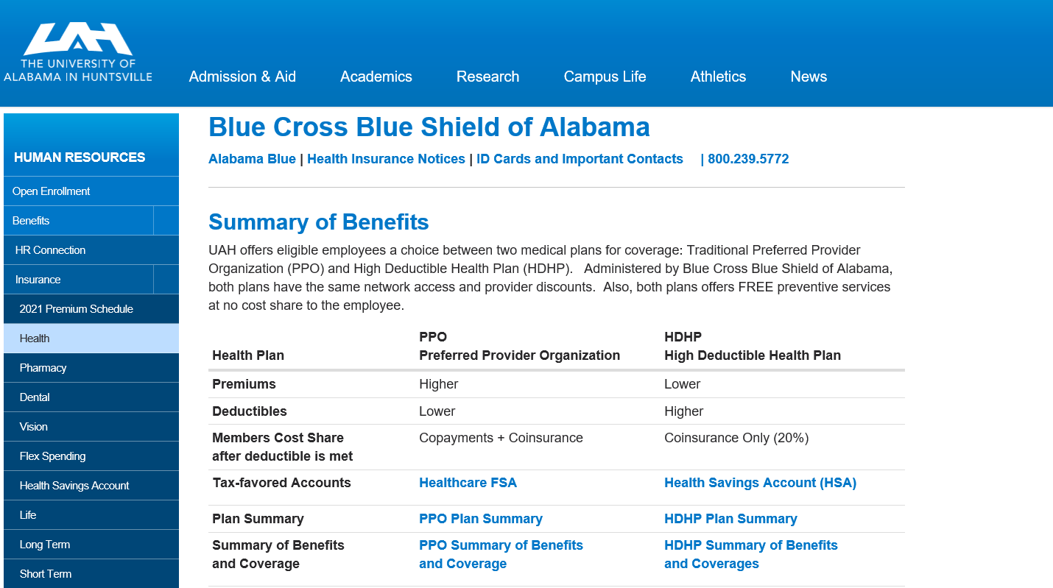
Web scraping tool (1)
Motivation
To collect SBC forms:
Many SBC forms can be found online
Analysts manually search for certainty government insurance forms through web searches
Respondents can upload forms into data collection tool
Manually searching for these forms takes significant time
Policy: Among the first projects to get approval from Census to perform web scraping
Method: Scrapy web crawling framework looks for every pdf which are processed to find the SBC forms
SBC Forms

Slide 8
Web scraping tool (2)
Benefits
Save analysts' time in manually searching for forms
Allows for early data collection
Potentially save respondents' time
Don't need to ask government units to upload forms
Improve data quality: SBC forms may be used to impute missing information or in the edits process, to assist with estimates

Slide 9
PDF extraction tool (1)
Motivation
Analysts manually extract information from SBC forms and hand enter into excel spreadsheets
Data from SBC forms is not exhausted
Method
Step 1:
Use Camelot python library, which uses visual design to extract table cells from text-based pdfs. These are saved to a json file
Step 2:
Reads in the json file and uses regular expressions to identify response items from the table contents

Slide 10
PDF extraction tool (2)
Benefits
Tool identifies and extracts SBC form in 15 seconds compared to 2-4 minutes in the manual process
Extraction tool can provide additional plan-level information without additional cost
Identifies PDF SBC forms from the web

Slide 11
Results
Web scraping
For survey year 2021, 1197 SBC forms have been collected which accounts for 22% (205) of the 893 certainty government units
On average, 5 SBC forms per government unit
PDF Extraction
On average, Camelot parses each response item at least 88% of the time

Slide 12
Challenges
PDF Extraction Tool
Not all units will have SBC forms (those with fewer than 50 employees, noncompliant employers)
Can only extract SBC forms saved as readable PDFs (not scanned or in Word or plan brochures)
Some forms are trickier than others to extract: inconsistent number of columns, varying patterns of text
Web scraping Tool
Cannot scrape SBC forms on websites that require login information to retrieve forms
Not all units may have web presence

Slide 13
Next steps
Employ named entity recognition (NER) to increase the accuracy of the extraction tool
Validate the web scraping tool results against manually searched SBC forms
Explore how web scraping and pdf extraction tool results can be used in edits and imputation processes
Apply the web scraping and pdf extraction tools to other types of respondents (Non-Certainty government, Private)

Slide 14
Thank you
Virginia Gwengi
martha.v.gwengi@census.gov

