Slide 1
Machine Learning and the Commodity Flow Survey
Christian Moscardi
FCSM
11/4/2021
Any views expressed are those of the author(s) and not necessarily those of the U.S Census Bureau.

Slide 2
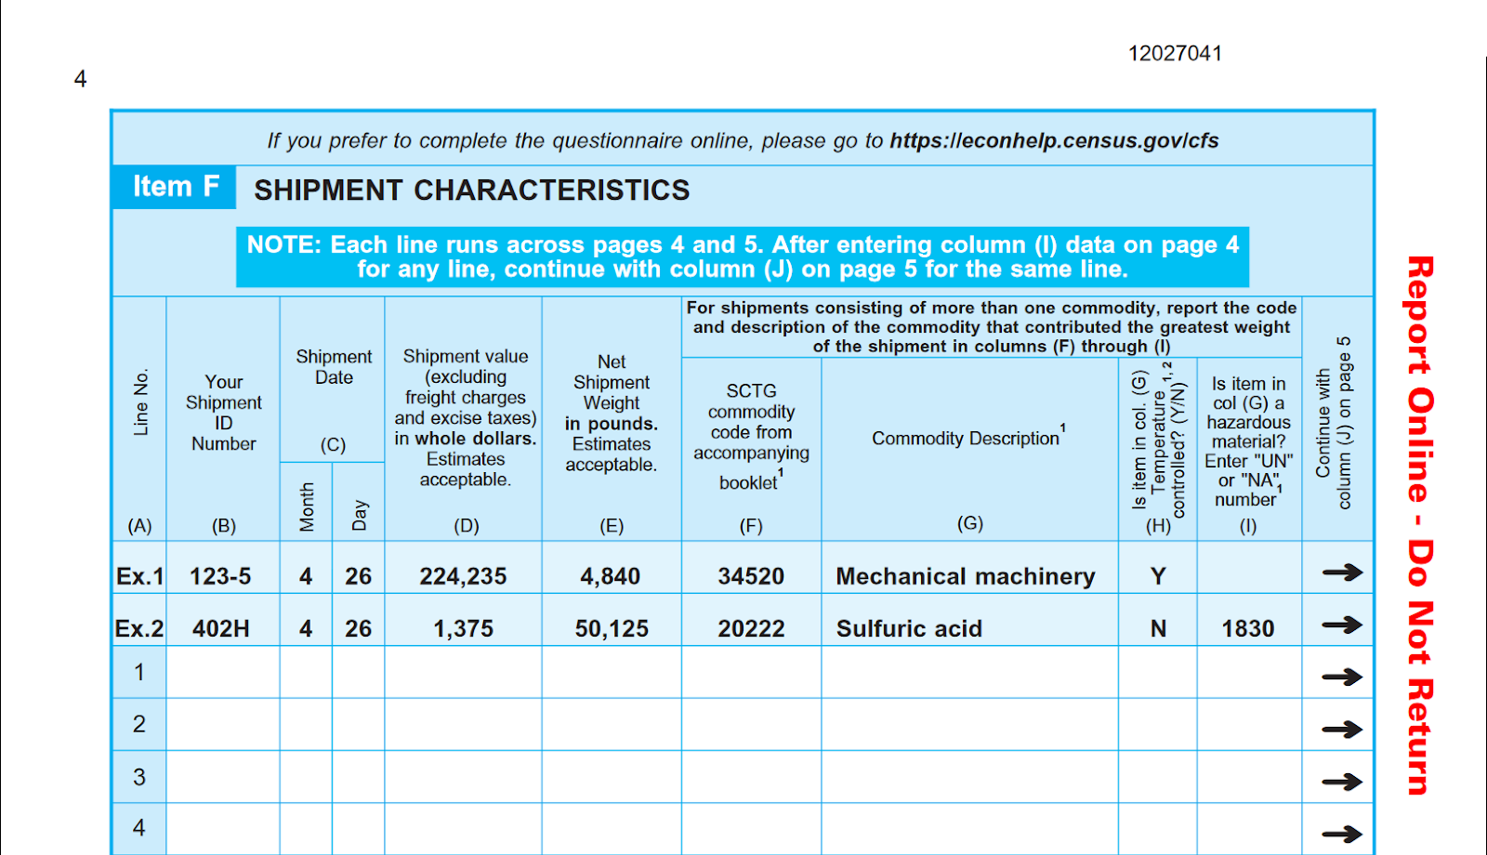
Overview
Commodity Flow Survey (CFS)
Sponsored by U.S. DOT Bureau of Transportation Statistics
Conducted every 5 years (2017, 2022)
Many uses, including infrastructure funding decision-making
Respondents provide sampling of shipments from each quarter

Slide 3
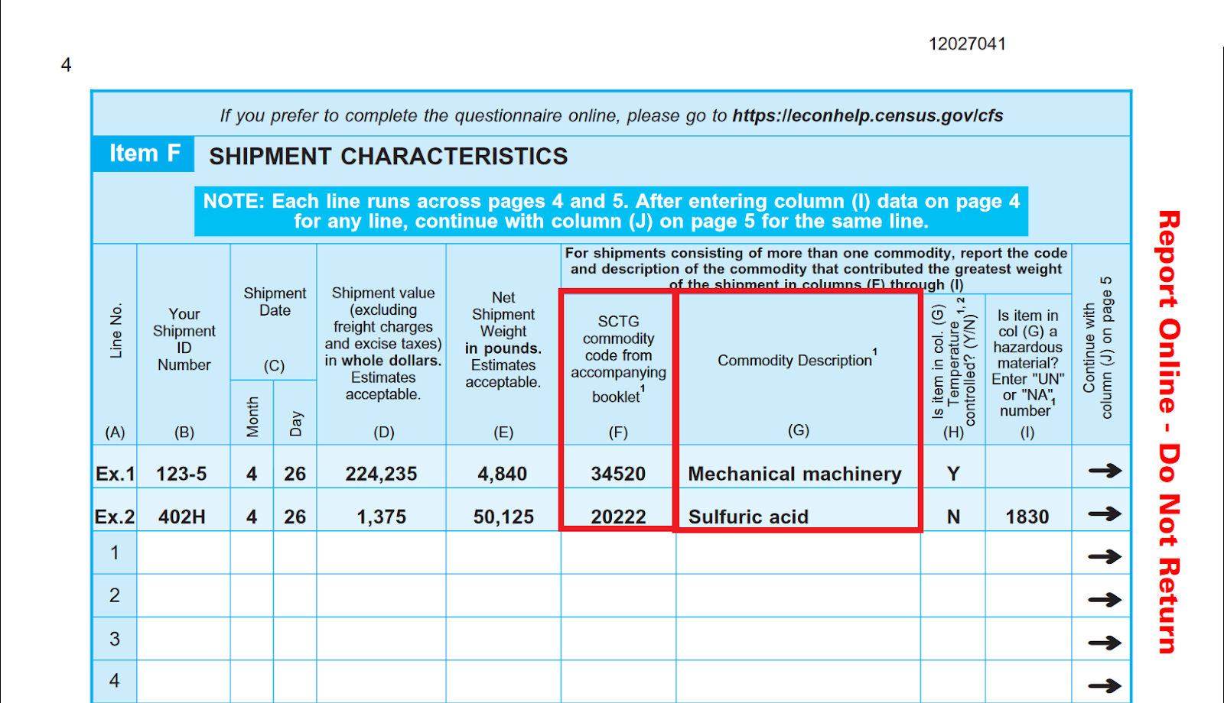
Overview

Slide 4
ML model – details and pilot
Training data: 6.4M shipment records from 2017 CFS
Data provided by respondents, cleaned and edited by analysts
Model output: 5-digit product code (SCTG)
Model input: free-text shipment description, establishment’s NAICS (industry) Code
Model form: Bag-of-words logistic regression
Initial uses: Correcting and imputing 2017 CFS response data
Proved concept on a small scale
Notes:
Eliminating need for respondents to provide product code benefits:
Improved data quality for codes themselves
Ability to ask respondents for significantly more shipment data

Slide 5
ML model – in production
Upcoming uses (2022 CFS)
Eliminating the need for respondents to provide SCTG product codes
Benefits
Reducing respondent burden -> increased response rates
Reducing Census cost to process data
Improving data quality
Notes:
Eliminating need for respondents to provide product code benefits:
Improved data quality for codes themselves
Ability to ask respondents for significantly more shipment data

Slide 6
Improving Model -- Crowdsourcing
To improve the model, we need improved training data
More coverage of product types
More variety in description text
To improve training data, need humans to label more records
Solution: Crowdsourcing new data labels
Train model
Predict Labels
Model
Labeled Data
Unlabeled Data
Human
Update training dataset
Send least confident predictions for labelling

Slide 7

Amazon MTurk
Overview
“Crowdsourcing marketplace”
Used for surveys (incl. pre-testing), data labelling for AI/ML
Anyone can offer a task
Anyone can complete a task
Workers (aka Turkers) paid per task completed
Alternatives we considered
In-house labelling prohibitively expensive
For AI/ML labelling, alternatives exist (e.g. CrowdFlower) but not as flexible and larger-scale

Slide 8
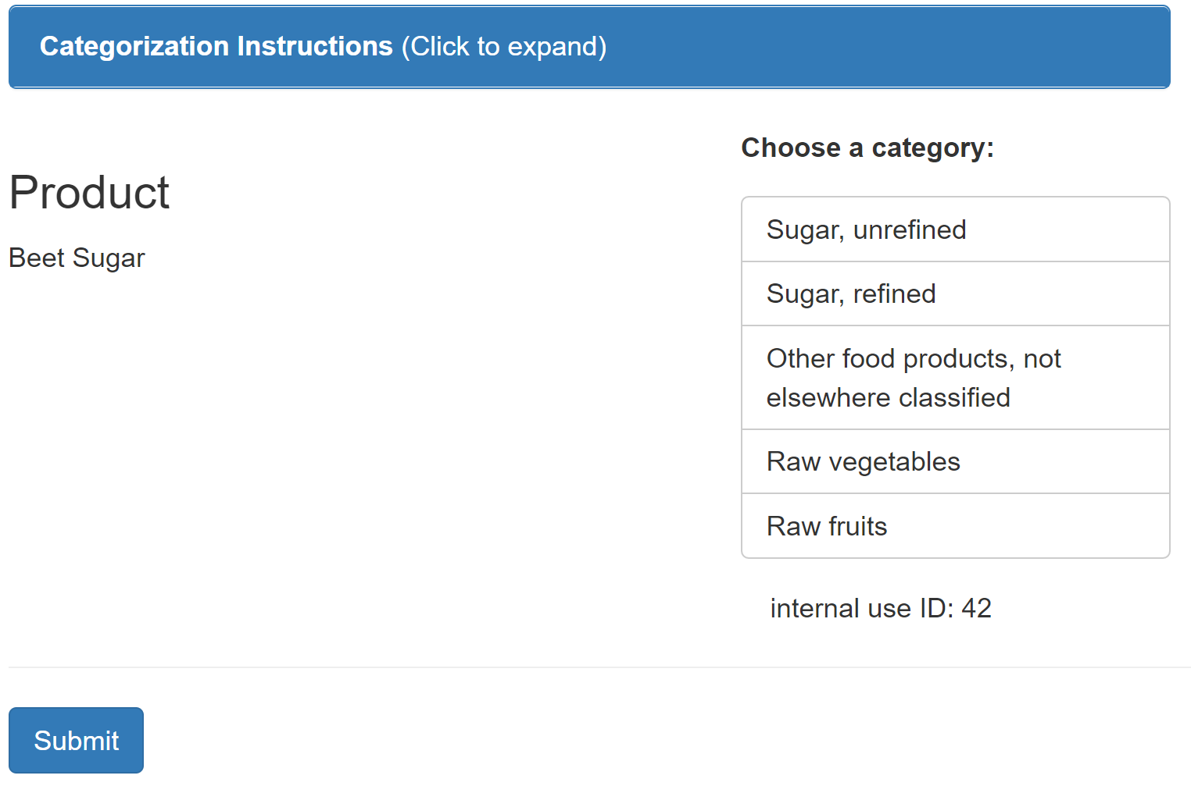
Crowdsourcing Task Setup
Product description data sources
NAICS manual
Publicly available online product catalogs
~250,000 descriptions total
Task details
“Which product category best matches the given product description?”
List of categories comes from current best model (Top 10 shown in random order + “None of the above”)
U.S. workers only
Calculated reasonable pay rate

Slide 9
Crowdsourcing Quality Control
How do we ensure quality?
Gateway/gold standard task
Label 50 “gold standard” records
Worker must be at least 60% correct on min. 5 records
Production task: “Quadruple-key entry”
Only qualifying workers
4 workers label each record
Work in batches of 1,000; update model
Continuous validation
Keep track of inter-rater reliability
Inject “gold standard” records during production task
Remove poorly performing workers after each batch of production task

Slide 10
Crowdsourcing Worker Onboarding
Step 1: Onboard workers with “gold standard” task
Upload Gold Standard data to MTurk
Task Type | Records per batch | Purpose
Gold Standard | 50 | Recruit workers. Compare worker quality to gold standard. Workers who correctly label >=60% of time qualify to Production task.
Production | 1000 | Label records. Have 4 workers label per task. Records with >50% agreement, or 2-1-1 vote split considered labelled. 2-2 records or 1-1-1-1 records considered difficult, require further review.
Workers label gold standard product descriptions
Evaluate workers for agreement to gold standard
Qualify high performers for Production

Slide 11
Crowdsourcing Production Task
Step 2: Label new data in “production task”
Baseline model, predict top 10 codes for all product descriptions
Task Type | Records per batch | Purpose
Gold Standard | 50 | Recruit workers. Compare worker quality to gold standard. Workers who agree with gold standard >=60% of time qualify to Production task.
Production | 1000 | Label records. Have 4 workers label per task. Records with >50% agreement, or 2-1-1 vote split considered reliable. 2-2 records or 1-1-1-1 records considered difficult, require further review.
Sample 1,000 descriptions where model is not highly confident
Upload Production batch type to MTurk; 4 workers label each desc.
Download results; incorporate results with majority agreement into baseline model; worker QC

Slide 12
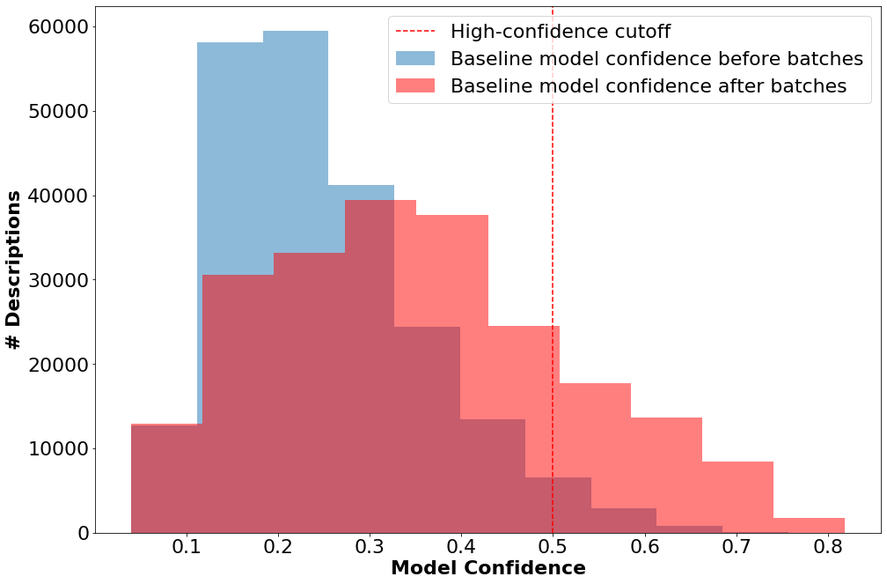
Results
To date
Workers labelled ~5,000 records
~25,000 tasks completed
82% classified with high reliability by majority vote
Among reliable classifications, estimated correct classification rate of 95%
16% improvement to model’s classification ability on public product descriptions (~40,000 more records)
Direct cost: ~$3,000
Model’s classification power before/after MTurk labels
Note: all results in figure derived from public product description data

Slide 13
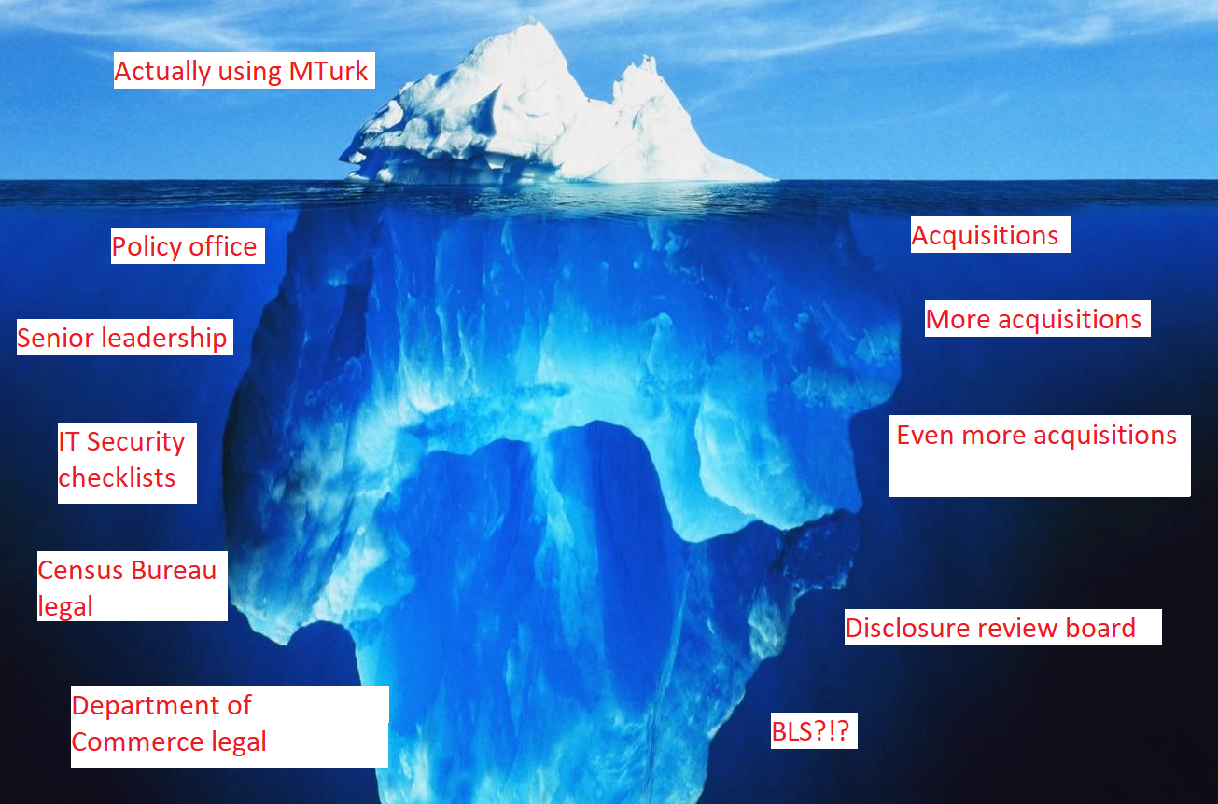
Zooming out – Costs of Implementation

Slide 14
Thank you!
Email: Christian.L.Moscardi@census.gov

Slide 15
Crowdsourcing Best Practices
Provide clear, simple instruction and fair pay to crowd-workers.
Perform preliminary tests to improve instructions, pre-qualify and recruit skilled workers.
Use a gold standard to onboard workers and continuously monitor workers’ quality; contact or replace workers if necessary.
Use batches to continuously update workers’ qualifications based on gold standard and agreement metrics.
Use a baseline model if possible, to help limit the choices that workers need to make and simplify the task.
* Thanks to Magdalena Asborno and Sarah Hernandez at University of Arkansas for collaborating to develop best practices.

