Slide 1
Using Open Source Tools to Build a Custom Data Entry Application
Cecile Murray and Katie Genadek
Business Development Staff, Economic Reimbursable Surveys Division
U.S. Census Bureau
November 4, 2021
Any views expressed are those of the author(s) and not necessarily those of the U.S Census Bureau.

Slide 2
Decennial Census Digitization and Data Linkage (DCDL) project overview
Goal: Capture the names from digitized images of 1960-1990 decennial census forms to enable longitudinal research
Problem: 850+ million records would make hand entry prohibitively expensive and slow
Solution: Custom Optical Character Recognition (OCR) machine learning algorithm to automate name capture
Need to efficiently collect high-quality data to train OCR algorithm: have professional keyers hand enter data using custom application

Slide 3
Roadmap
Demonstration
Some technical details
Why build a custom application?
Bringing the application into production
Recommendations

Slide 4
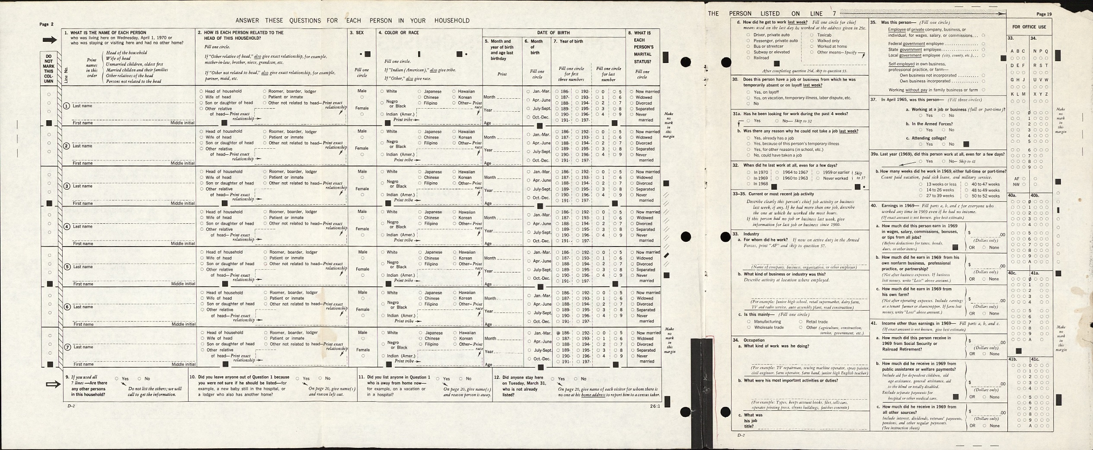
Collecting a name from a 1970 form

Slide 5
Demonstration with blank forms

Slide 6




Technical details
Django: open source Python library
Backend database is Postgresql
Runs on an AWS govcloud server
Keyers access the application in their web browser via a local port forward
Notes:
Cloud enables lightweight install on keyer machine + ability to push updates easily

Slide 7
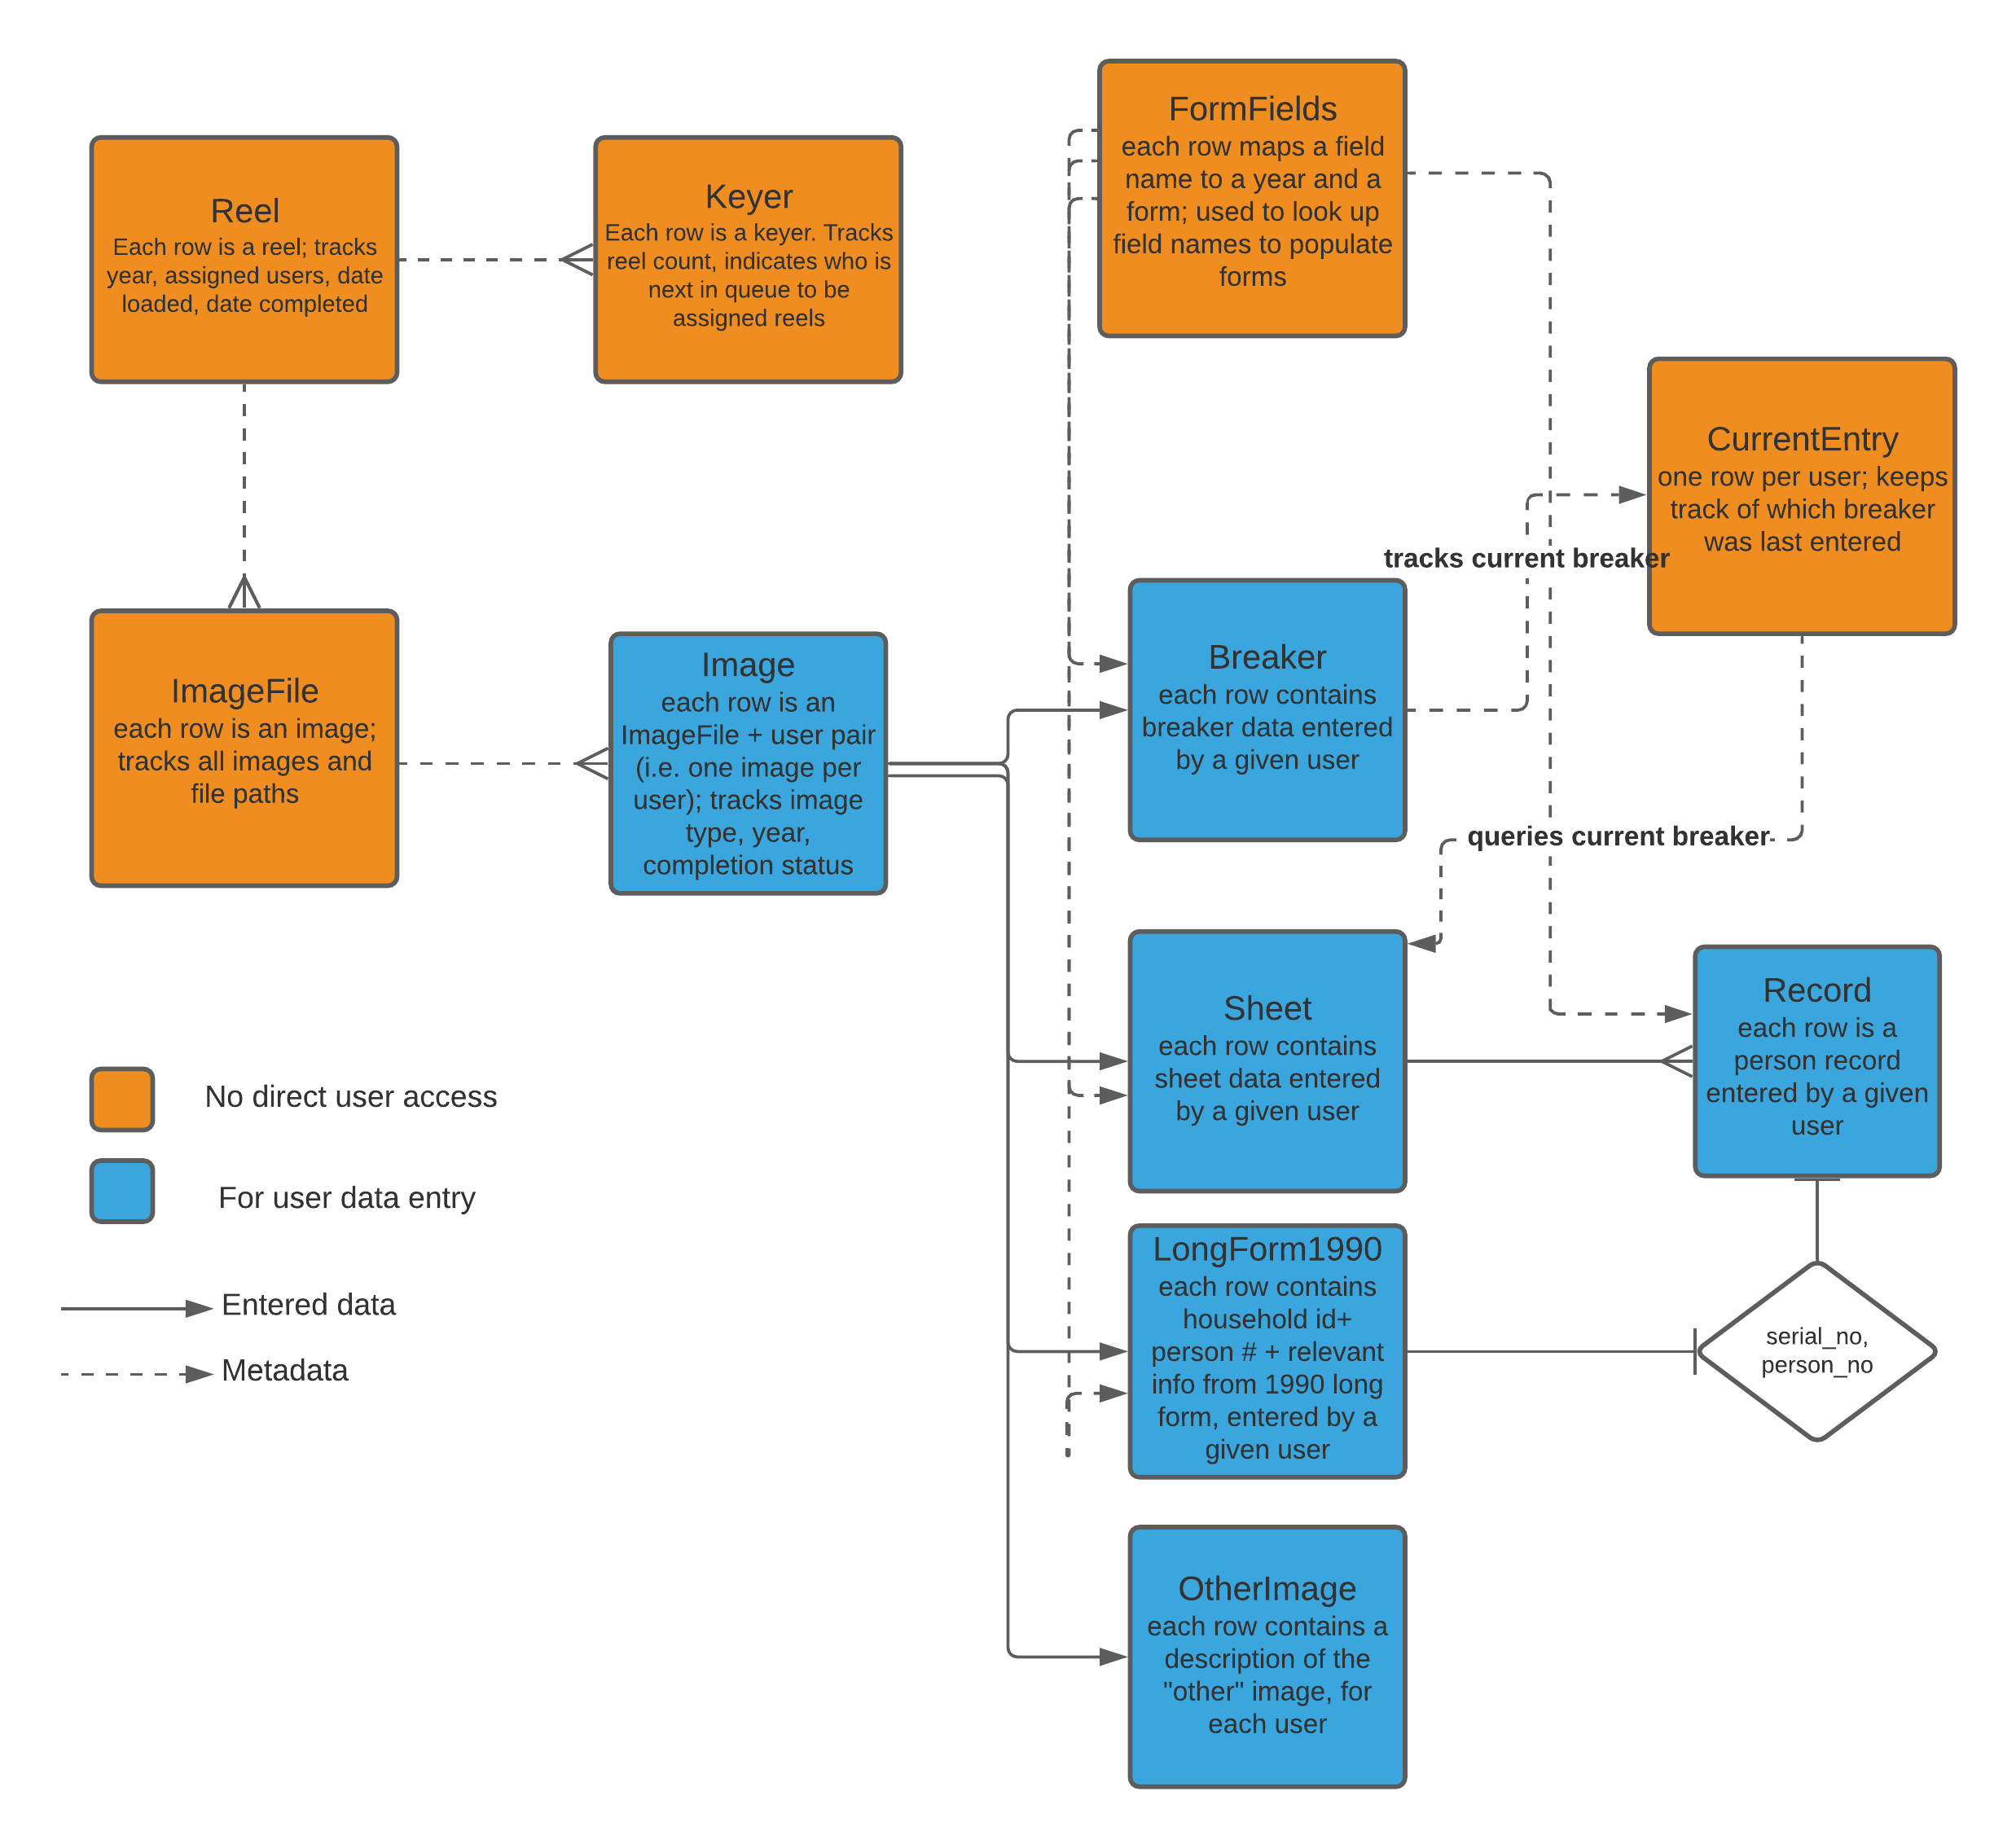
Data structure
Entity-relationship diagram: tool for designing database schema
Color-coding and arrows to illustrate flow of data

Slide 8
Why build a custom application?
Existing Census Bureau systems are not configured for these images
Data are protected, so we cannot use external solutions like Amazon mTurk
Entry in MS Excel offers low start-up costs, but a custom application provides features that pay off in the long run

Slide 9
Why build a custom application?
Challenge/feature | Excel | Our custom data entry application
Is the keyer looking at correct image? | Risk of human error | No risk of error
Complex data structure | Would require repetitive entry | Can accommodate complex relationships between data items
Visually relate data in image to entry form | No | Yes
Danger of accidental modification/deletion of records | Substantial | Minimal
Managing reel/image assignment | Manual, cumbersome | Mostly automated
Getting usable data out | Manual, cumbersome | Can be automated
Time required for development | Minimal | Substantial

Slide 10
Bringing the application to production
Internal testing as development proceeded:
Small group demos
Team demos
Rollout to select group of keyers and collecting feedback
Creating and positioning a suffix field
What to do about blank values
Figuring out ways to further avoid repetitive keying
Fixing lots of bugs!
Eventual rollout to more keyers

Slide 11
Challenges we faced
Steep technical learning curve + substantial up-front time investment in development
Deployment to production
IT approvals to make sure keyers can access application while protecting server
Understanding keyer workstation requirements
Training and reference material development

Slide 12
Recommendations
Document installation/setup, maintenance, and update processes
Use an iterative development process: build something, test it, and incorporate feedback
Do structured demos to test specific features early and often
Use git/version control, and split development into development, test, and production branches
Use logging and automated testing to help identify bugs

Slide 13
Thank you! Questions?
Code on GitHub: https://github.com/census-bds/dcdl-data-entry
Cecile Murray, Data Scientist cecile.m.murray@census.gov
Katie Genadek, DCDL Project Director katie.r.genadek@census.gov

