Slide 1


Federal Real Property Map Group FRPP1 Solutions
June 17, 2019

Slide 2


Federal Real Property Profile Management Reimagined
June 17, 2019

Slide 3
Problems we need to solve:
General usability of the map tools
Unforgiving interface.
Filtering and layering tools are confusing to the users.
Non-hierarchical and non-linear search process.
Confusing terminology (Tasks vs Filters vs Views)
Hidden functionality, confusing tabs
Lag, long load times

Slide 4
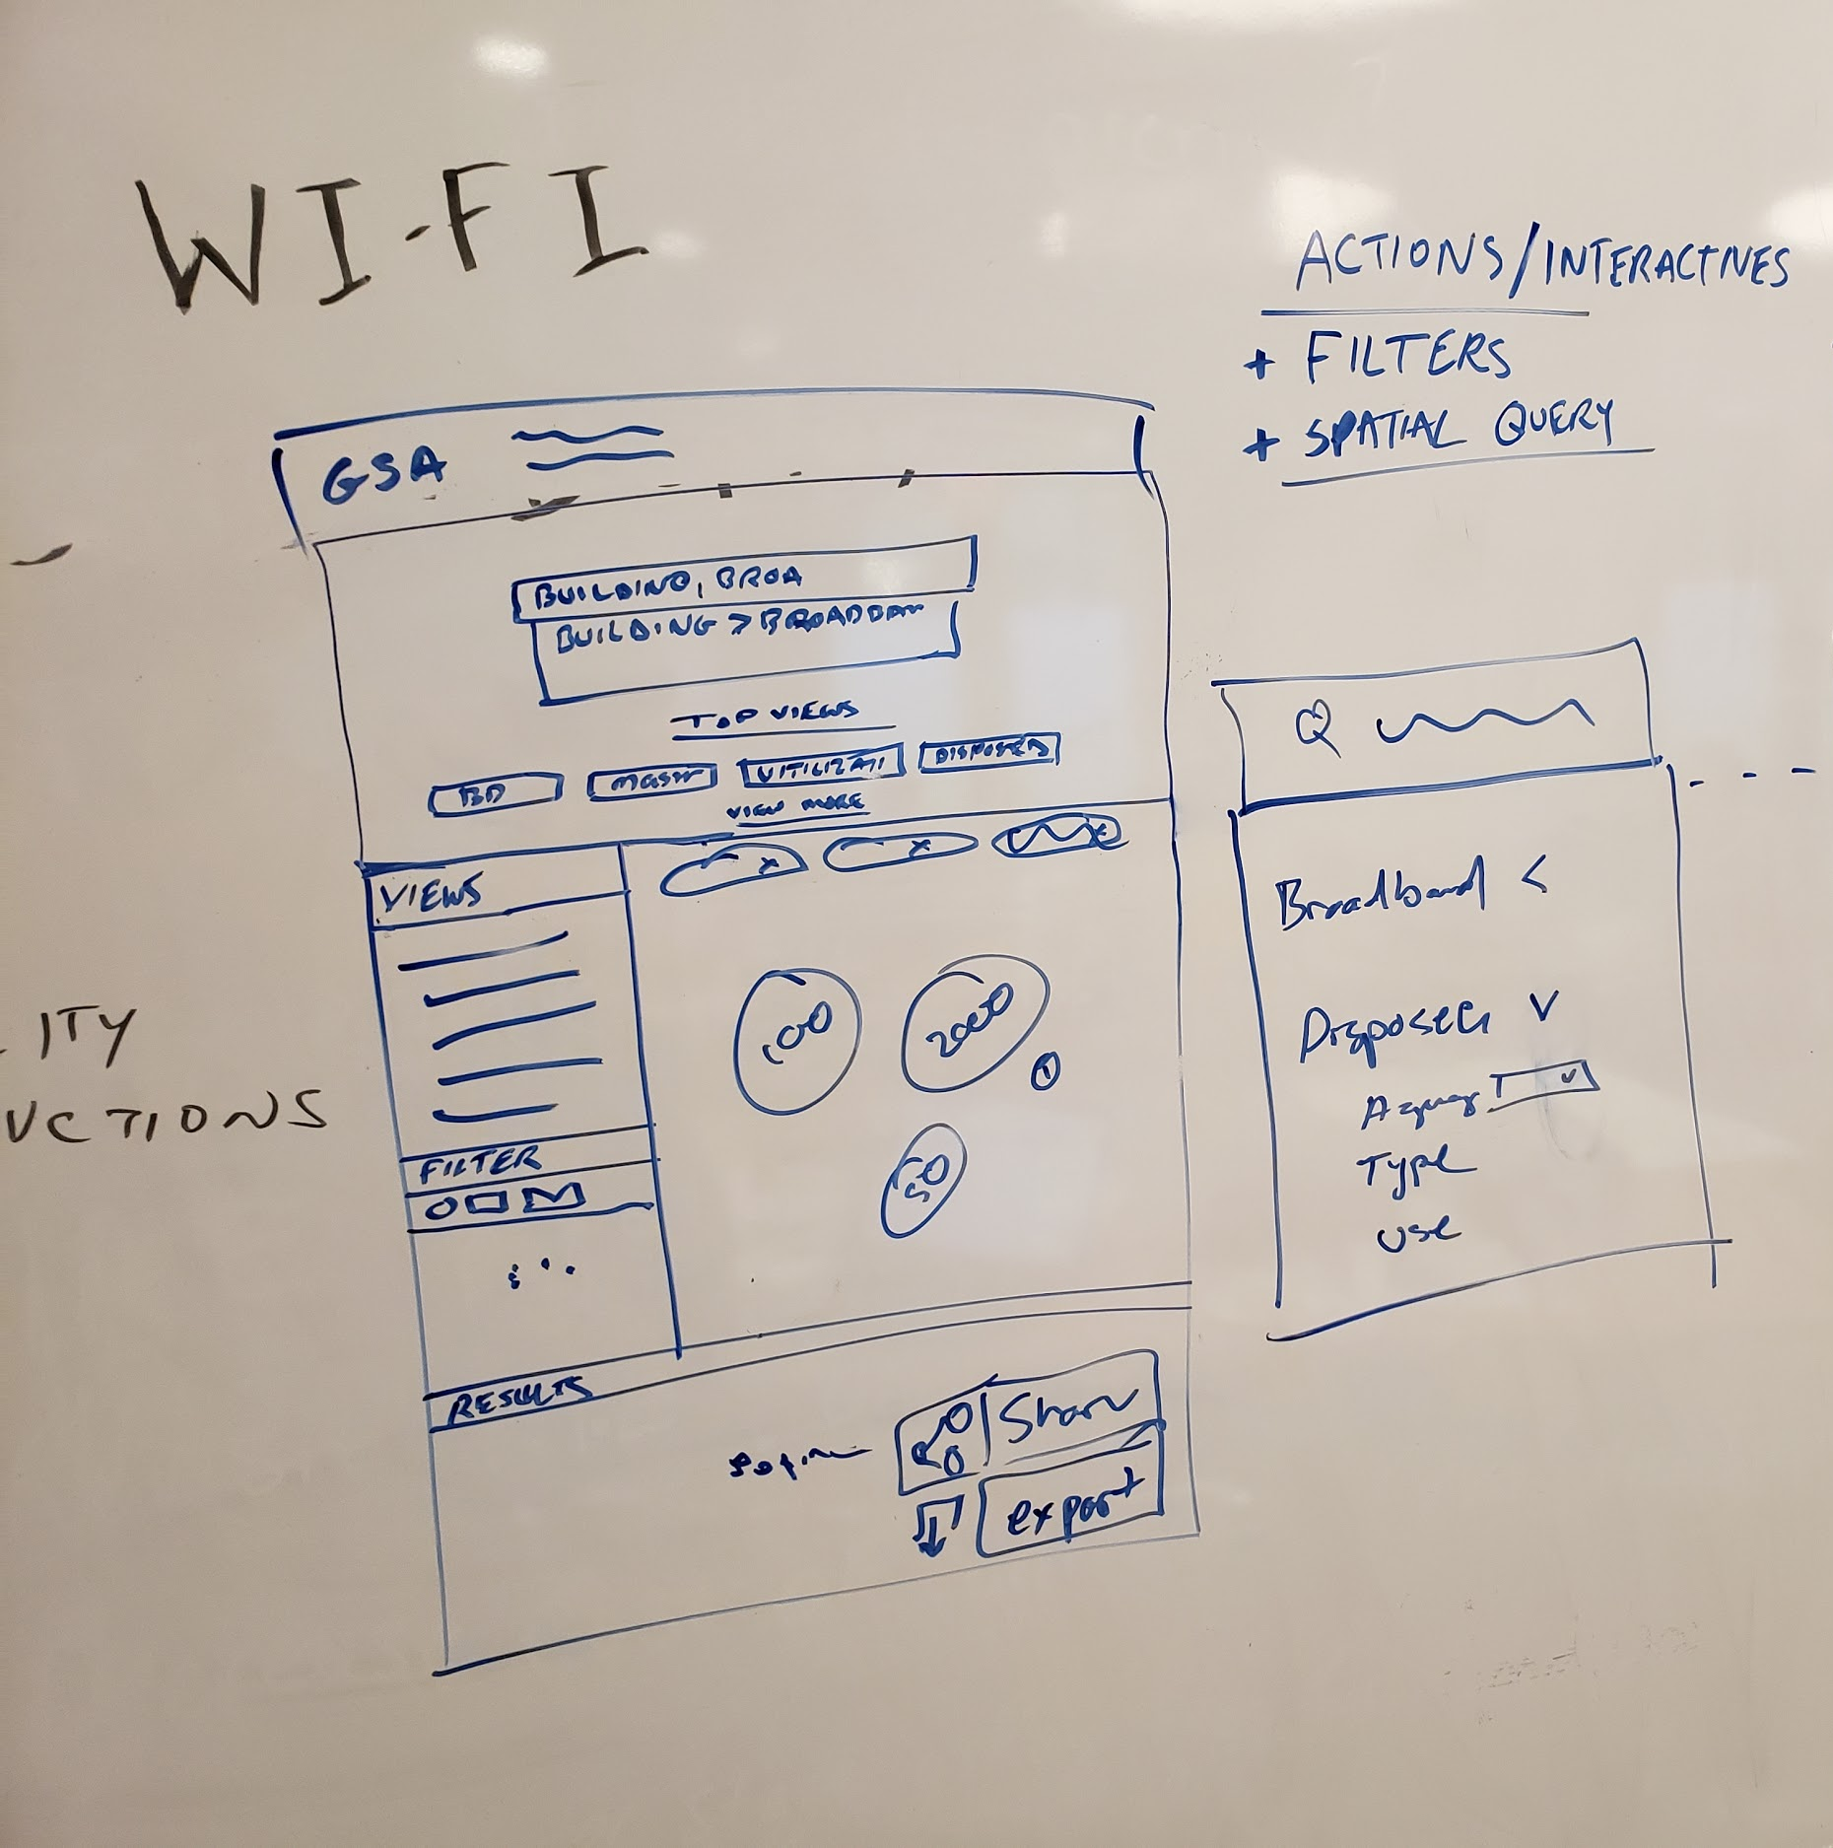
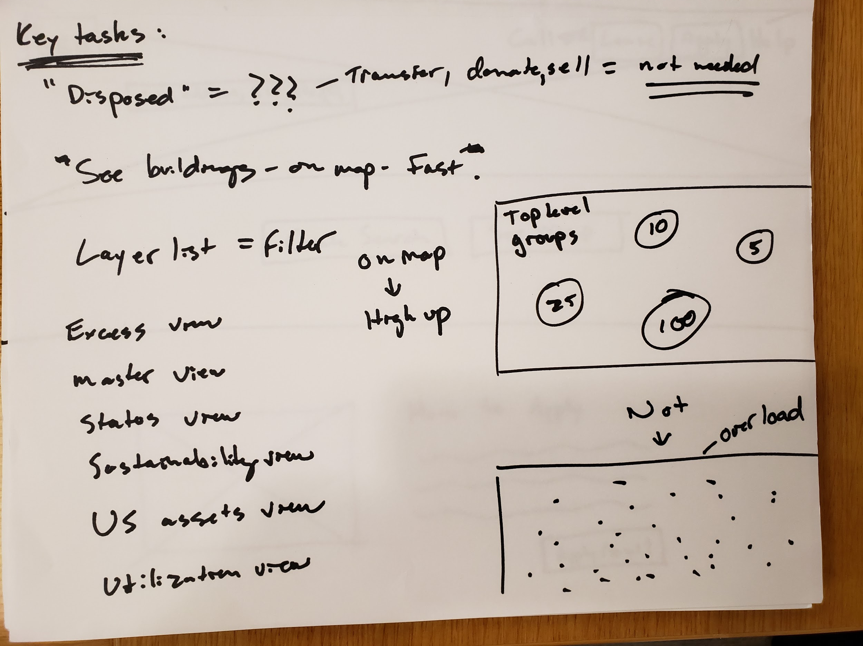
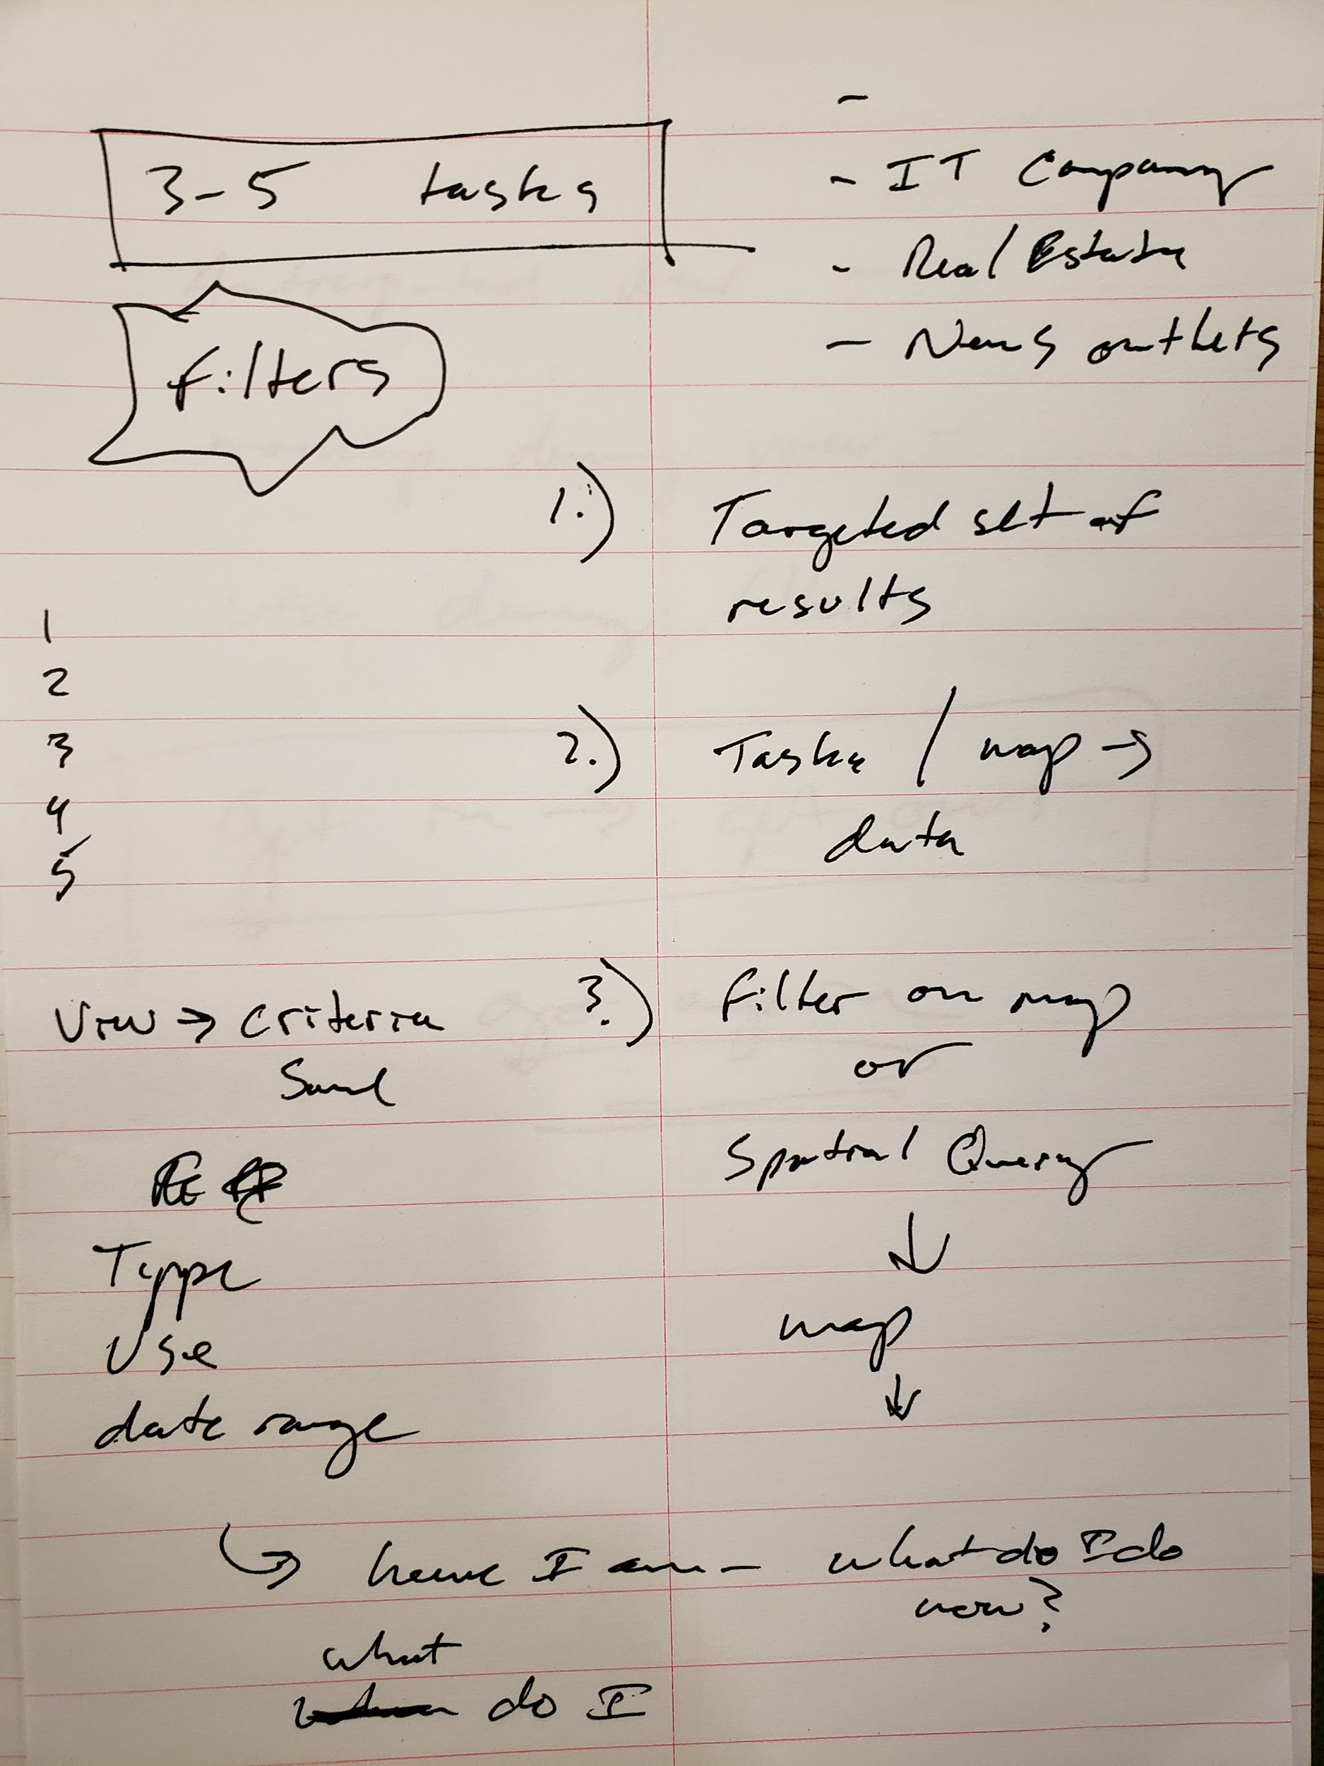
Whiteboarding and Initial Sketches

Slide 5
OUR SOLUTION

Slide 6
BACK END TO FRONT END COMMUNICATION

Slide 7
Theoretical Solution Proposal:
Begin to obtain query results after applying Layer List filter
Prompt a loading animation on map until completed
Zoom centered on closest query obtained, allowing visibility to results on map

