Slide 1
Mastering Your Search Data
Michelle Chronister | UX Team Lead, USAGov
U.S. General Services Administration
michelle.chronister@gsa.gov

Slide 2
Why Look at Search Data
Learn what visitors want and when they want it
Identify pain points
Improve your content
Notes:
Learn what visitors want and when they want it
You may notice seasonal or cyclical trends in searches
Identify pain points
Find your no results or bad results
Improve your content
All of this help to improve your content and improve the entire experience on your website

Slide 3
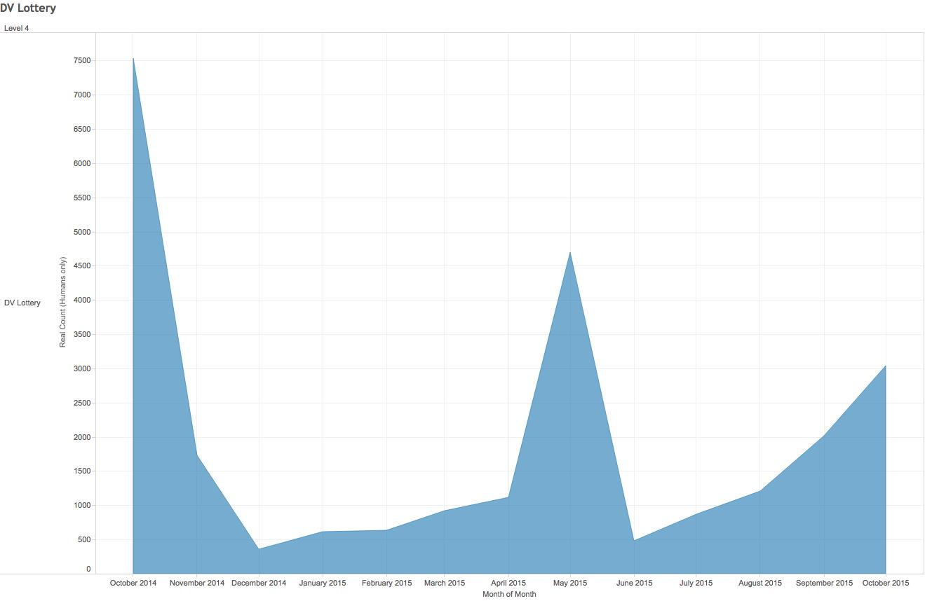
How We Use Search Data
Plan future content

Slide 4
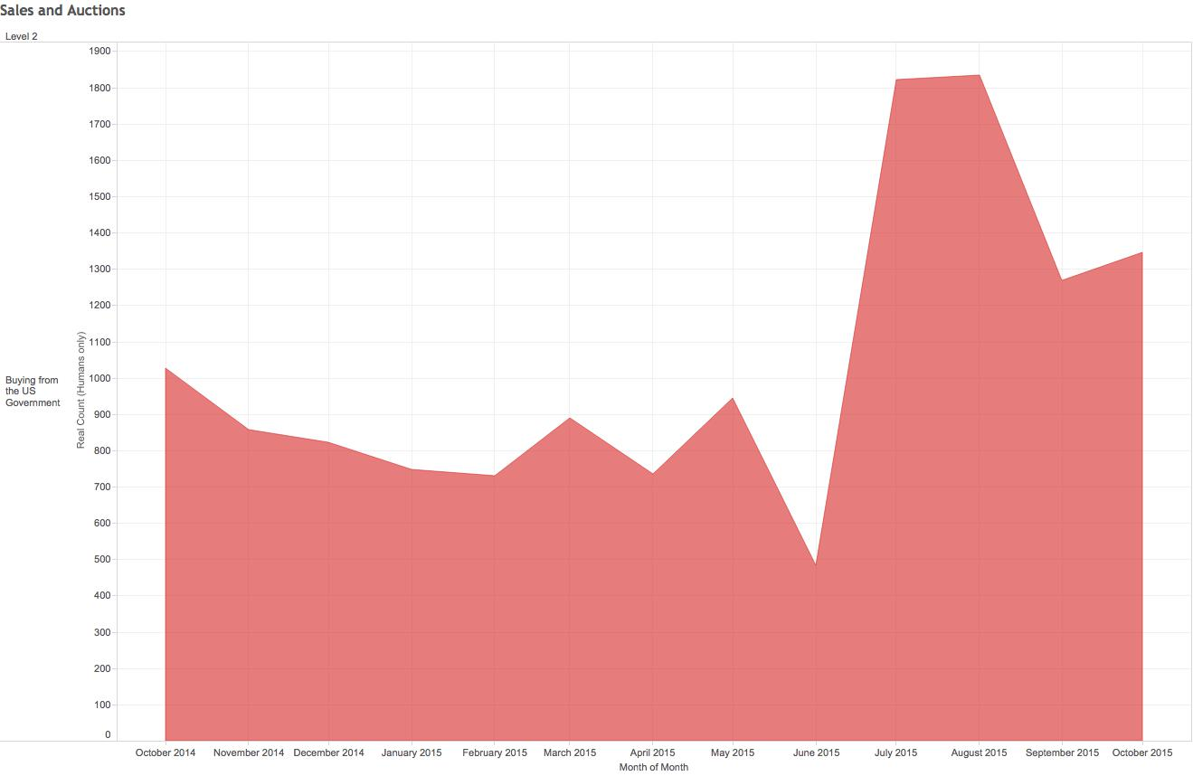
How We Use Search Data
Measure success of content and find areas to explore
Searches for auctions and sales have increased in the new platform. Is it because we have less content? Is that content not as search engine friendly?

Slide 5
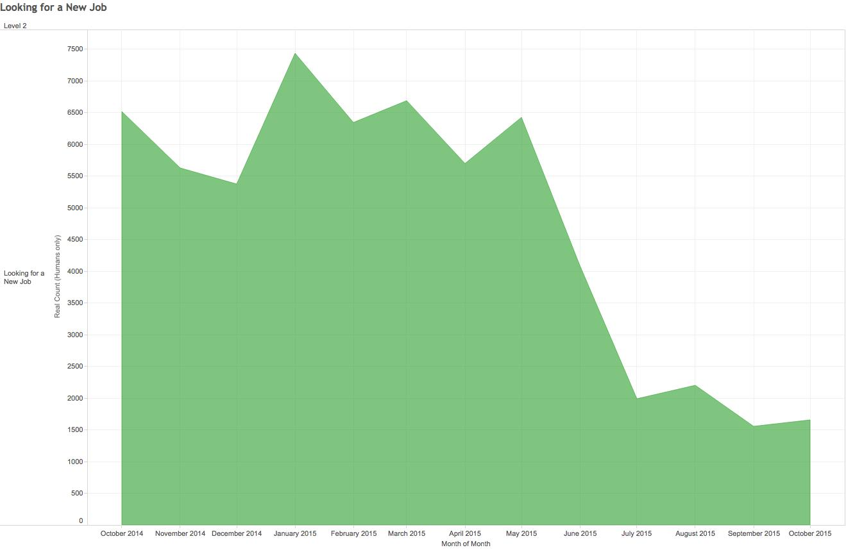
How We Use Search Data
Measure success of content and find areas to explore
Searches related to looking for a job are down in the new platform. Is it because our content is better and easier to find in external search engines?

Slide 6
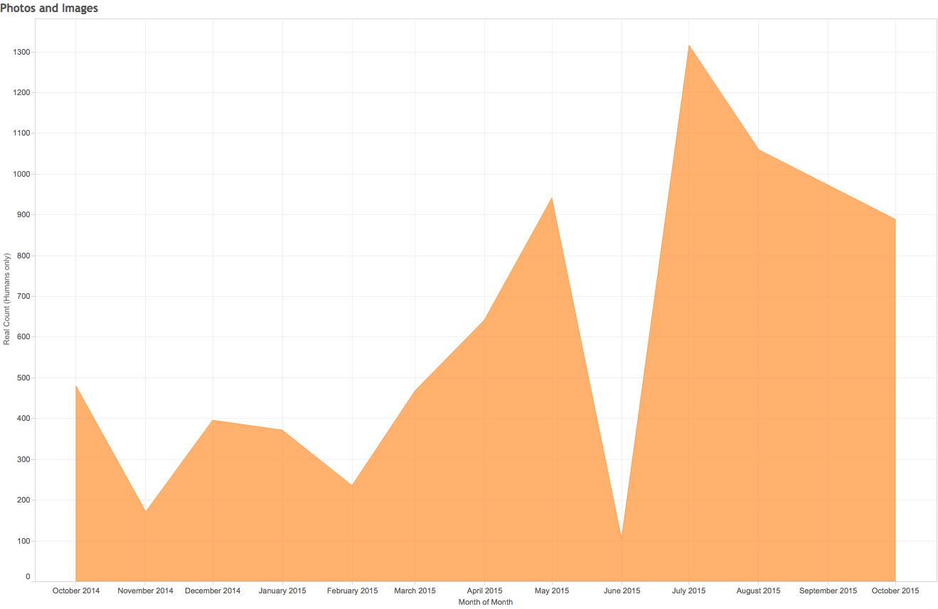
How We Use Search Data
Measure success of content and find areas to explore
Searches for photos and images are also on the rise since we removed the photos and images page in the new platform.

Slide 7
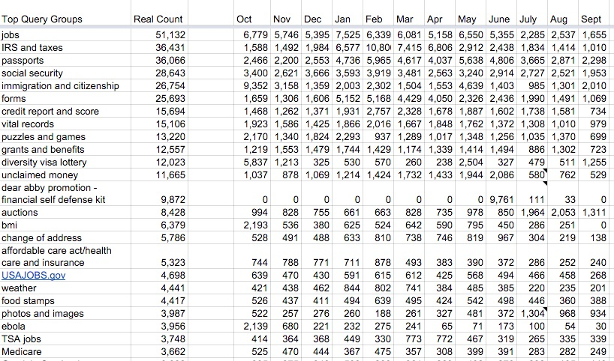
The Tool

Slide 8
How to Create Your Own Tool
Export Your Data
Review Terms
Create Groups
Create Formulas
Test Formulas
Repeat
Analyze and Share

Slide 9
Step 1: Export Your Data

Slide 10
Step 2: Review the Terms

Slide 11
Review the Terms
Look for
variations - jobs and job openings
synonyms - jobs, careers, and employment
acronyms - FDA and Food and Drug Administration
misspellings - passport and pasport
meaning confusion - colonel and kernel
double meanings - birth certificate
President Obama’s birth certificate? Get a new copy of your birth certificate?

Slide 12
Step 3: Create Groups

Slide 13
Create Groups
Make a list of groups you noticed when reviewing the terms.
Write down similar terms and name the group later.
Don’t overthink it. It doesn’t need to be perfect at this point.

Slide 14
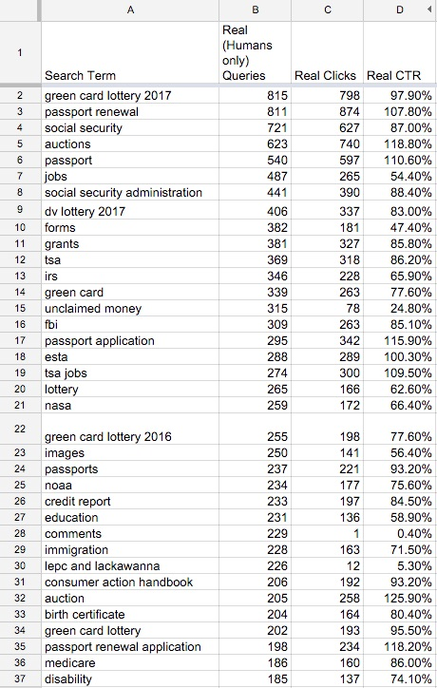
Passports
passport renewal
passport
passport application
passports
passport renewal application

Slide 15
Create Groups
Decide how broad or specific to make each group.
There’s no right way to do this.
Think about the goals and purpose of your site.
Consider the number of searches for the topic.
Refine as you work.
Your groups will likely change over time.

Slide 16
General passports
passport
passport application
passports
Renew a passport
passport renewal
passport renewal application

Slide 17
Create Groups
Creating groups helps you see the forest, not just the trees.
September 2015 - USA.gov
“passports” - 237 searches
Passports category - 2,298 searches

Slide 18
Step 4: Create Formulas

Slide 19
Create Formulas
When you are finished creating groups, write formulas to add up terms in the group automatically.
This is the smarter, faster part.

Slide 20
For a passports group:
=sumif(A:A,"*passport*",B:B)
If column A includes the word “passport” anywhere in it, add up the number in column B.
The * around the word says look for this word anywhere in the cell. This counts “passport,” “passports,” “passport application,” etc. in a single formula.

Slide 21
=sumif(A:A,"*passport*",B:B)
It’s usually better to use a singular term - job not jobs.
You don’t always need the *.
You can use wildcard characters in your formulas. Some tools handle these better than others.

Slide 22
Step 5: Test Formulas

Slide 23
Test Your Formulas
Compare the formula results to a manual check.
Refine until they match as closely as possible.
If they don’t match, look for possible places where the formula may be double counting.
There may be times when they don’t match and there’s no way to fix it. Decide how important it is to you.

Slide 24
Step 6: Repeat

Slide 25
Repeat
Now you can analyze your search terms on a regular basis in less time
Use a tab for each month.
Copy and paste the formulas to the new month.
Look for new terms and see if they are being counted in your current formulas. If not, refine and recheck.

Slide 26
Step 7: Analyze and Share

Slide 27
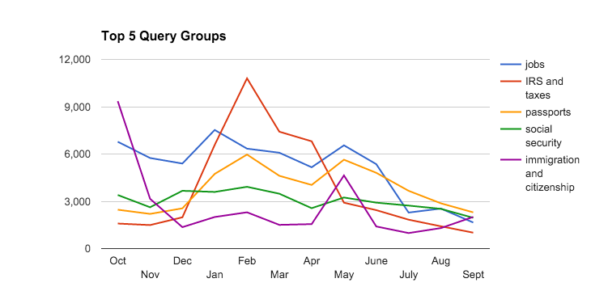
Analyze
Quickly create graphs
Easily pull historical data for data calls
Spot trends and seasonal occurrences

Slide 28
Share
Give your searchers a seat at the table
Share with your content team and others
Use it to support decisions

Slide 29
Build Your Own
Read Understanding Your Users' Needs By Analyzing Search Terms
Watch an earlier version of this presentation
Download USA.gov’s FY13 spreadsheet (MS Excel, 371 KB, October 2013)
Feel free to email me - michelle.chronister@gsa.gov

Slide 30
Main Take-Aways
Feel confident navigating the analytics section
Set up analytics alerts
Steal Michelle’s tool

