Slide 1
USASearch.gov
Query Analytics Demo
Sept 29, 2009

Slide 2
Search Dominates Information
Search is a killer app on the Internet, yet
Government is barely scratching the surface of making its information and data seamlessly discoverable and useful to citizens.
We should:
Provide search across boundaries
Provide answers, not redirection
Learn what citizens need from their behavior

Slide 3
Federal Search:
Three Main Efforts
Improve
USASearch.gov
Improve
Govt Web Site
Search
Editorial and
Analysis Tools

Slide 4
A Tool to Analyze User Behavior
Take the “citizens’ pulse”.
  Help decision makers understand the landscape.
Improve government search and information content.
  Need to study clickthrough as well as queries.

Slide 5
Query Analytics Demo
  Compare most frequent queries for
    Prior day
    Prior 7 days
    Prior 3 days
  See accelerating queries for these periods
  Go back in time (change date)
  Search through the queries

Slide 6
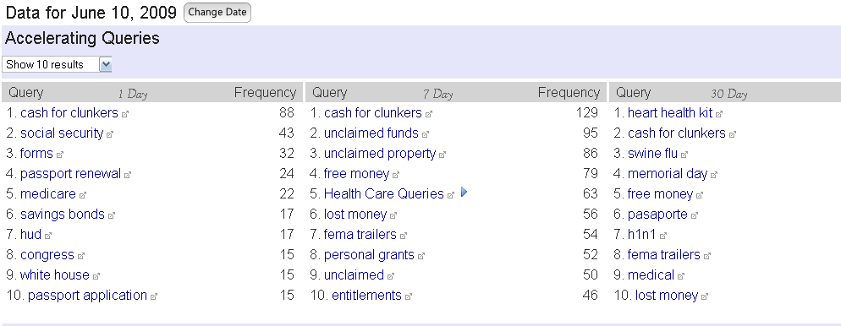
Example: Cash for Clunkers

Slide 7
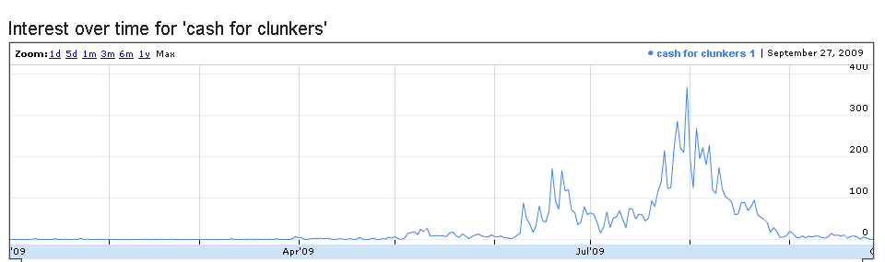
Example: Cash for Clunkers

Slide 8
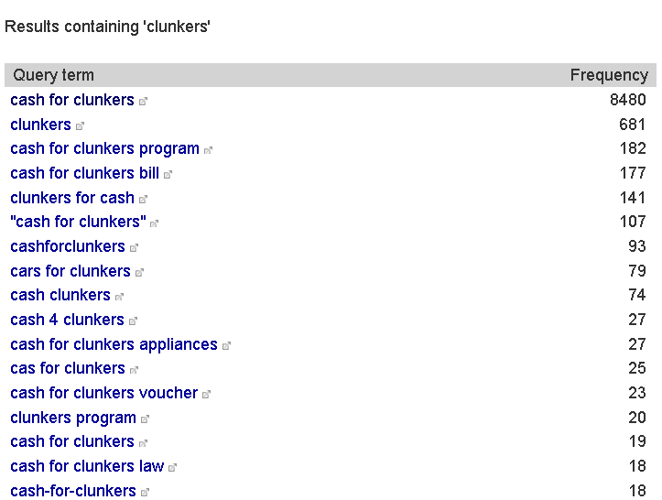
Example: Cash for Clunkers

Slide 9
Future Directions: Analysis Tools
Improve analytics both for external communication and for internal performance analysis.
  Streamline reporting
    Provide email alerts about critical events to decision makers
  Categorize queries
    Go beyond most popular
  Clickthrough analysis
    What are people searching for but not finding?
Provide integrated analysis dashboards across government information
  Data.gov
  Cross-cutting topics (financial, environmental, etc.)

Slide 10
Future Directions: Search
Integrate search across govt information
  Data.gov, USA Search, govt news, govt social media, etc
Move USASearch to the cloud
Expand the scope & utility of USASearch
  Providing an open search api to govt sites
  Providing a structured search solution too.
  Supporting SEO for gov web sites,
  Leveraging govt meta-data via data.gov and other sources to improve search on govt info
Determine what works for govt search; publish it to larger search community.

Slide 11
Analytics Demo Info
searchdemo.usa.gov/analytics
Id: demo
Pwd: usasearchdem0 (zero at the end)
Send questions to marti.hearst@gsa.gov, 202-219-1437

