Slide 1
AbilityOne Program Overview Jason Endicott

Slide 2
Presentation Agenda
Program Mission
Program Organization
Roles and Responsibilities
Program Benefits
Products and Services
Ordering Guide
Questions and Answers

Slide 3
Program Mission
Provide employment opportunities for people who are blind or have significant disabilities in the manufacture and delivery of products and services to the Federal Government.

Slide 4
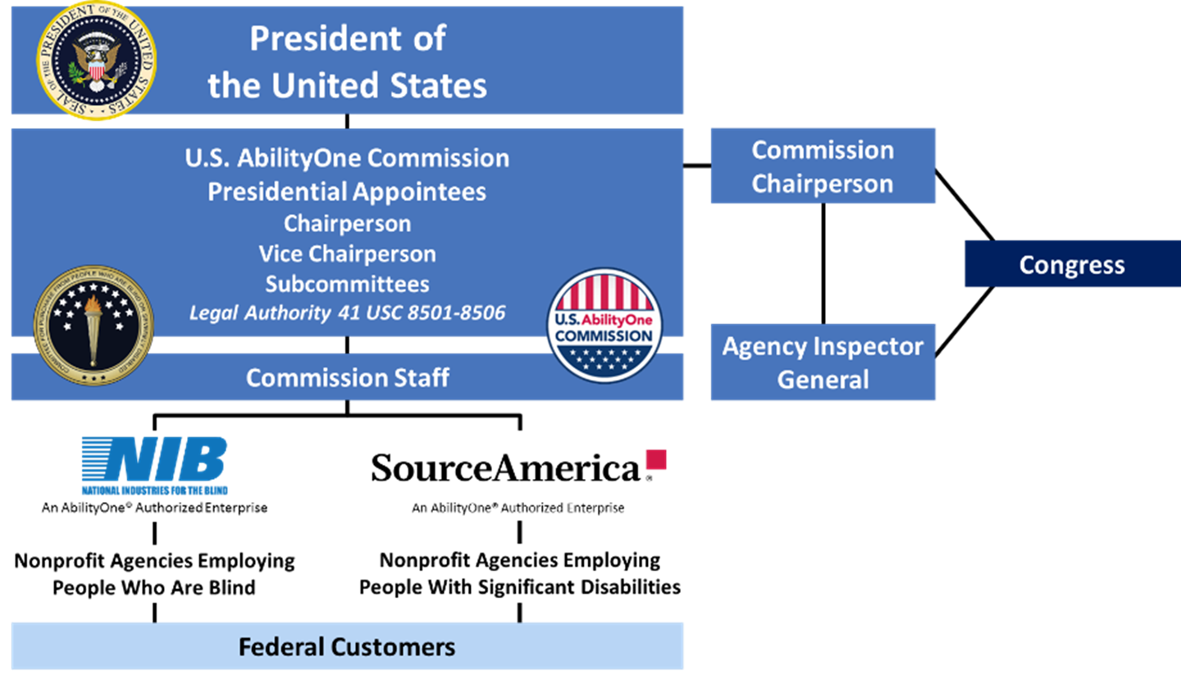
Program Organizational Chart

Slide 5
U.S. AbilityOne Commission Responsibilities
Establishing strategic direction for program
Creating/maintaining Procurement List
Setting and revising Fair Market Prices
Designating Central Nonprofit Agencies (CNAs)
Making rules and regulations necessary to administer the Javits-Wagner-O’Day Act
Assisting Federal customers to increase their purchases under the program

Slide 6
CNAs: NIB/SourceAmerica Responsibilities
Overseeing and assure nonprofit agency (NPA) contract compliance
Solving problems; single point of contact for complaints or delivery issues
Helping educate customers
Representing NPAs to the Commission
Evaluating and reporting NPA qualifications and capabilities to the Commission
Recommending suitable additions to the Procurement List including the initial Fair Market Price

Slide 7
NPA: Nonprofit Agency Responsibilities
Manufacturing and delivering products or performing services as assigned by the CNA
Meeting qualification for participation
75% of direct labor hours performed by people who are blind or have significant disabilities
Net income cannot benefit individual shareholder or other individual
Maintaining qualifications to continue to participate
Meeting other requirements of Federal contractors

Slide 8



Why is this important?
Over 18 million working-age adults are blind or have significant disabilities, nearly 70% of this population is not employed
The AbilityOne Program serves people who may otherwise have difficulty obtaining or maintaining employment
The AbilityOne Program is one of the largest sources of employment in the U.S. for people who are blind or have significant disabilities

Slide 9
Customer Focus
Federal Government is the AbilityOne Customer
The AbilityOne Team must balance the needs of the Government and the employment needs of people who are blind or have significant disabilities
Preferred Source vs. Mandatory Source
Provide Solutions

Slide 10
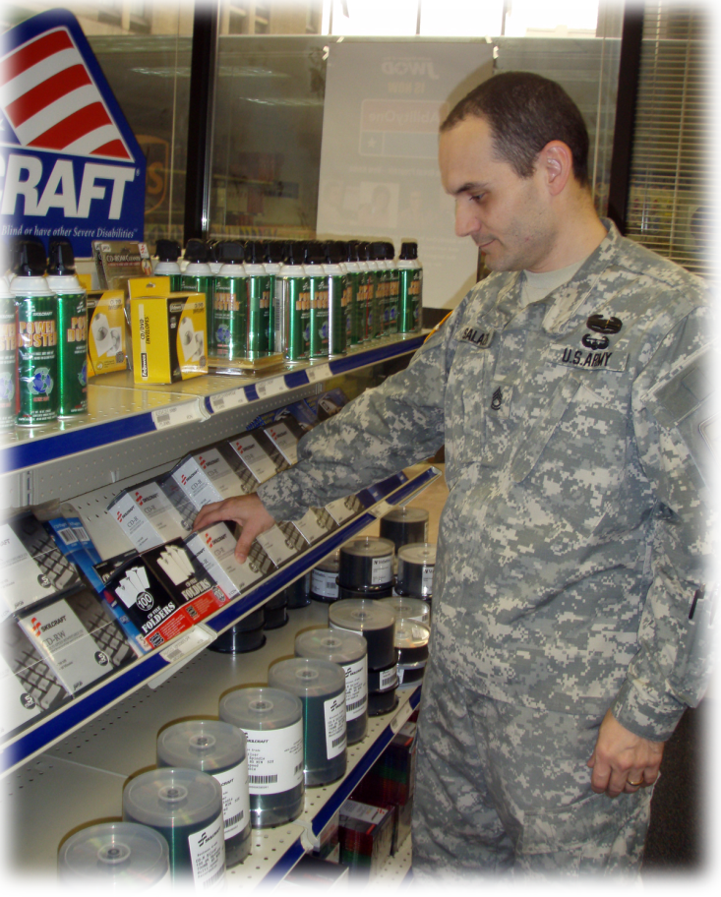
Benefits to the Government Customer
Quality products and services, on-time delivery
Fair market prices, best value procurement
National network of solution providers
Long-term relationships
Moral satisfaction in helping people to help themselves

Slide 11

Benefits to the Employees
Wide range of employment opportunities
Long-term work experience
Marketable job skills
Equitable wages and benefits, plus a chance to advance
A measure of independence

Slide 12

AbilityOne Program Product and Service Offering

Slide 13
What Kind of products can I buy?
Chemical Supplies
Cleaning Products
Clocks
Clothing
Computer Accessories
Disposable Paper Products
Furniture
Kitchen & Break Room Supplies
Mattress & Bedding
Medical Supplies
Military/Combat Clothing
Office Supplies
Paint & Accessories
Personal Care & Safety
Picture Frames
Safety & Maintenance Items
Shipping & Packaging Supplies
Writing Instruments

Slide 14
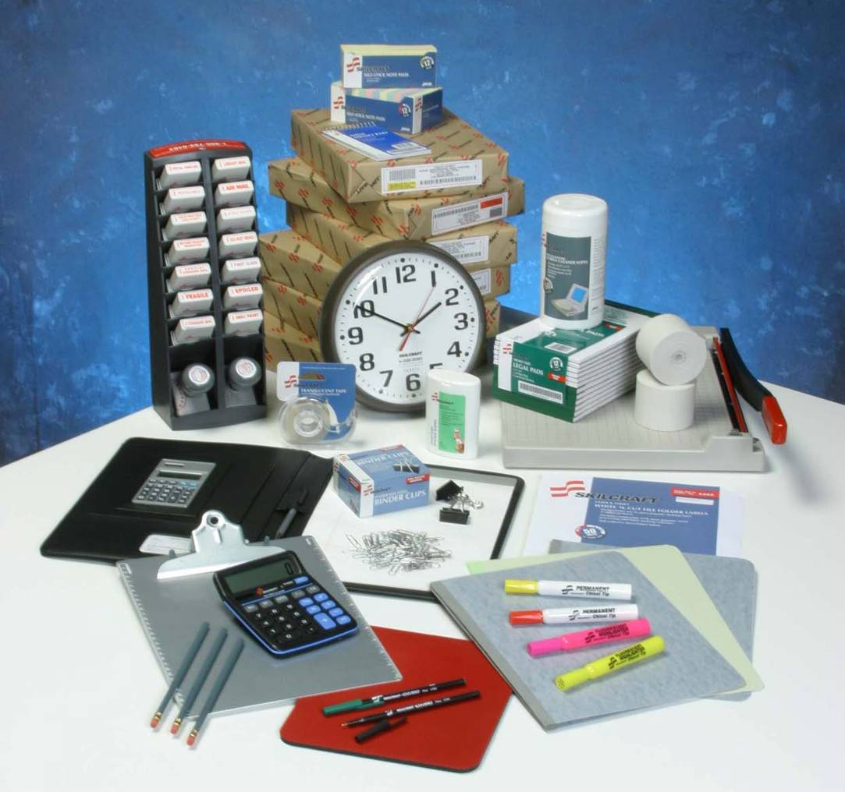
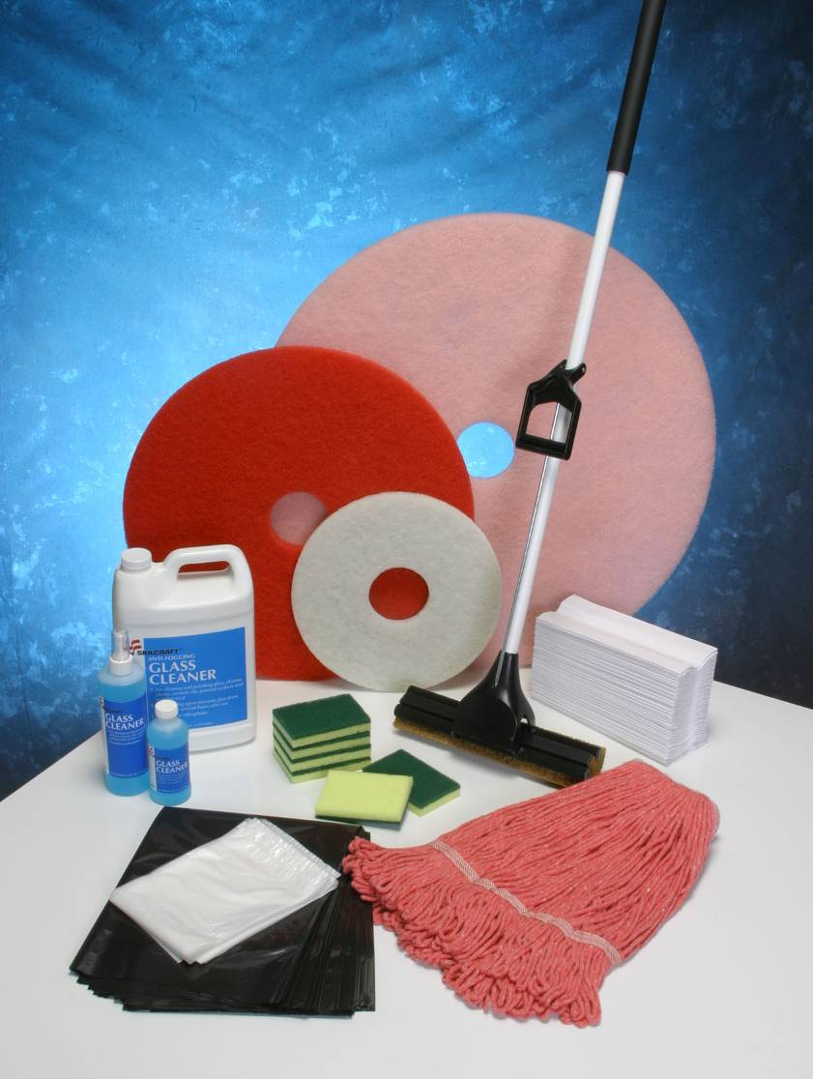

Office and Cleaning Supplies

Slide 15
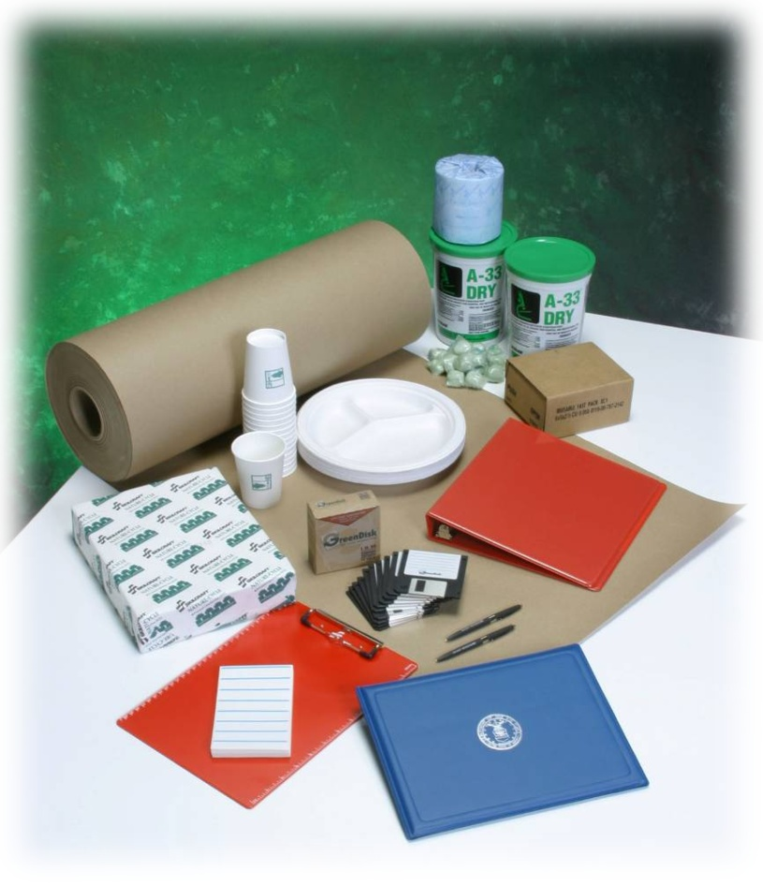

Go Green with AbilityOne
Biodegradable paper cups
Process Chlorine Free (PCF) office paper
Products made from recycled materials
Disposable cutlery
Environmental cleaning agents

Slide 16
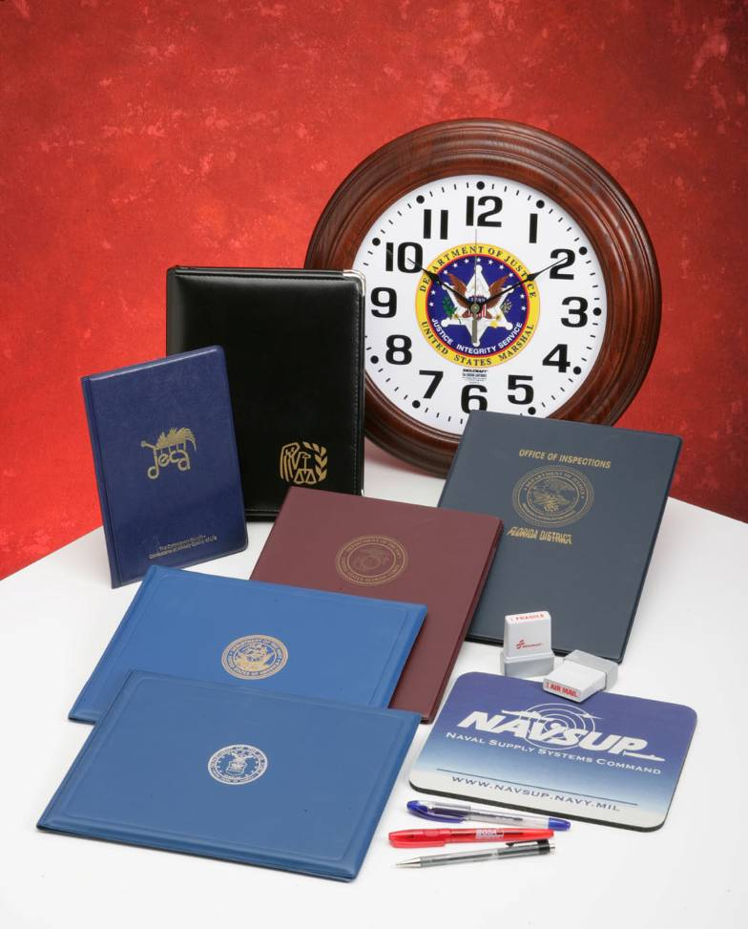
Custom Products
Awards and recognition items
Plaques
Pen sets
Clocks
Military picture frames
Stamps

Slide 17
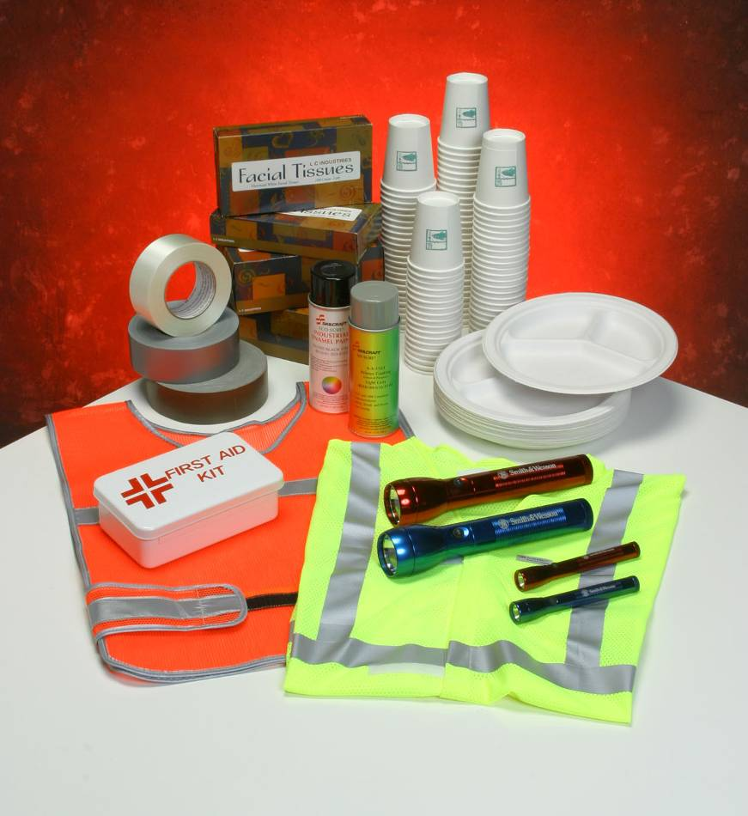
Safety and Personal Care
First aid kits
Fire hoses
Flashlights
Gloves
Nonskid deck covering
Traffic safety clothing items

Slide 18

Government Unique Products
Military Police belts
Gloves for the TSA and VA
Military clothing
Slacks
Trousers
Shirts
BDUs, ACUs, ABUs
Food
Military ration components
Bakery and cake mixes

Slide 19
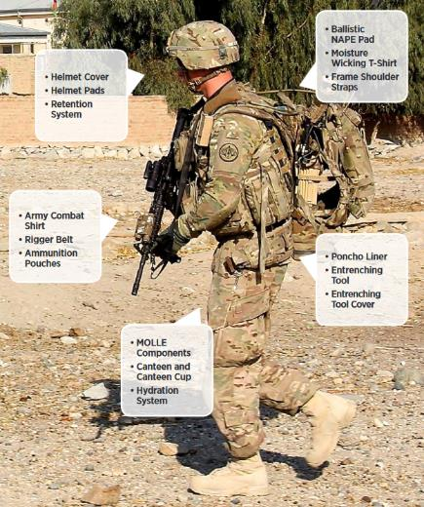
Supporting the Warfighter
Military
Textiles and apparel
Protective equipment
Professional services
Base Supply Centers
Veterans and Families
Eyewear
Prescription bottles
VA Customer Care Centers
Military Resale
Wounded Warrior Program

Slide 20
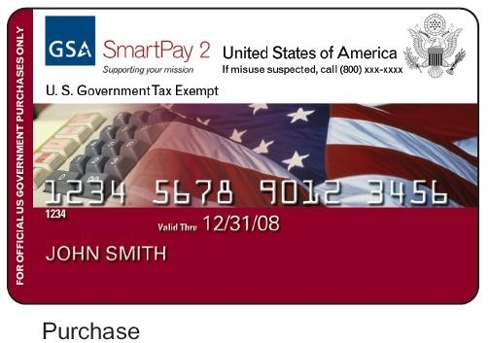
Micro Purchase Limits
Is AbilityOne still a required source if I only buy small amounts with my purchase card?
Yes, the AbilityOne Program is applicable at any dollar amount
No exemptions for
micro-purchases

Slide 21
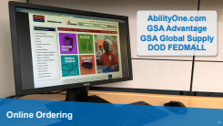
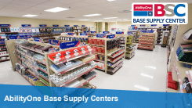
How to purchase AbilityOne Products
GSA Global Supply
www.GSAglobalsupply.gsa.gov
GSA Advantage!®
www.gsaadvantage.gov
Multiple Award Schedule Holders - Authorized AbilityOne Distributors
https://www.abilityone.gov/distributors
Base Supply Centers
www.abilityone.com
AbilityOnecatalog.com

Slide 22
AbilityOne Procurement List
Official list of all AbilityOne items
Maintained by the U.S. AbilityOne Commission
Identifies name and National Stock Number (NSN) or commercial name for each product
Access the list: www.abilityone.gov

Slide 23
What services are available?
Administrative Support
Contract Management
Facilities Management
Food Service
Grounds Maintenance
Secure Document Services, which includes: - Document Management - Secure Mailroom Services - Secure Documentation - Destruction
Janitorial/Custodial
Section 508 Compliance
Order Processing
Recycling
Fleet Management & Maintenance
Warehousing/Distribution
TeleServices (Call Centers, Customer Service, hotlines, etc.)
Healthcare Environmental Services

Slide 24

How do I order AbilityOne Services?
Services are specific to the customer and location(s) when added to the Procurement List
Standard procurement process with certain exceptions
Nonprofit agencies follow the Performance Work Statement (PWS)
If additional services are needed outside of the scope of the Procurement List, must add new work to the Procurement List

Slide 25
Customer Satisfaction
Customer satisfaction is the key to keeping people employed, so…
Performance
+
Value
=
Customer Satisfaction
=
Jobs

Slide 26
Questions

Slide 27
Thank You!
Jason Endicott
National Industries for the Blind
Sr. Channel Sales Representative
jendicott@nib.org
703-310-0451

Slide 28

GSA Starmark Logo

