Slide 1

Innovation in Payments A Strategic Approach Andrew Lee
Notes:
Welcome to the “Innovation in Payments: A Strategic Approach” session. This will be a pre-recorded presentation about the role of innovation in charge card programs and the process to strategically implement payment solutions, currently available under the GSA SmartPay 3 master contracts. The focus of the presentation will be a panel discussion with representatives from an agency using GSA SmartPay payment solutions in unique ways to address challenges or opportunities, make payment operations more efficient, and potentially drive more spend and earn refunds.

Slide 2
Point of Contact Andrew Lee andrew.lee@gsa.gov
Notes:
My name is Andrew Lee and I will be facilitating the session today. I am a Business Management Specialist from the GSA Center for Charge Card Management. If you have any questions following this presentation, please don’t hesitate to reach out to me. The best way to contact me is through email, which is andrew.lee@gsa.gov.

Slide 3
The Purpose
Notes:
Everyone here knows that many agencies already manage efficient and effective charge card programs. Through the experience, diligence, and hard work of agency coordinators, including everyone in this session, your efficiently make payments to merchants and vendors, generate refunds in the process, and more importantly support the missions of your agencies. Our program has found, that even in the most well-run agencies, there may still be opportunities to take advantage of solutions currently available through the GSA SmartPay program and master contracts. The purpose and goal of this session today is to get agency charge card managers at all levels, from management to work-level A/OPCs, to strategically think about the most effective uses for payment solutions in your agency’s day to day payment processes.

Slide 4
Identifying Challenges or Opportunities
Consider your agency’s needs, current payment processes, opportunities for improvement, and potential refunds generated with GSA SmartPay solutions:
What are the payment challenges your agency faces or potential opportunities?
Are you paying vendors with the best solution possible? Can a GSA SmartPay payment solution solve a problem or make our lives easier?
Can we use a GSA SmartPay payment solution for qualifying contract payments? Can we conduct an accounts payable file review to identify opportunities?
Notes:
As we talk about the role of innovation within your payments program, let’s take a moment to ask a few questions:
What are there current challenges your agency has for making payments? For instance, are there situations where a physical card cannot be used? Are there cardholders in remote locations purchasing from vendors that don’t accept cards? Or do a lot of cardholders purchase from online platforms and don’t actually need physical cards?
Are there opportunities to more efficiently pay your vendors? Meaning, are you maximizing the use of available payment solutions for products, services, or travel? Is there a better or easier way to pay? For example, do you use a GSA SmartPay payment solution for recurring payments such as utilities or subscriptions?
Do you use a GSA SmartPay payment solution for qualifying contract payments? Have you looked into the percentage of contract payments being made with a GSA SmartPay payment solution? Are there opportunities to have more contracts be paid with a GSA SmartPay solution? Are there opportunities to insert clauses into new or existing contracts to allow for contract payments? Have you conducted an accounts payable file review to identify other opportunities?
The answers to these questions will help drive the strategy and process for increasing the use of GSA SmartPay payment solutions and opportunities to earn refunds.

Slide 5
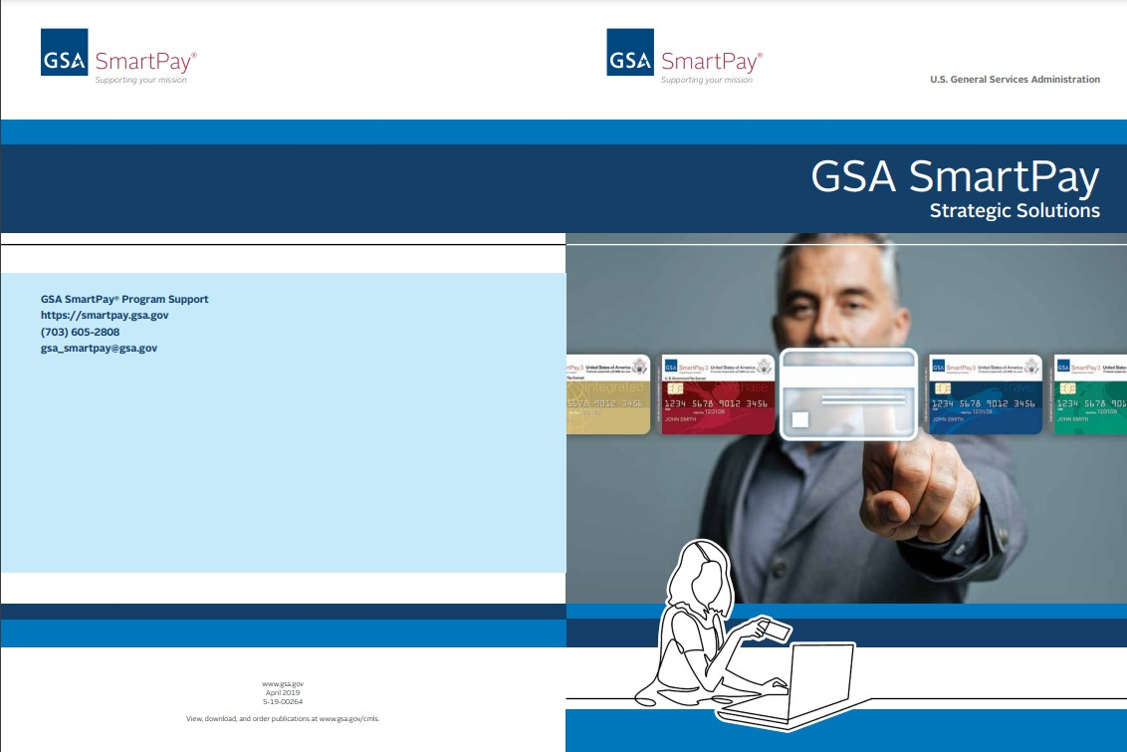
GSA SmartPay 3 Innovative Solutions
Innovative payment solutions currently available under the GSA SmartPay 3 master contracts:
Ghost Card
Declining Balance Cards
Single Use Accounts
Mobile Payments
Travel Tax Advantage Cards
ePayables
Virtual Cards
Contract Payments
The GSA SmartPay Strategic Payment Solutions brochure is available at: https://smartpay.gsa.gov/general-resources-aopcs
Notes:
Once you have answers to the questions asked, innovative or strategic application of available payment solutions may be able to help fill in gaps where more “traditional” means of payment or plastic cards may be falling short. As you can see on this list, there are a number of innovative payment solutions available under the GSA SmartPay 3 master contracts. More information about each of these payment solutions can be found in the GSA SmartPay Strategic Payments brochure and through the GSA SmartPay 3 master contract. These payment solutions are also commercially available and have actual uses both inside and outside of the government.

Slide 6
A Strategic Approach to Payments
The key concepts to innovation are strategy and process:
Solutions themselves can be are important but the approach, strategy and process will play critical role
You don’t always need an innovative solution, just the will and desire to do things differently
Notes:
With that said, it’s important to keep in mind as we continue to talk that the innovative solutions in the previous slide themselves may not be the answer to problems. There may even be times where an innovative payment solution may not be needed, just a different approach to implementing an existing GSA SmartPay payment solution.
Instead of focusing on the payment solutions themselves, we’d like to highlight the thoughtful ways that agencies have strategically implemented payment solutions available under the GSA SmartPay 3 master contracts. In other words, we focus less on the solution themselves and more on the approach and processes that help implement or expand the use of solutions. To discuss the real world considerations to innovation in payments, we’ve invited representatives from the US Department of Agriculture to talk about the USDA Payments Plus initiative and how innovation has helped strategically address existing payment challenges or capitalized on opportunities.

Slide 7
Panelists
United States Department of Agriculture
Office of the Chief Financial Officer
Lynn Moaney
Deputy Chief Financial Officer
Christopher Corder
Mission Area Senior Program Manager
Director, Program Management Office
Notes:
Panel script

Slide 8
USDA Payment Plus Initiative
Description of Opportunity
Technology has progressed, enabling a fully automated solution.
Payment solution poses no additional burden to Contracting Officers.
Gives vendors increased security and flexibility with electronic payments.
Potential rebates that could be possible if we were able to move our top 20 vendors to payments to charge card solution.
Notes:
Panel script

Slide 9
USDA Payment Plus Initiative
Background
Commissioned by USDA Office of Contracting and Procurement and Office of the Chief Financial Officer
Determine the viability of implementing US Bank’s Payment Plus automated payment solution as an additional contract payment option for USDA vendors
Notes:
Panel script

Slide 10
USDA Payment Plus Initiative
Overview
Provide vendors an automated charge card solution as an additional accounts payable option.
Fast, secure payment receipt
A proactive approach to protect vendors’ banking information
Transactions are eligible for refunds
Provide an automated solution that does not change or increase the workload of Contracting Officer
Serve as model to other Federal Government Agencies
Notes:
Panel script

Slide 11
Additional Questions
Did you explore other options for resolution and why did you choose the specific GSA SmartPay solution or approach?
What was the process or journey to get management or leadership to buy in?
What was the experience implementing the solution or approach?
What are some of the challenges for implementation?
What are the current plans for training users and approvers?
Notes:
Panel script

Slide 12
Additional Questions
What were some of the road blocks you experienced and what would you have done differently?
What were some of the best decisions that were made that facilitated implementation?
Lessons learned?
How will you track the benefits of solution implementation?
What will the impact be?
Notes:
Panel script

Slide 13
Themes and Topics for Consideration
Assessment of challenge and solution identification
Management buy-in
Accounts payable file review
What is available under your current task order?
Pilot projects
Notes:
Thank you both again for coming to discuss your experience. We look forward to having you back sometime soon once Payments Plus launches to revisit some of these questions and talk about the data you are seeing.
To close out today’s discussion, let’s wrap up with some themes and items for consideration.
As discussed earlier in the class and through Lynn and Chris’s feedback, it is important to assess both challenges and opportunities in payment and thoughtfully identify ways to strategically address those challenges and opportunities
Management and leadership buy-in from all agency stakeholders is a key part to implementation and continued success of an initiative.
An accounts payable review can be conducted by your agency bank at no cost. The file review has the potential to identify opportunities for innovative payment solution use or vendors that can be paid with GSA SmartPay payment solutions.
Talk to the owner or COR of your agency’s task order to see what solutions are available for your challenges. Is there an opportunity to work with your agency or even our program to pilot a program?
We encourage agencies to consider starting pilot projects for any potential innovative solutions implementation. If you start a pilot project, please contact our team with process and lessons learned so we can share the information with interested agencies

Slide 14

GSA Starmark
Notes:
Thank you all for attending this class. A huge thank you to Lynn and Chris from the USDA Office of the Chief Financial Officer for their great work and for sharing their experiences. I hope the discussion has given you some ideas for innovation within your own agency programs. I look forward to interacting with you and the panelists, fielding questions, and sharing agency experiences on the live questions and answers session.

