Slide 1

Use of Data Analytics for Effective Program Oversight Shane Brosius

Slide 2
GSA SmartPay® Training Agenda
Overview and Expectations
Foundations of Data Analytics
Benefits of using Data Analytics
Application of Data Analytics
Audit Review
Metrics
Available Tools and Resources

Slide 3
Overview & Expectations
This training provides an overview of data analytics and shares best practices and commercial tools currently available as part of the GSA SmartPay® (SP) Program
1 - The concepts of data analytics;
Upon completion of this course, participants should have a better understanding of:
2 - The application of data analytics;
3 - The resources available to Agency/Organization Program Coordinators (A/OPCs) and card managers;
4 -The use of data analytic tools to enhance oversight within agency card programs

Slide 4
Foundations: What is Data Analytics
Data analytics refer to the use of advanced computational and statistical methods. There are different levels of analytics including:
Reporting: consists of running basic functions to organize data (e.g., using Microsoft Excel to output data in table formats or charts)
Discovery Analytics: involves the creation of real-time dynamic visualizations and benchmarking
Predictive Modeling/Data Mining: involves the use of advanced statistical techniques to predict future outcomes
GSA SmartPay Data Warehouse
Gov’t-wide Metrics Dashboard
Bank EAS Reports

Slide 5

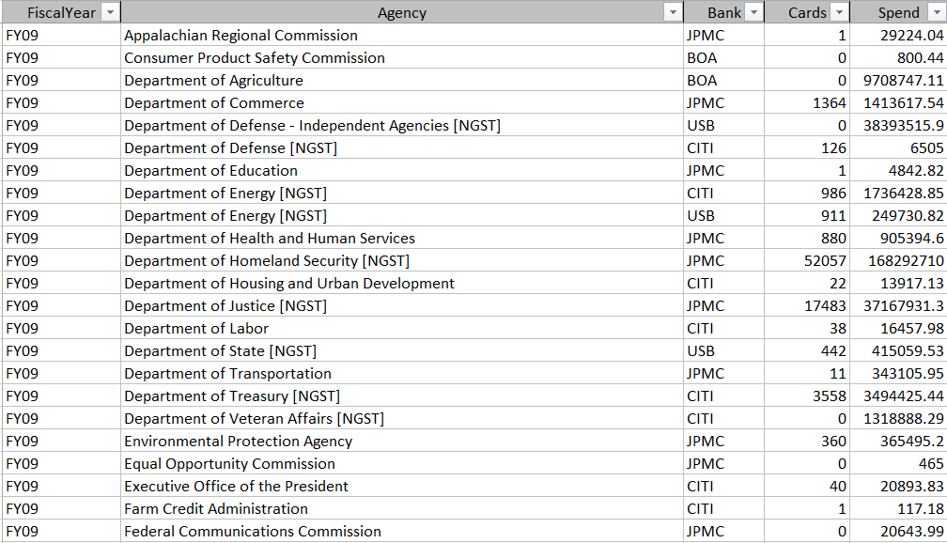
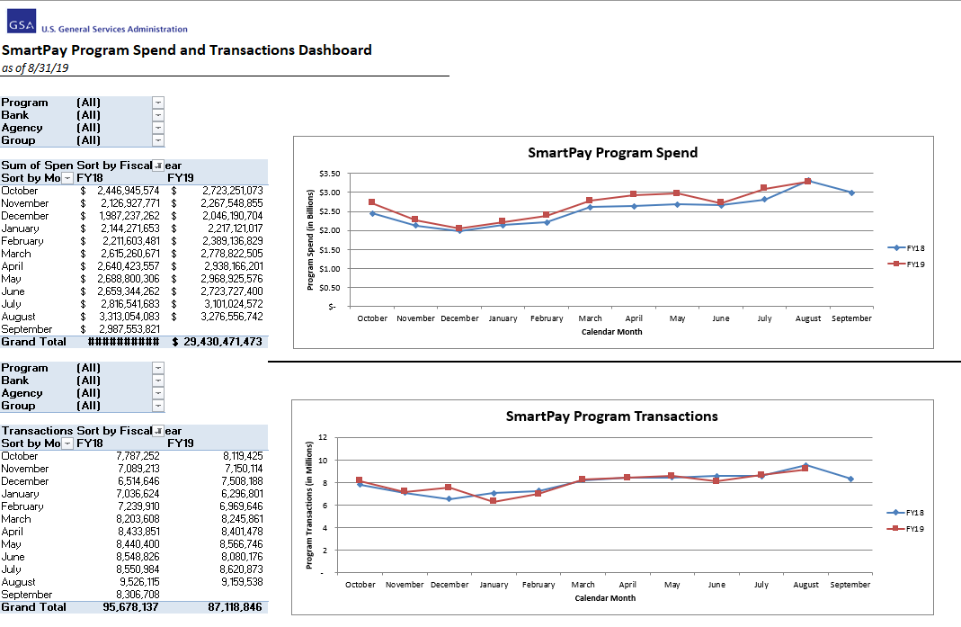
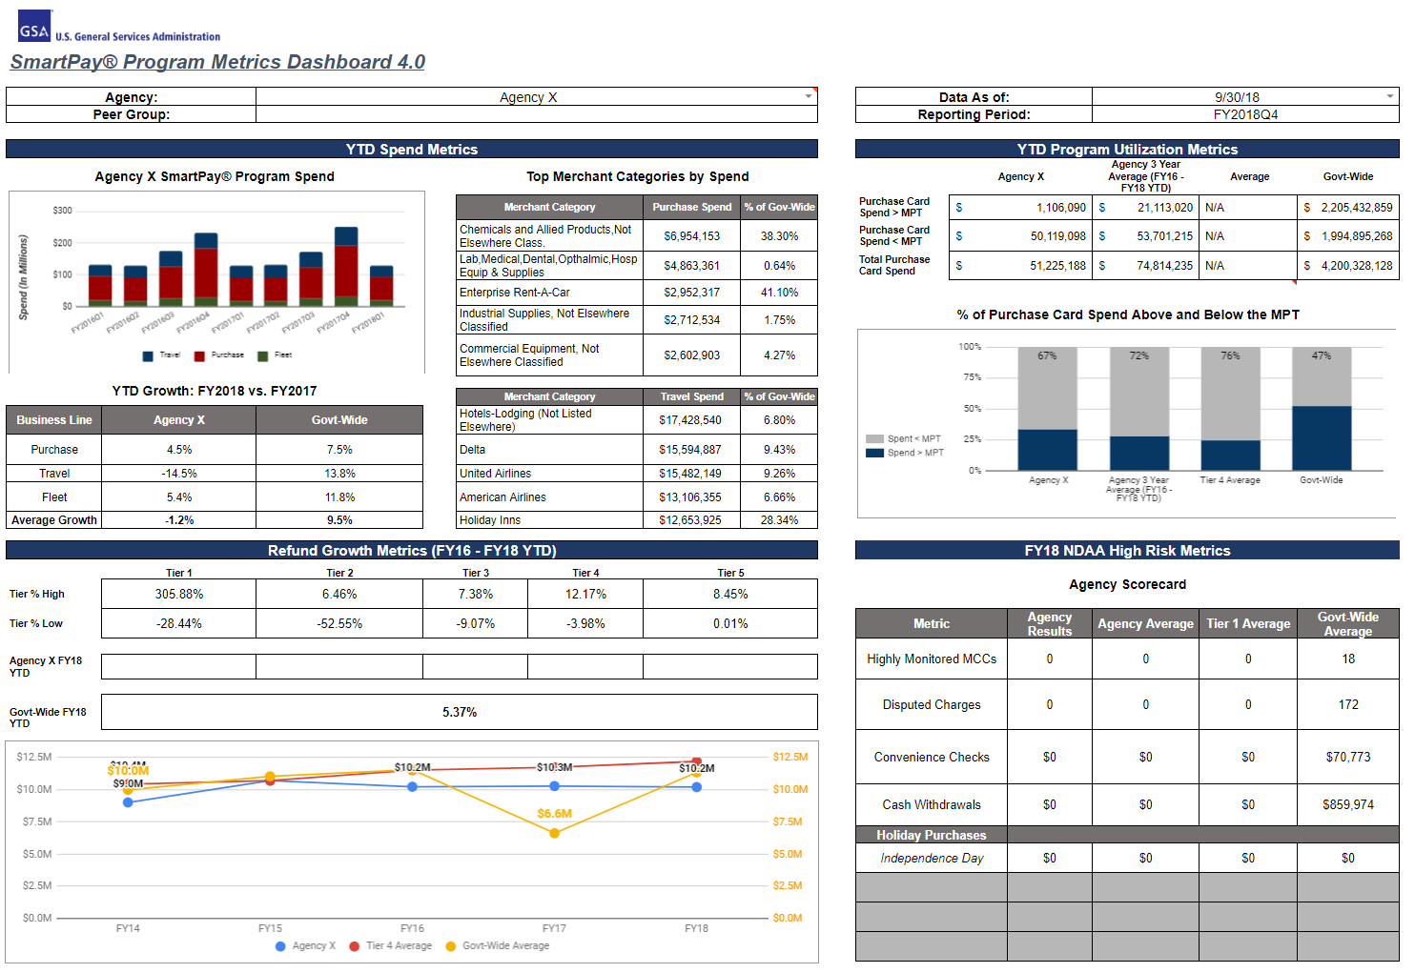
Levels of Data Analytics
Data
Analytics
Visualization
Storage and Access
Insights & Predictions
User Interfaces & Dashboards
Spreadsheets
Statistical Analysis
Dynamic Visualizations
Data Aggregators
Predictive Analytics
Business Intelligence

Slide 6

Why Should You Use Data Analytics
Prevent potential fraud, misuse and abuse
Significant improvements in their decision making and risk avoidance
Data analytics provide meaningful indicators and empower agencies to leverage data to:
Support the management of their card program, enhance internal controls, and make decisions based on real-time data
Improve operations and oversight capabilities through benchmarking and predictive analysis

Slide 7



Impact of Data Analytics
The implementation of key data analytic principles can enhance controls against fraudulent activity and support A/OPCs in running their card programs more efficiently
Agencies can use data analytics to grow their programs by analyzing trends in transaction data to increase card spend and earn more refunds. This includes opportunities for the expanded use of the purchase card for contract payments
In addition to the positive impacts on program efficiency, data analytics solutions help agencies maintain compliance with public laws and congressional mandates

Slide 8
FY18 NDAA Title XVIII: Purchase & Travel
TO DO LIST
NDAA Title XVIII
On December 12, 2017, the FY18 NDAA became Public Law 115-91. Title XVIII contains the full text of S.1099/H.R.4047, “Saving Federal Dollars Through Better Use of Government Purchase and Travel Cards Act of 2017.”

Slide 9
FY18 NDAA Title XVIII: Purchase & Travel
Identify examples or patterns of questionable transactions
Identify opportunities for agencies to leverage administrative process stream­lin­ing and cost reduction
Develop a set of metrics and benchmarks for high-risk activities
Develop a plan to create a library of analytics tools and data sources
Expanded Use Of Data Analytics
Issue guidance on improving information sharing by agencies
Require agency officials to identify and communicate high-risk activities
Require that agency officials review the reports issued by card-issuing banks on questionable transactional activity
Provide sharing of information related to questionable transactions, fraud schemes, and high-risk activities
Consider recommendations made by Inspector General
Improving Information Sharing To Curb Improper Payments
GSA and OMB shall co-chair an interagency charge card data management group
Cover rules, edits, and task order or contract modifications related to card-issuing banks
Include review of accounts payable information and transaction data for the purpose of identifying potential strategic sourcing
Include other best practices as determined by the Administrator and Director
Interagency Charge Card Data Management Group
GSA Report
Agency Reports and Consolidated Report to Congress
Office of Management and Budget Report to Congress
Report on Additional Savings Opportunities
Reporting Requirements

Slide 10
FY18 NDAA Title XVIII – Expanded Use of Data Analytics
1
The objective for leveraging analytics is to identify patterns of questionable transactions and to develop tools and methods for use by GSA and agencies to:
Identify questionable transactions
2
Recover improper payments
3
Leverage the program’s administrative process streamlining and cost reduction, including card-based strategic sourcing
4
Develop a set of metrics for high-risk transactions
5
Create a library of analytic tools and data sources for agency use

Slide 11
FY18 NDAA Title XVIII – GSA SmartPay® High Risk Metrics
The GSA Center for Charge Card Management (CCCM) and the GSA SP Data Management Group (DMG) identified the initial set of government-wide high-risk metrics
Metrics
Cash Withdrawals
Convenience Checks
Holiday Purchases
Transactions at Highly Monitored MCCs
Disputed Charges
These metrics are in addition to what CCCM is currently posting and are generated and updated for CFO Act agencies and posted in the GSA SP data warehouse portal on a quarterly basis

Slide 12
Fraud Analytics and Enhanced Capabilities
Under GSA SP3, Citibank and US Bank offer the following customizable tools to meet the unique mission of agencies:
US Bank Payment Analytics
Citi Program Audit Tool (PAT)
Mastercard Insights on Demand (IOD)
Visa IntelliLink

Slide 13
Rule Templates & Case Management
Rule Templates
Are flexible and easy to use
Can be customized to meet the specific needs of an agency
Can be modified quickly
Can be applied at the hierarchy or account level
Is flexible and can be managed by designated personnel
Can be used with other data mining tools to enhance the management of your card program
Case Management

Slide 14
Sample Rule Templates (1 of 3)
Rule | What It Tracks
Account Balance | Daily account balances that are outside an over/under designation and a dollar amount parameter.
Excessive Cash Withdrawals | Excessive cash withdrawals on a specific account.
Extensive Use of Convenience Checks by Dollar Amount | Extensive use of convenience checks based on dollar amount during a specified number of calendar days.
Foreign Currency Transactions | Transactions in a currency other than U.S. dollars.
Holiday Purchases | Transactions on holidays.
Merchant Watch List | Transactions with non-preferred suppliers.
Source: Information is from US Bank Payment Analytics and is for illustration purposes only

Slide 15
Sample Rule Templates (2 of 3)
Rule | What It Tracks
Purchase Split Across Multiple Merchants with the same MCC | Transactions that appear to be a split purchase (e.g., multiple transactions at similar MCCs to avoid a single purchase limit) during a time period of 1 to 3 days that the agency specifies in the rule.
Purchase Split Into Multiple Transactions at the same Merchant | Transactions that appear to be a split purchase (e.g., dividing a single transaction at the same merchant to avoid a single purchase limit) during a time period of 1 to 3 days that your agency specifies in the rule.
Transactions in Highly Monitored MCC | Transactions with MCCs that are on the highly monitored MCC list.
Source: Information is from US Bank Payment Analytics and is for illustration purposes only

Slide 16
Sample Rule Templates (3 of 3)
Rule | What It Tracks
Travel Card Purchase in Cardholder’s ZIP Code or Postal Code | Transactions with merchants that are in the cardholder’s ZIP/Postal code.
Two or More Purchases at the Same Merchant within the Same Hierarchy | Transactions at the same merchant on the same day from 2 or more cardholders in the same hierarchy position.
Weekend Purchases | Transactions on Saturday and Sunday.
Source: Information is from US Bank Payment Analytics and is for illustration purposes only

Slide 17
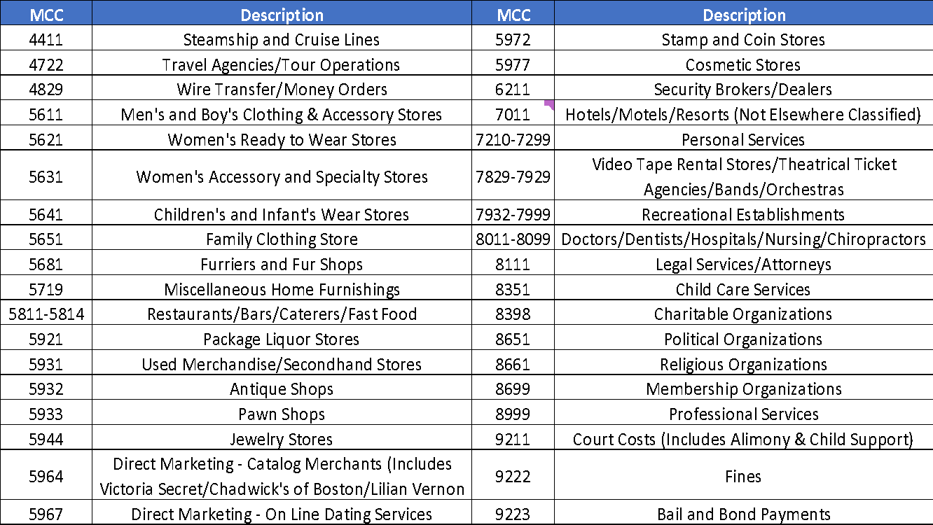
Transactions with unauthorized MCCs
Sample list of unauthorized MCCs
The list should be customized based on the policy and specific needs of the agency
Source: Commerce CAM 1313.301_August2020-Final
Notes:
'P' in ('5698', '5933', '4829', '5094', '5681', '5813', '5921', '7273', '7995', '9223') )or
'T’ in ('5698', '5933', '4829', '5094', '5681', '7273', '7995', '9223') ) )

Slide 18
Machine Learning
Reviewing transactions individually to detect waste, fraud and abuse can be labor intensive and error prone
Machine learning can effectively and efficiently help identify anomalies from typical spending patterns
Ex: Predictive module in Visa IntelliLink
Scores each transaction with a proprietary predictive algorithm to help identify out of policy spend
Can extend date range for spending history
Provides reason codes for high scores
Contains a learning capability based upon cardholder behavior and spend patterns

Slide 19
Audit
Very important that agencies select the right sample size and frequency for audit
Audits help to validate program compliance and ensure policies and procedures are being followed
One of the most common risk factors cited by auditors is a weak internal control environment, i.e., a failure to implement adequate safeguards against card misuse
Opportunity for fraud and abuse arises if cardholders know that their purchases are not being properly reviewed
Documentation
is key!!!
For convenience checks, subject to agency’s specific policy, if possible conduct 100% review of all convenience check transactions
Provide assurances that controls are properly implemented

Slide 20
Methods for Audit
Statistical Sampling
Selecting a random sample from the transactions
Non-Random Sampling
Non-random method of selecting a sample based on judgmental factors
Data Mining
This is a form of non-random sampling that typically employs
Spot Checks
These are random, on-site or desk reviews of cardholders, AOs, etc.
Source: HHS GPC Program Directive (Version 7.0 - Nov 2021)

Slide 21

Audit Methods
+
-
ADVANTAGES | DISADVANTAGES
1 - Allows review results to be projected to the entire population. 2 - Minimizes possible bias in the sample selection process. 3 - Can be applied to individual cardholders, AOs, or to the entire organization. | 1 - Requires knowledge of statistics to determine sample size, selection, and projection to entire population. 2 - Requires resources to identify and select the sample, and to review transactions in the sample.
1 - Simplifies sample selection. 2 - Can be easily scaled to fit the resources available for conducting the review. | 1 - Review results cannot be projected to the entire population. 2 - The sample may be biased and not be indicative of overall performance, whether positive or negative
1 - Software-based data mining can screen and identify suspicious transactions faster than a manual review of the data. 2 - Serves as a good compliance technique by directly targeting suspicious transactions. | 1 - May result in additional expense to acquire and use software. 2 - May not project results to the entire population Subtleties and exceptions in data may generate false positives.
1 - Useful for ensuring compliance because personnel never know when they may be reviewed. 2 - Useful for targeting high-risk areas. | 1 - Cannot project results to the population. 2 - Requires resources to conduct the reviews.
Statistical
Sampling
Non-Random Sampling
Data Mining
Spot Checks
Source: HHS GPC Program Directive (Version 7.0 - Nov 2021)

Slide 22
Helpful Tips for Fraud Prevention
1 - Ensure key duties are separated, such as making purchases, authorizing purchases, and reviewing and auditing purchase documentation. | 5 - Review statements that included duplicate transactions or questionable transactions, such as purchases of jewelry, home furnishings, cruise tickets, electronics, and other consumer goods.
2 - Review cardholder statements, receipts and invoices to detect delinquency and misuse. | 6 - When having goods shipped, the same person should not approve and place the order, or place the order and receive the goods.
3 - Review span of control: AO to cardholders' ratio and the average number of monthly purchase card transactions each AO reviews. | 7 - Ensure each cardholder is assigned an AO other than the cardholder.
4 - Pay attention to accounts with questionable history and/or high predictor score. Look for spend at department stores, e.g., Macy’s, Jos.A.Bank, Saks Fifth Ave, etc. | 8 - Pay attention to returned goods for store credit instead of credit going back to the agency.

Slide 23
Revised OMB Circular No. A-123
On August 27, 2019, the Revised OMB Circular No. A-123, Appendix B was issued. Appendix B contains “A Risk Management Framework for Government Charge Card Programs”
Under Section 5.3.2 and Section 5.3.3 of the revised OMB No. A-123 Circular, Appendix B, CFO Act Agencies are required to provide Statistical and Narrative Reporting to CCCM on an annual basis
These submissions provide insight into agency best practices for charge card management as well as monitoring delinquency and interesting statistical metrics

Slide 24
Revised OMB Circular No. A-123: Insights
Key Insights from statistical reporting based on data received from CFO Act Agencies in FY21:
Average number of Purchase cards with limits above the MPT per agency. Decrease of -42% compared to FY20 (543)
Average increase in Fleet card counts compared to prior reporting period. Decrease of -53% compared to FY20 (735)
Number of convenience checks written. Decrease of -70% compared to FY20 (23.9K)
Average Purchase span of control. (1 AOPC:1.7 Cardholders)
317
644
7.5K
1:1.7

Slide 25
Leverage Data - Government-Wide Metrics
GSA provides interactive dashboards for each CFO Act agency that allow agencies to compare key statistics to their own thresholds, their peer group, and government-wide averages
CFO Act agencies can access the GSA SmartPay Portal, including the Quarterly Metrics dashboards at https://spdatawarehouse.gsa.gov/

Slide 26
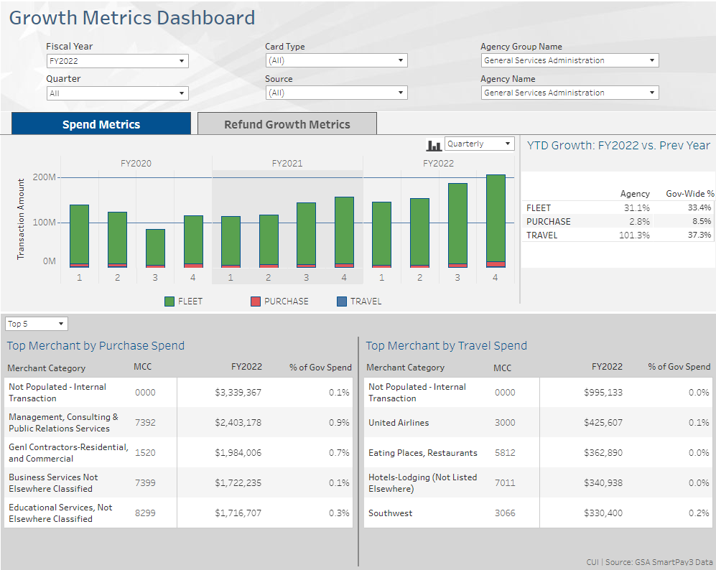
Leverage Data - Government-Wide Metrics

Slide 27
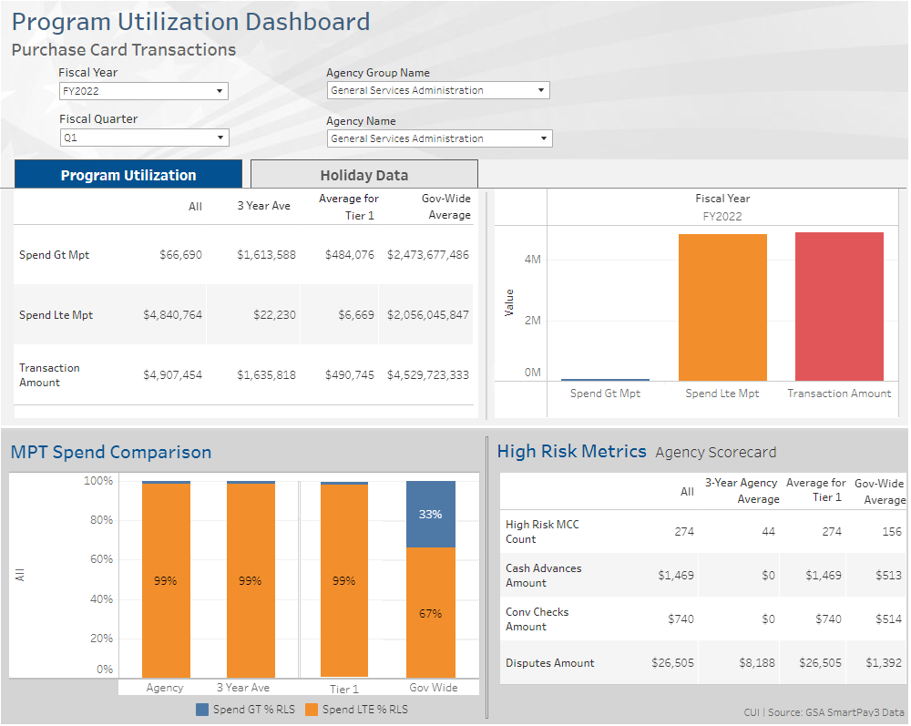
Leverage Data - Government-Wide Metrics

Slide 28
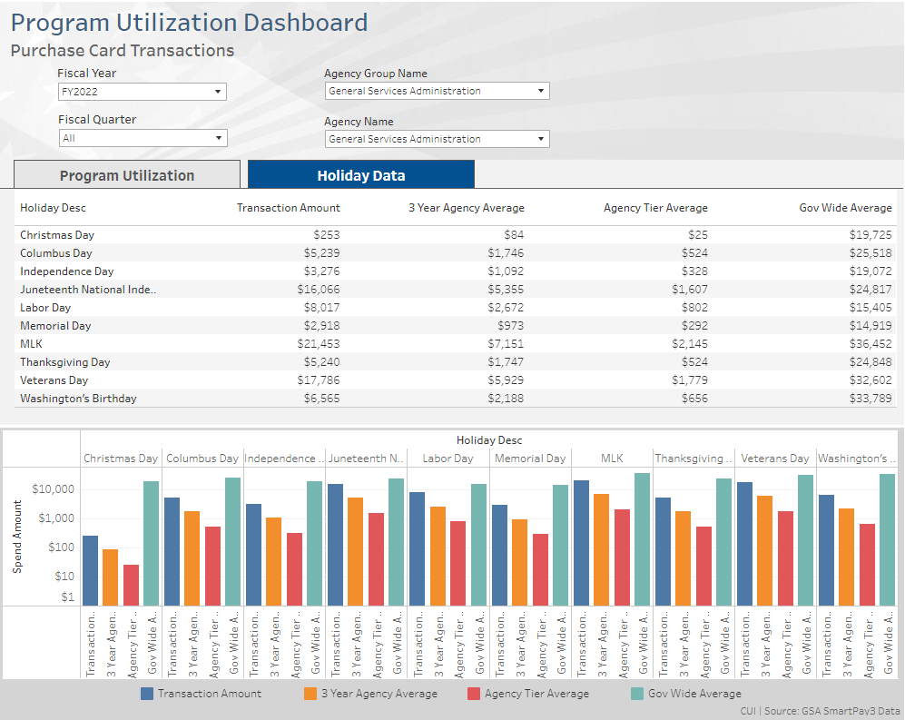
Leverage Data - Government-Wide Metrics

Slide 29
Other Tools – EAS Reports
Sample Reports from Bank EAS
Declined Authorizations Report
Leverage available reports from bank EAS to:
Review declined transactions and the reason for the decline
Identify outstanding and resolved disputes including status on the dispute from the original charge through resolution
Identify lost, stolen, invalid or canceled cards, and unusual spending activities
Review cash withdrawal report and monitor pattern of excessive cash withdrawals – cash withdrawals with no associated travel, e.g., air, hotel, car rental
Disputes Report
Lost/Stolen Card Report
Cash Withdrawals Report
Each contractor bank’s EAS provides over 50 standard reports to
help agencies manage their card programs

Slide 30
GSA SmartPay® Analytic Tool Set
EAS Reporting Tools
Visa IntelliLink®
US Bank Payment Analytics
Brand Tools
Agency Tools
Other Tools
Mastercard Insights on Demand (IOD)
Citi Program Audit Tool (PAT)
Government-wide Metrics Dashboard
Bank Tools
Effective applications of data analytics involve using multiple tools and processes to address agency specific needs

Slide 31
Best Practices
Initiate
Take full advantage of the tools offered by banks and brands
Leverage
Leverage available rule templates to detect questionable transactions
Track
Use case management to track questionable transactions
Best Practices
Scrutinize
Select the right data sampling size to achieve meaningful results
Audit
Develop robust auditing processes and conduct regular audits
Review
Conduct frequent review of MCC restrictions to ensure efficiency
Document
Document findings and monitor repeat offenders

Slide 32
Additional Training from SP3 Banks
Please see the Training Schedule for information on training offered by contractor banks at the Forum.
For more information on the training offered by your contractor bank, please see the following sites and contact information:
Citibank: http://www.cards.citidirect.com/welcome.asp
Customer Service: (800) 790-7206
U.S. Bank: https://access.usbank.com/cpsApp1/index.jsp
Customer Service: (888) 994-6722

Slide 33
Additional Training from Brands
More information and specific trainings on Visa IntelliLink and Mastercard IOD can be accessed at the following sites:
http://intellilink.spendmanagement.visa.com
http://globalrisk.Mastercard.com/online-resources-2016/

Slide 34
GSA SmartPay® Resources
GSA Smart Bulletins
https://smartpay.gsa.gov/content/smart-bulletins-news-events
Other Program Manager Resources
https://smartpay.gsa.gov/content/resources
GSA SmartPay Training
General Info: https://smartpay.gsa.gov/content/training
Log In: https://training.smartpay.gsa.gov/user
GSA SmartPay Portal
https://spdatawarehouse.gsa.gov/smartpay/

Slide 35
Contact Information
Shane Brosius
Shane.Brosius@gsa.gov
(509)353-4661

Slide 36
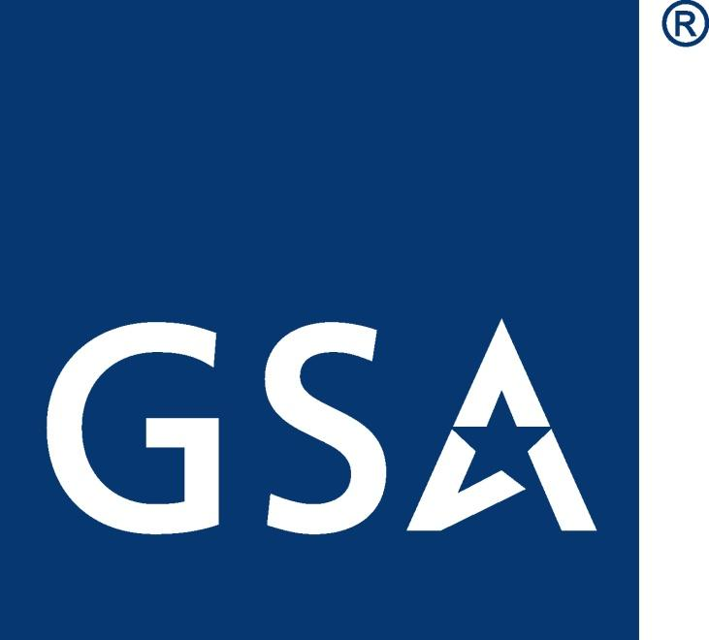
GSA Starmark

