Slide 1
OS4 Purchasing Channel
Sourcing Office Supplies Has Never Been Easier!
Maria Viscione
R2 MAS Branch Chief
Program Manager, OS4 FSSI, BIC

Slide 2
Agenda
Overview
Ordering Procedures
Requisition
How to Buy FSSI OS4 Products
Points of Contact

Slide 3
FSSI OS4 Overview
Federal Strategic Sourcing Initiative (FSSI) for Office Supplies Fourth Generation (OS4)
Program consists of 63 OS4 contracts to date (as of January 1st 2023)
Enhanced Special Item Numbers (SINs)
SIN 339940OS4: Enhanced SIN For Office Products & Services / Office Supplies 4th Generation (OS4)
SIN 339940OVER: Enhanced SIN For Overseas Office Products & Service / Office Supplies 4th Generation (OS4)

Slide 4
FSSI OS4 Overview SIN 339940OS4 (On Consolidated MAS 99)
Offerors may offer their entire commercial catalog, or may offer a select, limited line of office products.
This SIN also includes all commercially available services related to support office products.
Optional services include, but are not limited to:
Desktop Delivery
Secure Desktop Delivery
On-Site Stores
Walk-in Stores

Slide 5
FSSI OS4 Overview SIN 339940OVER (On consolidated MAS 99)
This SIN covers items for use only in overseas destinations
This SIN also includes all commercially available services related to the support office products.
Optional services include, but are not limited to:
Desktop Delivery
Secure Desktop Delivery
On-Site Stores
Walk-in Stores

Slide 6
OS4 Solution OS4, the Office Supplies solution, has awarded 63 contracts! (as of January 1st 2023)
This list is updated frequently. For the updated list of vendors on SIN 339940OS4 and SIN 339940OVER, please see:
https://www.gsaelibrary.gsa.gov/ElibMain/sinDetails.do?scheduleNumber=MAS&specialItemNumber=339940OS4&executeQuery=YES
Major features:
Real time order status! – Find out where your order is in real time.
Convenience fees – No longer be limited by minimum orders – vendors will ship orders below minimum order amount for a nominal shipping fee.

Slide 7
OS4 Features
Improved pricing and savings
Enhanced vendor requirements
Capture data (data spending tracking capabilities)
Vendor accountability
Provide 4-day direct delivery (CONUS) and 7-day direct delivery (OCONUS)
Enable achievement of socio-economic goals
Support nation’s Small Businesses
Drive compliance with mandates, acts, orders (e.g., TAA, AbilityOne/ETS)
Conform with Agency business practices
Easy to use
Makes it easy to purchase green items
Offers enhanced delivery options including next-day delivery, desktop delivery, and secure desktop delivery

Slide 8
Value to the Customer
Continue to provide Government Savings under OS4
Enable Agency Socio-economic Goals
Meet all Procurement Regulations
Government Savings

Slide 9
Value to the Customer
OS4 Figures since inception:
OS4 FY19:
$23.6M sales
$5.2M cost avoidance
OS4 FY20:
$92.7M sales
$26.3M cost avoidance
OS4 FY21:
$155.2M sales
$60.9M cost avoidance
OS4 FY22:
$157.3M sales
$96.2M cost avoidance

Slide 10
OS4 Discounts
Discounts are activated at GSA Advantage!® checkout.
Order Volume Discounts
Consolidate orders and save as discounts are triggered on individual orders starting at $300 for some vendors
Discounts increase at $1,000, $3,000, $5,000, and $10,000 orders depending on the vendor

Slide 11
What if my order doesn’t meet the minimum purchasing requirement?
The minimum purchasing amount is currently $100, depending on vendors, if you do not wish to pay a convenience fee (see last bullet)
We recommend that you pool together other purchases in your office using the “Park Cart” feature on GSA Advantage!®
Develop a strategy to purchase more items less frequently, planning ahead, so that you are making larger purchases.
Remember, order minimums result in added value: better prices and less shipping waste.
All OS4 vendors offer a convenience fee to bypass minimum order requirements. If you need to make an order below the minimum order, you may do so for a convenience fee.

Slide 12
Help Meeting Vendor Minimums Searching a Single Vendor’s Catalog on GSA eLibrary:
https://www.gsaelibrary.gsa.gov/ElibMain/sinDetails.do?scheduleNumber=MAS&specialItemNumber=339940OS4&executeQuery=YES

Slide 13
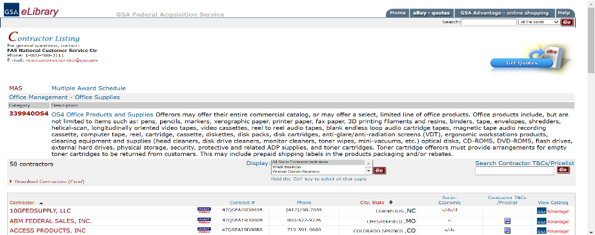
Go to GSA eLibrary

Slide 14
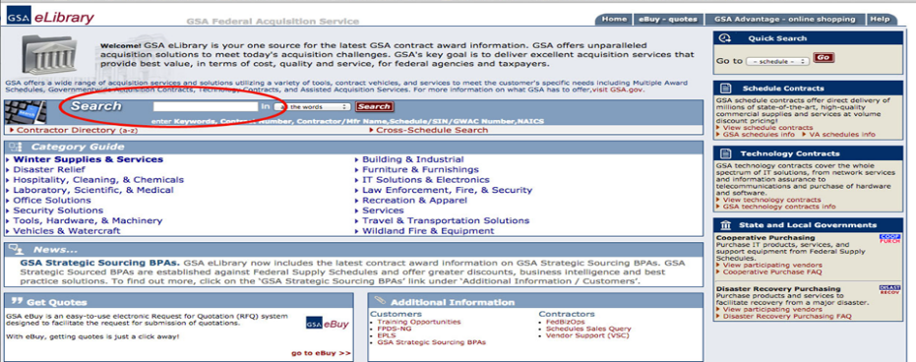
Within GSA eLibrary
www.gsaelibrary.gsa.gov on your internet browser.
Type “OS4” into the search bar.

Slide 15
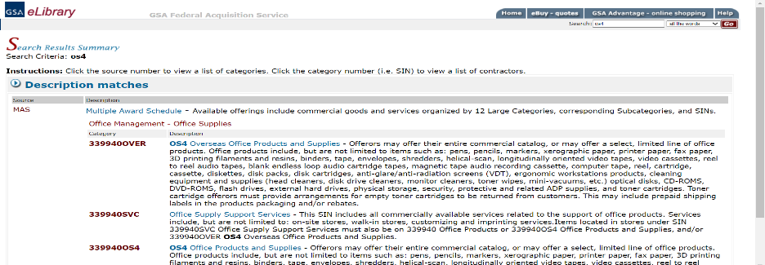
Select SIN Under Category

Slide 16
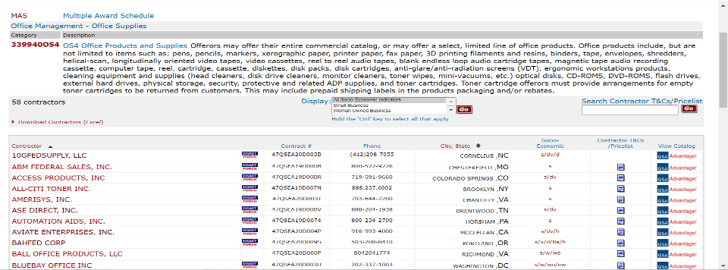
Choose a vendor and click the GSA Advantage!® icon under “View Catalog”

Slide 17
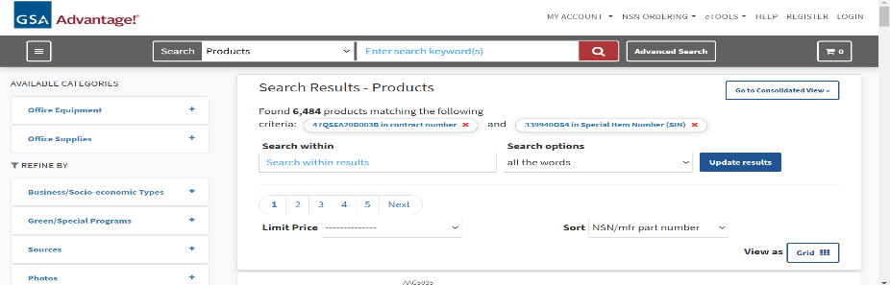
This brings you to that vendor’s catalog on GSA Advantage!® Now type the item you need under “Search within results.”

Slide 18
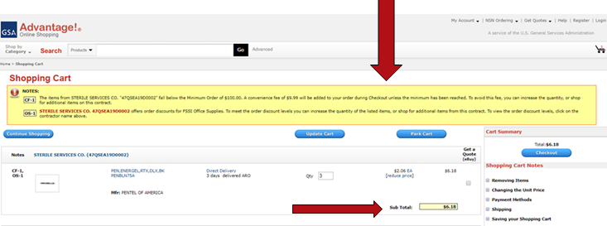
Avoid vendors’ minimum order requirements with Convenience Fees
If your order is below a vendor’s minimum order requirement, you will receive a prompt in your shopping cart.

Slide 19
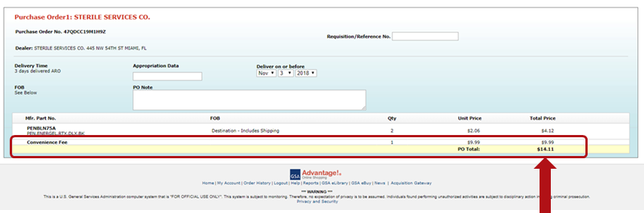
Avoid vendors’ minimum order requirements with Convenience Fees *
If your order remains below a vendor’s minimum order requirement, their convenience fee will be added at checkout

Slide 20
Ordering Procedure For Orders At Or Below the Micro Purchase Threshold ($10,000)
As part of the government’s sustainable (“green”) mandates, place larger orders to reduce the number of deliveries and transactions.
Keep in mind Delivery Tier discounts for orders at $300 and above from some vendors.
Attempt to distribute orders among multiple OS4 contractors.
Order minimums are currently $100, but some vendors will accept lower minimums without a convenience fee.
Smaller orders may be placed with vendors for a convenience fee.

Slide 21
What if the Office Supply I want to buy is not on OS4?
In general, the OS4 program includes a wide range of products, brands, and part numbers although not every brand or part number may be included.
By purchasing office supplies through OS4, customers are able to ensure that they are meeting all relevant mandates and procurement regulations (TAA, EO 13834).
We recommend purchasing an item that is a “close second” to the office supply you are intending to buy.

Slide 22
Orders Exceeding Micro-Purchase Threshold but less than the SAT ($10,000 to under $250,000)
Orders exceeding Micro-Purchase threshold but less than the Simplified Acquisition Threshold (SAT) must follow FAR Part 8.405-1(c).
Survey at least 3 contracts through GSA Advantage or request quotes from at least 3 OS4 awardees.

Slide 23
Orders equal to or above the SAT ($250,000)
Must provide fair opportunity to all OS4 vendors
Encouraged to use GSA’s E-Buy system or a reverse auction
Consult FAR part 8.405-1(d) for more information

Slide 24
I’m outside the Continental US, can I use FSSI OS4?
You can use the FSSI OS4 REQUISITION CHANNEL (Global Supply) for OCONUS ordering or the FSSI OS4 SIN 339940OVER for OCONUS ordering as well.

Slide 25
GSA Global Supply™ – A Government to Government Wholesale Supply Source
GSA Global Supply™ has already procured the most in-demand products on the government’s behalf, meaning that your order is a simple requisition between agencies.
Requisitions satisfy all Federal Acquisition Regulation (FAR) requirements, including Trade Agreements Act policies, socioeconomic goals, AbilityOne mandates, executive orders and overall competitive pricing.
Place a requisition via DoD Activity Address Code, Civilian Activity Address Code, and/or Government Purchase Card.

Slide 26
Organization of the Products
Three categories established for contractors:
General Office Products (staplers,clipboards,binders,etc.)
Paper Products – office paper only (no paper towels)
Toner and Inkjet Products
Market basket (MB)
Mandatory items (high demand) vendors must offer
Supplemented by non-MB NSNs they can offer
Invited to supplement further with the part numbered items in that category
Currently have approximately 1300 NSNs (includes both Market Basket and Non Market Basket) and 6000 Part Numbers.
OS4 Awards went into effect in August 2020.

Slide 27
Vendor Partners for Office Supplies (OS4 Requisition)
CLIN 0001 – General Office Products
East Coast: Mono Machines LLC dba Supply Chimp (SB)
West Coast: Noble Sales, Co., Inc. dba Noble Supply and Logistics (SB)
CLIN 0002 – Office Paper
East Coast: Document Imaging Dimensions, Inc. (SB)
West Coast: Pacific Ink, Inc. (WOSB)
CLIN 0003 – Toner Products
East Coast: Access Products, Inc. (SDVOSB)
West Coast: Supplies Now (SB)

Slide 28
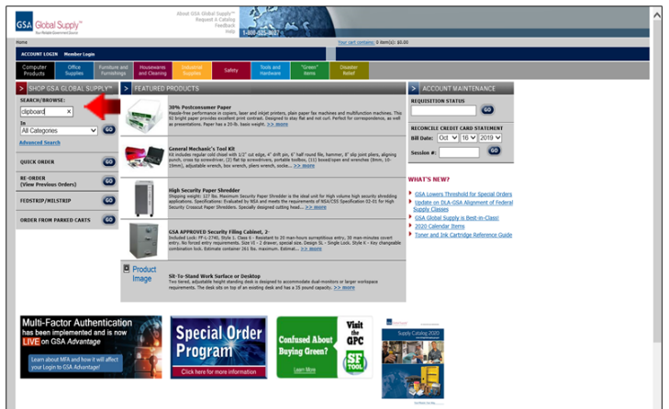
Shop GSA Global Supply™

Slide 29
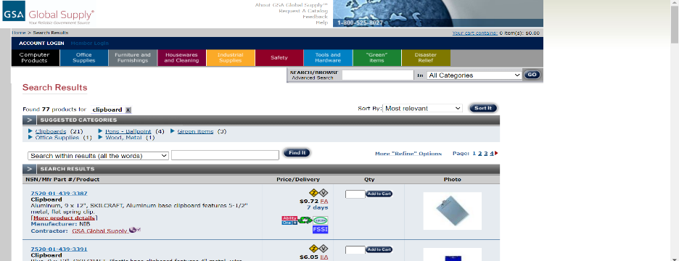
Shop GSA Global Supply™*

Slide 30
Shop GSA Global Supply™
OS4 Requisition Channel has a $0 minimum order.
OS4 Requisition Channel contractors will appear as “GSA Global Supply.”

Slide 31

GSA Global Supply™ – Ordering Methods
Call Center
(800) 488-3111, option 2
DSN 465-1416
Fax: 800-856-7057
7:30a.m. to 8:00p.m. Eastern Time
Friendly, professional service
The Call Center is able to take orders utilizing a DoDAAC, AAC or government Purchase Card.

Slide 32
Ordering Options
MILSTRIP
Internal Supply System
Manual Transmission via DD1348-6
Web:
http://www.GSAglobalsupply.gsa.gov
http://www.GSAAdvantage.gov
FedMall

Slide 33
GSA eBuy Overview
You can use GSA eBuy to post RFQs (Request for Quotes) for FSSI OS4.
GSA eBuy is an online Request for Quote (RFQ) tool. Buyers may prepare and post RFQs for specific supplies.
When searching GSA eBuy, search “OS4” instead of
“Office Supplies.”
For orders over the micro-purchase threshold

Slide 34
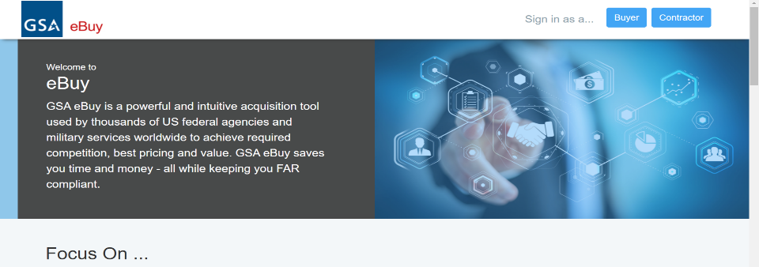
eBuy Login
Select “Buyer” at the top right

Slide 35
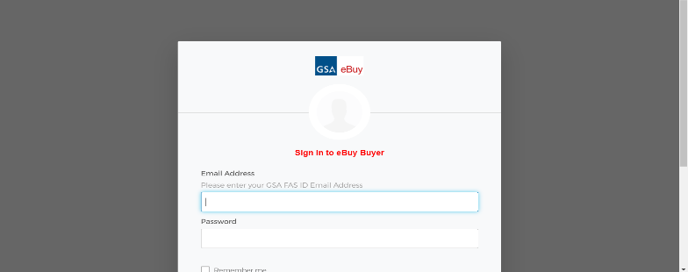
eBuy Login
Enter your GSA Advantage!® ID and Password to log in.

Slide 36
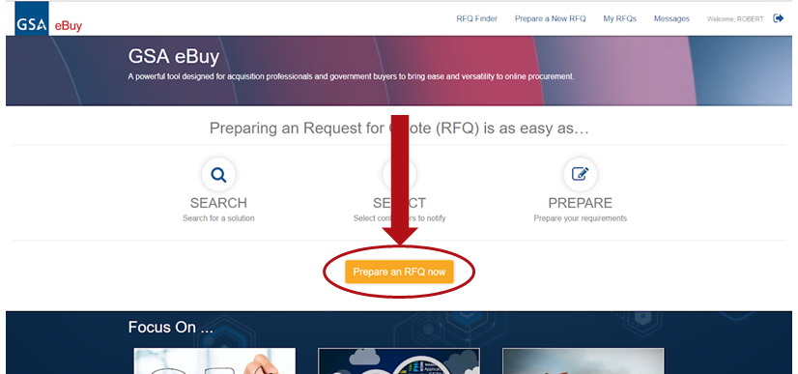
eBuy Search
Click “Prepare an RFQ now”

Slide 37
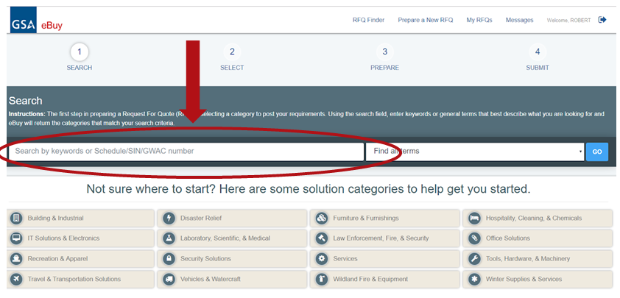
eBuy Search
Type “OS4” into the eBuy Search Bar

Slide 38
GSA Advantage!®

Slide 39
Why order through GSA Advantage!®?
Step-by-step ordering guide available
Multiple ways to evaluate vendors, products, and pricing
Filters to limit results to green items, small business vendors, toner, and AbilityOne products
Quantity discount pricing
Park Cart feature
Varied shipping options

Slide 40
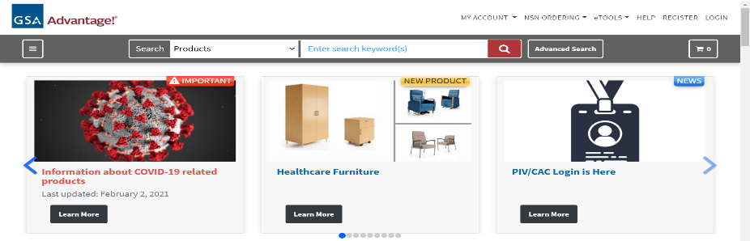
Access GSA Advantage!® Online
https://www.gsaadvantage.gov
Select Login, or Register if you have not yet done so.

Slide 41
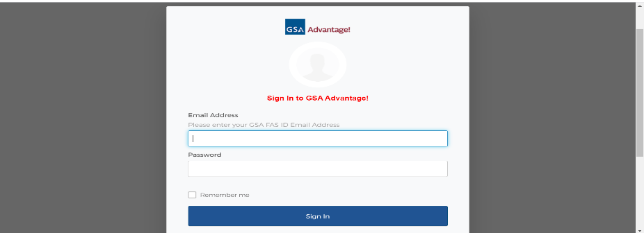
Log in to GSA Advantage!®

Slide 42
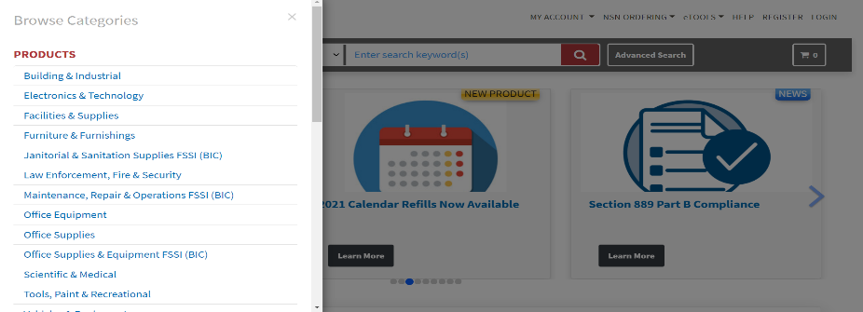
Access the FSSI Office Supply Items
Hover your mouse over Products; click on “Office Supplies & Equipment FSSI (BIC)”

Slide 43
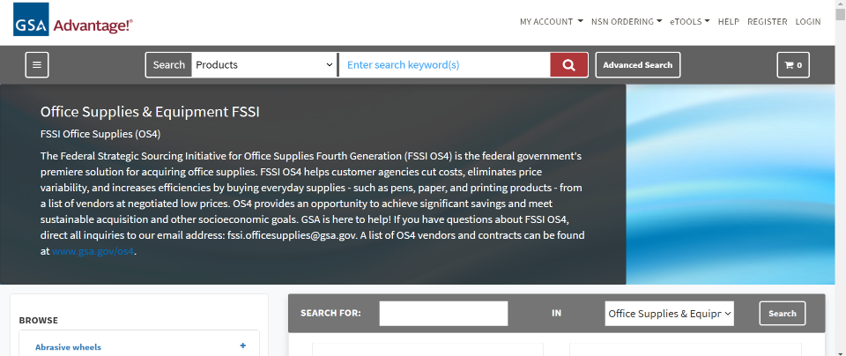
FSSI Office Supplies (OS4)

Slide 44
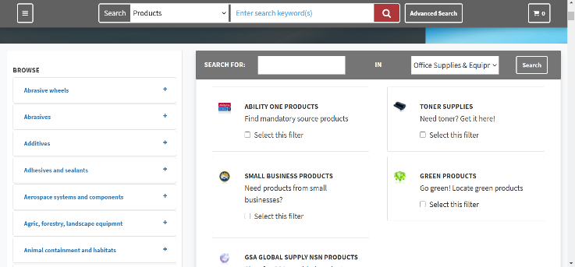
Find your desired product within the FSSI store
Option 1: Search for your product by typing it into the FSSI search bar

Slide 45
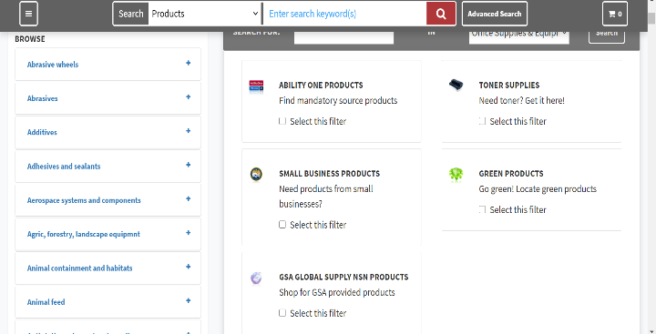
Find your desired product within the FSSI store
Option 2: Search for your product by clicking Select this filter in at least one category.

Slide 46
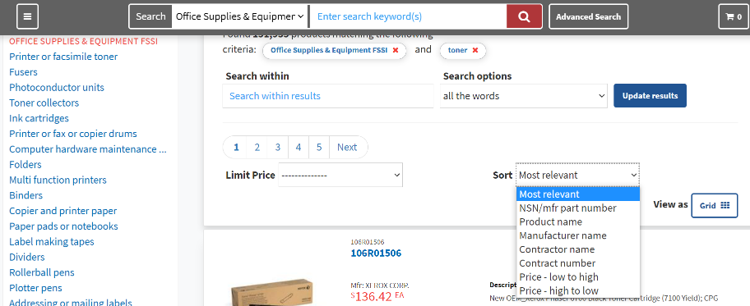
Browse the search results to find what you want
Review the Search Results by the most important criteria to you: Most Relevant (default option), Product name, NSN/mfr, Part number, Manufacturer Name, Price – High to Low, or Price – Low to High

Slide 47
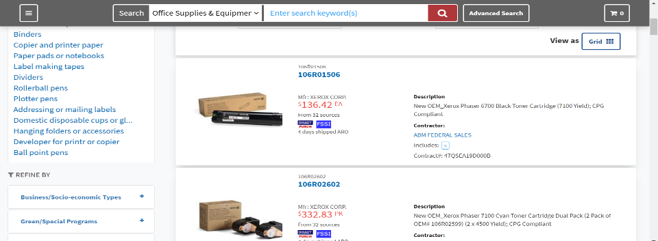
Browse the search results to find what you want
Click on the item name to select

Slide 48
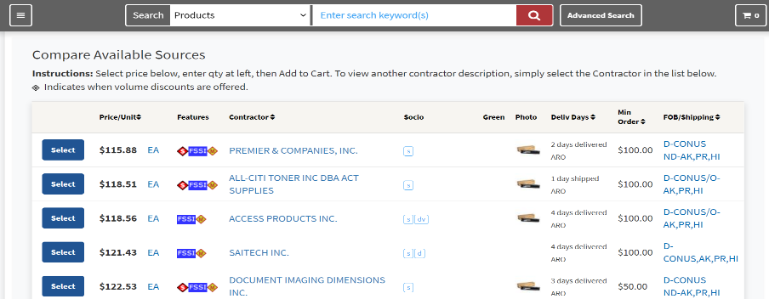
Look for the BLUE “FSSI” Icon!!

Slide 49
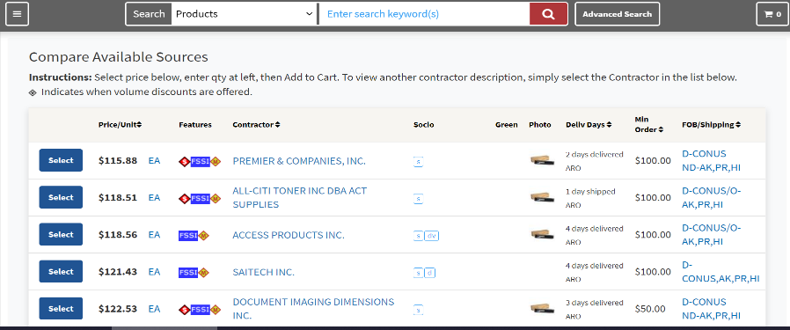
Select the product you want to buy
Review the Features, Contractor, Socio-economic labels, and Minimum Order Requirements. Then, select a radio button.

Slide 50
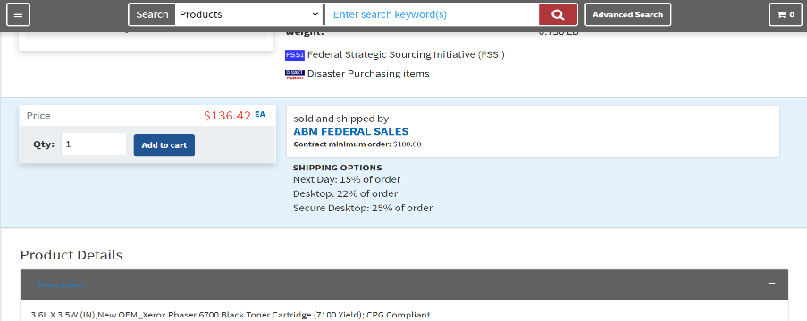
Select the product you want to buy
Enter your desired quantity and select Add to Cart.

Slide 51
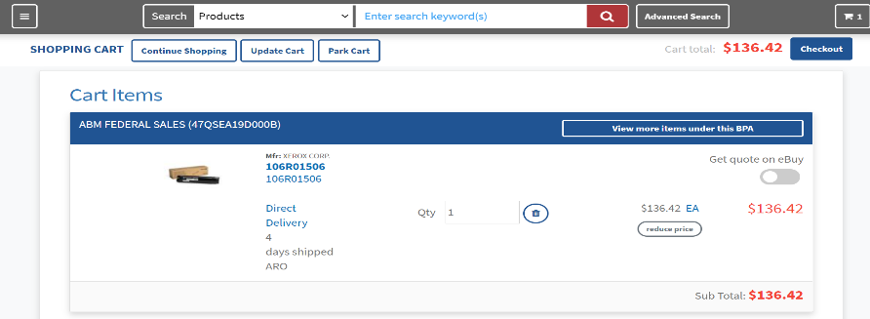
Review your order
Option 1: Select Checkout to finalize your order.

Slide 52
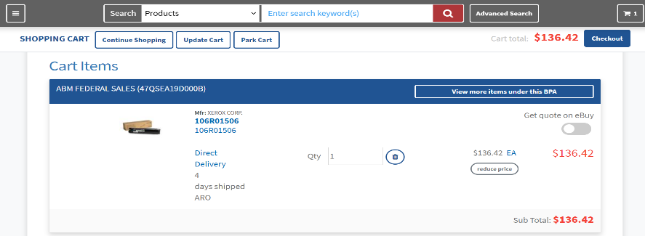
Review your order
Option 2: Take advantage of FSSI’s economies-of-scale pricing system by selecting Park Cart to allow your colleagues to access your account and add items to your cart, or to return at a later date to consolidate your order.

Slide 53
Park Cart Feature
Proceed to Checkout Take a moment to review all of the items you've placed in your Shopping Cart. If you decide that you don't want to purchase the items right away, click the "Park Cart" button. The item(s) will move from your current Shopping Cart to a Parked Cart. After you park a cart, you will also be given the option to forward the cart to another user. When you're ready to place an order for everything in your Shopping Cart, click the "Checkout" button. You will be taken to the "Checkout Review" page.

Slide 54
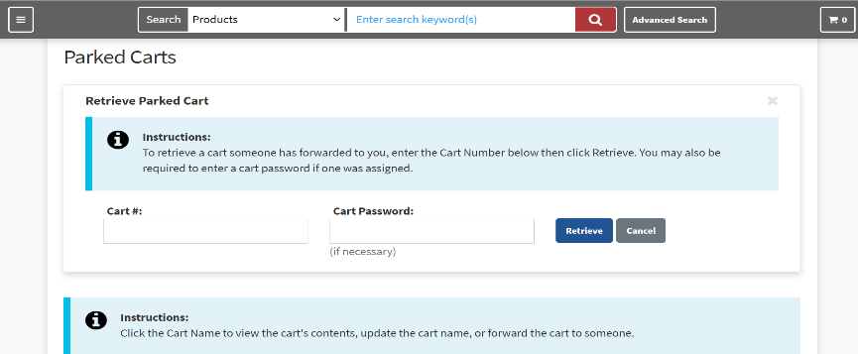
Park Cart Feature

Slide 55
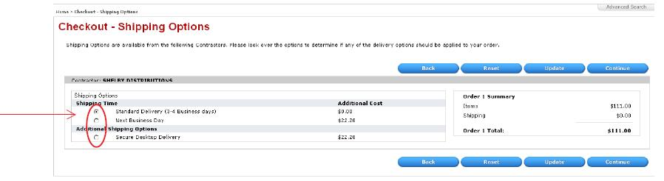
Pay for your order
Select your Shipping Time and Additional Shipping Options.

Slide 56
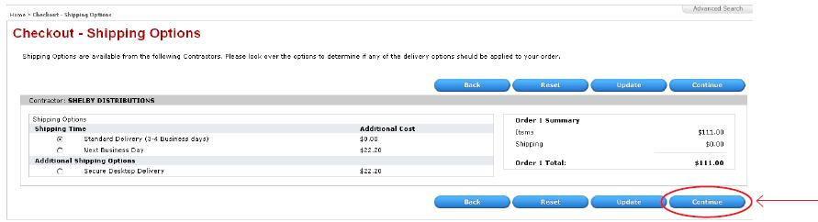
Pay for your order
Select Continue to enter your payment information.

Slide 57
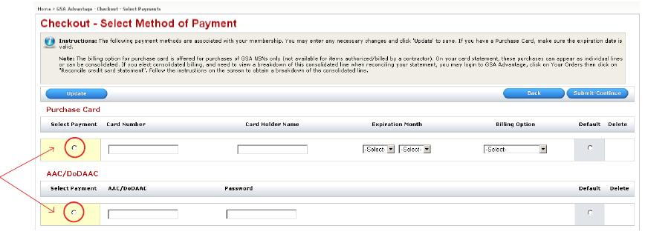
Pay for your order
Select your payment method, then enter your credit card information.

Slide 58
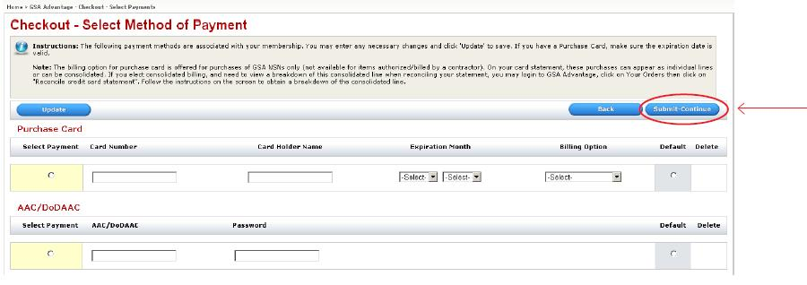
Pay for your order
Select Submit-continue.

Slide 59
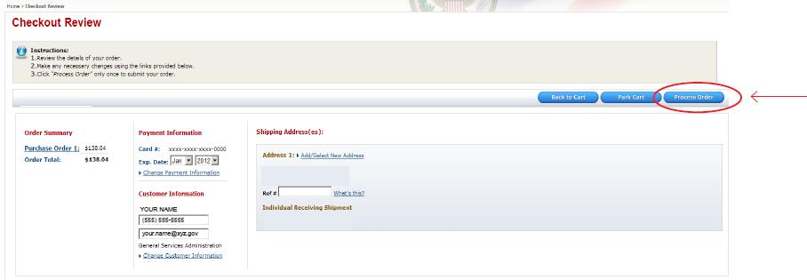
Confirm and process your order
Review your order and select Process Order.

Slide 60
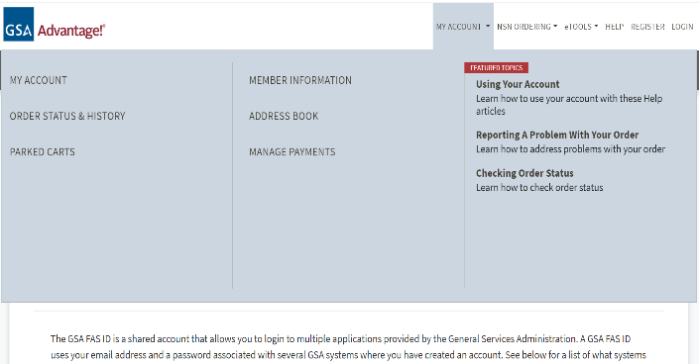
Real Time Order Tracking
Once you have made an order, visit GSA Advantage homepage. Under My Account, select Order Status and History.

Slide 61
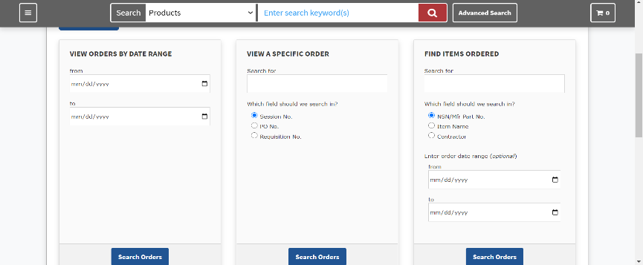
Real Time Order Tracking

Slide 62
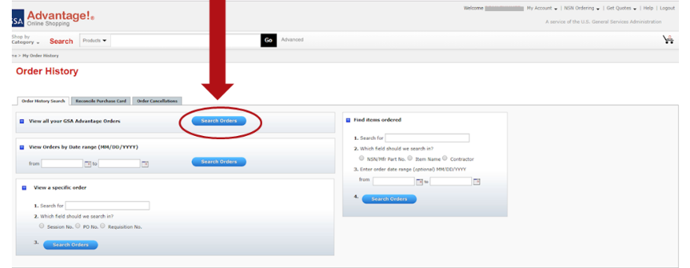
Real Time Order Tracking
Choose “View All Orders” and click Search Orders.

Slide 63
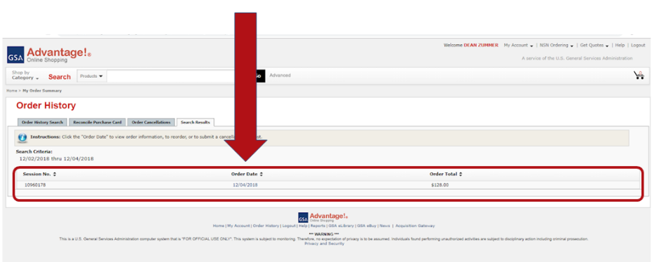
Real Time Order Tracking
View Order history and select the order you would like to track.

Slide 64
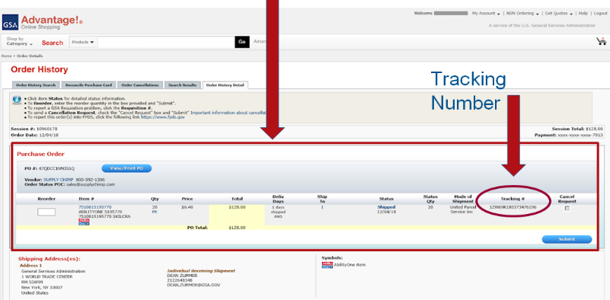
Real Time Order Tracking
Order information is available in real time.

Slide 65
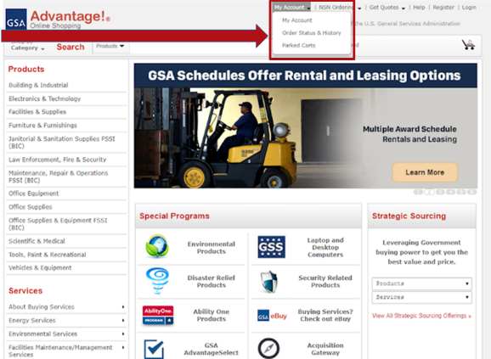
Make sure you are getting order updates
Visit the GSA Advantage homepage. Under My Account, select “My Account.”

Slide 66
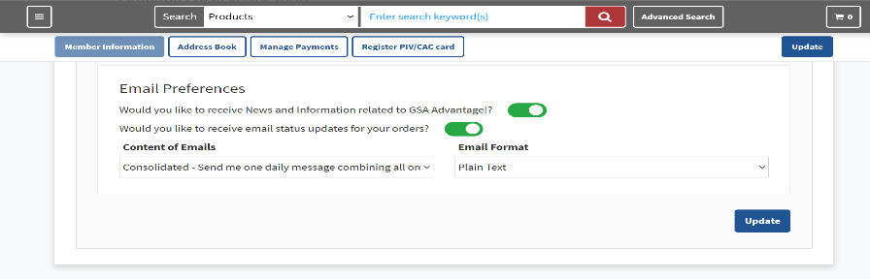
Make sure you are getting order updates
Under Email Preferences,
Select “Yes” and “Consolidated.”

Slide 67
Other Purchasing Channels Available
Other Purchasing Channels Available
Agency virtual stores
Vendors’ websites
FedMall
Phone, fax, or directly with the vendor
OS4 pricing for walk-in customers
However, GSA Advantage!® Is the simplest to use and best for tracking agency spend!

Slide 68
Can I order directly from an OS4 Vendor?
You are encouraged to order from FSSI vendors on GSA Advantage.
You may order directly from the vendors. Please first ensure that an item is on the FSSI contract before ordering.
If you order an FSSI item directly from the vendor with your purchase card, you will get the FSSI pricing.

Slide 69
Information Sources
https://www.gsa.gov/buying-selling/purchasing-programs/gsa-schedules
Overview of GSA Schedules Program
https://www.gsa.gov/buying-selling/purchasing-programs/gsa-schedules/gsa-schedule-offerings/mas-categories/office-management-category
Office Management Category under Schedules Program
http://www.gsa.gov/os4
Links to information on OS4 Program
http://www.gsa.gov/csd
Find your local GSA Customer Service Director

Slide 70
Thank You!
From the GSA OS4 Program Team
Feel free to contact us!
FSSI.OfficeSupplies@GSA.GOV
Maria Viscione
maria.viscione@gsa.gov

Slide 71

GSA Starmark logo

