Slide 1
GSA Fleet Offerings Christina Perez

Slide 2
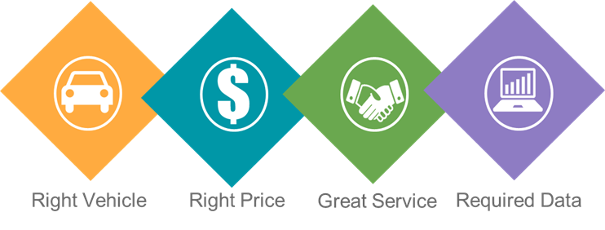
GSA Fleet Value Proposition

Slide 3
GSA Fleet Offerings
Vehicle Purchasing
Vehicle Leasing
Vehicle & Equipment Rentals

Slide 4
Vehicle Purchasing
Mandatory source for all non-tactical vehicles
Over 38,000 vehicles purchased in FY22, valued at $1.55B
GSA Fleet Leasing is the biggest customer
Leverage buying power of federal government and achieve outstanding discounts below dealer invoice
Automated Online Ordering Tool
https://autochoice.fas.gsa.gov/

Slide 5
Vehicle Purchasing Details
IDIQ contracts
Multi-year contracts based on product line (i.e., light-duty, ambulance, bus, etc.)
Open season
Continuous solicitation for emerging technology
Compliance with all regulations
Dedicated engineering team
Determine Federal Vehicle Standards
https://vehiclestd.fas.gsa.gov
Design unique custom builds

Slide 6
Vehicle Purchasing Guide
Who may purchase vehicles from us
The types of vehicles available
Details about how to order and access our systems
Instructions on ordering special vehicles and
What the Federal Vehicle Standards are and how they work
Available on GSA’s website: www.gsa.gov/vehiclepurchasing
Contact: vehicle.buying@gsa.gov

Slide 7
Leasing
Over 227K leased vehicles worldwide serving 80+ federal organizations
Non-mandatory leasing shared service
Full Service Offering
Approximately half the non-postal Federal Fleet
Leverage commercial marketplace

Slide 8







Leasing Offering Features
Maintenance & Accident Mgmt
Fleet Service Representative
Fleet Services Card
GSAFleet.gov & Telematics
Acquisition
Safety
Remarketing

Slide 9

Benefits to GSA Leasing
Streamlined Fleet Overhead
Industry Expertise
Guaranteed vehicle replacements
Predictable budgeting
Full Service
Low Cost Provider through Shared Service
Flexibility in fleet configuration and size
Automated Information Systems

Slide 10
How to Consolidate with GSA Leasing
Inventory Needs
Finalize and Sign
Transfer
Replace
Agency provides inventory listing along with equipment needs; GSA creates rate quote for cost comparison analysis.
Vehicle listing finalized and both sign a Memorandum of Agreement.
GSA & Agency local points of contact work together to transfer vehicles into the leased fleet.
Converted vehicles are replaced based on agreed upon consolidated timeline. After complete turn-over, vehicles enter GSA Fleet’s normal replacement schedule.
10
Contact us to consolidate at gsafleet-consolidation@gsa.gov

Slide 11
Short-Term Rental (STR)
Provides vehicle and equipment rentals
Ideal for seasonal work, special events and emergency requirements
Eliminates ownership and maintenance costs
Always have the proper vehicles/equipment
Streamlined procurement/ordering process
Expanded STR offerings allows customers to rent a variety of different equipment pieces for entire projects
Summer demand is high - submit requests early

Slide 12
Other Happenings at GSA Fleet
Telematics
GSAFleet.gov
Fleet Electrification

Slide 13
Telematics
Cost Effective: no additional cost; optional enhanced subscription
Seamless: GSA facilitated installation & no procurement activities required
Advantages: Automated mileage reporting, EV energy consumption, and other maintenance data
Secure: FedRAMP Cybersecurity Certification, No GPS

Slide 14
GSAFleet.gov
Total System Modernization
Increased Automation
Expansion of Offerings
Centralized Services

Slide 15
Fleet Electrification
Executive Order 14008 & EO 14057
More zero-emission vehicle offerings
New charging infrastructure BPA
Partnering with GSA’s Public Building Service
New financing opportunities
Fleet card acceptance at public charging
Information is available at:
https://www.gsa.gov/electrifythefleet

Slide 16
Electric Vehicle Supply Equipment (EVSE) Blanket Purchase Agreement
$228M Estimated Contract Value; 60 Month Timeline
16 offerors awarded
9 are small businesses and 7 are large
30+ EVSE brands and 1,165 line items
Continuous onboarding opportunities exist
Cyber Security Requirements Addressed
FEDRAMP or NIST 171 + Supply Chain Risk Management
Staggered availability due to rigorous security evaluation
PBS contractors can buy from BPA

Slide 17
Training Opportunities
Federal Fleet Manager Certification Program (FFMCP) www.gsa.gov/ffmcp
Desktop Workshops
https://www.gsa.gov/gsa-fleet-training
Driver Safety Course (Leasing Customers Only)
https://gsa.gov/driversafety

Slide 18
Questions? Contact: gsafleet@gsa.gov

Slide 19

GSA Starmark Logo

