Slide 1
DoD Travel Card Program Update
Alec Cloyd Chief, Travel Operations Division
Defense Travel Management Office (DTMO)

Slide 2
Agenda
DTMO Travel Card Program Team
Program/Policy Updates Since 2022 Training Forum
Key Program Metrics for CY2022
Program Strategic Goals
References
Question/Answer Period

Slide 3
DTMO Travel Card Program Team
Alec Cloyd; Chief, Travel Operations Division
Ray Wall; Chief, Travel Resources Branch
JP Miller; Travel Card Team Lead
DeQuan Harrison; Army/USAF Liaison
Rick Lynn; Navy/USMC Liaison
Crystal Heath; Defense Agencies Liaison
Email the team: dodhra.mc-alex.dtmo.list.government-travel-charge-card-team@mail.mil
*However, please go through your higher-level APC or CPM first, if possible

Slide 4
Program/Policy Updates Since 2022 Training Forum
Extended the time allotted for CitiManger (CM) One-Time Passcode (OTP) entry to 5 minutes (for email OTP delivery only)
Remains at 120 seconds for CM OTP voice/text delivery
Pilot program for the Virtual Travel Card being conducted by USAF
Will pass along lessons learned to the HL2 CPMs
Implemented transfer transaction capability in CM for CPMs
Working with Visa/Citi to test Merchant Blocking capabilities for SP3
Effort to block the GTCC from being used at a specific merchant
Plan to implement mobile wallet/mobile payments capability in mid-year 2023

Slide 5
Key Program Metrics for CY2022
CY22 IBA Delinquencies Range |  |  |  | CY22 CBA Delinquencies Range
 | High | Low |  | High | Low
Army | 1.98% (Jan) | 1.46% (May) |  | 9.15% (Nov) | 2.81% (Feb)
USMC | 1.82% (Jul) | 0.62% (Jan) |  | 44.37% (Jul) | 2.95% (Feb)
Navy | 1.56% (Dec) | 0.73% (Sep) |  | 5.85% (Nov) | 0.14% (May)
USAF | 1.02% (Jan) | 0.59% (May) |  | 5.62% (Jan) | 0.85% (Oct)
IAs | 0.58% (Oct) | 0.22% Mar) |  | 47.75% (Jun) | 1.45% (Mar)
Overall, the program saw acceptable/low delinquency rates for IBA
However, we need to reduce longer term (90+ days past billing) delinquencies
This led to unacceptable/high levels of write-offs and credit losses, which also reduces your earned rebates; a $670K reduction in 4QFY22
CBA delinquency rates experienced more of a ‘roller coaster’, in many cases related to processing issues at DAI for the USMC and IAs

Slide 6
Key Program Metrics for CY2022 (continued)
Declined Transactions (IBA) - Q1FY23
 | Oct | Nov | Dec
Army | 9.76% | 9.84% | 8.87%
USMC | 11.10% | 10.70% | 9.67%
Navy | 9.13% | 8.73% | 8.02%
USAF | 8.05% | 8.10% | 7.16%
IAs | 6.26% | 6.40% | 5.16%
We also track the percentage of declined transactions and APCs should be running these reports nearly every day
A decline impacts your cardholders’ ability to use their card; however, some declines are “good”, e.g., cardholder not in a travel status, or cardholder trying to use their card at an unauthorized merchant
We ended the year with a split-disbursement rate at or above 90% (percentage of payments to Citibank made via split-disbursement)

Slide 7
Program Strategic Goals
Enhance CitiManager/EAS Performance
Improve the APC and Cardholder experience
Implement Roles-based Management capability
Expand the use of other card products
Virtual Accounts
Mobile Wallet / Mobile Payments
Reduce Misuse through Automation
Merchant-level blocking
Expand use of IntelliLink

Slide 8
References
DTMO website/Programs/GTCC (www.travel.dod.mil)
GTCC Regulations
Cardholder Reference GTCC Regulations
APC Guide
Training available in DTMO’s Travel Explorer (TraX) (secure.defensetravel.dod.mil)
“Travel Card 101” (mandatory for new cardholders)
“Managing Travel Card Misuse” (for commanders/supervisors)
APC Training
Citibank Learning Center (www.citibank.com/tts/sa/training-series/dod)
CitiManager User Guides, training registration, etc.

Slide 9
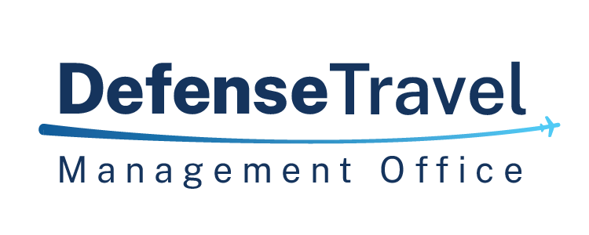
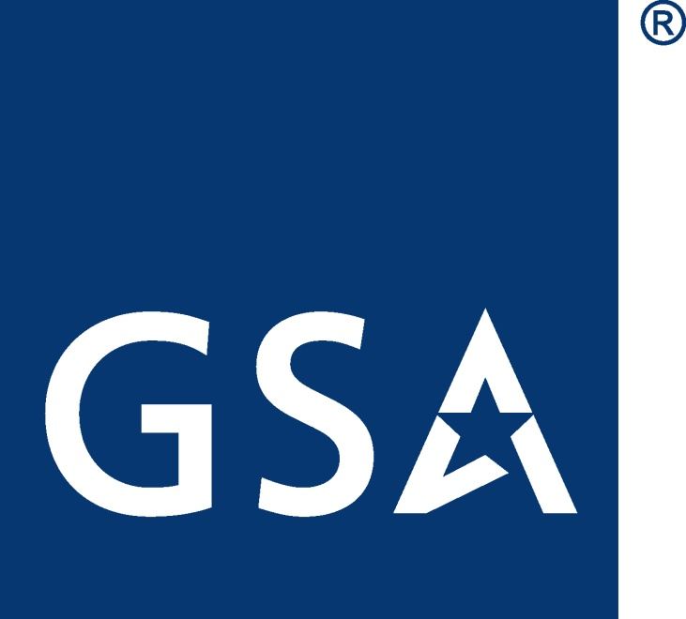
GSA Starmark Logo

