Slide 1

Travel Management Essentials GSA SmartPay® Erin VanDagna

Slide 2

GSA SmartPay® Training Agenda
Introduction to the GSA SmartPay® Travel Card
Travel Card Legislation and Policies
Types of GSA SmartPay® Travel Cards
Roles and Responsibilities
Best Practices in Travel Card Management
Notes:
Local travel is considered official travel when the individual is performing official duties in and around the area of the permanent duty station. Federal Travel Regulation (FTR) - for civilian employees (41 CFR., Chapters 301-304).
Joint Travel Regulations (JTR) - for DoD civilian employees
Foreign Affairs Manual, Volume 4, Chapter 460 (4 FAM 460) and Foreign Affairs Manual, Volume 14, Chapter 500 (14 FAM 500) for members of the Foreign Service, U.S. Department of State

Slide 3
Introduction to the GSA SmartPay® Travel Card

Slide 4
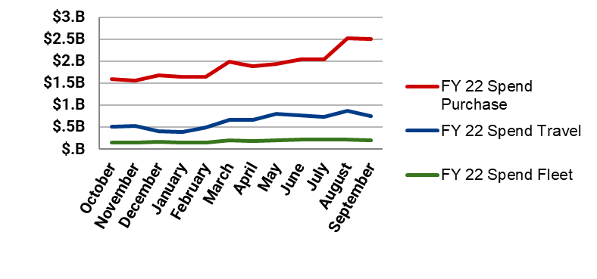
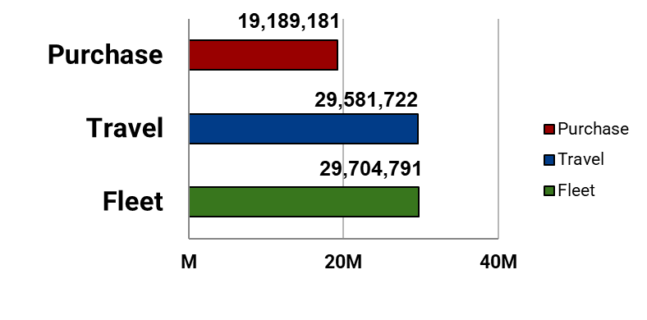
FY22 Program Statistics
Spend
Total Spend:
$32.8B
Total Transactions:
78.5M
12.2% vs. FY21.
12.9% vs. FY21.
Total Refunds:
$426.5M
Total Accounts:
6.6M
9.4% vs. FY21.
5.46% vs. FY21.
Transactions
Accounts
Notes:
Fix Account numbers

Slide 5
Travel Card Legislation and Policies

Slide 6
Local Travel Policy
Federal Travel Regulation (FTR):
Optional use of the card for local travel will be at the discretion of agencies
DoD Joint Travel Regulations already permits use of the travel card for local travel expenses
Examples of local travel include -- but are not limited to -- taxi fares, public transportation, and ferry tickets
Recommend that agencies develop and issue internal policies addressing oversight and internal controls for managing use of the travel card for local travel
FTR Amendment 2016-01 included updates to ensure that the Government contractor-issued travel charge card is used as often as practicable. In addition, it strengthens card issuance and use policies and provides the agency head/designee with waiver authority.
To visit the FTR and related files, go to: http://www.gsa.gov/portal/content/102886.
Notes:
Local travel is considered official travel when the individual is performing official duties in and around the area of the permanent duty station. Federal Travel Regulation (FTR) - for civilian employees (41 CFR., Chapters 301-304).
Joint Travel Regulations (JTR) - for DoD civilian employees
Foreign Affairs Manual, Volume 4, Chapter 460 (4 FAM 460) and Foreign Affairs Manual, Volume 14, Chapter 500 (14 FAM 500) for members of the Foreign Service, U.S. Department of State

Slide 7
Laws and Governing Policies
OMB Circular A-123, Appendix B - A Risk Management Framework for Government Charge Card Programs
Updated – Chapter 2 Internal Controls
Travel cards
New tools available under GSA SmartPay 3
Updated – Chapter 3 Charge Card Management Plan
Every 2 years
Updated – Chapter 5 Performance Metrics and Data Requirements
Now requires CFO Act agencies to submit their Narrative & Statistical Reports to GSA (not OMB) in January each year
Updated – Attachment 6 Disciplinary Category Definitions
Notes:
Updates to the Circular have been made through an inter-agency work group of AOPCs and GSA’ s CCCM. Some key updates for the travel card program that were included in the Circular update are: a breakout of travel card specific internal controls and additional internal control suggestions through things like data mining/data analysis and business case analyses.
In addition, the Chapter on training was also updated to provide more specific training information for cardholders, program managers and approvers. Before, the training requirements were kind of lumped together and were confusing. The update gave us an opportunity to treat each business line and its stakeholders separately so that training requirements are clearly outlined and applicable.
Chapter 3 – Charge card management plan - each agency must develop, issue, and maintain written policies and procedures for the appropriate use of charge cards consistent with the requirements of this Guidance. The plan is no longer sent to OMB. Agencies maintain their plans and only provide them to OMB upon request. The plan is not required to be sent to GSA.
The plan must be updated in accordance with the following schedule: • Within 12 months after agency/organization task order placement under a newly awarded GSA SmartPay master contract; • Tag and Pool entities within 12 months after joining an agency's task order; • Within 12 months after a new statute, EO, addressing charge card management becomes effective; • Otherwise, every 2 years from the date of the last update or more frequently, if needed, to address valid agency/organization IG findings or to otherwise remain current.
GSA will begin taking over the statistical reporting process for agencies by reporting the information directly to OMB on an annual basis. This alleviates a burden from agencies on having to report this information to OMB quarterly (CFO Act agencies) and annually – all other agencies. Agencies will still need to provide a narrative report to OMB annually, on or before January 31 each year.
Many of the Circular updates were made to include elements of PL 112-194 (Charge Card Abuse Prevention Act) which affects the travel business line less so than the purchase business line.

Slide 8
Laws and Governing Policies
OMB Memorandum M-13-21, Implementation of Charge Card Abuse Prevention Act of 2012
Serves as a response to the Government Charge Card Abuse Prevention Act and provides supplemental guidance to OMB Circular A-123, Appendix B
Provides an overview of the following aspects of compliance:
Safeguards and internal controls
Reports on violations and penalties for violators
Inspector General (IG) risk assessments/audits*
Effective date September 6, 2013
Part of the most recent Circular update
Notes:
M-13-21 provides supplemental guidance for implementing PL 112-194. With respect to the travel card program, the memo points out the following aspects of PL 112-194 for travel card program managers:
To prevent an individual from being reimbursed for a bill already paid by the Government, by ensuring that agency officials who approve or settle official travel verify that charges paid directly by the Government to the bank are not also reimbursed to an employee or an employee's individually-billed account.
To prevent the Government from spending money on unused tickets, by verifying the agency (travel management center or service or commercial travel office) submits requests to servicing common carriers for refunds of :fully or partially unused tickets, and tracks the status of these tickets to ensure resolution.
As mentioned in the previous slide, IGs will conduct periodic risk assessments of agency travel card programs to analyze the risks of illegal, improper, or erroneous purchases. All executive departments and agencies are required to implement the Charge Card Act's required internal controls for travel card accounts.

Slide 9
Laws and Governing Policies
Government Charge Card Abuse Prevention Act of 2012 (P.L. 112-194)
Requires that all federal agencies establish certain safeguards and internal controls for government charge card programs
Requires that all federal agencies establish penalties for violations, including dismissal when circumstances warrant
Increases oversight by requiring that each agency’s Inspector General (IG) periodically conduct risk assessments/audits to identify fraud and improper use of government payment solutions
Effective date October 5, 2012
Now part of the most current Circular update
Notes:
The Charge Card Abuse Prevention Act was passed a few years ago. The purpose of this law is to strengthen internal controls around the card program. The law calls for risk assessments to be determined and performed by agency IGs. It also included violations reporting for purchase card programs. The violations reporting is not required for travel or fleet card programs at this time. OMB in coordination with GSA’s Center for Charge Card Management developed M-31-21 to help agencies implement PL 112-194.

Slide 10
Laws and Governing Policies
Travel and Transportation Reform Act of 1998 (P.L. 105-264)
Mandates that employees use the government travel card for all payments of expenses related to official government travel
Some exemptions from mandatory use of the travel card may be granted in accordance with the Federal Travel Regulation (FTR), 41 Code of Federal Regulations (CFR) §§ 300 – 304
Effective date October 19, 1998
Notes:
PL 105-264 has been in place since GSA SmartPay® 1. The law mandates use of a government charge card when paying for travel or travel related expenses. There are exceptions to the law which can be found in the Federal Travel Regulations. Many agencies have policies in place that require use of the travel card when individuals travel 3 or more times a year while other agencies mandate that employees traveling once or more a year need a travel card. Use of the travel card does help agencies to earn refunds, so it’s use should be encouraged for anyone traveling in accordance with your agency’s policies.

Slide 11
Laws and Governing Policies
FY18 NDAA Title XVIII
FY18 National Defense Authorization Act (NDAA) Sec. 1806. Reporting Requirements:
“The head of each Federal Agency…shall submit a report to the Director of the Office of Management and Budget on that agency’s activities to implement this title.”
CCCM provided a reporting template for agency use due to OMB on December 12, 2018. The report template addresses an agency’s implementation actions described in FY18 NDAA Title XVIII in the following areas:
How the agency is expanding the use of data analytics.
What the agency has done to improve information sharing.
How improper payments have been addressed at the agency.
Notes:
PL 105-264 has been in place since GSA SmartPay® 1. The law mandates use of a government charge card when paying for travel or travel related expenses. There are exceptions to the law which can be found in the Federal Travel Regulations. Many agencies have policies in place that require use of the travel card when individuals travel 3 or more times a year while other agencies mandate that employees traveling once or more a year need a travel card. Use of the travel card does have agencies to earn refunds, so it’s use should be encouraged for anyone traveling in accordance with your agency’s policies.

Slide 12
Laws and Governing Policies
P.L. 115-34 – Modernizing Government Travel Act – enacted May 16, 2017
Requires the head of each federal agency to report information on travel and transportation expenditures, relocation expenditures, and number of trips for official Government travel.
Effective date May 16, 2017
Notes:
PL 105-264 has been in place since GSA SmartPay® 1. The law mandates use of a government charge card when paying for travel or travel related expenses. There are exceptions to the law which can be found in the Federal Travel Regulations. Many agencies have policies in place that require use of the travel card when individuals travel 3 or more times a year while other agencies mandate that employees traveling once or more a year need a travel card. Use of the travel card does have agencies to earn refunds, so it’s use should be encouraged for anyone traveling in accordance with your agency’s policies.

Slide 13
Types of GSA SmartPay® Travel Cards

Slide 14
Types of GSA SmartPay® Travel Cards
Individually Billed Accounts (IBA)
Established by the bank at the request of the program coordinator for an individual traveler
Bank sends the individual traveler a Cardholder Agreement with the travel card
Billing statement mailed directly to the cardholder
Cardholder responsible for making payment in full to the bank by the due date of each billing statement
Government reimburses IBA cardholders to pay for authorized expenses related to official Government travel
Liability for all charges rests with the individual cardholder

Slide 15
Types of GSA SmartPay® Travel Cards
Standard IBA Travel Cards
Minimum credit score required
Higher credit/cash advance limits
Split disbursement mandatory
Billing statement mailed to cardholder's address
Restricted IBA Travel Cards
Credit score below required minimum or credit check declined
Lower credit/cash advance limits
Split disbursement mandatory
Billing statements mailed to cardholder's address
A/OPC "Activation/Deactivation required"
Notes:
http://www.defensetravel.dod.mil/site/govtravelcard.cfm
Required minimum = 660
Below minimum = 500-659
Split disbursement provides for payments to be made by the agency on behalf of the cardholders. At the cardholder's direction and in accordance with agency policy, disbursement is split. The bank receives a direct payment by the agency of the cardholder specified/claimed amount. The rest of the payment is disbursed to a cardholder account or directly to the cardholder. Large ticket items such as common carrier, hotel and rental car charges are commonly paid directly to the bank on behalf of the cardholder while other disbursements are paid to the employee.
Split disbursement is an effective tool to reduce delinquency and improve refunds paid to the agency. It will require coordination with the bank to ensure proper payments are made by the Government and properly posted to a cardholder's account. A pilot to test the process is highly recommended before implementation.

Slide 16
Types of GSA SmartPay® Travel Cards
Centrally Billed Accounts (CBA)
Established to pay for official Government travel expenses
Limit consistent with agency mission
Typically used for transportation carriers (i.e. airplane, train, bus, etc.)
Government directly pays the bank
Government accepts liability only for proper charges made by an authorized CBA cardholders
Agency is responsible for management and reconciliation

Slide 17
Types of GSA SmartPay® Travel Cards
Tax Advantage Card
New product offering that combines an Individually Billed Account (IBA) and Centrally Billed Account (CBA)
Provides a means to obtain tax exemption automatically at the point of sale for rental cars and lodging charges.
Charges for other travel-related purchases such as meals and incidentals are billed to the IBA portion of the account, will still incur tax, and the individual traveler will still be liable for payment to the bank for those charges.
Allows traveler to use one card that simplifies tax-exemption procedures by automatically diverting tax-exempt charges at the point of sale.
Notes:
Tax advantage of the CBA and accessibility of the IBA

Slide 18
Types of GSA SmartPay® Travel Cards
Virtual Cards
New product offering that generates a unique account number for travel purchases made via an agency’s eTravel system.
Unique card for every purchase
Specific to employee and purpose
Spend amount, MCC and date restricted
Rich centralized data on total corporate spend
Automated reconciliation

Slide 19
Roles and Responsibilities

Slide 20
Agency Roles and Responsibilities
When establishing a GSA SmartPay® Travel Card Program, agencies:
Designate an Agency/Organization Program Coordinator (A/OPC)
Identify account holders
Designate a billing and disputes office

Slide 21
A/OPC Roles and Responsibilities
Agency/Organization Program Coordinators (A/OPC) are responsible for the overall management/oversight of the accounts. They act as liaisons between agency management, GSA SmartPay® contractor banks, and cardholders. Roles may differ, but responsibilities could include:
Managing the GSA SmartPay® Travel Card program and promoting the proper use of travel cards
Auditing travel card accounts and taking appropriate action in the instances of fraud, waste, or abuse
Resolving travel card issues, as required
Developing agency/organization-specific policies and procedures, as necessary

Slide 22
AO Roles and Responsibilities
Approving Officials (AO) are typically the account holder’s supervisor and assures proper use of the travel card. They play key roles in preventing fraud, abuse, and misuse. Roles may differ, but responsibilities could include:
Reviewing and approving all GSA SmartPay® travel vouchers
Verifying charges were within scope of government travel
Monitoring for and resolving all questionable charges
Verifying receipt of purchases and/or transactions

Slide 23
Cardholder Roles and Responsibilities
Cardholders must use the GSA SmartPay® travel card in accordance with agency policy and government regulations. Cardholders should:
Secure the travel card and immediately report a lost or stolen card
Monitor and track expenses, as well as maintain receipts, in accordance with agency policy
Use the card ethically - for official travel expenses only
Ensure vouchers are submitted in a timely manner and submit full payment for each undisputed bill
Keep up to date with program and agency-specific training requirements and communications from A/OPCs (and take appropriate action, as necessary)

Slide 24
Cardholder Roles and Responsibilities
Cardholders must NEVER:
Use the GSA SmartPay® Travel Card for personal use
Obtain ATM advances that exceed expected out-of-pocket expenditures
Allow monthly bill to become overdue; this could result in suspension or cancellation
Wait for receipt of the monthly bill to file claims
Pay for another employee’s travel card expenses
Write Personal Identification Numbers (PIN) on the GSA SmartPay® charge card

Slide 25
Bank Roles and Responsibilities
The GSA SmartPay® Program contractor banks (Citibank, and U.S. Bank) have important responsibilities, which include:
Paying the merchants for credit card transactions
Establishing accounts and issuing charge cards
Preparing monthly statements for the cardholders
Providing A/OPC or AO with the ability to view current statements, payment history, and account information to make payments electronically
Issuing required reports to A/OPCs
Providing assistance with audits and investigations

Slide 26
Best Practices in Travel Card Management

Slide 27
Communicate with Cardholders
Successful GSA SmartPay® Travel Card Programs communicate travel policy, procedures, and updates with their cardholders. For example, consider:
Publishing “Frequently Asked Questions” on the agency/organization’s internal website
Creating a monthly newsletter for updates on travel policies and procedures

Slide 28
Opportunities for Increased Savings
By using the GSA SmartPay® travel card, there are opportunities for increased savings to the Federal government. Agencies should:
Emphasize that use of the GSA SmartPay® travel card for official Federal government travel expenses is required by the Federal Travel Regulations and benefits agencies from a refund perspective
Leverage GSA SmartPay® contract bank processes to reduce improperly assessed state taxes on IBA travel cards

Slide 29
Tax Exemption Savings
GSA’s Center for Charge Card Management (CCCM) maintains a list of tax-exempt states. For a complete listing of states, requirements, and forms, visit the GSA SmartPay® website. Please note:
In accordance with the Supremacy clause of the U.S. Constitution, CBA charge cards are always exempt from taxes in all 50 states and U.S. territories; however, some states require CBA tax exemption forms for CBA travel cards
IBA charge cards are exempt from taxes in some states

Slide 30
Mitigating Abuse and Misuse
Abuse and misuse impacts travel card performance and refund earning potential. Mitigation strategies include:
Implementing proper training
Emphasizing standards of conduct/ethics and clearly state consequences for misuse
Monitoring authorization controls and setting reasonable credit and transaction limits
Reviewing card activity and restricting spend use through Merchant Category Code (MCC) blocks
Managing delinquency
Deactivating cards, as appropriate

Slide 31
Fulfilling Training Requirements
OMB Circular A-123, Appendix B discusses training requirements. Cardholders must take mandatory training and A/OPCs should:
Ensure cardholders fulfill training requirements
Provide comprehensive in-person training/orientation for new cardholders, if possible
Engage in bank-sponsored training
Ensure training is easily accessible
Address standards of conduct/ethics and clearly state consequences for misuse

Slide 32
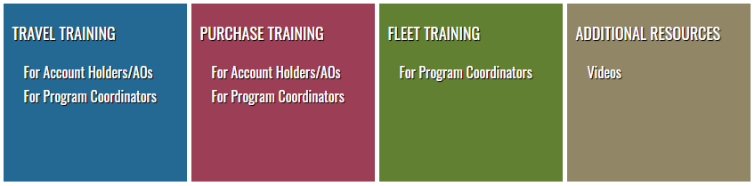
GSA SmartPay® Online Training
GSA’s Center for Charge Card Management (CCCM) offers free online travel card training for cardholders and A/OPCs. Please note:
Cardholders are able to register, set up a profile, and manage their online training courses and certificates
Level 1 A/OPCs have access to run reports and search for cardholders within agencies
https://training.smartpay.gsa.gov

Slide 33
Available Reporting Resources
There are a number of reports available from GSA SmartPay® contractor banks to help A/OPCs review transactions, payments, disputes, and delinquencies. It is suggested that A/OPCs:
Regularly monitor bank reports for fraud, abuse, and misuse
Use bank reports proactively, not reactively for payment
Understand available reports**
Request ad hoc reports
Available Reports
Reports include, but are not limited to:
Account Activity Report
Declined Authorizations Report
Pre-Suspension Report
Transaction Dispute Report
Renewal Report
** A full list of reports is available in section C.3.3.1 of the GSA SmartPay2 Master Contract
Notes:
Account Activity Report: This report consists of summary totals for the reporting period, the fiscal year-to-date, by card and agency/organization. This report is generally used at all levels to obtain and manipulate program data. See CP.3.3.1 Account Activity Report for the Purchase Card Program, CT.3.3.1.1 Account Activity Report for the Travel Card Program, and CF.3.3.1.1 Account Activity Report for the Fleet Card Program for specific data elements Declined Authorizations Report: The Declined Authorization Report will identify account holders who have attempted to use an account to buy an item: For which they are not authorized;
That exceeds their single-purchase limits;
That exceeds their monthly purchase limit; or
From a merchant that falls under a blocked Merchant Category Code (MCC)
Pre-Suspension/Pre-Cancellation Report: This report lists accounts eligible for suspension or cancellation as defined in C.1.18.2 Account Suspension and Cancellation and identifies account name, account number, status, balance past due, number of days past due, and interest penalty for centrally billed accounts. This report is generally used by the A/OPC to flag cardholders and accounts for A/OPC action and delinquency control. NOTE: The Travel Card Program requires this information segregated by individually and centrally billed accounts Transaction Dispute Report: This report lists all outstanding and resolved transaction disputes and includes all information necessary to identify, track, balance, and obtain status on the dispute from the original charge through resolution. This report must include all attributes of the original charge. This report is generally used by the Transaction Dispute Office to manage disputes. NOTE: The Travel Card Program requires this information segregated by individually and centrally billed accounts Renewal Report: This report lists cards/accounts due to expire and identifies account name, account number, expiration date, and any other information required to determine renewal status. This report is generally used by the A/OPC to flag expiring cards Ad Hoc Reporting: Provides the ability for the A/OPC community, at a minimum, to access all data elements of the AO, cardholder, and transaction records and create a report in html, Excel, and text (ASCII) formats as defined by the A/OPC.

Slide 34
Account Deactivation
To help streamline travel card programs and mitigate the risk of fraud, abuse, and misuse, please remember to deactivate accounts that are no longer in use. Please note:
A/OPCs can quickly deactivate/reactivate cards electronically or by contacting the bank’s designated representative
A/OPCs should close charge card accounts for cardholders who leave the agency (will vary by agency policy and business line)
If a card is deactivated, authorizations are declined at the point of sale

Slide 35
Contact Information

Slide 36
GSA Contact Information
GSA SmartPay® Program
Helpline: (703) 605-2808
Website: http://www.smartpay.gsa.gov
Email: gsa_smartpay@gsa.gov
GSA SmartPay®’s Social Media Pages:
Twitter
Facebook
LinkedIn

Slide 37
Bank Contact Information
Bank Contact Information:
Citibank
Customer Service: (800) 790-7206
U.S. Bank Customer Service: (888) 994-6722

Slide 38
Audience Questions

Slide 39
Thank you for your time and attention!
Contact Information Erin VanDagna
Erin.VanDagna@gsa.gov

Slide 40

GSA Starmark

