Slide 1
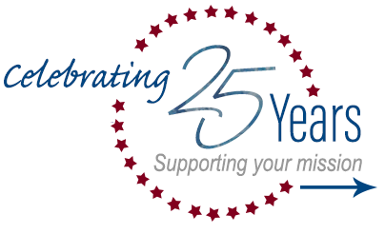
GSA SmartTax Lessons Learned for State Sales Tax Andrew Lee
Notes:
Welcome to “GSA SmartTax - Lessons Learned for State Sales Tax.” This will be a short pre-recorded presentation, and most of the session will be focused on reviewing the available State sales tax exemption resources on the GSA SmartPay website, answering questions you may have, and sharing best practices and lessons learned.

Slide 2

Who I am and how you can reach me
Notes:
My name is Andrew Lee and I am a Business Management Specialist from the GSA Center for Charge Card Management. Please note that I am not a tax attorney or trained tax specialist. I am however, the point of contact for our program for State sales tax issues as I have worked with and along side subject matter experts and specialists about these issues for more than thirteen years. The material presented today has been consolidated not just based on GSA experience, but also feedback and best practices from agencies, State tax offices, and merchants.

Slide 3
Point of Contact Andrew Lee andrew.lee@gsa.gov
Notes:
If you have any questions, please don’t hesitate to reach out to me. The best way to contact me is through email. My email address is andrew.lee@gsa.gov and for folks overseas or out west, I am usually available during business hours on eastern time.

Slide 4
Who will benefit from this class?
Notes:
This class is designed for charge card managers of all levels and experience. Likely those who are newer to charge card management will find the class more helpful. But being confused and frustrated about when charge card holders should or shouldn’t pay tax, isn’t just reserved for newbies.
We hope to provide enough information for a baseline level of knowledge of how we at the GSA Center for Charge Card Management, merchants, and even some States, view state tax assessment. I also hope to introduce you to tools and resources that are shareable with your cardholders and merchants. The goal is to make the process for determining where and when to pay State taxes a less anxiety filled and stressful experience, as I know everyone seems to have at least one horror story about state taxes.
One note. This class is likely most relevant for A/OPCs and Approving Offices in managing Purchase, Travel, and Integrated business line solutions. Even though the content can apply to Fleet transactions, taxes are usually processed differently by Fleet merchants and the Fleet specific networks. For those of you hoping to take a more in-depth look at Fleet taxes, please consider taking the “GSA Fleet Management Essentials” course, as offered by the GSA Center for Charge Card Management.

Slide 5
What topics will this class cover?
Notes:
Here are some of the most common questions I get:
I’m a Federal Government employee and my cardholders are too. Aren’t we exempt from all taxes?
What do we do when hotels and merchants don’t want to exempt transactions from taxes, even if those States should honor tax exemption?
There are so many different tax exemption forms for different States, isn’t there just one standard form somewhere we can use?
I have cardholders that choose to use personal cards and are assessed taxes in tax exempt States. Should that be happening?
What authority does the Federal Government have for these issues?
Today, we will try and address all of those questions and hopefully more.

Slide 6
Introduction and Agenda
The GSA Center for Charge Card Management (CCCM) administers the GSA SmartPay® Program, which offers Purchase, Travel, Fleet, and Integrated solutions. This presentation discusses State sales tax assessment for GSA SmartPay® charge card transactions. Discussion topics includes:
Legal History of State Tax Assessment
When and Where do I Pay Taxes? What Forms do I need?
What is CCCM Doing to Support Customers?
Please note, topics discussed are for informational purposes only and should not be considered as formal interpretation of law, tax advice, or recommendations to changes to existing policy
Notes:
To give you a more comprehensive understanding of State tax issues, we are going to tackle this from a few angles. We’ll explore the legal history of State sales tax assessment, discuss what the courts have ruled, and how it applies to tax exemption. We will then discuss how cardholders can determine if and when they need to pay taxes and what forms may or may not be required. Next, I’ll discuss some lessons learned from our office and the resources available.
As a reminder, the topics that we will be discussing will be for informational purposes only and should not be considered a formal interpretation of law, tax advice, or recommendations to changes to existing policy, as I am not a lawyer or tax policy expert.

Slide 7
Legal History of State Tax Assessment
Notes:
Let’s jump right in and discuss the legal history and precedents that inform State tax exemption. Reviewing the information will help us understand what authority the Federal Government does and does not have, and the role of the States and merchants in the tax collection process.

Slide 8
Types of GSA SmartPay® Accounts
Under the GSA SmartPay Program, there are two primary types of billing accounts:
Centrally Billed Accounts
Issued to agency, bureau, division, or fleet level
Credit limit determined by mission and spend policies
Federal government liable and billed directly
Individually Billed Accounts
Authorized Federal government employees
The account holder is liable and billed directly
Notes:
Let’s look at the two types of accounts available under the GSA SmartPay Program.
Centrally Billed Accounts are accounts for which the Federal Government is directly billed for purchasing activity. The government directly pays the vendor, which in this instance, is the GSA SmartPay contractor bank. In other words, the government buys an item or service, and it directly pays for that item or service. We’ll review this again in a few slides, but Centrally Billed Accounts are Purchase, Centrally Billed Travel, GSA Travel Tax Advantage, Fleet, and Integrated accounts.
Individually Billed Accounts are accounts for which an agent of the Federal Government may make a purchase, however the individual is liable for payment. The Federal Government is responsible for reimbursing the individual, but the responsibility for making the payment is not directly the government’s responsibility. The only GSA SmartPay product that is individually liable is the Individually Billed Travel account.
To summarize, for Centrally Billed Accounts, the Federal Government is liable for payment. For Individually Billed Accounts, the individual Federal employee using the charge card is liable for payment.

Slide 9
What Does the Constitution Say?
Article VI, paragraph two of the United States Constitution, most commonly known as the Supremacy Clause, reads:
This Constitution, and the Laws of the United States which shall be made in Pursuance thereof; and all Treaties made, or which shall be made, under the Authority of the United States, shall be the Supreme Law of the Land; and the Judges in every State shall be bound thereby, any Thing in the Constitution or Laws of any State to the contrary notwithstanding.
Notes:
What you are seeing here is known as the Supremacy Clause of the United States Constitution. This clause establishes that the Constitution and established Federal laws to be “the Supreme Law of the Land,” over State laws.

Slide 10
The Constitution and the Courts
High court rulings applied the Supremacy Clause to make determinations and cases include, but are not limited to, the following:
McCulloch v. Maryland, 17 U.S. 316 (1819)
U.S. v. New Mexico, 455 U.S. 720 (1982)
Alabama v. King & Boozer, 314 U.S. 1 (1941)
Notes:
Several Supreme Court and Federal Court cases applied the Supremacy Clause in determining if and when the Federal Government, or instrumentalities and representatives of the government, are responsible for paying State taxes. Just a brief summary of some of the relevant cases:
In McCullough v. Maryland, the State of Maryland tried to impose a tax on a newly established national bank. The Court ruled that the Federal Government has implied powers that are not explicitly established in the Constitution. The ruling concluded that a State cannot directly assess taxes on a Federally established entity.
In U.S. v. New Mexico and Alabama v. King and Boozer, Federal contractors argued that the Federal Government’s exemption for State taxes should extend to entities or individuals supporting Federal Government activities and using Federal funds. The Court ruled that immunity from State taxation cannot be conferred to entities, like contractors, just because the government ultimately bears the financial or operational burden. In other words, just because something is paid for ultimately with Federal dollars, does not automatically mean the entity or person making the payment shares the Federal Government’s tax exemption privilege.

Slide 11
Summary of Court Rulings
States have the sovereign right to assess taxes on individuals. However, States do not have the authority to assess taxes on Federal Government transactions, when the government is directly liable for payment.
Federal government or agent/instrumentality of the government
“Agent “or “instrumentality” is any Federal employee conducting official business on behalf of the government
High court rulings are based on payment liability; if the government is directly responsible for payment, then States cannot assess taxes
Notes:
What this all means is that the States retain the sovereign right to assess taxes on any entity or individual it deems eligible. The only exception is for applicable Federal Government transactions. This applies to both agents and instrumentalities of the Federal Government. What is important to take away here how the Court defines “agents” and “instrumentalities” of the Federal Government. It’s not based on employment by the Federal Government, but on liability of payment being made. When the government is directly liable for payment, States cannot assess tax, and specifically State sales tax. If an individual is liable for payment, the States have the right to assess the tax, even if the government later reimburses the employee.

Slide 12
Determining Payment Liability
How does the high court ruling impact GSA SmartPay?
All CBA transactions are exempt from State taxes
Purchase
CBA Travel
GSA Travel Tax Advantage
Fleet
Integrated
IBA transactions may be subject to State taxes
IBA Travel
Taxes apply for IBA split disbursements
Notes:
What this all means is there are legal precedents to support tax exemption for purchases made with Centrally Billed Accounts. However, any Individually Billed Travel account can be subject to State taxes. Meaning, all States and U.S. territories should exempt State sales tax for Purchase, Centrally Billed Travel, GSA Travel Tax Advantage, Fleet, and Integrated accounts. States are not required to exempt State sales tax for Individually Billed Travel Accounts. Note that even if an agency uses a process like split disbursement, which means that an individual still has an Individually Billed Travel Account, the agency just makes a payment on behalf of the individual, the payment liability is still on the individual or cardholders. Also note that agencies are still liable for fees as those are not defined as State sales tax.

Slide 13
When and Where do I Pay Taxes? What Forms do I need?
Notes:
Next, let’s talk about the practical and operational applications for your programs. I’d like to highlight as we transition into the discussion of specific States, that legal precedents are established only for exemption of State sales tax specifically. If a State or locality imposes another tax, like a convenience tax, bed tax, tourism tax, there is not legal precedence to support exemption, even for Centrally Billed solutions. Therefore, assessed taxes that are non-State sales tax are allowable.

Slide 14
How Most States Collect Sales Taxes
States rely on merchants to collect sales tax assessed on purchases at the point of sale. Merchants make the decision for whether or not to assess taxes:
States establish tax laws and regulations
Merchants collect tax on behalf of States
Laws may change suddenly
Point of sales personnel may assess taxes even for CBA cards or in States where IBA cards are exempt
Please Note: GSA does not have the authority to mandate tax exemption
Notes:
This is one of the most important concepts for this class. States have the legal authority to assess State sales taxes on cardholders. The merchants are only the collection point for the State sales tax and have no authority beyond complying with State sales tax collection laws, regulations, and policies. However, for all practical purposes, merchants are often asked to interpret the eligibility of cardholders for State sales tax exemption, which there may be varying degrees of ability for these merchants to accurately do. It is important to note that if a merchant improperly determines that a cardholder is tax exempt, the State has the authority to collect the taxes from the merchant and assess penalties.
What this means is that merchants are responsible for both interpreting State sales tax law and are financially responsible for correctly determining whether or not to assess State sales tax. There is likely little to no State penalty for over-collecting State sales tax for merchants. Understanding that the financial risk is completely on merchants, many merchants are incentivized to err on the side of collecting sales tax – even if there is an eligible exemption – to avoid the risk of penalties.
In addition, the Federal Government does not have any enforcement authority in the eligibility determination or collection of State sales tax. This often results in confusion of what taxes are due when by both the merchant and cardholder. Merchants might exempt or not exempt taxes, not necessarily based on State law or policy, but when they feel the most comfortable doing so based on their own assessment of risk.

Slide 15
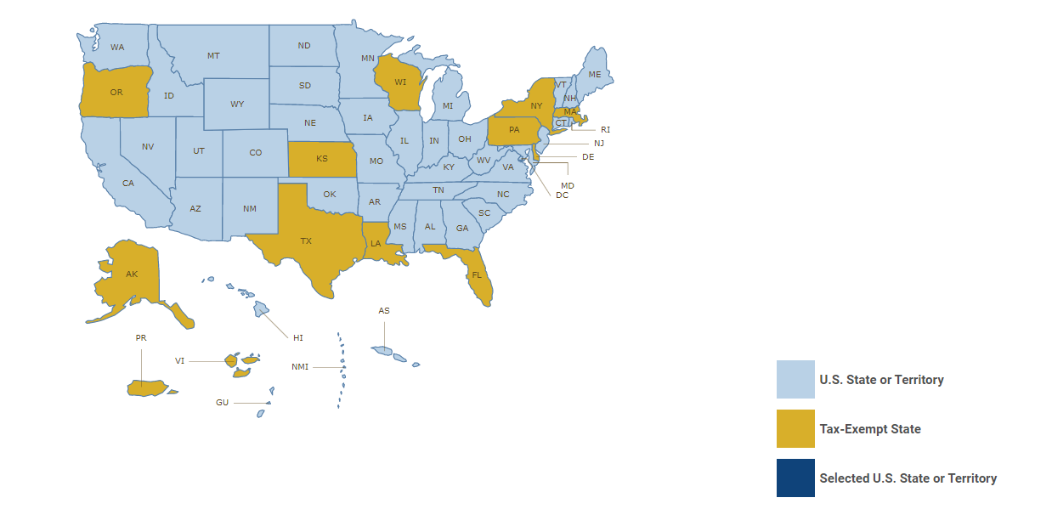
Which States Exempt CBA Transactions?
All 50 States and U.S. territories exempt direct State sales taxes for CBAs. Some States require exemption forms. For more information about documentation requirements please visit: https://smartpay.gsa.gov/content/state-tax-information
Notes:
All 50 States and U.S. territories exempt direct State sales tax on Centrally Billed transactions. There are four States where this absolute statement is slightly less absolute, but we’ll come back to it in a moment. Please note that for both Individually Billed and Centrally Billed accounts, States may – but some may not – have documentation requirements. These are determined by the State and the Federal Government again, does not have the authority to change State documentation requirements for State sales tax exemption. To help navigate State sales tax exemption and documentation requirements, there is a State sales tax map available on the GSA SmartPay website.

Slide 16
Which States Exempt IBA Transactions?
CCCM maintains a list of States that exempt State sales tax for IBA transactions. For a complete listing of States and requirements, please visit https://smartpay.gsa.gov/content/state-tax-information:
Alaska
Delaware
Florida
Kansas
Louisiana
Massachusetts
New York
Oregon
Pennsylvania
Texas
Wisconsin
Puerto Rico
Virgin Islands
Notes:
As of now, there are about a dozen States and a few U.S. territories that choose to offer State sales tax exemption for Federal Government travelers. This State sales tax exemption is offered sometimes as courtesy to the Federal Government. There are some States that do not have a State Sales tax, like Alaska or Delaware. Again, the exemption is for State sales tax only, and municipalities have the right to assess other taxes on the transaction, like an entertainment tax or tourism tax.
Just a quick note, in some States it is often unclear if a merchant is required by State law to exempt State sales tax for exempt entities like the Federal Government. What this means is there is legal justification for a merchant to determine that an Individually Billed Account is exempt from States sales tax, but the merchant is not legally required to do so.

Slide 17
States That “Don’t” Exempt CBAs
There are States that assess taxes directly to merchants and not to cardholders. For example, some States assess a gross receipts tax. Merchants have the ability to pass along this tax on CBAs to the Federal Government and there is no conflict with the Courts’ application of the Supremacy Clause for tax exemption. These States include:
Arizona
Hawaii
Illinois
New Mexico
For specific information about each State, please visit: https://smartpay.gsa.gov/content/state-tax-information
Notes:
As I mentioned in the “How Most States Collect Sales Taxes” slide, all States and U.S. territories must exempt State sales tax for Centrally Billed accounts. There is a little complexity here. In most States, the State directly assesses taxes on the cardholder in the form of a State sales tax. The merchant collects the tax and then provides the revenue from the State sales tax directly to the State. In the four States on this slide, the State does not directly assess State sales tax on the cardholder. Rather, the State directly taxes the merchant in the form of a gross receipts tax. It is important to understand that a gross receipts tax is not a State sales tax.
It is also important to know that merchants have the ability to pass along the amount of the gross receipts tax to the cardholder. This pass along tax is not considered a State sales tax and therefore is allowable. Even though the pass along tax may effectively perform a function similar to that of a State sales tax, it is not legally considered a State sales tax.
Two important points here:
Merchants may not be required to pass along the gross receipts tax to the cardholder, meaning merchants can choose to absorb the cost of the tax as a courtesy to the government.
Some State governments may extend an exemption of the gross receipts tax for merchants, when transacting with the Federal Government. If the merchant seeks the exemption – which is not required – then the merchant can forgo the pass along tax.

Slide 18
What About Other Taxes & Fees?
Cardholders may see other taxes assessed on bills or invoices for transactions in which State sales tax is exempt. These taxes may be assessed by local governments or municipalities and are allowable. These taxes may include the following:
Bed tax
Tourism tax
Room tax
Fees may also be assessed on transactions. Please consult with agency policy to determine if your agency allows cardholders to accept fees.
Notes:
Our office frequently receives questions about exemption for taxes that are not sales tax. For example, if sales tax is exempt in a State, why is there a city or local government still assessing local taxes? As discussed earlier in the presentation, there is legal precedent for the exemption of State sales tax for centrally billed accounts and some States choose to exempt State sales tax for individually billed Travel. However, the legal precedent does not extend to other taxes, especially those assessed by local governments. If another tax is imposed like a bed tax, tourism tax, or room tax, there is not legal precedence to support exemption, even for Centrally Billed solutions. The only exception is in a circumstance if a local government specifically exempts Federal government employees from those taxes by law, regulation, or policy. That is a decision specifically made by the local government.
Also note that Federal government employees are not exempt from fees. Please note that agencies may have specific policies that allow or not allow cardholders to accept fee assessment on transactions. Cardholders must verify with agency charge card management offices whether or not accepting fees is allowable under agency policy.

Slide 19
What is CCCM Doing to Support Customers?
Notes:
Now, let’s talk about how the GSA Center for Charge Card Management supports agency charge card programs and cardholders.

Slide 20
Tax Exemption at Point of Sale is Key
GSA Tax Recovery Pilot results:
Significant administrative effort for little financial recovery
State laws vary (often must seek recovery from vendors rather than directly from the States)
Types of exempt taxes and the reclamation process varies by State, municipality, or vendor
Many States do not accept information from 1099s or contractors
Tax recovery amounts are minimal
Ask for the exemption upfront!
Notes:
The Center for Charge Card Management engaged in a State sales tax recovery pilot project in 2013. The pilot tested the hypothesis that a significant amount in taxes are being improperly assessed and collected by States and merchants. The results of the pilot project did not support the hypothesis, as the team was only able to prove improper States sales tax collection and ultimate recovery of a very small fraction of transactions. The most important finding and lesson learned from the pilot project is the importance of education and knowledge of both the merchants and the cardholder at the point of sale.
As such, the program has focused efforts to educating and providing information and resources to cardholders, States, and merchants.

Slide 21
Outreach to States
CCCM conducts outreach to State Departments of Revenue. Information requested includes:
Updated exemption information for each State
Verification of documentation requirements and updated forms
Continued and further consideration for tax exemption status for all GSA SmartPay Travel IBA accounts
Numbering information for GSA SmartPay 3, including BIN and 6th digit for identification purposes
Card artwork for all business lines
Notes:
Our office attempts to continuously coordinate and communicate with State departments of revenue to document the changes to State tax laws and policies and documentation requirements. Unfortunately, the responsiveness of States are inconsistent and few proactively notify the Federal Government of changes to laws and policies. One of the best resources for us to keeping our information current and up-to-date have been cardholders and A/OPCs sharing information with our program if they notice a discrepancy or inconsistency. We then work with the State to verify potential updates.

Slide 22
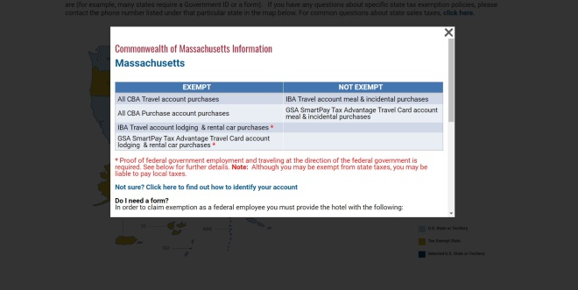
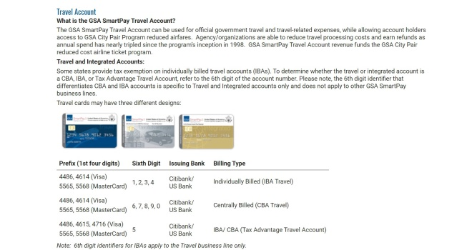
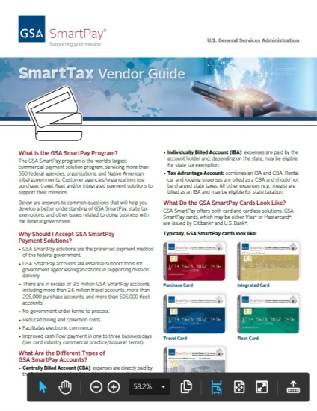
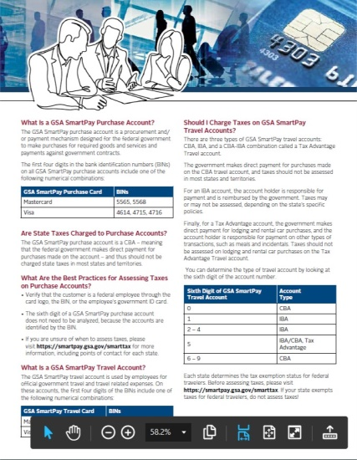
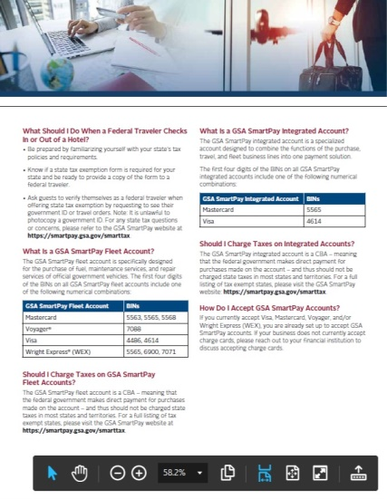
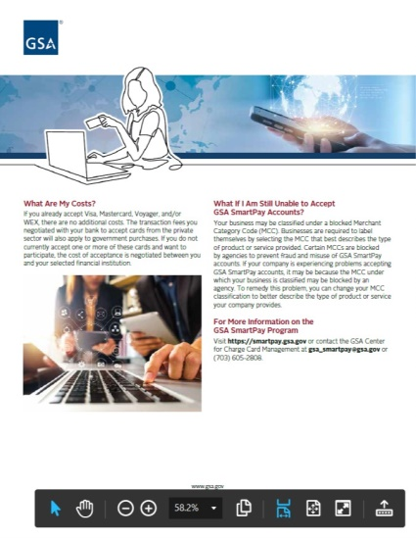
Online Resources
Please visit the GSA SmartPay SmartTax homepage for resources including the State tax map, common questions, and vendor guides.
Notes:
Our online resources include a State tax map with the most recent collected information for exemption and documentation requirements, and vendor guides providing merchants with information about State sales tax exemption and recognizing GSA SmartPay cards and BIN numbers.
A quick note here, the website includes identification information to help States and merchants identify Federal Government cards and determine if a card is centrally or individually billed. The 6th digit identifier is only applicable to the Travel business line. This means that a Purchase Card (for instance) with a 6th digit of 1, 2, 3, or 4 – which denotes Individually Billed for Travel accounts only – is a Centrally Billed solution that is exempt from sales tax.

Slide 23
State Sales Tax Exemption FAQs
Along with a newly updated GSA SmartPay State tax map site, CCCM developed a Frequently Asked Questions document which addresses questions such as:
Why won’t a hotel exempt me from all taxes even though I am using a government charge card? Aren’t all government employees exempt from all taxes?
I am participating in the Amazon Tax Exemption Program. Why am I still being charged taxes?
The hotel is asking for a form and/or information that doesn’t seem to be required. Do I need to provide it?
The merchant refuses to honor state sales tax exemption and this is the only merchant I can use. What should I do?
Notes:
The program developed a frequently asked questions section about taxes that may be helpful. These are a collection of questions that we hear from charge card managers like you, agency management, cardholders, States, and merchants. We update these regularly and if there are any questions that you get, but are not included in this section, please feel free to contact me.

Slide 24
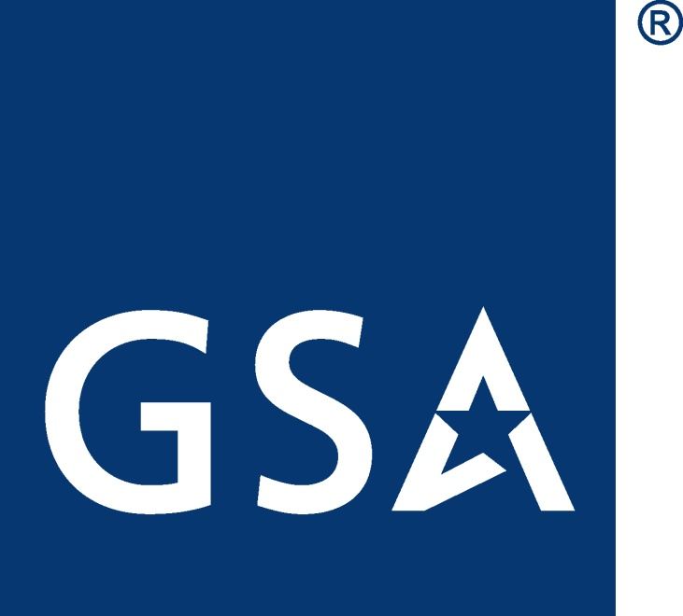
GSA Starmark
Notes:
Thank you for attending this class. As a final reminder, the topics that we’ve discussed today were for informational purposes only and should not be considered a formal interpretation of law, tax advice, or recommendations to changes to existing policy. I hope you enjoyed the class and found the information helpful for performing your duties as an agency charge card manager or Approving Official. I look forward to interacting with you, fielding questions, and sharing agency experiences on the live chat.

