Slide 1
FedMall Overview James Mette

Slide 2
Agenda
FedMall Basics
FedMall Key Partners & Stakeholders
FedMall Updates- Timeline
FedMall Completed Updates
Commerce Modernization
Manual Order Entry System (MOES) Rebuild
Business Intelligence (BI) Tool Phase 2
Supplier Portal- Enhancements

Slide 3
Agenda, continued
Subsistence Total Order and Receipt Electronic System (STORES) Rationalization
Why Shop on FedMall?
Useful FedMall Features
FedMall FAQs
Becoming a FedMall Shopper
Questions

Slide 4
FedMall Basics
FedMall provides e-Commerce purchasing for:
Department of Defense (DOD) agencies
Federal, State, and Local governments
DoD contractors under Contractor Logistics Support Agreements
FedMall offers over 88 million items for purchase, including National Stock Number (NSN), commercial contract and “Marketplace” commercial items
FedMall “Marketplace” supports market-driven competition with dynamic pricing, ability for vendors to upload catalogs and allowance for GPC Purchases under the micro-purchase threshold.
FedMall supports 38K active customers
Customer orders valued at $202M were placed in FY22
US Military customers account for 57% of FedMall sales

Slide 5

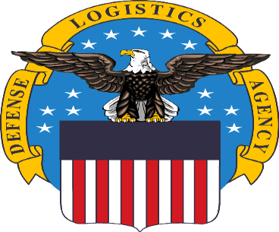
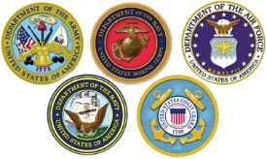

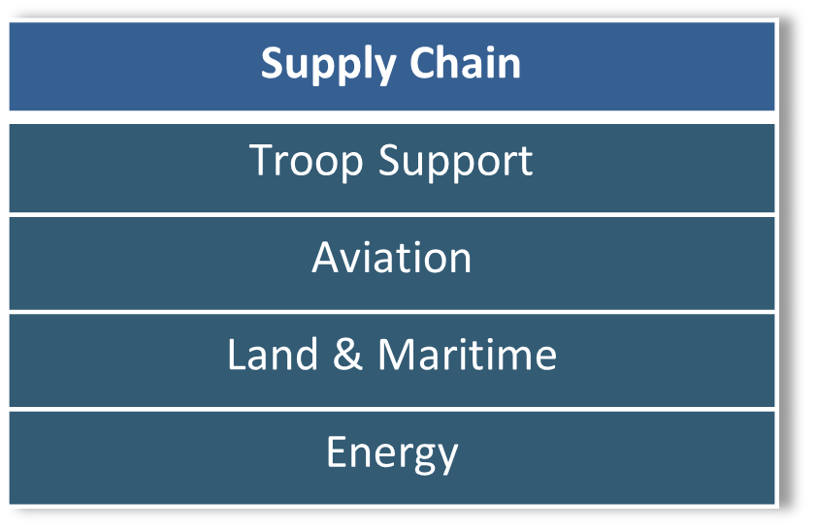
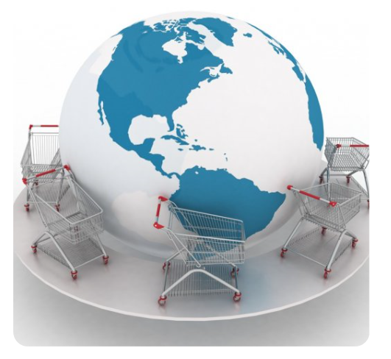



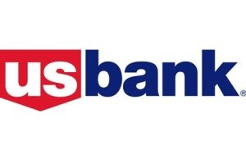


FedMall Key Partners & Stakeholders
DAAS
EDA
DISA
OCSP
Foreign Military Sales
EBS
FPDW
NGA
NIB
Partners
Military Services
Customers/Stakeholders
Suppliers
Federal, State & Local Gov
Payment Processing
Sponsor
US Bank

Slide 6
FedMall Updates- Timeline
AbilityOne Marking/ Search Improvements
Section 889 Compliance Indicators
FedMall Commerce Modernization – Development for Production Update in October 2023
FedMall Custom Utilities Modernization – MOES, WSSP, MRA
Business Intelligence Tool Implementation- Phase 2
FedMall Supplier Portal Improvements
STORES Rationalization- Initial Requirements Development
MAY
JUN
JUL
AUG
SEP
OCT
NOV
DEC
JAN
FEB
MAR
APR
MAY
2022
2023

Slide 7
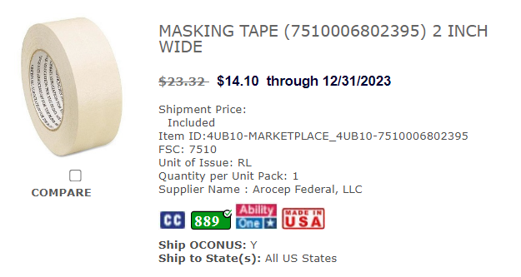
FedMall Completed Updates
AbilityOne Marking/Search Improvements
Validates vendors/catalog items against the approved AbilityOne-Authorized Distributor and Procurement Lists
Prevents non-authorized vendors from marketing items as “AbilityOne” on FedMall
Ensures AbilityOne items display in search per the FAR mandatory source guidance
NDAA Section 889 Compliance
Validates vendor cage codes against SAM.gov to confirm the vendor has attested to not using covered telecommunications equipment or services (per FAR 52.204-25) as a substantial or essential component of any system, or as critical technology as part of any system.
Catalog items from vendors who have attested to Section 889 compliance will be marked with a green 889 icon. The icon will be red if the vendor has not attested to Section 889 compliance.
Indicates Authorized AbilityOne Product
Green 889 Icon validates the vendor complies with NDAA Section 889

Slide 8
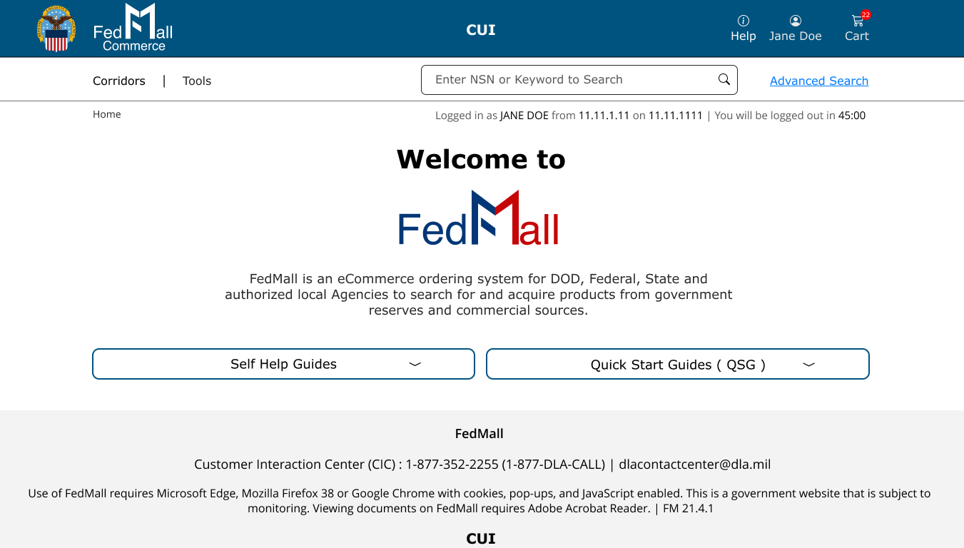
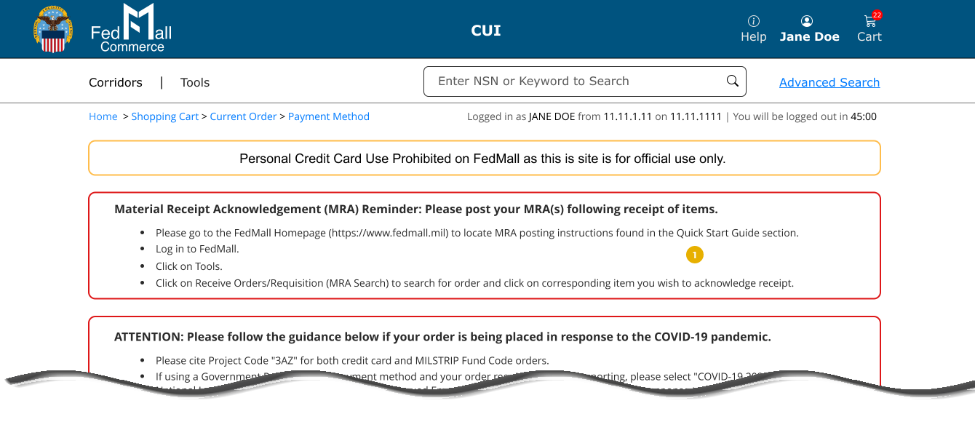
Commerce Modernization
Benefits of Modernization
More commercial look and feel
Increased flexibility and responsiveness to emerging requirements
Responsive web interface
Increased capability for banners, promotions & related on-screen content
Enhanced order tracking (from order to delivery)
Access to shipping information through interfaces with commercial vendor/carrier order tracking systems
Estimated completion- Fall 2023

Slide 9
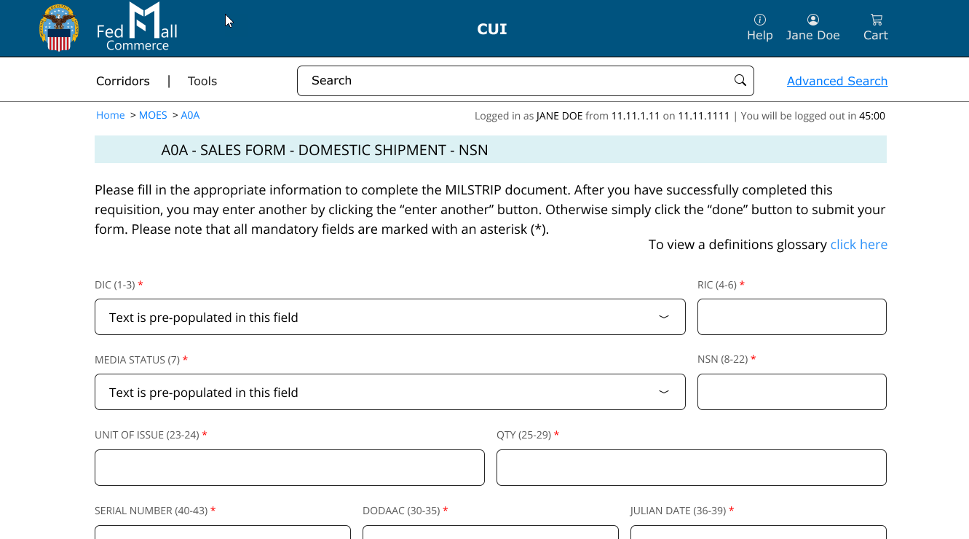
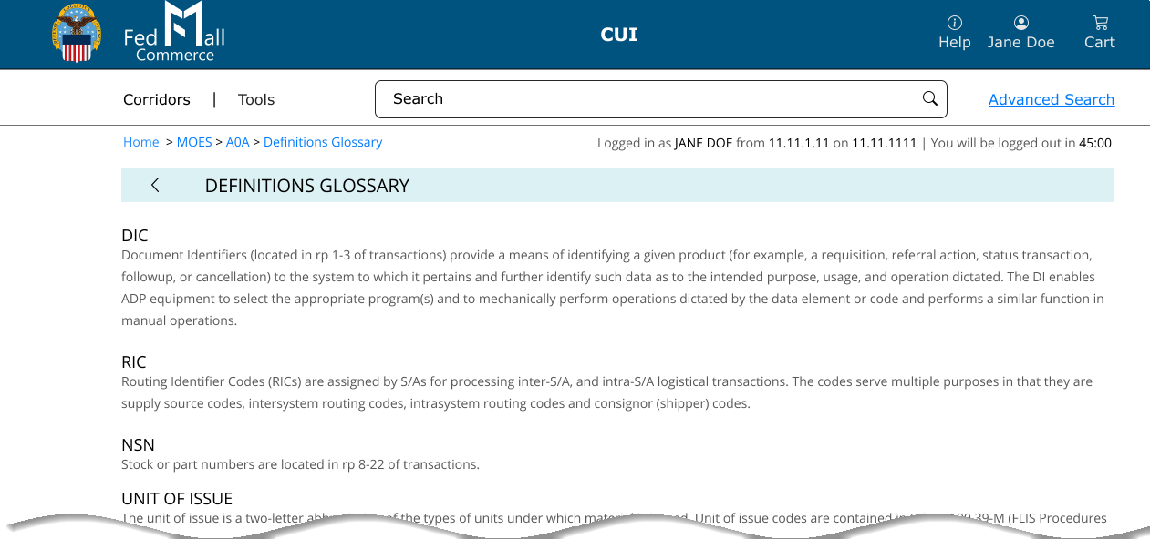
Manual Order Entry System (MOES) Rebuild
Benefits of Rebuild
Required to bring outdated code into cybersecurity compliance
User-friendly interface
Glossary of terms to assist in completing forms
Design/architecture integrated into FedMall vs. existing as a stand-alone function
Estimated completion- Summer 2023
Note: All Custom Utilities (MOES, WSSP, MRA, DLA Orders, SASOR, FEDLOG) scheduled for rebuild in the next 2-3 years.

Slide 10
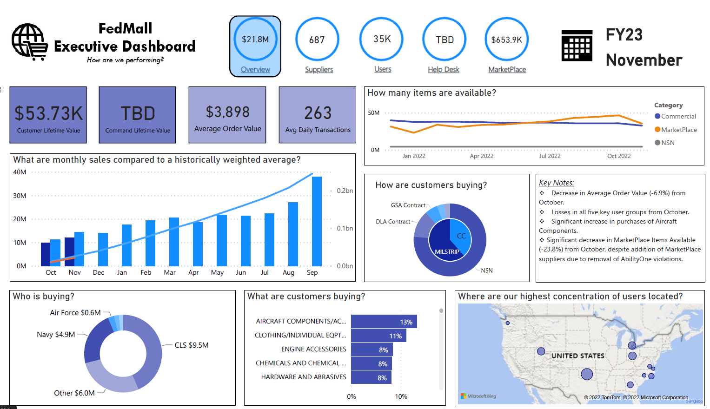
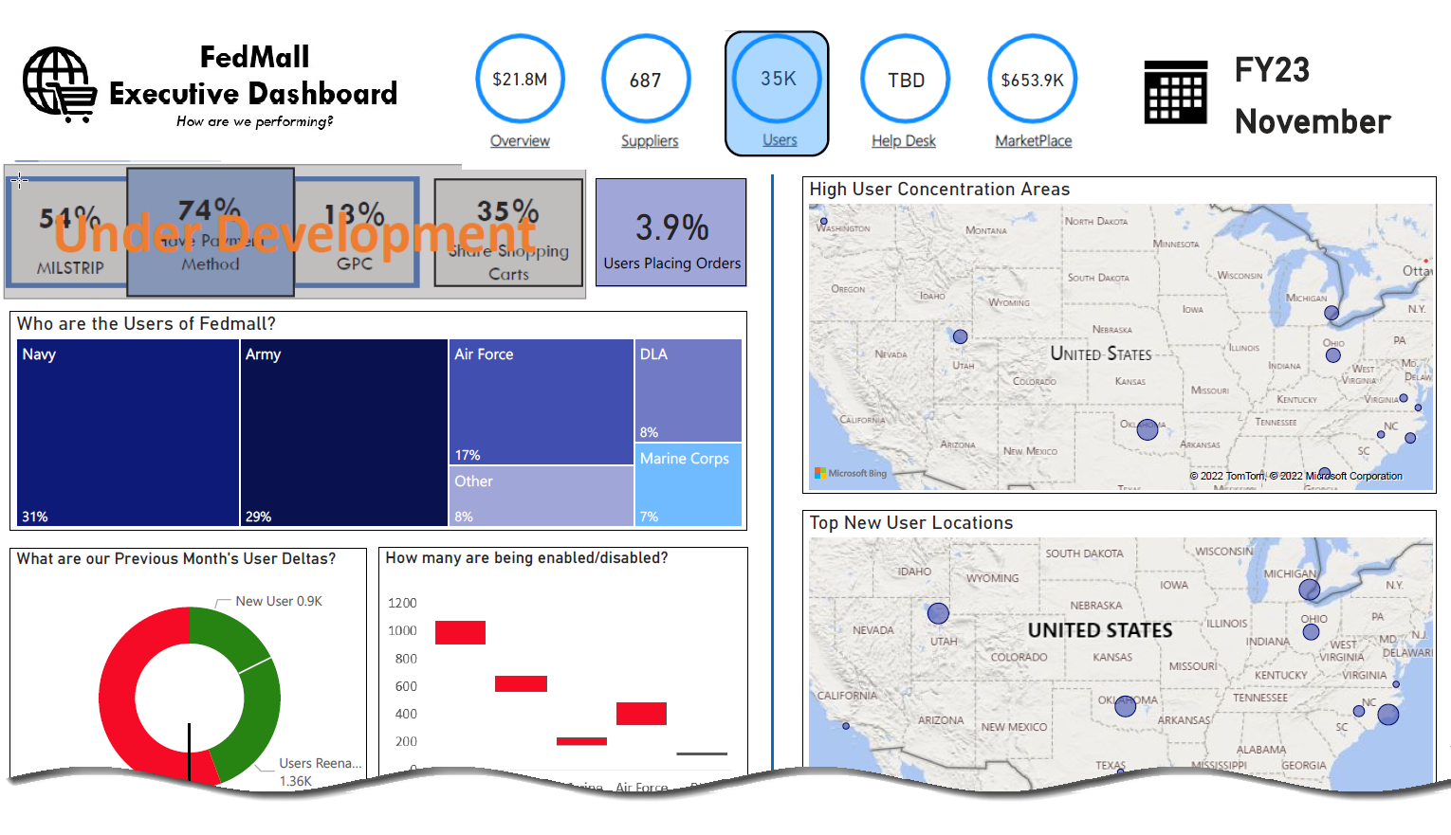
Business Intelligence (BI) Tool Phase 2
BI Tool Phase 1 - monthly metrics generated from the tool
Enhancements being worked:
Automated data extract
Error checking
Integration with Qlik Sense
Improved metrics
Future Enhancements (FY24-25):
Ad-hoc reporting
Artificial intelligence/machine learning to optimize performance
Prescriptive analytics (fraud detection, funnel analytics, upselling)

Slide 11
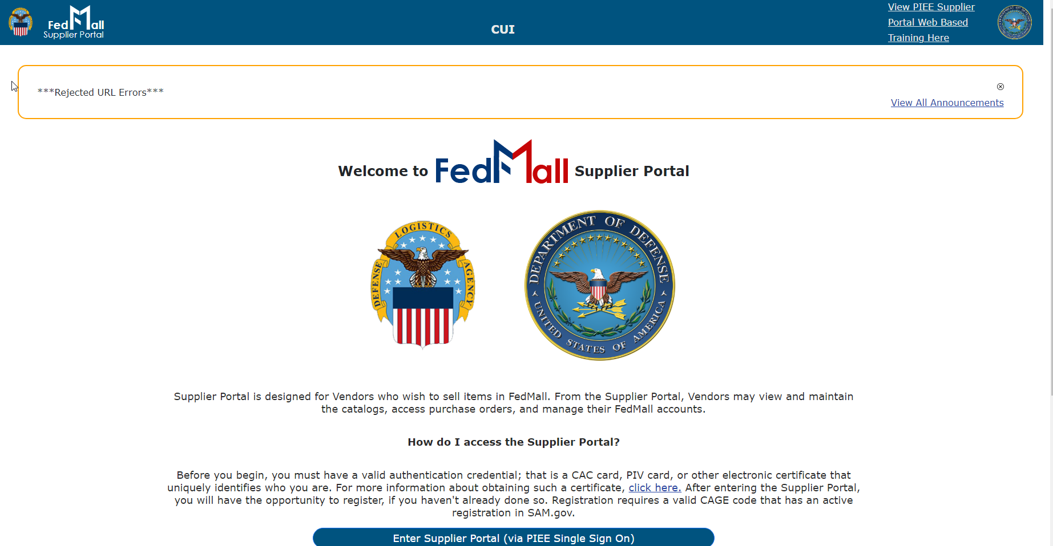
Supplier Portal- Enhancements
New user interface introduced June 2022
Further enhancements planned (FY23-24):
Improved order delivery methods
Better search functionality
Consistent naming conventions between the vendor and customer portals
Add additional contract data
Added help features
Notes:
Future Enhancements:
Use same ECA cert for login and order delivery- eliminating need for PGP certificate
Make attribute names match those that are displayed in the Commerce Product Detail Page
Add Order Number, Document Number to the purchase order search and results screens
Add contracting officer’s email address to the contract data information
Add access to registration instructions and other QSGs on the registration page

Slide 12

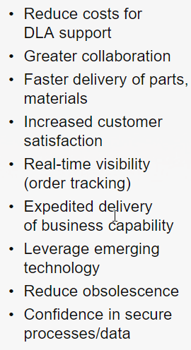
Subsistence Total Order and Receipt Electronic System (STORES) Rationalization
Part of DLA’s Digital Business Transformation strategy
Capabilities of STORES will be integrated into FedMall
Timeline:
Initial requirements gathering/architecture layout to be completed Fall 2023
System development/ integration targeted for completion early FY26
DBX Customer Benefits

Slide 13
Why Shop on FedMall?
FedMall allows you to use your GPC for:
FedMall Requisitioning: Acquire Defense Logistics Agency (DLA) and General Services Administration (GSA) NSN stock items. These transactions are routed to DLA Enterprise Business System (EBS) or GSA Global Supply for fulfillment.
FedMall Commercial Ordering: Acquire commercial supplies and services by leveraging existing DLA and Service-issued contracts and GSA schedules: FedMall automatically completes mandated Federal Procurement Data System-Next Generation (FPDS-NG) reporting for these orders.
FedMall Marketplace: Make open market micro-purchases for commercial supplies directly from suppliers: FedMall allows cardholders to compare items and prices and information about use of mandatory sources of supply and DoD supplier risk scores are readily apparent. This option supports market-driven competition and allows for GPC purchases under the micro-purchase threshold.

Slide 14
Useful FedMall Features
You can shop and add items to your shopping cart and then send the shopping cart to your authorized cardholder.
FedMall suppliers must be registered in SAM.gov - Section 889 compliance is verified and displayed in FedMall.
FedMall prioritized search function results return NSN items first for ease of purchase.
FedMall interactively works with the Supplier Performance Risk System (SPRS) for customers to provide vendor feedback and vendors to improve customer service based on the results.
FedMall items include intuitive visual markings (e.g., mandatory supply sources of supply, green compliant, MILS compliance).

Slide 15
FedMall FAQs
FedMall is not a mandatory source – however, FedMall is another source for cardholders to use
FedMall completes the FPDS-NG reporting for GSA purchases made through FedMall
FedMall Marketplace orders considered open market micro-purchases
FedMall’s FAQs are hosted on a public page, under https://www.dla.mil/info/FedMall/TownHalls - and are located under the most updated “Master FAQs for Buyers”

Slide 16
Becoming a FedMall Shopper
Items need to Register
A valid authentication credential, such as a Common Access Card (CAC) or Personal Identify Verification (PIV) card, or other electronic certificate that uniquely identifies you (i.e. Public Key Infrastructure (PKI) certificate)
A valid DoD Activity Address Code (DODAAC/FEDAAC) with requisition authority.
If you intend to make purchases, a valid payment method (i.e. MILSTRIP, GPC). For GPC purchasing, you must have a DODAAC with purchasing authority to enter with your GPC payment method.
Visit https://piee.eb.mil to register through PIEE, then request the FedMall User Role
Need Assistance? Contact the PIEE Helpdesk @ 866-618-5988

Slide 17

Questions

Slide 18

GSA Starmark Logo

