Slide 1
DoD GPC Electronic Systems Update Mr. Jim Tew and Ms. Pam Talbott

Slide 2
Agenda
GPC Systems Summary Functional Workflow and PIEE/JAM Benefits
Access Online Purchase Log
Access Online/Insights on Demand – Disputed Transactions
GPC Program Oversight in Insights on Demand Reminders
Purchase Card Oversight Module (PCOM) Updates
JAM Updates
Helpful Hints and Tips for PIEE/JAM Success
Defense Enrollment Eligibility Reporting System (DEERS) Interface with PIEE
Access Online Integration
FedMall SSO & Relationship to a PIEE User Profile
How the Help Desk Can Assist You
Help Desk Process

Slide 3
Reminders
Chat and Q&A will be at the end of the presentation
Class surveys

Slide 4
GPC Systems Summary Functional Workflow and PIEE/JAM Benefits

Slide 5
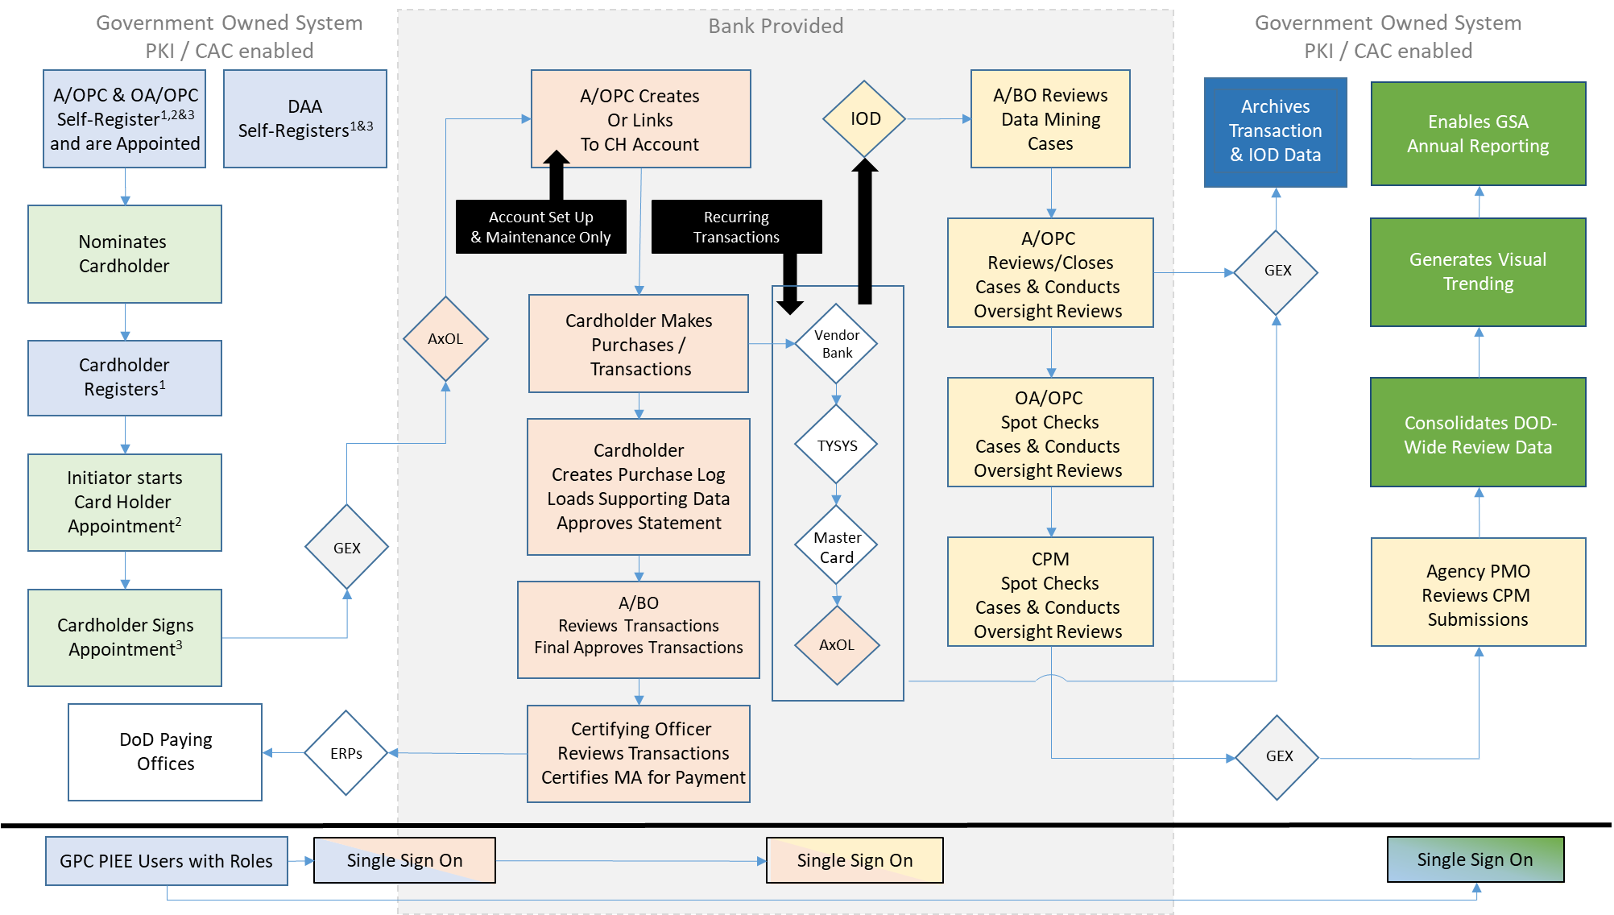
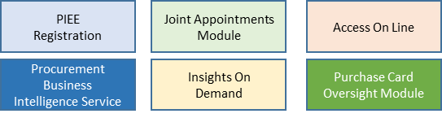
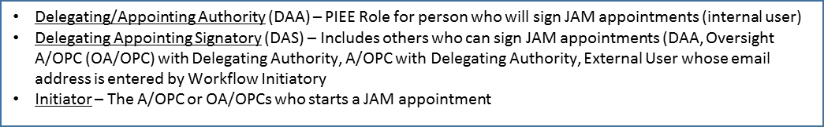
GPC Systems Summary Functional Workflow
SP3 GPC Systems Summary Functional Workflow
Supervisor Electronically Signs
DAS Electronically Signs
Group Account Manager Approves

Slide 6
PIEE/JAM References
Governmentwide Commercial Purchase Card (GPC) Program One-Pagers cover the Procurement Integrated Enterprise Environment (PIEE) and Joint Appointment Module (JAM) GPC-related processes: https://www.acq.osd.mil/asda/dpc/ce/pc/training.html
JAM GPC Role Descriptions: https://www.acq.osd.mil/asda/dpc/ce/pc/systems.html
Include the 10 Special Designation Authority Types
Delegating/Appointing Authority (DAA) is usually the head of contracting or another senior official
Delegation Authority Signatories (DAS) are individuals authorized to sign JAM GPC delegation of Authority and Appointment Letters. Four roles are DAS:
DAA who is registered in (PIEE)
DAA who is not registered in PIEE
Oversight Agency/Organization Program Coordinator (OA/OPC) with Delegating Authority
Agency/Organization Program Coordinator (A/OPC) with Delegating Authority

Slide 7
JAM GPC Appointment Benefits
DoD GPC policy mandates use of JAM to issue GPC Appointments
Ensures compliance with the Federal Acquisition Regulation (FAR), Defense Federal Acquisition Regulation Supplement (DFARS), and DoD GPC Appointment/Delegation of Authority policy
Ensures appointment access by appointee, supervisor, and GPC program officials
Validates training completion prior to issuance of appointments and issues periodic reminders
Satisfies FAR record retention and termination requirements
JAM use, in conjunction with U.S. Bank’s (the Bank’s) Access Online PIEE Task Queue (PTQ), ensures account purchasing limits cannot exceed delegated procurement authority.
Triggers automatic access to other PIEE modules such as Access Online (including Web-based Training and Insights On Demand (IOD)), Supplier Performance Risk System (SPRS), FedMall, and Purchase Card Oversight Module (PCOM).

Slide 8
Access Online Purchase Log

Slide 9
Access Online Purchase Log
DoD and Component GPC policy mandate use of the Bank’s Access Online Purchase Log (Order Management and Transaction Management) and Electronic Attachment Capabilities. Examples of Purchase Log entries that are mandatory include 889 Compliance and Emergency-Type Operations (ETOs) (commonly referred to as “Contingency Operations”) transactions.
Access Online data reveals significant compliance issues
Recent and pending Access Online enhancements will be leveraged to improve data quality

Slide 10
Access Online Capabilities 101
Cardholders (CHs) use Order Management (OM) to enter Purchase Log information.
Includes 20 Header/Order Detail custom fields and 10 line-item custom fields that can be configured by DoD and Components
Orders can be created or edited before or after transactions take place
Functionality deployed in May 2022 which allows drop-down fields to default to a blank entry, thereby requiring CHs to select a value for mandatory drop-down fields
CHs use Transaction Management (TM) to view vendor-provided transaction data, reconcile their transactions, retain transaction-supporting data (TSD), and approve their CH statements.
Includes 5 custom fields
Can be used only after the transaction posts
Updated on 7/1/2022 to include mandatory drop-downs for “889 Designation” and “Emergency-Type Operations”
OM and TM are configured to work in concert to ensure the monthly reconciliation process cannot be completed before each transaction is matched to an order.
Access Online updates present the Department with the opportunity to improve data integrity.

Slide 11
Access Online Capabilities 101, Cont.
All Purchase Log fields can be found on the DPC GPC website at https://www.acq.osd.mil/asda/dpc/ce/pc/systems.html
Document is entitled “Access Online Enterprise Purchase Log Requirements” or “Purchase Log Requirements”, and is CAC enabled
Contains both Standard and Custom fields
Standard Fields:
Make up the vast majority of the fields
Include fields such as Order Date, Match Status, Amount, Merchant Name, Line of Accounting (LOA), Item Description, etc.
Custom Fields:
Fields that can be configured by DoD. Include the 20 Header/Order Detail custom fields and 10 line-item custom fields that can be configured by DoD and Components.
Have not been updated for several years except for adding “889 Designation” and “Contingency Operations” (now “Emergency-Type Operations”).
Identified in the “Custom Field” sections of the Purchase Log Requirements document
Access Online updates present the Department with the opportunity to improve data integrity.

Slide 12
Automated GPC Account Funding
Some Enterprise Resource Planning (ERP) / Access Online system interfaces to bulk fund GPC accounts have been implemented, including procedures that result in the CH’s inability to enter all required Purchase Log data in Access Online.
Results in automatic creation of a single e-Order in OM for use on all requirements/transactions made using the bulk funding.
When transactions for multiple items at multiple vendors are matched to a single bulk order, compliance and data consistency often are disrupted.
TM does not include a sufficient number of fields to capture all required data.
Defense Pricing and Contracting / Contracting eBusiness (CeB) is working with the DoD Comptroller to identify bulk funding alternatives that will comply with both financial management and purchasing policies.

Slide 13
Upcoming/Recent Purchase Log Custom Field Changes in Order Management
To improve the quality of data, compliance, and oversight for the Purchase Log, CeB is updating the mandatory Purchase Log data standard established in DoD SmartPay® 3 (SP3) Government-wide Commercial Purchase Card Policies, Procedures and Tools – SP3 Transition Memorandum #6 to support consistent Department-wide reporting, data integrity, and auditability. This is the Phase 2 effort addressed in Governmentwide Commercial Purchase Card Guidance Related to Recording 889 Designation and Emergency-type Operation Values (GPC 2022-02).
OM drop-down issue was fixed in May 2022.
A working group was established in July 2022 with members from the Army, Air Force, Navy, and Other Defense Agencies and Activities. The working group reviewed and voted on 20 order/header-level custom fields and 10 line-item-level custom fields.
Non-editable eOrders will remain noncompliant unless action is taken to make the eOrders editable or to have the source ERP populate the standardized Access Online Purchase Log.

Slide 14
Upcoming/Recent Purchase Log Custom Field Changes in Order Management: What Was Considered
What was considered?
Field names
Attributes (free-form text versus drop-down)
Current usage rate
Quality of data entered
Useful data: Data for end users and ways it could be used at Component and Department levels to improve the program
Preservation of historical data
SP3 Data Mining (DM) Transaction Review Questions
DoD GPC Program Policy
Statutes, regulation, policy, etc.
Frustrated freight
Workload drivers: Balanced value of fields versus time and resources to complete the Purchase Log

Slide 15
Upcoming/Recent Purchase Log Custom Field Changes in Order Management: Header/Order Detail Level (1 of 5)
Current (For Majority of Components) |  | Future
Field |  | To Be Field Name | Freeform or Drop down? | Values in Drop Down | Mandatory or Optional?
Authorization Number |  | Request to Purchase Received | Drop Down | 1. Written request provided 2. Self-Generated Purchase-Ind Recpt/Accept Required 3. Refund, Credit, External Fraud, or Disputed | Mandatory
Requestor Name |  | Requestor Email | Free Form |  | Mandatory
Socioeconomic Indicator/Merchandise Received Date |  | A/BO or Financial Mgr Pre-Purch Approvals Obtained | Drop Down | 1.Yes 2. None Required 3. Non-Compliant: Pre-Purchase Approval not Obtained | Optional
Contract Payment Method |  | Delegated Procurement Authority Used | Drop Down | 1. Micro-Purchase (MP) Cardholder (CH) 2. Micro-Purchase Convenience Check Writer 3. Micro-Purchase ETO CH and/or Check Writer 4. Higher Education Micro-Purchase CH 5. Warranted Overseas ETO CH 6. Contract Ordering Official CH 7. Overseas Simplified Acquisition CH 8. Contract Payment Official CH 9. Misc Payments Official CH (SF-182 Training) 10. Inter/Intra-Government Payment Official CH 11. N/A-Refund or Credit 12. N/A-External Fraud 13. N/A-Disputed Transaction | Mandatory
Note: Fields are listed in approximation of order completion by the CH.
Legend
Exact Same | Current and New Field are Similar | NOT Keeping field | Moving to Line Item | New Field | PMO or Component Reserved Field

Slide 16
Upcoming/Recent Purchase Log Custom Field Changes in Order Management: Header/Order Detail Level (2 of 5)
Current (For Majority of Components) |  | Future
Field |  | To Be Field Name | Freeform or Drop down? | Values in Drop Down | Mandatory or Optional?
Contract/Federal Supply Schedule # |  | Contract/BPA/FSS/Order Number | Free Form |  | Optional
Hazardous Materials |  | Special Pre-Approval Obtained | Drop Down | 1. No Items require Special Approvals 2. Yes-Unmanned Aerial Systems (UAS) 3. Yes-Bottled Water 4. Yes-Hazardous Material 5. Yes-Information Technology (IT) 6. Yes-Other - Identify in Comments Fields 7. Yes-Multiple-Identify All in Comments Fields 8. Non-Compliant: Required Pre-Approval not Obtained | Mandatory
Transaction Method Code |  | Emergency-Type Operation (OM) | Drop Down | 1. Not in support of ETO 2. Applicable code not in this list 3. O14S-Operations in Iraq and Syria 4. O15F-Operation Freedom’s Sentinel 5. O21R-Operation Allies RefugeWelcome | Mandatory
Contingency Operations |  | ADD’L Code or Event Info (ETO) (OM) | Free Form |  | Optional
Note: Fields are listed in approximation of order completion by the CH.
Legend
Exact Same | Current and New Field are Similar | NOT Keeping field | Moving to Line Item | New Field | PMO or Component Reserved Field

Slide 17
Upcoming/Recent Purchase Log Custom Field Changes in Order Management: Header/Order Detail Level (3 of 5)
Current |  | Future
Field |  | To Be Field Name | Freeform or Drop down? | Values in Drop Down | Mandatory or Optional?
UID Required |  | Sustainable Acquisition | Drop Down | 1. Sustainable Acquisition Considered & Followed 2. Delivery, price or perf reasonableness not met 3. Exception - Performed outside the U.S. 4. Other FAR 23 exemption applies 5. Refund, Credit, External Fraud, or Disputed 6. Non-Compliant: Sustainable Acq not Considered | Optional
Merchandise Due Date |  | Items subject to section 508 Consideration? | Drop Down | 1. No item(s) in order are subject to 508 requirement 2. Yes-Subject item(s) are compliant 3. Yes-Exception (Excp)-Legacy ICT (Safe Harbor) 4. Yes-Excp-National Security Systems 5. Yes-Excp-Federal Contract (ICT that is incidental) 6. Yes-Excp-In Maintenance/Monitoring spaces 7. Yes-Excp-Undue Burden/Fundamental Alteration 8. Yes-Excp-Best meets 9. Yes-Excp-Revised 508 Standards Applicability CkLst 10. Non-Compliant: Subject Item(s) are not compliant | Optional
Merchandise Need Date |  | Third Party Payment service required | Drop Down | 1. No 3rd Party pay service was required 2. See attached detail review/approval from ABO/AOPC 3. Non-Compliant: Review/Approval not Obtained | Optional
Property Book |  | Required Source Screened | Drop Down | 1. Purchased from Required Source 2. Exception or Waiver Applies 3. No FAR 8 Required or Other Required Sources Apply 4. Non-Compliant: Not Purchased from Required Source | Mandatory
Note: Fields are listed in approximation of order completion by the CH.
Legend
Exact Same | Current and New Field are Similar | NOT Keeping field | Moving to Line Item | New Field | PMO or Component Reserved Field

Slide 18
Upcoming/Recent Purchase Log Custom Field Changes in Order Management: Header/Order Detail Level (4 of 5)
Current (For Majority of Components) |  | Future
Field |  | To Be Field Name | Freeform or Drop down? | Values in Drop Down | Mandatory or Optional?
Source Currency Amount |  | Equitable Distribution Accomplished? | Drop Down | 1. Yes 2. No 3. Overseas Simplified Acq WITH max Competition 4. Overseas Simplified Acq WITHOUT max Competition 5. N/A | Optional
E-Order User ID |  | Vendor Responsibility Determination Completed | Drop Down | 1. Yes 2. No 3. N/A-Refund, Credit, External Fraud, or Disputed | Optional
Miscellaneous Amount |  | 889 Designation (OM) | Drop Down | 1. 889 Merchant Rep 2. 889 ODNI 3. 889 Exception 4. 889 Payment 5. 889 Non-Compliant 6. Fraudulent (external) Transactions 7. Disputed Transactions 8. US Bank Fee (e.g., Convenience Check) 9. Refunds & Trans Credits/Discounts 10. Memo For Record approved by A/OPC | Mandatory
Note: Fields are listed in approximation of order completion by the CH.
Legend
Exact Same | Current and New Field are Similar | NOT Keeping field | Moving to Line Item | New Field | PMO or Component Reserved Field

Slide 19
Upcoming/Recent Purchase Log Custom Field Changes in Order Management: Header/Order Detail Level (5 of 5)
Current (For Majority of Components) |  | Future
Field |  | To Be Field Name | Freeform or Drop down? | Values in Drop Down | Mandatory or Optional?
OCONUS Shipment Method |  | Final Delivery Location Outside United States? | Drop Down | 1. No 2. Yes-Ship commercial carrier (e.g., DHL)-DTS NOT req 3. Yes-Via postal service to APO/FPO 4. Yes-MSLabel provided to vendor for DTS Shipment | Mandatory
Shipping Data |  | MSLabel-enter TCN/TAC/Dest DoDAAC | Free Form |  | Optional
PMO Reserved 1 (was 889 Designation) |  | PMO Reserved 1 | Free Form |  | Optional
PMO Reserved 2 |  | PMO Reserved 2 | Free Form |  | Optional
Other Data |  | Component/Agency Reserved 1 | Free Form |  | Optional
Note: Fields are listed in approximation of order completion by the CH.
Legend
Exact Same | Current and New Field are Similar | NOT Keeping field | Moving to Line Item | New Field | PMO or Component Reserved Field

Slide 20
Upcoming/Recent Purchase Log Custom Field Changes in Order Management: Line Item Level
Current (For Majority of Components) |  | Future
Field |  | To Be Field Name | Freeform or Drop down? | Values in Drop Down | Mandatory or Optional?
Part # / MPN |  | Part # / MPN | Free Form |  | Optional
Req Tracking No |  | Req Tracking No | Free Form |  | Optional
Mat Group |  | Mat Group | Free Form |  | Optional
Requisitioner |  | Requisitioner | Free Form |  | Optional
Plant |  | Plant | Free Form |  | Optional
Storage Loc |  | Storage Loc | Free Form |  | Optional
Delivery Date |  | Estimated Delivery Date | Free Form |  | Optional
SRN |  | SRN | Free Form |  | Optional
 |  | Is/will be entered into Property Book when req.? | Drop Down | 1. No 2. Yes | Optional
 |  | UID Required | Drop Down | 1. No 2. Yes | Optional
Legend
Exact Same | Current and New Field are Similar | NOT Keeping field | Moving to Line Item | New Field | PMO or Component Reserved Field

Slide 21
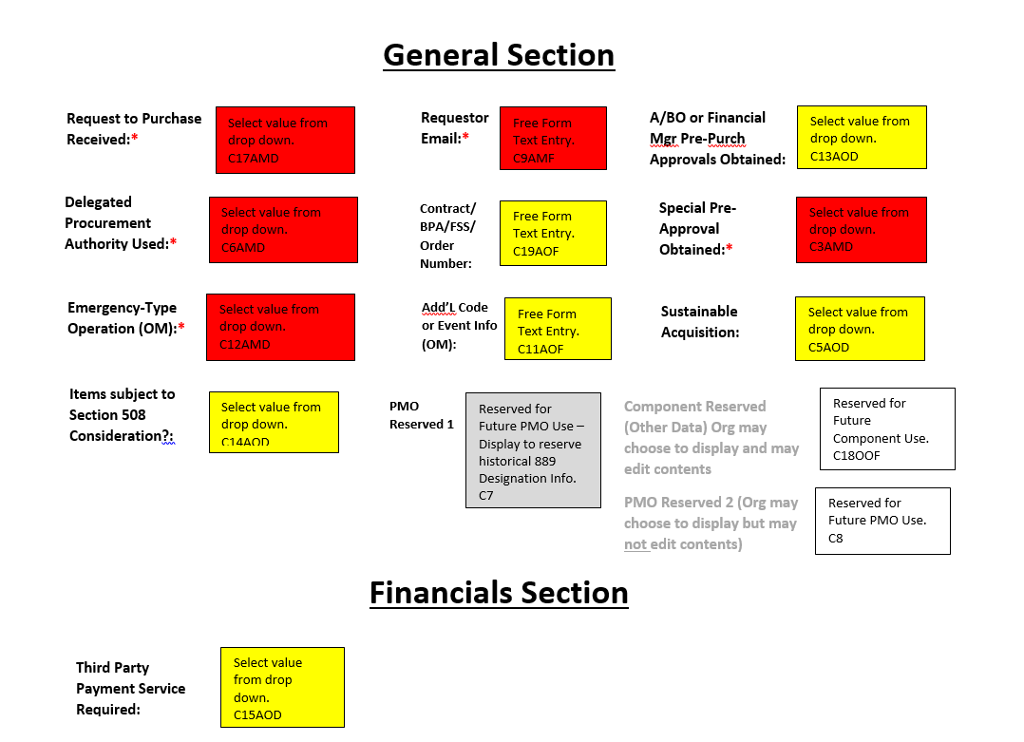
Upcoming/Recent Purchase Log Custom Field Changes in Order Management: Header/Order Detail Level Mockup (1 of 2)
C=custom; CLI=Custom Line Item; 1-20=Field Number; A=Appears on form; M=Mandatory, O=Optional; D=drop down, F=Free Form; B=Bank
Red fill= Must appear on form and must be completed by CH; Yellow fill=Must appear on form and Optional for CH to complete—Org may choose to make mandatory for CH to complete; Grey fill=appears on form; White Fill=Org may choose to appear on form.

Slide 22
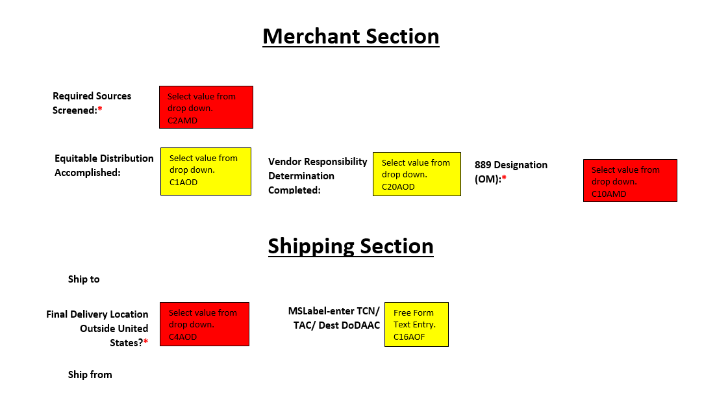
Upcoming/Recent Purchase Log Custom Field Changes in Order Management: Header/Order Detail Level Mockup (2 of 2)
C=custom; CLI=Custom Line Item; 1-20=Field Number; A=Appears on form; M=Mandatory, O=Optional; D=drop down, F=Free Form; B=Bank
Red fill= Must appear on form and must be completed by CH; Yellow fill=Must appear on form and Optional for CH to complete—Org may choose to make mandatory for CH to complete; Grey fill=appears on form; White Fill=Org may choose to appear on form.

Slide 23
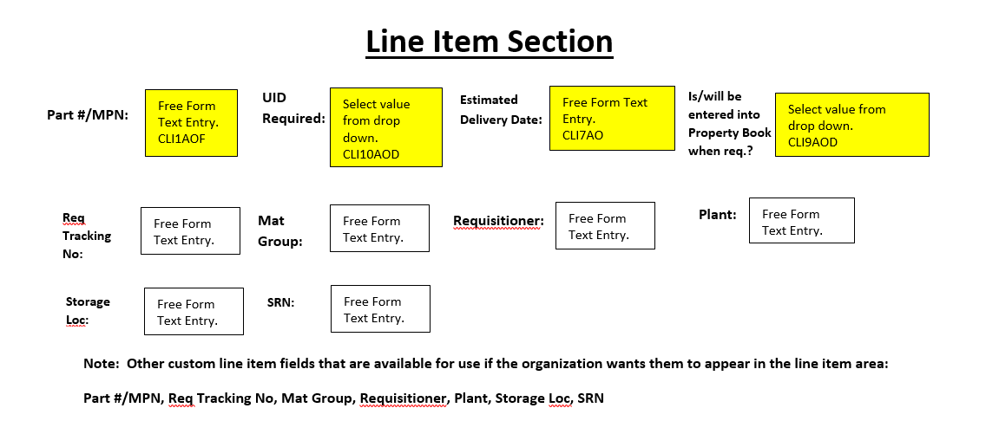
Upcoming/Recent Purchase Log Custom Field Changes in Order Management: Line Item Level Mockup (1 of 1)
C=custom; CLI=Custom Line Item; 1-20=Field Number; A=Appears on form; M=Mandatory, O=Optional; D=drop down, F=Free Form; B=Bank
Red fill= Must appear on form and must be completed by CH; Yellow fill=Must appear on form and Optional for CH to complete—Org may choose to make mandatory for CH to complete; Grey fill=appears on form; White Fill=Org may choose to appear on form.

Slide 24
Purchase Log Best Practice and On the Horizon
Best Practice: Until drop-downs are available in OM for 889 Designation and ETOs, input values in free form text exactly as indicated in Governmentwide Commercial Purchase Card Guidance Related to Recording 889 Designation and Emergency-type Operation Values (GPC 2022-02).
Current and future steps in the process:
Work with the Bank to deploy the new Standard Purchase Log.
Issue a Purchase Log Standard Operating Procedure that includes new fields/values guidance.
Preserve historical data for fields that have changed attributes in the new standard.
Facilitate (map) appropriate data transmission from the ERP to the new standard fields, where applicable.
Analyze issues related to non-editable/non-bulk-funded eOrders to determine what solutions are available.
Analyze issues related to bulk funding to determine what solutions are available.

Slide 25
Access Online/IOD – Disputed Transactions

Slide 26
Access Online/IOD – Disputed Transactions
SP3 Data Mining (DM) has helped to identify risk areas to focus on to improve the purchase card program. As a result of DM, Integrated Solutions Team (IST) meetings, and Component Program Manager (CPM) monthly meetings, it has become clear that improvements are needed, and possible, for disputes.
An analysis of DoD disputes data showed that 56.8% of disputed transactions are resolved in favor of the merchant, a significantly higher amount than expected.
During the COVID-19 pandemic, the Bank developed a capability to use email correspondence rather than paper communication with CHs for some disputes. For some disputes, the Bank uses the Account Administration email address in Access Online to contact the CH and collect dispute documentation. Requirements:
CHs must have a valid email address recorded in Account Administration in Access Online to receive dispute documentation correspondence via email
CHs must enable email notification for Disputes via My Personal Information in Access Online

Slide 27
Access Online/IOD – Disputed Transactions: Potential Reasons for High Rate of Resolution in Favor of Merchant
CHs dispute transactions inappropriately
CHs “forget” they ordered something and dispute the transaction rather than calling the merchant to work it out
CHs work it out with the merchant AND dispute the transaction
CHs dispute transactions to cover up fraud or other suspect behavior

Slide 28
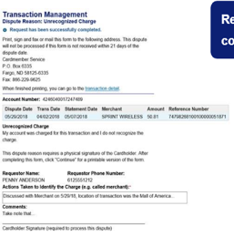
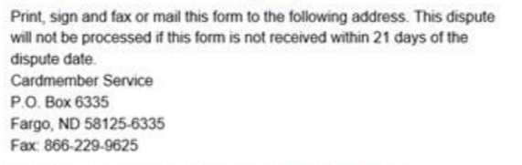
Access Online/IOD – Disputed Transactions: Potential Reasons for High Rate of Resolution in Favor of Merchant, Cont.
CHs do not provide dispute supporting documentation to the Bank, or do not provide it on time
Time frames required by the Bank may vary; CH must pay close attention to dispute instructions in Access Online and/or from the Bank and comply with the time frame provided for each specific dispute.
Example: If disputing in Access Online, the CH MUST print, sign and fax or mail (within 21 days) the form from Access Online and the other required documentation to the Bank in accordance with instructions (screen to do so pops up after the request has been successfully completed so CHs may not know this is required)
If disputing in Access Online, the CH MUST print, sign and fax or mail (within 21 days) the form from Access Online and the other required documentation to:

Slide 29
Access Online/IOD – Disputed Transactions: Potential Reasons for High Rate of Resolution in Favor of Merchant, Cont.
CHs do not provide dispute supporting documentation to the Bank, or do not provide it on time, cont.
Telework may delay/prevent CHs from receiving mail from the Bank, making it difficult to send required documents in a timely manner.
CHs often not in the office to receive mail, send mail, or use fax machine
CHs may not have access to a printer-scanner or fax machine at the telework location
As addressed in a previous slide, the Bank can now use the Account Administration email address to contact the CH and collect dispute documentation. If available, the Bank typically will contact CHs using email. Therefore, continued Component CH training is needed to reinforce that:
Users must have a valid email address recorded in Account Administration in Access Online to receive dispute documentation correspondence via email. Email would be the first method of communication if a valid email is associated with a CH account in Access Online Account Administration. If a valid email is not associated with the CH account in Access Online Account Administration, communication to the CH will be sent via U.S. Postal Service. Note: email must be included in Account Administration for each account the CH has.
Users may enable email notification for Dispute Status Changes via My Personal Information in Access Online. Once in “My Personal Information,” navigate to the “Email Notifications” section, and select the radio button for “Dispute Status Email Notification.”

Slide 30
GPC Program Oversight in Insights On Demand (IOD) Reminders

Slide 31
3-Pronged Oversight Review Process
Aged Open Cases Result in Mandatory Account Suspensions

Slide 32
Monthly A/OPC Reviews and Semi-Annual Head of Activity Review (SAHAR) Schedule
 | Transaction Period |  | Review Period
Review Name / Required Action | Cycle Start Date | Cycle End Date | A/OPC Runs Report | A/OPC Review Complete - Can Suspend Purchasing | 1st Oversight A/OPC Review Complete - Can Suspend Purchasing | 2nd Oversight A/OPC Review Complete -Can Suspend Purchasing | CPM Review Complete - Shall Suspend Purchasing | CPM Provides HA Results to DPC
Monthly A/OPC Review 1 (October 2022 cycle) | 9/20/2022 | 10/19/2022 | 10/20/2022 | 11/18/2022 | 11/28/2022 | 12/8/2022 | 12/13/2022 | -
Monthly A/OPC Review 2 (November 2022 cycle) | 10/20/2022 | 11/19/2022 | 11/20/2022 | 12/19/2022 | 12/29/2022 | 1/8/2023 | 1/13/2023 | -
Monthly A/OPC Review 3 (December 2022 cycle) | 11/20/2022 | 12/19/2022 | 12/20/2022 | 1/18/2023 | 1/28/2023 | 2/7/2023 | 2/12/2023 | -
Monthly A/OPC Review 4 (January 2023 cycle) | 12/20/2022 | 1/19/2023 | 1/20/2023 | 2/18/2023 | 2/28/2023 | 3/10/2023 | 3/15/2023 | -
Monthly A/OPC Review 5 (February 2023 cycle) | 1/20/2023 | 2/19/2023 | 2/20/2023 | 3/21/2023 | 3/31/2023 | 4/10/2023 | 4/15/2023 | -
Monthly A/OPC Review 6 (March 2023 cycle) | 2/20/2023 | 3/19/2023 | 3/20/2023 | 4/18/2023 | 4/28/2023 | 5/8/2023 | 5/13/2023 | -
Semi-Annual Head of Activity Review (1st Half FY 23) | 9/20/2022 | 3/19/2023 | 5/14/2023 | 6/13/2023 | 6/23/2023 | 7/3/2023 | 7/8/2023 | 7/14/2023
Monthly A/OPC Review 7 (April 2023 cycle) | 3/20/2023 | 4/19/2023 | 4/20/2023 | 5/19/2023 | 5/29/2023 | 6/8/2023 | 6/13/2023 | -
Monthly A/OPC Review 8 (May 2023 cycle) | 4/20/2023 | 5/19/2023 | 5/20/2023 | 6/18/2023 | 6/28/2023 | 7/8/2023 | 7/13/2023 | -
Monthly A/OPC Review 9 (June 2023 cycle) | 5/20/2023 | 6/19/2023 | 6/20/2023 | 7/19/2023 | 7/29/2023 | 8/8/2023 | 8/13/2023 | -
Monthly A/OPC Review 10 (July 2023 cycle) | 6/20/2023 | 7/19/2023 | 7/20/2023 | 8/18/2023 | 8/28/2023 | 9/7/2023 | 9/12/2023 | -
Monthly A/OPC Review 11 (August 2023 cycle) | 7/20/2023 | 8/19/2023 | 8/20/2023 | 9/18/2023 | 9/28/2023 | 10/8/2023 | 10/13/2023 | -
Monthly A/OPC Review 12 (September 2023 cycle) | 8/20/2023 | 9/19/2023 | 9/20/2023 | 10/19/2023 | 10/29/2023 | 11/8/2023 | 11/13/2023 | -
Semi-Annual Head of Activity Review (2nd Half FY 23) | 3/20/2023 | 9/19/2023 | 11/14/2023 | 12/14/2023 | 12/24/2023 | 1/3/2024 | 1/8/2024 | 1/16/2024
Due

Slide 33
Daily DM Cases and Monthly/SAHARs
Example: DM Case created in the April 2023 cycle*
April Daily DM Cases should have been adjudicated and closed no later than 6/13/2023, and accounts suspended when the cases were not closed.
The April cycle Monthly A/OPC Review should be completed by 6/13/2023. To complete this, all April cycle DM cases have to be adjudicated and closed.
The second half of fiscal year 2023 (FY23) SAHAR must be completed and submitted to DPC by 1/16/2024. All Daily DM cases must be adjudicated and closed and all Monthly A/OPC Reviews must be completed for the 6-month period. Additionally, any DM case that was “Closed-Not Reviewed” due to a deferral needs to be closed with a valid review.
Purchase Log and Supporting Documentation Impact**
A complete and documented Purchase Log assists in adjudicating and closing Daily DM cases in IOD.
GSA Statistical Reporting Impact***
DM cases from the second half SAHAR period (3/20 – 9/19) must be adjudicated and closed by 11/13 to ensure GSA Statistical Reporting for the Department can be submitted by the end of December.***
*Department of Defense SmartPay® 3 Government-wide Commercial Purchase Card Policies, Procedures and Tools – SP3 Transition Memorandum #6
**Department of Defense Government Charge Card Guidebook for Establishing and Managing Purchase, Travel, and Fuel Card Programs
***OMB Circular No A-123 Appendix B (Revised 8/27/2019)

Slide 34
SAHAR Guides
When using the Bank-generated “Insights on Demand A/OPC Monthly/SAHAR Report Line Item Validation Using Access Online” guide at https://www.acq.osd.mil/asda/dpc/ce/pc/smart-pay.html to verify IOD data against Access Online:
Make sure to schedule reports in Access Online according to directions
Any deviation from the instructions can result in large variances and will likely indicate, incorrectly, that the data is inaccurate
Detailed “Monthly A/OPC Review Report Guide” and “Semi-Annual HA Review Report Guide” are available at https://www.acq.osd.mil/asda/dpc/ce/pc/smart-pay.html. Information includes:
A description of each line
The source of the data that populates each line
The calculation used for each line
User guidance for each line

Slide 35
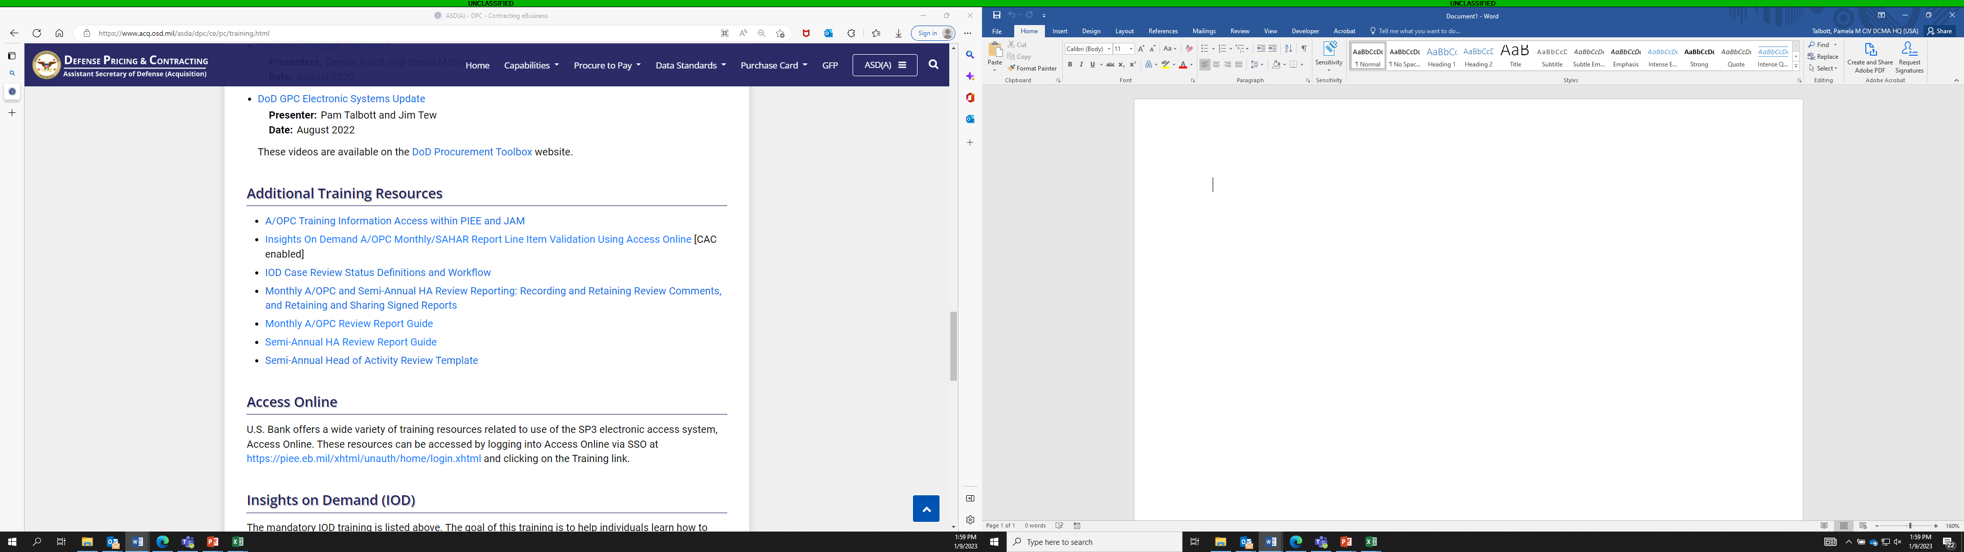
Semi-Annual Head Of Activity Review Template
The Semi-Annual Head of Activity Review Template slides found under “Additional Training Resources” on the DPC website at https://www.acq.osd.mil/asda/dpc/ce/pc/training.html, were updated in January 2023.
Updates include:
Slides now include instructions on how to populate charts with your Component’s data.
The Backlog analysis was removed from the slides.

Slide 36
Semi-Annual Head Of Activity Review Template, Cont.
Information included in the Template slides:
Volume of Transactions and Spend for the Period
Refunds for the Period
Delinquencies for the Period
Total Transaction Volume compared to DM Cases
Case Data for the Period - Total DM cases flagged, auto closed by Tier 2 Tailoring, and manually created; and True Positive Rate
An important note included in the updated slides is that Heads of Activity are responsible for managing program risk. This includes validating that any Component Tier Two Tailoring of the DM business rules (e.g., auto closing potentially high-risk cases without requiring A/BO and A/OPC review) is consistent with regulations and policy, and results in an appropriate number of cases being manually reviewed to detect and prevent fraud and other policy non-compliance.

Slide 37
Semi-Annual Head Of Activity Review Template, Cont.
Per SP3 Transition Memorandum #6, Semi-Annual HA Reviews are conducted to ensure adherence to internal controls and facilitate senior management’s awareness of their GPC program’s health (e.g., strengths and areas requiring improvement).
Use of the Template slides, or portions of the slides, is considered a best practice. The Template slides include data that is not directly displayed in the SAHAR, such as data broken out by monthly cycle.
The template provides assistance in having conversations with your Component’s HA.

Slide 38
Purchase Card Oversight Module (PCOM) Updates

Slide 39
What is PCOM?
PCOM is a module within PIEE.
It is a system that supports the preparation and submission of SAHAR reporting by Components as required by the Office of the Under Secretary of Defense (Acquisition and Sustainment) (OUSD(A&S)) / Assistant Secretary of Defense (Acquisition) / Defense Pricing and Contracting (DPC).
In the future, it will also support the preparation of routine reports required by the Office of Management and Budget (OMB) and the General Services Administration SmartPay® Center for Charge Card Management (CCCM).

Slide 40
PCOM Purpose
Primary users are DPC and GPC CPMs.
The first phase of PCOM was released in July 2022. It is currently used by waived organizations (do not use IOD) to generate and submit their SAHAR reporting.
PCOM is currently being developed with its second release planned for 2023. The second phase will be used by non-waived organizations to update and submit their SAHAR reporting.
With both data aggregates, PCOM can serve as the single source of Department-wide GPC Program Oversight Reporting (e.g., SAHAR Reporting, DoD Statistical reporting required by OMB).
Other functions that fit the scope of an Oversight Module may be released in the future.

Slide 41
JAM Updates

Slide 42
JAM Updates
Engineering Change Proposal (ECP) 1297 JAM Enhancements Phase 4 is planned for deployment in early FY24.
*Note* – we will get as many of these developed as possible, but it is likely that not all requirements will be delivered.
Following are the requirements we are requesting in this ECP:
Reuse Appointment Data or Expand Access:
Allow the original initiator and other A/OPCs and OA/OPCs at the same role location DoDAAC or Group to re-initiate an appointment using details from an appointment that was initiated but never fully approved (i.e., it was rejected or abandoned).
Allow all A/OPCs and OA/OPCs [at PIEE Level 2 Group] to leverage appointment details for an individual with a prior or current PIEE/JAM appointment to initiate a new appointment.
Allow A/OPCs and OA/OPCs to delete nominations within their span of control. Once deleted, the same nomination can be started again. Only restriction would be if the nomination would result in an appointment that is already active.

Slide 43
JAM Updates, Cont.
Allow OA/OPCs to terminate other OA/OPC appointments.
Allow appointments to be updated temporarily for valid reasons such as TDY overseas. This would function like the auditor feature with a suspense date, after which the original appointment becomes “active” again.
As a CH or A/BO, when an appointment is initiated OR AFTER IT HAS BEEN APPROVED, need to be able to add attachments that are retained and can be viewed by anyone who can view the appointment in JAM. Allow the A/OPC and OA/OPC to add attachments, as well as the appointee.
Allow CPMs to resend appointments to the Bank; CPMs cannot do this now. Mirrors capabilities that A/OPCs and OA/OPCs currently have.
Add the Appointment ID to the JAM Appointment Details screen (i.e., where the Resend to Bank button currently exists).

Slide 44
JAM Updates, Cont.
Automatic Access Granted Based on GPC Role:
Automatically grant all new CPMs, OA/OPCs, A/OPCs, DAAs, AAs, Component Resource Managers (RM), and Oversight RMs the Electronic Data Access (EDA) Advance Reporting role.
Automatically grant all current CPMs, OA/OPCs, A/OPCs, DAAs, AAs, Component RMs, and Oversight RMs the EDA Advance Reporting role.
Automatically grant all new CHs with the Contract Pay and Contract Ordering Officer SD, and their A/BOs and A/OPCs the EDA Advanced Reporting role.
Automatically grant all current CHs with the Contract Pay and Contract Ordering Officer SD, and their A/BOs and A/OPCs the EDA Advanced Reporting role.
Stop providing CHs with the Acceptor role automatically.
Provide GPC View Only user access to PCOM. The user must be at Level 2.

Slide 45
JAM Updates, Cont.
Automatic Termination of JAM Appointments
Update existing PIEE (not JAM-specific) email notifications sent to users when PIEE roles are archived to include notification that all associated JAM appointments will be terminated within the number of days specified in the configurable system parameter. The email notification should identify the initiator and other OA/OPCs and A/OPCs with the same Role Group/DoDAAC.
Create email notification for when appointments are auto terminated due to archiving (and subsequent days having passed) that JAM appointments has been terminated. The email notification should include the initiator (where this is an appointment that is not self initiated) and other (O)A/OPCs with the same Role Group/DoDAAC.

Slide 46
JAM Updates, Cont.
Training Data
Add a drop down to the training page that allows GPC PMO to specify for which Component the course is being added. In the training list, present DoD's Training list and the component identified training. Add drop down to the training report parameters and report itself. "Component Specified" -> "DON" -> "How to dance 101" -> then normal fields
Allow the training table to have breaks “----Mandatory----, --Component Specific---, etc.”
Provide the GPC PMO the ability to move courses up and down in the dropdown.
Notify the PIEE PMO and GPC PMO user if data for a DAU course stops flowing for 5 consecutive days.
Where training data is acquired from DAU, under the "Certificate" column in the training table instead of leaving it blank, insert "Certificate stored within DAU".

Slide 47
JAM Updates, Cont.
For each Course, allow the GPC PMO to determine whether the course is displayed to the end user. If it is not displayed it will be used to capture information from the DAU feed, but not available for manual selection and entry/completion. These courses will still appear in reporting.
Use Case: Completion of certain DAU Contracting, Ethics and Contingency, 889 courses will be useful for A/OPCs to see when delegating specific Special Designations, but users would not be adding them to their profile separate from the feed. As currently functioning, the pick list has become too long for a manageable UI.
Add the ability to edit training entries in PIEE profiles. Currently one must archive the training entry in JAM and re-add it just to edit the frequency, date etc. Often, course names are input incorrectly and need to be updated.

Slide 48
JAM Updates, Cont.
Allow Supervisors/Alt Supervisors with a PIEE Account to see the training and appointment data for their users.
If refresher training has not been taken timely, allow the OA/OPC and A/OPC who can see the appointment to archive the role. This will give the appointee 30 days to complete their training.
If refresher training is completed after the role was archived and before the appointment was auto terminated, allow the OA/OPC or A/OPC to reactivate the role.
Update training reminder email to remove Provider/DAU reference:
Change from: "Please logon to [Provider] and retake the training course as soon as possible."
Change to: "Please retake the training course as soon as possible.“

Slide 49
JAM Updates, Cont.
Other
Capture the Total Business Reporting (TBR) hierarchy on the JAM appointment. (PTQ Access assistance)
In each of the appointment letters, the reference to 10 U.S.C. 2784 needs to be replaced with 10 U.S.C. 4754. Additionally, we need to review the other references to see if they are accurate.
Allow OA/OPCs to make administrative changes to appointments without requiring the full workflow. For Example - update the direct user and demographics from the profile.
Update the appointment workflow visualization for A/BO, CO, and CH appointments so the Nomination steps are also included.

Slide 50
JAM Updates, Cont.
Add a full Appointment History section to an appointment and letter. Create a new section on the appointment that captures all changes that happen to the appointment. Discuss how to integrate the existing Appointment Workflow section in the appointment history section. This section will be added to the end of the letter (new page). Addendum will be added here, as well.
Update the appointment Workflow section at the bottom of the JAM appointment to match the updates to the appointment letter identified above.
Show a time stamp and the individual responsible for when the appointment was Initiated, Approved by DAS, Activated, Updated (including admin updates), and Terminated. Show the link to the old appointment that this updates. Show the changes from old to new, including specifics about the updates to the appointment such as new DA added, and old DA authority removed.

Slide 51
JAM Updates, Cont.
Bulk Appointment Updates
Create an area in JAM for CPMs, OA/OPCs and A/OPCs to enter role specific text for use in all their appointments.
Add three fields to CH and A/BO appointments: CPM Agency Specific Text; OA/OPC Specified Language; A/OPC Specified Language. Each of these text boxes will pre-populate with the language specified in their CPM, OA/OPC, and A/OPC specific text. It will not be editable as individual language can be modified in existing user's appointment text boxes.
Allow the OA/OPC and A/OPC to make bulk changes by appointment type based on the language in their specific text boxes.
Allow for the Mass Updating of Appointments. This will allow (O)A/OPCs the ability to quickly update the appointments of individuals who need, for example, updates to their Delegated Limits.
Provide the ability for GPC PMO to Update Standard text on letters, add the specific changes (Z was changed from :X to :Y) to the Appointment History, and send a notice to the Initiator, Supervisor, Direct User, and the appointee when this occurs. The email notification should document what, when, and by whom the change was made.
When standard text is updated, allow the GPC PMO to determine if the full appointment approval workflow needs to be completed, if a single approval is required, or no approvals are required. Follow the workflow as necessary thereafter.

Slide 52
JAM Updates, Cont.
Reporting
EDA reporting (JAM appointment status report) should show the reason for inactivation: Inactive-due to update (old appointment), inactive-terminated (appointment terminated), inactive-in progress (Workflow never completed)

Slide 53
JAM Updates, Cont.
Interface
Capture Authorized DoDAACs and send them via "Auto Administrative Update" status.
TBD, Pending acceptance by Bank to go this route for PTQ fix
Send user information to the Bank when a role becomes archived. The Bank will be told to v9 the user's CH and Managing Accounts or to suspend the user account (not a CH or A/BO). This would be important to DEERS updates and user inactivity cut-off spending. This would apply if the OA/OPC or A/OPC archived the appointee's role due to failure to take refresher training.
TBD, Pending agreement with Bank
Ingest Access Online User file into JAM/EDA and Develop reporting that ties appointment and account data together (BIR309).
TBD, Pending Bank's agreement to provide data
Add an identifier in JAM to display whether the appointment is tied to an Account based on the data provided by the Bank.
TBD, Pending Bank

Slide 54
Helpful Hints and Tips for PIEE/JAM Success

Slide 55
Helpful Hints and Tips for PIEE/JAM Success
Issue: A GPC nomination cannot be completed or advanced to JAM appointment initiation
Reasons:
Nomination has exceeded 30 days and the role has moved from “inactive” to “archived”
An incorrect Role Location Code was entered, and nominator can’t fix it
A GAM blocks the role nomination trying to help fix a stuck nomination
Helpful Hints:
Nomination acceptance and approval, JAM appointment completion and GAM activation of the GPC role ALL must occur within 30 days after the supervisor approves the nomination.
If possible, avoid GAM involvement with the nomination process.

Slide 56
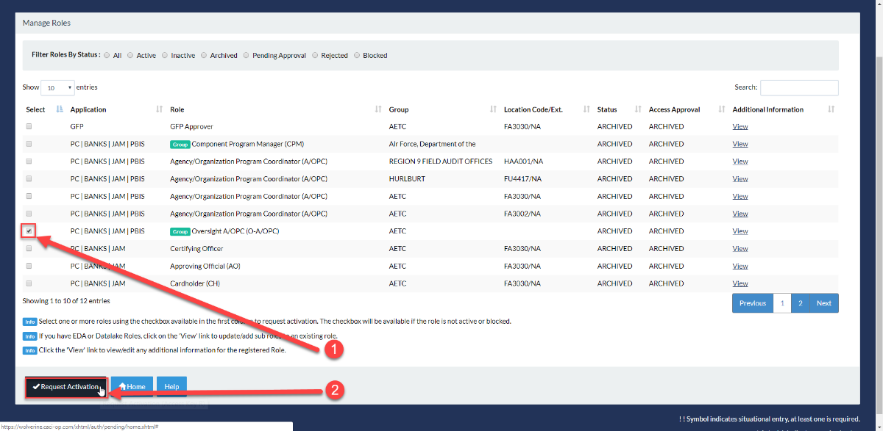
Helpful Hints and Tips for PIEE/JAM Success, Cont.
If a role goes to “Archived” status take the following steps:
The nominee should log into PIEE and navigate to “Manage Roles.”
Select the “Archived” JAM role/roles (if A/BO and CO combo) that require reactivation by checking the box that corresponds with the role/roles being reactivated.

Slide 57
Helpful Hints and Tips for PIEE/JAM Success, Cont.
After selecting “Request Activation” the following steps will be completed to re-activate (role will return to “inactive” status) the role:
Verify Profile, Verify Supervisor/Agency, Verify Roles and Justification/Attachments
When these steps are complete, a Success page is displayed.
The Supervisor will receive an email for approval and will need to approve the role.
Once the nomination is supervisor approved, the nominator should be able to immediately go into JAM, verify that the user is on the initiation list, and initiate the JAM appointment.
*Note* – if the nomination has exceeded 60 days, the A/OPC or nominator will have to login to PIEE, go to the GPC Nomination menu, and select “Create Nomination” to nominate the individual again.
There are occasions where the nomination cannot be advanced to allow initiation of the JAM Appointment. If this is the case, please contact the DISA GSD to open a ticket and we can get the nomination removed to allow a re-nomination to occur.

Slide 58
Helpful Hints and Tips for PIEE/JAM Success, Cont.

Slide 59
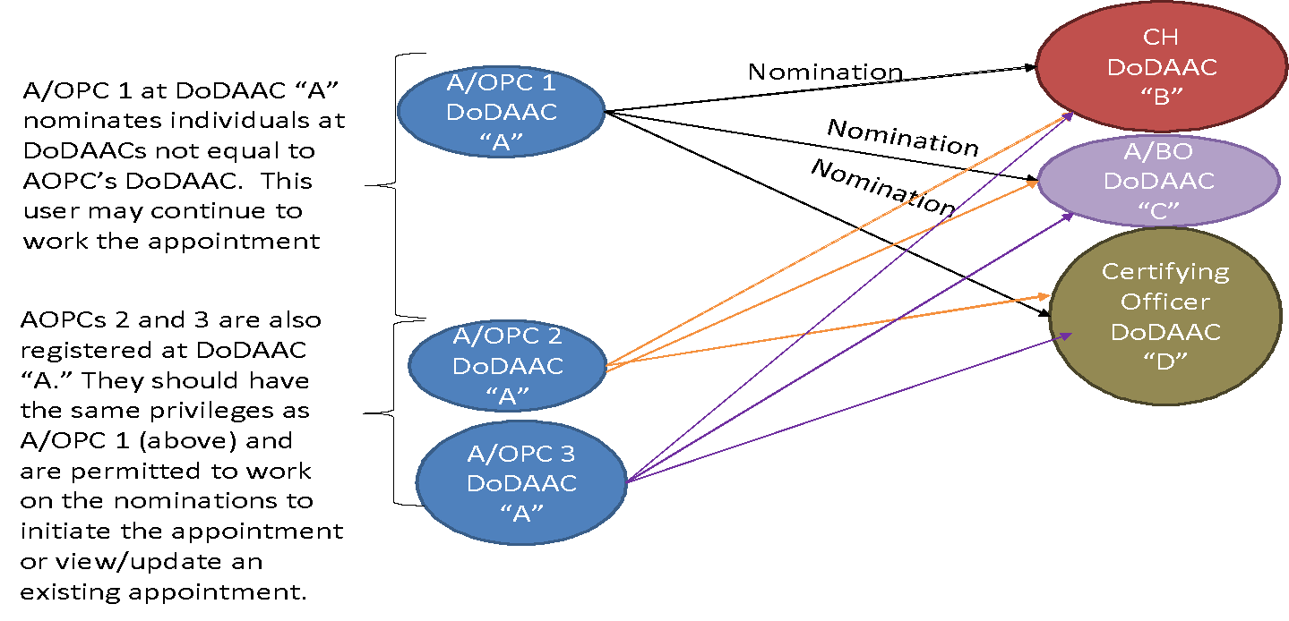
Helpful Hints and Tips for PIEE/JAM Success, Cont.

Slide 60
Defense Enrollment Eligibility Reporting System (DEERS) Interface with PIEE

Slide 61
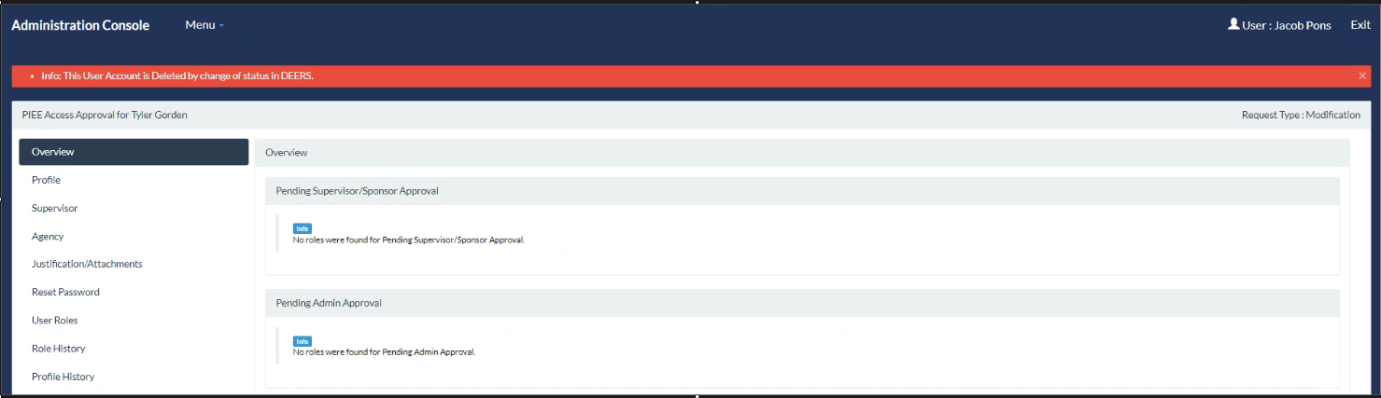
DEERS Interface with PIEE
DEERS interface functions in two ways across PIEE:
When the user is registering, the system will query DEERS for the user’s demographic data and will populate the PIEE profile.
DEERS will send an update to PIEE letting PIEE know that a user has been terminated/has retired.
PIEE will archive the account at this point with a message stating: “The User Account is Deleted by change of status in DEERS”

Slide 62
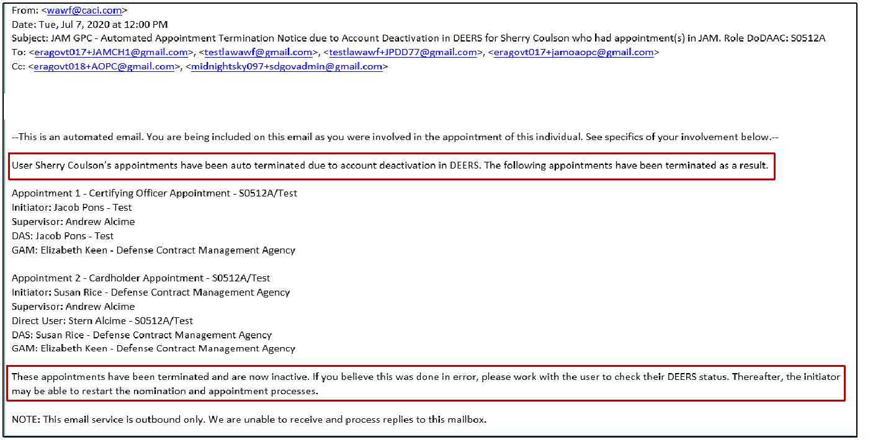
DEERS Interface with PIEE, Cont.
PIEE will send an email notification to the PIEE Supervisor, A/OPC, O/AOPC, and terminated user.

Slide 63
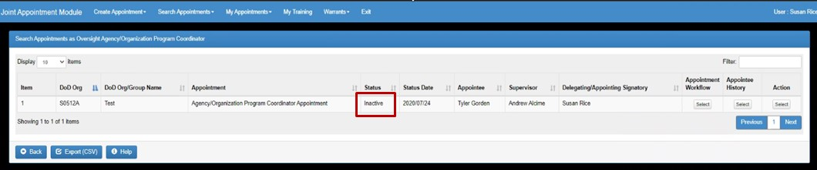
DEERS Interface with PIEE, Cont.
Specific to JAM, in the event an account is archived due to DEERS interface, the appointment will be terminated (Status: Inactive).
After a short delay, the termination update will be sent to Access Online.
Appointments in JAM can still be searched/viewed within the module.
The appointment workflow section shows reason for auto termination.

Slide 64
Access Online Integration

Slide 65
Single Sign On (SSO) from PIEE to U.S. Bank
Access to the SSO from PIEE to U.S. Bank has been turned on for all GPC users.
Once a purchase card role is activated in PIEE, the U.S. Bank Access Online icon will be available on the PIEE landing page.
When the user clicks the U.S. Bank icon in PIEE, a system check occurs to confirm the first name, last name, and email address for the user are an exact match to the data for accounts in Access Online.
Ensure that your official Government email address is used in PIEE and Access Online.
All Access Online accounts that match this criteria will be added to the SSO landing page in Access Online. The user will have the ability to select between all the accounts that are presented.
Once logged in, the user can go back to the role selection page and select a different role, as necessary.

Slide 66
PIEE Task Queue (PTQ) in Access Online
The PIEE Task Queue was established in 2022 to allow A/OPCs and other designated users with the ability to take actions on JAM appointments.
JAM Appointments, once activated, will be sent to Access Online every few minutes.
Users with the correct PTQ Functional Entitlement Groups (FEGs) will have access to the PTQ to take actions on the appointments that they can see, including, but not limited to: setup a new account, maintain an account, and manage POCs.
These activities can be done from outside of the PTQ but must be done at least once to associate DoDAAC information to Access Online accounts.
Multiple Access Online reports have been updated to include DoDAACs.
For CH appointments, the Single Purchase Limits from the appointment will serve as the ceiling limits for each special designation.
Multiple special designations can be associated with a single card account, though the A/OPC should assign them appropriately to reduce risk.
We recommend users attend the U.S. Bank sessions to learn about the “PIEE Task Queue.”

Slide 67
FedMall SSO & Relationship to a PIEE User Profile

Slide 68
FedMall SSO for PIEE Users
The primary user benefit of PIEE/FedMall SSO implementation is that CHs with JAM appointments do not have to separately request access, and maintain username and password access, to shop in FedMall.
As long as user's login to PIEE at least once every 60 days, they do not lose access to FedMall or any other PIEE App.
Use of SSO also allows the Department to:
Capitalize on the initial and recurring protections realized with CAC issuance, and Supervisor and GAM account approvals.
Ensure accounts are associated with only known, appointed individuals who are uniquely identified by their DoD ID/Public Key Infrastructure (PKI), thereby reducing the risk of GPC fraud and misuse.

Slide 69
FedMall SSO for PIEE Users, Cont.
All CHs with an active JAM appointment and active PIEE role now automatically get the FedMall icon on their PIEE home page.
CHs who had FedMall access prior to migration have seamless access through the SSO.
CHs accessing FedMall for the first time are directed to their FedMall user profile page and asked to enter any required data that was not available from their PIEE user profile. CHs have to enter their GPC account information in the My Payment Methods section.
PIEE will maintain the user’s information and history, and FedMall will maintain the user’s shopping information and order history.

Slide 70
How the Help Desk Can Assist You

Slide 71
How the Help Desk Can Assist You
The Defense Information Systems Agency (DISA) Global Service Desk can:
Provide initial point of entry for all PIEE related issues.
Create an Information Technology Service Management (ITSM) ticket.
Perform Tier 1 support for PIEE related issues.
Assist with PIEE and module access issues due to:
Computer settings (JAVA, operating browsers, etc.)
Certificate issues when signing on or due to multiple PIEE accounts (GAMs should also be able to assist with this).
Answer most GPC-related questions.
The DISA Global Service Desk cannot:
Provide in-depth GPC related analysis for procedural or potential system issues.

Slide 72
How the Help Desk Can Assist You, Cont.
The Defense Business Systems Support Office (DBSSO) Tier 2 Help Desk (HD) group and the Joint Interoperability Test Command (JITC) can:
Provide Tier 2 SME support for escalated process and functionality questions involving:
GPC nominations in PIEE
JAM Appointments
JAM Reporting
Test potential system issues in the test environment to validate.
Escalate confirmed or believed system issues for developer analysis and resolution as appropriate.
The JITC cannot:
Take actions on behalf of the customer in the production environment to resolve their issue.

Slide 73
How the Help Desk Can Assist You, Cont.
The PIEE Program Management Office (PMO) User Engagement Team:
Monitors all tickets escalated to Tier 2 analysis to ensure issues are being addressed by monitoring ticket movement to correct areas of responsibility in a timely fashion.
Facilitates a weekly Tier 3 trouble ticket call to discuss Tier 2 ticket issues.
Liaison for Policy/Functional related issues and forwards issues to the appropriate DPC Product Owners.
Contains the Defense Business Systems Support Office (DBSSO) Tier 2 Help Desk (HD) group, who are now again the primary point of Tier 2 HD support to assist in analyzing and resolving GPC related issues.

Slide 74
Help Desk Process

Slide 75
Help Desk Process
To report a JAM GPC or related PIEE issue, please reach out to the
DISA Global Service Desk at:
Phone: 866-618-5988, 801-605-7095 or by
Email: disa.global.servicedesk.mbx.eb-ticket-requests@mail.mil
For JAM training materials visit our PIEE Web-Based Training page:
https://wawftraining.eb.mil/wbt/

Slide 76
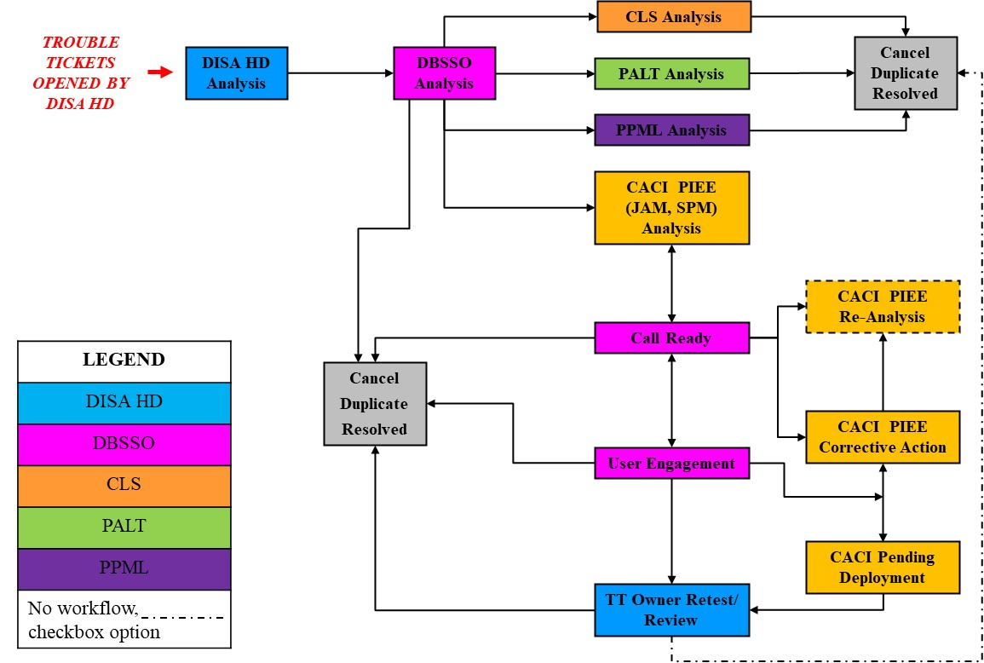
Help Desk Process, Cont.

Slide 77

Questions

Slide 78

DoD GPC Shared Mailbox
If you have additional questions, please contact us at the
DoD GPC Shared Mailbox
dodpcpo@sterlingheritage.com with the subject
“TrainingForum2023”

Slide 79

GSA Starmark Logo

