Slide 1
Beginner Friendly Introduction to R
November, 2017

Slide 2
What is R
R is a system for statistical computing and graphics, includes:
R language to script math operations
R environment to run R scripts
RServe – an interface for analytical applications
R is interpreted language
You do not have to write a program to run it
Every line is interpreted on the fly
R is free under GNU General Public License
R is maintained by volunteers at
https://www.r-project.org
R is well developed, well documented, and extensively used around the world
Over 2000 extension packages expanding R functionality

Slide 3
RStudio
RStudio is a development environment for R
Created by a company called RStudio
A member of R community
One can develop directly in R, but RStudio is more productive
Every DSVD user will have his/her own RStudio Desktop
RStudio closely resembles Eclipse
Rstudio requires R

Slide 4
Working with RStudio in DSVD
Login into Horizon Client
Open GSA Pool 6
Open All Programs
Open RStudio folder (not R folder!)
Open Rstudio
Connect to/upload your data
Develop your R script

Slide 5
R Basic Concepts
Workspace
The workspace is your current R working environment and includes any user-defined objects, e.g. variables and functions
R Session
Time you work in R. At the end of an R session, the user can save an image of the current workspace and use it later
Data Types
Numeric, integer, character, logical
Variables
Scalars, vectors, matrices, data frames, and lists
Commands and Operators
Functions
A piece of code written to carry out a specific task
Comments
# not executable lines
Extension Packages
Additional functionality

Slide 6
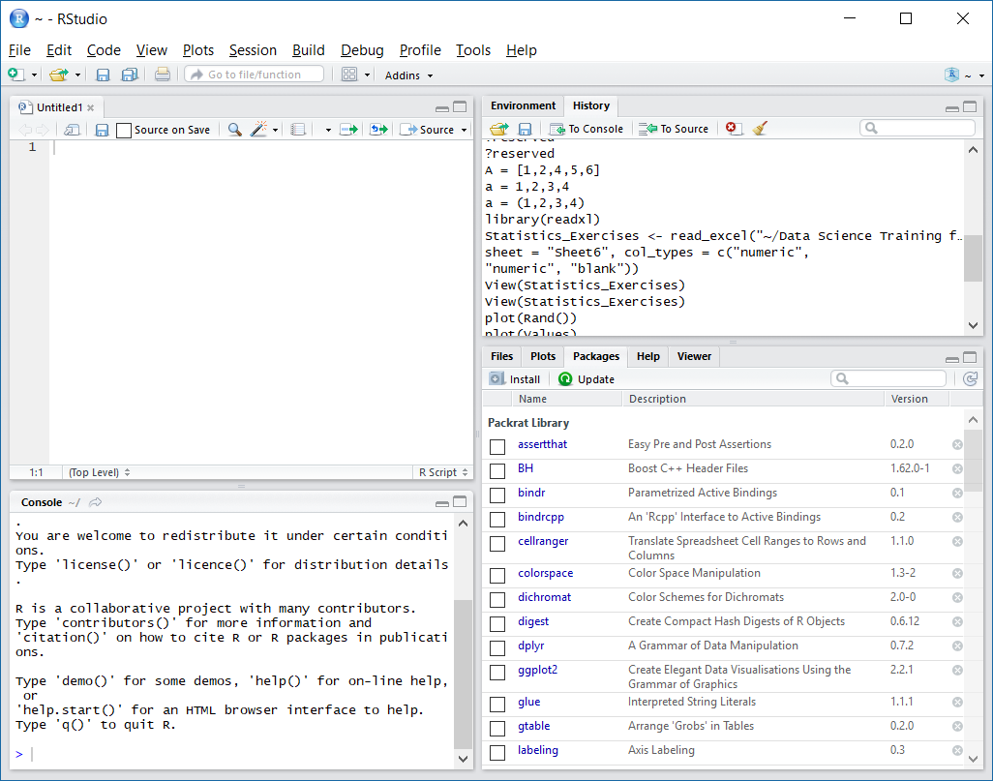
RStudio Interface
Switch tabs to see
Commands
Variables
Write R Script
View data
Switch tabs to
Import files
Plot data
View installed packages
Create variables
Enter commands
See results

Slide 7
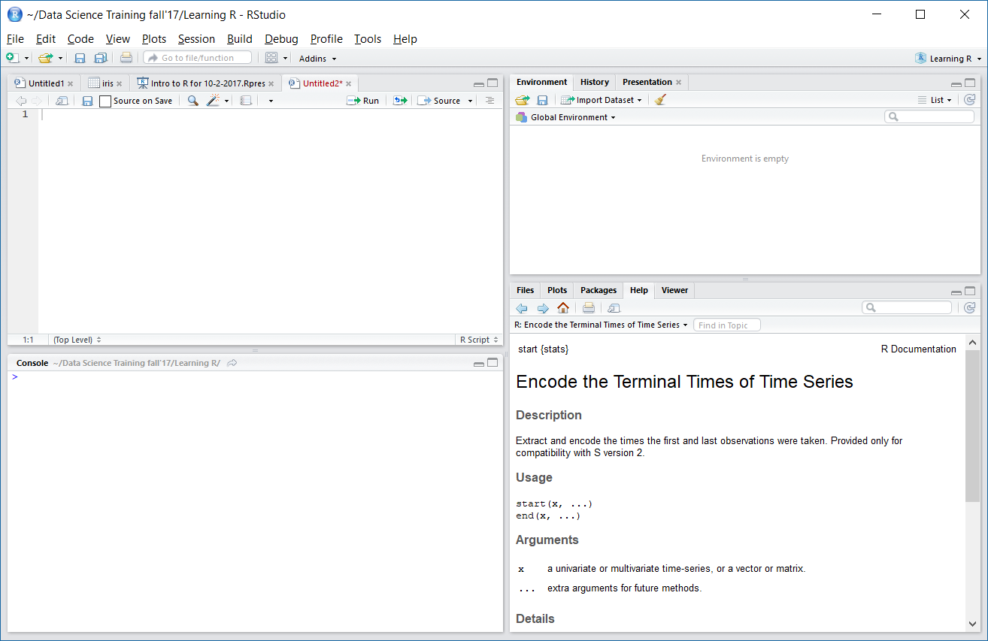
Help
Click Help tab
Enter search term
Or type in the console:
> help() #opens help in the right bottom window
> help("if") #opens help on the subject "if"

Slide 8
Data Types

Slide 9
Data Types: Numeric and Integer
Numeric
> k = 1 > k # print the value of k [1] 1 > class(k) # print the class name of k [1] "numeric“
> is.integer(k) # is k an integer? [1] FALSE
Integer
> y = as.integer(3) > y # print the value of y [1] 3 > class(y) # print the class name of y [1] "integer" > is.integer(y) # is y an integer? [1] TRUE
Try this
> y = as.integer(3.14) > y [1] 3

Slide 10
Data Types: Complex
A complex value in R is defined via the pure imaginary value I = sqrt(−1) = i
> z = 1 + 2i # create a complex number > z # print the value of z [1] 1+2i > class(z) # print the class name of z [1] "complex"
The following gives an error as −1 is not a complex value
> sqrt(−1) # square root of −1 [1] NaN Warning message: In sqrt(−1) : NaNs produced
Instead, we have to use the complex value −1 + 0i
> sqrt(−1+0i) # square root of −1+0i [1] 0+1i
An alternative is to coerce −1 into a complex value
> sqrt(as.complex(−1)) [1] 0+1i

Slide 11
Data Types: Logical
A logical value is often created via comparison between variables
> x = 1; y = 2 # sample values > z = x > y # is x larger than y? > z # print the logical value [1] FALSE > class(z) # print the class name of z [1] "logical"
Standard logical operations are "&" (and), "|" (or), and "!" (negation)
> u = TRUE; v = FALSE > u & v # u AND v [1] FALSE > u | v # u OR v [1] TRUE > !u # negation of u [1] FALSE
Case sensitive!

Slide 12
Data Types: Character
A character object is used to represent string values in R. We convert objects into character values with the as.character() function
> x = as.character(3.14) > x # print the character string [1] "3.14" > class(x) # print the class name of x [1] "character"
Two character values can be concatenated with the paste function
> fname = "Joe"; lname ="Smith" > paste(fname, lname) [1] "Joe Smith“
Try this:
> z = as.character(3.14)
> 2 * z
Error in 2 * z : non-numeric argument to binary operator

Slide 13
Data Types: Character (Cont.)
It is convenient to create a readable string with the sprintf function, which has a C language syntax.
> sprintf("%s has %d dollars", "Sam", 100) [1] "Sam has 100 dollars"
To extract a substring, we apply the substr function. Here is an example showing how to extract the substring between the third and twelfth positions in a string.
> substr("Mary has a little lamb.", start=3, stop=12) [1] "ry has a l"
To replace the first occurrence of the word "little" by another word "big" in the string, we apply the sub function.
> sub("little", "big", "Mary has a little lamb.") [1] "Mary has a big lamb."

Slide 14
Variables

Slide 15
Variables: Vector
A vector is a sequence of data elements of the same data type
A vector containing three numeric values 2, 3 and 5
> c(2, 3, 5) [1] 2 3 5
A vector of logical values
> c(TRUE, FALSE, TRUE, FALSE, FALSE) [1] TRUE FALSE TRUE FALSE FALSE
A vector of character strings
> c("aa", "bb", "cc", "dd", "ee") [1] "aa" "bb" "cc" "dd" "ee"
The number of members in a vector is given by the length function
> length(c("aa", "bb", "cc", "dd", "ee")) [1] 5
c() function (mnemonic: combine)

Slide 16

Variables: Matrix
A matrix is a collection of data elements arranged in a two-dimensional rectangular layout. The following is an example of a matrix with 2 rows and 3 columns
We reproduce a memory representation of the matrix in R with the matrix function. The data elements must be of the same basic type
> A = matrix( + c(2, 4, 3, 1, 5, 7), # the data elements + nrow=2, # number of rows + ncol=3, # number of columns + byrow = TRUE) # fill matrix by rows A = matrix(c(2, 4, 3, 1, 5, 7),nrow=2, ncol=3,byrow = TRUE)
> A # print the matrix [,1] [,2] [,3] [1,] 2 4 3 [2,] 1 5 7
“Shift” + “Enter”
to get to the next line

Slide 17
Variables: Matrix (Cont.)
We reproduce a memory representation of the matrix in R with the matrix function. The data elements must be of the same basic type.
> A = matrix( + c(2, 4, 3, 1, 5, 7), # the data elements + nrow=2, # number of rows + ncol=3, # number of columns + byrow = TRUE) # fill matrix by rows > A # print the matrix [,1] [,2] [,3] [1,] 2 4 3 [2,] 1 5 7
An element at the m^{th} row, n^{th} column of A can be accessed by the expression A[m, n].
> A[2, 3] # element at 2nd row, 3rd column [1] 7
The entire m^{th} row A can be extracted as A[m, ].
> A[2, ] # the 2nd row [1] 1 5 7

Slide 18
Variables: Matrix (Cont. 2)
Similarly, the entire n^{th} column A can be extracted as A[ ,n].
> A[ ,3] # the 3rd column [1] 3 7
We can extract more than one rows or columns at a time.
> A[ ,c(1,3)] # the 1st and 3rd columns [,1] [,2] [1,] 2 3 [2,] 1 7
If we assign names to the rows and columns of the matrix, than we can access the elements by names.
> dimnames(A) = list( + c("row1", "row2"), # row names + c("col1", "col2", "col3")) # column names > A # print A col1 col2 col3 row1 2 4 3 row2 1 5 7 > A["row2", "col3"] # element at 2nd row, 3rd column [1] 7

Slide 19
Variables: List
A list is a generic vector containing other objects.
For example, the following variable x is a list containing copies of three vectors n, s, b, and a numeric value 3.
> n = c(2, 3, 5) > s = c("aa", "bb", "cc", "dd", "ee") > b = c(TRUE, FALSE, TRUE, FALSE, FALSE) > x = list(n, s, b, 3) # x contains copies of n, s, b
List Slicing: retrieve a list slice with the single square bracket "[]" operator. The following is a slice containing the second member of x, which is a copy of s.
> x[2] [[1]] [1] "aa" "bb" "cc" "dd" "ee"
With an index vector, we can retrieve a slice with multiple members. Here a slice containing the second and fourth members of x.
> x[c(2, 4)] [[1]] [1] "aa" "bb" "cc" "dd" "ee" [[2]] [1] 3

Slide 20
Variables: List (Cont.)
To reference a list member directly, we have to use the double square bracket "[[]]"operator. The following object x[[2]] is the second member of x. In other words, x[[2]] is a copy of s, but is not a slice containing s or its copy.
> x[[2]] [1] "aa" "bb" "cc" "dd" "ee"
We can modify its content directly.
> x[[2]][1] = "ta" > x[[2]] [1] "ta" "bb" "cc" "dd" "ee" > s
[1] "aa" "bb" "cc" "dd" "ee" # s is unaffected

Slide 21
Variables: List (Cont. 2)
To reference a list member directly, we have to use the double square bracket "[[]]"operator. The following object x[[2]] is the second member of x. In other words, x[[2]] is a copy of s, but is not a slice containing s or its copy.
> x[[2]] [1] "aa" "bb" "cc" "dd" "ee"
We can modify its content directly.
> x[[2]][1] = "ta" > x[[2]] [1] "ta" "bb" "cc" "dd" "ee" > s
[1] "aa" "bb" "cc" "dd" "ee" # s is unaffected

Slide 22
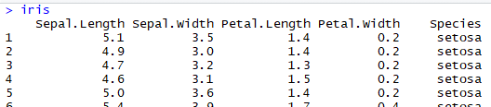
Variables: Data Frame
A data frame is used for storing data tables. It is a list of vectors of equal length. For example, the following variable df is a data frame containing three vectors n, s, b.
> n = c(2, 3, 5) > s = c("aa", "bb", "cc") > b = c(TRUE, FALSE, TRUE) > df = data.frame(n, s, b) # df is a data frame
Build-in Data Frame
For example, here is a built-in data frame in R, called iris
............

Slide 23
R Objects
Variables are objects, they have
mode – class(), numeric, character, etc.
length() – number of elements
Object name can be
Letters (A – Z and a – z)
Numbers (0 – 9)
Dots (.)
Underscores (_)
Can reuse object names
> k = 1
> k
[1] 1
> k = 2
> k
[1] 2
Remove object
> rm(k)
Create multiple objects at once
> n = 2; m = 3; l = 4
R is case sensitive!
[1] – means first element

Slide 24
Commands

Slide 25
Input and Display Commands
x <- c(1,2,4,8,16 ) #create a data vector with specified elements
y <- c(1:10) #create a data vector with elements 1-10
n <- 10 x1 <- c(rnorm(n)) #create a n item vector of random normal deviates
y1 <- c(runif(n))+n #create another n item vector that has n added
to each random uniform distribution
z <- rbinom(n,size,prob) #create n samples of size "size" with probability
prob from the binomial
vect <- c(x,y) #combine them into one vector of length 2n
mat <- cbind(x,y) #combine them into a n x 2 matrix
mat[4,2] #display the 4th row and the 2nd column
mat[3,] #display the 3rd row
mat[,2] #display the 2nd column
subset(dataset,logical) #those objects meeting a logical criterion
subset(data.df,select=variables,logical) #get those objects from a data frame that meet a criterion
data.df[data.df=logical] #yet another way to get a subset
x[order(x$B),] #sort a dataframe by the order of the elements in B
x[rev(order(x$B)),] #sort the dataframe in reverse order

Slide 26
Moving Around Commands
ls() #list the variables in the workspace
rm(x) #remove x from the workspace
rm(list=ls()) #remove all the variables from the workspace
attach(mat) #make the names of the variables in the matrix
or data frame available in the workspace
detach(mat) #releases the names
(remember to do this each time you attach something)
with(mat, .... ) #a preferred alternative to attach ... detach
new <- old[,-n] #drop the nth column
new <- old[-n,] #drop the nth row
new <- old[,-c(i,j)] #drop the ith and jth column
new <- subset(old,logical) #select those cases that meet the logical condition
complete <- subset(data.df,complete.cases(data.df))
#find those cases with no missing values
new <- old[n1:n2,n3:n4] #select the n1 through n2 rows of variables n3 through n4)

Slide 27
Arithmetic Operators
Operator | Description
+ | addition
- | subtraction
* | multiplication
/ | division
^ or ** | exponentiation
x %% y | modulus (x mod y) 5%%2 is 1
x %/% y | integer division 5%/%2 is 2
2^10
[1] 1024
2**10
[1] 1024

Slide 28
Logical Operators
Operator | Description
< | less than
<= | less than or equal to
> | greater than
>= | greater than or equal to
== | exactly equal to
!= | not equal to
!x | Not x
x | y | x OR y
x & y | x AND y
isTRUE(x) | test if X is TRUE
x = c(1:10) x 1 2 3 4 5 6 7 8 9 10 x > 8 F F F F F F F F T T x < 5 T T T T F F F F F F

Slide 29
Functions

Slide 30
Built-in Numeric Functions
Function | Description
abs(x) | absolute value
sqrt(x) | square root
ceiling(x) | ceiling(3.475) is 4
floor(x) | floor(3.475) is 3
trunc(x) | trunc(5.99) is 5
round(x, digits=n) | round(3.475, digits=2) is 3.48
signif(x, digits=n) | signif(3.475, digits=2) is 3.5
cos(x), sin(x), tan(x) | also acos(x), cosh(x), acosh(x), etc.
log(x) | natural logarithm
log10(x) | common logarithm
exp(x) | e^x

Slide 31
Built-in Statistical Functions
Function | Description
mean(x, trim=0, na.rm=FALSE) | mean of object x # trimmed mean, removing any missing values and # 5 percent of highest and lowest scores mx <- mean(x,trim=.05,na.rm=TRUE)
sd(x) | standard deviation of object(x). also look at var(x) for variance and mad(x) for median absolute deviation.
median(x) | median
quantile(x, probs) | quantiles where x is the numeric vector whose quantiles are desired and probs is a numeric vector with probabilities in [0,1]. # 30th and 84th percentiles of x y <- quantile(x, c(.3,.84))
range(x) | range
sum(x) | sum
diff(x, lag=1) | lagged differences, with lag indicating which lag to use
min(x) | minimum
max(x) | maximum
scale(x, center=TRUE, scale=TRUE) | column center or standardize a matrix
x = c(1:10)
> X = c(1:10)
> mean(x) [1] 5.5
> range(x) [1] 1 10
> sum(x) [1] 55
> x = rnorm(100)
> x[1]= NA
> mean(x) [1] NA
> mean(x, na.rm = TRUE)
> [1] -0.007524422

Slide 32
Built-in Statistical Probability Functions
Function | Description
dnorm(x) | normal density function (by default m=0 sd=1) # plot standard normal curve x <- pretty(c(-3,3), 30) y <- dnorm(x) plot(x, y, type='l', xlab="Normal Deviate", ylab="Density", yaxs="i")
pnorm(q) | cumulative normal probability for q (area under the normal curve to the left of q) pnorm(1.96) is 0.975
qnorm(p) | normal quantile. value at the p percentile of normal distribution qnorm(.9) is 1.28 # 90th percentile
rnorm(n, m=0,sd=1) | n random normal deviates with mean m and standard deviation sd. #50 random normal variates with mean=50, sd=10 x <- rnorm(50, m=50, sd=10)
dbinom(x, size, prob) pbinom(q, size, prob) qbinom(p, size, prob) rbinom(n, size, prob) | binomial distribution where size is the sample size and prob is the probability of a heads (pi) # prob of 0 to 5 heads of fair coin out of 10 flips dbinom(0:5, 10, .5) # prob of 5 or less heads of fair coin out of 10 flips pbinom(5, 10, .5)
dpois(x, lamda) ppois(q, lamda) qpois(p, lamda) rpois(n, lamda) | poisson distribution with m=std=lamda #probability of 0,1, or 2 events with lamda=4 dpois(0:2, 4) # probability of at least 3 events with lamda=4 1- ppois(2,4)
dunif(x, min=0, max=1) punif(q, min=0, max=1) qunif(p, min=0, max=1) runif(n, min=0, max=1) | uniform distribution, follows the same pattern as the normal distribution above. #10 uniform random variates x <- runif(10)

Slide 33
Built-in Character Functions
Function | Description
substr(x, start=n1, stop=n2) | Extract or replace substrings in a character vector. x <- "abcdef" substr(x, 2, 4) is "bcd" substr(x, 2, 4) <- "22222" is "a222ef"
grep(pattern, x , ignore.case=FALSE, fixed=FALSE) | Search for pattern in x. If fixed =FALSE then pattern is a regular expression. If fixed=TRUE then pattern is a text string. Returns matching indices. grep("A", c("b","A","c"), fixed=TRUE) returns 2
sub(pattern, replacement, x, ignore.case =FALSE, fixed=FALSE) | Find pattern in x and replace with replacement text. If fixed=FALSE then pattern is a regular expression. If fixed = T then pattern is a text string. sub("\\s",".","Hello There") returns "Hello.There"
strsplit(x, split) | Split the elements of character vector x at split. strsplit("abc", "") returns 3 element vector "a","b","c"
paste(..., sep="") | Concatenate strings after using sep string to seperate them. paste("x",1:3,sep="") returns c("x1","x2" "x3") paste("x",1:3,sep="M") returns c("xM1","xM2" "xM3") paste("Today is", date())
toupper(x) | Uppercase
tolower(x) | Lowercase

Slide 34
Some Useful Built-in Functions
Function | Description
seq(from , to, by) | generate a sequence indices <- seq(1,10,2) #indices is c(1, 3, 5, 7, 9)
rep(x, ntimes) subset(x, …) | repeat x n times y <- rep(1:3, 2) # y is c(1, 2, 3, 1, 2, 3) select columns from variable subset(mydata, columnname == “x”)
> Setosa = subset(iris, Species == "setosa")

Slide 35
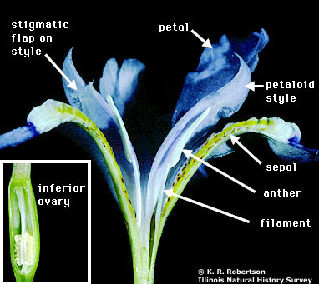
Data Exploration: Iris

Slide 36
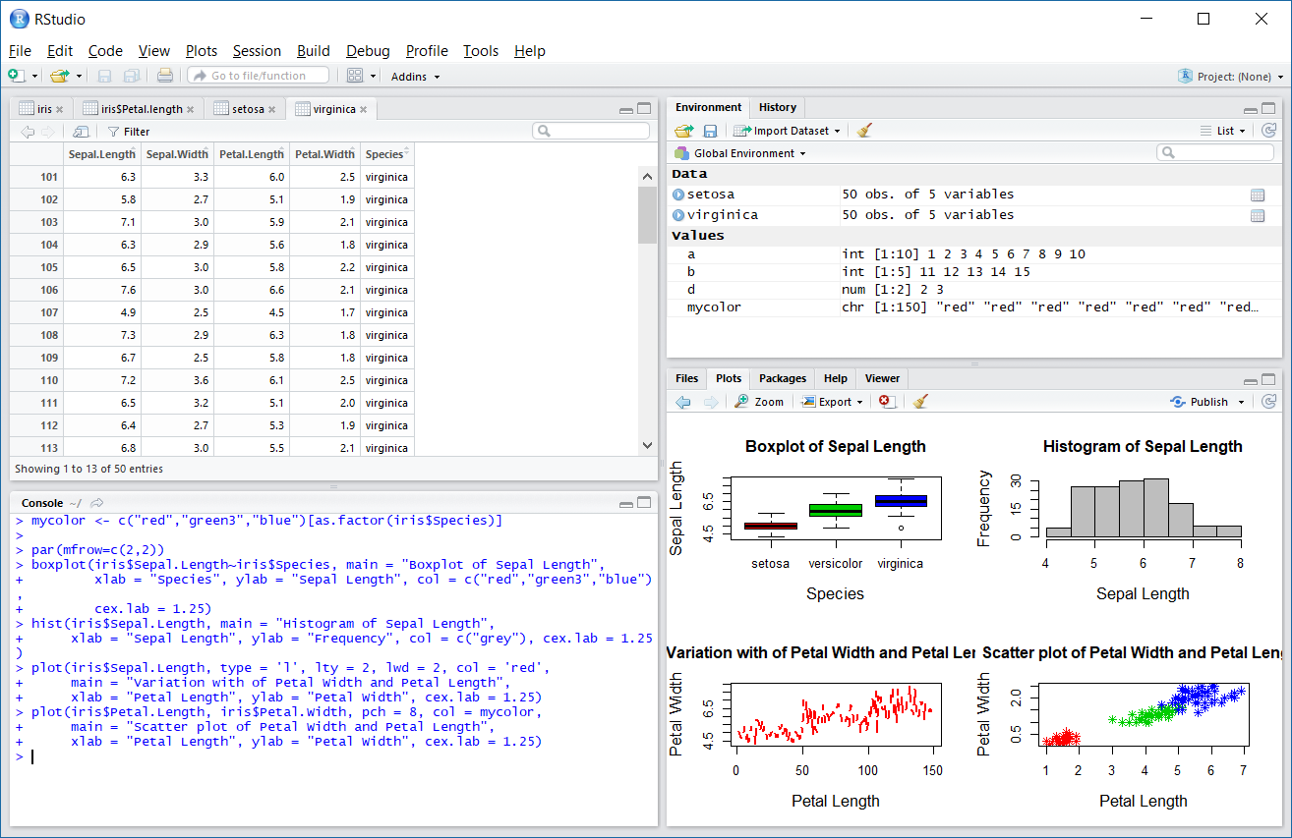
Example of R Plotting Capabilities

Slide 37
Scripts for Iris Example
> mycolor <- c("red","green3","blue")[as.factor(iris$Species)]
> par(mfrow=c(2,2)) # split plotting area
> boxplot(iris$Sepal.Length~iris$Species, main = "Boxplot of Sepal Length", xlab = "Species", ylab = "Sepal Length", col = c("red","green3","blue"), cex.lab = 1.25)
> hist(iris$Sepal.Length, main = "Histogram of Sepal Length",
xlab = "Sepal Length", ylab = "Frequency", col = c("grey"), cex.lab = 1.25)
> plot(iris$Sepal.Length, type = 'l', lty = 2, lwd = 2, col = 'red', main = "Variation with of Petal Width and Petal Length", xlab = "Petal Length", ylab = "Petal Width", cex.lab = 1.25)
> plot(iris$Petal.Length, iris$Petal.Width, pch = 8, col = mycolor)

Slide 38
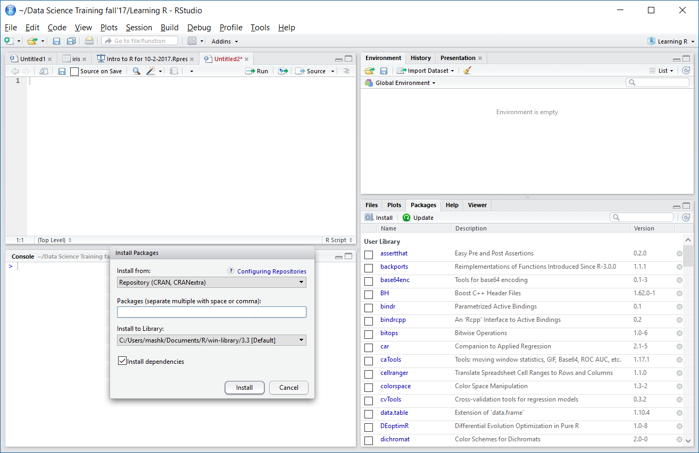
Extension Packages Open ServiceNow ticket to request a new Package on DSVD
Click on Packages tab
In your personal version only!
Click Install
Scroll down to review installed packages

Slide 39
Data Import

Slide 40
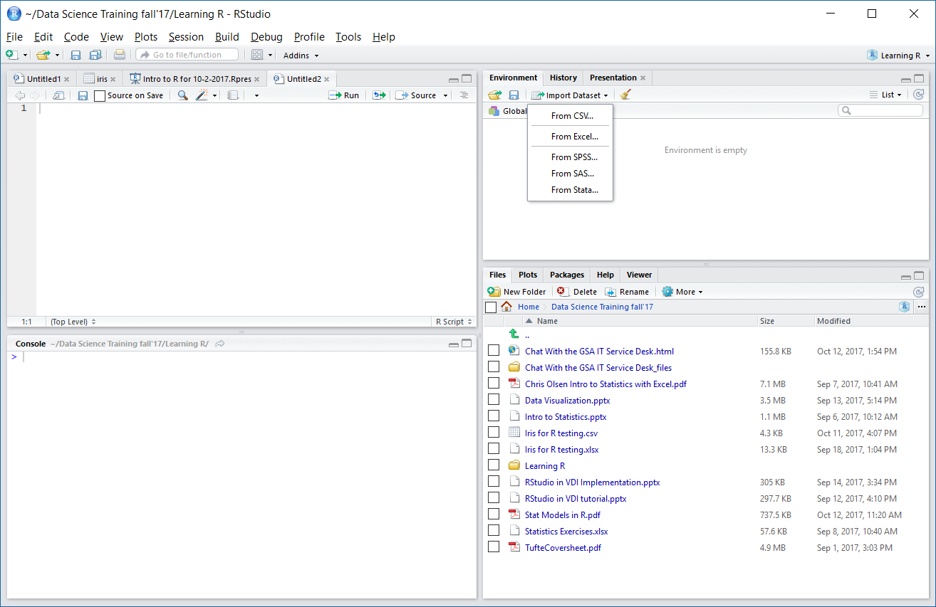
Import Data
Select data format
Click on Environment tab
Or, type in a command:
df <- read.table("<FileName>.txt",
header = TRUE)

Slide 41
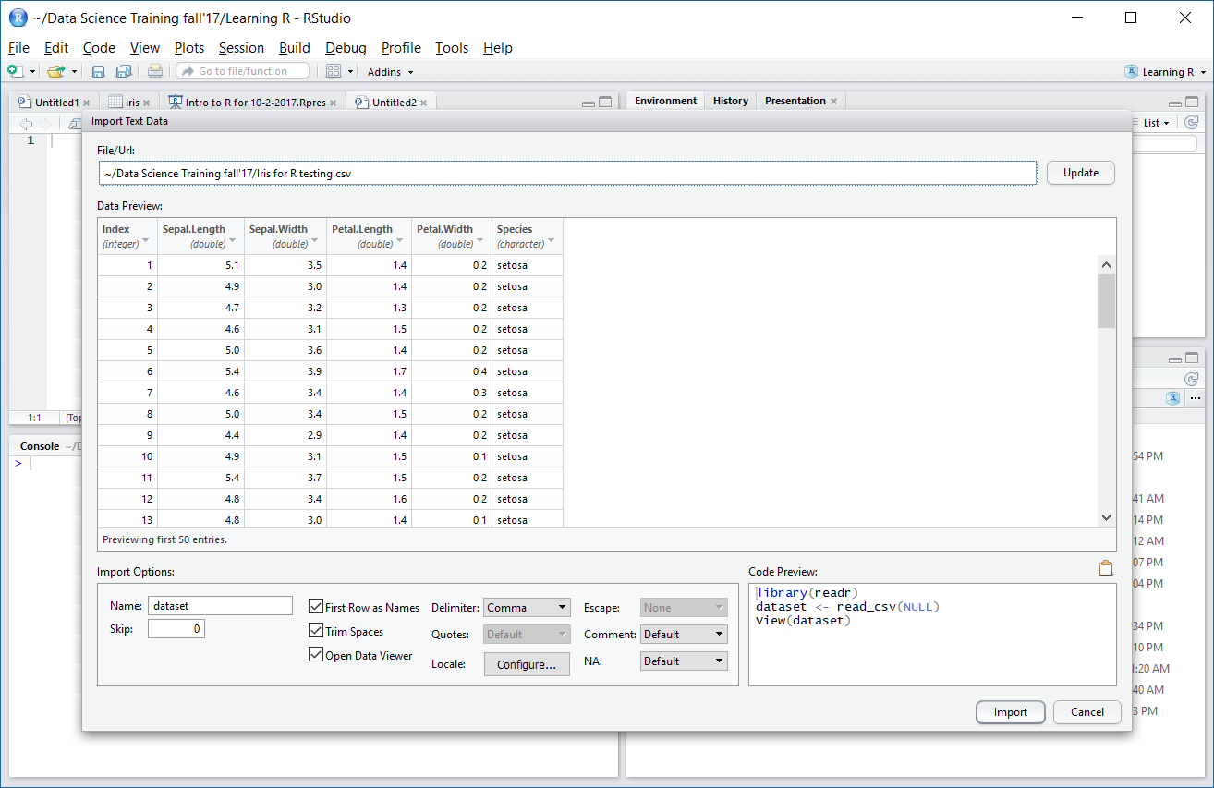
Wrangle Data
Browse to File
Change Data Types
Import Options

Slide 42
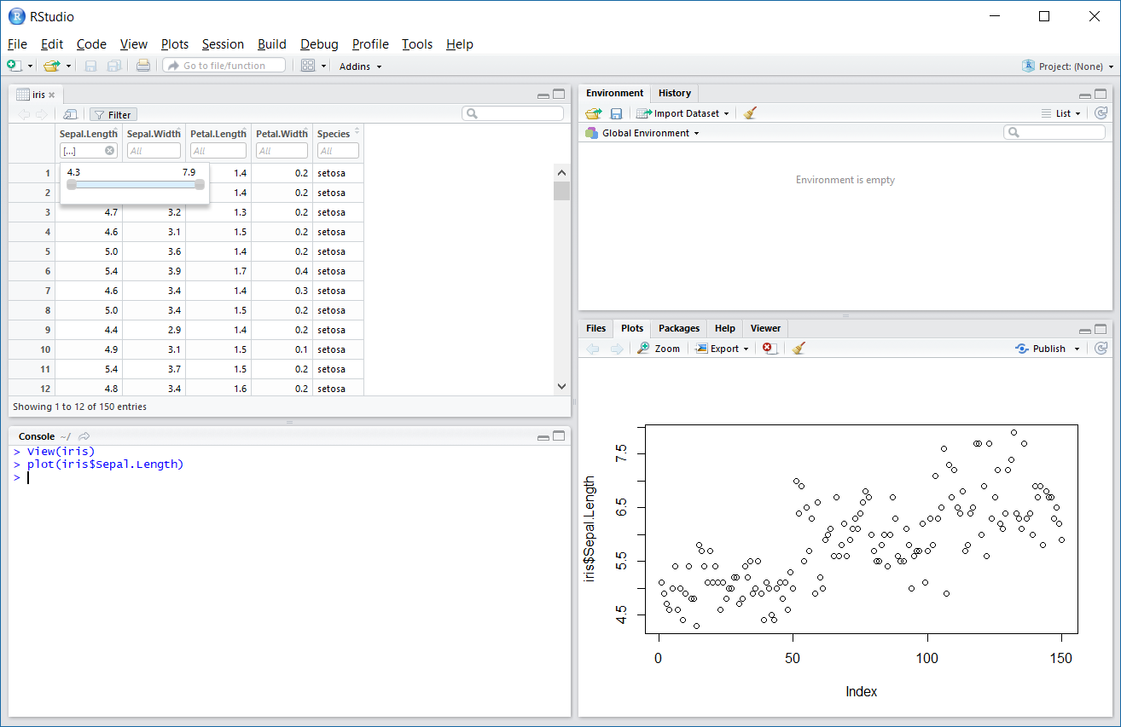
Data Viewer for Simple Exploratory Data Analysis
Filter
View plots
View()
w/ capital V
- opens data viewer

Slide 43
Summary of Plotting Commands
High level graphical commands create the plot
plot( ) Scatter plot, and general plotting
hist( ) Histogram
stem( ) Stem-and-leaf
boxplot( ) Boxplot
qqnorm( ) Normal probability plot
mosaicplot( ) Mosaic plot 2
Low level graphical commands add to the plot
points( ) Add points
lines( ) Add lines
text( ) Add text
• abline( ) Add lines
• legend( ) Add legend
Most commands accept additional graphical parameters par( ) Set parameters for plotting
cex Font size
col Color of plotting symbols
lty Line type
lwd Line width
mar Inner margins
mfrow Splits plotting area (mult. figs. per page) 16
oma Outer margins
pch Plotting symbol
xlim Min and max of X axis range
ylim Min and max of Y axis range

Slide 44
Useful Links
https://www.r-project.org/
https://www.rstudio.com/products/RStudio/
http://www.statmethods.net/r-tutorial/index.html
R commands
https://www.personality-project.org/r/r.commands.html
Plotting in R
http://gfc.ucdavis.edu/events/arusha2016/_static/labs/day2/day2_lab2a_graphics.pdf
http://www.cyclismo.org/tutorial/R/plotting.html
https://www.datacamp.com/community/tutorials/r-tutorial-read-excel-into-r

Slide 45
Q & A

